Slide 1
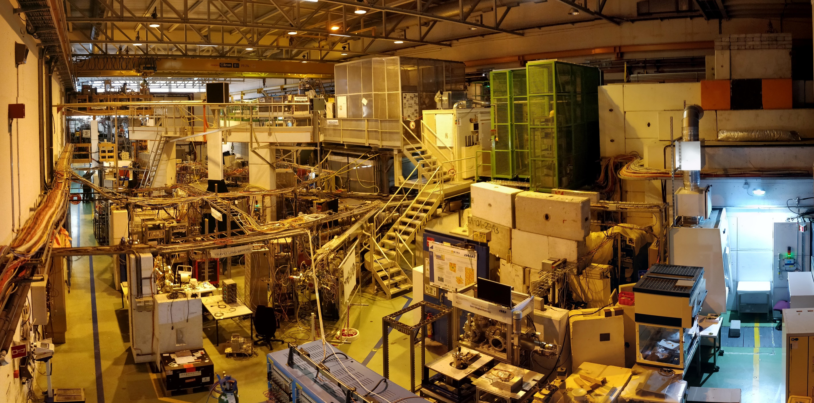
Update on the GLM area upgrade

Slide 2
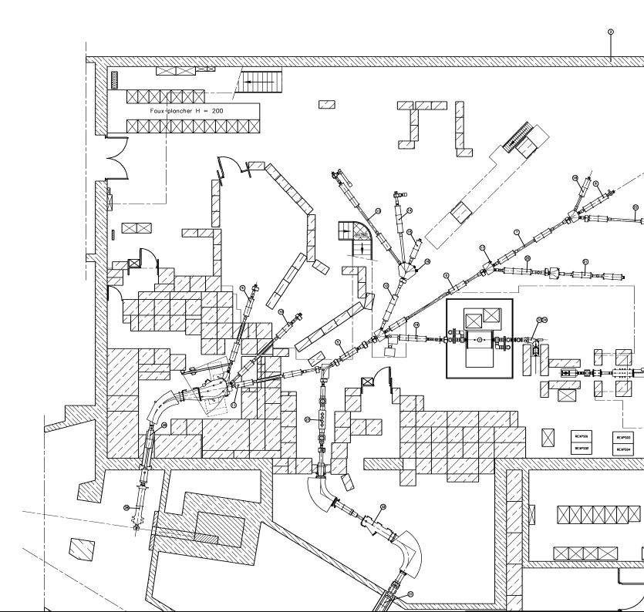



Recap…
New collection chamber
Additional Fast tape station to allow for transparent TISD work while HRS performs physics
Retain need for travelling experiments to be installed…e.g. biophysics chamber; mossbauer; detector setups such as windmill, Gandalph etc
Votre texte ici
Reconfigure blocks to allow for removal of samples without exposing other users to risk of contamination.
Avoid installing a roof for many reasons…
Design work starts Q2 2019.

Slide 3
Responsible
Letizia di Giulio (EP Safety)
Elodie Aubert (RP)
Alexandre Dorsival (RP)
Fabio Pozzi (RP)
Karl Johnston (EP ISOLDE)
Richard Catherall (EN ISOLDE)
Joachim Vollaire (soon EN ISOLDE)
Plus EP, EN, BE DSOs

Slide 4

Why a consolidation project?
These activities (some > 1LA, but always < 100 LA) should be done in Work Sector Type C
ISOLDE Hall is classified as such, but it is not fully compliant with Swiss ordinances
All CERN Work Sector should be audited once a year (existing RP procedure), but ISOLDE Hall has never been audited
Risk of coactivity with visitors and the other experiments present in the hall
  Risk of contamination and radiation in the surrounding of the working area
Notes:
In addition, there have been in 2016 a visit of the OFSP related to an extremities dose above 10 mSv over 1 month (?). This visit was followed by an official letter pointing out some weak points in terms of ergonomics and compliance with the requirements for work sectors.

Slide 5
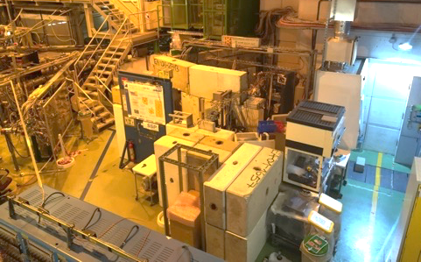
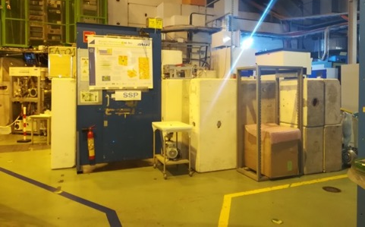
Expected improvements
Improve delimitation of the zone (lack of fully closed perimeter, no access control)
  Specific PPE might be required
  Possibility to temporary classify as Limited Stay Controlled Area

Slide 6
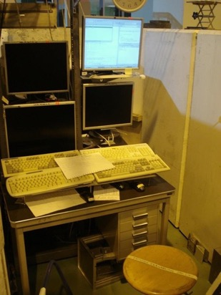
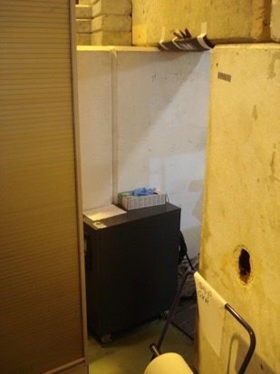
Expected improvements
Improve ergonomics of the zone (narrow working spaces and not easy access)
160 cm
40 cm

Slide 7
Consolidation proposal
Closing GHM and GLM beam lines plus fume hood zone in a Work Sector Type C
Creation of a local shielding for the collection chambers and a general shielding of the area (concrete blocks and lead)
The idea is to isolate the collection and handling activities to protect the surrounding area (other experiments, visitors)

Slide 8
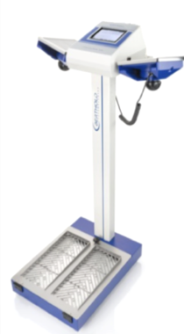
Consolidation proposal
Installing a door with access control system (dosimeter, approved IMPACT)
Placing an hand and foot monitor (with a probe) inside the zone to control potential contamination before exit
Evacuate all non necessary objects and leave the area as “empty” as possible
No permanent working station inside
Need to check that these proposals comply with the OFSP requirements

Slide 9
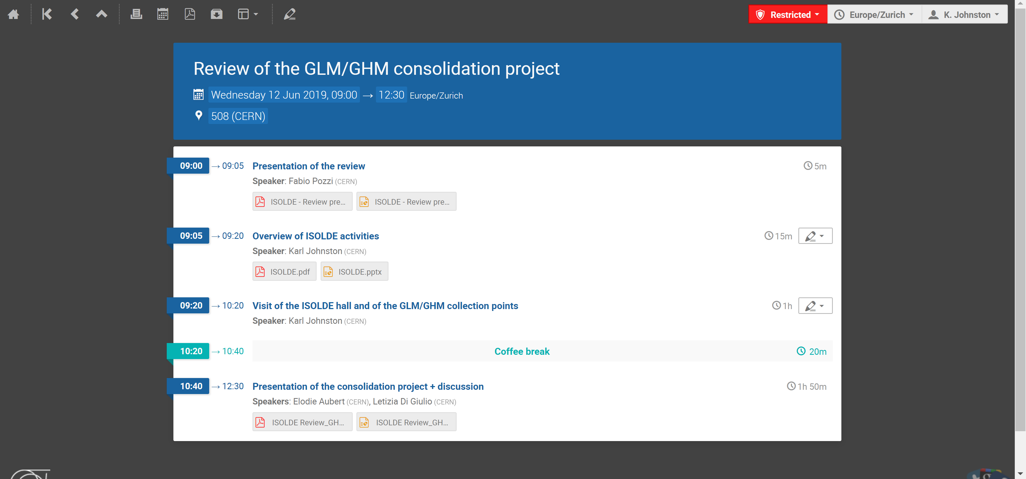

Slide 10
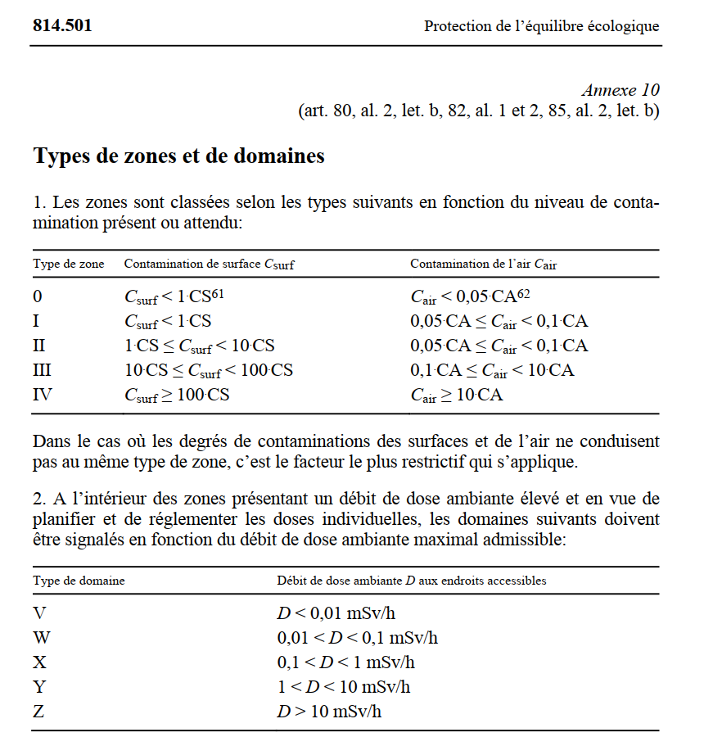
Outcome from review meeting
Consultant Jerome Daumet: head of RP group at IRA/CHUV (and familiar with CERN)
Since project was launched, Swiss ORAP has changed (Feb 2019)
  Areas can now be classified as «zones»
  This could replace the more strict «work sector» e.g. Class C
  Difficult to convert area to Class C with current infrastructure and funding
  Allows for more flexibility and tends to be better appreciated by OFSP: specific RP aspects can be addressed.

Slide 11
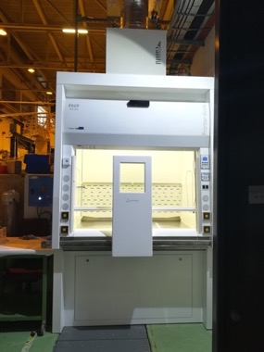
Recommendations
Suggestion to only consider recently installed fume cupboard as a type C work sector.
Focus on the specifics of activities at other beamlines and classify in terms of zones
Strengthen training/ restrict user access for certain identified activities e.g. volatile Hg collections.
Reduce clutter in the space and remove workspaces outside the zone
Stairs at GLM should be removed….instead land between LA1/LA2
Increase users awareness of emergency prodcures/training for these activities.
Install cleanable walls in the area…e.g. perspex plates to allow for cleaning after contamination.
Careful coordination of project needed.
Next Steps
RP assessing the recommendations:requires a change of «culture» at CERN…
Based on these assessments, EP safety and ISOLDE will launch re-design.

Slide 12
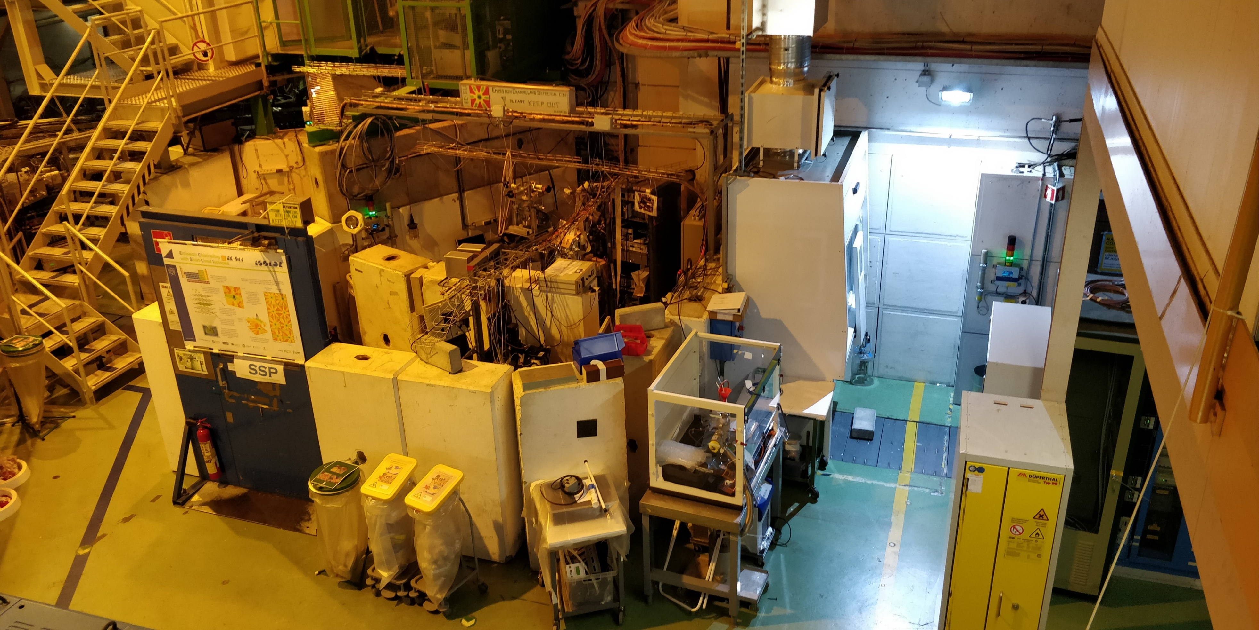

Slide 13
