Slide 1
VACUUM ACCEPTANCE TESTS FOR PARTICLE ACCELERATOR COMPONENTS AT CERN

Slide 2
OUTLINE
What is a vacuum acceptance test?
Why is it needed?
How is it performed? which physical quantities and information are we interested in?
How to use the results?
Few examples;
What happens in case of non conformity?
Some statistics.

Slide 3
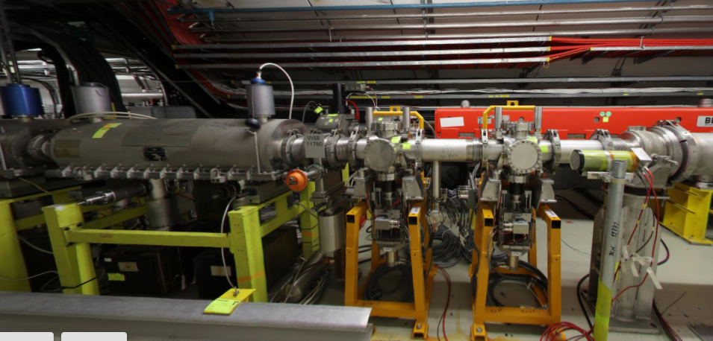
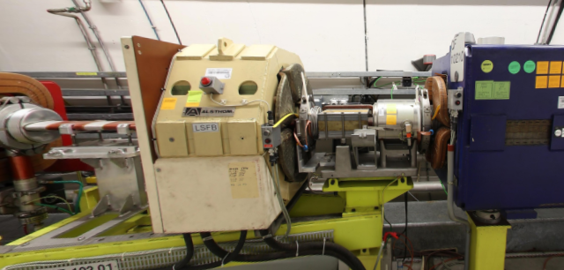
What is a vacuum acceptance test of a component of a particle accelerator?
In order to check if the component outgassing and eventual contamination can alter the vacuum conditions of the accelerator, specific tests are performed to evaluate its gas load and its residual gases footprint.
Kicker
Scrapers
Beam Position Monitors

Slide 4

Why is it needed?
In order to guarantee a certain beam lifetime, or certain machine operation conditions, a maximum acceptable pressure is defined for each machine. Therefore, vacuum components’ outgassing and residual gas analysis have to be compliant with these acceptance levels.
One of the main mandates of TE-VSC is to provide beam operation with the required vacuum in our accelerators.
Questions box:
Is the existing pumping layout going to cope with the additional gas load?
Is the component going to degrade the beam vacuum?(leaks, hydrocarbons..)
For new layouts: do I have to modify the vacuum layout accordingly? Or foresee a specific procedure for critical components?
Is the component going to limit the machine operation?
REMINDER!! Outgassing rates spans over orders of magnitude, while the effective pumping speed is conductance limited.

Slide 5
Beam and residual gas interactions
H₂0
CO₂
CH₄
e -
CO
H₂
e -
C_{n}H_{n+2}
N₂
Types of interactions:
Nuclear interactions → high energy particles ( ) → particle loss, radiation to equipment and background to detectors;
Electromagnetic interactions → elastic scattering → emittance growth;
  → inelastic scattering → energy spread;
Ionisation of residual gases → Ion induced desorption;
→ e- cloud;
Synchrotron radiation → photon induced desorption;
→ e- cloud;
Beam instabilites and particles loss

Slide 6
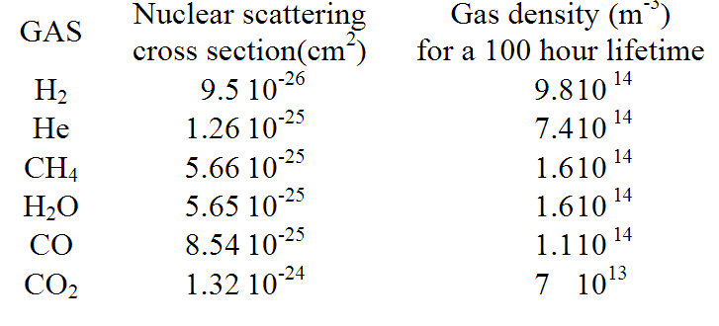


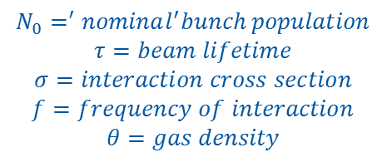
Beam and residual gas interactions
Particles loss leads to a decrease of bunch population:
$$N\left(t\right)=N_{0}∗e^{−t/τ}$$
$$N_{0}=^{′}nominal^{′}bunch population$$
$$τ=beam lifetime$$
$$σ=interaction cross section$$
$$f=frequency of interaction$$
$$θ=gas density$$
where
$$1/τ=σ∗f∗θ$$
The probability of a certain interaction depends on the mass of the molecule (Z) and energy of the particles.
Ex. LHC
LHC vacuum system, O.Grobner

Slide 7
Particle accelerator vacuum requirements
Beam lifetime is crucial, but is only a part of the full picture:
EQUIPMENT REQUIREMENTS:
  UHV insulating conditions for high voltage component (septa, kickers);
  MACHINE OPERATION:
  Beam downtime: operation should be resumed ASAP!

Slide 8
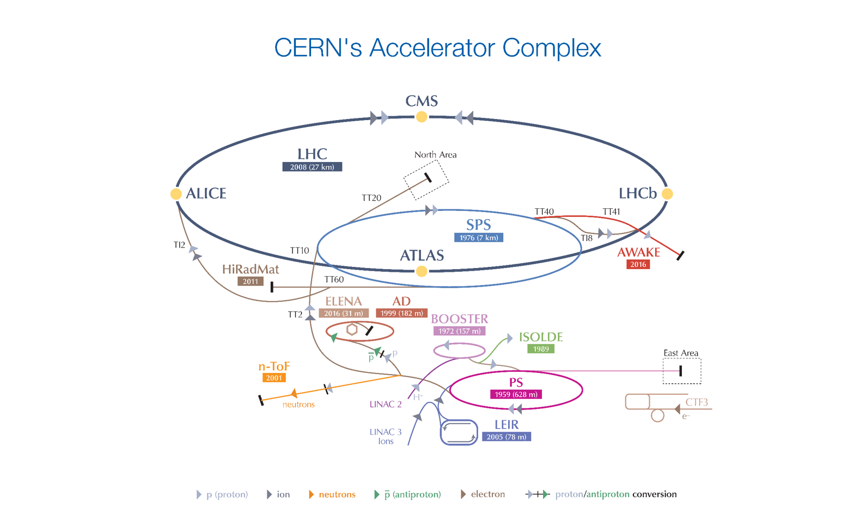
Operating pressure levels for CERN accelerator complex
Pressure spans over orders of magnitudes!

Slide 9
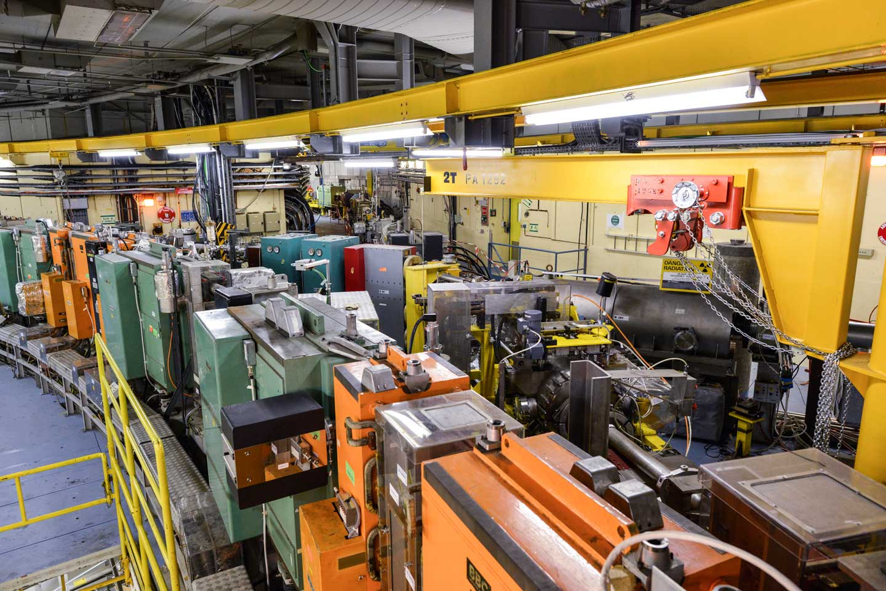
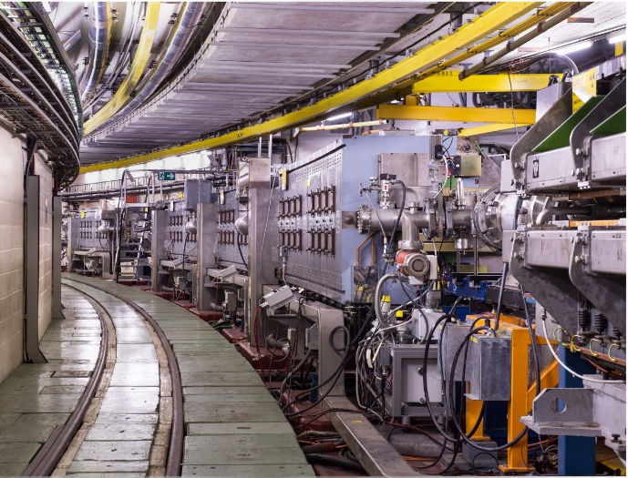
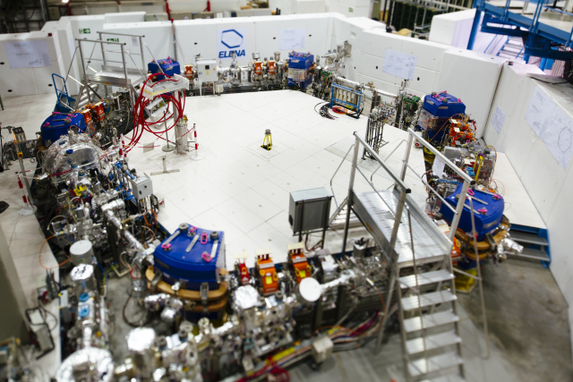
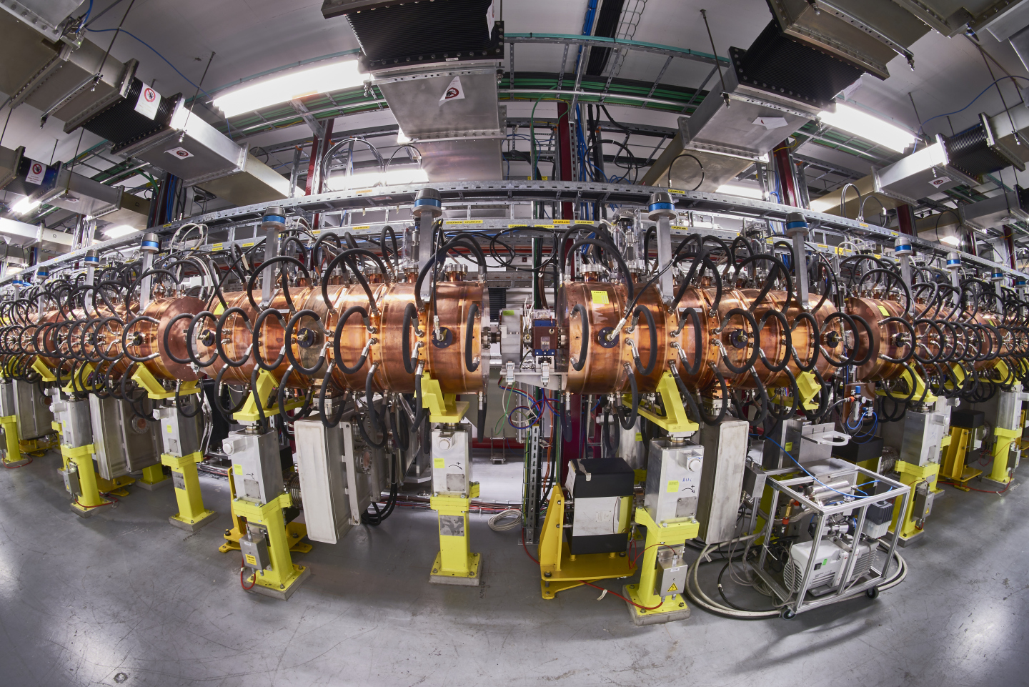
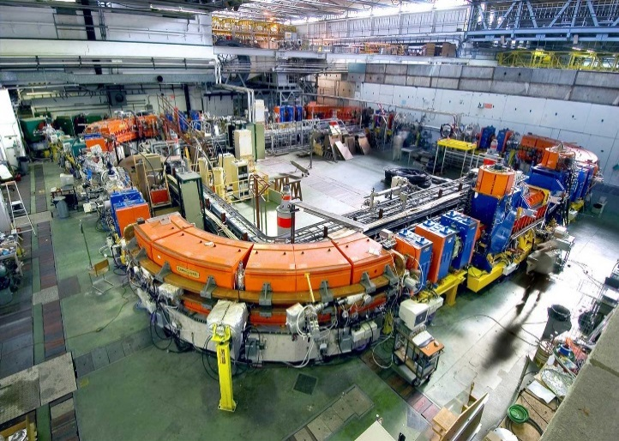
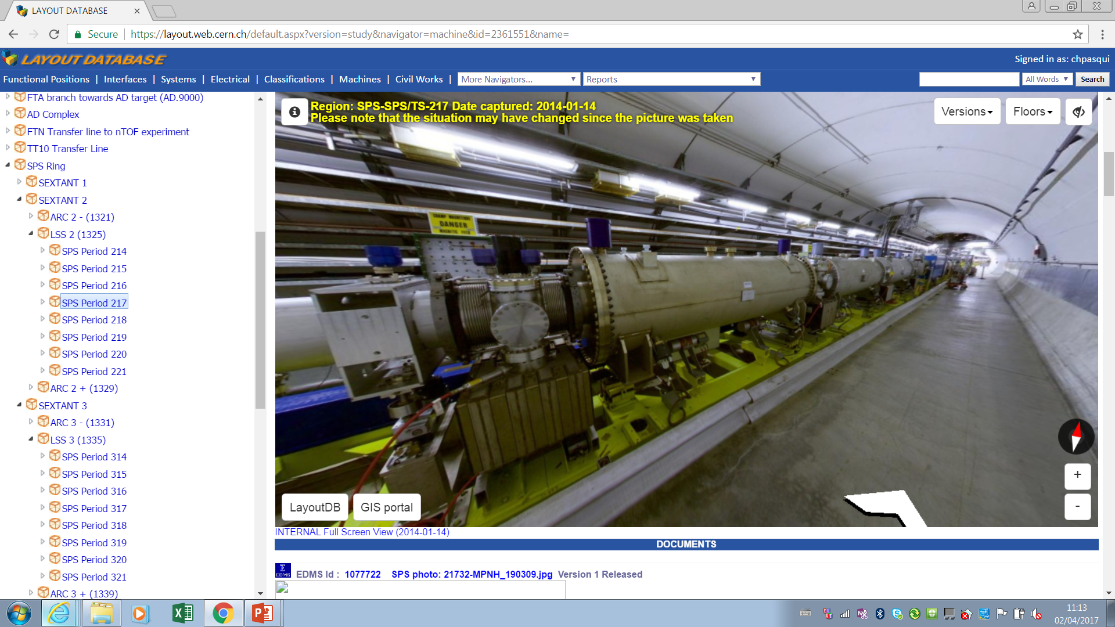
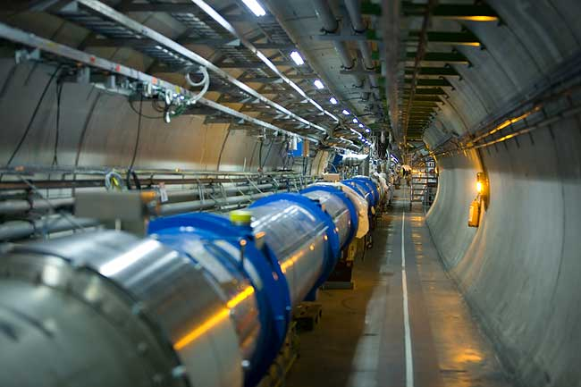
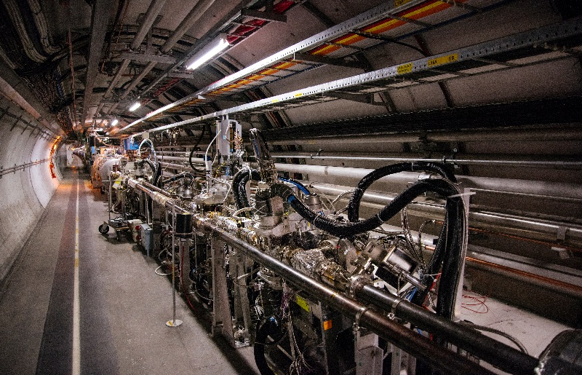
Operating pressure levels for CERN accelerator complex
LEIR
ELENA ring<4*10⁻¹² mbar
Linac 4 <2*10⁻⁶ mbar*
PSB <5*10⁻⁸ mbar*
PS<2*10⁻⁸ mbar*
<10⁻¹² mbar
SPS LSS <10⁻⁷ mbar*
LHC arcs <10⁻⁸ mbar
LHC LSS<10⁻¹⁰ mbar
UNBAKED SYSTEMS (SEPTA..):
TMP, ION PUMPS;
SUBLIMATORS;
CRYO SYSTEMS:
CRYOPUMPING;
BAKED SYSTEMS:
ION PUMPS;
Non Evaporable Getter (TiZrV) coating
* 24h pumpdown

Slide 10
Pressure requirements for LHC and ELENA
LHC
ELENA
Area | Pressure requirements | Effective pumping speed (indicative)
Arcs | ≤10⁻⁸ mbar | ≥100 l.s⁻¹
Experiments | ≤10⁻¹⁰ mbar
Area | Pressure requirements | Effective pumping speed (indicative)
Ring | ≤4 x10⁻¹² mbar | Depend upon position (NEG sticking probability)
Transfer lines | ≤10⁻¹⁰ mbar
ELENA ACCEPTANCE THRESHOLDS
Ensures the limitation of momentum and emittance blow up induced by the interaction of a low energy (100 keV) antiproton beam with residual gases.
LHC ACCEPTANCE THRESHOLDS
Ensures 100 h of circulating beam lifetime and minimize the background to the experiments.
In both examples, the pressure requirements are driven by beam lifetime requirements.
Notes:
100 KeV

Slide 11
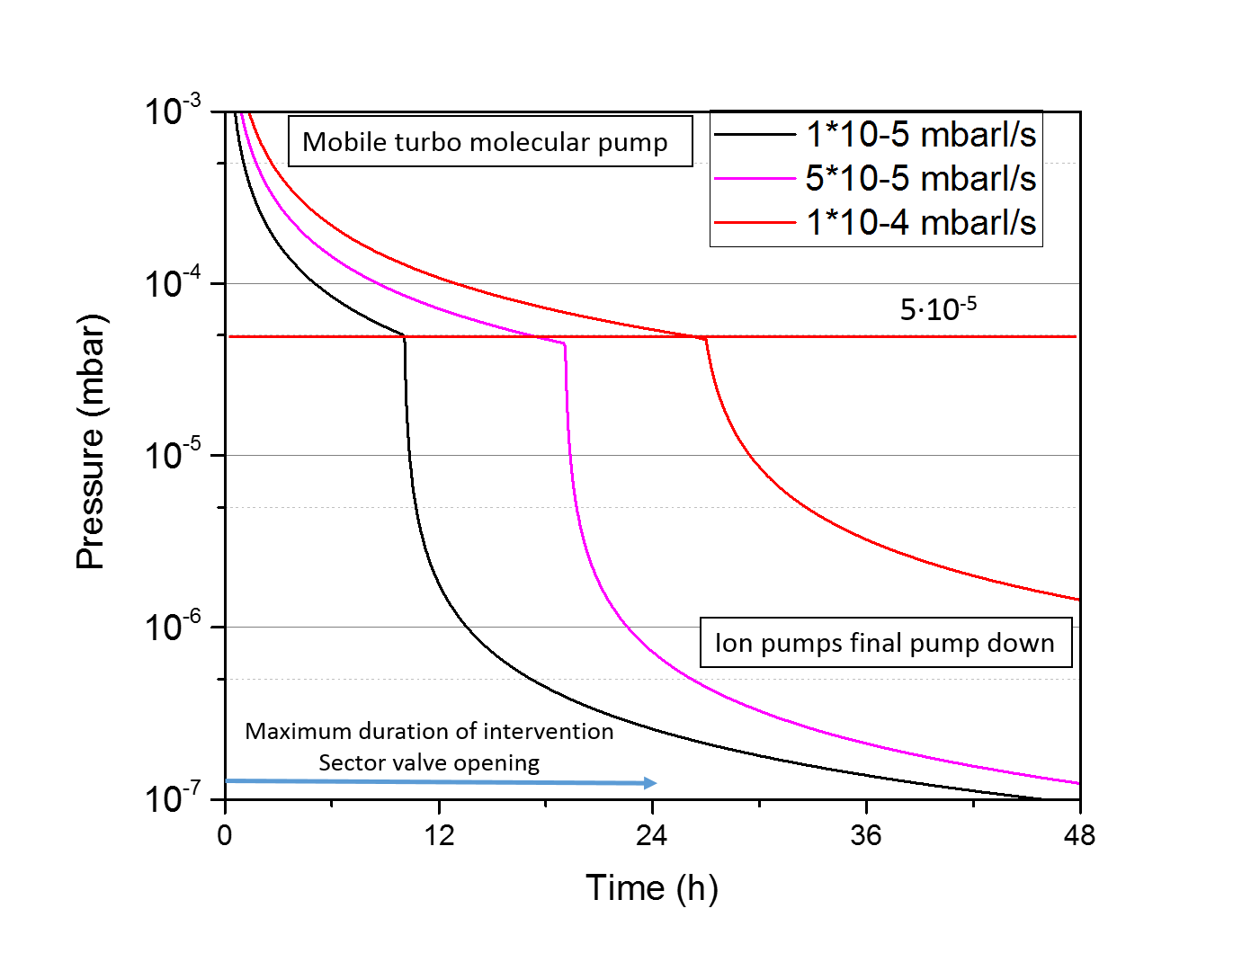
Pressure requirements for the LHC Injectors
Accelerator | Area | Operational pressure requirement (24h pumping) [mbar] | Average effective pumping speed (indicative) [l s⁻¹] | Outgassing rate limit at 24 h [mbar.l.s⁻¹]
PS complex | LINACS, ISOLDE AND TRANSFER LINES CLOSE TO PSB AND PS | ≤2.10⁻⁶ | 100 | 5∙10^{-5 (*)}
 | PSB, HIE-ISOLDE, REX AND TRANSFER LINES CLOSE TO THE PS RING | ≤5.10⁻⁸ | 100 | 5.10^{-6 (*)}
 | PS ring | ≤2.10⁻⁸ | 70 | 1.5.10^{-6 (*)}
SPS | Arcs | ≤10⁻⁶ | 10 | 10⁻⁵
 | LSS (kickers, septa, RF cavities) | ≤10⁻⁷ | 100 | 10^{-5 (*)}
 | TI2&TI8: From SPS to TED | ≤10⁻⁵ | 1-2 | 2.10⁻⁵
 | TI2&TI8: From TED to LHC | ≤5.10⁻⁷ | 5 | 2.5.10⁻⁶
SPS ARCs PUMPDOWN
  Ensure beam operation after 24h pumpdown;
  Ensure proper functioning of High Voltage and RF devices;
  Ensure ion operation at low energy (e.g. LEIR, PS);
We must comply with beam requirements minimising the beam downtime

Slide 12
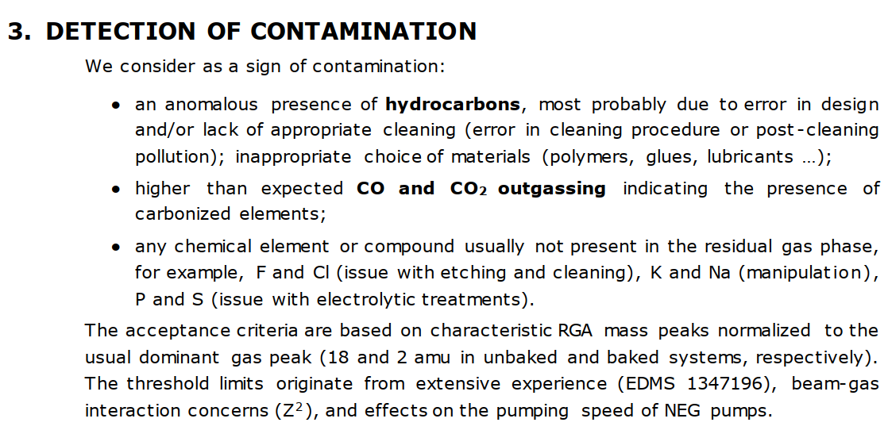
What about contaminations?
Criteria for vacuum acceptance tests, P. Chiggiato, J.A.F. Somoza, G. Bregliozzi, EDMS 1752123

Slide 13
Contamination acceptance levels for unbaked components
H₂O
H₂
N₂/CO
CO₂
C⁺
cPS, SPS, transfer lines
N⁺
*simulated spectra
The unbaked component is considered accepted if the ratio between the water peak and the peaks up to mass 44 is higher then 100 and if the same ratio is higher then 1000 for peaks above mass 44.

Slide 14
Contamination acceptance levels for baked components
H₂
H₂O
N₂/CO
CO₂
C⁺
e.g. LHC, AD, ELENA
N⁺
For baked components the H₂ peak becomes the reference with a more stringent acceptance criteria (i.e. 10⁴ ratio for masses > 44).
*simulated spectra

Slide 15
What about leak tightness?
Helium leak rate acceptance threshold is 1*10⁻¹⁰ mbar *l/s;
A leak is an indication of possible material defects (precipitates, cracks..), flaws in the fabrication process or in the mechanical assembly.
No deviation from this value are accepted.
Internal leak rate acceptance threshold is < 5*10⁻⁹ mbar*l/s both for LHC (NEG saturation), Injectors (<20% of the total pressure).
It is an indication of flaws in the conceptual design (trapped volumes).
Leak can be evaluated by accumulation;
External Leak
Internal leak

Slide 16
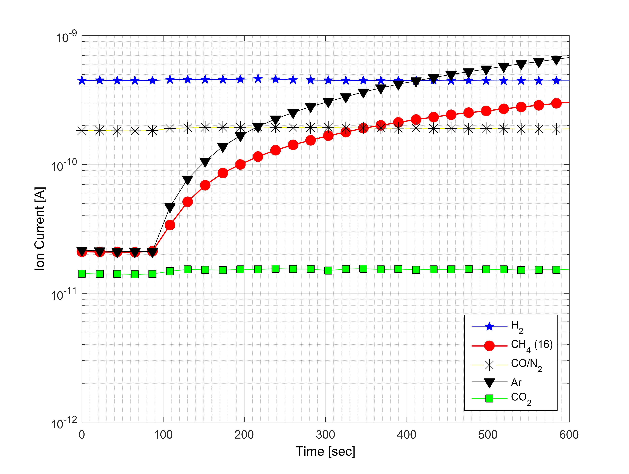
Finally, a vacuum component is accepted for installation if…
It is leak tight;
Its outgassing is compliant;
Its residual gases spectrum is compliant;
If no virtual leaks or acceptable virtual leaks are detected.

Slide 17
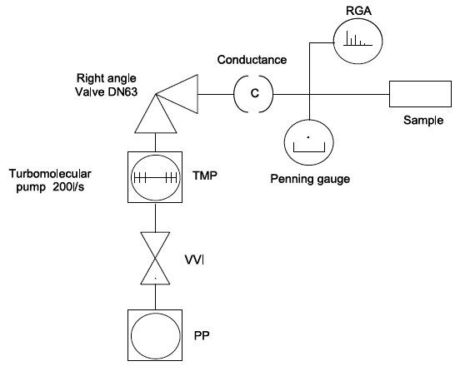
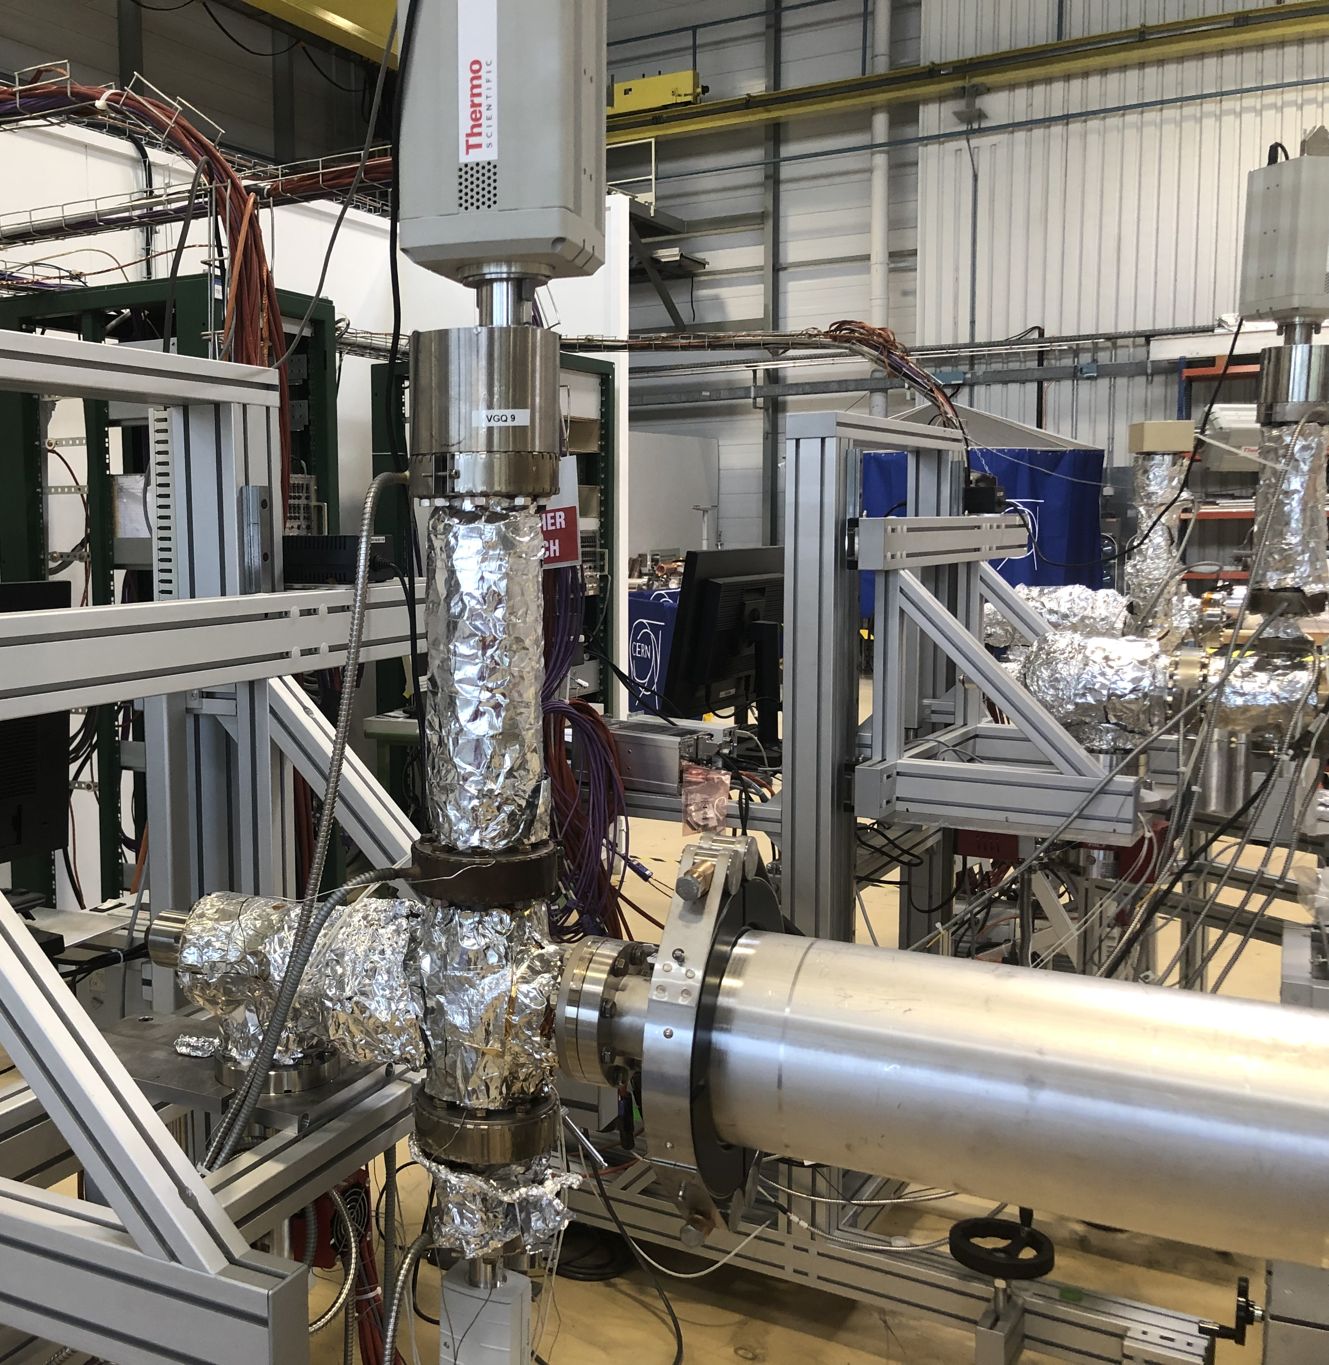
How is a vacuum acceptance test performed?
THROUGHPUT METHOD:
2
2
1
5
4
3
5
4
1
3
The pressure rise method (accumulation) and the coupled method (througput + accumulation) are often used as well.

Slide 18
How is an acceptance test performed?
UNBAKED COMPONENTS
BAKED COMPONENTS
Pumpdown;
Leak detection;
Outgassing estimation at 24h;
RGA scan after 4h of filament conditioning.
Pumpdown;
Leak detection;
Bake – out (dedicated recipes for specific components);
Outgassing evaluation at RT after 48h from the end of the bake-out;
RGA scan;
Evaluation of possible internal leaks by accumulation.

Slide 19

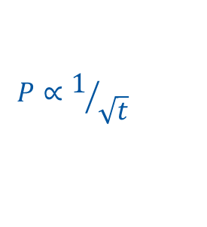
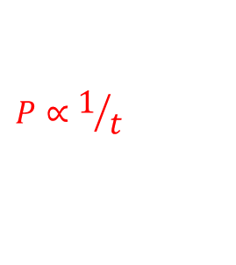
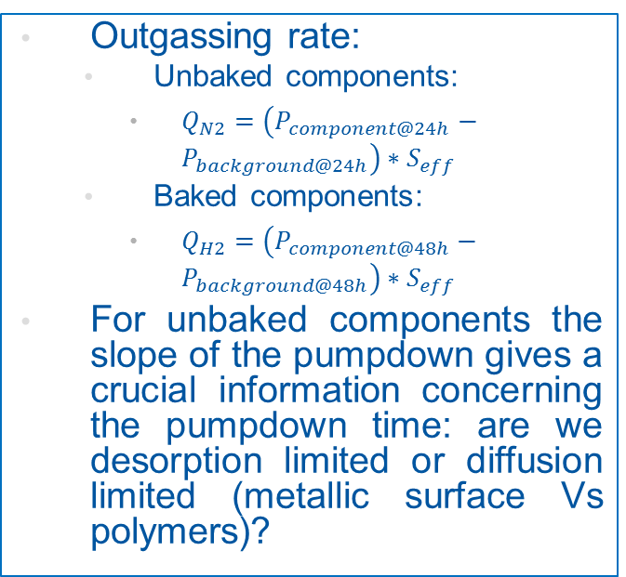

Which physical quantities and information are we interested in? Pumpdown curve
Outgassing rate:
  Unbaked components:
    $Q_{N2}=\left(P_{component@24h}−P_{background@24h}\right)∗S_{eff}$
  Baked components:
    $Q_{H2}=\left(P_{component@48h}−P_{background@48h}\right)∗S_{eff}$
For unbaked components the slope of the pumpdown gives a crucial information concerning the pumpdown time: are we desorption limited or diffusion limited (metallic surface Vs polymers)?
$$P∝1/{\sqrt{t}}$$
$$P∝1/t$$
$$∆P$$
$$∆P$$

Slide 20
Which physical quantities and information are we interested in? Residual Gas Analisys
The residual gas scan up to 100 a.m.u./e- gives an insight of the residual gases composition: once compared with the system scan, it is possible to attribute to the component its outgassing footprint.
In this example:
  Leak?
  Hydrocarbon contamination?

Slide 21
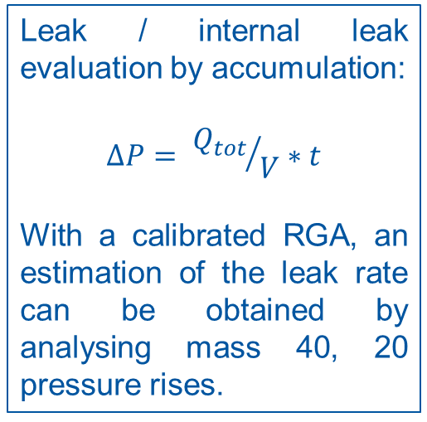
Which physical quantities and information are we interested in? Internal leak
Leak / internal leak evaluation by accumulation:
$$∆P= {Q_{tot}}/V∗t$$
With a calibrated RGA, an estimation of the leak rate can be obtained by analysing mass 40, 20 pressure rises.

Slide 22


Which physical quantities and information are we interested in? NEG coated components
Getter surfaces are characterized by the sticking probability:
$$α=\frac{number of molecules captured}{number of molecules impinging}$$
$$0≤α≤1$$
The sticking probability cannot be directly measured, it is obtained by combining experimental pressure measurements and MolFlow simulations.
Two methods are used:
  Fisher-Momsen dome, where the probability that a molecule entering the deposited component is pumped at the surface (capture probability) is evaluated.
  Measurement in transmission, where the probability that a molecule is not pumped and it is transmitted through a component is evaluated.

Slide 23
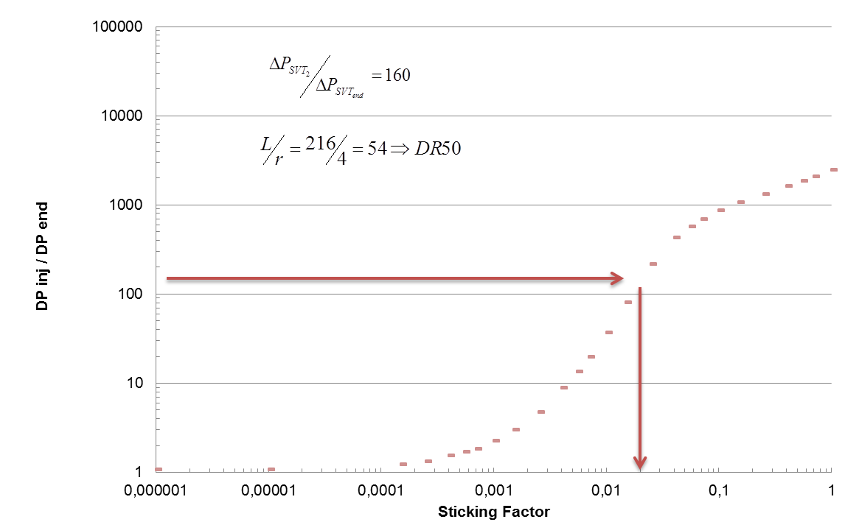
Which physical quantities and information are we interested in? NEG coated components
Transmission Probability of NEG coated components
SAMPLE
The measured pressure difference must be correlated through a Molflow simulation to the actual sticking probability of the coated surface.

Slide 24
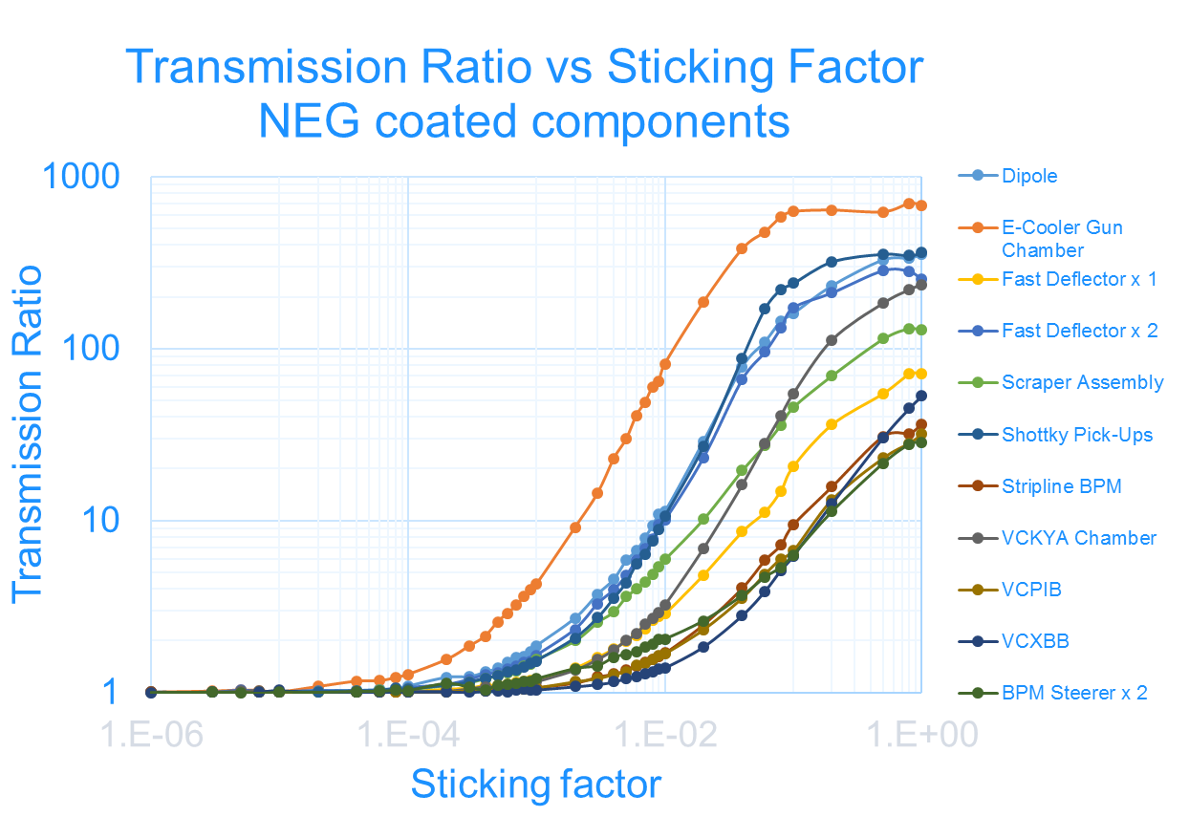
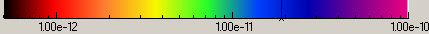
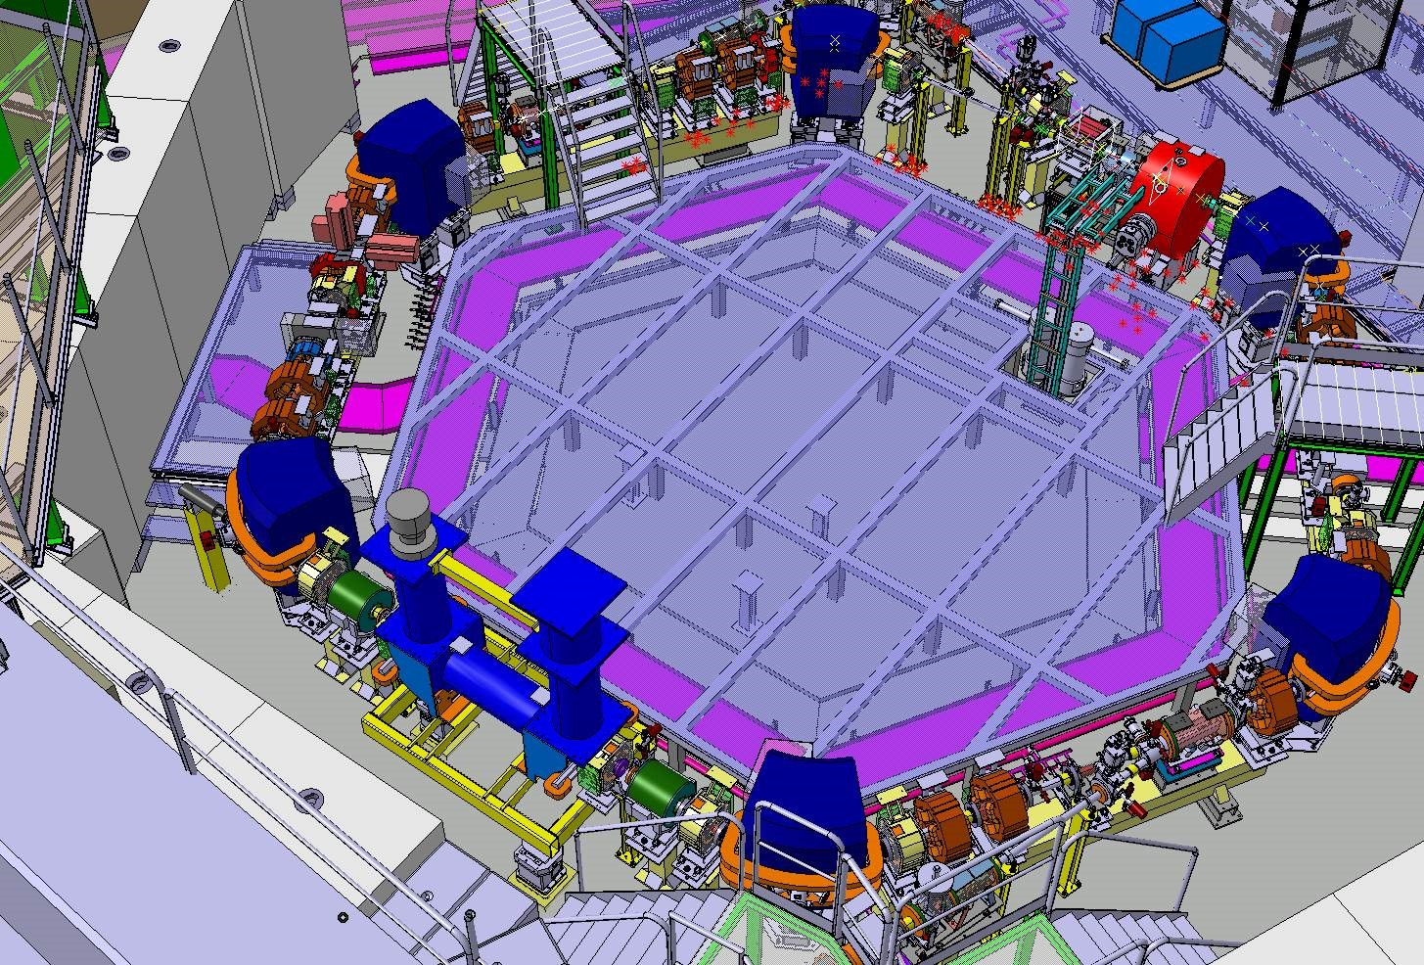
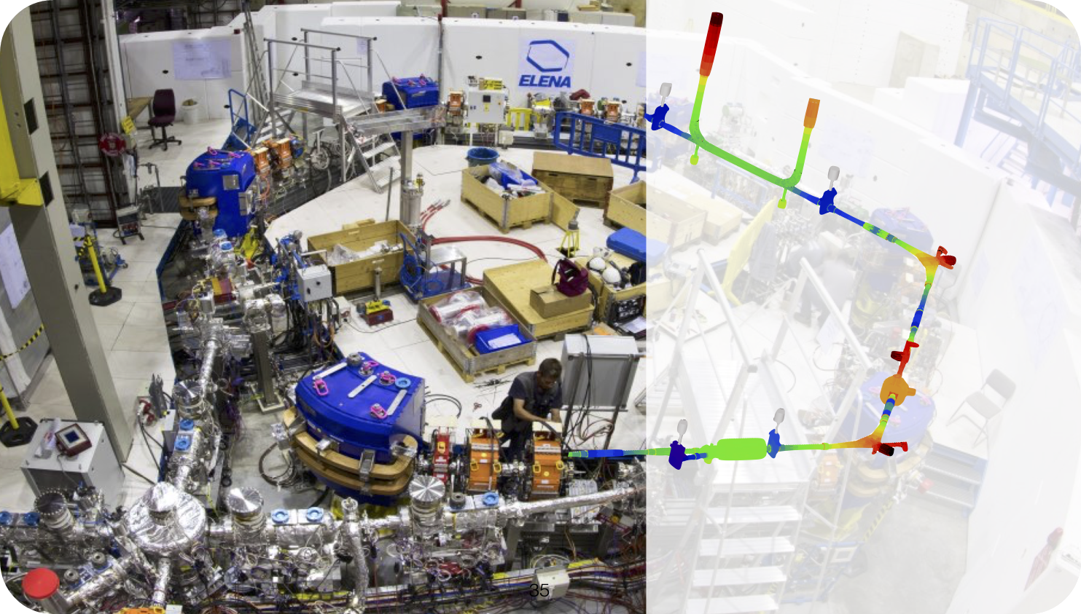
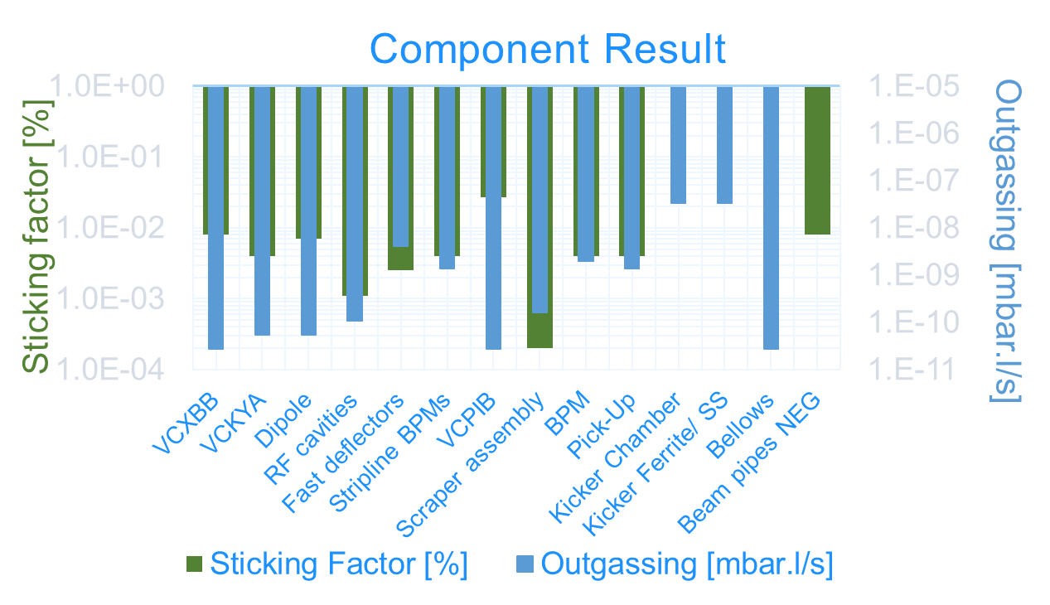

Which physical quantities and information are we interested in? NEG coated components
Courtesy of J. Hellstrom

Slide 25
How do we use these results?
Compare them with the acceptance levels:
  Depending on the machine;
  Depending on the final location of the component (local effective pumping speed);
  The installation of the component is finally accepted, tolerated or rejected.
For new machine or new layouts:
  The measured outgassing data can be used as input for vacuum simulations;
  The vacuum design can be adapted accordingly;

Slide 26
How do we use these results?
Compare them with the acceptance levels:
  Depending on the machine;
  Depending on the final location of the component (local effective pumping speed);
  The installation of the component is finally accepted, tolerated or rejected.
For new machine or new layouts:
  The measured outgassing data can be used as input for vacuum simulations;
  The vacuum design can be adapted accordingly;

Slide 27
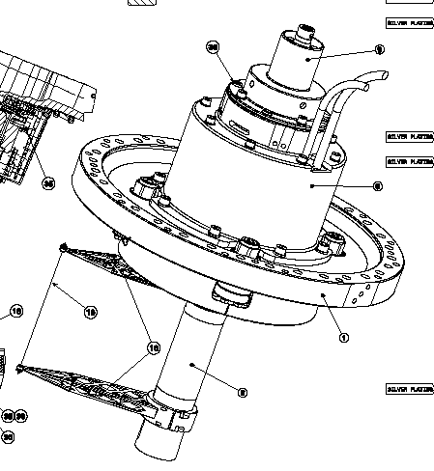
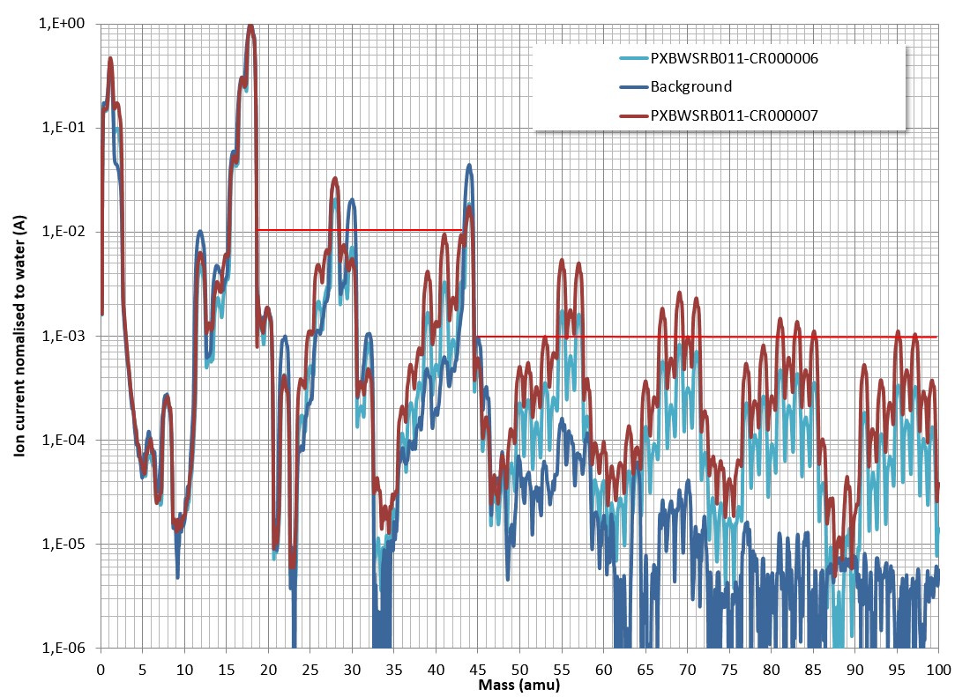
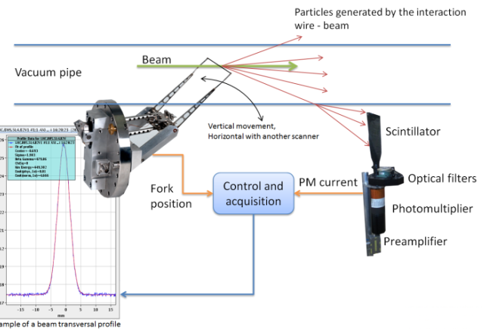
Few examples: PS & SPS FWS
Non conformities detected coming from the fork.
Courtesy of A.Michet and N. Thaus

Slide 28
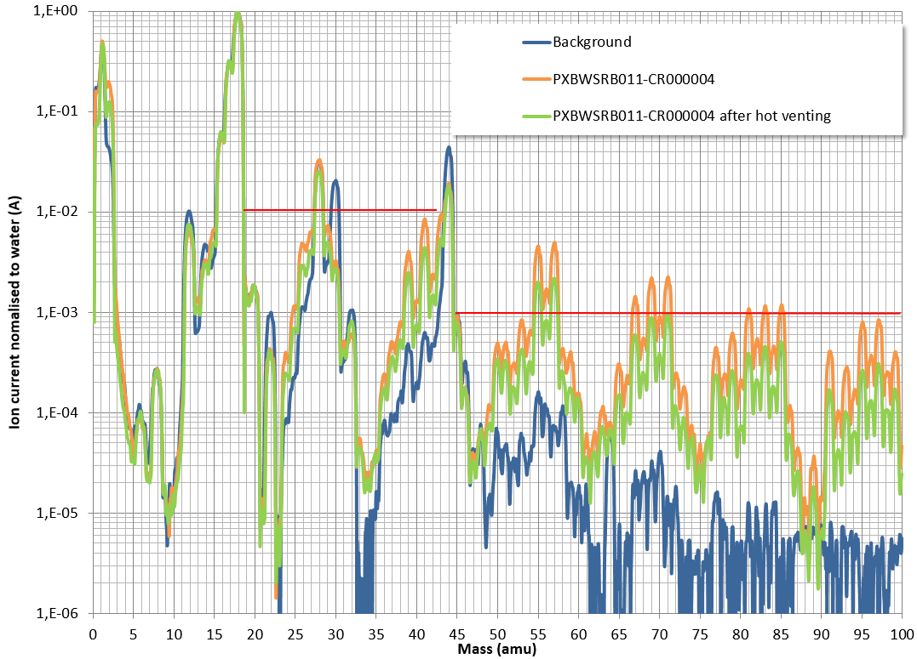
Few examples: PS & SPS FWS
Working toward the conformity:
Tanks stripped down and cleaned again;
Mild bake-outs;
N₂ hot injections;

Slide 29
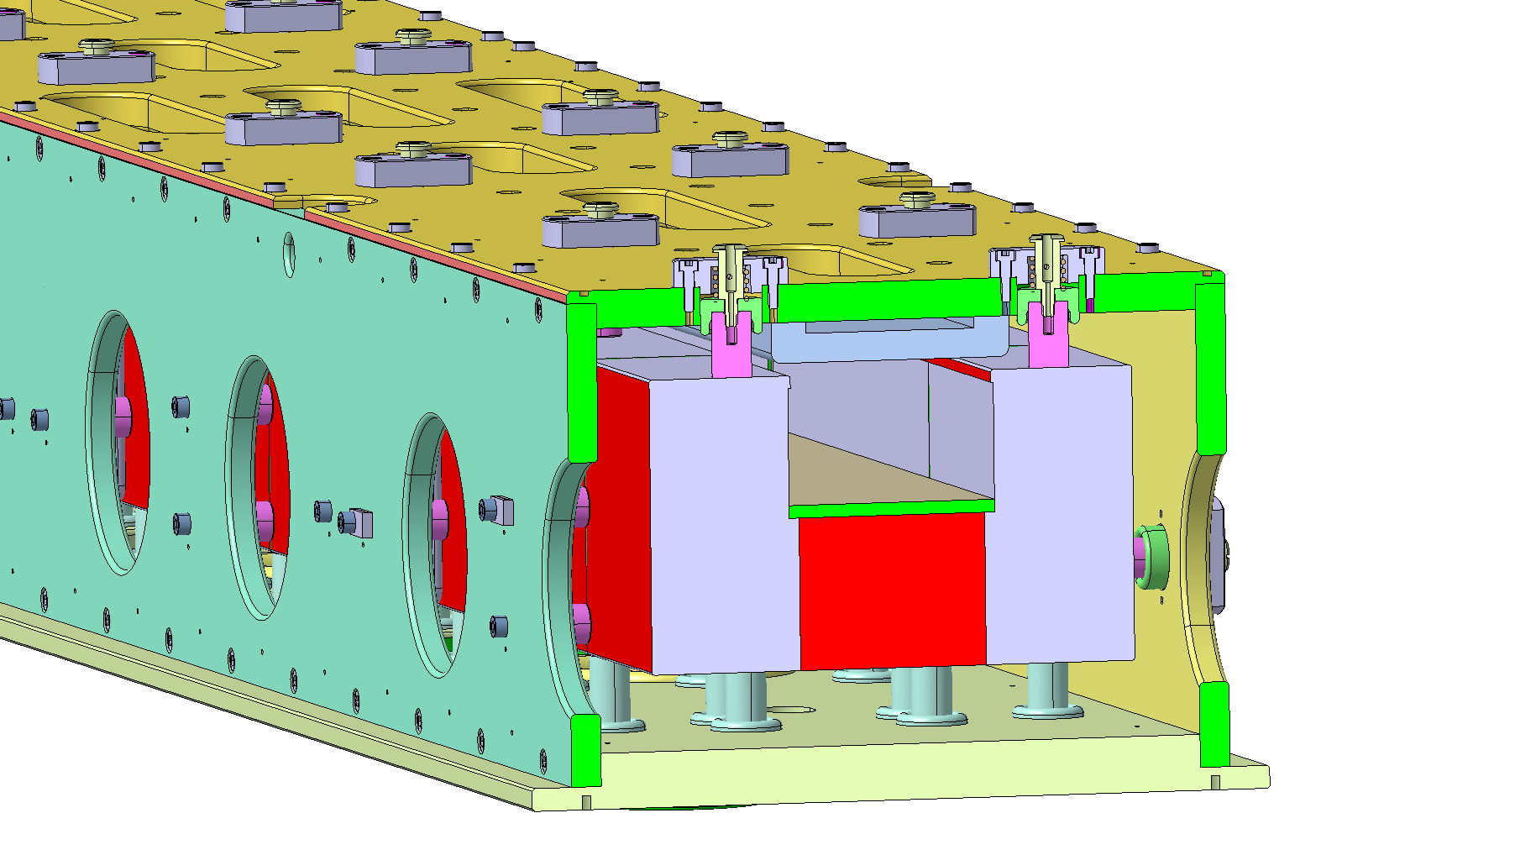
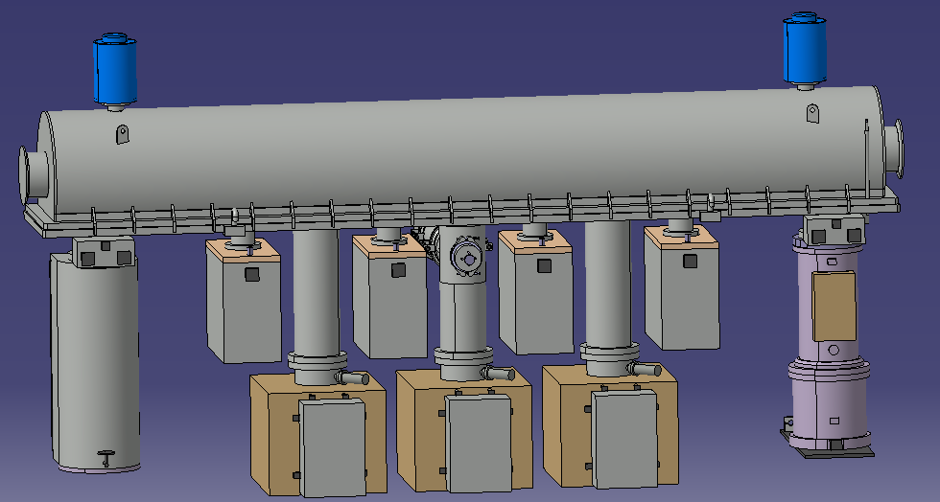
Few examples: SPS MKDV
The MKDVs are kickers magnet meant to vertically deflect the beam toward the dump. They are composed of a stacked lamination of ferrites (8C11, NiZn alloy) and metallic ground plates (AlMg3F26) over 3m length.
300 l/s Ion pumps are directly connected to the tank to cope with the high outgassing rate.

Slide 30
Few examples: SPS MKDV
Acceptance test is performed with ion pumps as well:
Outgassing rate at 24h with turbomolecular pumping exceeds the SPS acceptance levels (≈ 9*10⁻⁵ mbar l/s);
The additional ion pumps, reduce the pressure to an acceptable level for operation (≈ 7*10-8 mbar at 48h of ion pumping).
MKDV are and example of tolerated components.
Courtesy of A.Harrison and K. Owens

Slide 31
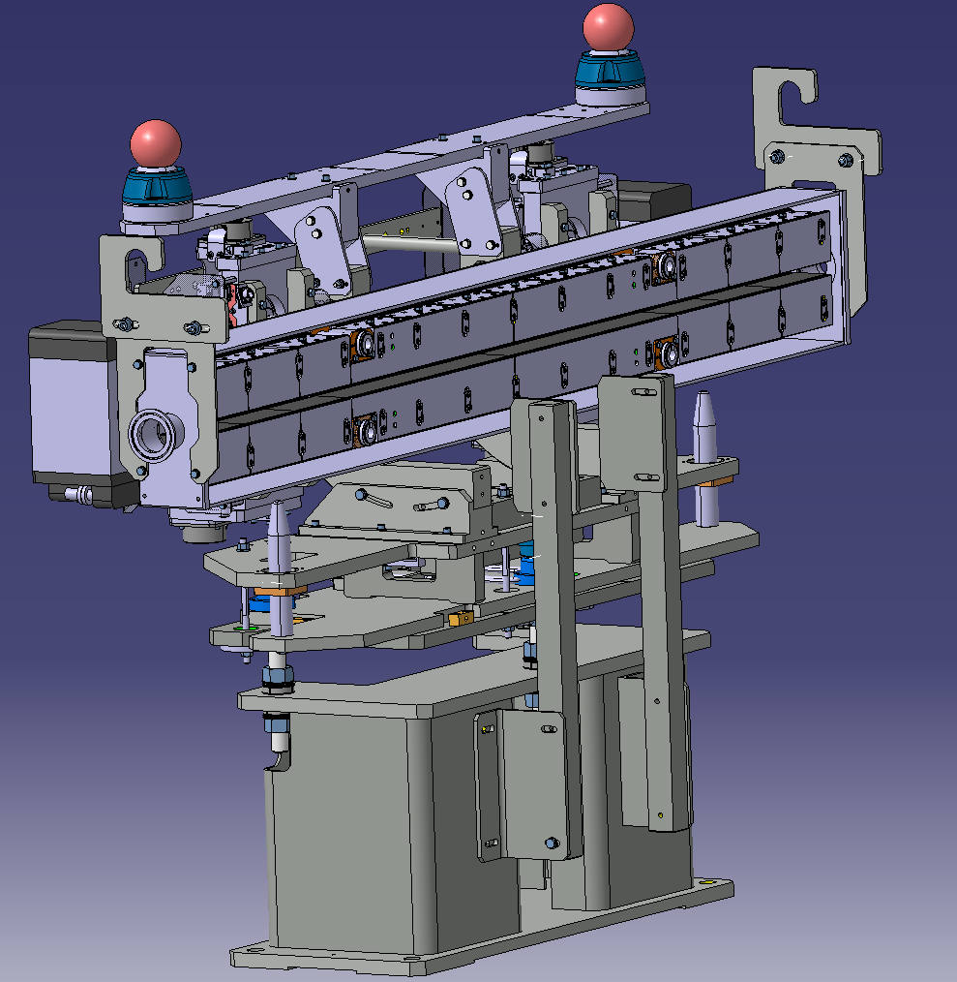
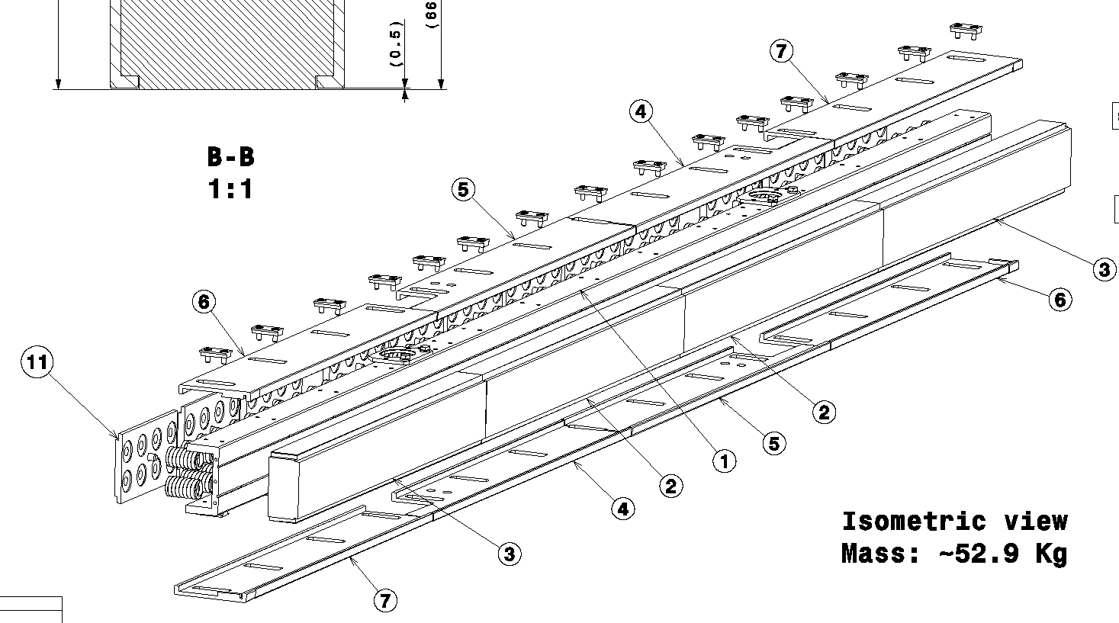
Few examples: TCDI, TI2-TI8 collimators
12 collimators will be installed in TI2 and TI8 to protect LHC beam injection from eventual mis-stirring of the beam during extraction from the SPS.
Each collimator is based on 2 graphite (3D-CC + isostatic) jaws, positioned at 4.5 - 5σ from the beam.
All collimators will be baked in the machine to reduce their impact to the vacuum lines:
  TI2 and TI8 transfert lines are caracterized by a low conductance and lumped, spaced ion pumping;
  Sectors 1204 and 1805 are interfacing LHC NEG coated sectors.

Slide 32
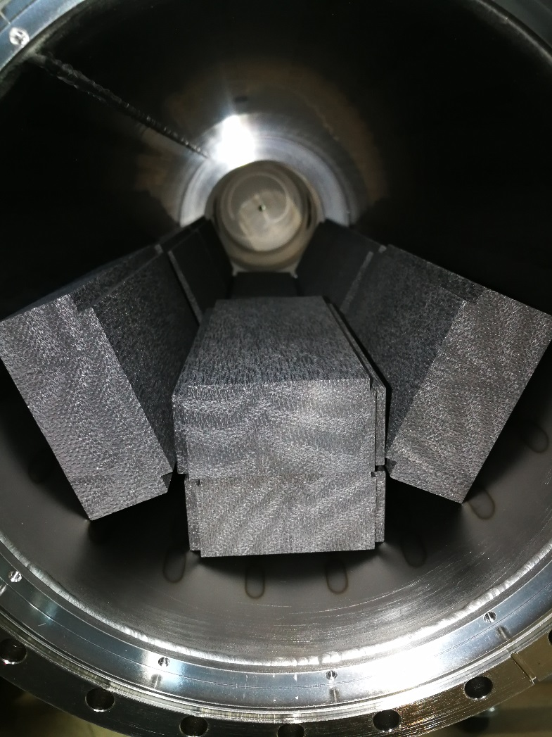
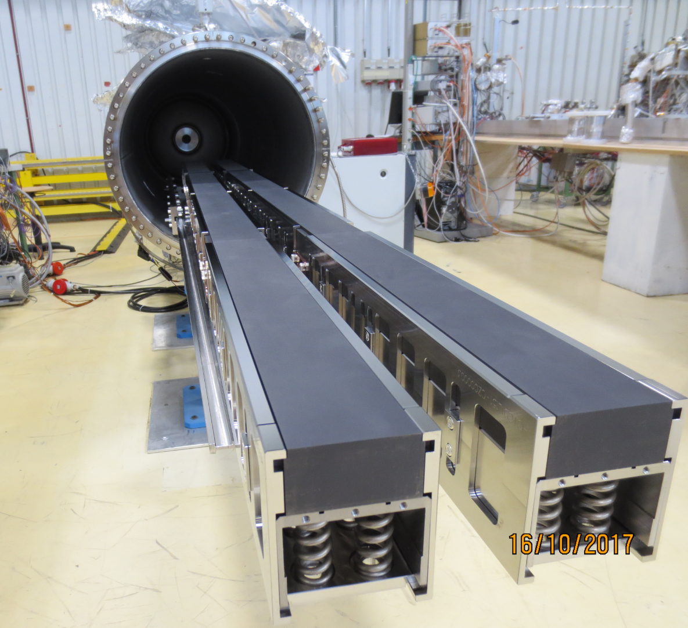
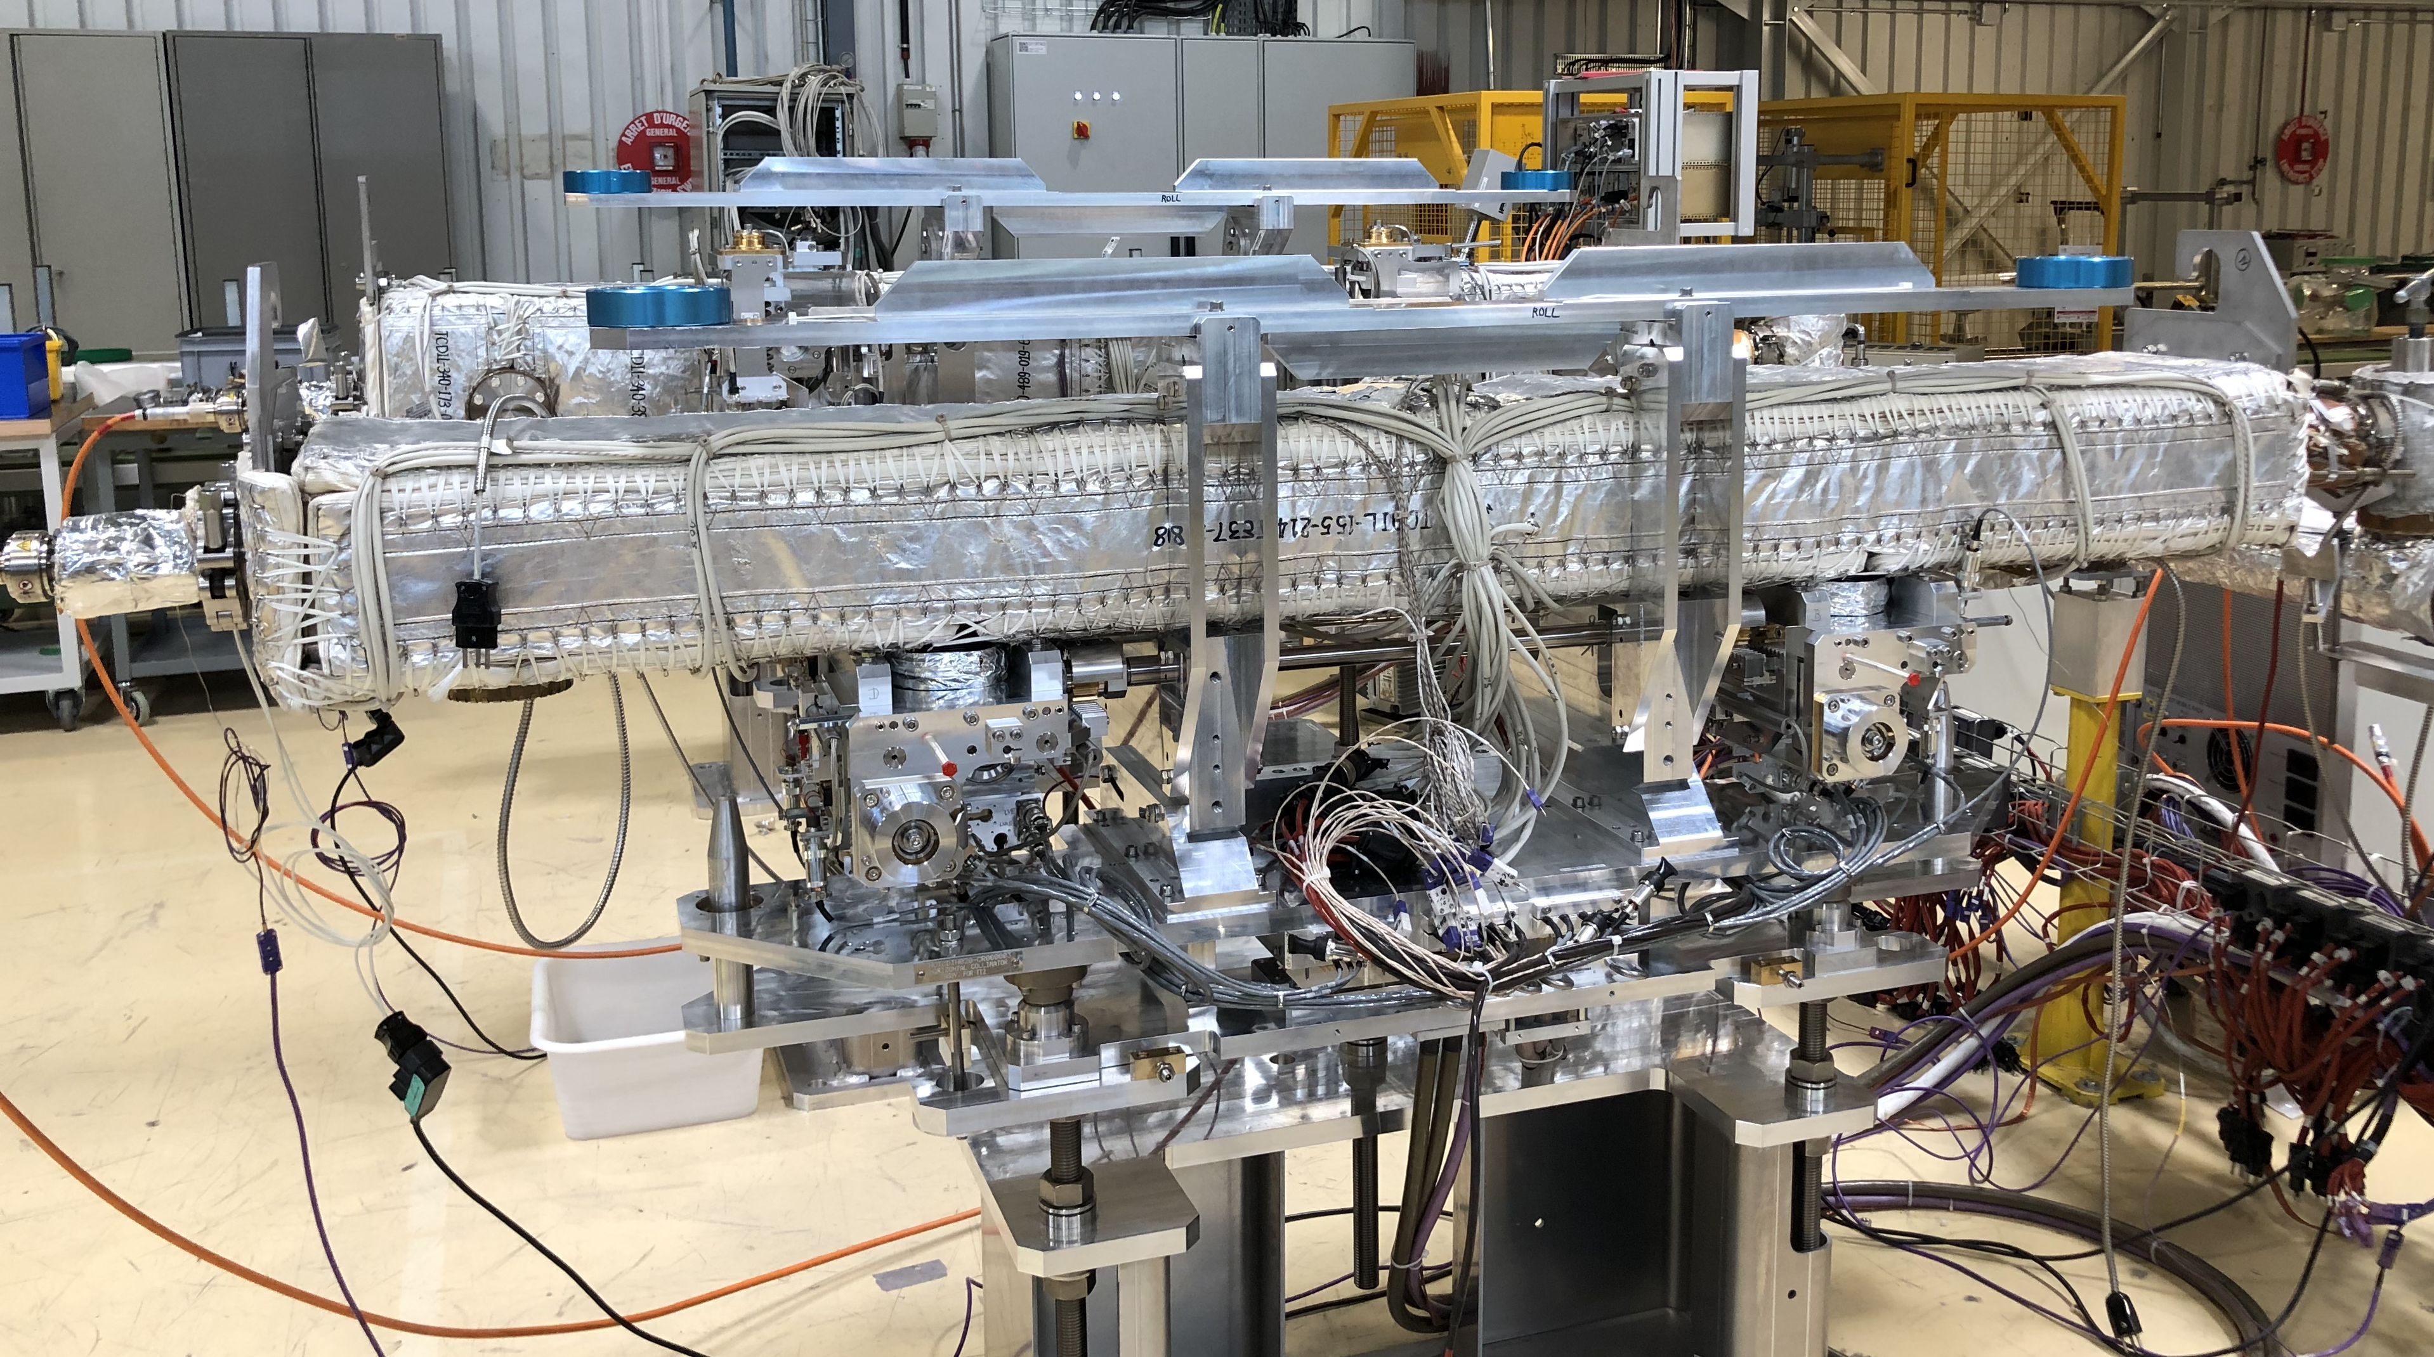
Few examples: TCDI, TI2-TI8 collimators
3D CC blocks
Jaws
For complex components, subassemblies are tested in order to anticipate possible non conformities before the final assembly.
TCDI – Final assembly
Courtesy of G. Cattenoz

Slide 33
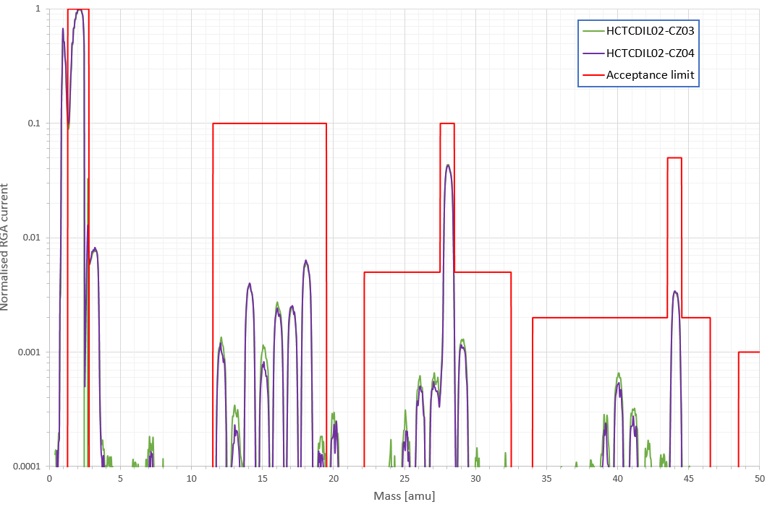
Few examples: TCDI, TI2-TI8 collimators
Total Outgassing rate measured after a bake out at 250 C for 48h. RGA scans measured after 48h at room temperature:
    Outgassing rates ≈ 6*10⁻⁸ mbar l/s; → conform!
    RGA scans all within acceptance limit.
Graphite conformity reached thanks to a vacuum firing at 950 ◦C for 6 h.
Courtesy of G. Cattenoz

Slide 34
Non conformities: why?
OUTGASSING RATE
Material choice (polymers, synthered materials, high vapour pressure materials);
Missing Thermal treatments (vacuum firing, air baking, prebaking for polymers);
Poor mechanical vacuum design (trapped volumes, wrong welding procedure, brazing alloys);
CONTAMINATIONS
Non conformity in the design (lubricants under vacuum, glues..)
Non conformity in the handling procedures;
Non conformity in the cleaning procedures;

Slide 35
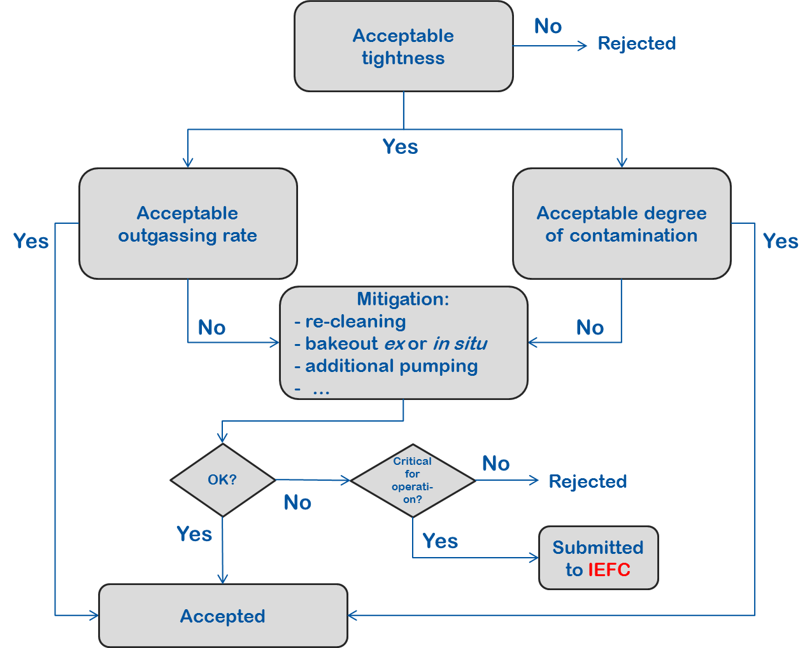
What happens in case of non conformity?

Slide 36
What happens in case of non conformity?
  Best way to deal with a non conformity is to avoid it!
  Early involvement of vacuum experts in the design phase of the components is crucial to avoid common design mistakes that can lead to non conformities at the final stage of the production cycle of the component.

Slide 37
A bit of statistics..
More than 120 components tested last year!
Courtesy of I. Wevers

Slide 38
A bit of statistics..
Outgassing rate acceptance limit
Courtesy of I. Wevers

Slide 39
Conclusions
A brief (non –exhaustive!) overview of vacuum acceptance tests;
Crucial role of BVO in testing and assessing the compliance of vacuum components to be installed in the accelerator chain;
Thanks to all BVO colleagues involved into these activities!

