Slide 1
Plan for ELENA commissioning with Ions in 2019

Slide 2
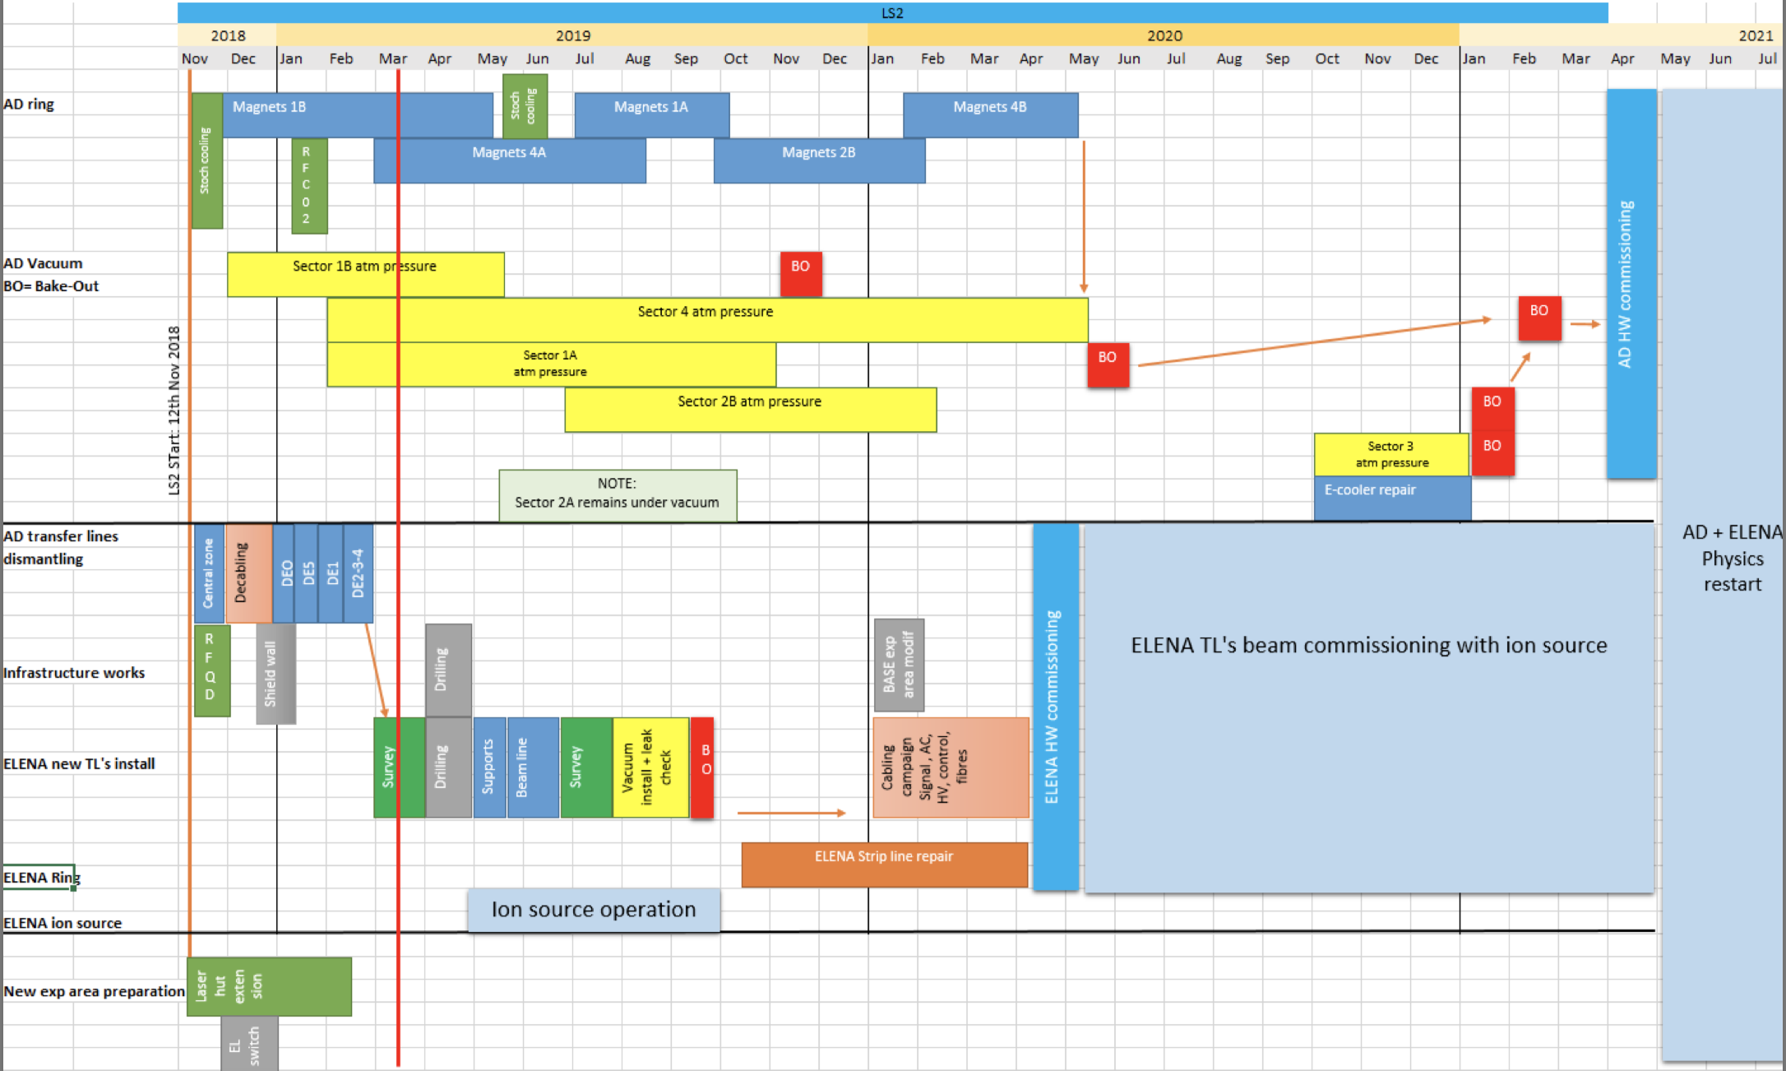
AD & ELENA LS2 activities
Cabling could be advanced by a few months
Cabling could be advanced by a few months

Slide 3
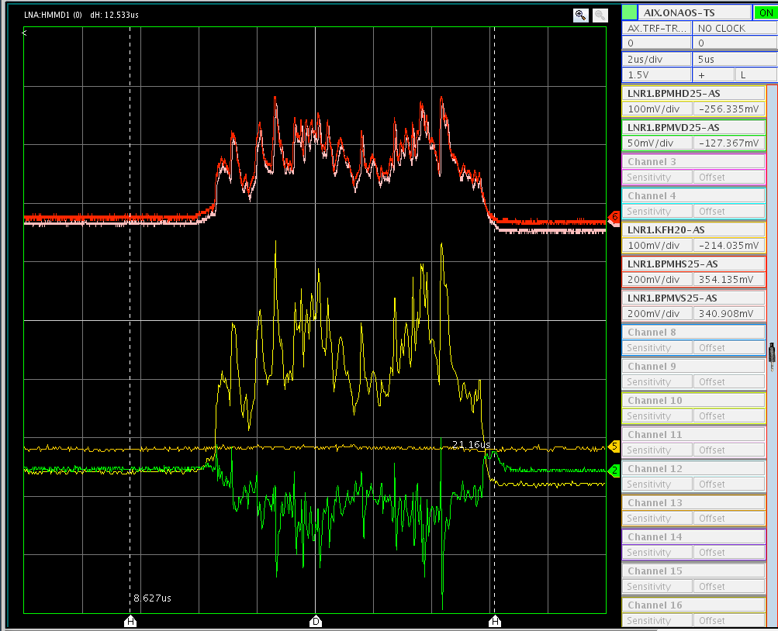
Ion source re-start after update
- Prepare for commissioning of new beam lines in 2020 -
  HV-tests of new, upgraded isolation transformer, can we operate the Ion source reliably at 100 keV ?
  Beam quality improvements:
    Can we increase intensity ? ( = more comfortable ej. line set-up)
    Can we improve longitudinal structure of the beam ?
    Investigate observed intensity fluctuations over several cycles
    Drifts/instabilities……
  Matching studies Source=>ELENA, continue tests with new optics
    Only (one) BTV available at the moment…
  Improve injection efficiency
    Can we inject more beam ?
  SEM tests (injection/ GBAR line)
  With RF (safety issue to be resolved): cooling tests, transverse optics, longitudinal…
  Also: GBAR interested in H⁻ beams in 2019
20us

Slide 4
Planning
The commissioning team will be on duty in the ACR during office hours from June to September
Monday morning briefings will be held when required

Slide 5
Systems
Control system
SW – BRS etc.
Vacuum
Power converters
Magnets
HV deflectors
Injection Septum/kicker
BPM:s
RF/Tomoscope
Safety/interlocks
Etc.

