Slide 1


Welcome – Καλώς ήρθατε
Delegation from the Republic of Cyprus
to Accelerating Science and Innovation
Notes:
1

Slide 2
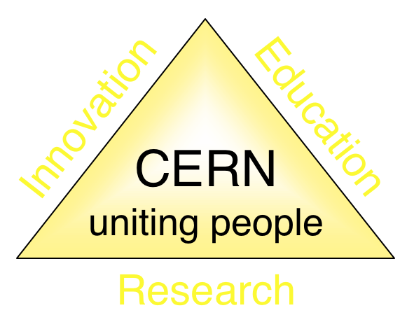
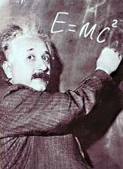
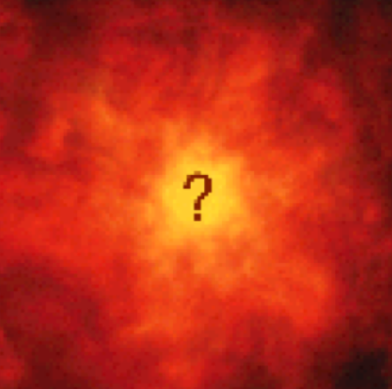


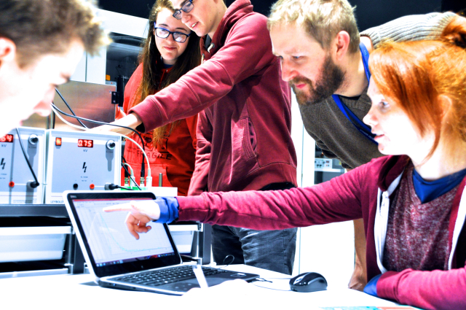
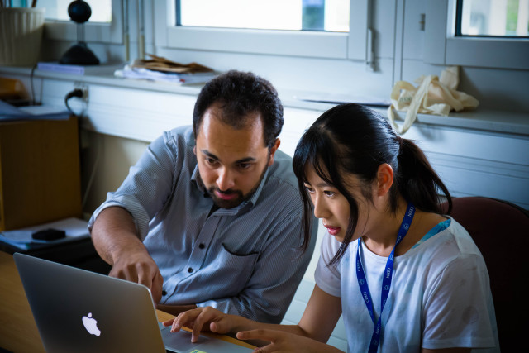
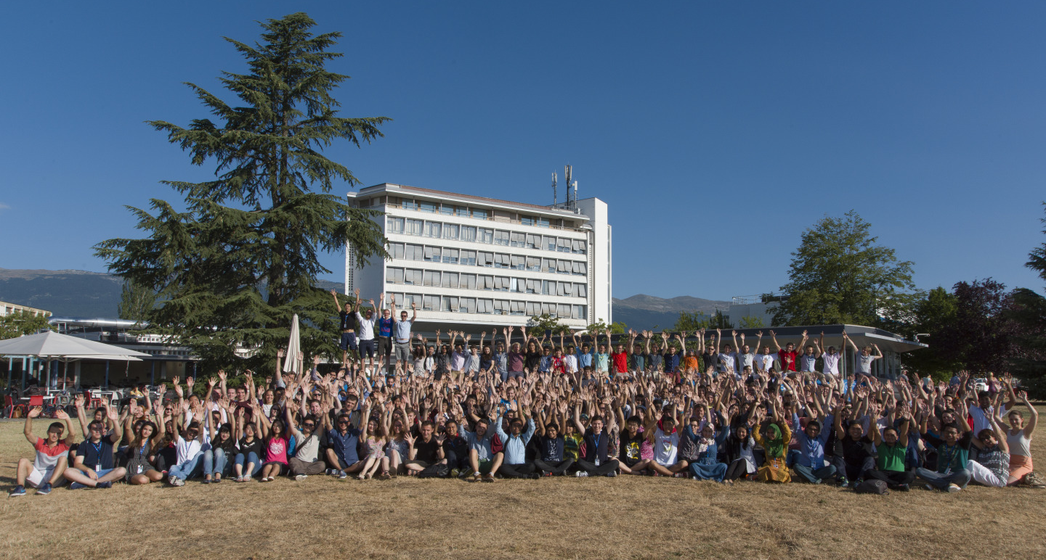
The Mission of CERN
Push back the frontiers of knowledge
E.g. the secrets of the Big Bang …what was the matter like within the first moments of the Universe’s existence?
Develop new technologies for accelerators and detectors
Information technology - the Web and the GRID
Medicine - diagnosis and therapy
Train scientists and engineers of tomorrow
Unite people from different countries
and cultures
Notes:
2

Slide 3
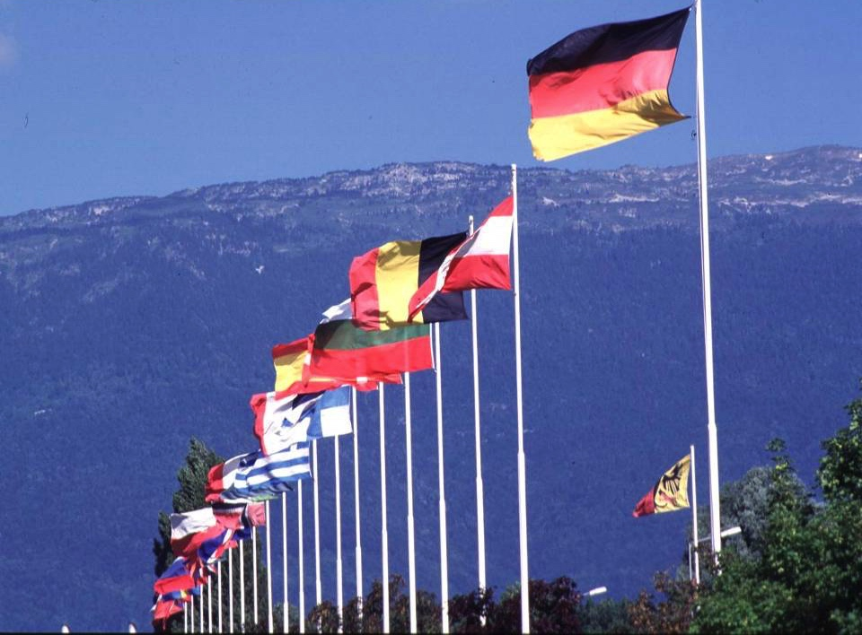

CERN: founded in 1954: 12 European States
“Science for Peace”
Today: 23 Member States
~ 2600 staff
~ 1800 other paid personnel
~ 13600 scientific users
Budget (2019) ~ 1200 MCHF
Member States: Austria, Belgium, Bulgaria, Czech Republic, Denmark, Finland, France, Germany, Greece, Hungary, Israel, Italy, Netherlands, Norway, Poland, Portugal, Romania, Serbia, Slovak Republic, Spain, Sweden, Switzerland and
United Kingdom
Associate Members in the Pre-Stage to Membership: Cyprus, Slovenia
Associate Member States: India, Lithuania, Pakistan, Turkey, Ukraine
Applications for Membership or Associate Membership:
Brazil, Croatia, Estonia
Observers to Council: Japan, Russia, United States of America;
European Union, JINR and UNESCO
3
Notes:
3
----- Meeting Notes (09/01/2013 14:16) -----
nnn

Slide 4
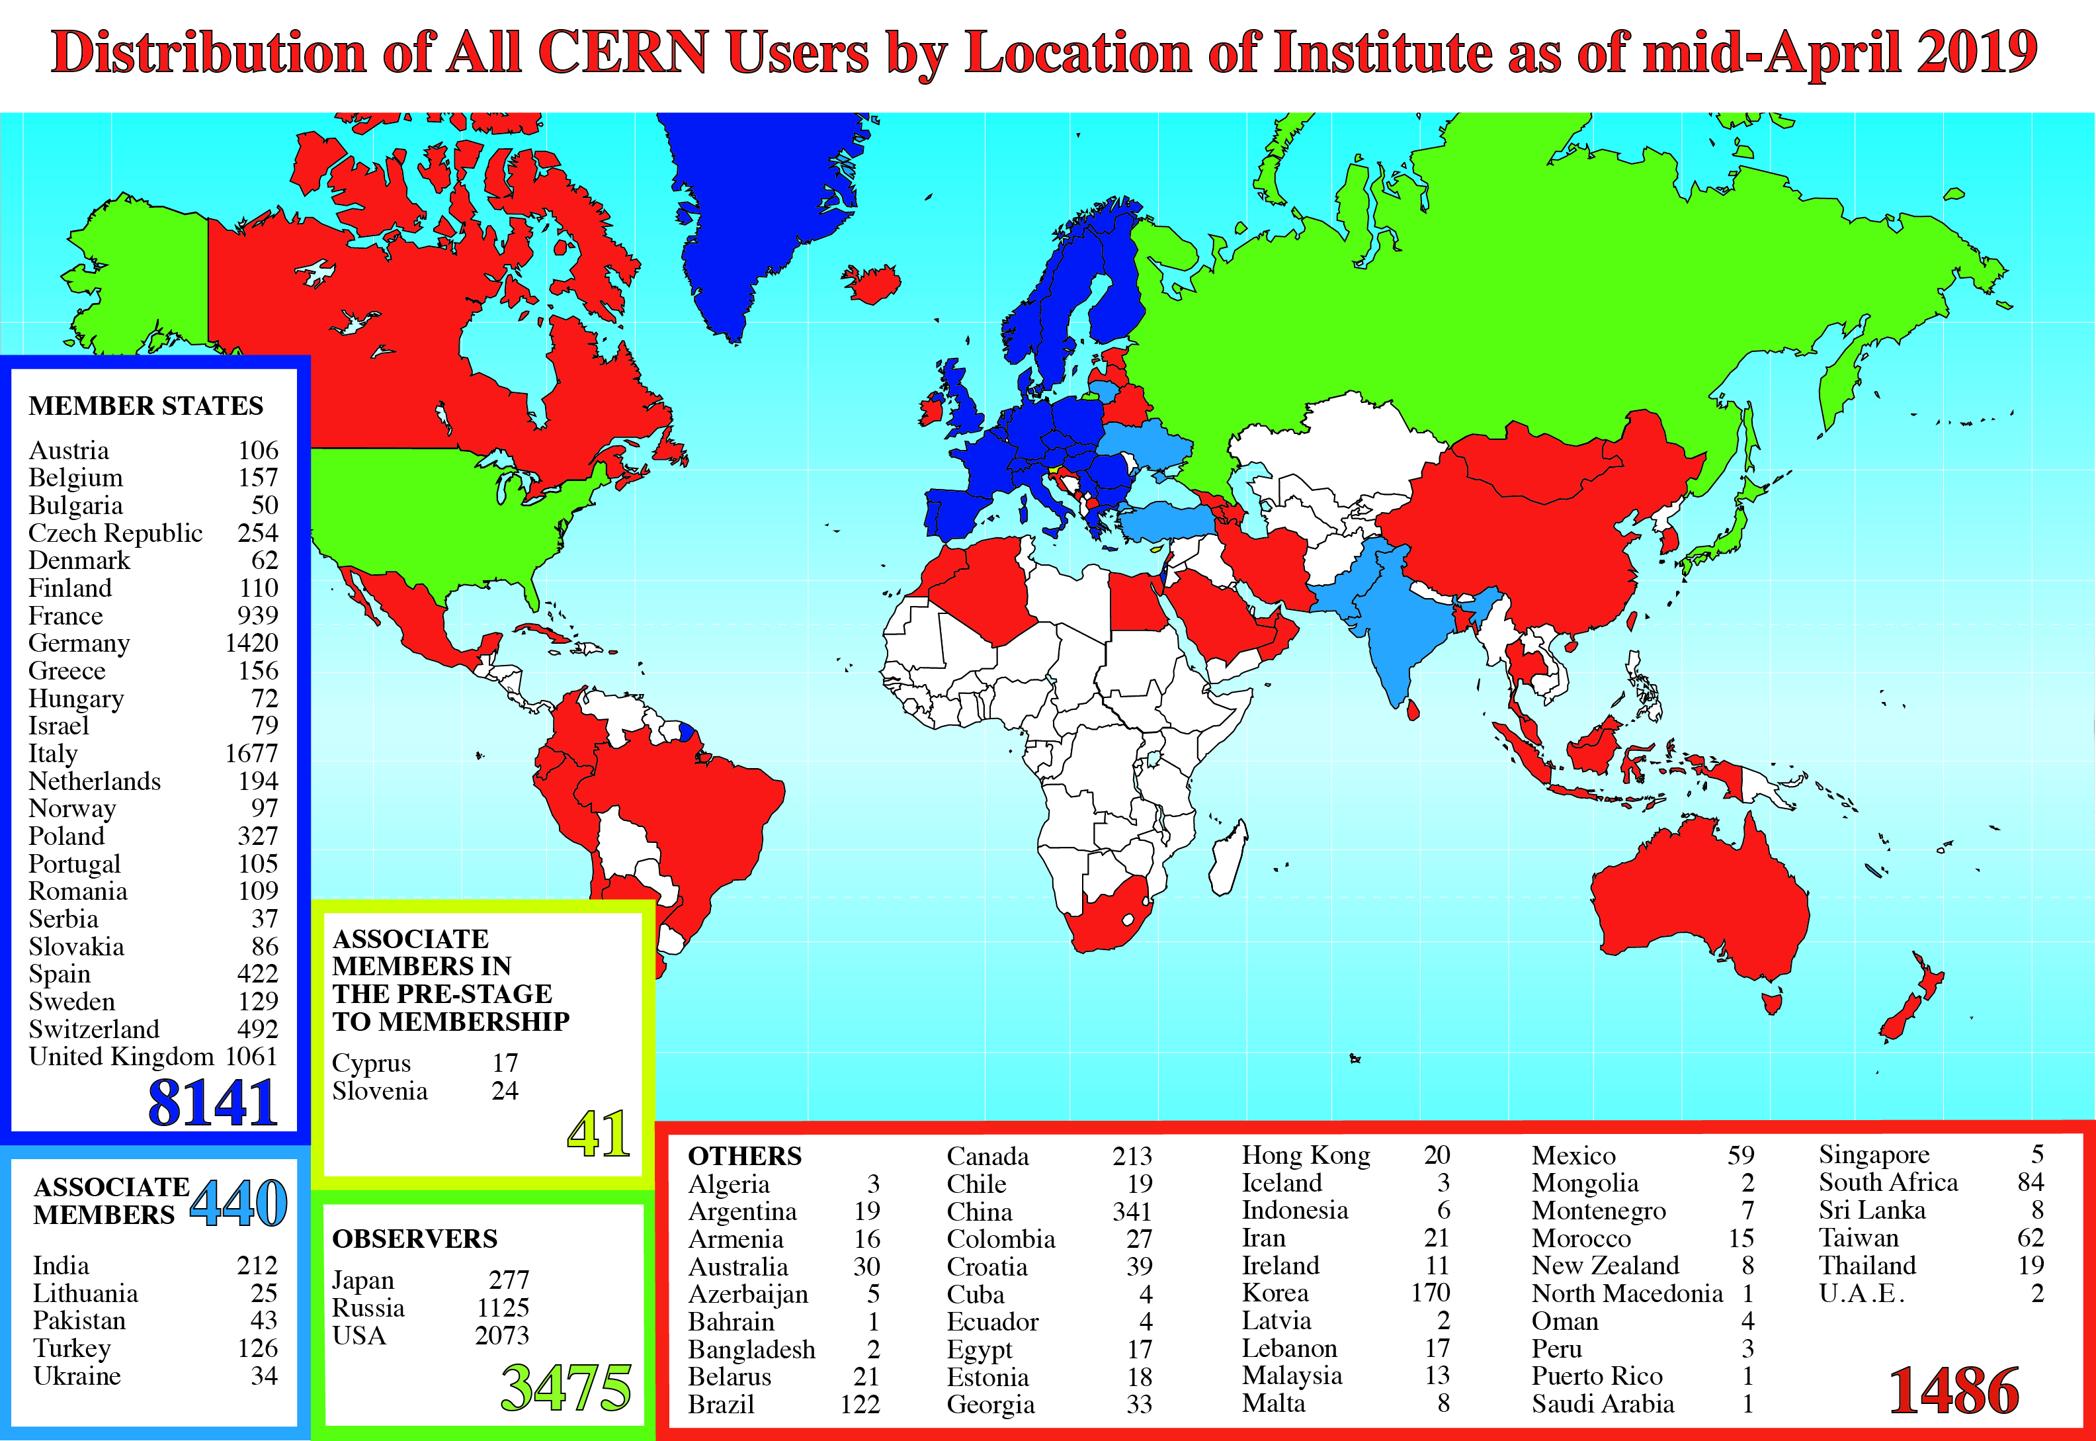
Science is getting more and more global
Notes:
4
4

Slide 5
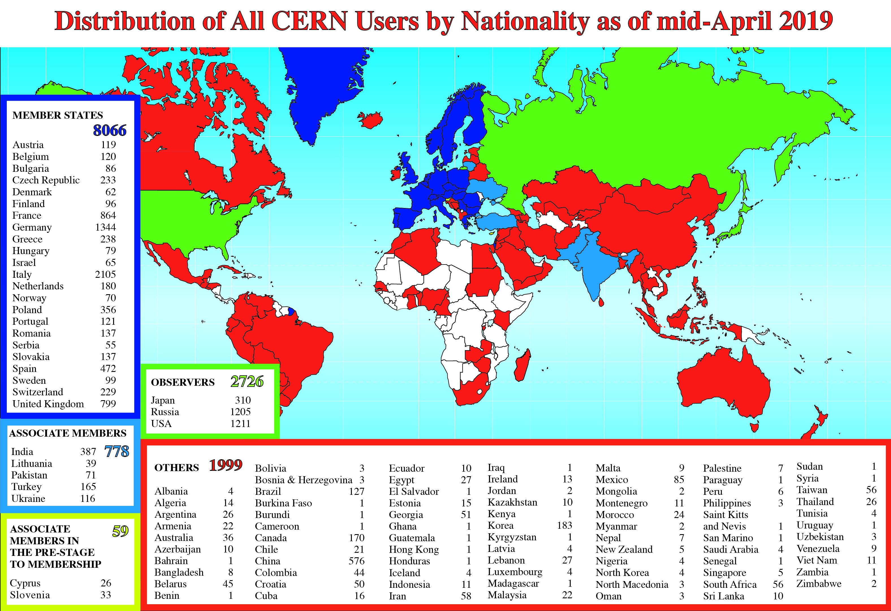
Science is getting more and more global
Notes:
5
5

Slide 6
Age Distribution of Scientists
- and where they go afterwards
27
Today:
>3000 PhD students
in LHC experiments
65
They do not all stay: where do they go?

Slide 7
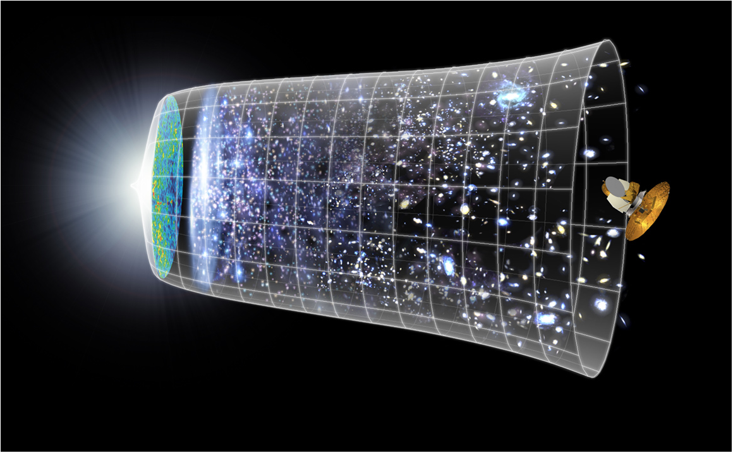
Our Scientific Challenge:
to understand the very first moments of our Universe after the Big Bang
Big Bang
WMAP
13.8 Billion Years
Today
10²⁸ cm

Slide 8
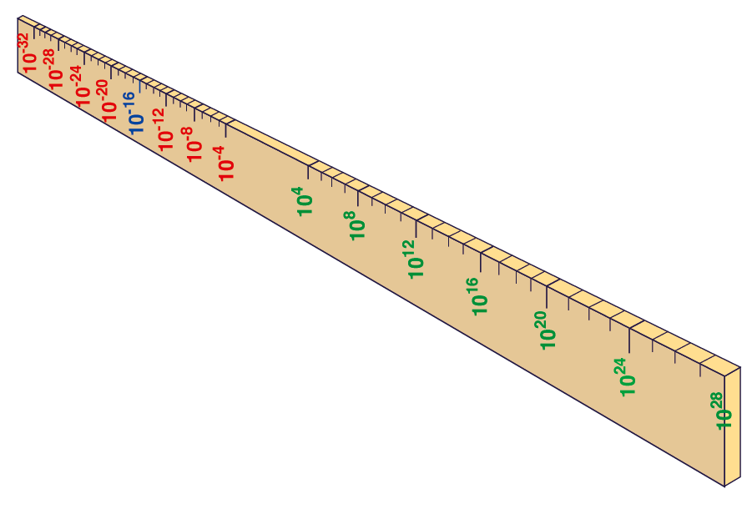
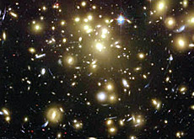

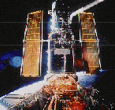
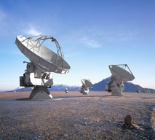

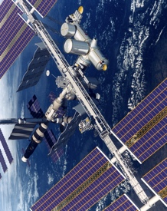
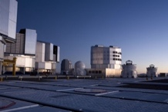
Big Bang
Proton
Atom
Radius of Earth
Earth to Sun
Radius of Galaxies
Universe
LHC
Super-Microscope
Hubble
ALMA
cm
Reproducing conditions
Looking back
AMS
VLT
Notes:
8
60 Grössenordnungen

Slide 9
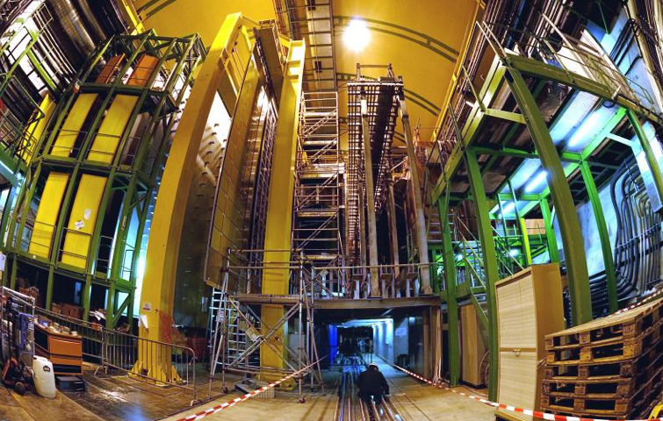


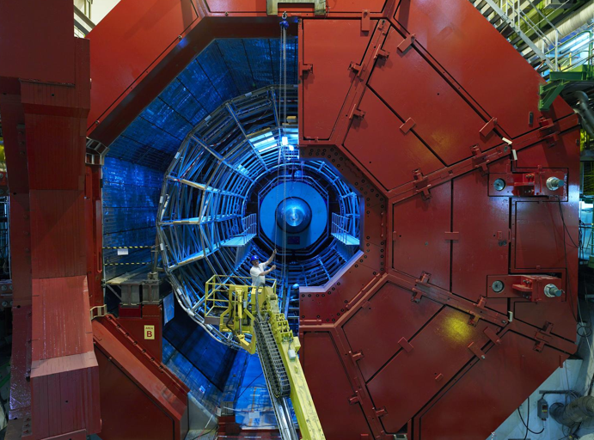

2010: a New Era in Fundamental Science
LHCb
CMS
ATLAS
Exploration of a new energy frontier
in p-p and Pb-Pb collisions
ALICE
LHC ring:
27 km circumference
Notes:
9

Slide 10
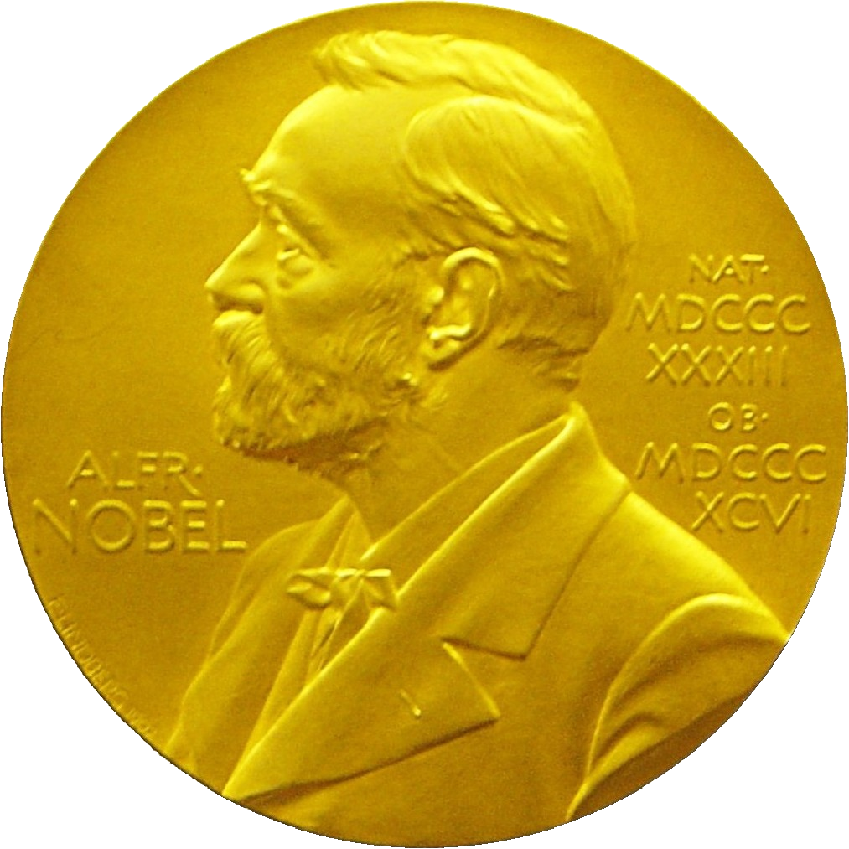
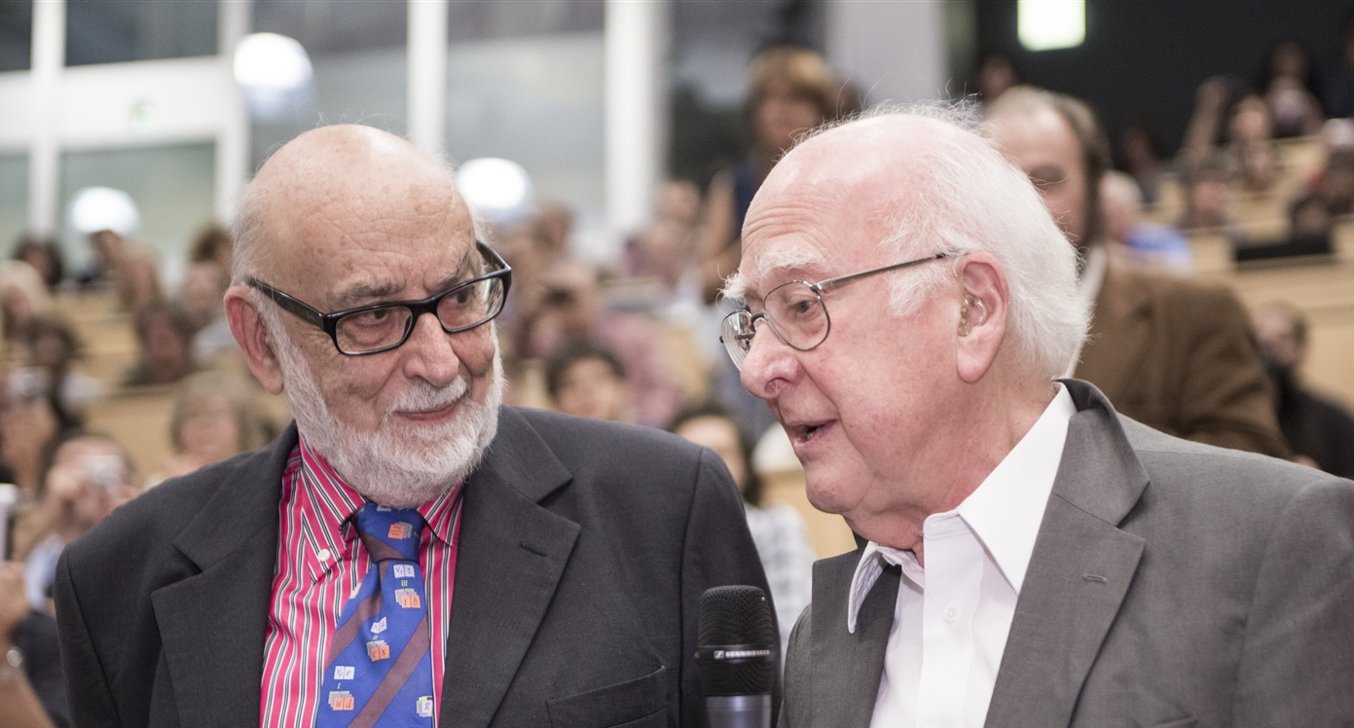
Discovery 2012, Nobel Prize in Physics 2013
The Nobel Prize in Physics 2013 was awarded jointly to François Englert and Peter W. Higgs "for the theoretical discovery of a mechanism that contributes to our understanding of the origin of mass of subatomic particles, and which recently was confirmed through the discovery of the predicted fundamental particle, by the ATLAS and CMS experiments at CERN's Large Hadron Collider”.

Slide 11
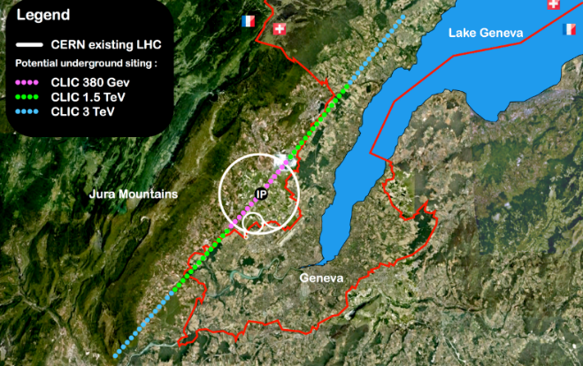

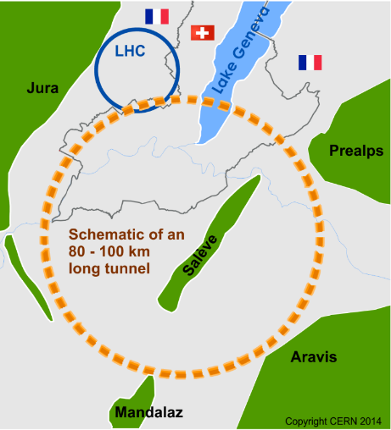

Future of particle physics
High Luminosity LHC until 2035
Ten times more collisions than
the original design
Studies in progress:
Compact Linear Collider (CLIC)
Linear e⁺e⁻ collider √s up to 3 TeV
Future Circular Collider (FCC)
New technology magnets →
100 TeV pp collisions in 100km ring
e⁺e⁻ collider (FCC-ee) as 1st step?
European Strategy for Particle Physics
Preparing next update in 2020

Slide 12
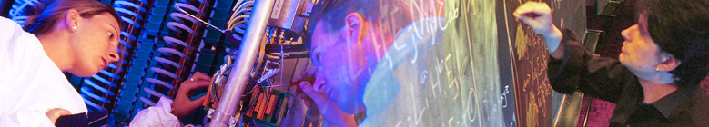

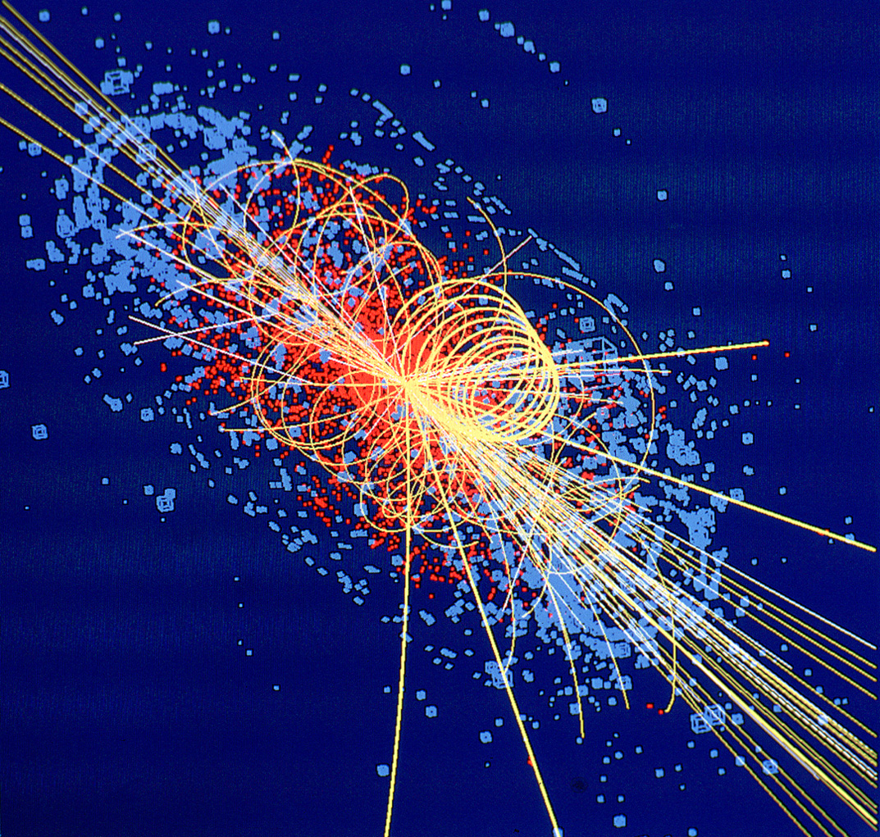
CERN: Particle Physics and Innovation
Interfacing between fundamental science and key technological developments
CERN Technologies and Innovation
Accelerating particle beams
Detecting particles
Large-scale computing (Grid)
Notes:
12

Slide 13
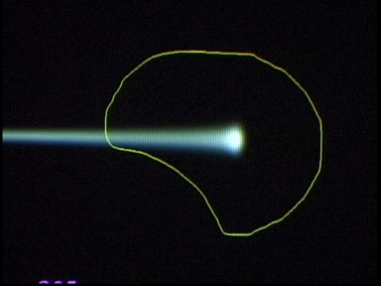
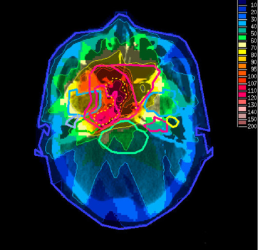
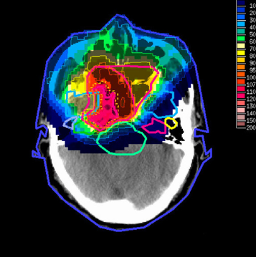
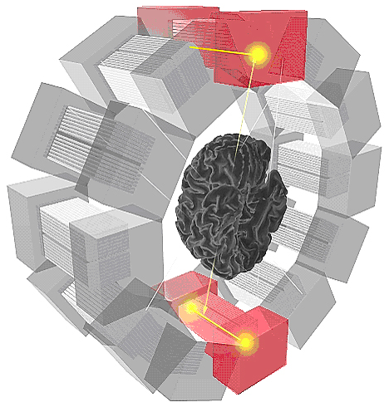
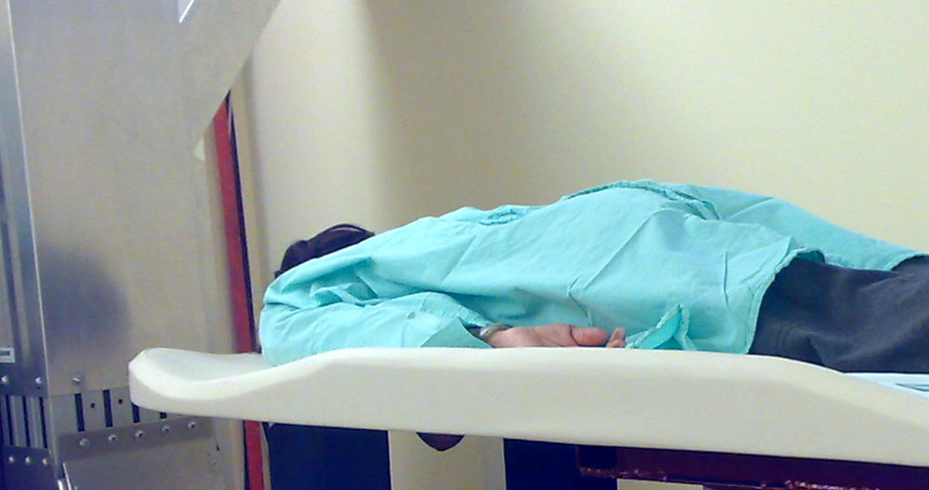
Medical Application as an Example of Particle Physics Spin-off
Combining Physics, ICT, Biology and Medicine to fight cancer
Hadron Therapy
Tumour Target
Leadership in Ion Beam Therapy now in Europe and Japan
Protons
light ions
Accelerating particle beams
~30’000 accelerators worldwide
~17’000 used for medicine
X-ray
protons
>100’000 patients treated worldwide (45 facilities)
>50’000 patients treated in Europe (14 facilities)
Imaging
PET Scanner
Clinical trial in Portugal, France and Italy for new breast imaging system (ClearPEM)
Detecting particles
Notes:
13

Slide 14
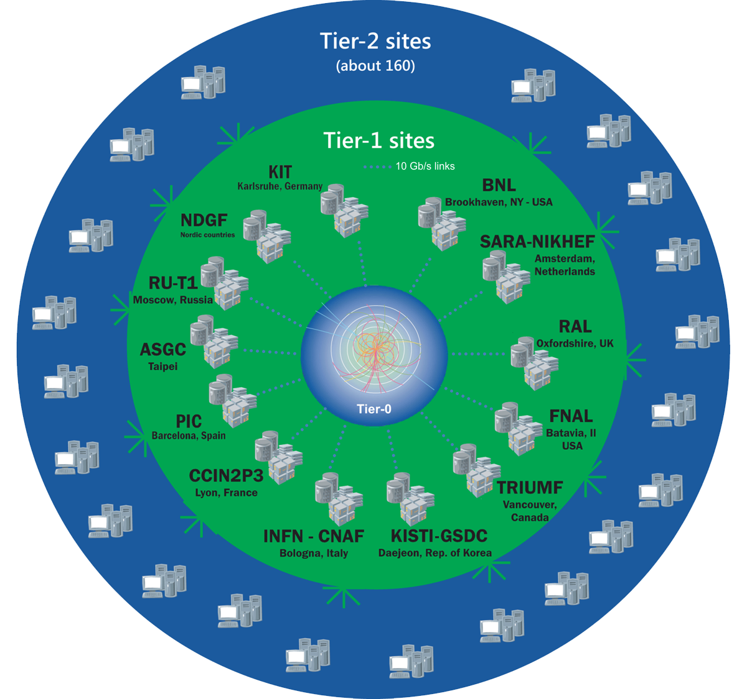
The Worldwide LHC Computing Grid
Tier-0
(CERN and Hungary):
data recording, reconstruction and distribution
>170 sites in,
42 countries
750k CPU cores
800 PB of storage
Tier-1: permanent storage, reprocessing,
analysis
> 2 million jobs/day
Tier-2: simulation,
end-user analysis
35 GB/s global transfers
WLCG:
An International collaboration to distribute and analyse LHC data
Integrates computer centres worldwide that provide computing and storage resource into a single infrastructure accessible by all LHC physicists

Slide 15

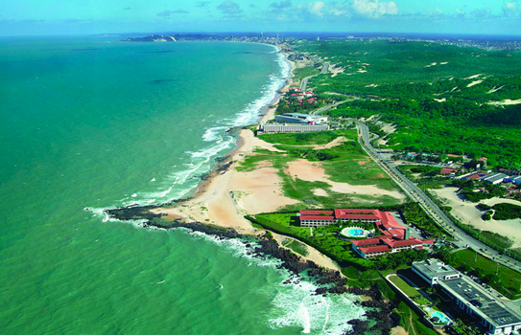
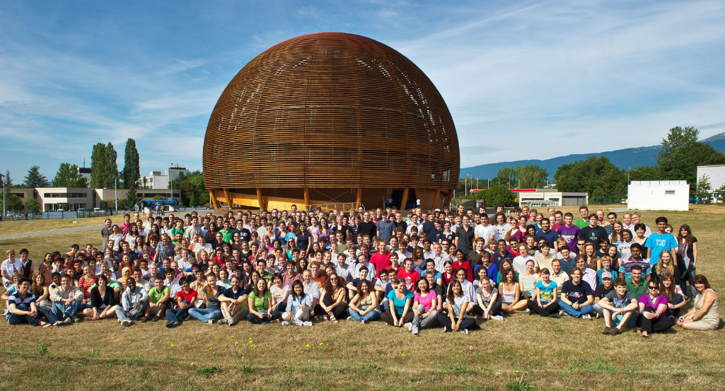
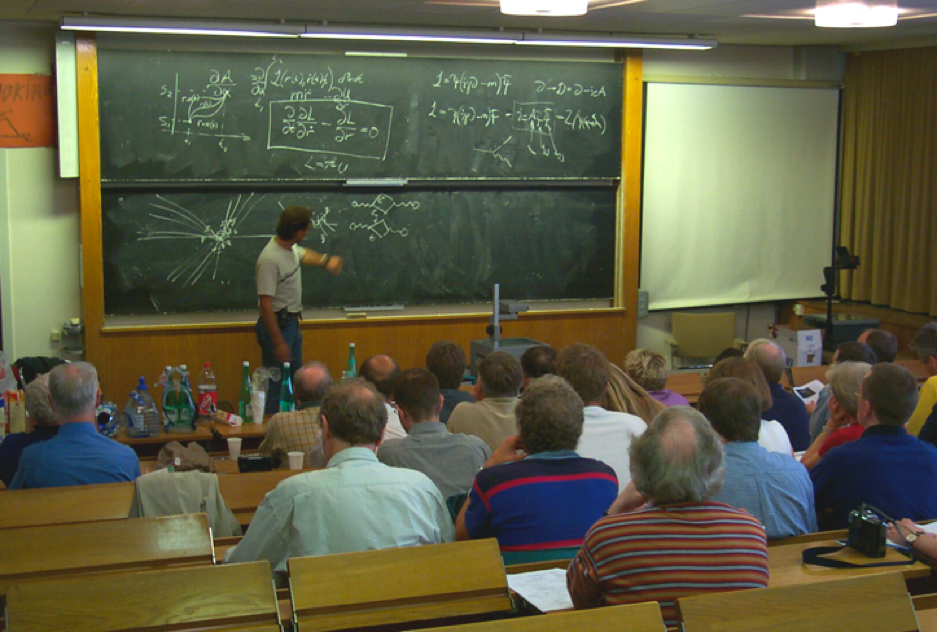
CERN Education Activities
Scientists at CERN
Academic Training Programme
Asia-Europe-Pacific School of High-Energy Physics
Fukuoka, Japan, 2012
Puri, India, 2014
2016 Beijing, China
2018 Quy Nhon, Vietnam
Latin American School of High-Energy Physics
Ibarra, Ecuador, 2015
San Juan del Rio, Mexico, 2017
Córdoba, Argentina 2019
Young Researchers
CERN School of High Energy Physics
CERN School of Computing
CERN Accelerator School
CERN
School of Physics
Italy, June-July 2018
Undergraduates
Summer Students
Programme
CERN Teacher Schools
International and National Programmes
Public visitors
135 thousand per year

Slide 16
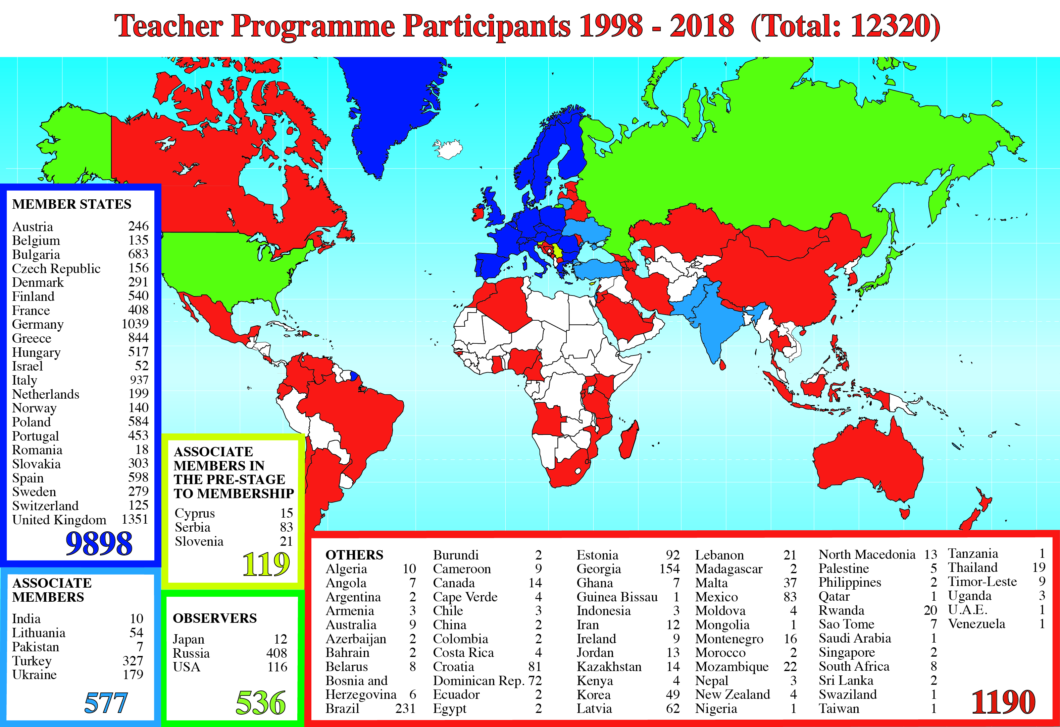
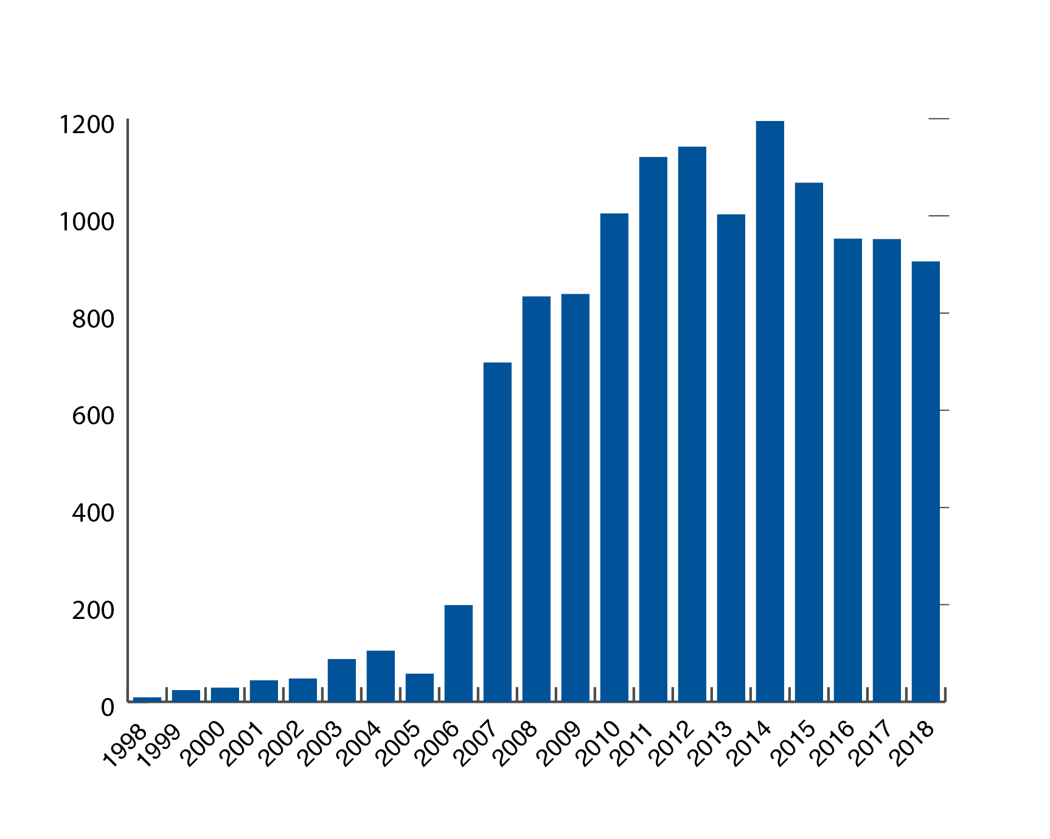
CERN Teacher Programme

Slide 17
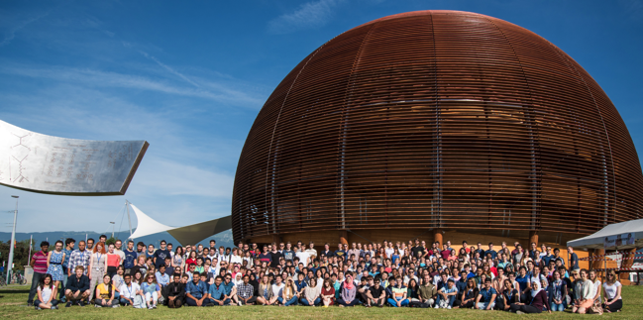
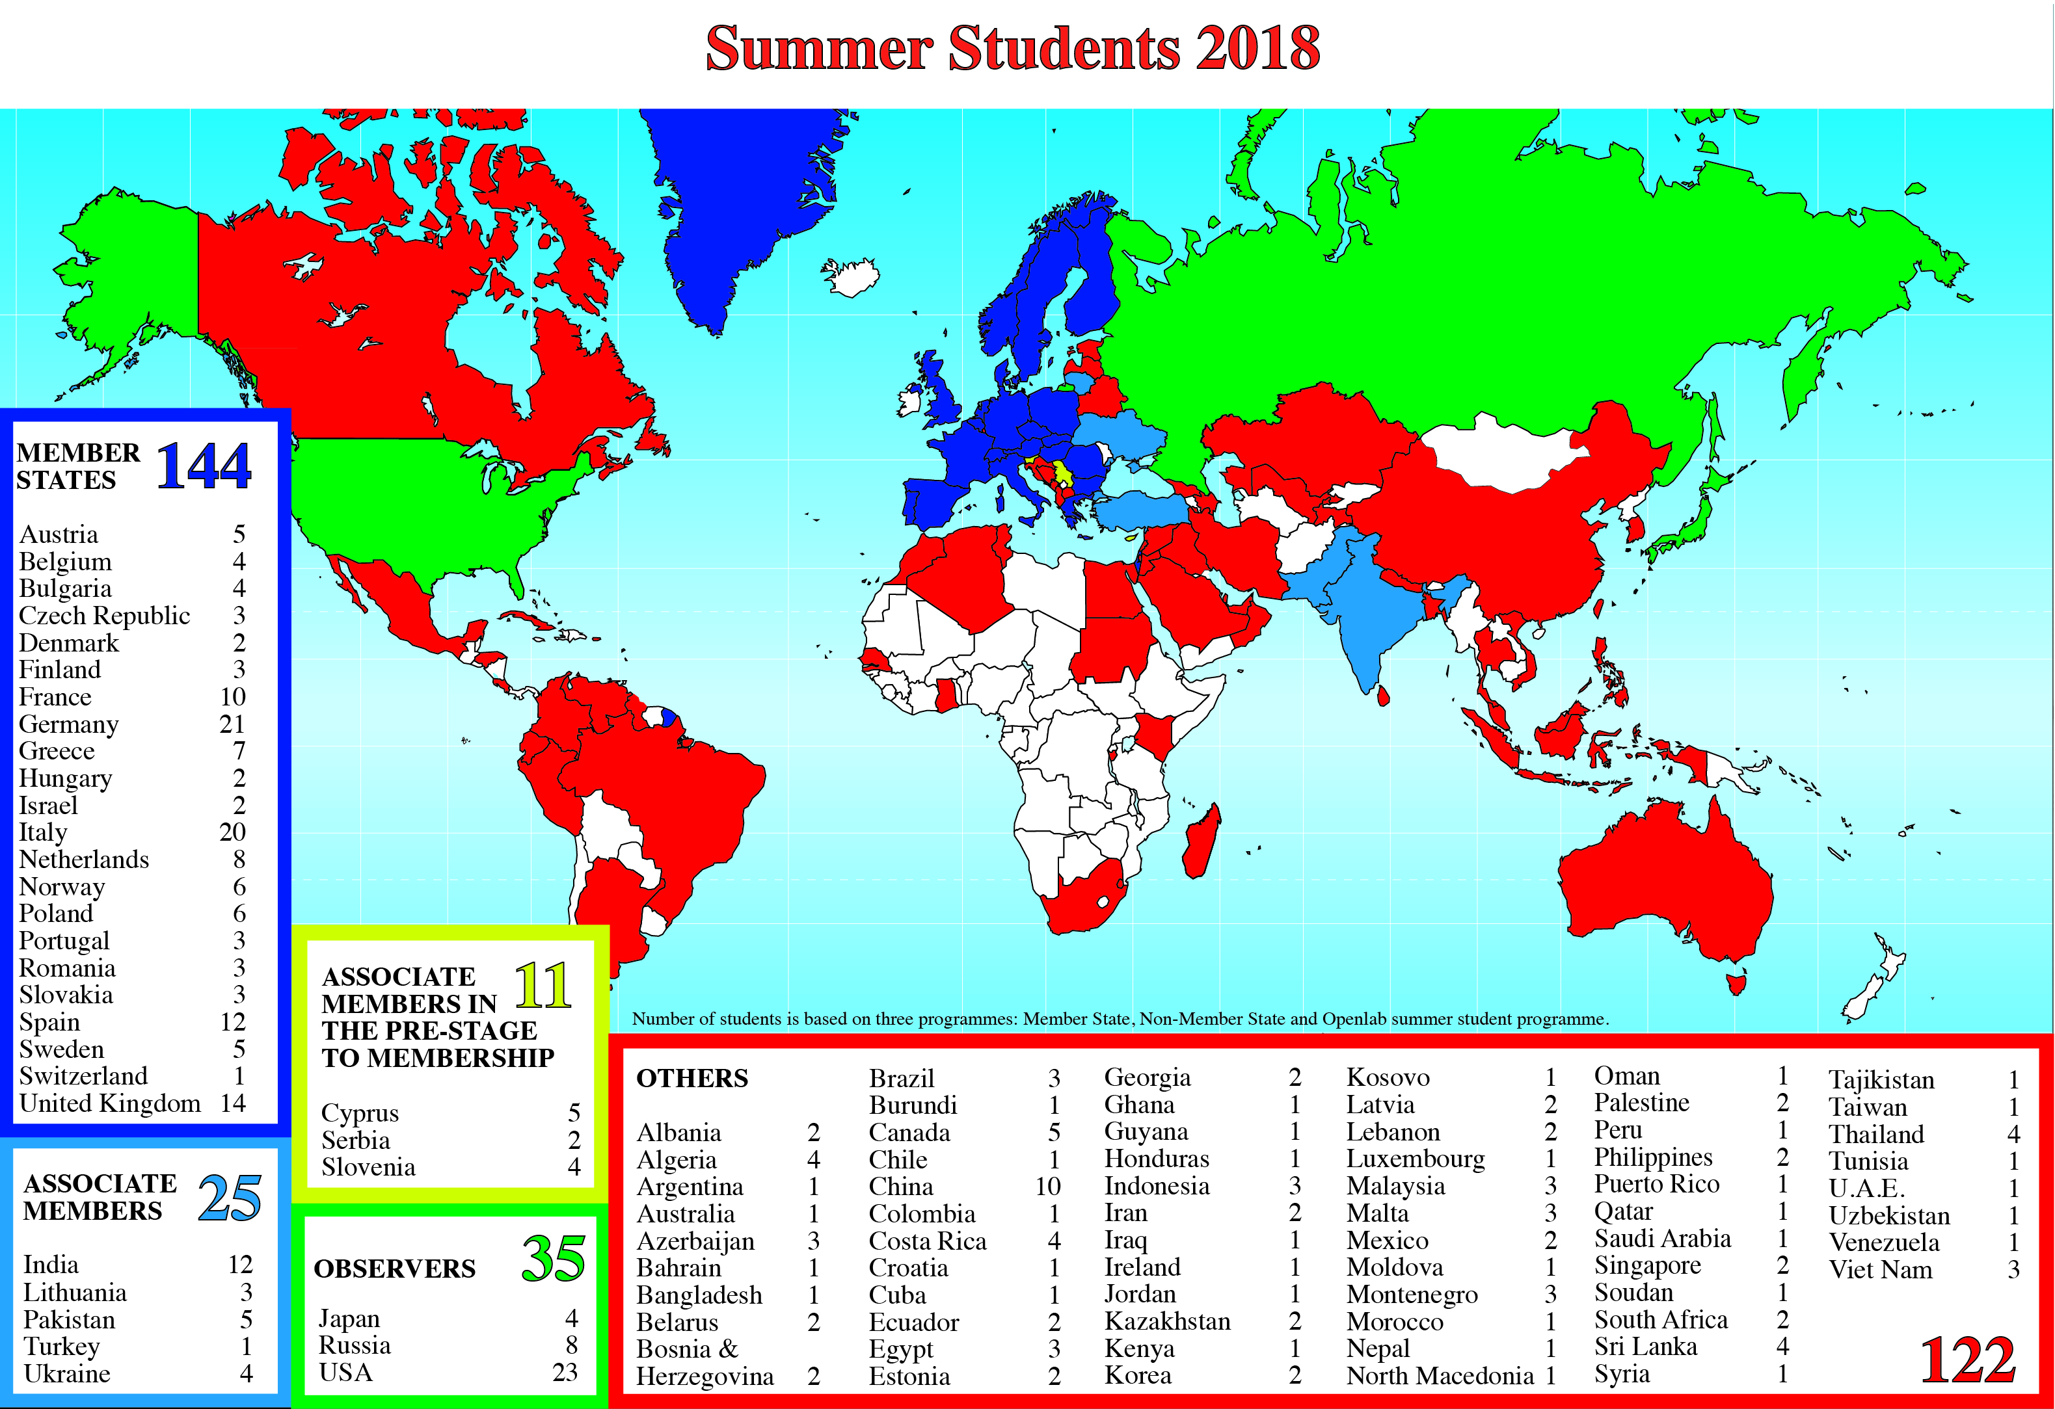
Summer Students 2018

Slide 18


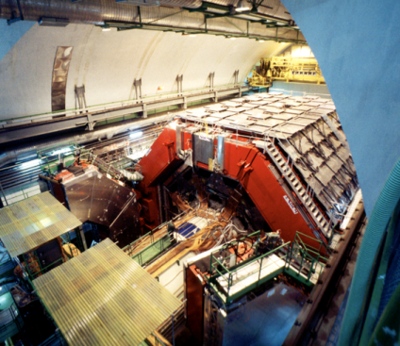
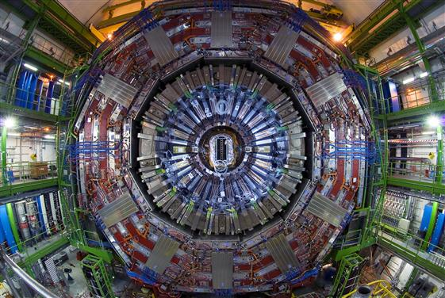
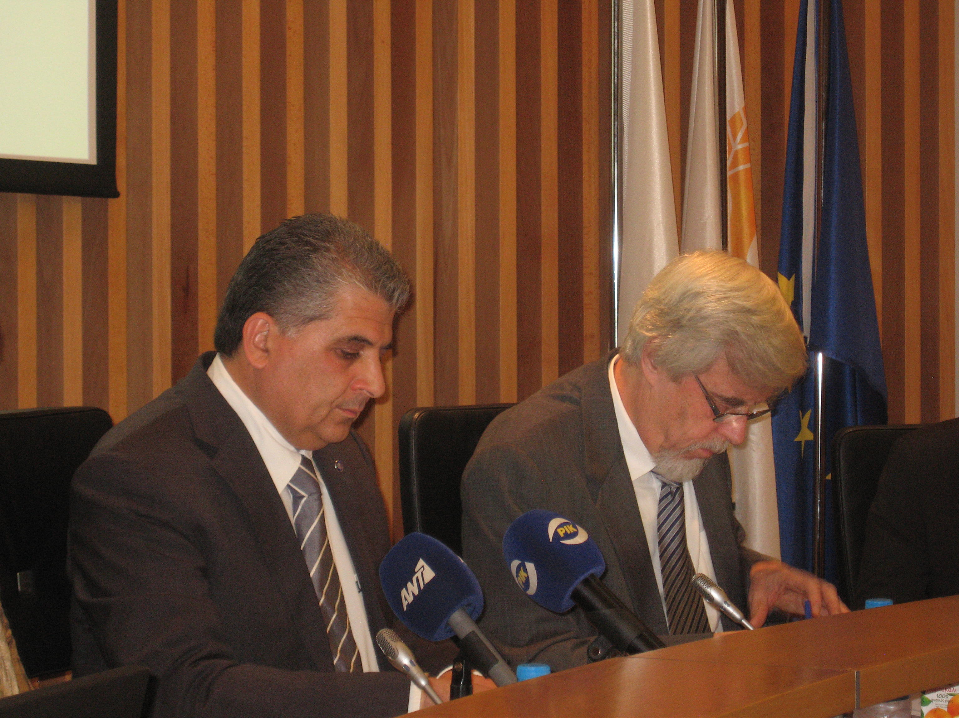
Cyprus and CERN
High-energy physicists from Cyprus, mainly from the University of Cyprus, have been participating in the L3 experiment at the LEP Collider
(operation from 1989 till Nov 2000)
L3
University of Cyprus is member of the CMS Collaboration at LHC since 1995,
MoU signed in 1999
International Co-operation Agreement signed in 2006 & two Protocols signed in 2007 strengthened scientific & technical links in areas of experimental & theoretical physics, high-performance computing & applications.
Cyprus became an Associate Member State
in the pre-stage to Membership on 1 April 2016.
Notes:
18

Slide 19
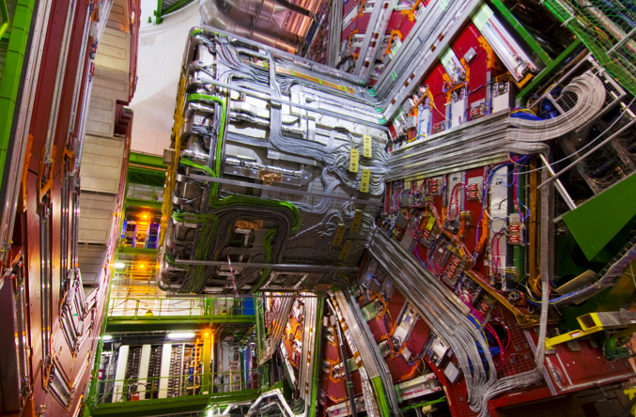
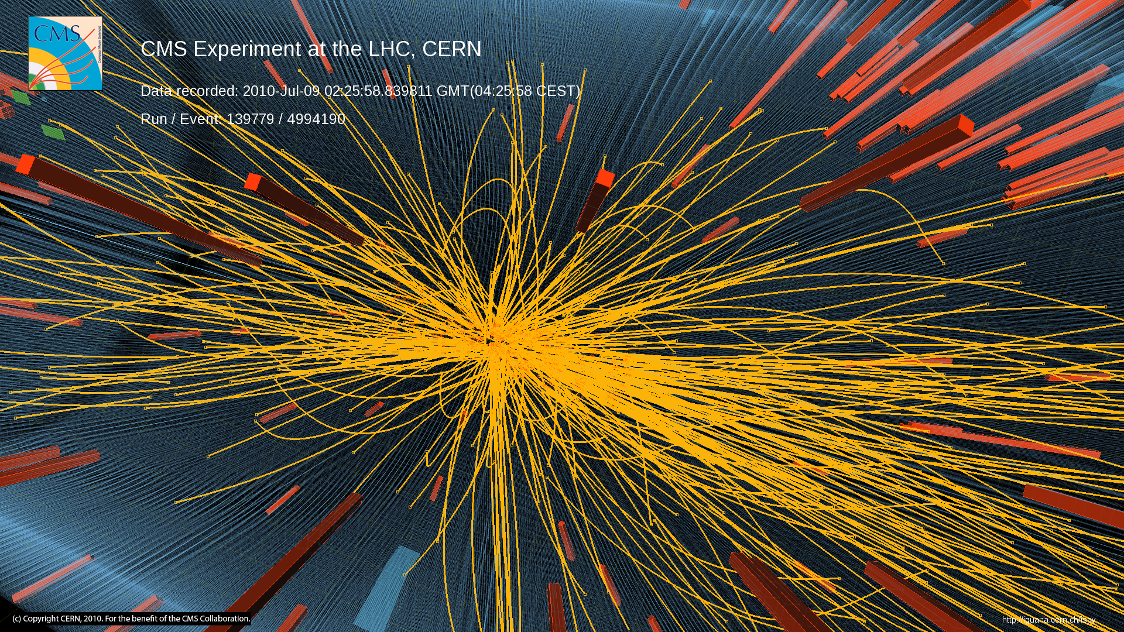
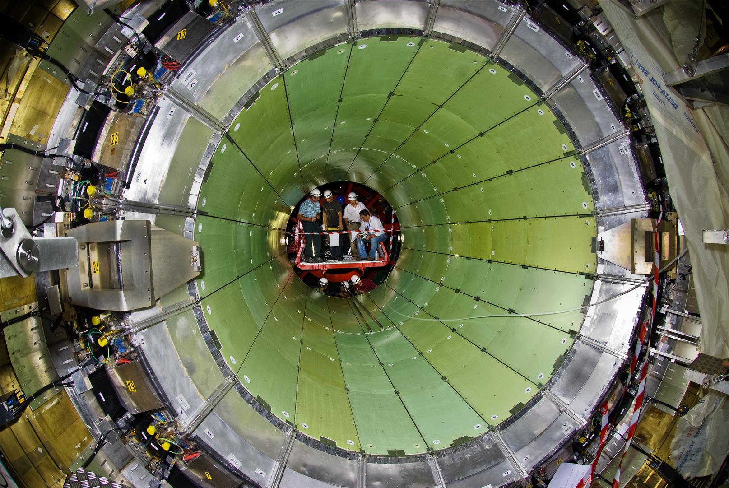
Cyprus and CERN
Contributions to the CMS Experiment at LHC
  Participation in manufacture of CMS Solenoid Magnet
  Electromagnetic Calorimeter test beams
  CMS physics analysis – new particle searches
Also involvement in theoretical physics
  Particle & strong interaction physics (String theory, Lattice QCD)
Cyprus is also developing high-performance computing infrastructure (possible LHC Tier-2 node)
  At Cyprus Institute & Computer Science Department of University of Cyprus
Notes:
19

Slide 20
Thank You!
σας ευχαριστώ!
Accelerating Science and Innovation
Notes:
20

