Slide 1

CERN Plans and Perspectives for the Future
Emmanuel Tsesmelis
Head of Associate and Non-Member State Relations, CERN
Joint CERN-Cyprus Committee
14 June 2019

Slide 2
Introduction
Physics and Colliders

Slide 3
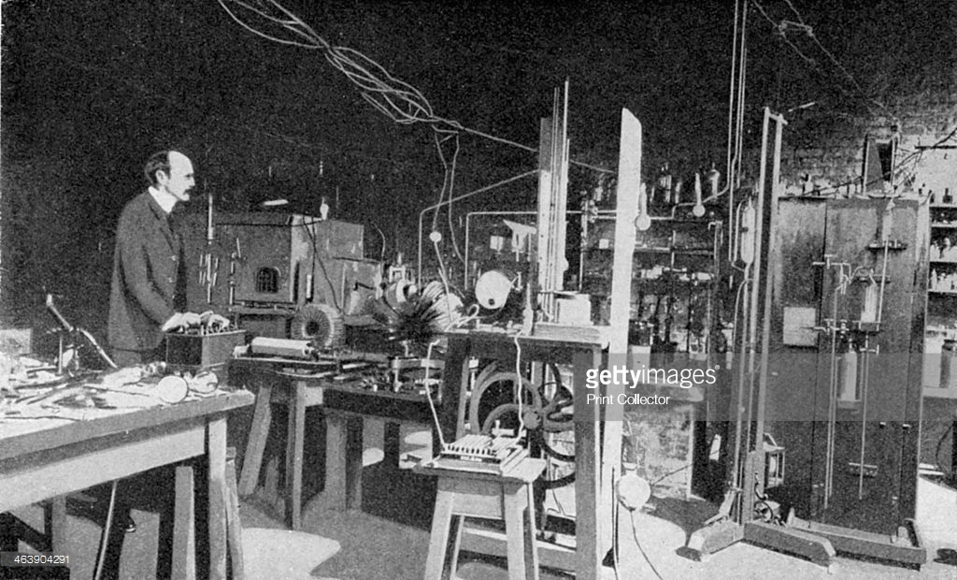
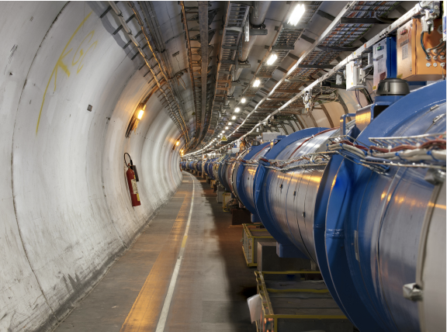
Accelerator Development
Characterised by rapid progress for over a century.
  From cathode-ray tubes to the LHC.
  From the discovery of the electron to the discovery of the Higgs boson.
Advances in accelerators require corresponding advances in accelerator technologies
  Magnets, vacuum systems, RF systems, diagnostics,...
But timelines becoming long, requiring:
  Long-term planning.
  Long-term resources.
  Global collaboration.

Slide 4
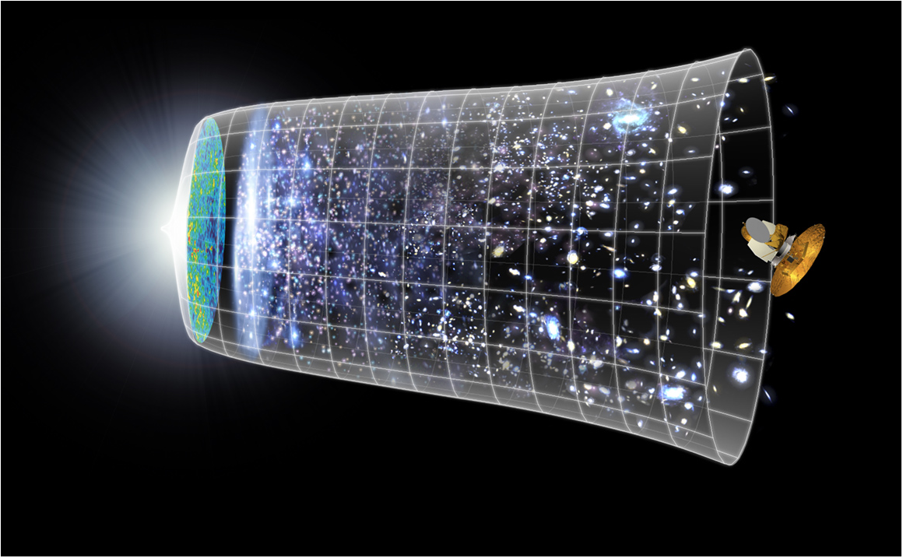

Scientific Challenge:
to understand the very first moments of our Universe after the Big Bang
Big Bang
WMAP
13.8 Billion Years
Today
10²⁸ cm

Slide 5
Circular colliders

Slide 6
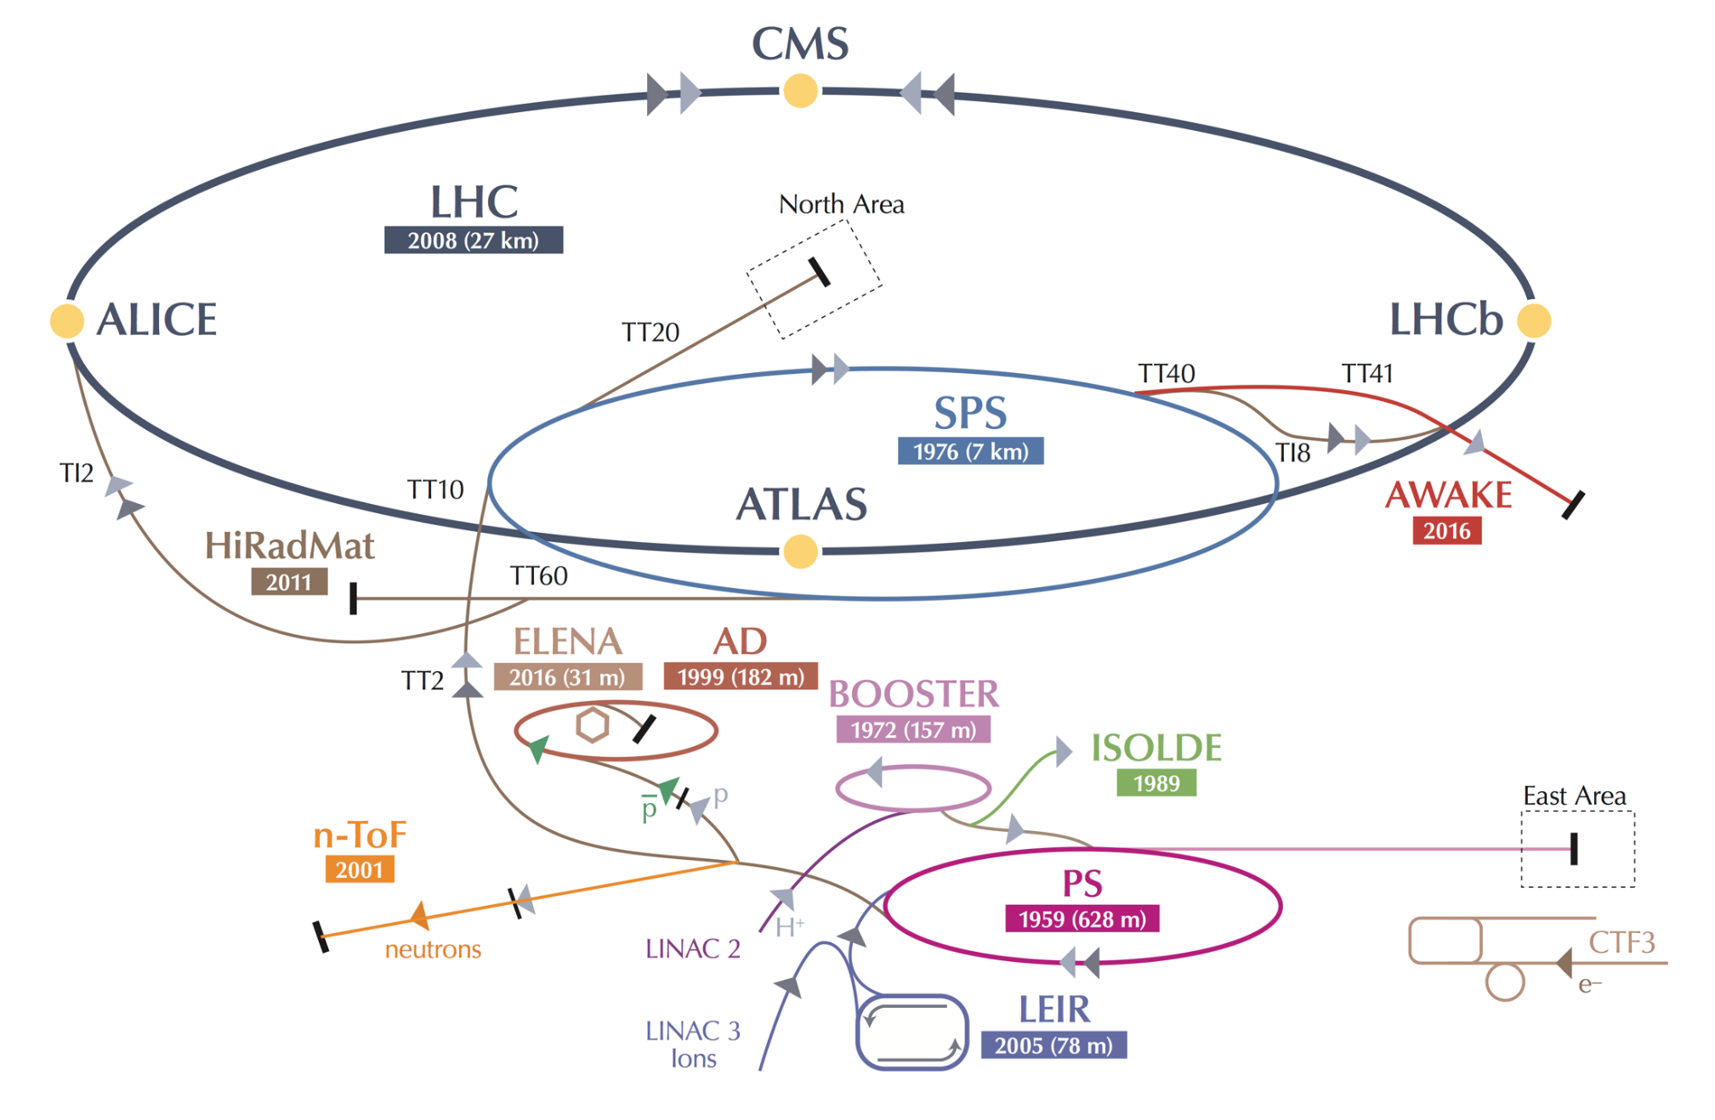
CERN Accelerator Complex

Slide 7

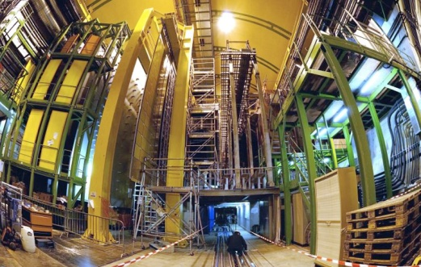


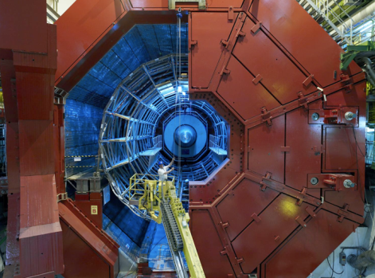

A New Era in Fundamental Science
LHCb
CMS
ATLAS
Exploration of a new energy frontier
in p-p, Pb-Pb and p-Pb collisions
ALICE
LHC ring:
27 km circumference
Notes:
7

Slide 8
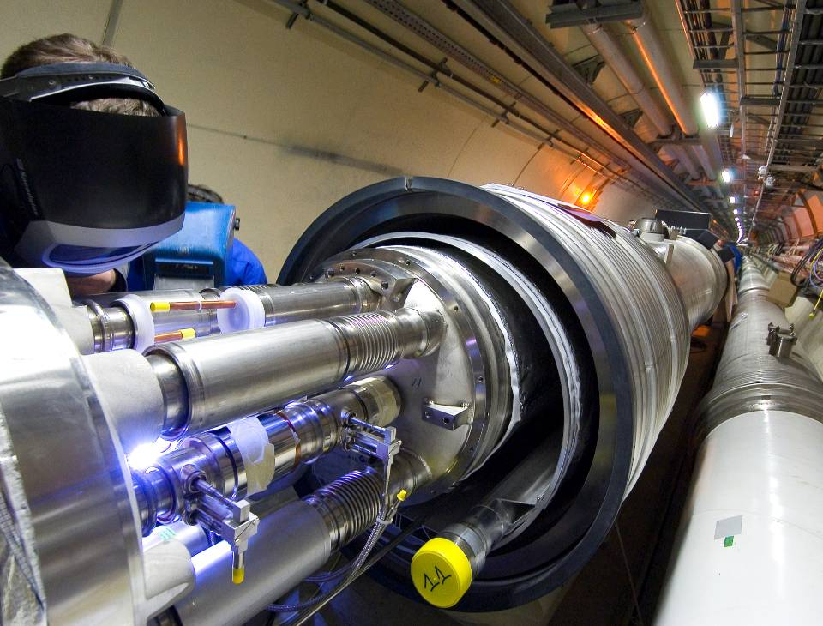
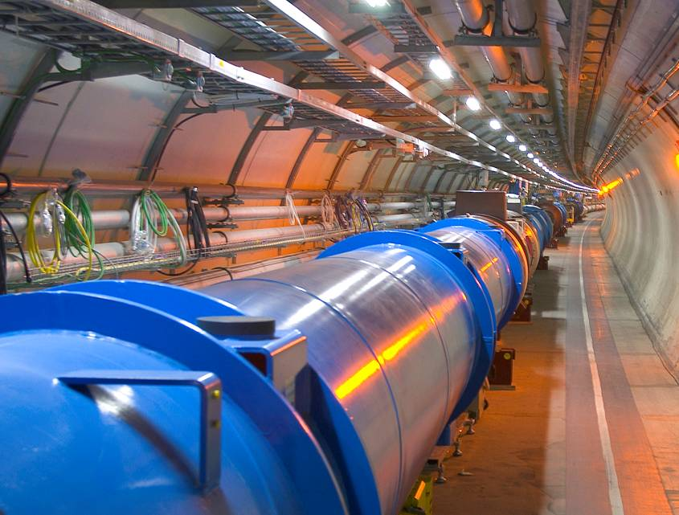
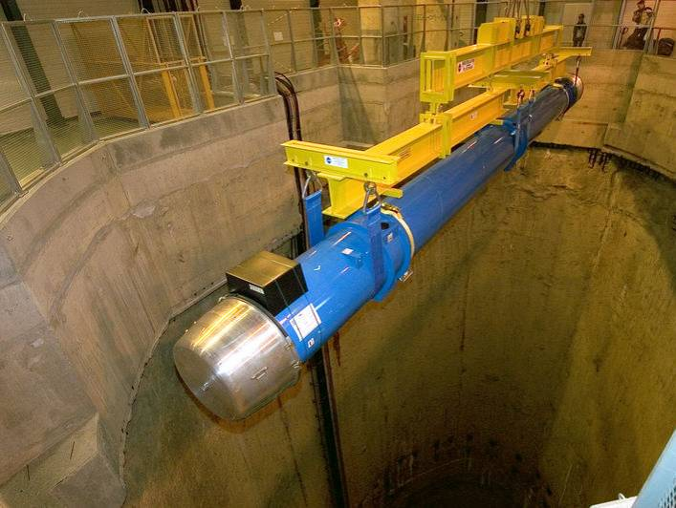
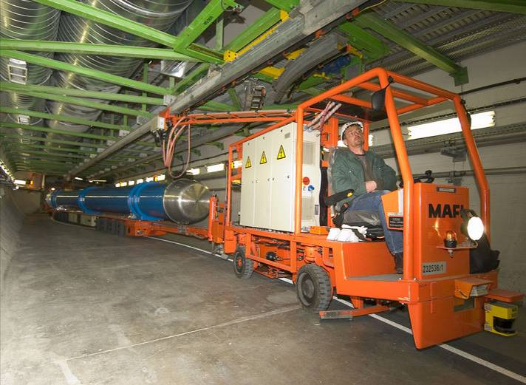
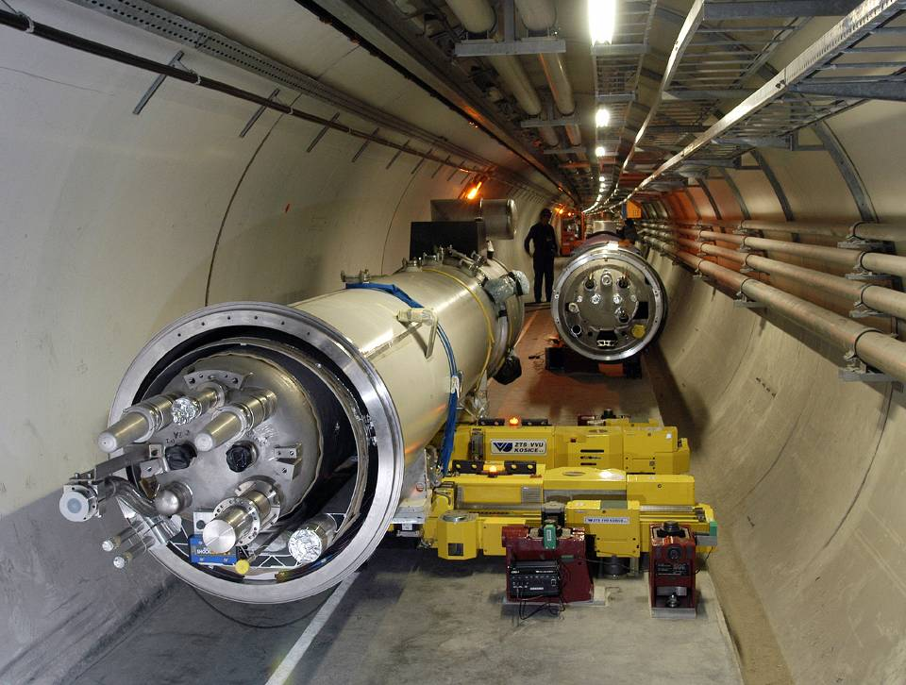
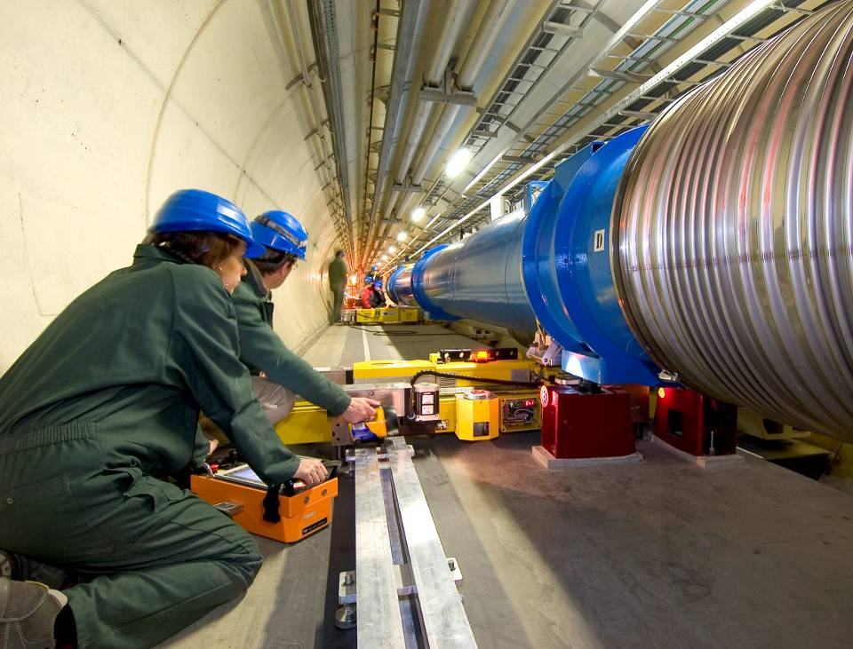
The LHC Arcs

Slide 9
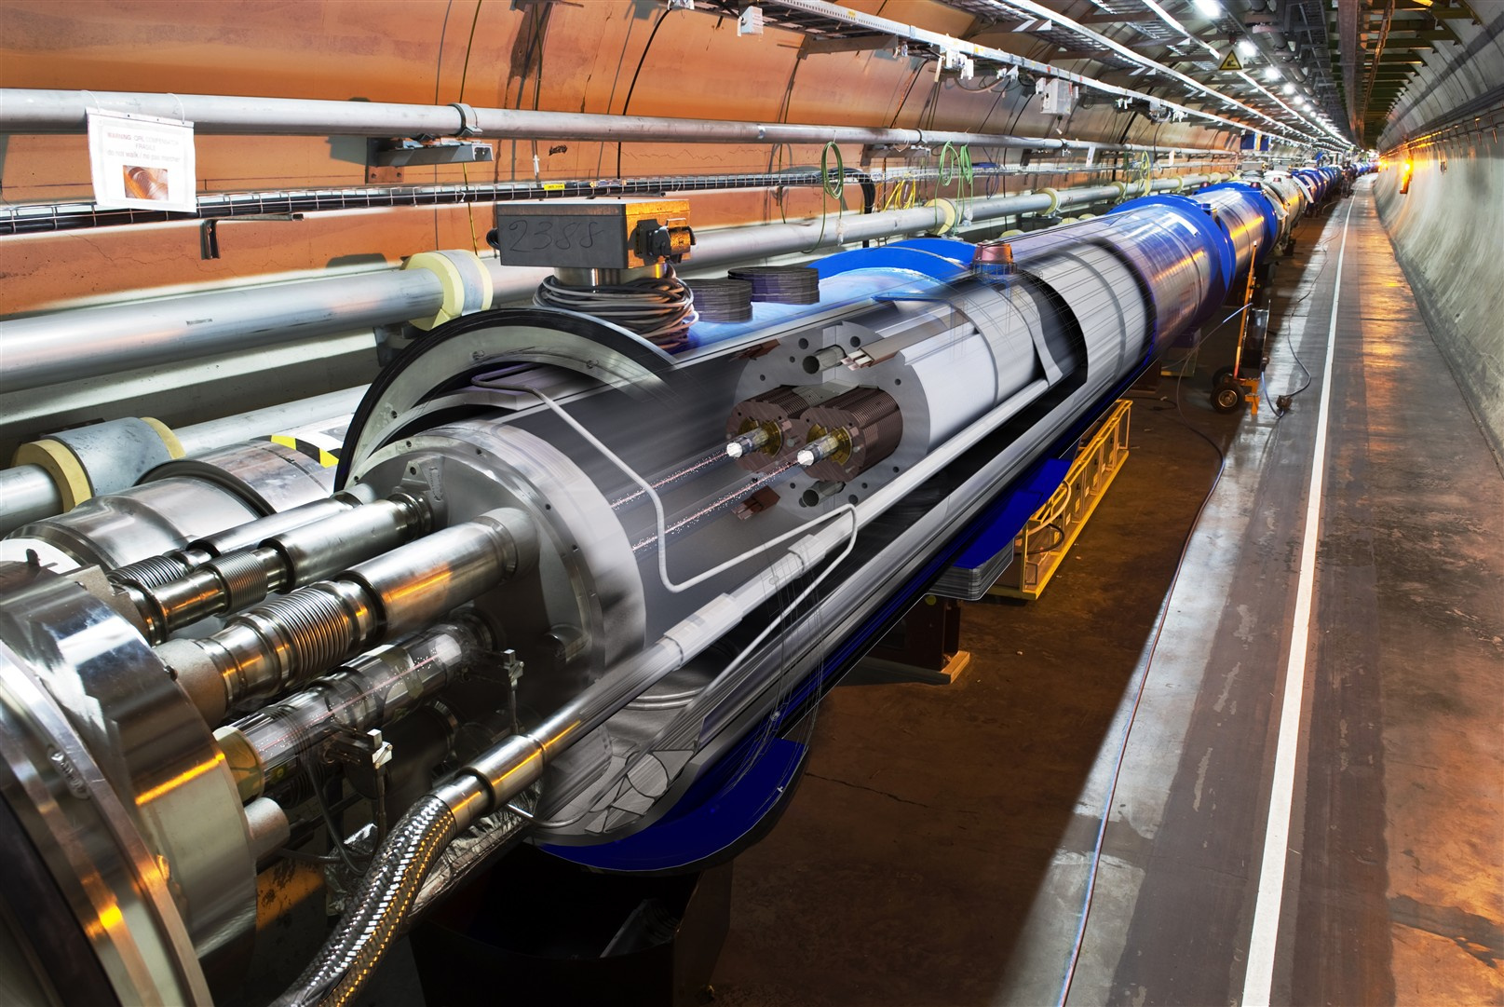

Slide 10
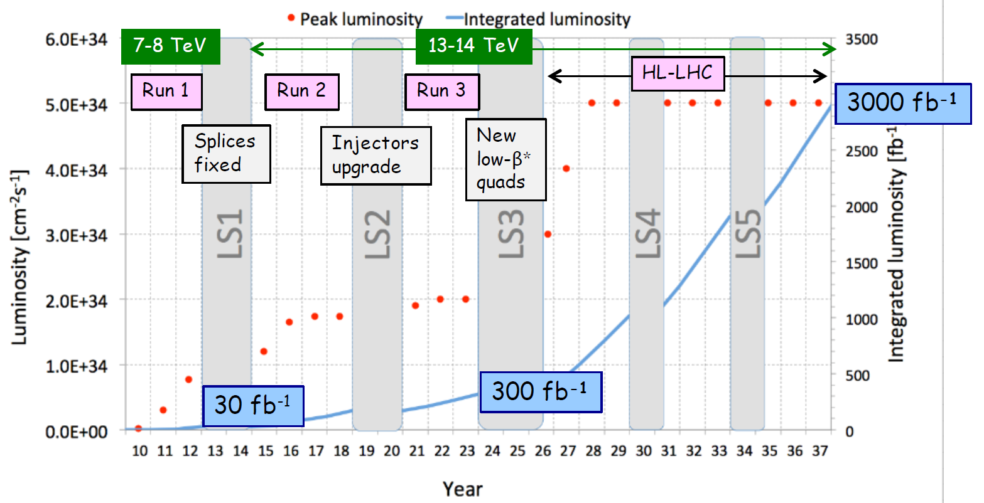
The LHC – Next Steps
Storing the data
High Luminosity LHC (HL-LHC) upgrade project

Slide 11
High Luminosity LHC (HL-LHC) Project

Slide 12
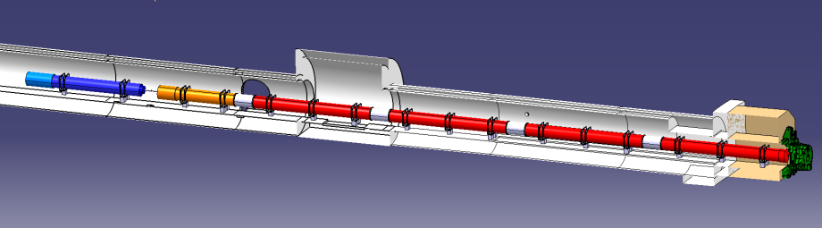





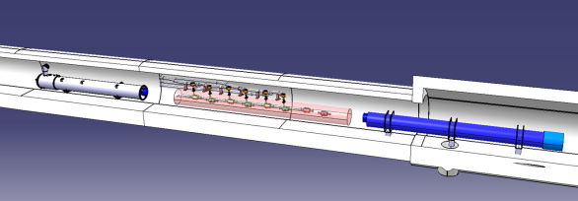


HL-LHC: In-kind Contribution and Collaboration
1.2 km of LHC to change !!
ATLAS
CMS
Q1-Q3 : R&D, Design, Prototypes and in-kind USA
D1 : R&D, Design, Prototypes and in-kind JP
MCBX : Design and Prototype ES
HO Correctors: Design and Prototypes IT
Q4 : Design and Prototype FR
CC : R&D, Design and in-kind USA
CC : R&D and Design UK

Slide 13

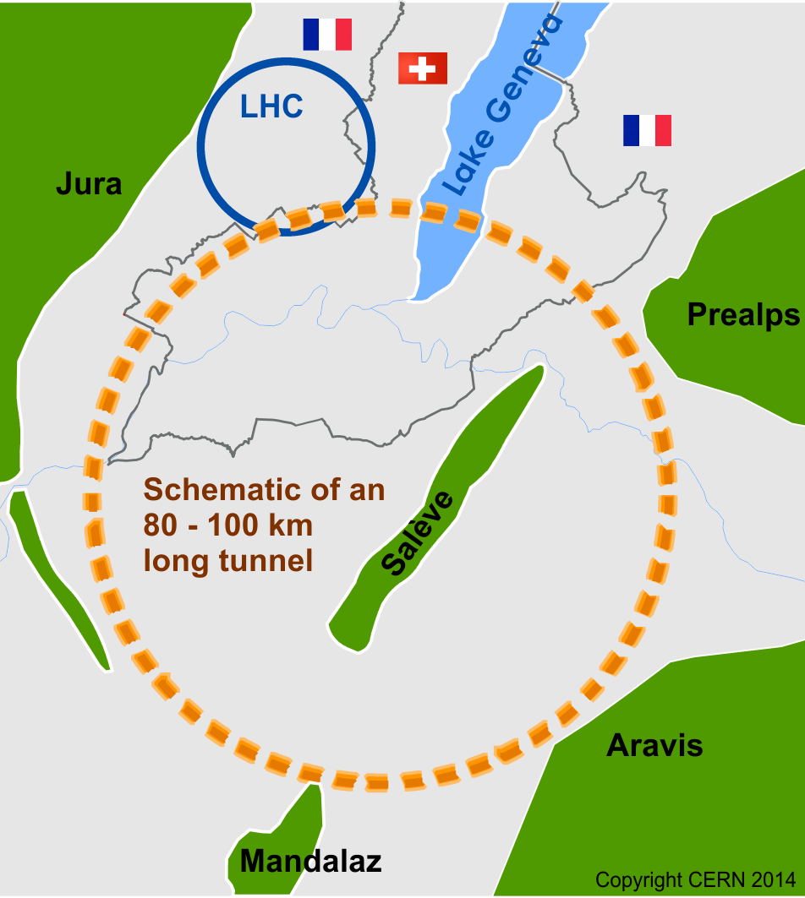

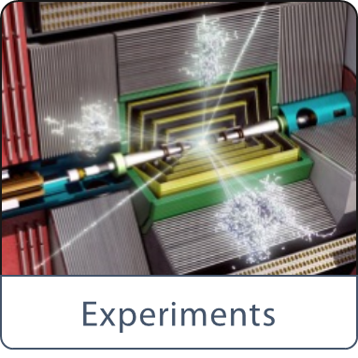
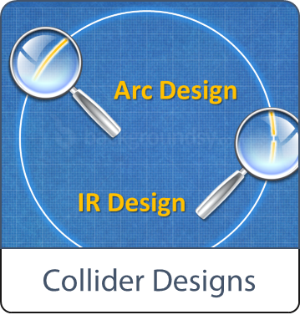
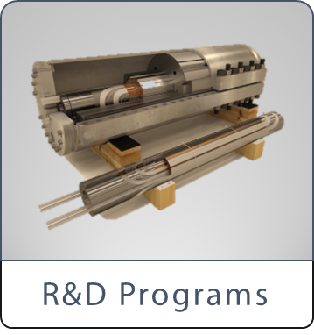


Future Circular Collider (FCC) Study
International FCC collaboration (CERN as host lab) to study:
pp-collider (FCC-hh) → main emphasis, defining infrastructure requirements
~100 km tunnel infrastructure in Geneva area, site specific
e⁺e⁻ collider (FCC-ee), as potential first step
HE-LHC with FCC-hh technology
p-e (FCC-he) option, IP integration, e⁻ from ERL
HE-LHC
~16 T ⇒ 100 TeV pp in 100 km

Slide 14
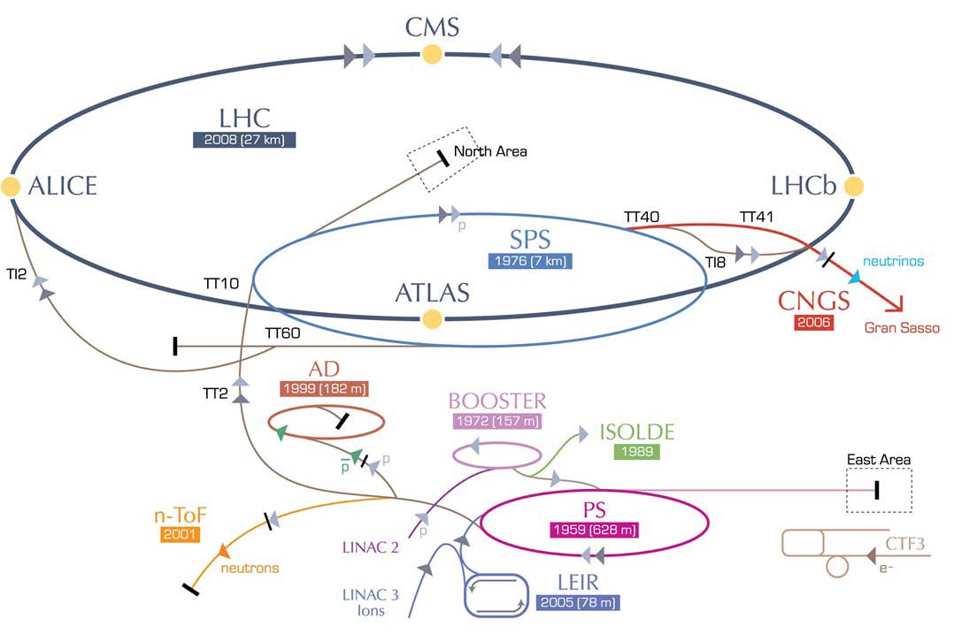
High-Energy LHC (HE-LHC)
HE-LHC
16-20T Dipoles
scSPS
1.3 TeV
2-GeV Booster
Linac4

Slide 15
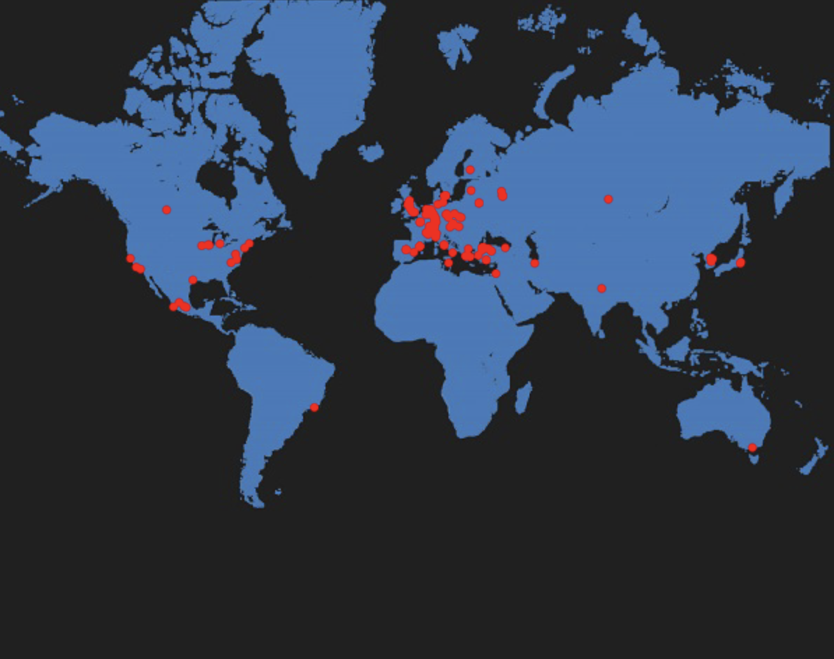
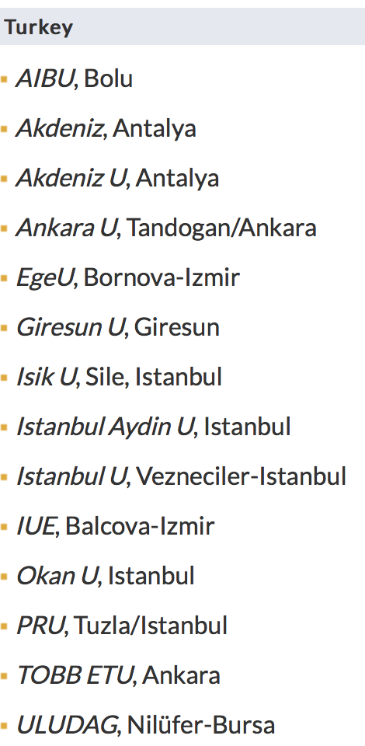

Collaboration & Industry Relations
135
Insitutes
34
Countries
30
Companies
EC
H2020

Slide 16
Linear COLLIDERS

Slide 17
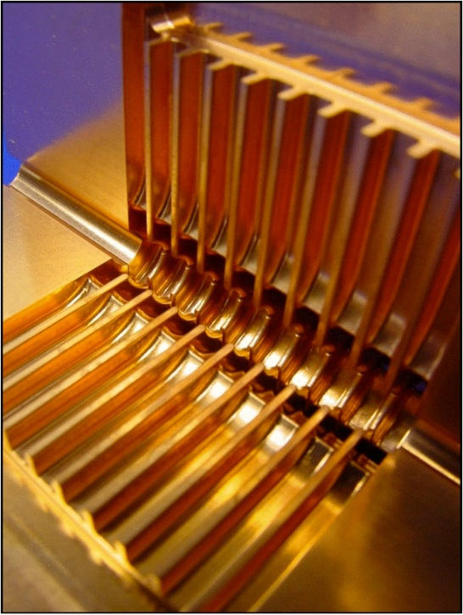
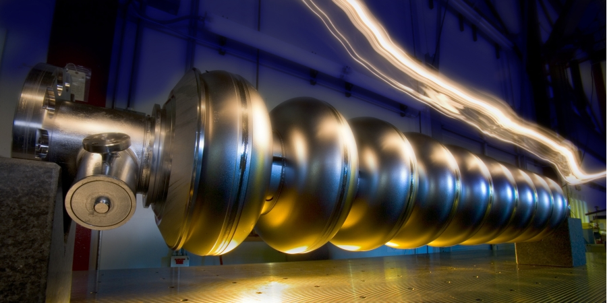
Linear Colliders
CLIC Compact Linear Collider
Linear e⁺e⁻ colliders
Luminosities: few 10³⁴ cm⁻²s⁻¹
ILC International Linear Collider
2-beam acceleration scheme
at room temperature
Gradient 100 MV/m
√s up to 3 TeV
Physics + Detector studies
for 380 GeV - 3 TeV
Superconducting RF cavities (like XFEL)
Gradient 32 MV/m
√s ≤ 500 GeV (1 TeV upgrade option)
Focus on ≤ 500 GeV, physics studies also for 1 TeV

Slide 18
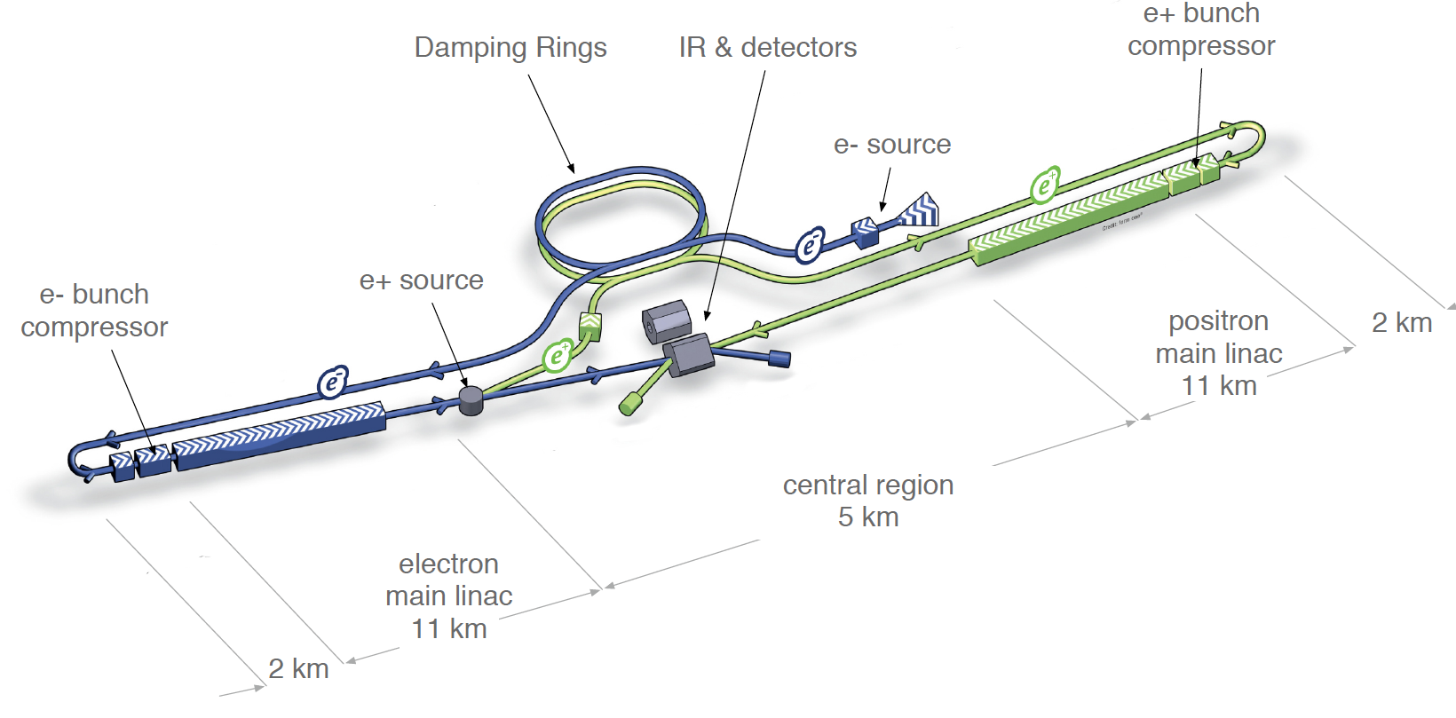
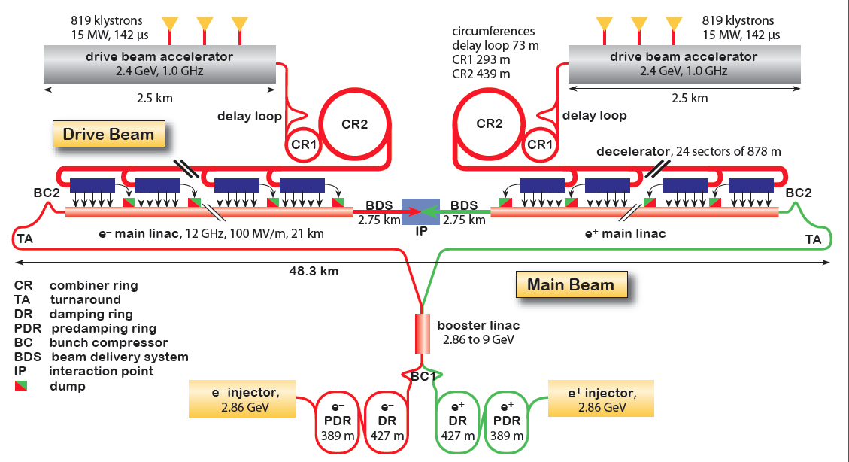
CLIC and ILC
ILC
0.5 TeV CM, upgreadable to 1 TeV
SC RF industrialized
mature design (TDR in 2012)
Possibility of hosting is evaluated by Japanese government
CLIC
Two-beam scheme, 1-3 TeV CM
Option for 380 GeV explored (klystrons)
CTF3 facility – key R&D done
Ready for demonstrator project

Slide 19
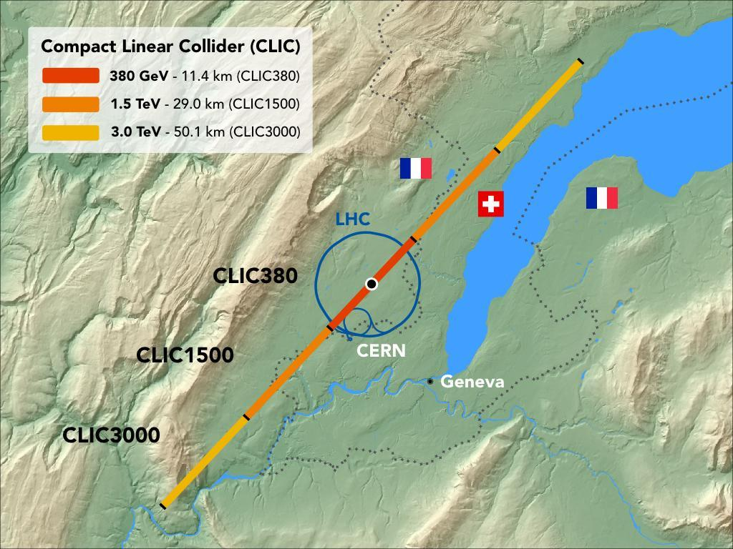
CLIC Site Near Geneva

Slide 20
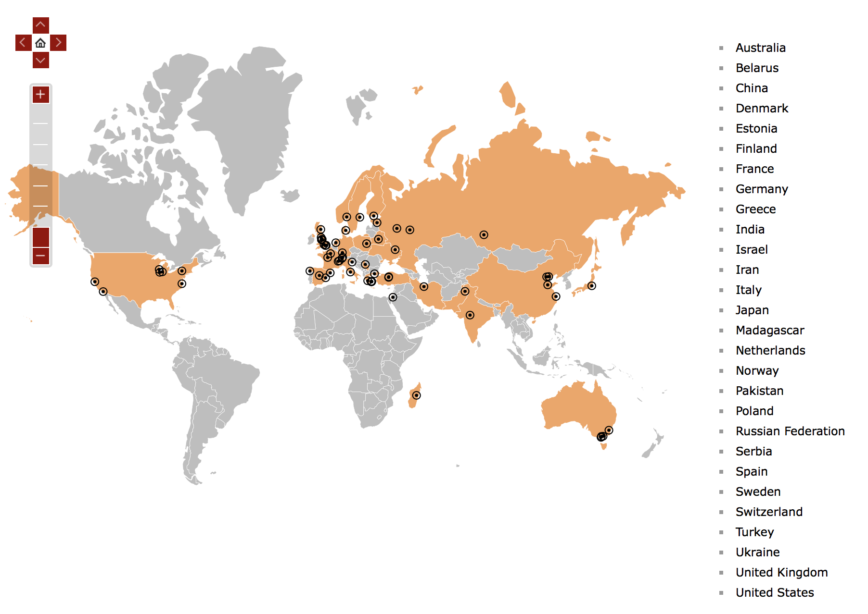
CLIC Collaboration
From Turkey – Ankara University and Ankara University Institute of Accelerator Technologies

Slide 21
Particle Physics Roadmaps

Slide 22
European Strategy for Particle Physics 2013
Scale of facilities required by particle physics is resulting in globalisation of the field.
Europe’s top priority should be exploitation of full potential of the LHC, including the HL-LHC machine and detectors with view to collecting 10x more data than in initial design, by around 2030.
  This upgrade programme will also provide further exciting opportunities for study of flavour physics & quark-gluon plasma.
CERN should undertake design studies for accelerator projects in a global context, with emphasis on proton-proton and electron-positron HE frontier machines.
  These design studies should be coupled to vigorous accelerator R&D programme, including high-field magnets and high-gradient accelerating structures, in collaboration with national institutes, laboratories and universities worldwide.

Slide 23
European Strategy for Particle Physics 2013
The initiative from the Japanese particle physics community to host the ILC in Japan is most welcome, and European groups are eager to participate.
  Europe looks forward to a proposal from Japan to discuss a possible participation.
CERN should develop a neutrino programme to pave way for substantial European role in future long-baseline experiments.
  Europe should explore possibility of major participation in leading long-baseline neutrino projects in US & Japan.
  Next update of European Strategy for Particle Physics has commenced and is to be finalised in 2020.

Slide 24
Thank You!
Notes:
24

