Slide 1


CERN – Cyprus Personnel status
From HR-Talent Acquisition group,
CERN HR Department
June 2019

Slide 2
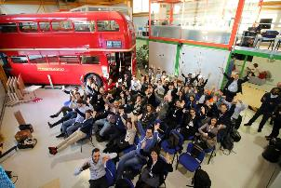
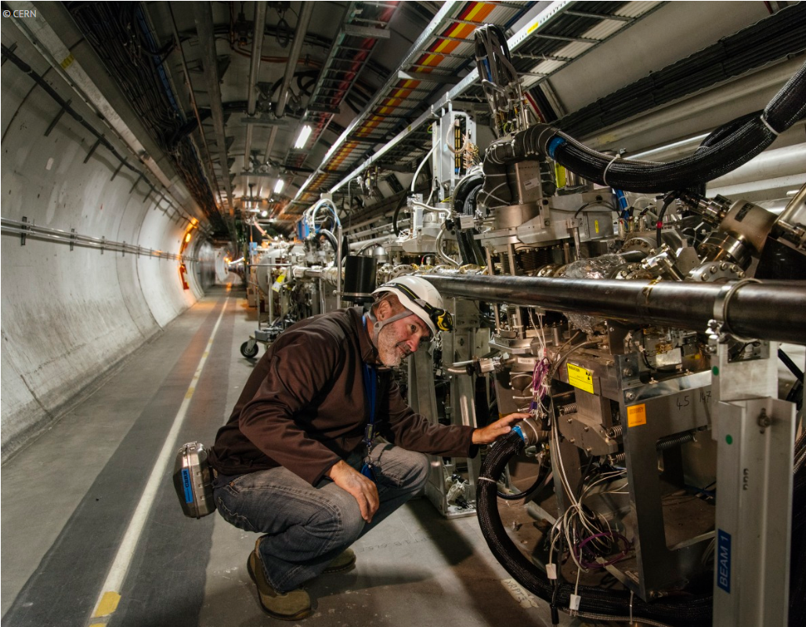

CERN’s People
Employed
(MPE)
Staff members
Fellows
Associated
(MPA)
Associates for the purpose of:
International collaboration (MPAc)
Users and other associates
Personnel
Training (MPAt)
-Students
-Trainees
- Apprentices
Exchange of scientists (MPAx)
e.g. Scientific/Corresponding Associates

Slide 3
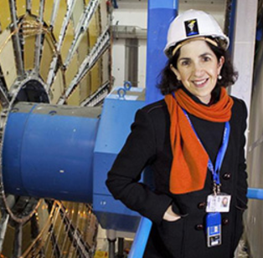
CERN’s Structure
  The DG is appointed by Council & acts as CEO and legal representative of the Organization (appointed for 5 years)
DEPTS
Director General
HSE
BE
TE
Finance and Human Resources
EP
EN
FAP
HR
SMB
IT
IPT
TH
Research and Computing
International Relations
DG Units
Accelerators and Technology
SECTIONS
GROUPS
EXPERIMENTS
TEAMS
SECTORS

Slide 4
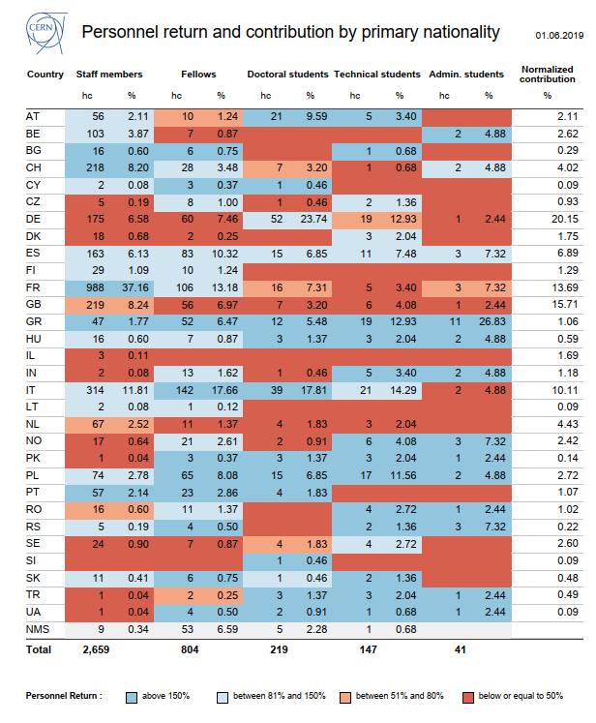
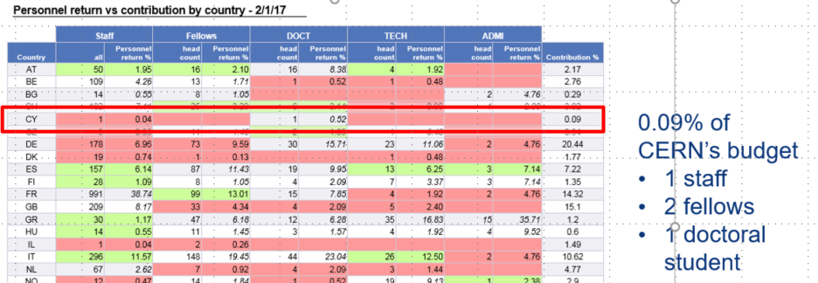
Cyprus @ CERN overview
In June 2019, for a contribution of 0.09%:
2 Staff (grade 6 and 10)
3 Fellows
1 Doctoral student
Note recent selection of 1 Technical student
Good return!
Positive evolution in 2 years
Notes:
Based on first nationality (no GR included – else add)
1 DOCT in BE-ABP – here until end aug
3 FELL – 2 ladies! – TH, HSE, EP (neutrinos) (all until 2020)
Paris Sphicas – EP-CMS, indef
1 STAFF BE-ABP – until 2022
1 PJAS abp
If we add GR: add 1 admin (EN), 2 staff (in EN and IT)

Slide 5
Cyprus @ CERN – a closer look
DOCT: Doctoral Student
FELL: Fellow
PJAS: Project Associate
STAF: Staff member
VISC: Visiting Scientist
USER
Data 7th June 2019 (CY first nationality)
Notes:
2 Staff members dual nationality GR/CY
1 Admin dual nationality GR/CY

Slide 6
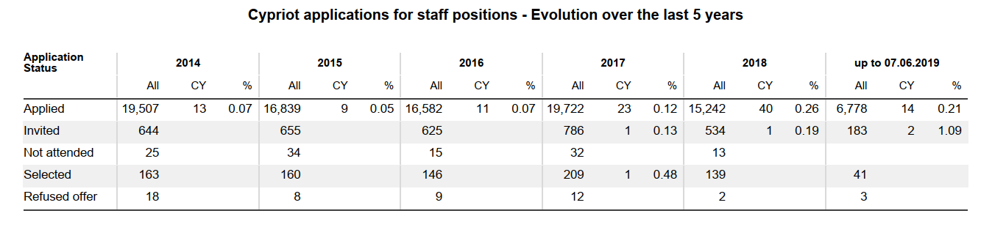
Cyprus @ CERN –Staff application evolution

Slide 7
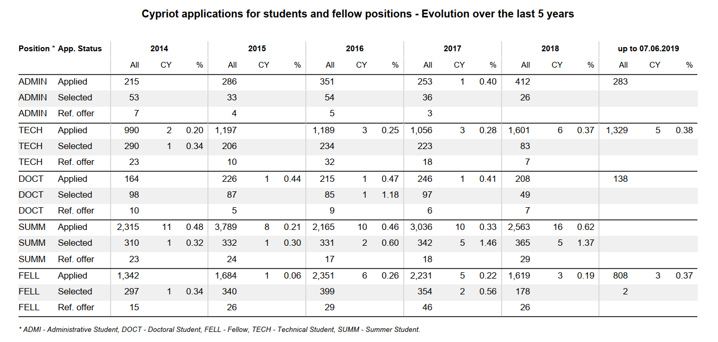
Cyprus @ CERN - Programme application evolution

Slide 8






Next application deadlines
Fellowship programme
  Last committee on 21 May
  Applications until 2 September; committee 19 November
  cern.ch/fell
Technical/Doctoral/Administrative student programme
  Last committee 9 May 2019
  Applications until 21 October; committee 3 December
  cern.ch/tech, cern.ch/admin
Technician Training Experience (open all year round with 3 selection committees per year):
  Last committee 12 June (Next: 15 Oct)
  Continuously open for applications
  cern.ch/tte
Summer student programme
  Closed – re-opens in Autumn
  cern.ch/summies

Slide 9
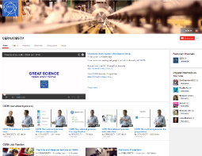

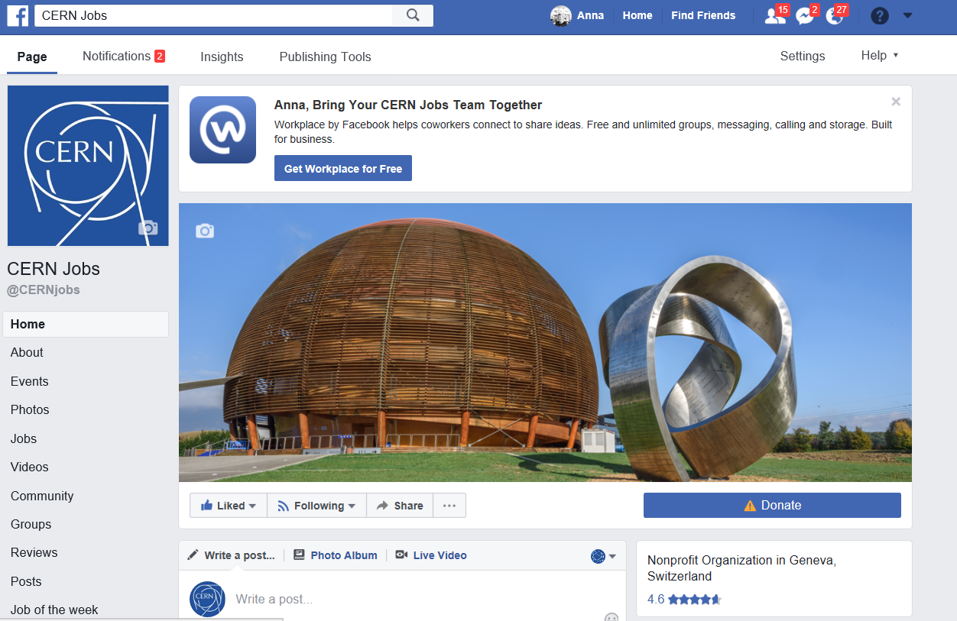




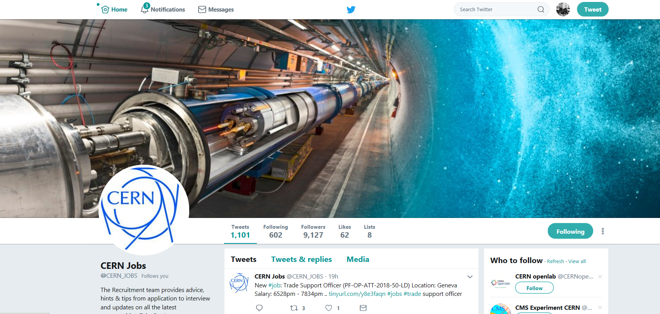
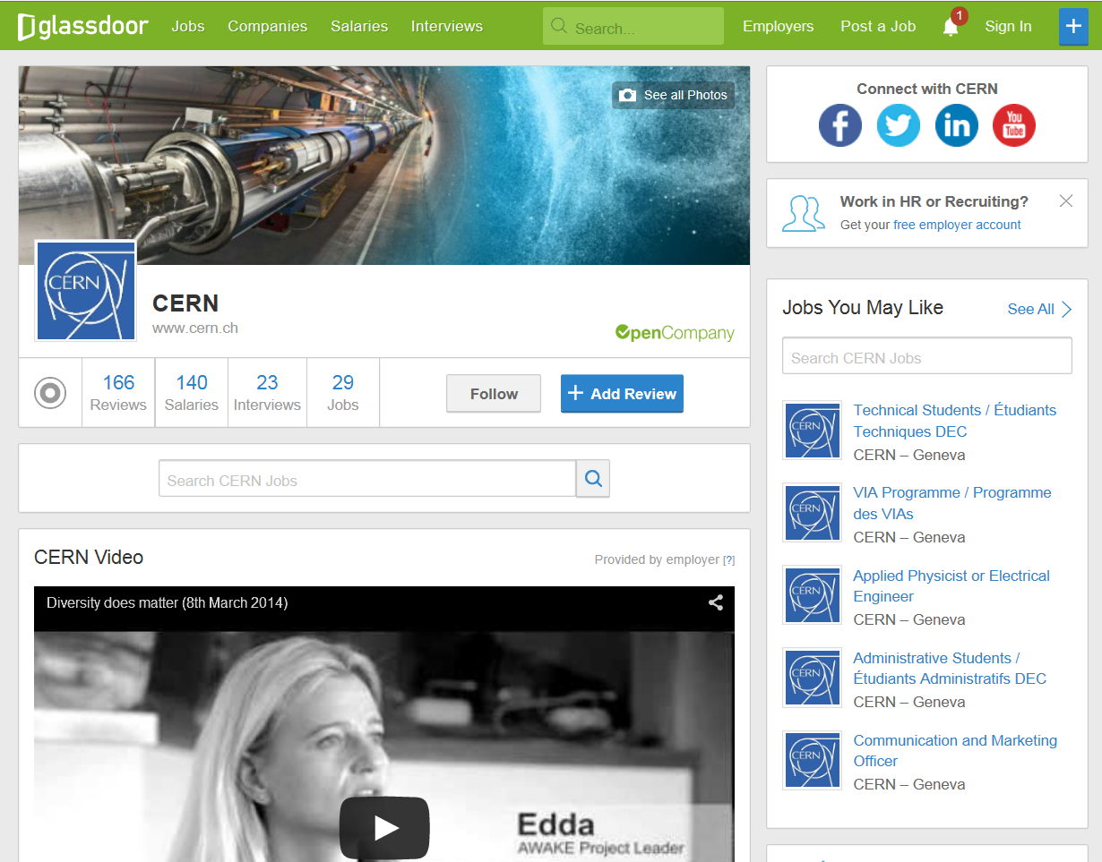
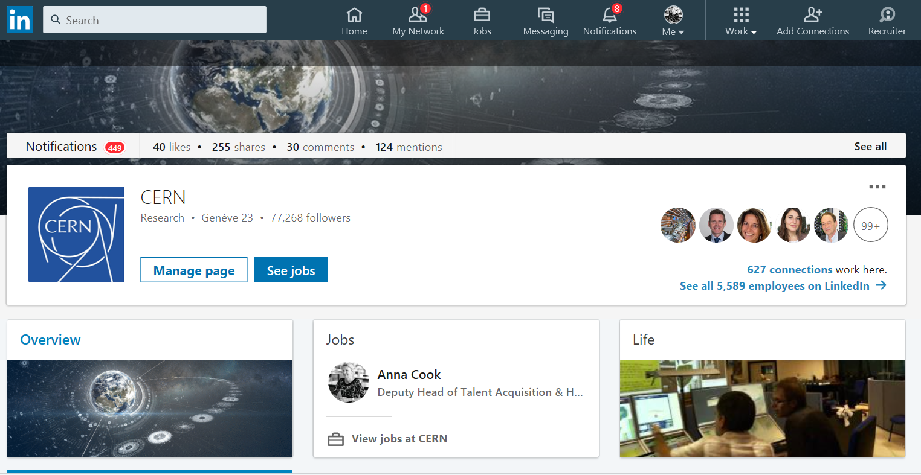
Follow us! “CERNJobs”

Slide 10
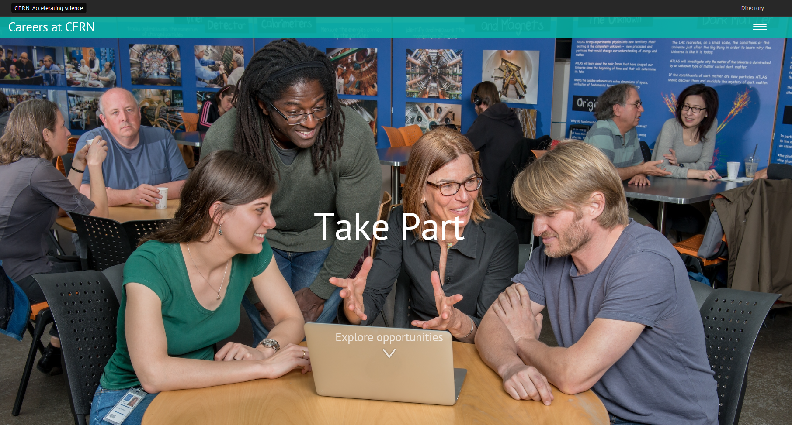
Take part!
careers.cern
Notes:
Twitter fb glassdoor linkedin

Slide 12

Technical Students programme
~ 200 positions/year
FIELDS : applied physics, engineering, computing
LENGTH : 4 to 14 months
ELIGIBILITY : 18 months of technical undergraduate studies
FEATURES : A technical project with a CERN supervisor
A living allowance, incl. health insurance
“It’s a great place to start a career,
it’s a great place to learn new skills, make new friends…”
Committees in May and December

Slide 13

Admin Students programme
~ 30 positions/year
FIELDS : Translation, human resources, business administration, law, finance, librarianship, science communication, audiovisual, communication and public relations…
LENGTH : 2 to 14 months
ELIGIBILITY : 18 months of undergraduate studies
FEATURES : An administrative project with a CERN supervisor
A living allowance, incl. health insurance
“My Admin Studentship was a great experience – I had exposure to more activities than I could have imagined”
Committees in May and December

Slide 14
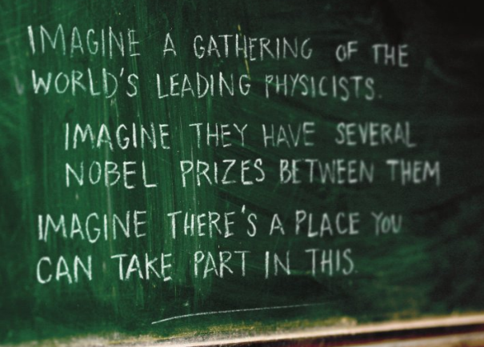
Doctoral Student programme
~60 positions/year
FIELDS : applied physics, engineering, computing
LENGTH : 6 months -3 years
ELIGIBILITY : Enrolled in a doctoral programme
FEATURES : A technical project, leading to a PhD thesis
co-supervised by the university thesis advisor and a CERN staff member
A living allowance incl. Health insurance
“Gave me the opportunity to meet important people, especially in the research fields”
Committees in May and December

Slide 15

Students by Discipline
Computing
39%
Applied Physics
50%

Slide 16

Summer Students programme
~300 positions/yr
FIELDS : physics, engineering, computing
LENGTH : 8 to 13 weeks, during the summer
ELIGIBILITY : 3 years of full-time studies at university level
FEATURES : High-quality lecture programmes- lecturers leaders in their field/ world-wide
Visits and workshops
Living allowance
Accommodation in CERN hostel
“Can’t imagine a better way
to spend my summer”
Selection March
Over 6000 young scientists have benefitted to date…
Notes:
NOTES: NMS 8 weeks maximum!!
Openlab to be mentioned explicitly as an additional IT-focused programme

Slide 17

Fellows
~250 positions/year
FIELDS : Physics, engineering, computing – from junior engineers to post-doc research physicists
LENGTH: 2-3 years
ELIGIBILITY : BSc, MSc or PhD
No more than 10 years relevant post-MSc experience
FEATURES : Employment contract
Attractive salary incl. social benefits
Training and networking
“An ideal place to follow
the most recent ideas in physics
and start new collaborations”
Committees in May and November
Notes:
Fellows are normally nationals of the Member States of CERN. Some opportunities arise for Fellows from non-Member States (none earmarked, no guarantee)
Post career break fellowship to mention
Some opportunities in the context of the Marie Sklodowska Curie framework

Slide 18

Marie Sklodowska-Curie
For university graduates
FIELDS : physics, engineering, computing
DURATION: up to 3 years
ELIGIBILITY : MSc or PhD
≤5 years post-degree experience
FEATURES : funded by the European Commission
an employment contract with CERN
specific Marie-Curie vacancies published on CERN web pages
an attractive salary, social benefits, allowances
international network
Notes:
Only use if you feel comfortable

Slide 19

Technician Training Experience
~30-50 positions/year
FIELDS : Mechanics, electronics, electricity, etc.
LENGTH: Typically 2 years
ELIGIBILITY : Technical diploma
no more than 4 years’ relevant experience
FEATURES : An initial contract of one year renewable for a second year
Project with CERN supervisor
  Training and networking (on the job, formal, languages)
  Employment contract with attractive salary incl. social
  benefits
“I never imagined the possibilities CERN would offer me.”
Several committees per year

Slide 20


Staff positions
~ 150 positions/year
FIELDS : Physics, engineering, computing, technicians, administrative staff
ELIGIBILITY : From apprenticeship to PhD
FEATURES: Up to 5 year initial limited duration contract
Competitive salaries incl. social benefits
Relocation expenses
Training (language courses, technical training)
“It’s the chance to focus on being the very best at what you do.”

Slide 21
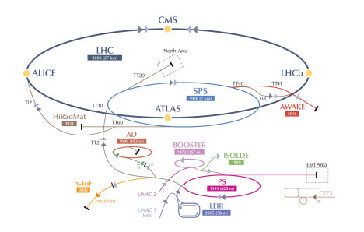
Associates
Scientific Associates
Experienced individuals on leave of absence
mainly in physics
Normally 12 months (24 months max)
Cooperation associates / Users
Scientists (including PhD students in physics)
Corresponding Associates
Experienced individuals from smaller Member States on
leave of absence mainly in physics
Up to 6 months
Project Associates
Physicists, engineers and technicians invited by
Departments (according to agreements)
Up to 3 years

Slide 22
Working at CERN is…
Being at the forefront of technology and physics
Collaborating with multicultural and multidisciplinary teams, without political or religious barriers
Following experts in their technical domain
Being part of a dynamic environment with training opportunities
Making valuable and long-lasting contacts from all over Europe
Learning languages: CERN is a bi-lingual organization (English and French)
An attractive remuneration package
A unique experience!

