Slide 1
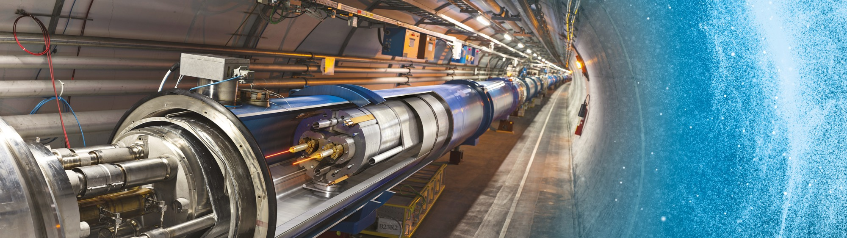
Doing Business with CERN
Cyprus@CERN
Anders Unnervik
13 June 2019

Slide 2
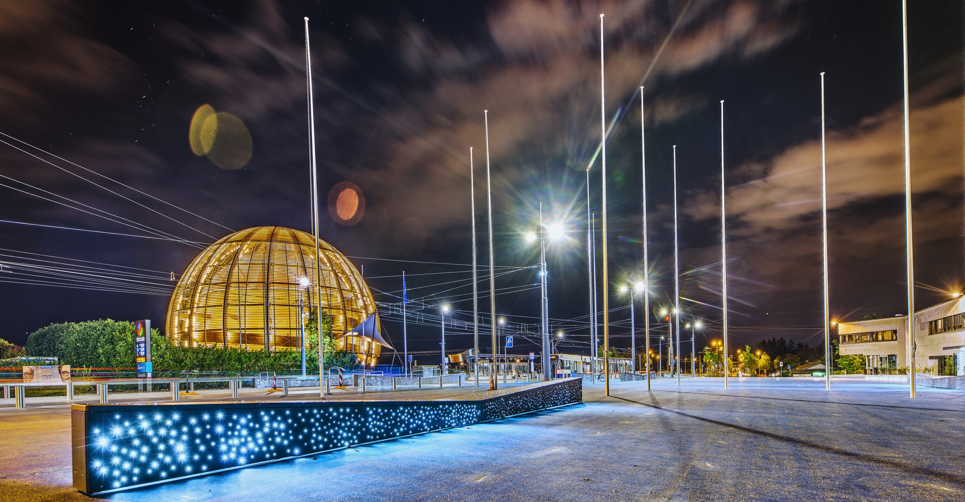
AGENDA
Statistics
Procurement @ CERN - the rules
Procurement website
Impact of
Doing business with CERN

Slide 3

STATISTICS

Slide 4
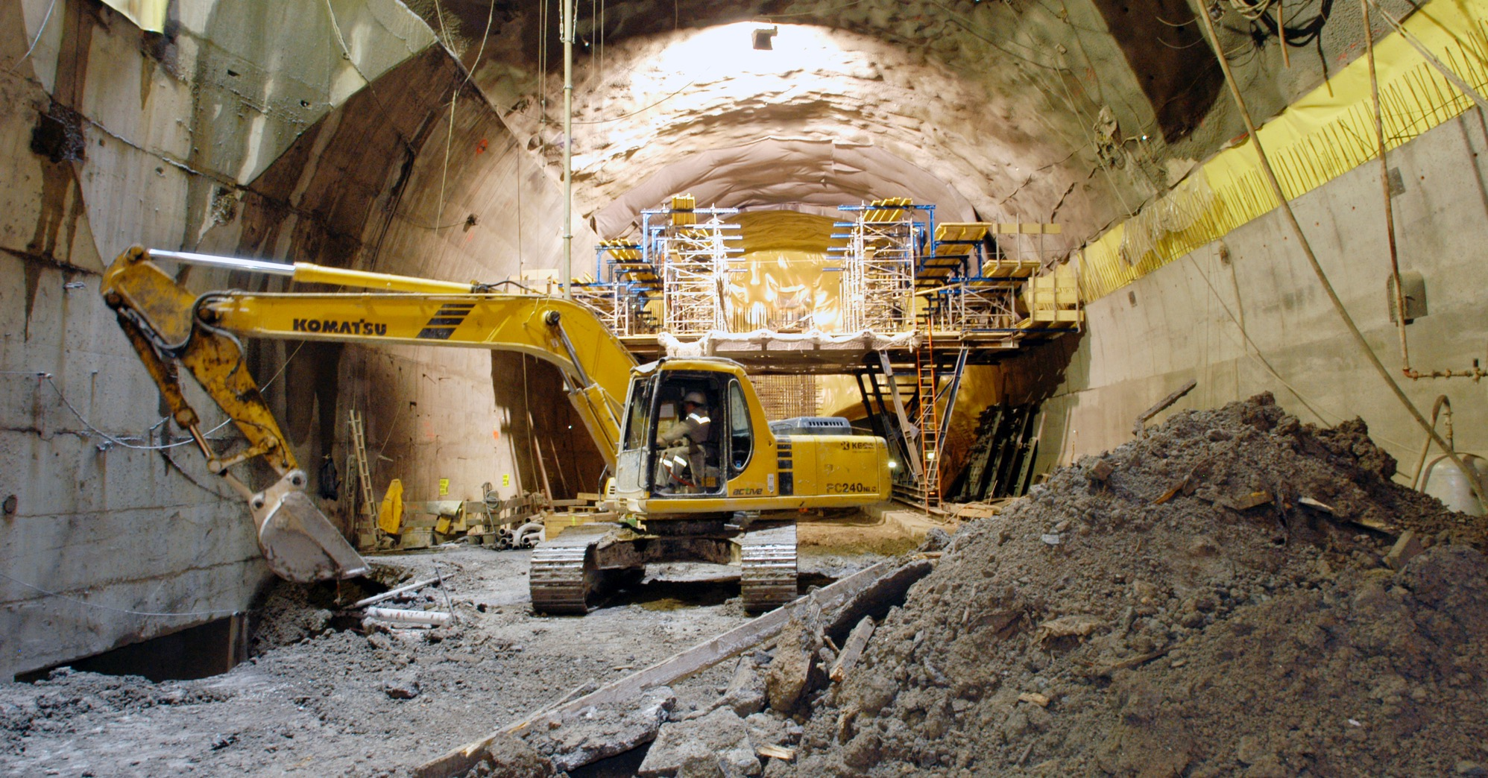
What do we buy?
Civil engineering:
  Construction
  Renovation of buildings
  Metallic structures
  Earthworks
  Roads
Cooling and ventilation
equipment

Slide 5
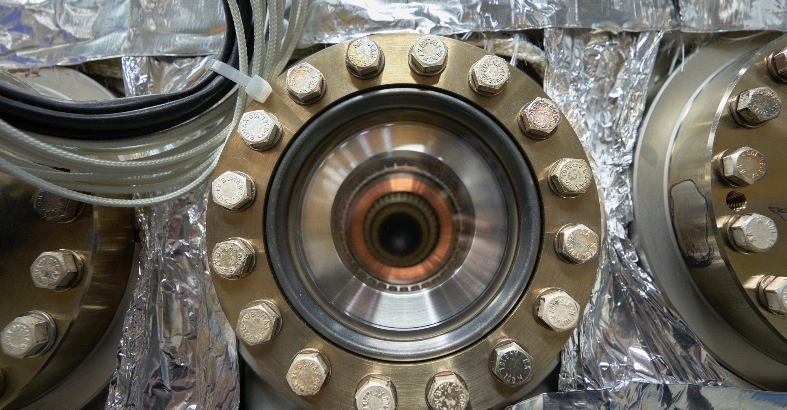
What do we buy?
Electical engineering and magnets
  Transformers
  Switchboards and switchgear
  Cables
  Automation
  Power supplies
  Magnets

Slide 6
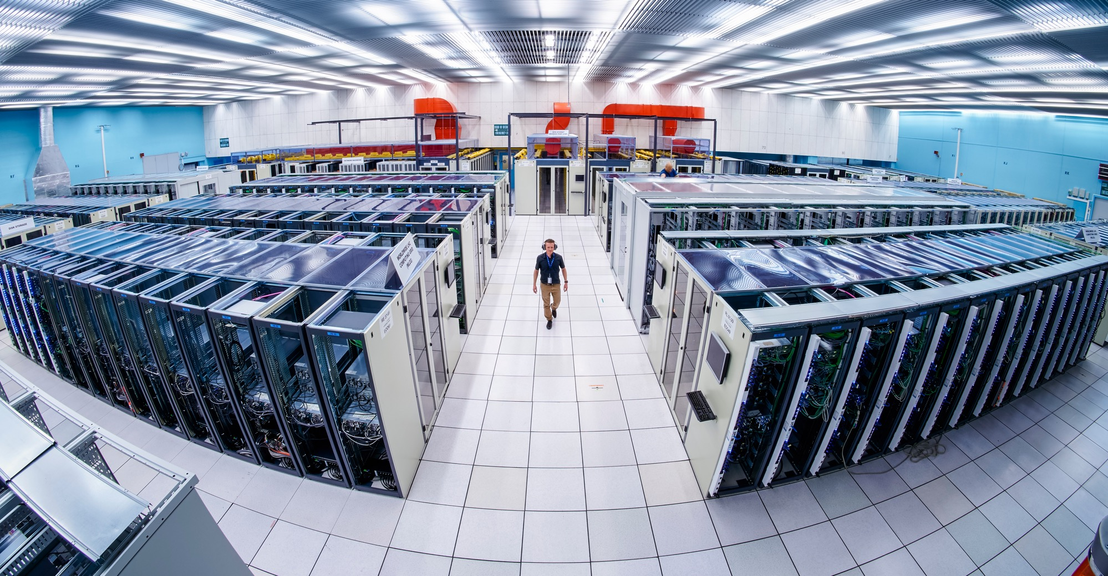
What do we buy:
Information Technology
  Computing systems
  Servers
  Software
  Network equipment
  Personal computer equipment

Slide 7
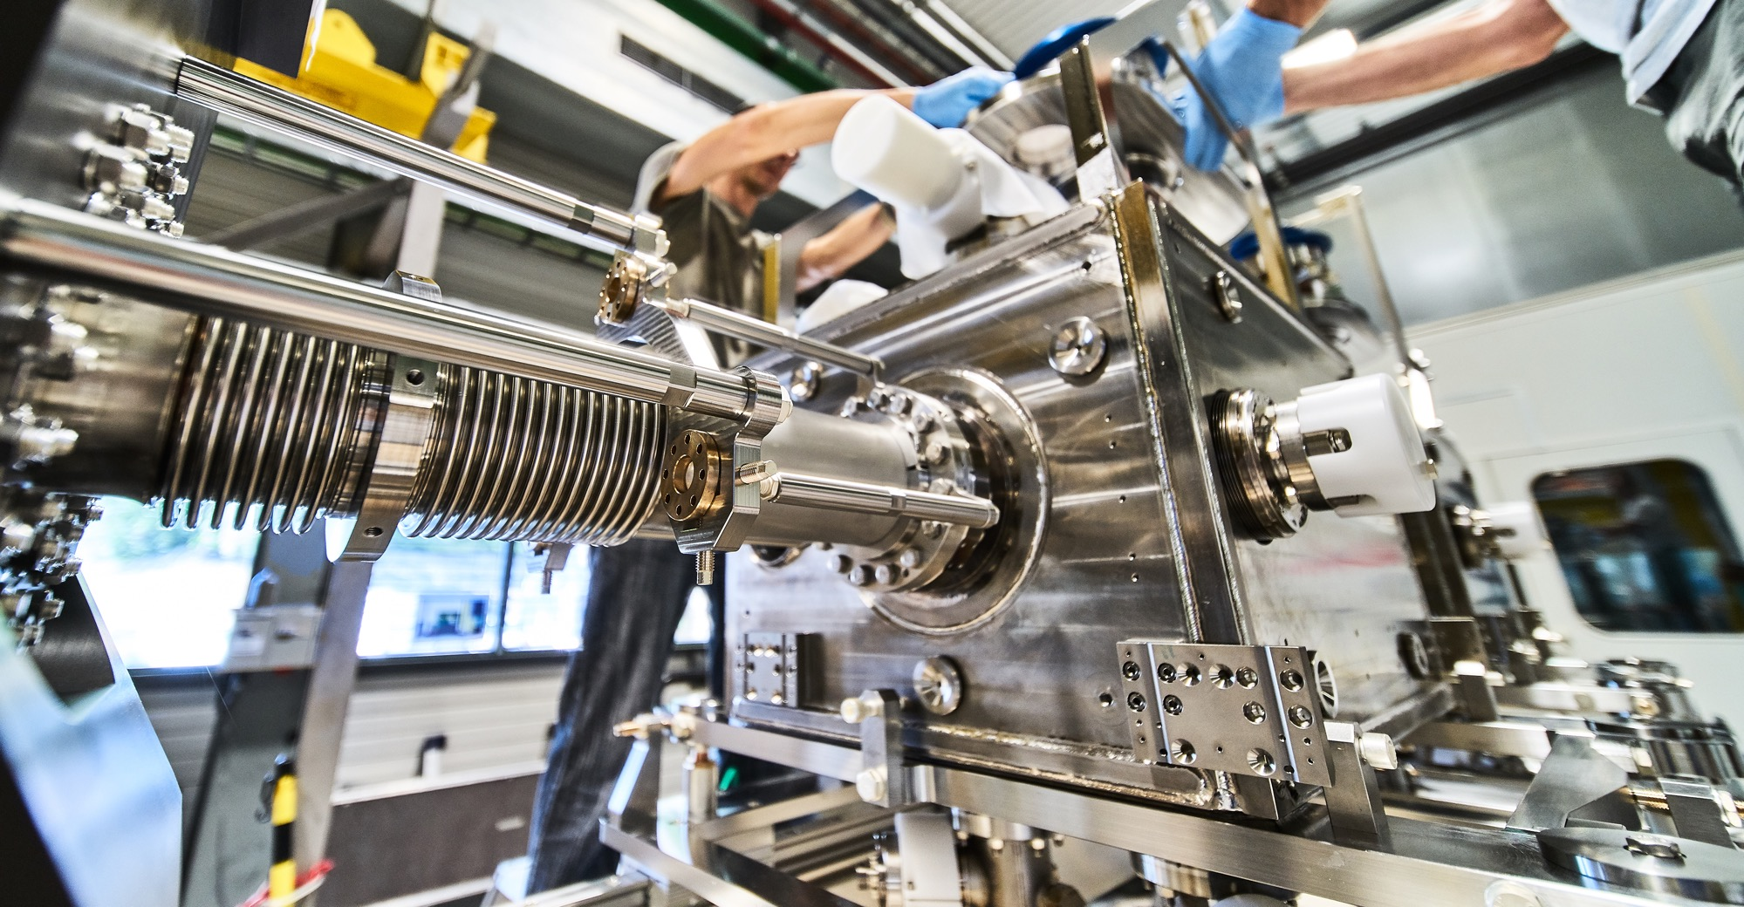
What do we buy?
Mechanical engineering and raw materials:
  Machining
  Sheet metal work and arc welding
  Special fabrication techniques
  Raw materials, finished and semi-finished products (plates, pipes, etc.)
  Offsite engineering and testing

Slide 8
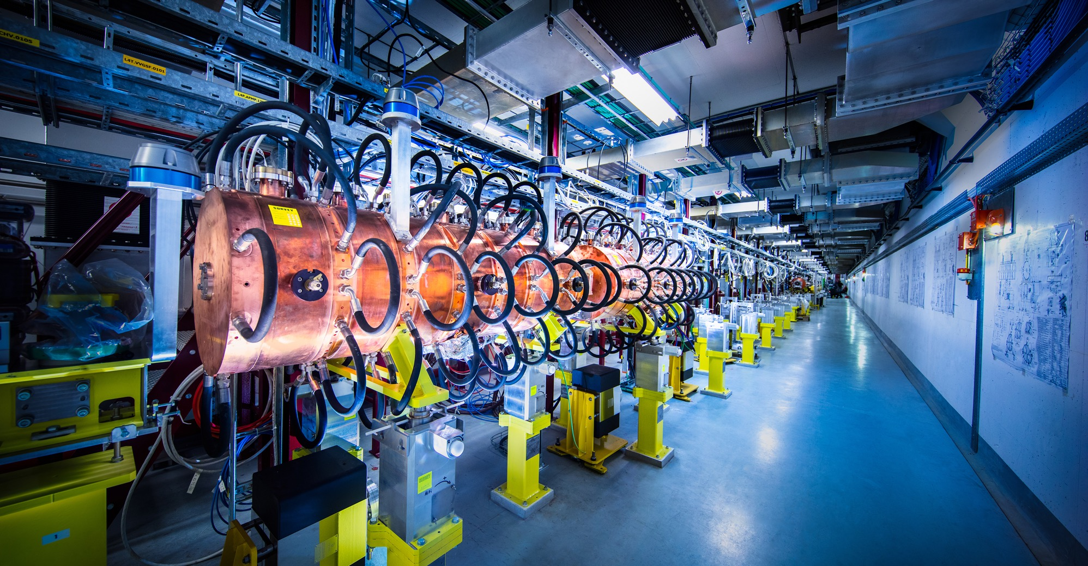
What do we buy?
Electronics and radiofrequency:
  Electronic components (active, passive)
  PCBs and assembled boards
  LV and HV power supplies
  Radiofrequency equipment
  Amplifiers

Slide 9
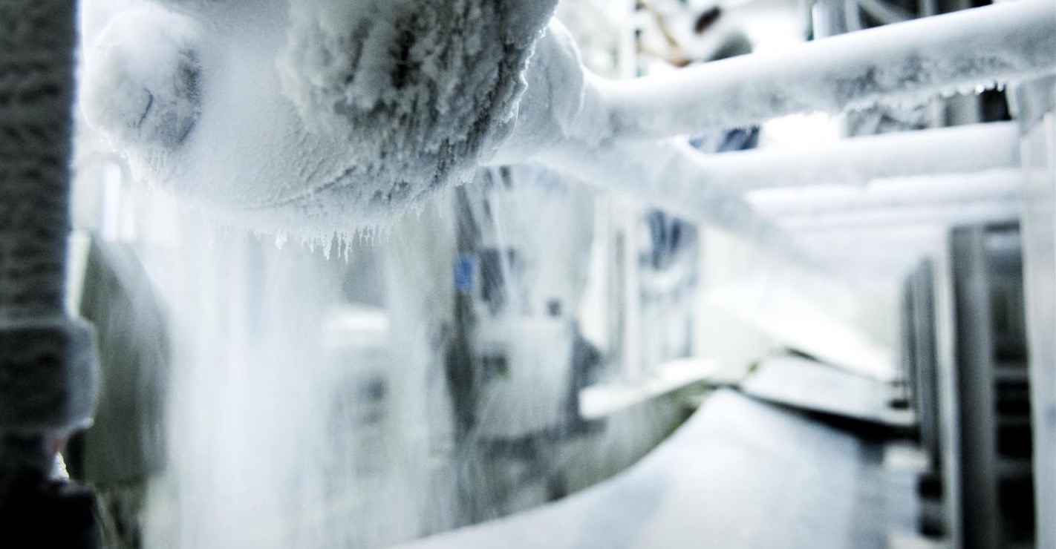
What do we buy?
As well as:
  Cryogenic and vacuum equipment
  Optics and photonics
  Particle and photon detectors
  Health and safety equipment,
  Transport and handling equipment
  Office supply, furniture
  Industrial services on the CERN site

Slide 10
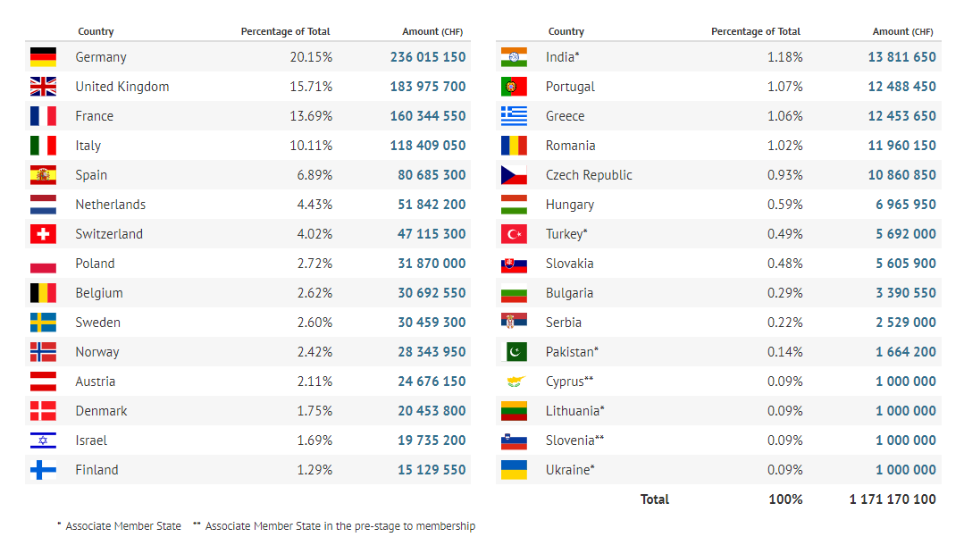
Yearly Budget (contributions 2019)

Slide 11
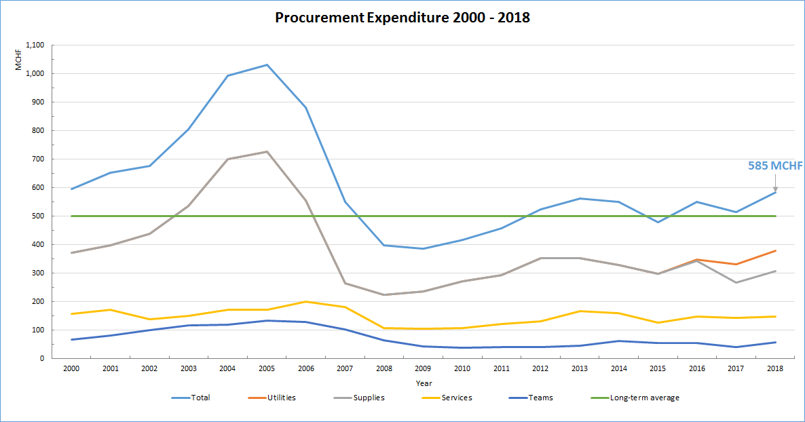
Procurement Expenditure

Slide 12
Supplies
(307MCHF spent in 2018 – CERN budget only)
2018 Expenditure of all Member States by Procurement Code Family (MCHF)
Health, safety and environment
9
Office supply, furniture, communication and training
20
Vacuum and low temperature
22

Slide 13
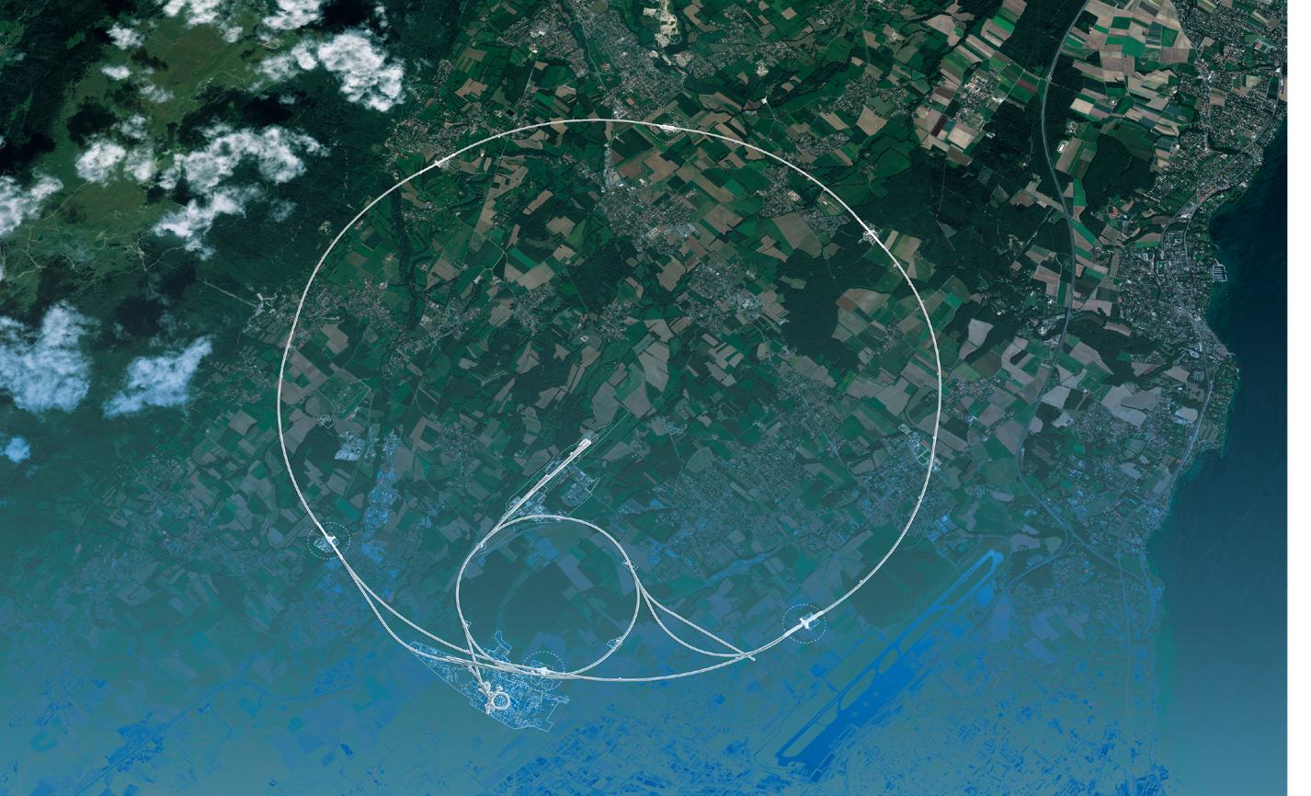
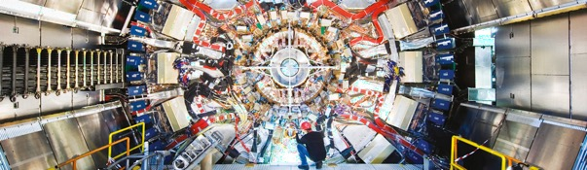
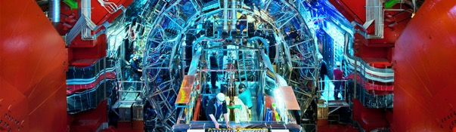
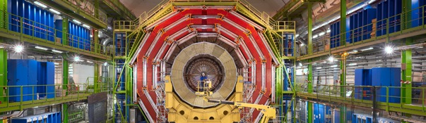
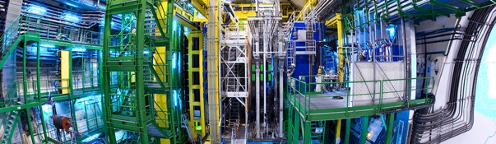
We also buy for the LHC experiments
CMS
ALICE
ATLAS
LHCb

Slide 14
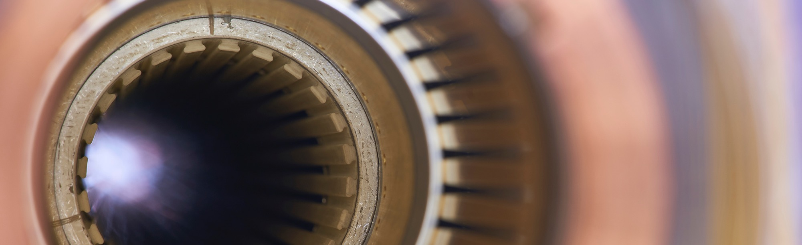
Current project - upgrade of the LHC to High Luminosity
Hi-Lumi will provide greater precision and discovery potential
Hi-Lumi will start operating in 2026, and run until 2035
CERN is already looking beyond 2035, with several projects in R&D or study stages

Slide 15
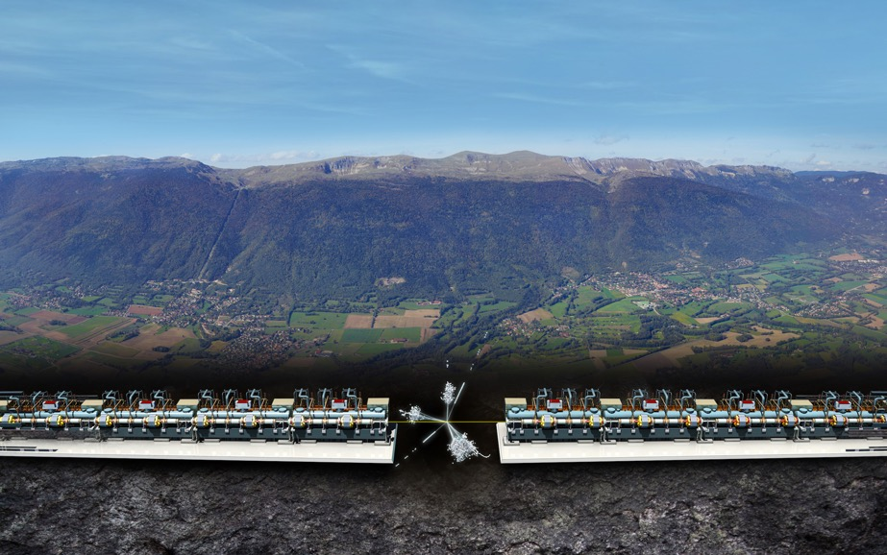


Two projects for the future of particle physics
Future Circular Collider (FCC)
New technology magnets 100 TeV pp collisions in 100km ring
e⁺e⁻ collider (FCC-ee) as 1st step?
Compact Linear Collider (CLIC)
Linear e⁺e⁻ collider √s up to 3 TeV

Slide 16


PROCUREMENT @CERN
the rules

Slide 17
The Procurement Service
Mission
The Procurement Service procures all supplies and services for CERN
Meeting the specified and contractual technical, delivery
and performance requirements
At the lowest possible overall cost
While achieving balanced industrial return for CERN Member States
Respecting CERN
Procurement Rules

Slide 18
Principles of the Procurement Rules (1/4)
1
Transparency and Impartiality
2
Tenders open to Member States only
3
Objectivity and equal treatment: tendering packages are objective and impartial

Slide 19
Principles of the Procurement Rules (2/4)
Selective tendering procedures: CERN’s tendering procedures are not open to all interested firms
Confidentiality: Opening and evaluation of bids as well as negotiations are not public

Slide 20
Principles of the Procurement Rules (3/4)
Award for supplies (and services, exceptionally) based on:
Lowest compliant bid
Technical
Financial
2
Delivery

Slide 21
Principles of the Procurement Rules (4/4)
Award for industrial services based on:
Best Value For Money
2
No alignment rule

Slide 22

How do we buy?
  Off-the shelf or non-standard products which can be produced with existing manufacturing techniques or technologies:
  Functional specification
  Non-standard products where industry has neither the required know-how nor the interest to develop and design the products:
  Build-to-Print specification
Prototypes and or Pre-series might be required.

Slide 23

Enquiries between 10’000 and 200’000 CHF
“Price enquiry” (Demande d’Offre - DO)
Submission deadline: 4 weeks from date of dispatch;
All price enquiries above 50’000 CHF are also sent to the
Industrial Liaison Officers (ILOs) for information;

Slide 24

Enquiries exceeding 200’000 CHF (1/2)
“Market Survey” (MS)
Prior announcement in CERN’s procurement website, see
“Business Opportunities”
  At this stage, interested firms are encouraged to contact CERN in
  order to have a clear understanding of the requirement, allowing
  them to begin their organization ahead of the tendering process.
Market surveys consist of:
  “Technical Description” and;
  “Qualification Questionnaire” (financial and technical).
Submission deadline: 4 weeks, or more if the MS is still online.

Slide 25

Enquiries exceeding 200’000 CHF (2/2)
“Invitation to tender” (IT)
Sent to qualified and selected firms only;
Submission deadline: 4 weeks from date of dispatch (with a longer period for more complex requirements);
Firms may ask questions in writing to understand all requirements and prepare a bid that best matches CERN’s needs;
All invitations to tender are sent to the Industrial Liaison Officers (ILOs) for information;
Bids shall be submitted via CERN’s e-tendering application.
Notes:
Invitations to tender consist of:
Technical specification and annexes;
Tender form (and a technical annex - optional);
General Conditions of CERN (contracts, invitations to tender, Safety, etc.)

Slide 26
Country of origin
SUPPLIES
“Country(ies) where the supplies (including their components and sub-assemblies) are manufactured or undergo the last major transformation by the contractor or its sub-contractor”
If at least 60% of the total amount of the bid comes from a poorly balanced MS, then the whole bid will be treated as that from a bidder in a poorly balanced MS.
SERVICES
“Country(ies) in which the bidder is established.”
If at least 40% of the total amount of the bid comes from a poorly balanced MS, then the whole bid will be treated as that from a bidder in a poorly balanced MS.

Slide 27
Alignment rule
Applicable for:
1
Contracts awarded on the lowest
compliant basis (mainly supply contracts)
2
With a total amount exceeding
100’000 CHF.
Under certain conditions as defined in CERN Procurement Rules, a bidder offering goods originating* in poorly balanced Member States is allowed to align his price to that of the
lowest bidder and thereby be awarded the contract.
RULE
* At least 60% for supply contracts or; at least 40% for service contracts awarded on the lowest compliant basis.

Slide 28
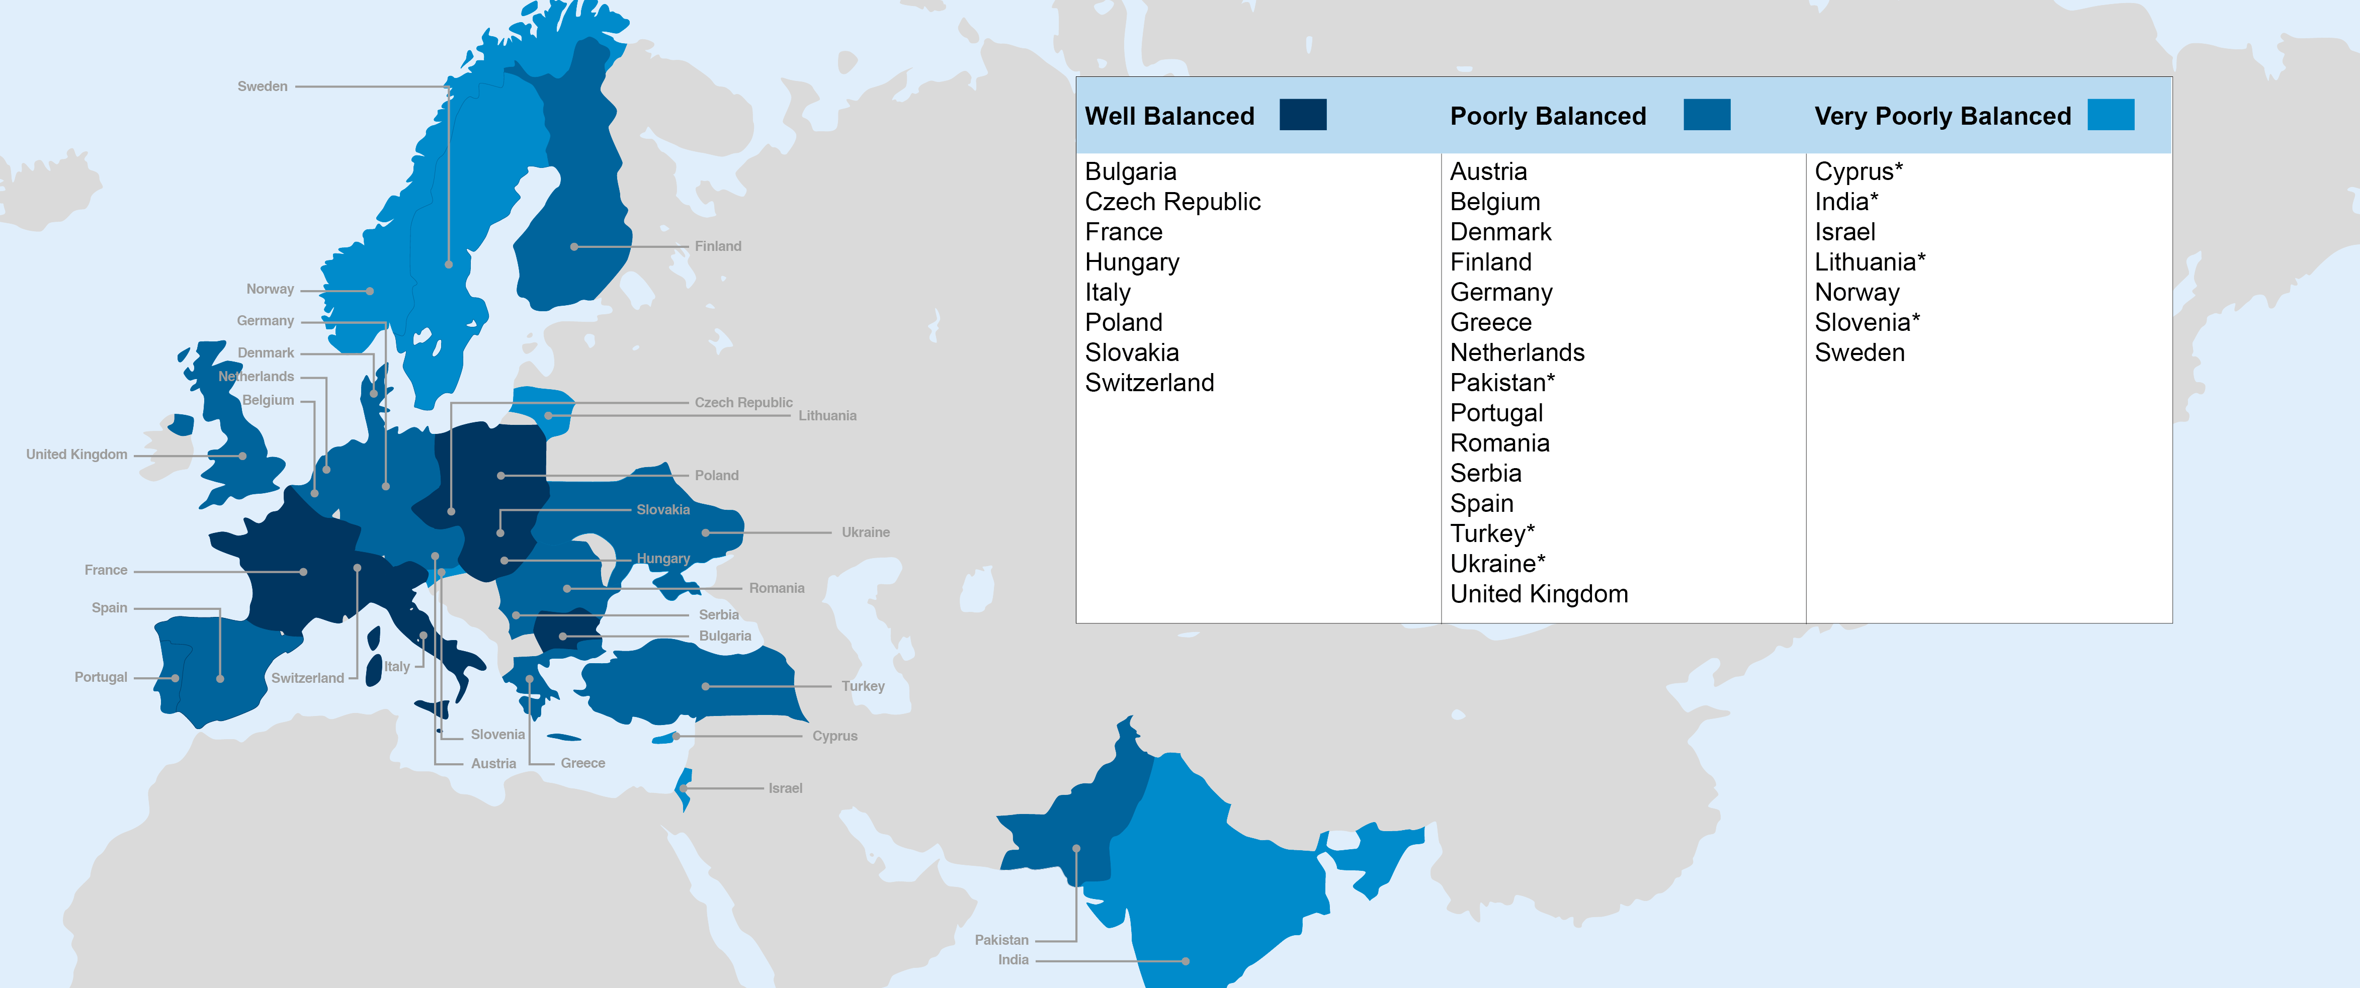
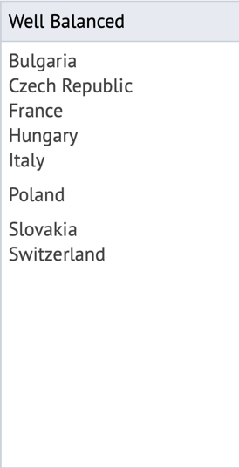
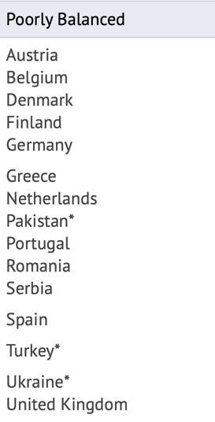
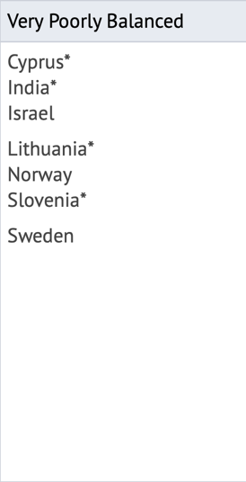
Poorly balanced Member States (Supplies)
(1st March 2019 – 29 February 2020, based on the previous 4 calendar years):

Slide 29
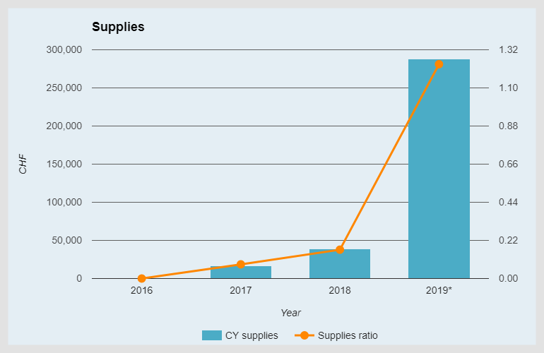
Industrial Return to Cyprus (supplies)
Target = 1.0
* As of 11 June 2019

Slide 30
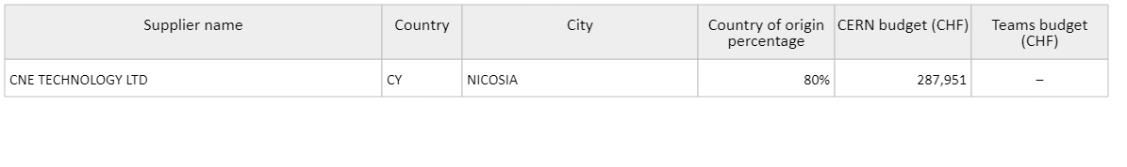
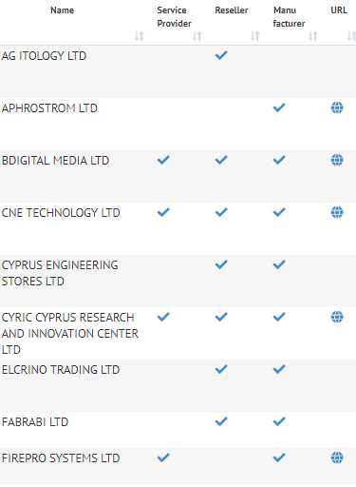

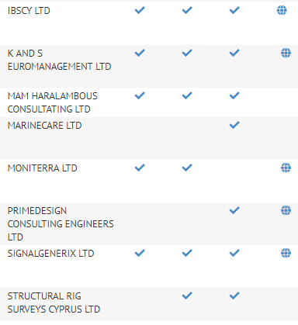
Industrial Return (Cypriot suppliers 2019)
Orders to CNE TECHNOLOGY 2017: Spare coils PXMQNAJPWC quadrupoles 2018: Spare solenoid PXMLNAAIWP 2019: CR200 magnets 2019: Yokes for the MDX L corrector magnets

Slide 31

Impact of
Doing business with CERN

Slide 32
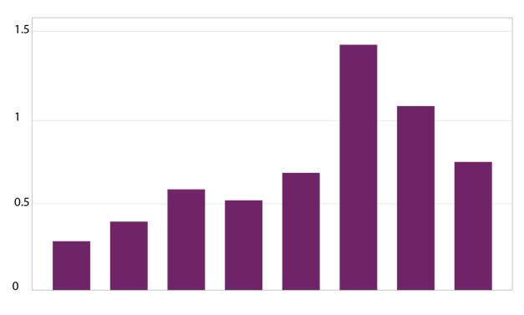
The economical impact of CERN Procurement on supplier’s performance (Castelnovo et al, 2018)
Empirical studies (by the analysis of financial data from 1995 to 2008 from 365 CERN suppliers for the LHC) show that after working with CERN on high-tech contracts, CERN suppliers
out-perform their peers by:
Investing more in R&D and filing more patents
Higher productivity, revenue and profitability
Order/contract received from CERN
Increase in R&D
Innovation
Productivity growth
increase revenues & profitability
Patents per firm
More than
2 years before
2-1 years before
Date of order
1,2 years later
3,4 years later
5,6 years later
7,8 years later
More than
8 years later
Notes:
Average number of patents filed before and after the beginning of the procurement relationship with CERN
The X-axis shows the «relative years», that are the difference between a given year and the year the first order is received. Therefore, CERN(0) is, for each company, the year of beginning of the procurement relationship.

Slide 33
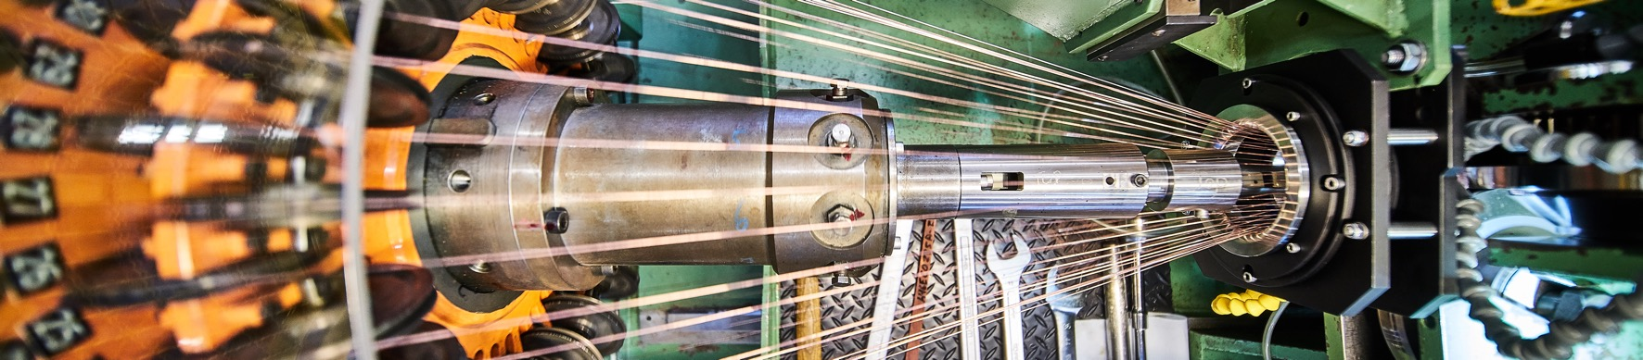
Doing business with CERN: the facts
Supplier survey (669 suppliers in 33 countries, 2017):
48%
improved products and services
42%
developed new products
55%
improved technical knowledge
in their field
18%
found or opened a new market to address
62%
used CERN as a marketing reference
Without financial loss.
Notes:
The key message here is that CERN is an open institution: open to its neighbours, and open to citizens from across the globe. We welcome them to CERN and go out to meet them
This slides summarises the outreach activities carried out by CERN.
It also includes a mention of CERN’s fundraising activities, for projects that are not part of CERN’s core activity. These fall into three categories: education & outreach, culture and creativity, innovation and knowledge exchange

Slide 34
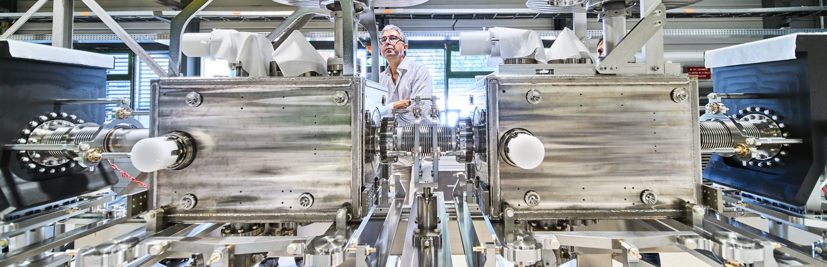
Doing business with CERN: the facts
Using CERN as a marketing reference improve
the reputation as suppliers

Slide 35
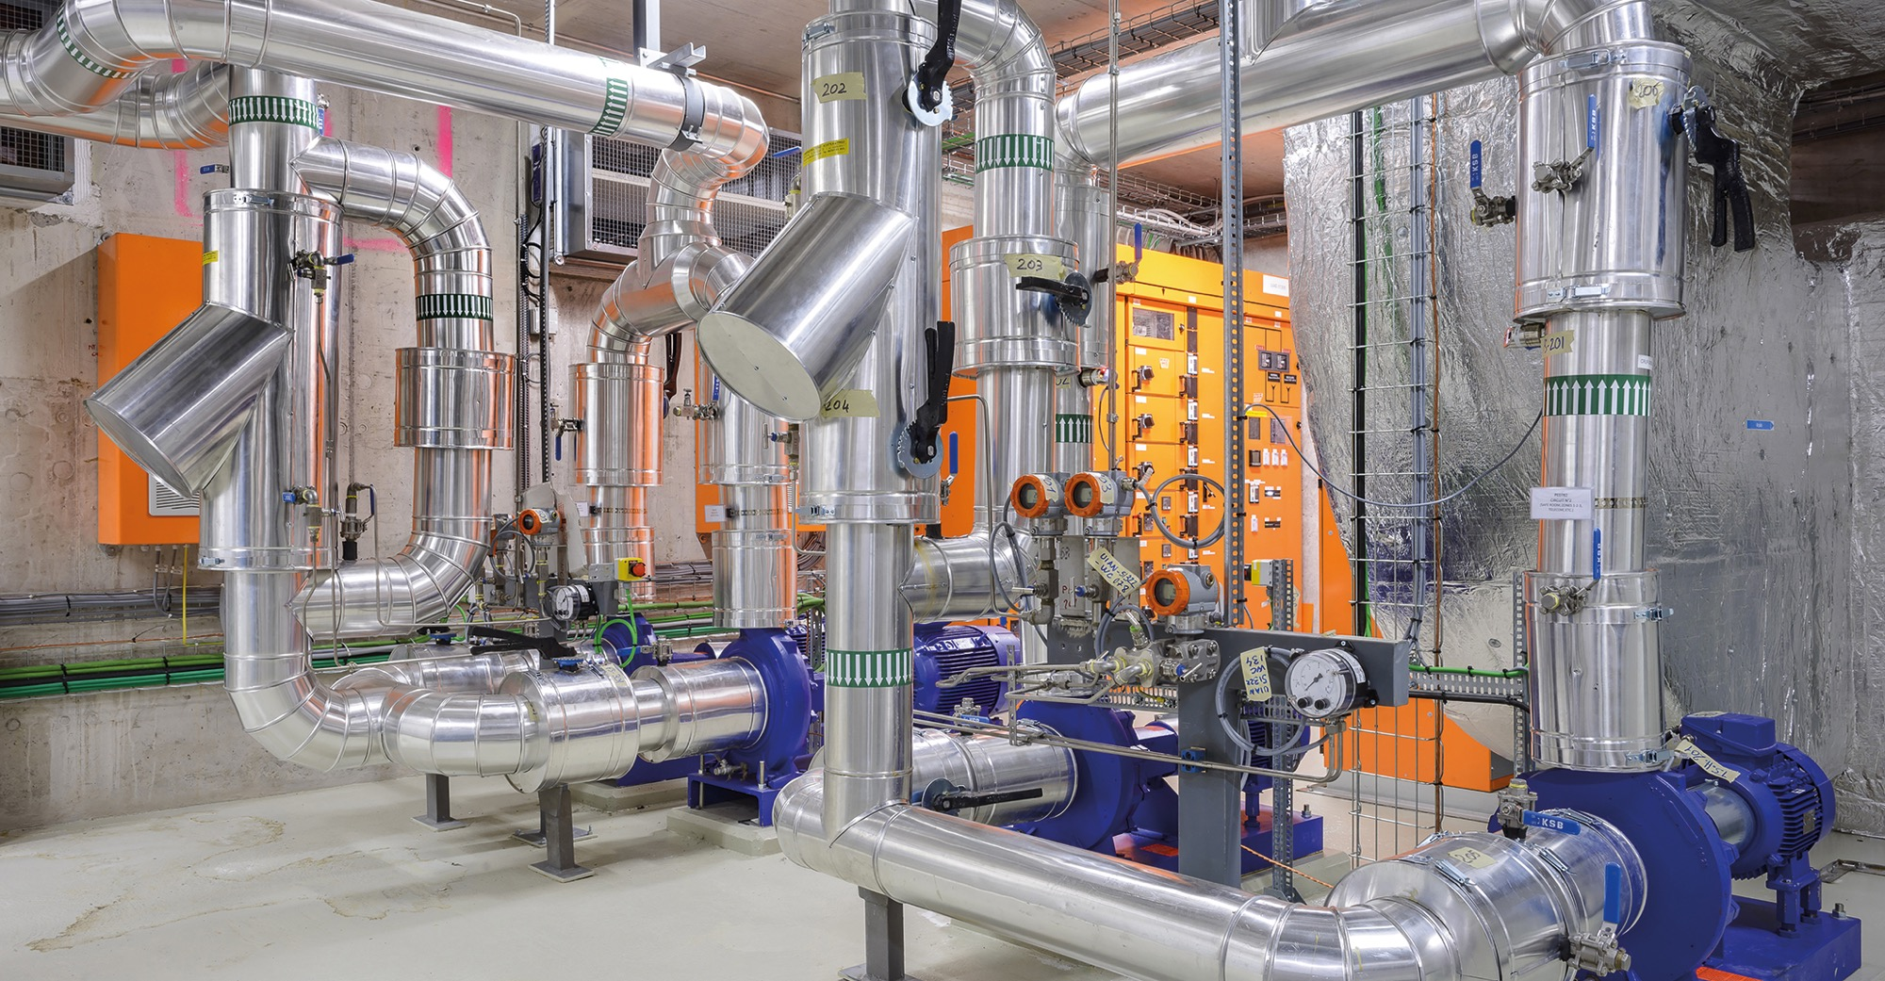
Social
Cost-Benefit Analysis (CBA) calculated by the University of Milan
“Each CHF invested in
HL-LHC project pays back approximately 1.8 CHF on societal benefits, including scientific, economic and cultural value (development of innovative technologies, industrial spillovers, skills acquired by students, etc.).”

Slide 36

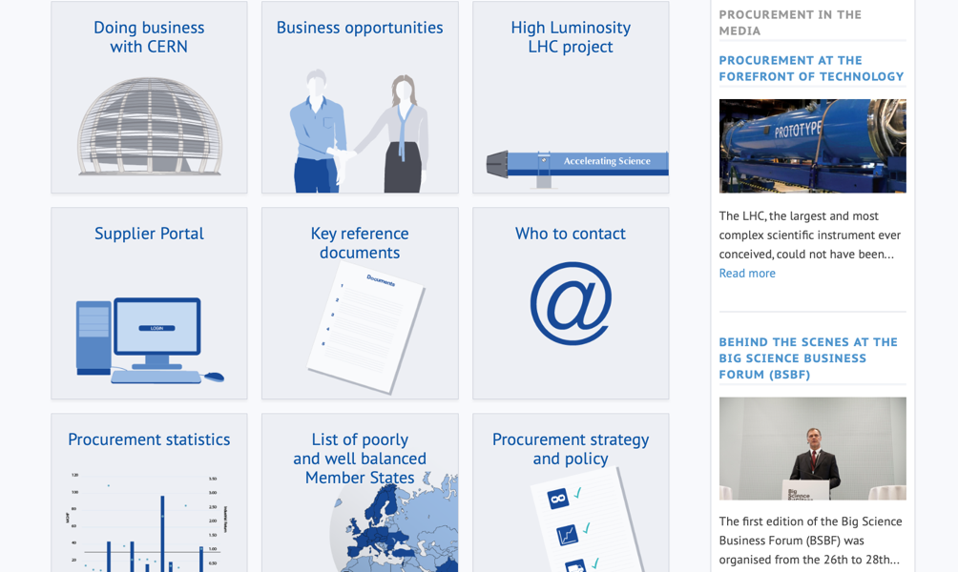
Procurement
website

Slide 37
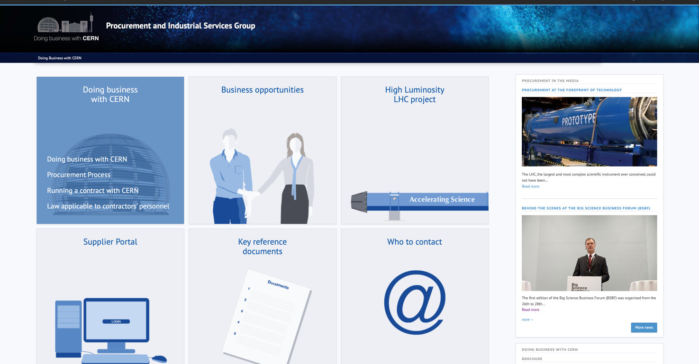
Website of the Procurement Service
http://procurement.web.cern.ch

Slide 38
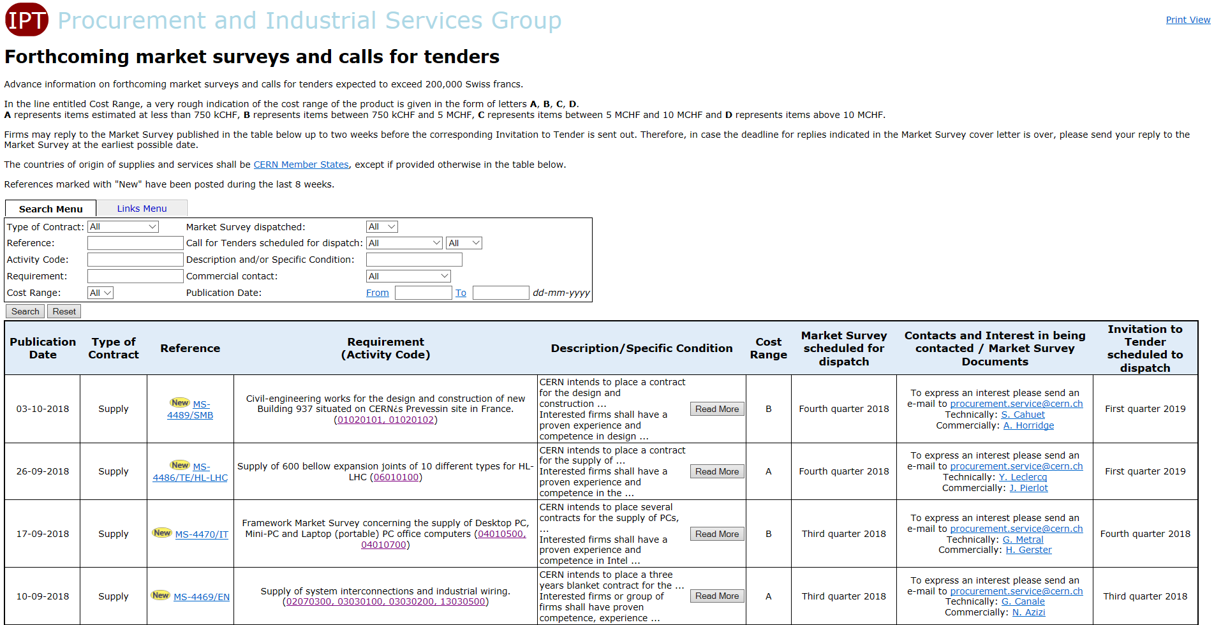
CERN Shopping List
https://found.cern.ch/java-ext/found/CFTSearch.do

Slide 39
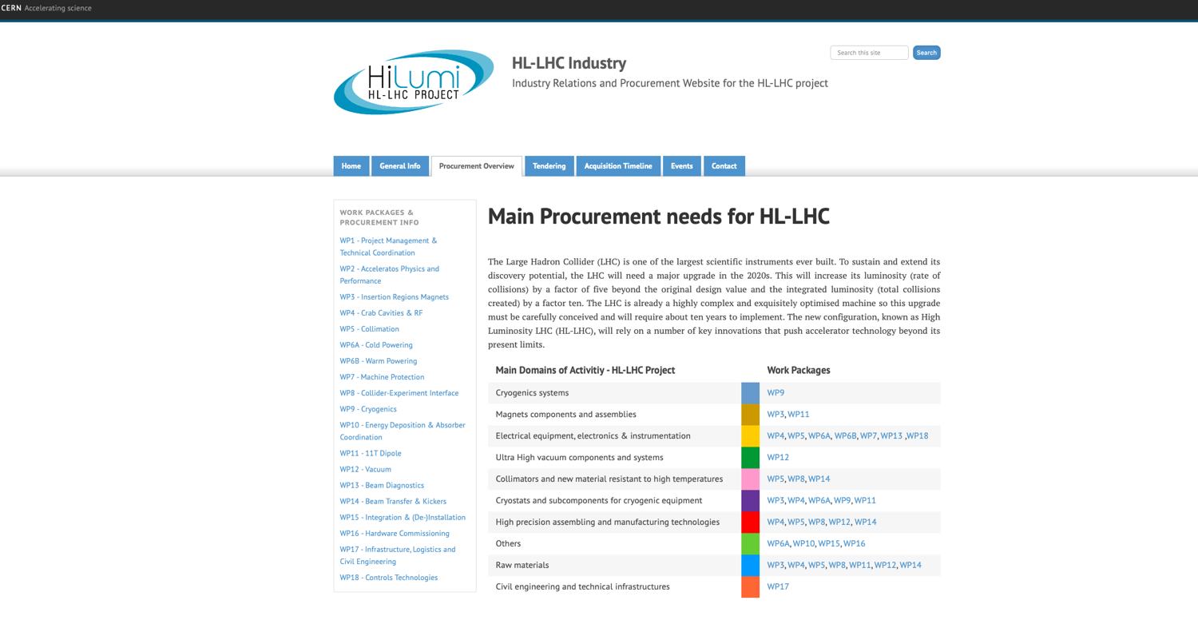
HL-LHC Shopping list
http://project-hl-lhc-industry.web.cern.ch/content/main-procurement-needs-hl-lhc

Slide 40
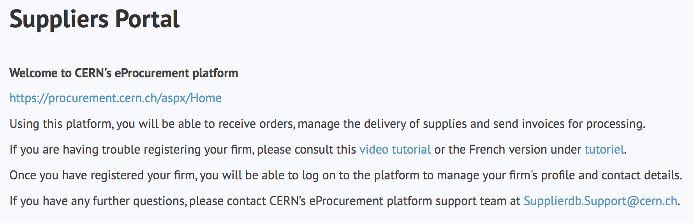
Suppliers must register in the Suppliers Portal
for all exchanges with CERN, in particular to:
Be visible for future opportunities
(with the procurement codes you have indicated),
Receive and follow-up orders,
Send invoices.
MANDATORY

Slide 41
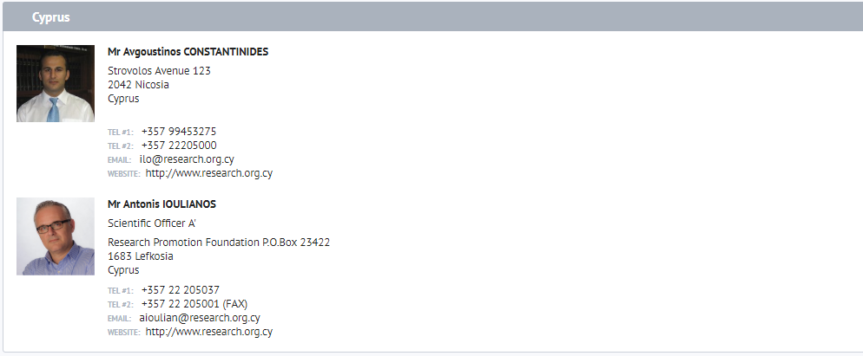
Contact in your country
ILO: Industrial Liaison Officer
    Industrial Liaison Officers (ILO's) are appointed by CERN's Member States to facilitate the flow of communication between CERN and its suppliers. ILO's can provide advice on the opportunities available for doing business with CERN and the support available to firms
    in their local regions.

Slide 42
Thank you

