Slide 2
CERN Alumni Network
14 June 2019
Orestis Galanis - CERN Office for Alumni Relations
Notes:
Working in the team since Sept 2018
Head of Alumni Relations, Laure Esteveny and CERN Alumni Community Manager, Rachel Bray are both away, so I am replacing them.

Slide 3
Contents
  Objectives and key figures
  What the programme offers
  Managing the Network & Governance
  Conclusions
Notes:
Three objectives to which we always come back

Slide 4
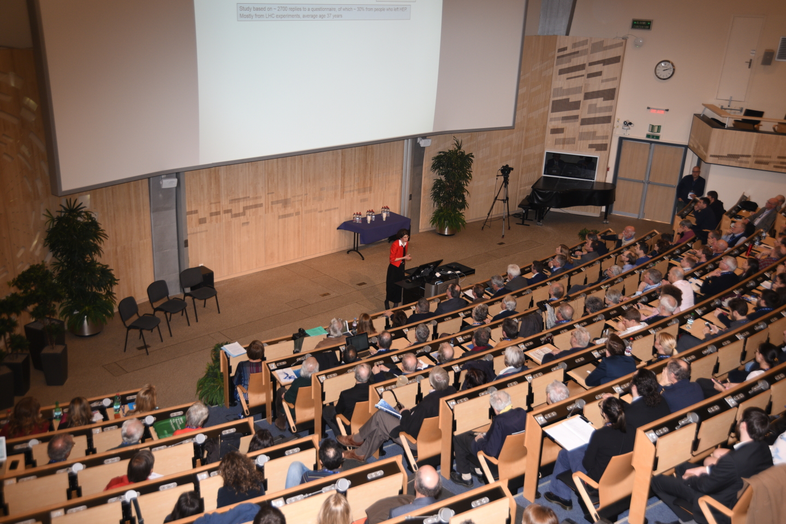

  To develop an inclusive and cohesive alumni community, strongly interacting with CERN and with all alumni stakeholders, from which research at CERN may leverage increased support
  Demonstrate to stakeholders CERN’s impact on society via the people
  Help early career physicists move out of academia if they choose to
  Leverage support from a network of CERN ambassadors
Welcome back to CERN!
Launched on 8 June 2017
4569 active members today
Fabiola Gianotti, 2 February 2018, in her address to 400 alumni present at CERN Alumni First Collisions
key milestones

Slide 5
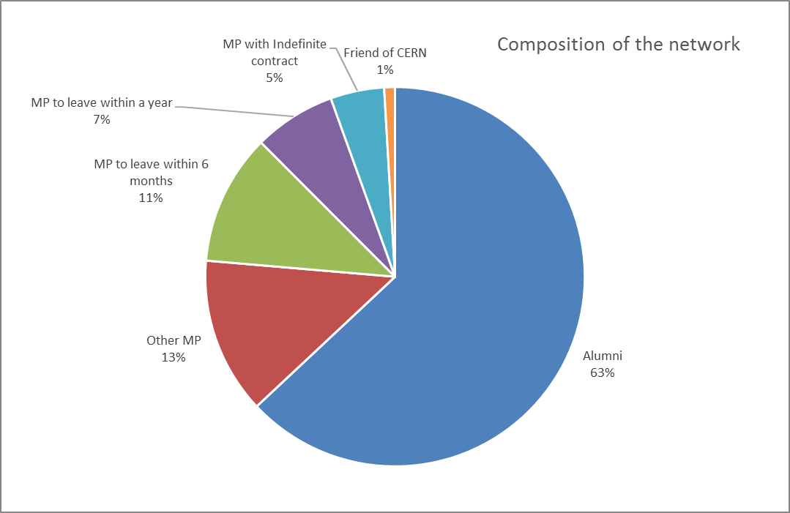
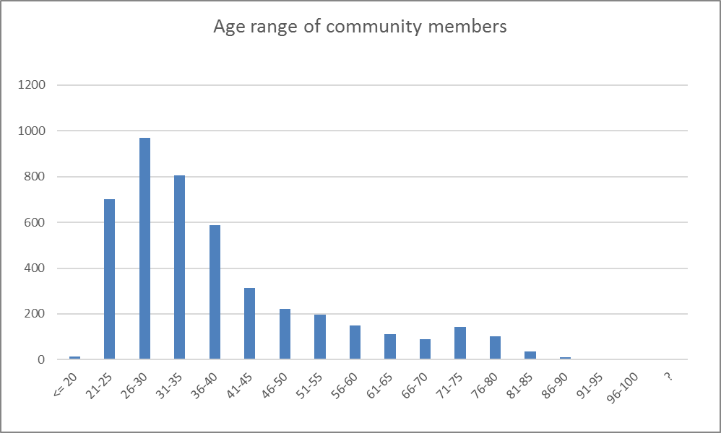

Key CERN Alumni network figures
Community = all network members (MPs + alumni)
Alumni = those who have left CERN
81% alumni or alumni within a year
56% in range 21-35
Notes:
Recall eligibility criteria:
All previous AND current members of CERN personnel, i.e. anyone who has been either an employed member of the personnel (MPE) or an associated member of the personnel (MPA) including USERs.
There is a grey zone between alumni and MP which is very different from traditional alumni community ( mostly in universities)
204 with indefinite contract out of 4453 = 4.6%

Slide 6
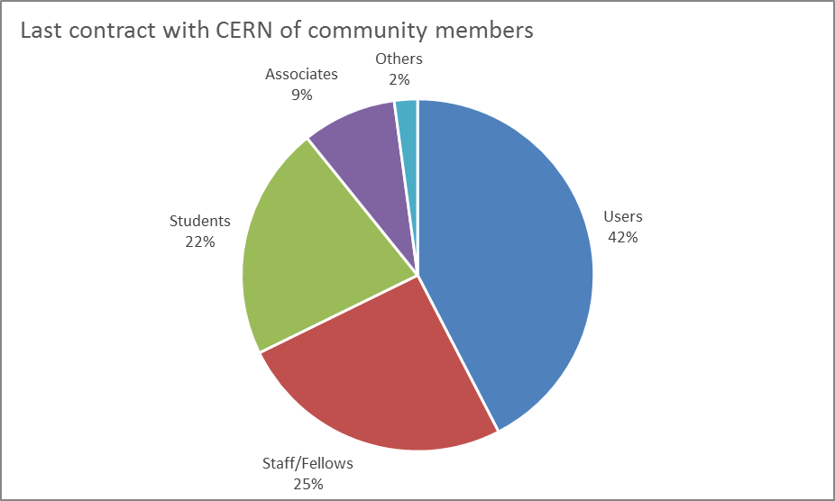
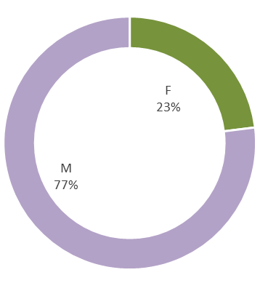
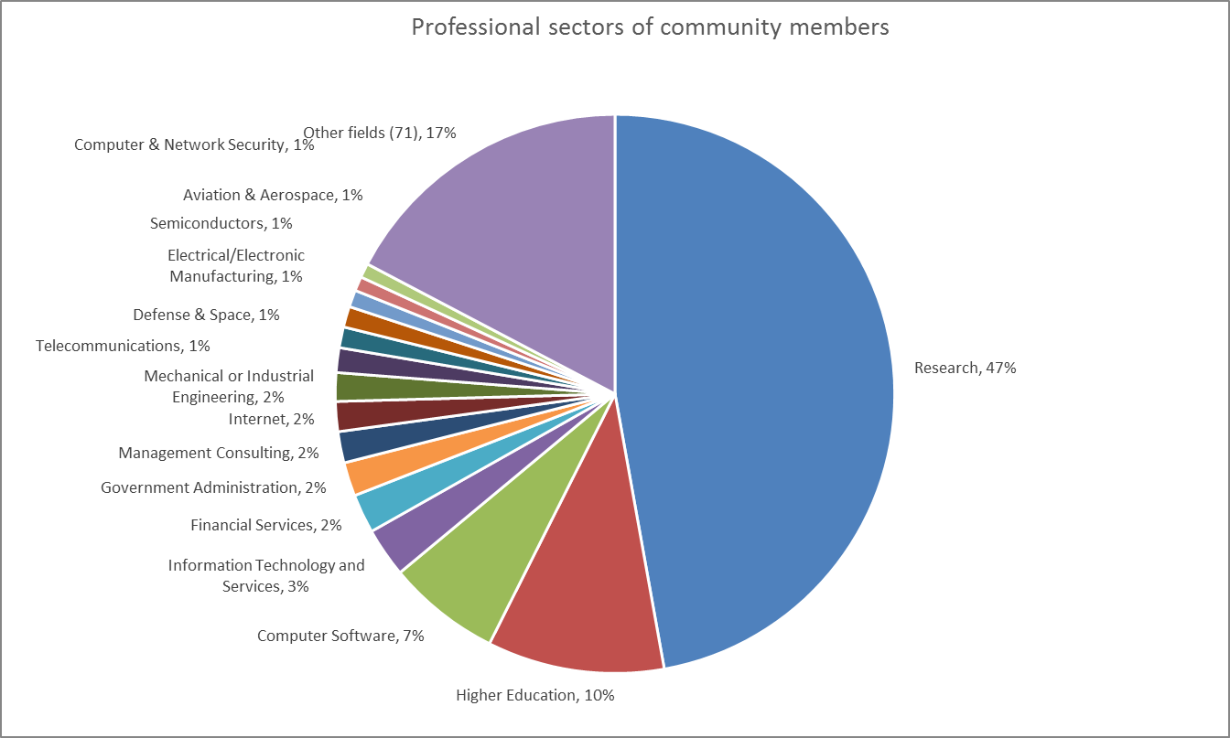
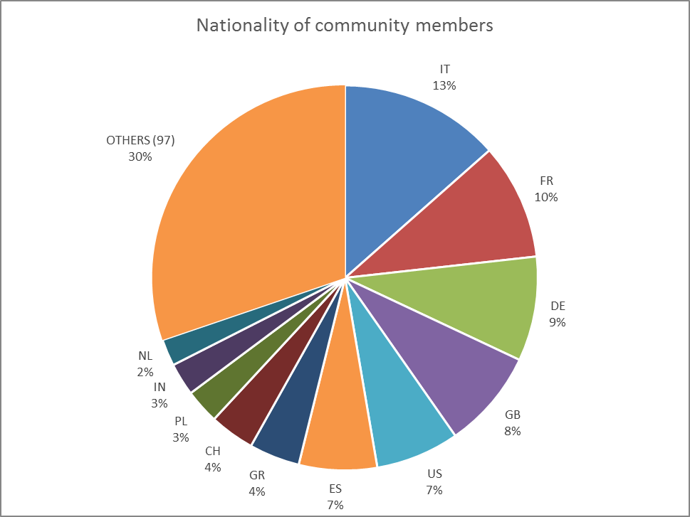
Diverse & inclusive
Notes:
75% not employed
108 different nationalities represented.

Slide 7
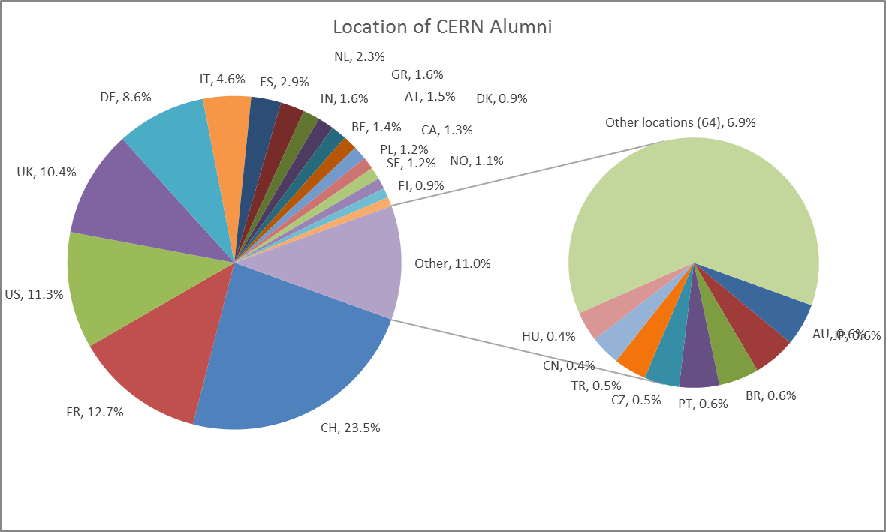
Notes:
Currently 6 alumni members in Cyprus

Slide 8
What the CERN Alumni programme offers
Access to an exclusive network of professionals with a common experience
Career opportunities that are targeted for the talents and profiles developed at CERN
Local CERN alumni interactions with regional groups (7)
Events geared to sharing professional experience
A framework for engagement
An entry point into the Organization
100% confidence in the way their data is managed
Notes:
A large variety of requests:
Contact within the organizations ( for expertise)
Searching for talents that they know are at CERN
Looking for someone
Very specific requests ( thesis of mother)
Accessing CERN for a short visit
Organisation of local events
Utmost care is given to data security:
Protection via CERN SSO
CERN Alumni was the first service at CERN to define its data privacy policy

Slide 9
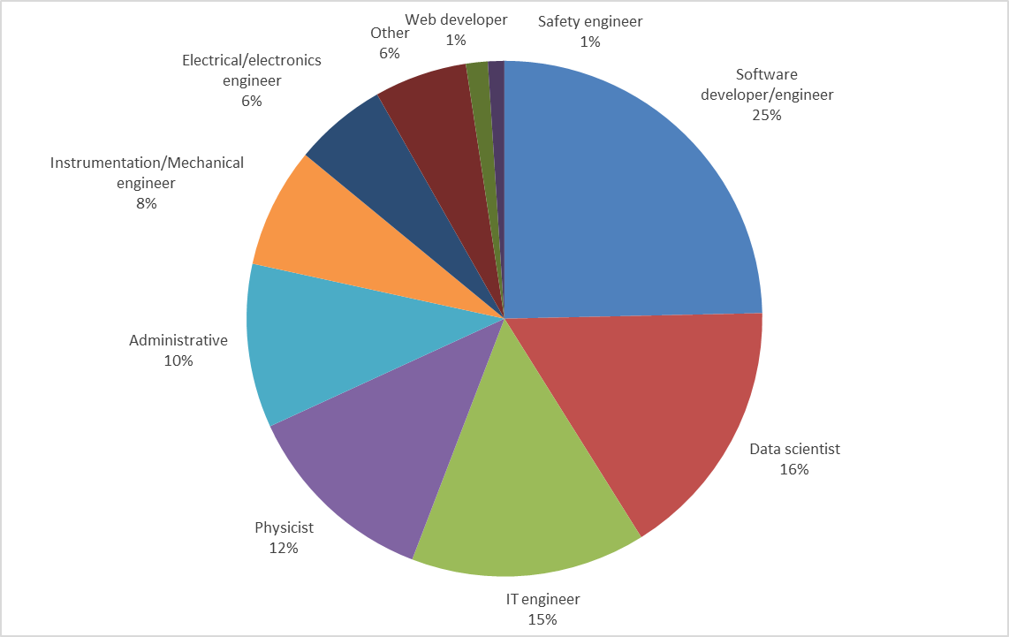
332 job opportunities shared
Notes:
Review and classification of all job offers – Some approximation was needed.
Some jobs posted by alumni themselves and others by Companies. Companies who have already recruited CERN Alumni are aware of the talents and profiles that are developed in CERN and the scientific collaborations.
Administrative inc. procurement officers, insurance officers, communication officers etc.
Other inc. civil engineering, board members, teachers, chemists

Slide 10
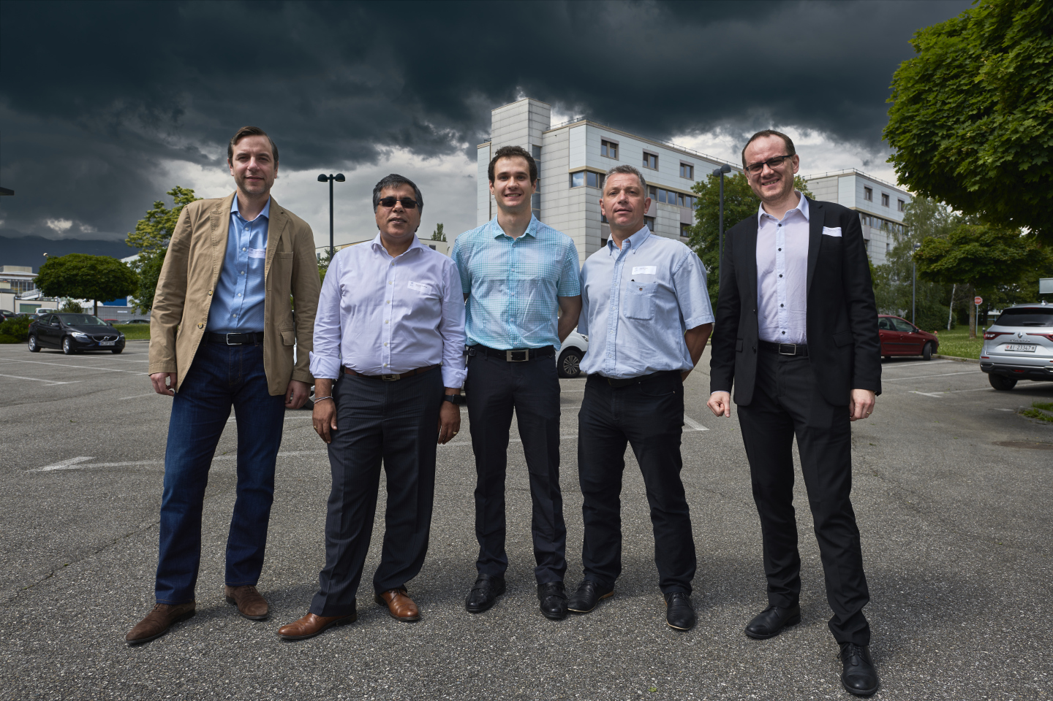
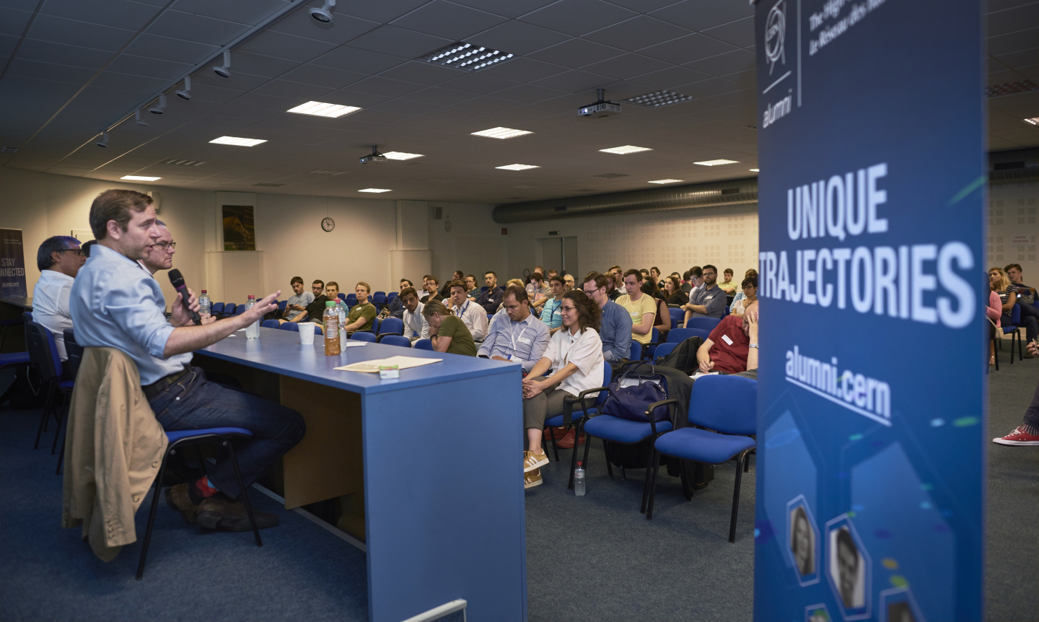
Moving out of Academia
Alumni Engagement
Target audience reached
the concept
Notes:
A true win win situation where:
Alumni son to be learn from the experience of others further in their careers
Mid career panellists find a way to engage, share and get some visibility in their own company and professional network.

Slide 11
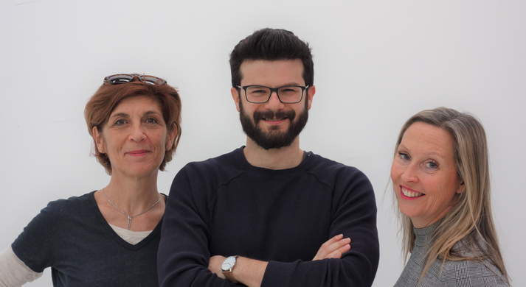
Managing the Network & Governance
Office for Alumni Relations (2.6 FTE)
CERN Alumni Advisory Board (CAAB)
  Chaired by the Director for International Relations
  6 CERN Alumni (4 MPA, 2 MPE)
  One professional in the field of alumni relations

Slide 12
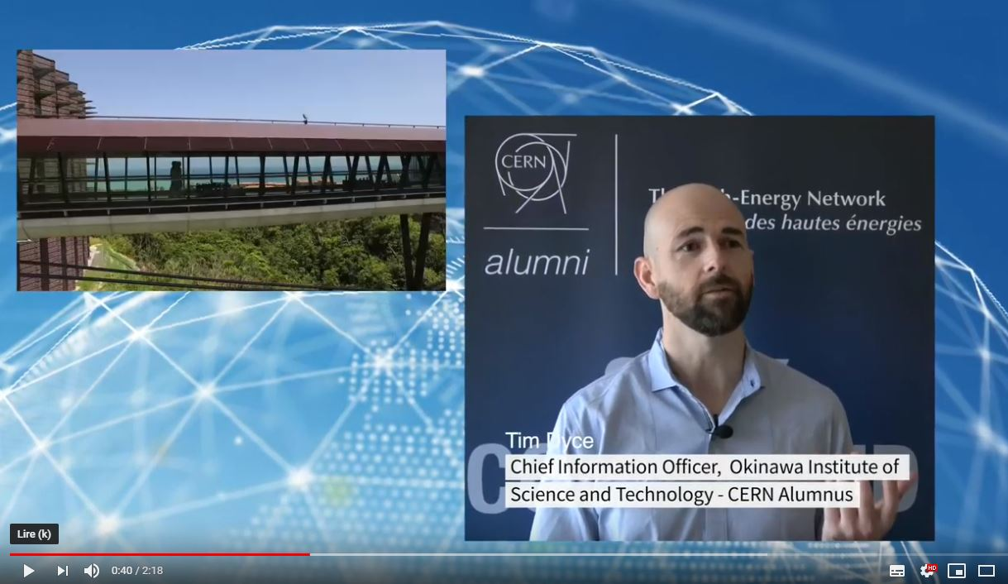
Conclusions
Notes:
For other conclusion I leave it to the members of the CERN Alumni Advisory Board who are featured in the CAAB video.

Slide 13
Thank you for your attention!
Laure Esteveny
Head of CERN Alumni Relations
CERN – International Relations
Laure.Esteveny@cern.ch
Rachel Bray
CERN Alumni Community Manager
CERN – International Relations
Rachel.Bray@cern.ch
Orestis Galanis
Communications & Support Officer
CERN – International Relations
Orestis.Galanis@cern.ch

Slide 14
SPARE SLIDES

Slide 15
What CERN alumni take with them
A unique experience characterized by
  A truly international environment
  Collaboration without borders
  The experience of enriching and autonomous jobs
  Common values of
    Integrity, Engagement, Professionalism, Creativity , Diversity
A highly sought after profile
  Working on projects from beginning to end
  Experience with presenting to and convincing a challenging, competitive audience
  Complex problem solving
  Unique and challenging technical environment
    E.g. extremely large data sets, confined space constraints, R2E
  A unique expertise that they developed at CERN (e.g. project management, specific tools or technology)
  Proximity with world experts in a particular domain or on a particular technology
  Cultivation of an international network which can boost a career – and a company
key messages
Notes:
This results form close to two years of contact and exchanges with alumni all around the worlds ( during events, telling us their stories)
In addition to the knowledge and knowhow that they have acquired
This is what we have learnt after two years of experience
Mention Carmen’s statement about international environment

Slide 16
Key milestones
  A Director-General’s project - June 2016 – September 2017
    Design of the programme with project team ( 20 members representative of all departments and key services (legal service, users 'office etc.)
  October 2017 – May 2017
    Detailed specifications , software selection and implementation
  June 2017 - launch of the network
    Starting from scratch – No import of data
    The first programme to define a comprehensive data privacy policy
    Creation of an Office of Alumni Relations, OAR ( 3 persons, 2.5 FTE)
    Eligibility criteria for entering the network:
      Anyone who has had a contract with CERN either of employment ( staff/fellow) or of association ( student, associate, user) and who is either working at CERN or has worked at CERN, may request to join.
back

Slide 17
Key messages to departing alumni
An entry point to the Lab and a continued link with CERN and the Scientific Collaborations
The support from a dedicated Office for Alumni Relations for their interactions with CERN and the community
The huge potential of a strong, exclusive network whose members are sharing a passion for STEM and the pride of having contributed
Exclusive career opportunities targeted at CERN developed talents and profiles
Access to knowledge and experience from fellow alumni that have made a successful career
Topical news picked up for them every week
Access to selected courses at CERN
Access to the CERN site
Possibilities to engage with CERN in a variety of ways
We adapt and manage to whatever request we get from them
back

Slide 18
Moving out of Academia – the concept
Towards objectives no 2 -> support young physicists who cannot stay in academic research
One professional sector targeted each time
Open to alumni and alumni-soon-to-be
Speakers are alumni who went through a transition into that sector
Speakers may invite guests (often their boss or from HR)
Focused on describing the nature of jobs and practical tips for a successful recruitment journey
back

Slide 19
2019-2021 road map for CERN Alumni
Better understand alumni expectations and clarify the Unique Selling Proposition
Improve the alumni.cern platform to enhance customer experience
Improve alumni data quality
Increase alumni interactions, engagement and empowerment
Develop appealing content
Increase awareness of and grow the network
Introduce the fundraising message for Science Gateway
back
Notes:
Takes into account CAAB recommendations – approved by DG
1. Better understand alumni expectations and clarify the Unique Selling Proposition
Focus groups to determine UVP and USP
2. Improve the alumni.cern platform to enhance customer experience
Review site for network anniversary – explore further integration of systems with IT – Influence software provider
3. Improve alumni data quality
Launch a “fill in your profile “campaign
4. Increase alumni interactions, engagement and empowerment
Encourage creation of regional groups and support to events .
Start a “My job as” series
Start a “in the driver’s seat “series
5. Develop appealing content
Publish more video based content. Increase the number of alumni stories.
6. Increase awareness of and grow the network
LinkedIn searches by country
CERN Alumni day
7. Introduce the fundraising message for Science Gateway
Advertise a very appealing outreach and education project

Slide 20
The LinkedIn quandary
LinkedIn main competitor for professional networking
  Data is gold
  In March, LinkedIn stopped enabling synchronization of profile
LinkedIn data is NOT validated
  E.g. a CERN geopolitical advisor …
Still, a very useful tool for searching and contacting alumni
21% of contacted alumni become active members
Notes:
Significant competition in online community management with LinkedIn as main competitor for professional network management
We have a good relationship with Lin

