Slide 1
A 4-minute presentation on GPU Clustering Speed-ups
Benjamin Kilian, 20/05/2019

Slide 2
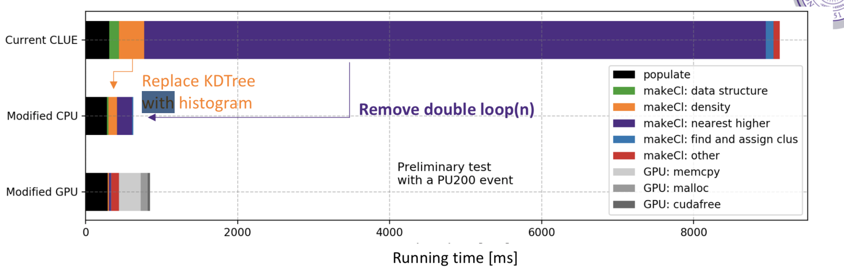
GPU Memory Management takes considerable time
Each iteration of our clustering algorithm makes 5 calls to GPU functions, allocating, copying, and freeing memory each time
With 104 layers in HGCal this is a total of 520 kernel calls
Data is represented as an array of structures (more memory to copy)

Slide 3
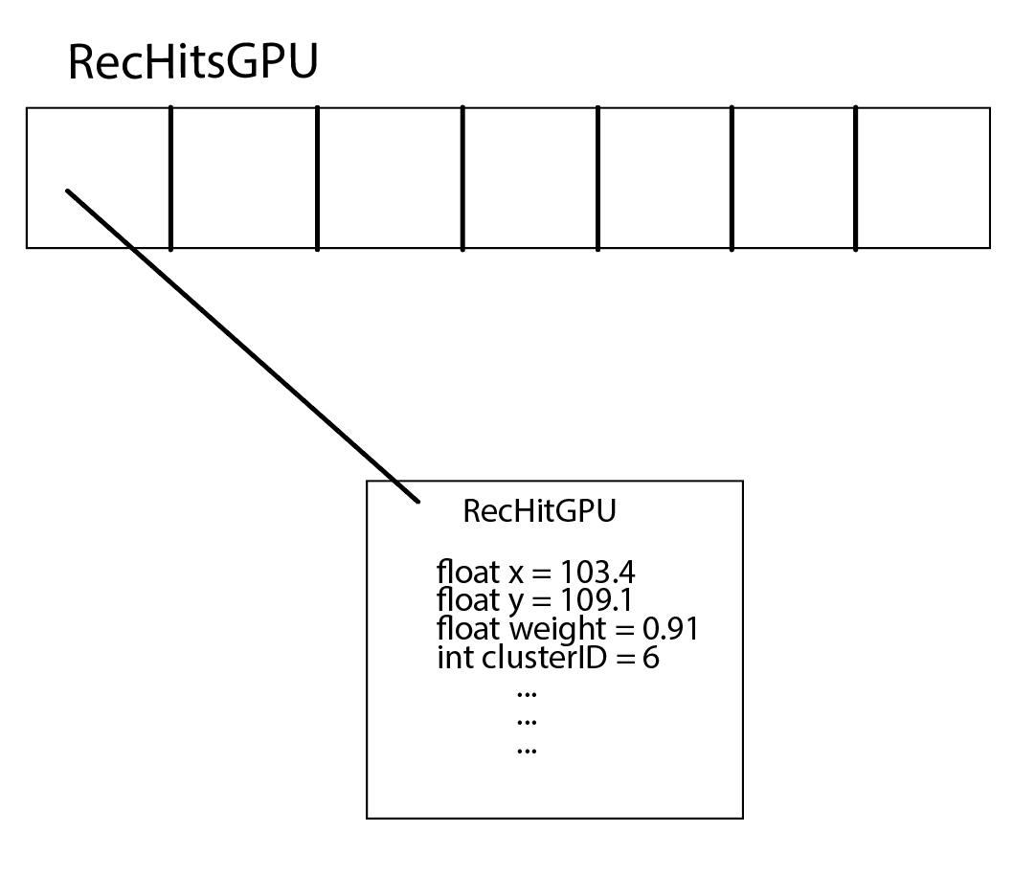
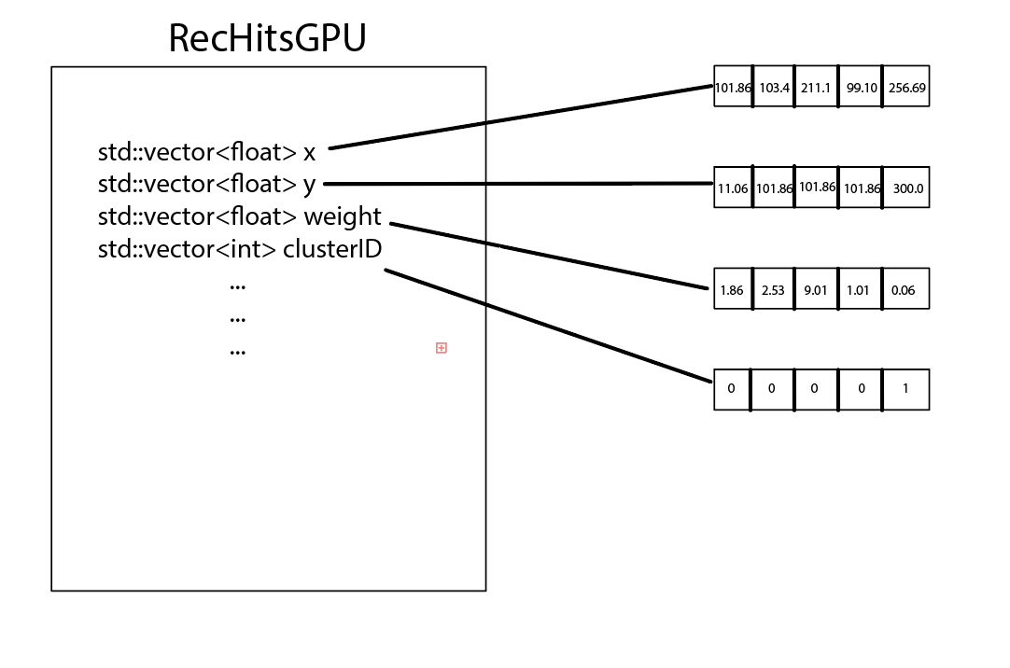
Data structure changed to Structure of Arrays
Can now select which attributes to pass to GPU and copy over

Slide 4
Current plan: Switch to 5 kernel calls instead of 520
By passing all data at once, the computation time will theoretically be the same.
We can eliminate a majority of the memory management time if all kernel calls are made at the same time.
I have written pseudo-code that I am will implement once we have a working version of the code.

Slide 5
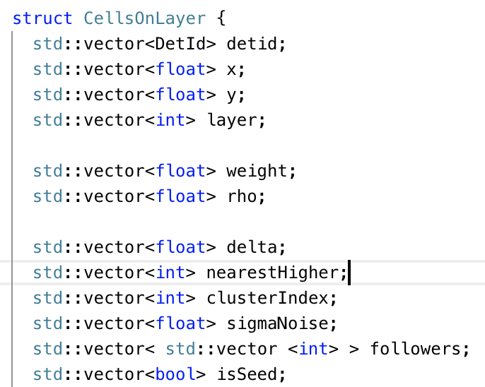
Added a Layer attribute to our data structure
This allows the kernel to keep track of which recHits are in which layer and will prevent comparisons of recHits in different layers.

