Slide 1


CMS HGCal:
Research Update
Gwen Gardner
May 20th, 2019

Slide 2
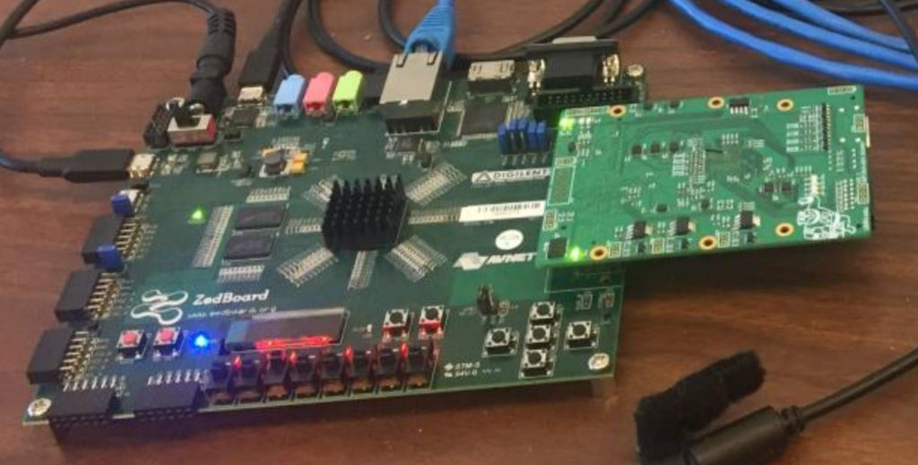
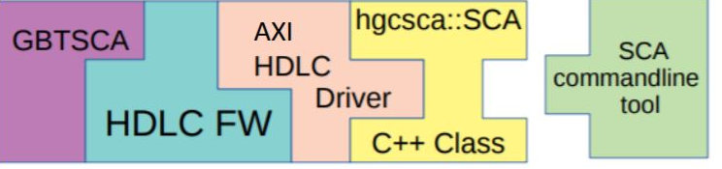
Review
PetaLinux
Zynq/Zedboard
GBTSCA
Last time:
Using scp’d scripts + on-Zynq development to communicate with GBTSCA
scp’d scripts
Notes:
I’m sure you guys remember what I’ve been up to.
This setup has mostly just been for practice -- the important part is learning how to work with the Zynq SoC.

Slide 3
Further I2C Progress
Zynq
Zedboard
Can write and read successfully, and scripts return read values
Requires two directions of communication
Tested running commands in immediate succession
Some issues with EEPROM
HDLC
GBT-SCA
FMC
GBT-SCA
I2C
I/O Expander
EEPROM
Temp Sensor
ADC
LEDs
3

Slide 4
New kind of root filesystem!
“Stationary” rootfs
Before: “INITRAMFS” | Now: SD card
Linux kernel contains a “zipped” version of the rootfs Rootfs is “unzipped” at boot On-Zynq development does not survive reboot Limited size | Partitioned SD card BOOT, rootfs Kernel directly mounts rootfs partition On-Zynq development survives reboot Size only limited by SD card

Slide 5
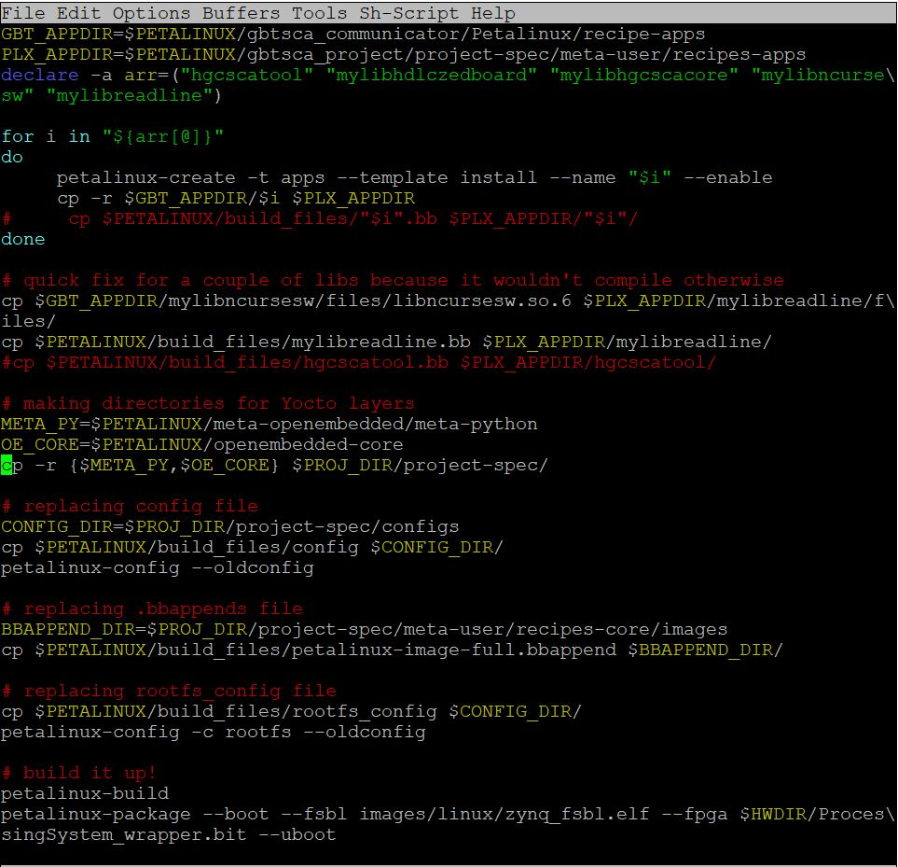
Automating the build process
Some challenges:
Bypassing the PetaLinux configuration “menu”
Incorporating someone else’s code
The fragile nature of PetaLinux

