Slide 1
Project Update 8
By: Ryan McCarthy

Slide 2

What did I do these past two weeks?
99
Find True Love
0
Histograms
1
0
Physics
Actual Coding
Prove Supersymmetry
0

Slide 3
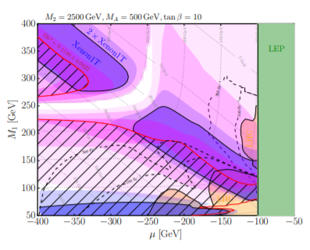
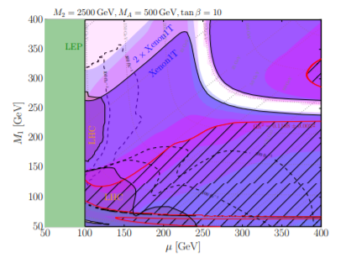
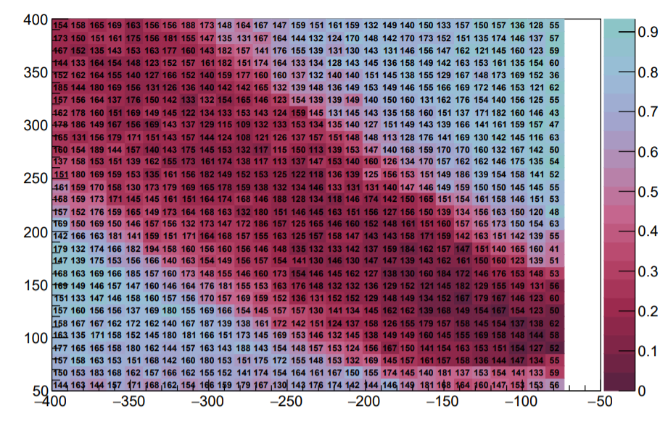
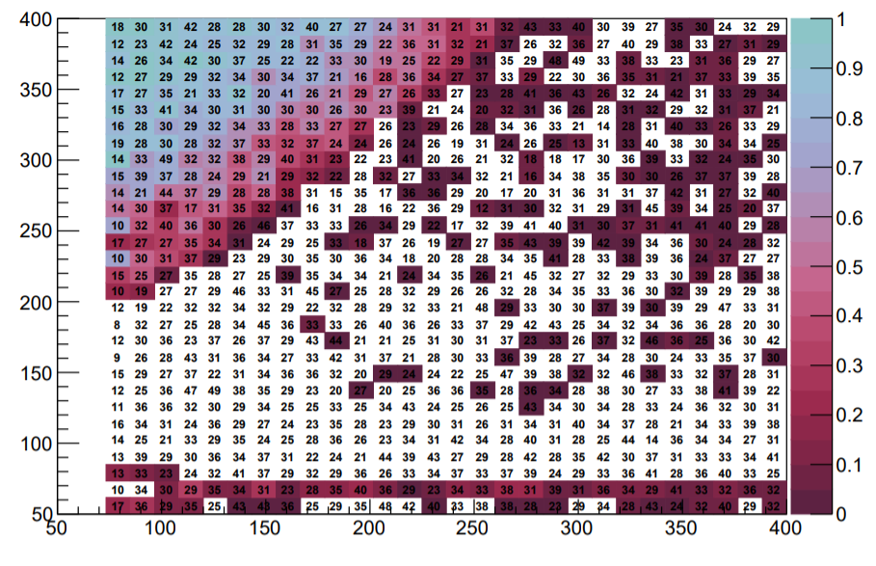
More “Not-So-Well Tempered Neutralino” Plots

Slide 4
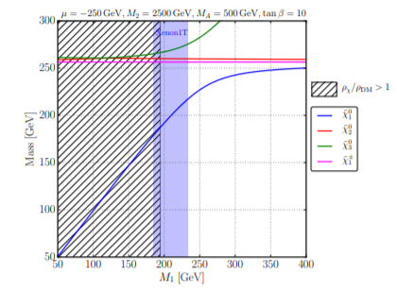
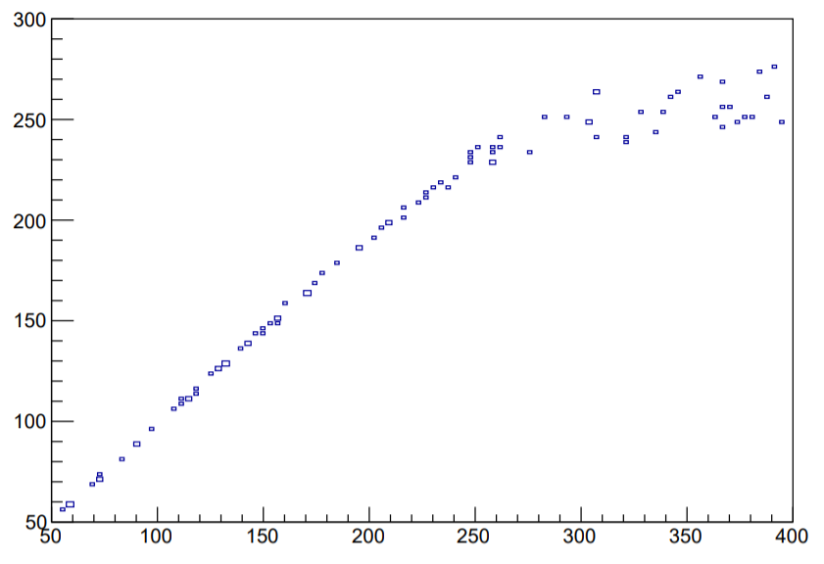
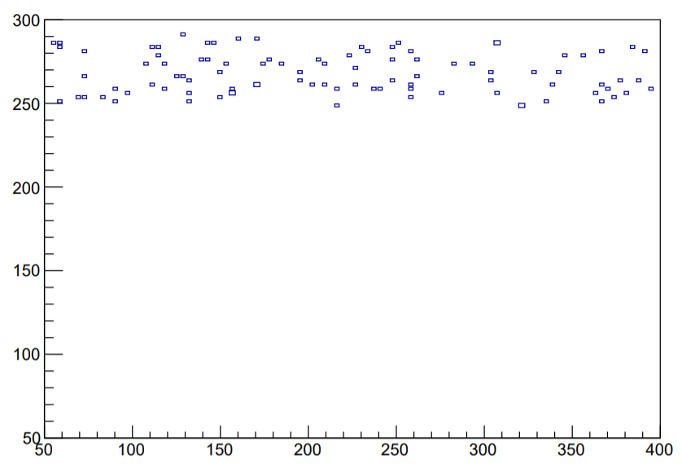
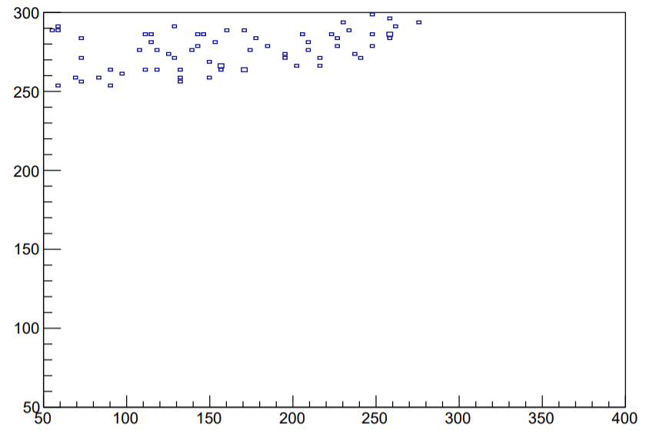
Additional Plots
Higgsino-like
Wino mixing
Lightest neutralino mass, the mass of chi10, is determined by the smallest of the bino, wino, and higgsino mass parameters
M1 is the bino mass
M2 is the wino mass
Mu is the higgsino mass
Heavier neutralinos, like chi30, depend on the larger of the mass parameters
Higgsino mixing
Bino-like

Slide 5
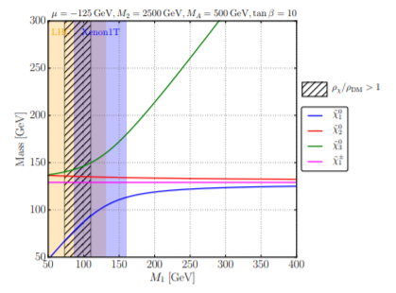
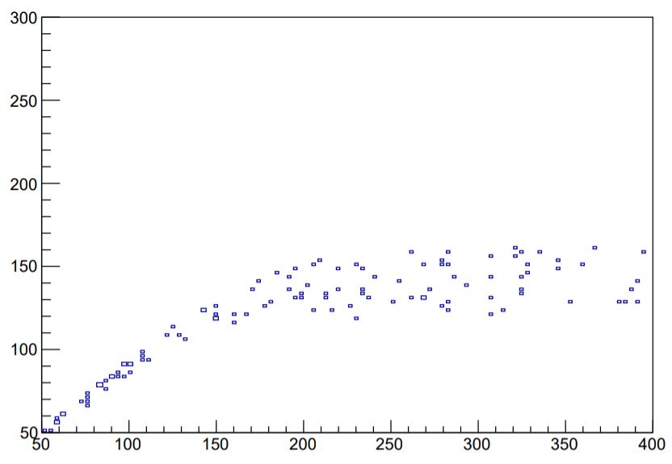
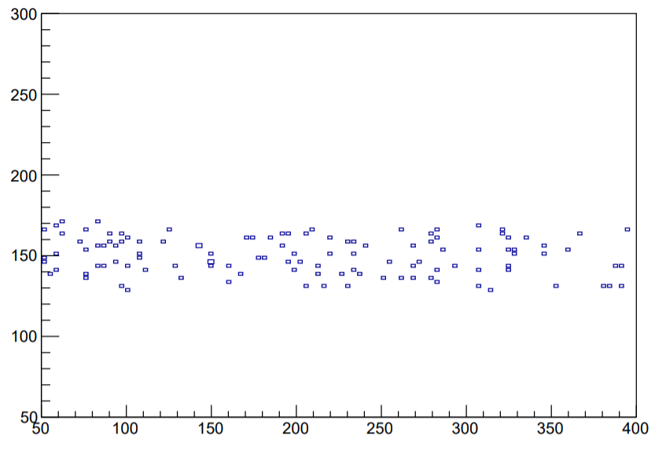
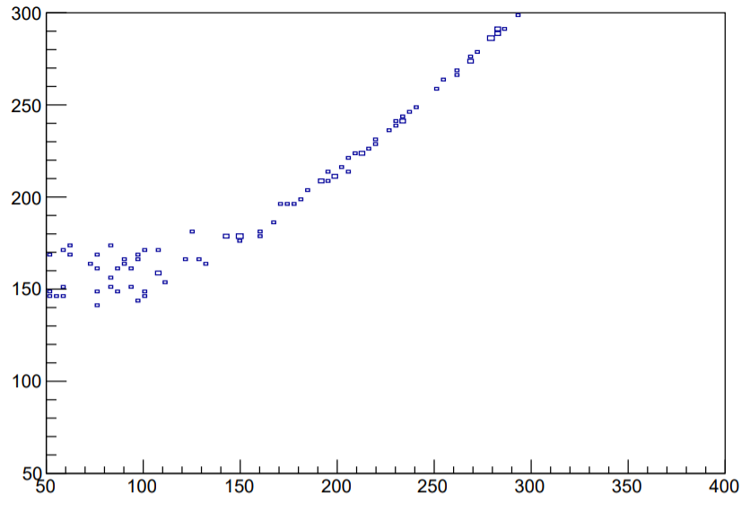
Further Plots
Once M1 passes 125GeV, the neutralino 1 becomes higgsino-like since the higgsino mass parameter is now the smallest while the neutralino 3 begins mixing with the bino mass parameter which is the largest and was previously decoupled

Slide 6
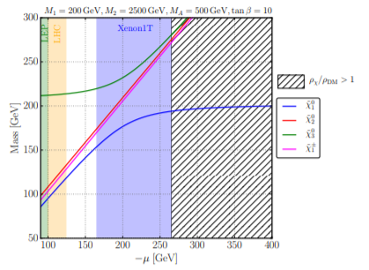
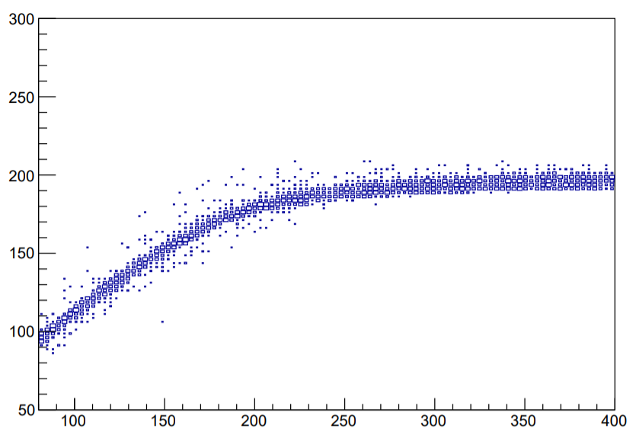
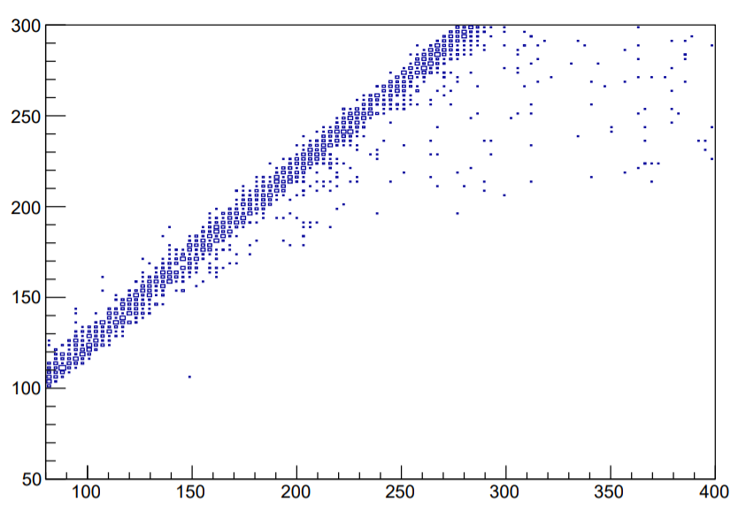
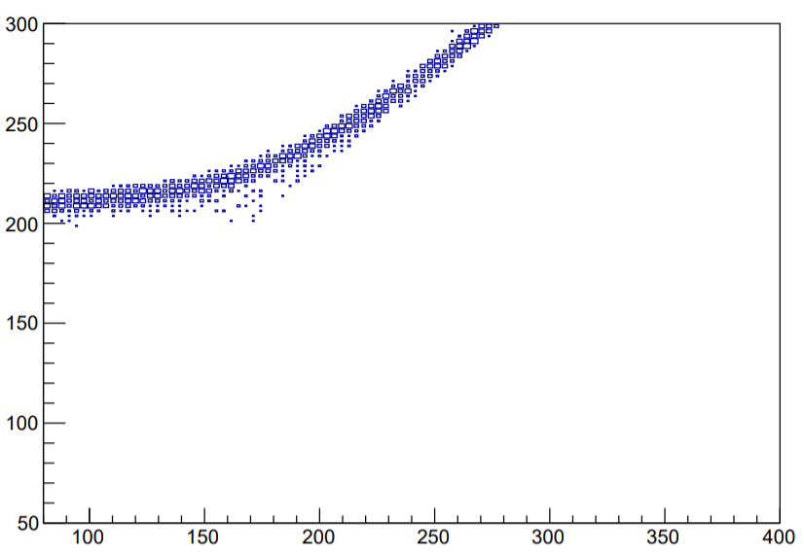
……….More Plots

Slide 7
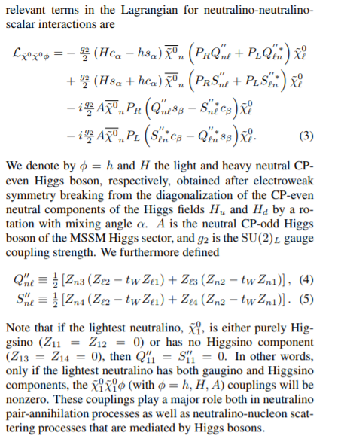
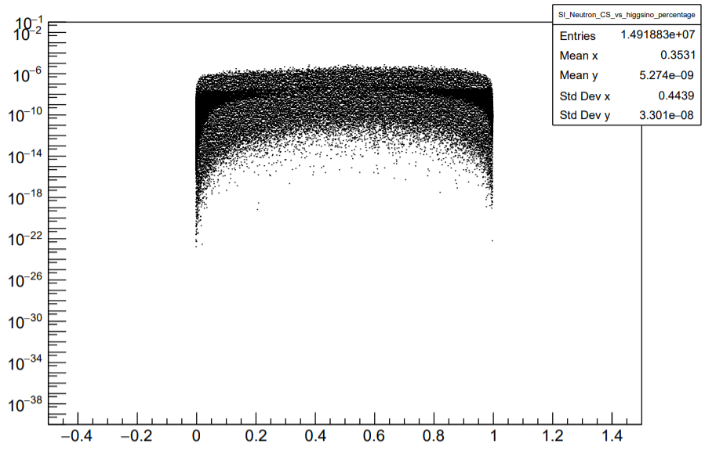
“Not-So-Well Tempered Neutralino” Calculations
SI Neutron Cross Section (pb)
N₁₃²+ N₁₄²

Slide 8
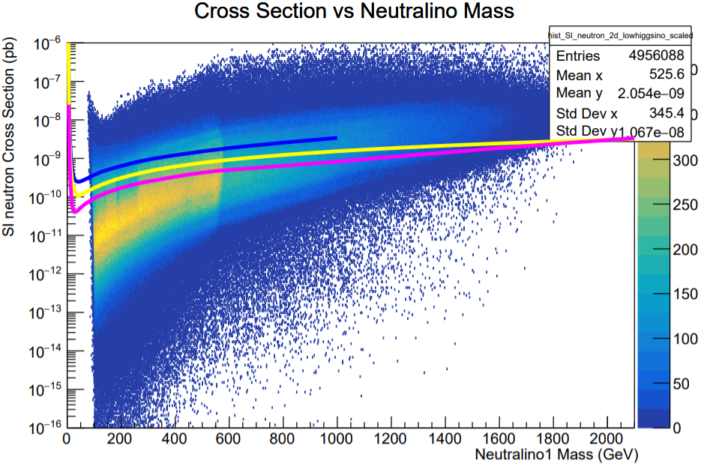
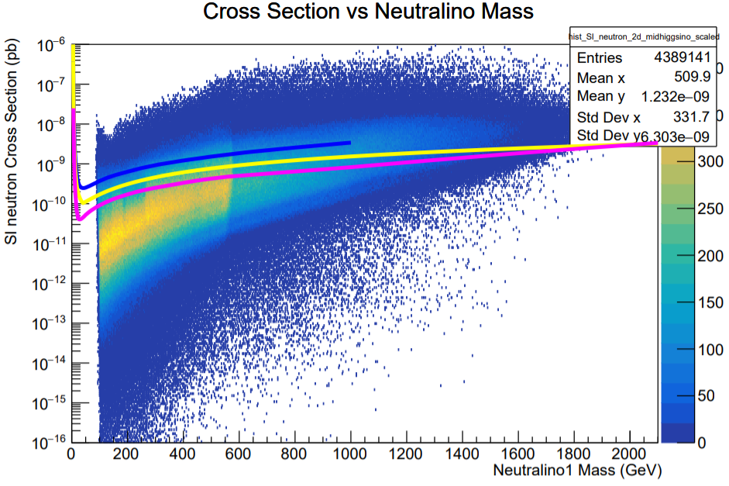
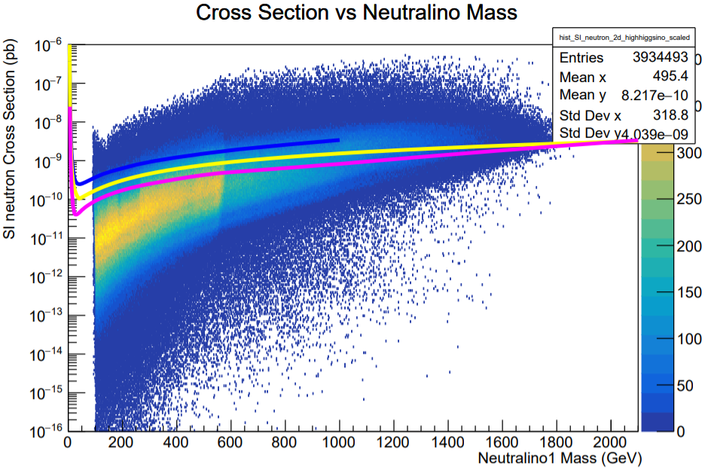
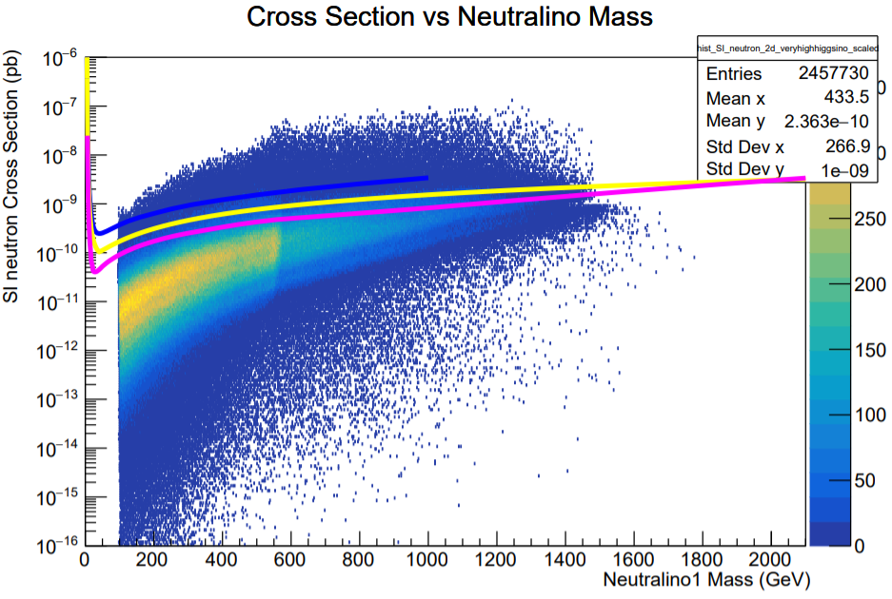
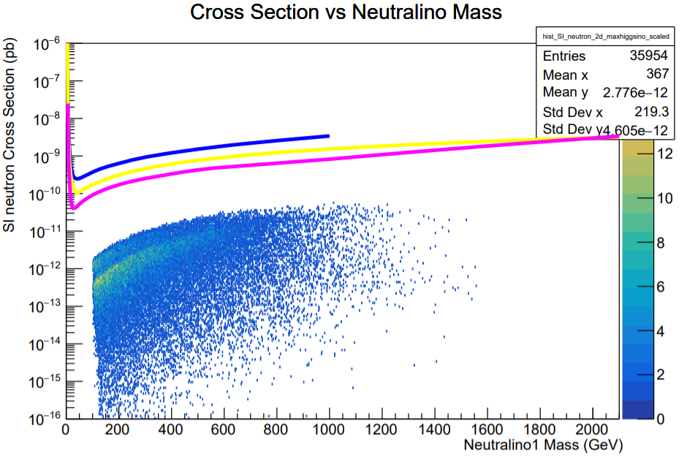
Cross Section vs LSP Mass with Higgsino Percentage Cuts
>= 90 % Higgsino-Like
>= 95 % Higgsino-Like
>= 70 % Higgsino-Like
>= 99 % Higgsino-Like
>= 99.9 % Higgsino-Like

Slide 9
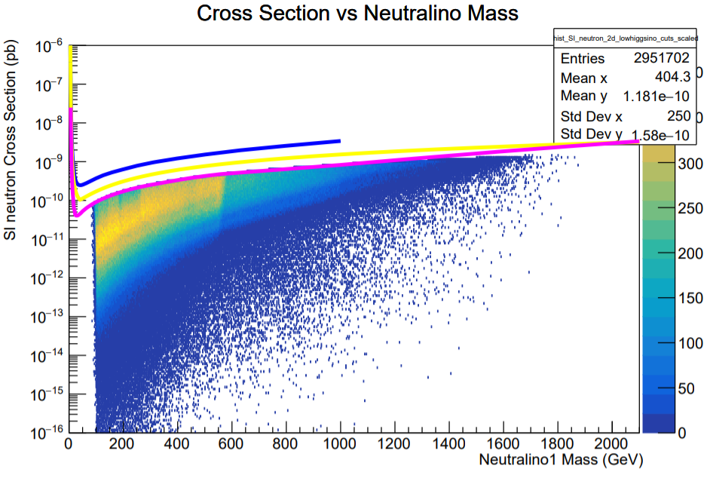
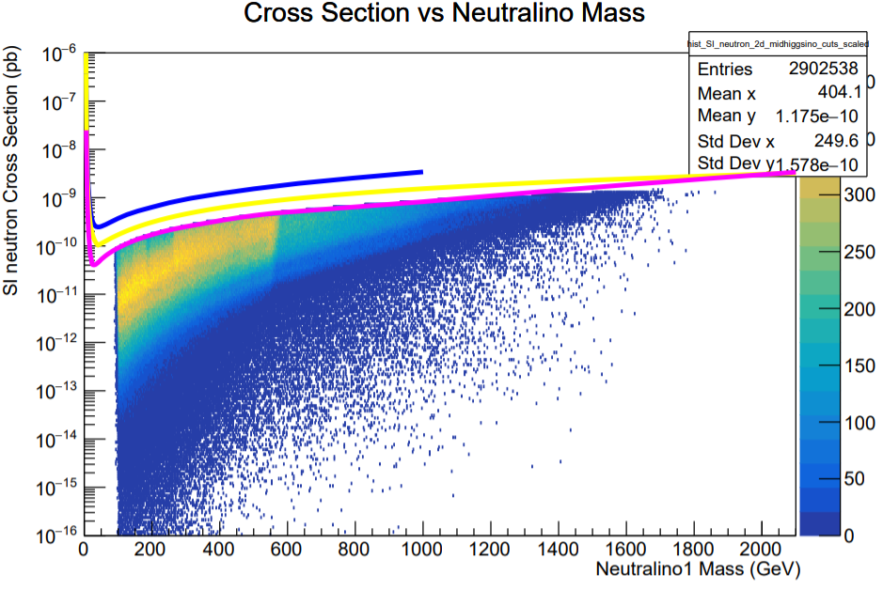
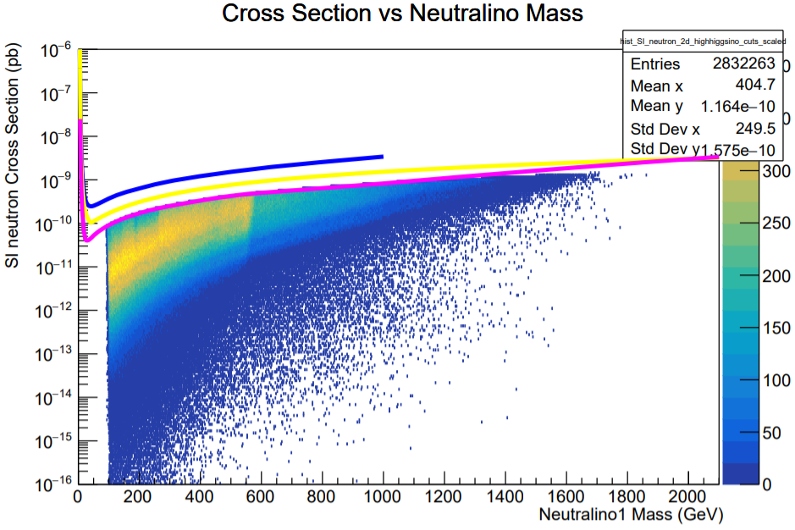
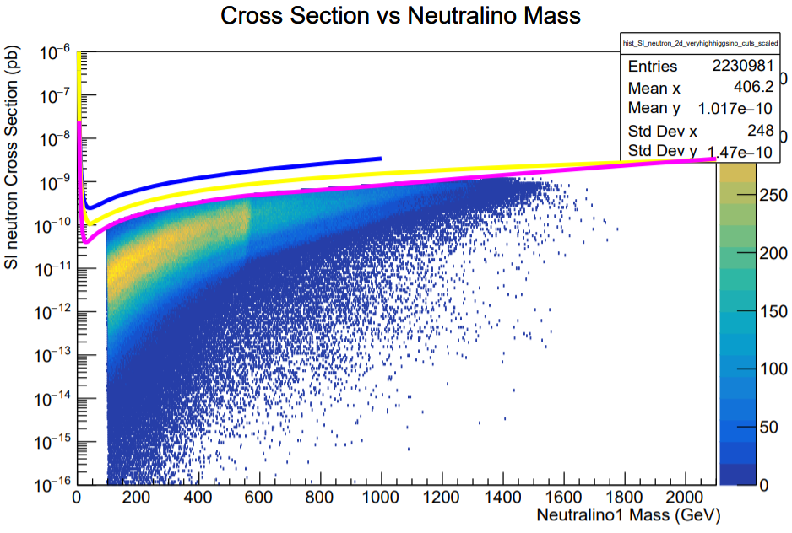
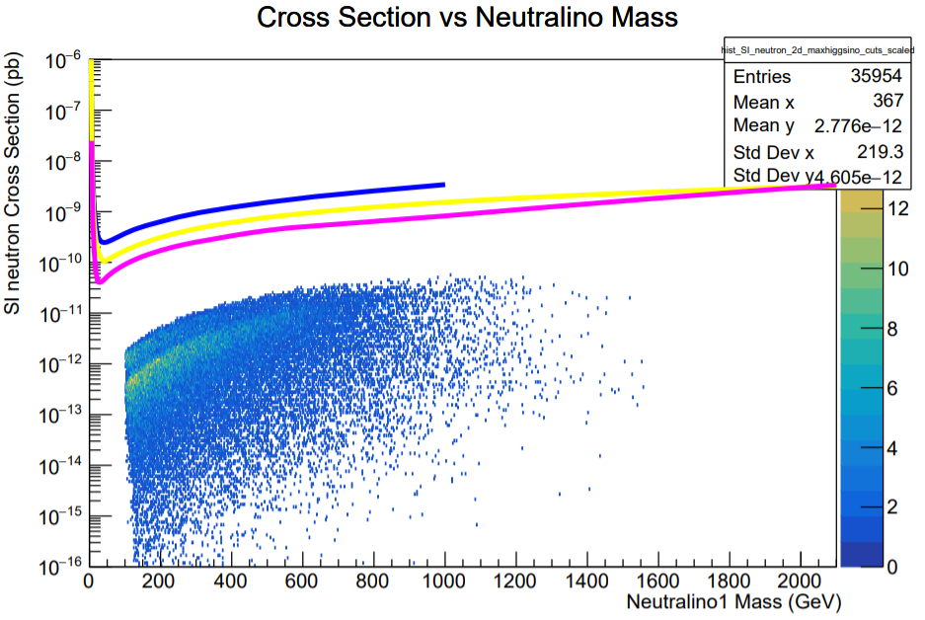
Cross Section vs LSP Mass with Higgsino Percentage Cuts
>= 90 % Higgsino-Like
>= 95 % Higgsino-Like
>= 70 % Higgsino-Like
>= 99 % Higgsino-Like
>= 99.9 % Higgsino-Like

Slide 10
Results
For lowhiggsino: 2951705 / 4976306 = 59.32%
for midhiggsino: 2902540 / 4407544 = 65.85 %
for highhiggsino: 2832265 / 3951376 = 71.68 %
for veryhighhiggsino: 2230982 / 2468395 = 90.38 %
for maxhiggsino: 35954 / 35954 = 100%
Cut efficiency goes up as expected due to the decreased cross section!
We see this behavior for wino percentage cuts but I’ve left those out since you’re definitely sick of histograms

Slide 11

What’s Next
This kid can only make histograms.
Get Ntuples from BigPanda and run further simulations
Even more histograms
Prettier histograms
Excellent presentation!

