Slide 1
Measuring E3 matrix elements in pear-shaped nuclei: Miniball or ISS?
Peter Butler (U. Liverpool)
(dσ/dΩ)_{l} ^{exp} = β_{l} ²(dσ/dΩ)_{l} ^{DWBA}
B(El;0 → l) = (3ZeR_{l}/4π)²β_{l} ²
H.I. Coulex (d,d’)
model independent model dependence (sys. error)
purely EM strong+Coulomb (sys. error but higher σ)
single channel competing channels (possible backgrd.)
multi-step (H.I.) ~single-step (simpler analysis)
transitions states (simpler analysis, see g.s.)
particle-gamma particle (no icc problems, higher ε)
thick target thin target (σ x ε x t ~ Coulex p-γ)
3-10 keV 20-50 keV

Slide 2
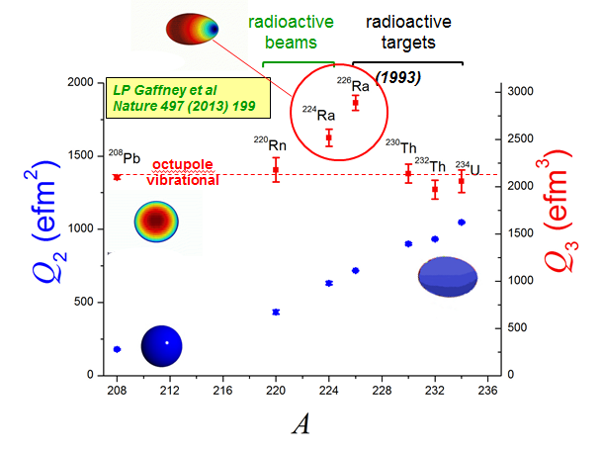
Motivation #1: Octupole enhanced atomic EDM moment
related to Q₃
P,T-violating n-n interaction,etc
Schiff moment:
energy splitting of parity doublet
Measured in ²²⁰Rn, ^{224,226}Ra, (²²²Rn,^{222,228}Ra)
(but not odd-A nuclei)
Measured in ^{223,225}Ra
(large in odd-A Rn)
ER Tardiff et al
Hyp Int 225(2014) 197

Slide 3
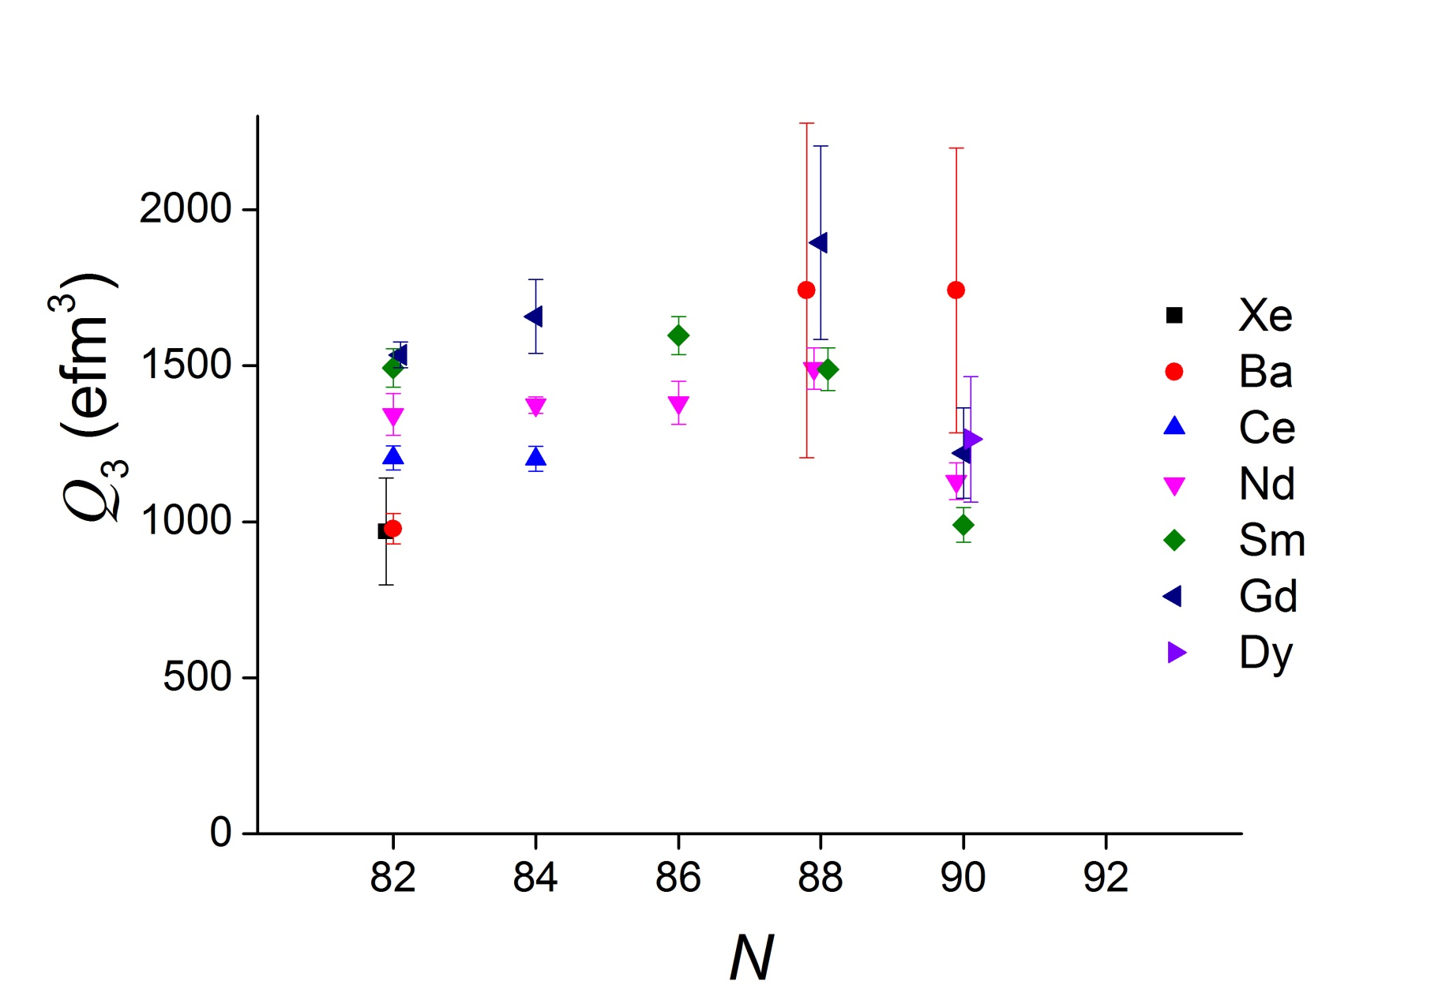
Motivation #2: B(E3)s in ^{144,146}Ba
B Bucher et al.
PRL 116, 112503 (2016)
B Bucher et al.
PRL 118, 152504 (2017)
See also ^{142, 144}Ba, Gaffney et al.

Slide 4
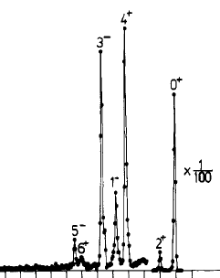
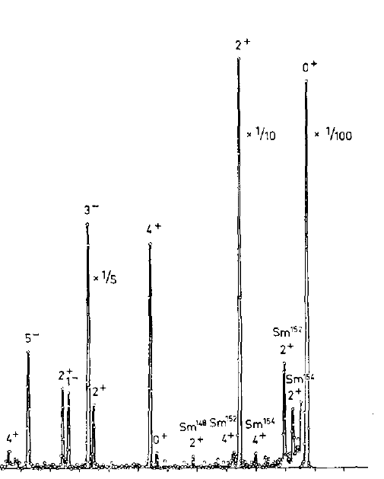
spectrograph data
²²⁶Ra(d,d’)
actual data
Thorsteinsen et al.
Phys. Scr. 42 (1990) 141
ΔE ~ 10 keV
-400 -200 0
¹⁵⁰Sm(d,d’)
actual data
Veje et al.
Nucl. Phys. A109 (1968) 489
ΔE ~ 10 keV
-1000 -500 0

Slide 5
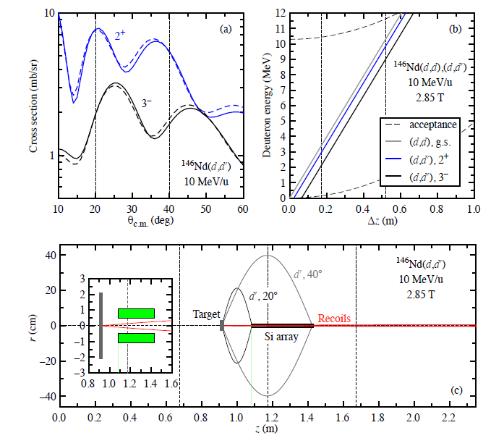
ISS Experimental details
(taken from Ben Kay et al., ATLAS #1619, scheduled September)
Using Ptolemy
Q-value = 1.01 E_{lab} (MeV) - 0.20Δz (cm)
competing
channels:
CN
(d,t)
(d,³He)
(d,α)
5 days:
~10% error in B(E3)
(10⁵ ions/s
20 μg/cm²)
Similar to Coulex IS553

Slide 6
ISS Q-value resolution
d(²⁴Ne,p)²⁵Ne @ 10 MeV/u
With HIE-ISOLDE beam: ~40 keV
With manipulated beam*: ~25 keV
Similar results obtained by M Labiche
*manipulated beam:
FWHM ΔE/E reduced from 0.5% to 0.1% through de-bunching and phase rotation
Transverse emittance (normalised rms) reduced from 0.1 to 0.02 mm mrad through collimation

Slide 7
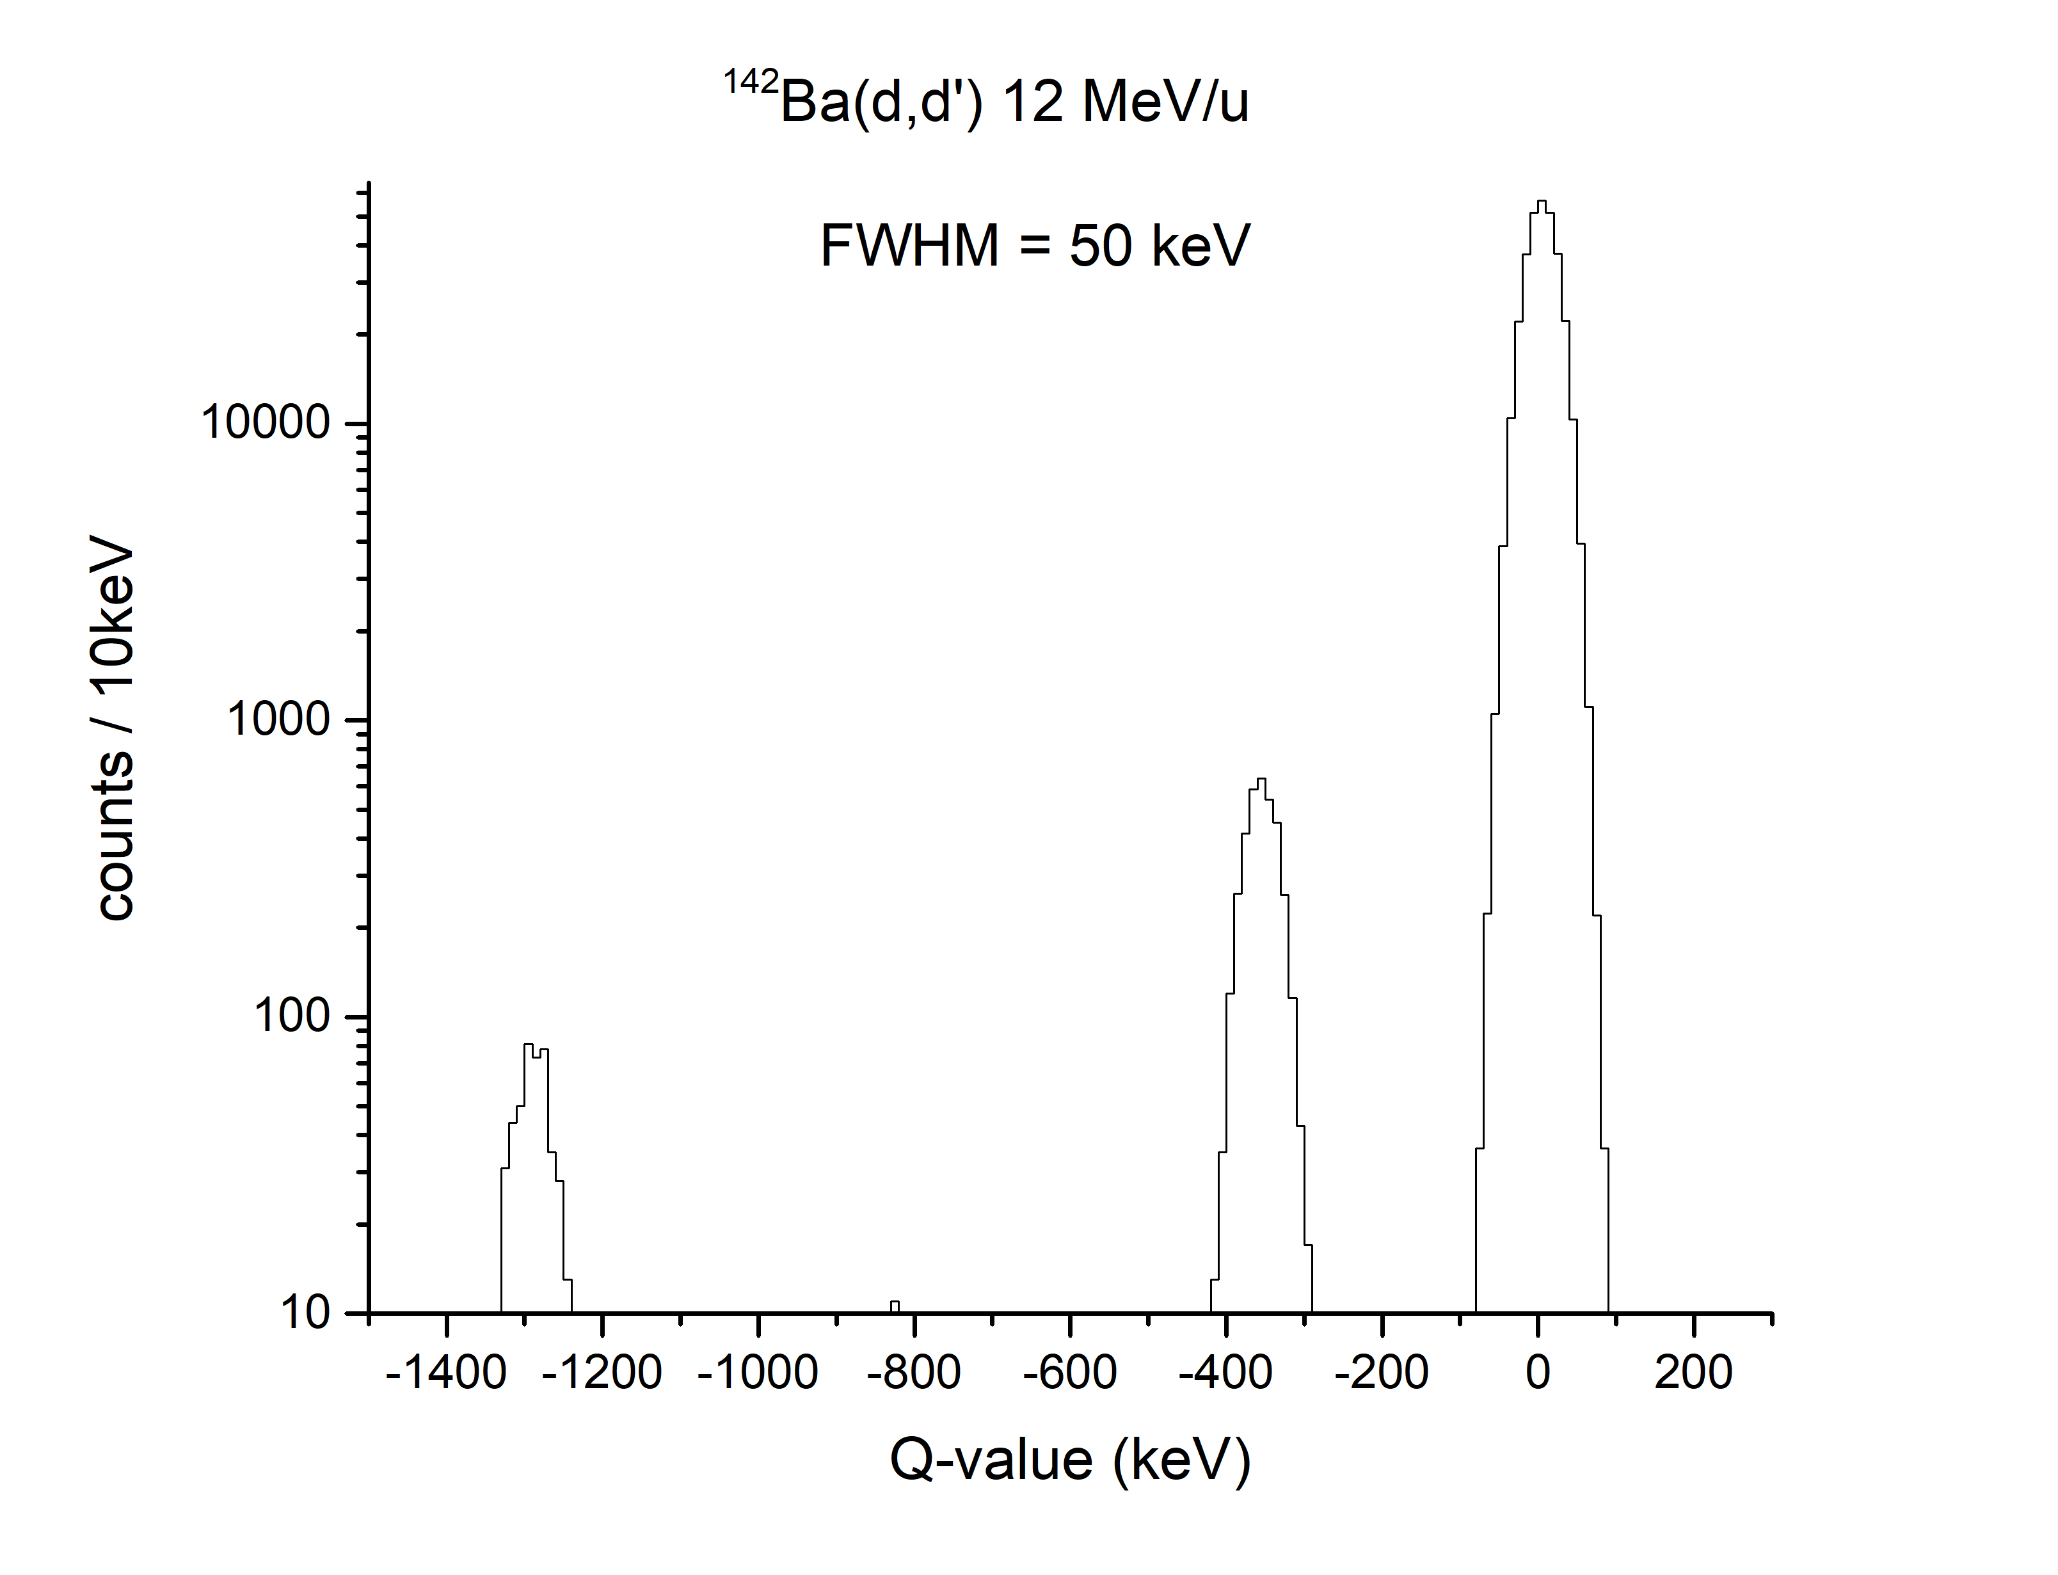
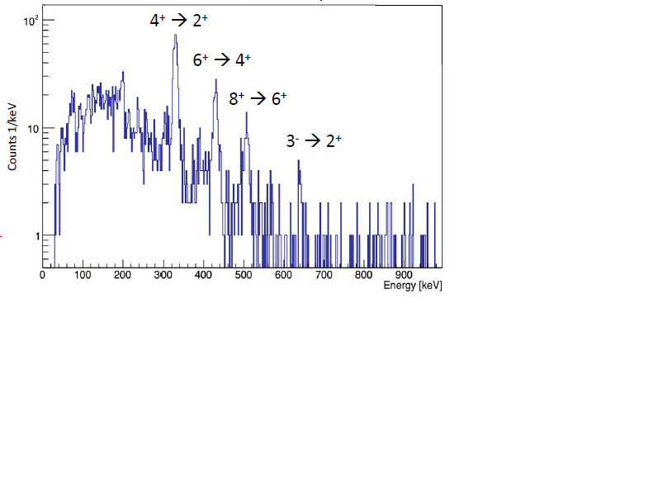
¹⁴²Ba MB v ISS
¹⁴²Ba + ²⁰⁸Pb HIE-ISOLDE + Miniball 2018
actual data (Liam Gaffney)
ISS simulated
0⁺
2⁺
3⁻
4⁺

Slide 8
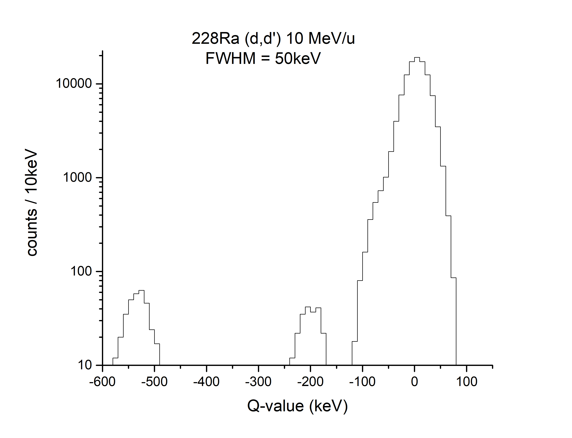
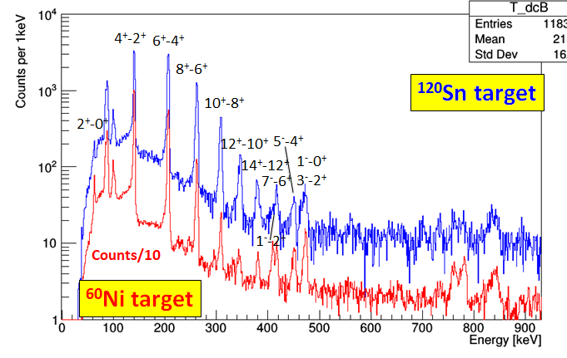
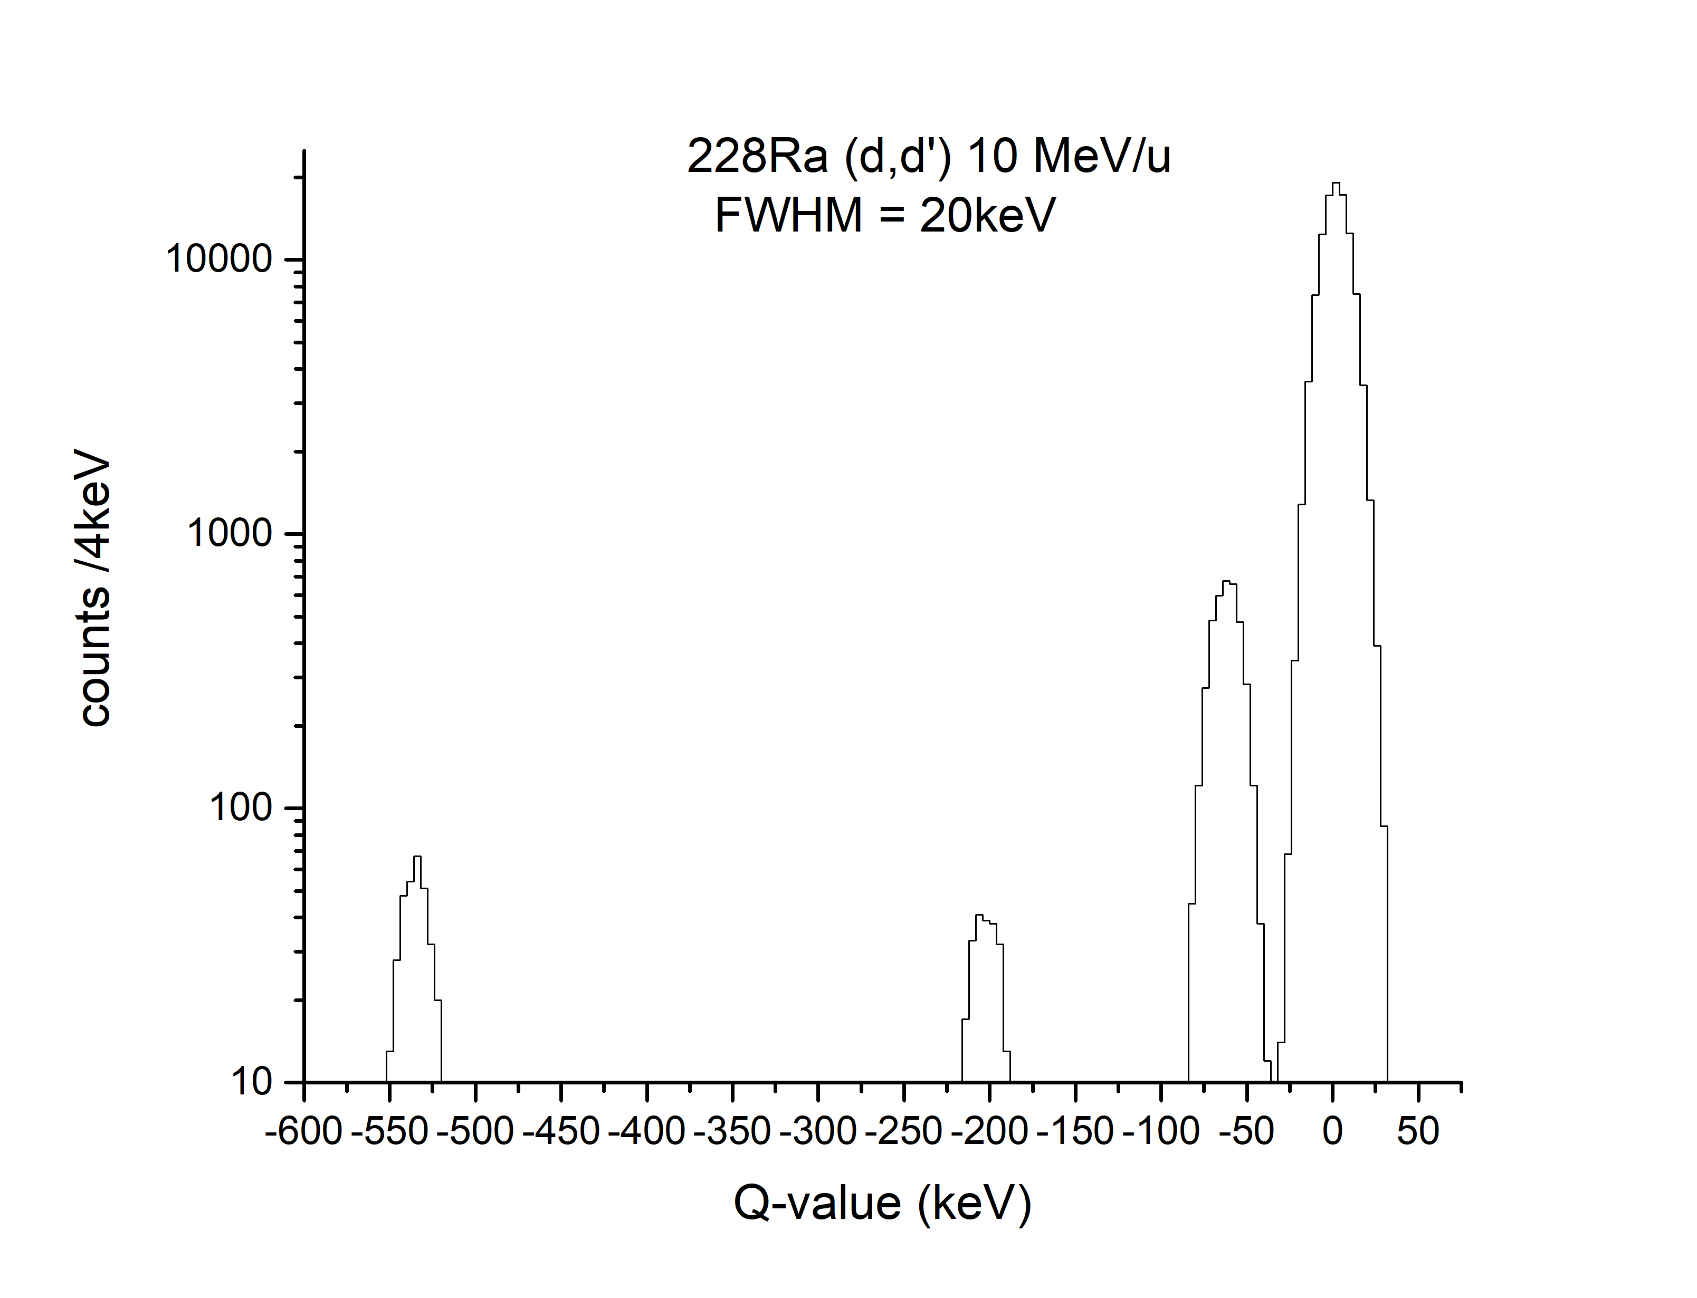
Even-even radium MB v ISS
ISS simulated
0⁺
²²⁸Ra HIE-ISOLDE + Miniball 2018
actual data
2⁺
3⁻
4⁺
0⁺
also measured ^{222,224,226}Rn and ²²²Ra
2⁺
3⁻
4⁺
NB in ²²²Ra 4⁺ and 3⁻ states cannot be resolved

Slide 9
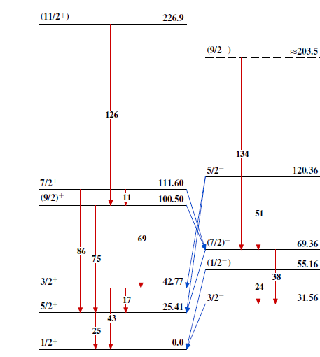
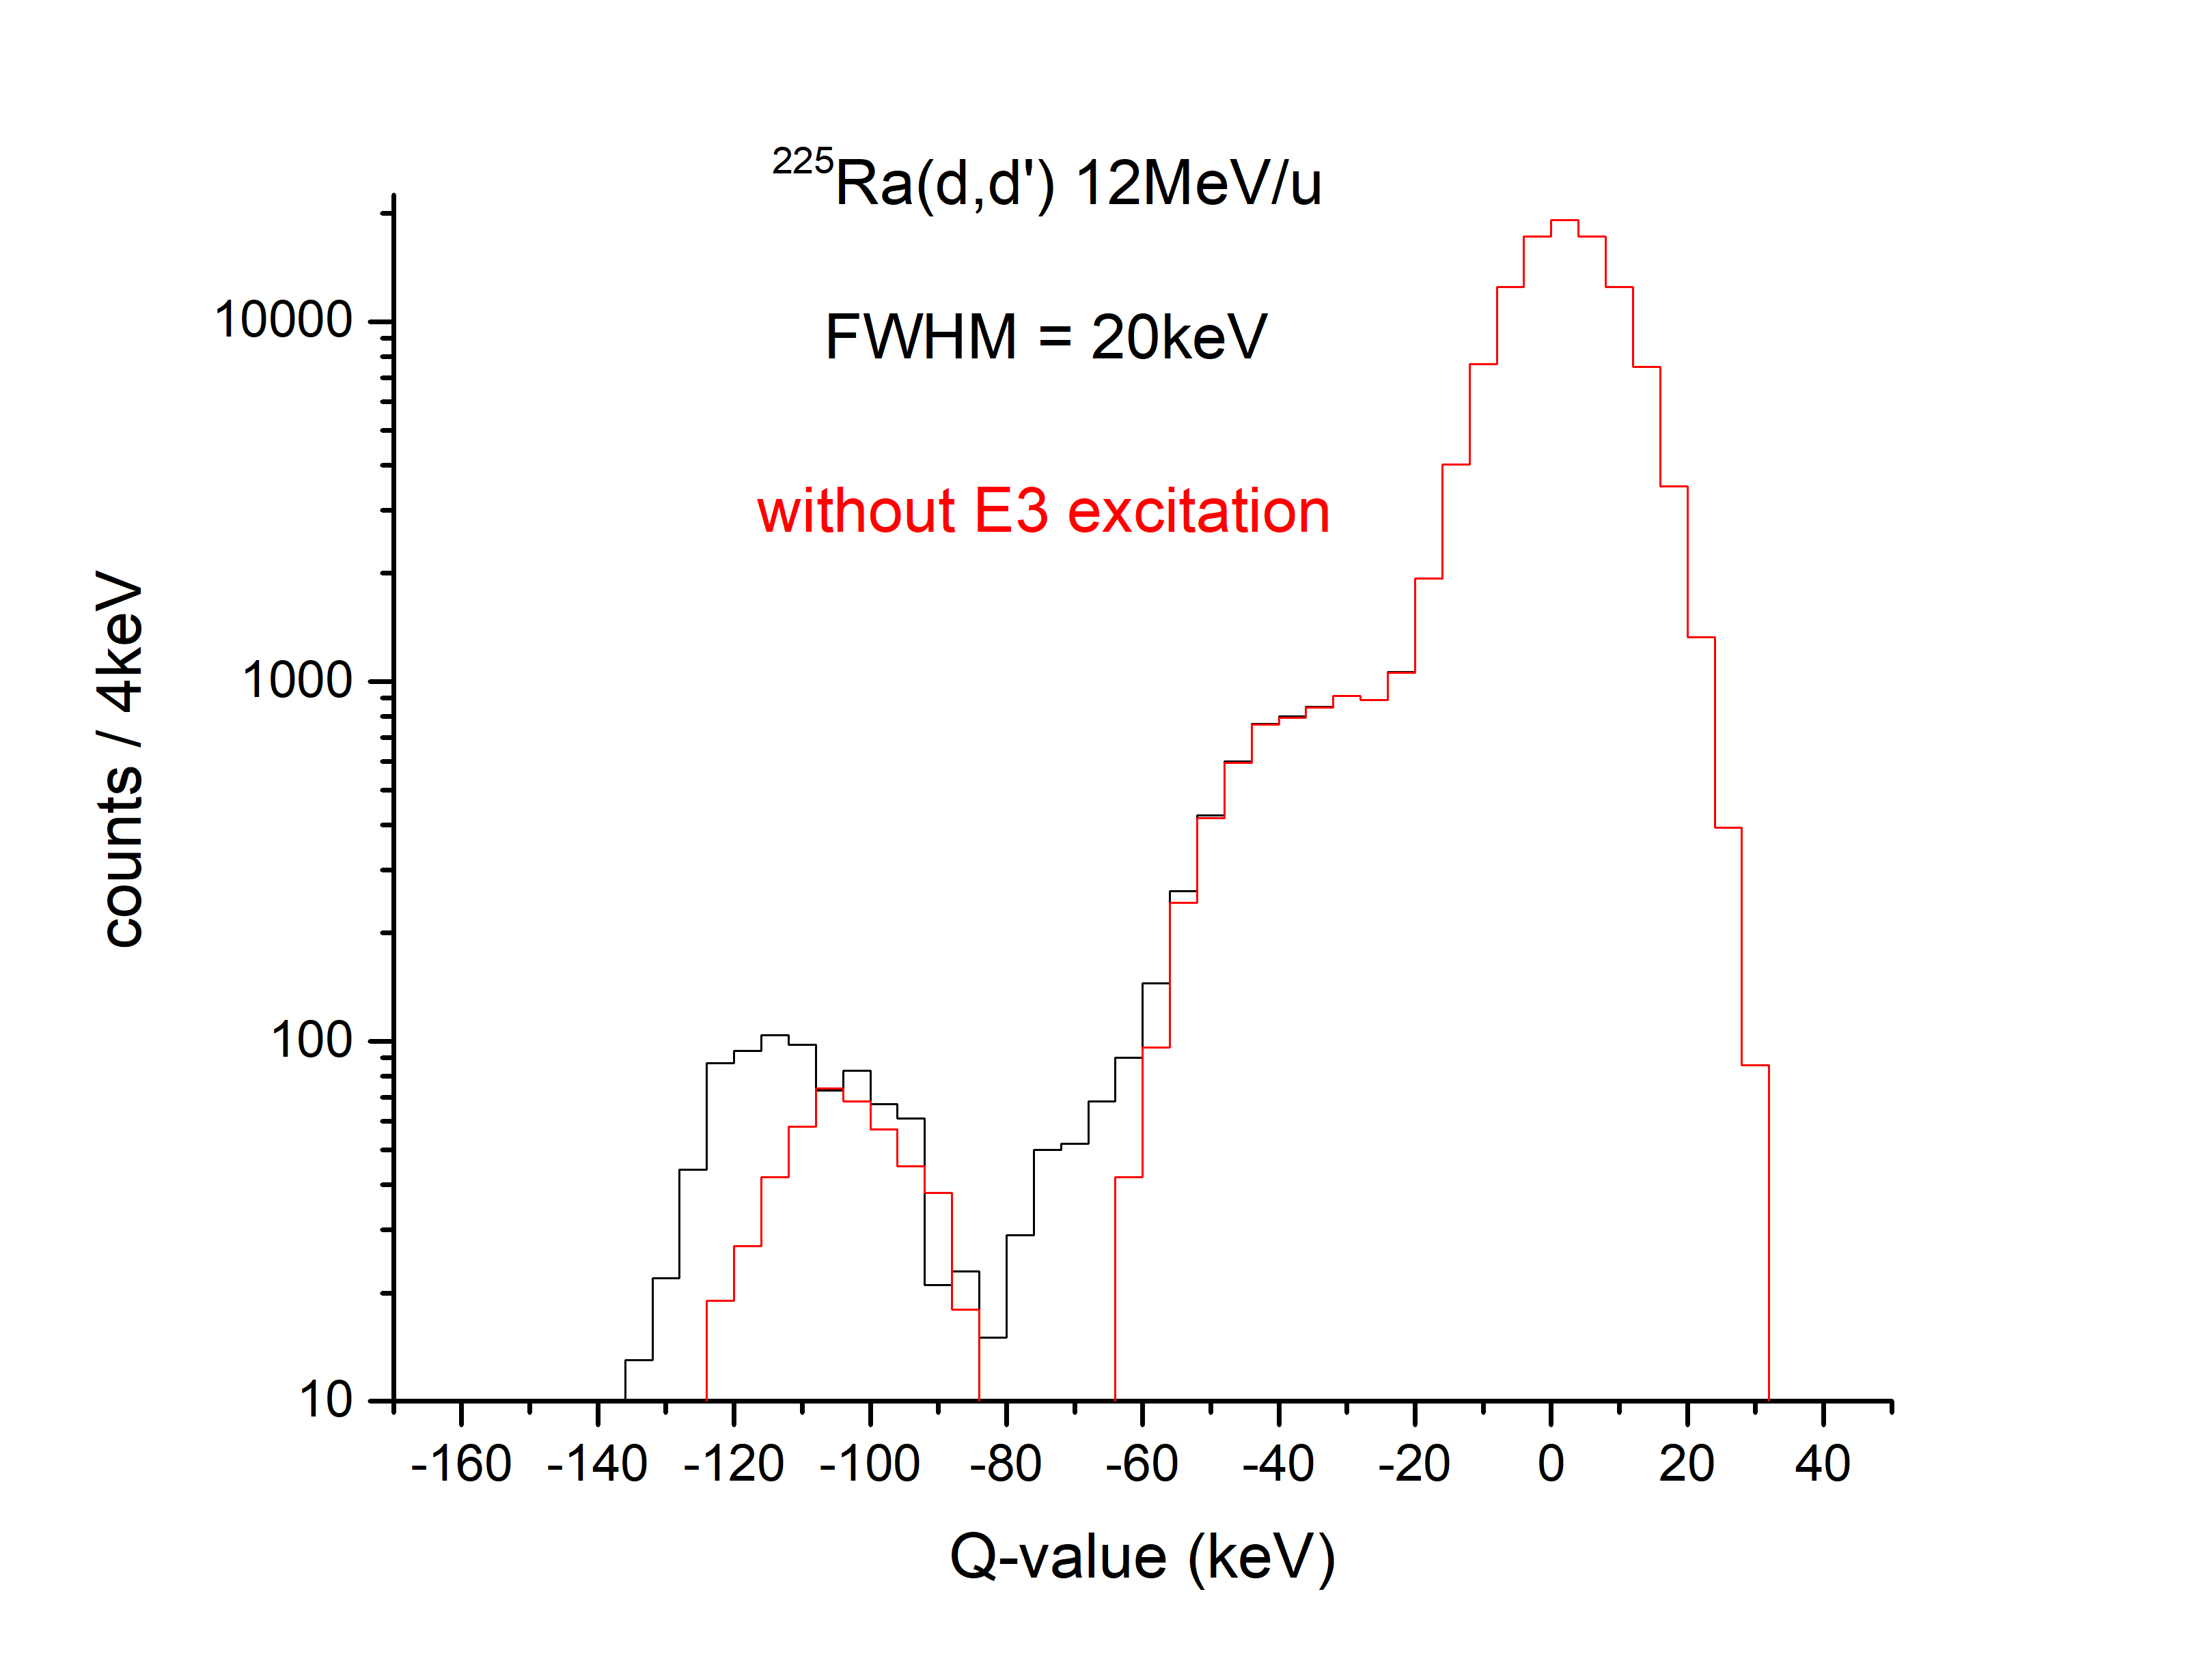
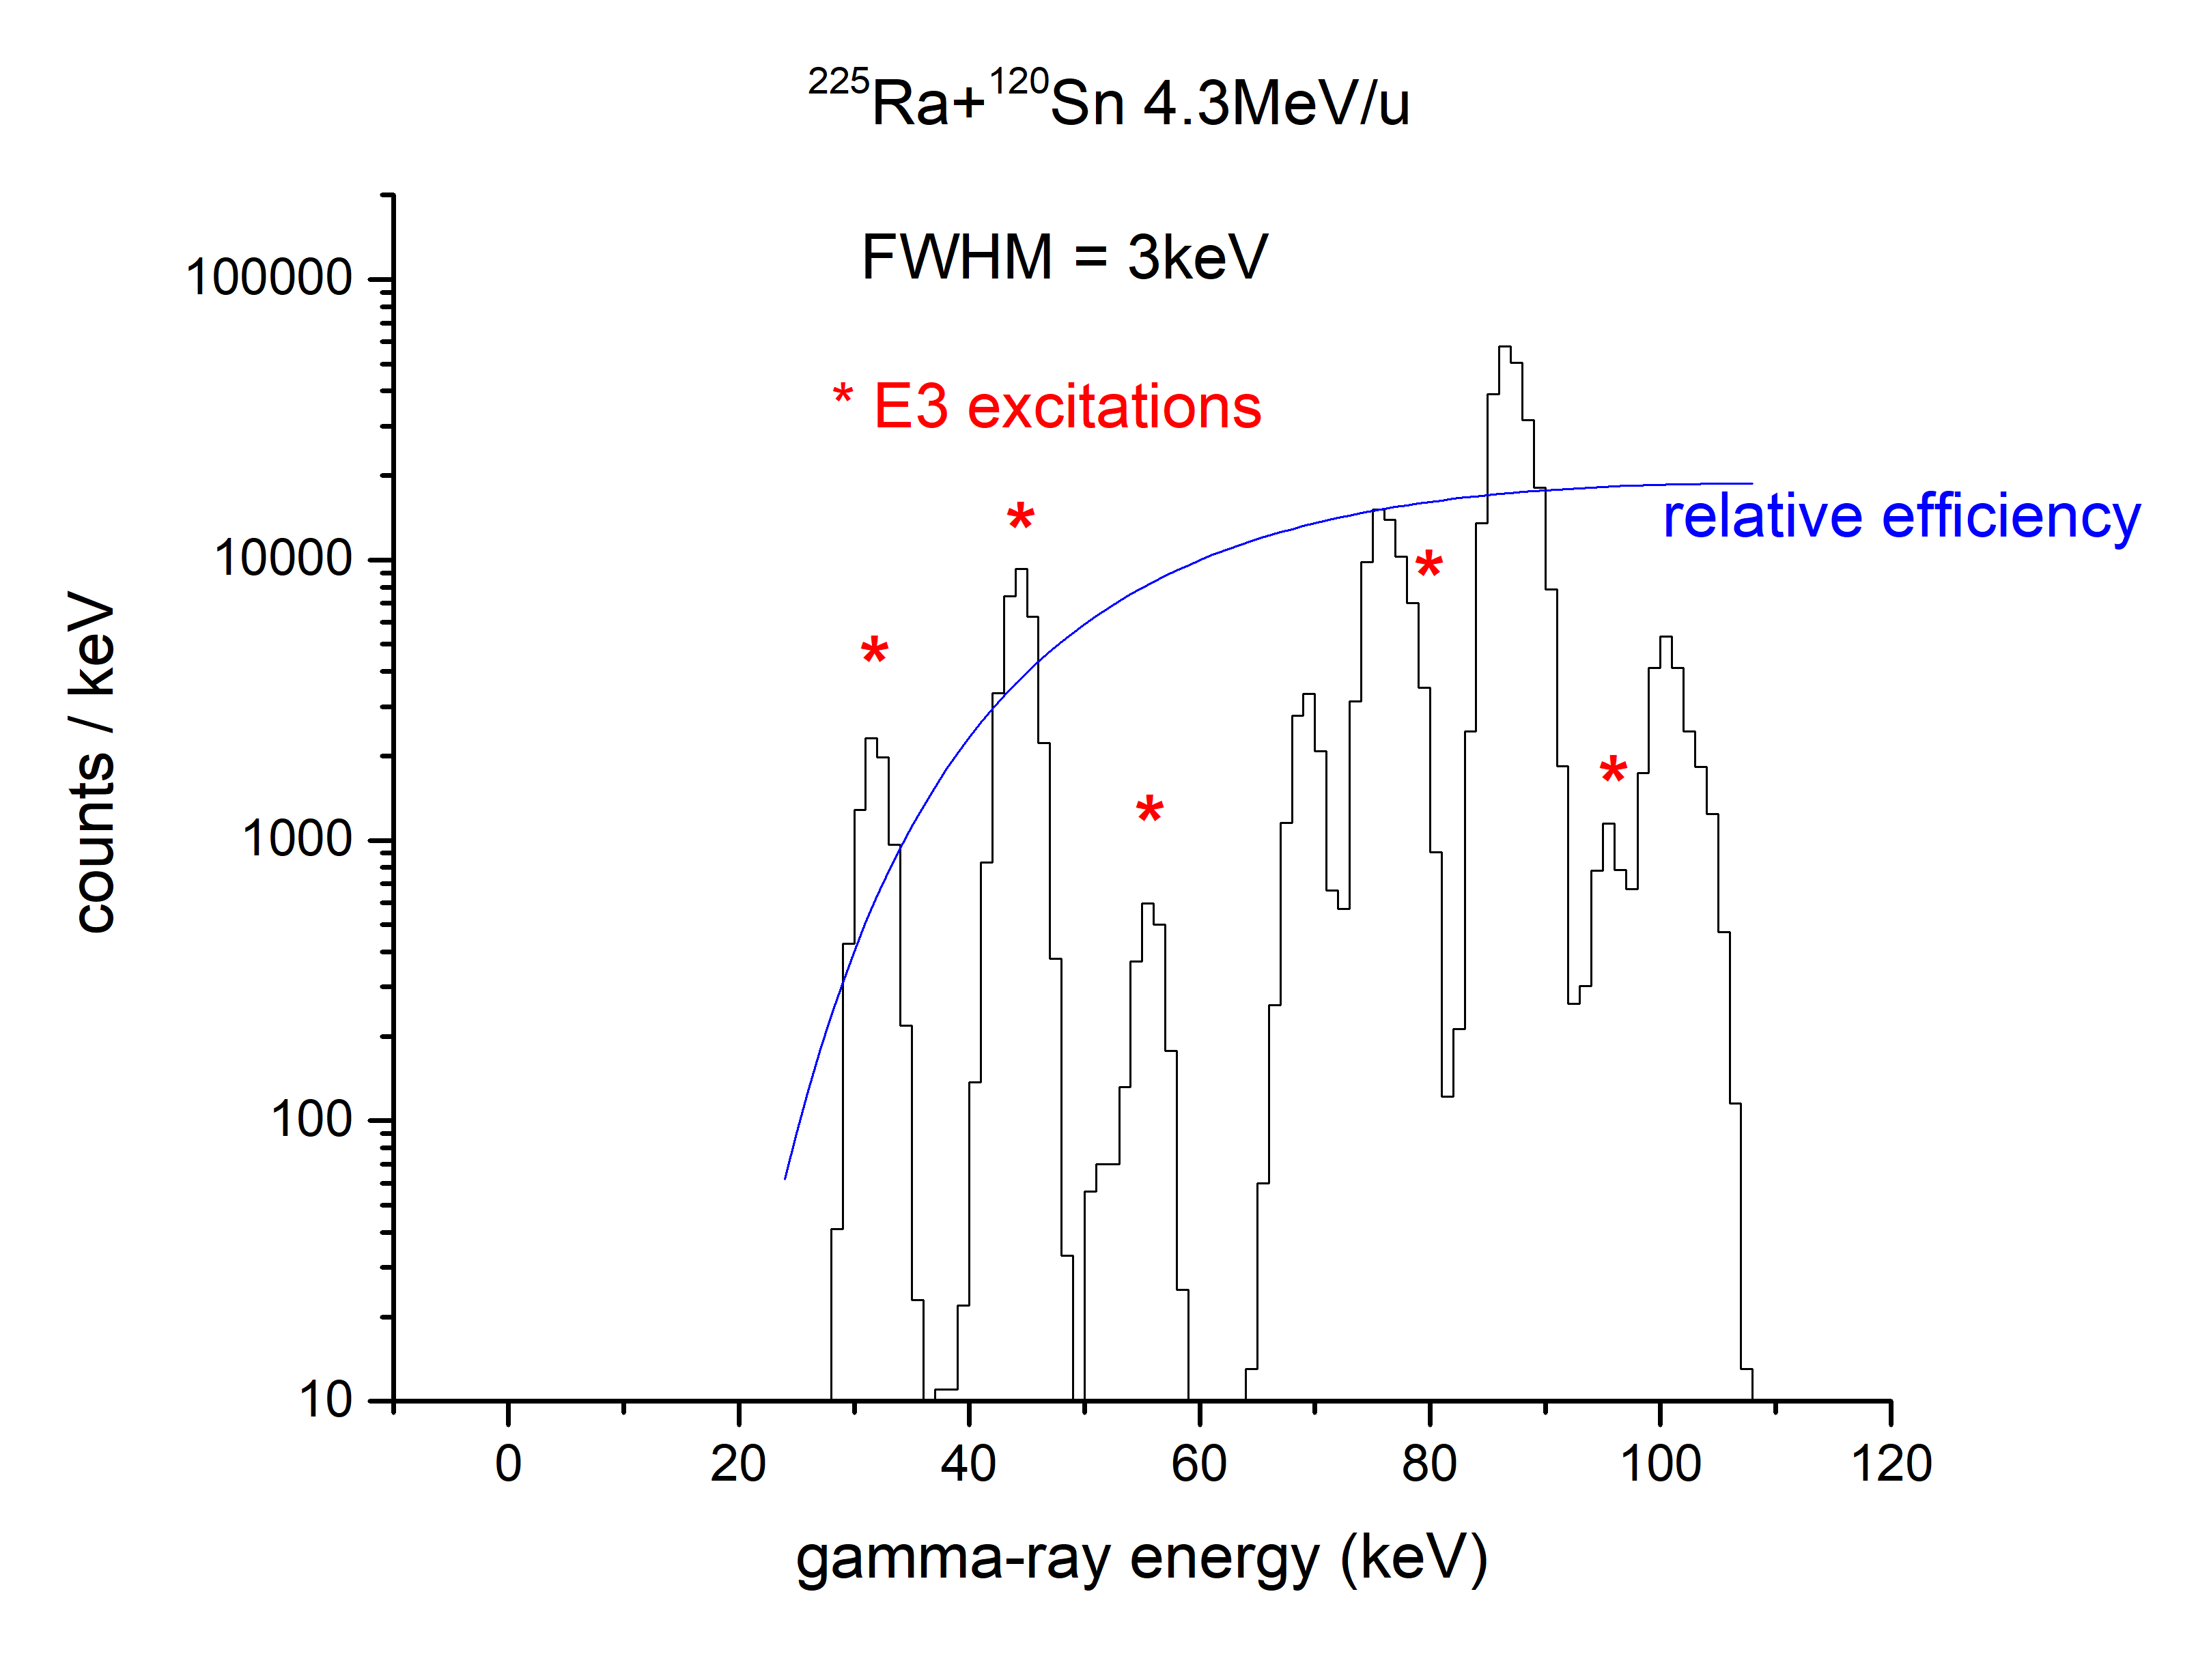
²²⁵Ra Miniball v ISS
Miniball simulated
ISS simulated
(includes X-rays)

Slide 10
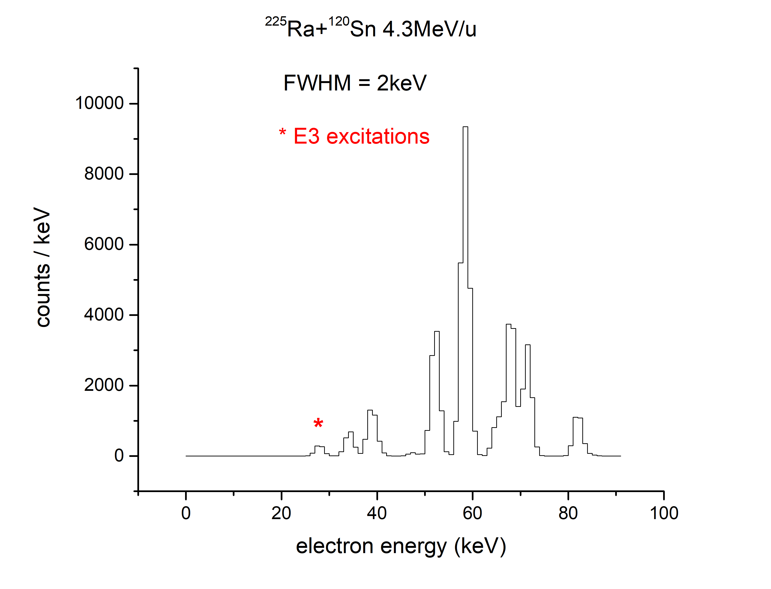
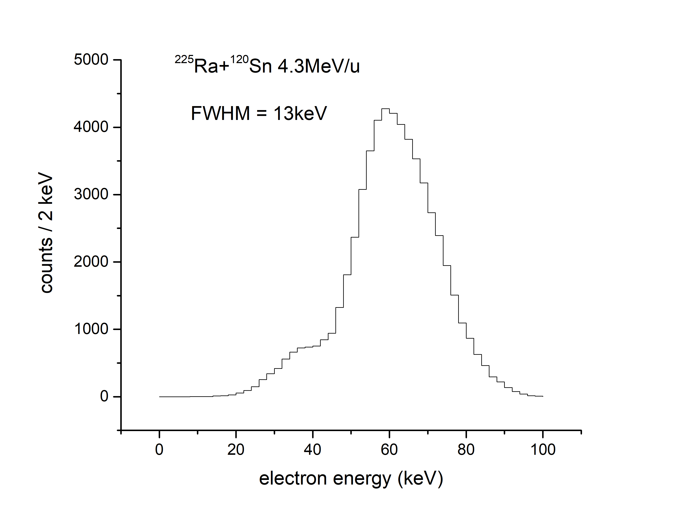
²²⁵Ra SPEDE

Slide 11
Summary
The Jury is out!
However…
ISS issue: timing reference
Heavy ion recoil angle ¹⁴²Ba(d,d’) ~ 0.8 deg
²²⁸Ra(d,d’) ~ 0.5 deg
rms beam divergence + multiple scattering ~ 0.015 deg (collimated)
~ 0.15 deg (direct beam)
Miniball issue: GOSIA analysis
THANKS: Ben – very useful discussions on (d,d’)
Matthew Fraser (CERN) & Alberto - beam manipulation
Liam – help with GOSIA
Philippos & Danny Cox (Lund) – SPEDE response

