Slide 2

Status of the REX/HIE-ISOLDE post-accelerator: before and after CERN’s long shutdown
Jose Alberto Rodriguez, CERN, BE-OP-ISO
on behalf of CERN’s technical teams

Slide 3
Outline:
Introduction
REX/HIE-ISOLDE before LS2
Improvements after LS2
Summary
J.A. Rodriguez – ISOLDE Solenoidal Spectrometer Workshop – 2019/08/27

Slide 4
Introduction:
Major changes in the LHC injector chain during the Long Shutdown LS2 (2019-20). Among many others:
Linac 2 will be replaced by Linac 4
PSB output energy will increase to 2 GeV (unfortunately, the transfer line to ISOLDE will not be upgraded)
J.A. Rodriguez – ISOLDE Solenoidal Spectrometer Workshop – 2019/08/27

Slide 5
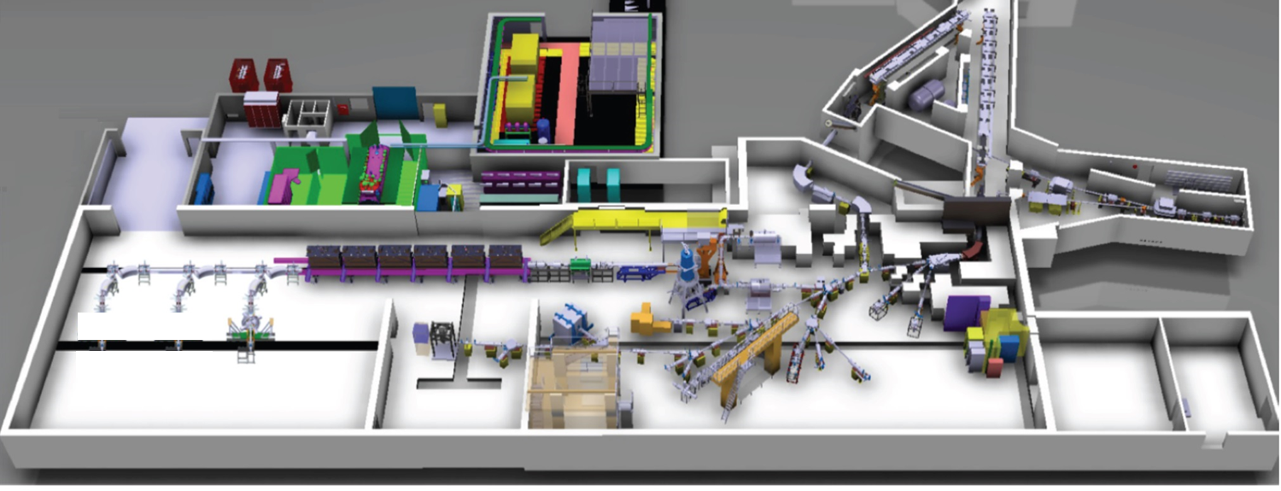
Introduction:
The low energy part of ISOLDE will also profit from the LS2 to upgrade many systems. Most notably:
New target front-ends
New tape station
Renovation and upgrade of the beam instrumentation
HRS
RIB
HIE-ISOLDE HEBT lines
BTY line
REX/HIE-ISOLDE post-accelerator
RIB
p beam
GPS
ISOLDE low energy lines
High energy experimental stations:
Miniball
ISS
Scattering Chamber
Low energy experimental stations:
IDS
ISOLTRAP
CRIS
COLLAPS
SSP stations
VITO
NICOLE
WISARD
J.A. Rodriguez – ISOLDE Solenoidal Spectrometer Workshop – 2019/08/27

Slide 6
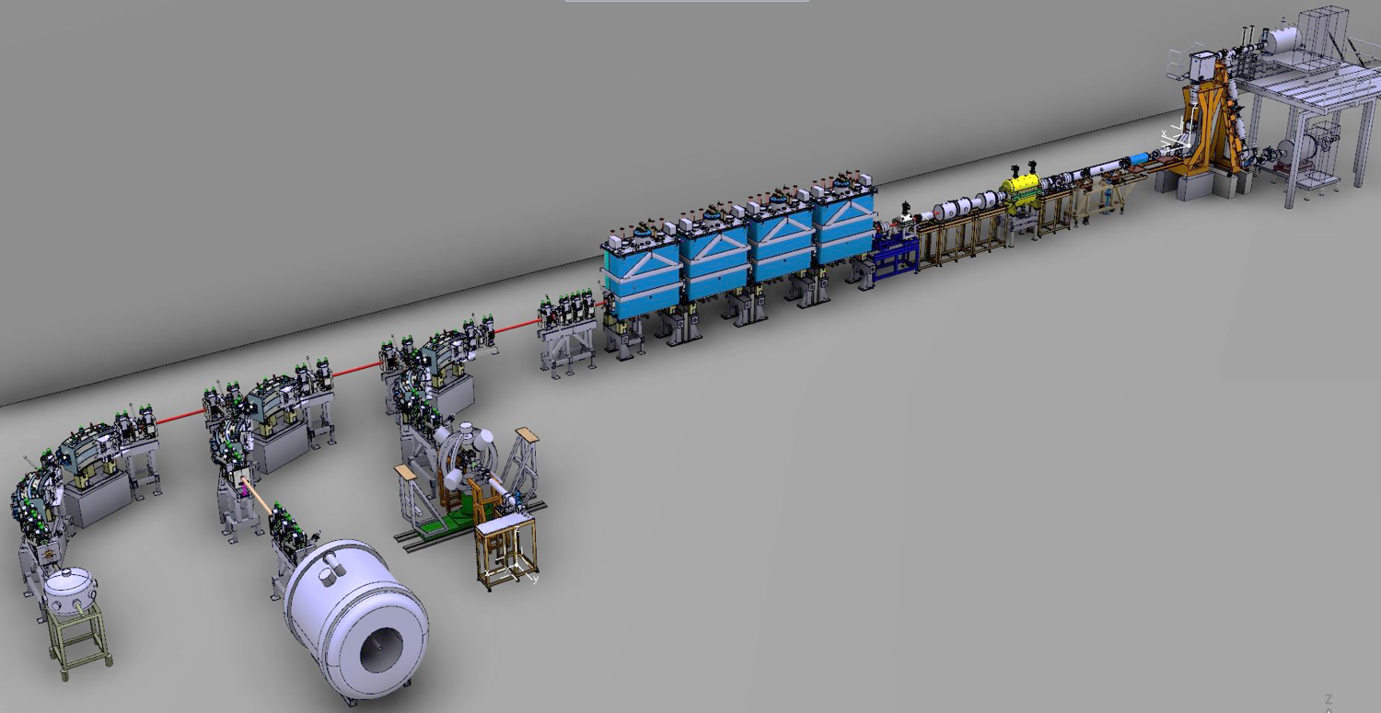
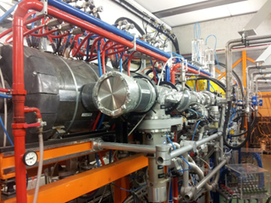
Introduction:
The REX normal conducting linac:
Beam from the charge breeder with 5 keV/u energy is accelerated to 2.8 MeV/u
Charge state acceptance: 2.5 < A/q < 4.5
Cavities: Seven RF structures: f = 101.28 MHz (except for 9gap at 202.56 MHz) up to 10% duty cycle
Focusing: 6 triplets, 1 doublet Steering: 1 pair of horizontal/vertical steerers
Beam instrumentation: 1 diagnostics box (FC, attenuators and collimators)
REX-EBIS
RF structure | E_{f} [MeV/u] | β_{f} [%] | P [kW] for A/q=4.0 | A/q acceptance
RFQ | 0.3 | 2.5 | 29 | < 5.5
Buncher | 0.3 | 2.5 | 1.3 | > 2.5
IHS | 1.2 | 5.1 | 40 | < 4.5
7gap1 | 1.55 | 5.7 | 60 | > 2.5
7gap2 | 1.88 | 6.3 | 60 | > 2.5
7gap3 | 2.2 | 6.8 | 60 | > 2.5
9gap | 2.85 | 7.8 | 71 | > 2.5
REX linac
REX separator
REX-TRAP
J.A. Rodriguez – ISOLDE Solenoidal Spectrometer Workshop – 2019/08/27

Slide 7
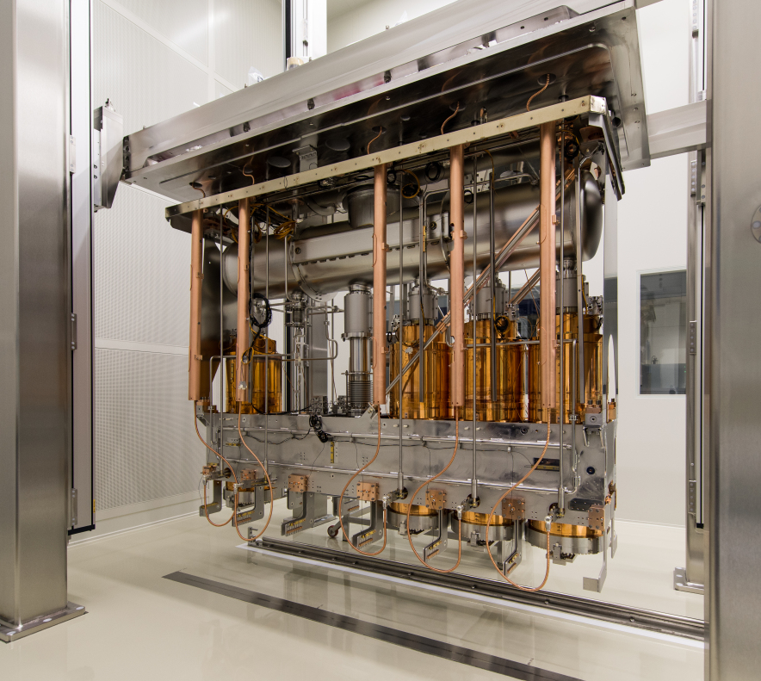
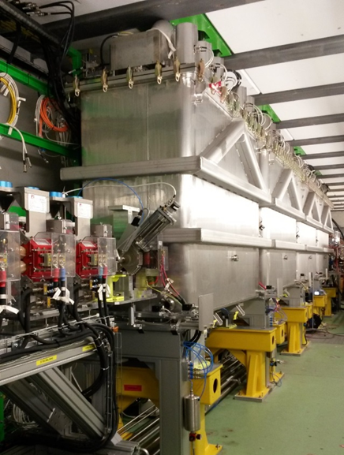
Introduction:
The HIE-ISOLDE superconducting linac:
Cavities: Quarter Wave Resonators (QWR) made of a copper substrate with niobium sputtered
Cryomodule: five QWR and one SC solenoid, common insulation and beam vacuum, top plate mounted
Nominal energy: 9.2 MeV/u for A/q = 4.5, 14.2 MeV/u for A/q = 2.5
Diagnostics: Scanning slits, collimators and FCs
Focusing: SC solenoids, quadrupoles Steering: Vertical/horizontal very few meters
Project staged (one cryomodule / year since 2015). Project completed in 2018
REX-EBIS
REX linac
HIE-ISOLDE linac
REX separator
REX-TRAP
2016
2015
2017
2018
f [MHz] | 101.28
Geometrical beta (β_{g}) | 10.3
E_{acc} [MV/m] | 6
Quality factor (Q_{o}) at E_{acc} | 5∙10⁸
Active length [m] | 0.3
Beam aperture diameter [cm] | 2
Max. Transit Time Factor (TTF) | 0.9
E_{peak} / E_{acc} | 5.6
J.A. Rodriguez – ISOLDE Solenoidal Spectrometer Workshop – 2019/08/27

Slide 8
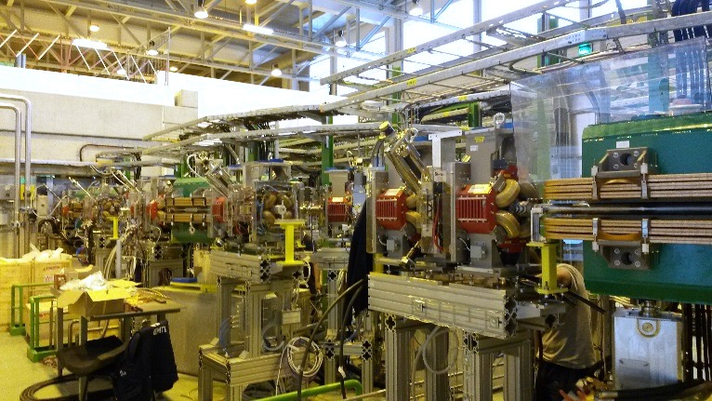
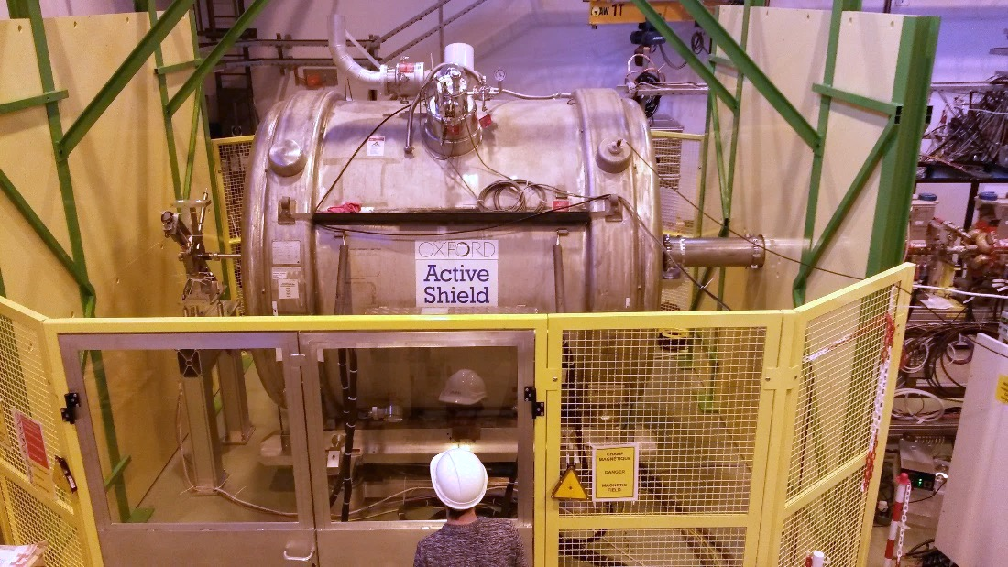
Introduction:
The HIE-ISOLDE High Energy Beam Transfer (HEBT) lines :
Three lines (XT01 – Miniball, XT02 – ISS and XT03 – Scattering Chamber / Travelling experiments)
Focusing: quadrupoles Steering: Vertical/horizontal very few meters
Beam instrumentation: Scanning slits, collimators, FCs and silicon detectors (3 units)
Stripping foils to clean contaminants (specially useful for light beams)
REX-EBIS
REX linac
HIE-ISOLDE linac
REX separator
REX-TRAP
2016
2015
HEBT lines
2017
2018
Miniball
SEC
ISS
J.A. Rodriguez – ISOLDE Solenoidal Spectrometer Workshop – 2019/08/27

Slide 9
Outline:
Introduction
REX/HIE-ISOLDE before LS2
Improvements after LS2
Summary
J.A. Rodriguez – ISOLDE Solenoidal Spectrometer Workshop – 2019/08/27

Slide 10
REX/HIE-ISOLDE before LS2:
Highlights 2018 Physics campaign (Jul. 11th – Nov. 21st):
Started after CM4 was installed and commissioned
Thirteen experiments conducted:
  First beams to the ISS (²⁸Mg and ²⁰⁶Hg)
  Light isotopes (⁷Be, ⁸B, ⁹Li…)
  Heavy isotopes (²²⁸Ra, ²²⁶Rn, ²⁰⁶Hg…)
  Slow extraction used during most of the experiments
  Stripping foils to clean contaminants (⁹Li, ^{7,11}Be , ⁸B)
  Molecular beams (⁸B¹⁹F₂, ¹³⁴Sn³⁴S) ← Not very sucessful
  Pre-irradiated target (⁷Be)
Multiple stable beams to the three experimental stations
Around 1320 hrs of RIBs and 370 hrs of stable beams
Experiment number | Isotope(s) | Energy [MeV/u] | Experimental station | Time [hours]
IS644 | ⁹⁶Kr | 4.7, 5.3 | Miniball | 178.2
IS506 | ²¹²Rn | 3.8, 4.4 | Miniball | 49.0
IS552 | ^{222, 228}Ra, ^{222, 224, 226}Rn | 4.3, 4.2, 5.1 | Miniball | 31.3, 82.9
IS553 | ¹⁴²Ba | 4.2 | Miniball | 38.5
IS562 | ¹⁰⁶Sn | 4.4 | Miniball | 91.4
IS616 | ⁸B | 4.9 | SEC | 97.2
IS655 | ¹¹Be | 7.5 | OTPC | 117.5
IS654 | ^{134, 132}Sn | 7.4, 7.2 | Miniball | 67.5
IS651 | ²⁸Mg | 9.5 | Miniball | 116.0
IS621 | ²⁸Mg | 9.5 | ISS | 116.8
IS631 | ²⁰⁶Hg | 7.4 | ISS | 98.0
IS561 | ⁹Li | 8.0 | SEC | 103.0
IS554 | ⁷Be | 5.0 | SEC | 135.0
 |  |  | Total | 1322.3
REX
REX/HIE-ISOLDE
Beam(s) | Energy [MeV/u] | Experimental station | Time [hours]
²²Ne⁷⁺ | 6.2, 4.6, 9.5 | Miniball | 110.5
²²Ne⁷⁺ | 9.5 | ISS | 126.8
¹²⁹Xe³¹⁺ | 4.8 | Miniball | 4.0
¹²C⁴⁺ | 2.8, 4.9, 8.0 | SEC | 89.8
¹³²Xe³¹⁺ | 7.2 | Miniball | 21.0
¹³⁰Xe²⁹⁺ | 7.4 | ISS | 14.5
¹⁸¹Ta⁴²⁺ | 7.4 | Miniball | 2.0
 |  | Total | 368.6
Number of High Energy Experiments at ISOLDE
J.A. Rodriguez – ISOLDE Solenoidal Spectrometer Workshop – 2019/08/27

Slide 11
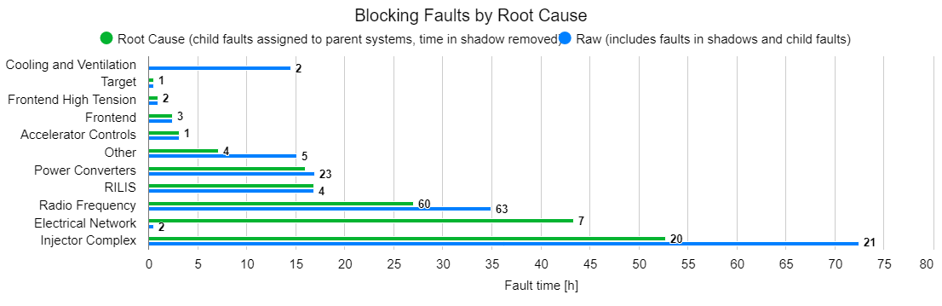
REX/HIE-ISOLDE before LS2:
Availability of the ISOLDE facility by week number
Low energy Physics
Installation & commissioning CM4
Initial block of high energy Physics
Parallel low and high energy Physics
Alternating low and high energy Physics
Wk. 30: CERN wide power cut
Wk. 38, 32: Problems in Linac2
Wk. 33: SRF controls / Timing problem with request
J.A. Rodriguez – ISOLDE Solenoidal Spectrometer Workshop – 2019/08/27

Slide 12
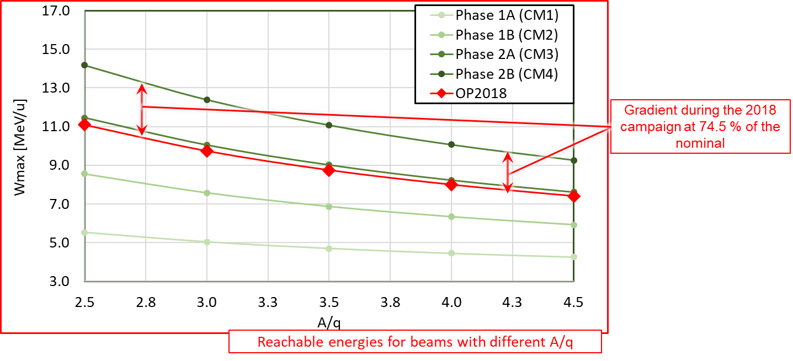
REX/HIE-ISOLDE before LS2:
Main issues/worries:
SRF cavities operating at 74.5 % of nominal gradient
  Three of the 13 experiments conducted last year would have benefited from higher energies
Not understood beam losses (15-20 %)
  Linac transmission better during the REX years. Not explained by beam dynamics simulations
REX-EBIS electron gun cathode degradation faster than anticipated
  No impact on the Physics in 2018. However, it had to be replaced once during the campaign and the second one also degraded towards the end of the year
Trips of SRF cavities after instability of the cryo system
  Main source of downtime in the post-accelerator. Additional set-up time required to re-phase the linac
J.A. Rodriguez – ISOLDE Solenoidal Spectrometer Workshop – 2019/08/27

Slide 13
Outline:
Introduction
REX/HIE-ISOLDE before LS2
Improvements after LS2
Summary
J.A. Rodriguez – ISOLDE Solenoidal Spectrometer Workshop – 2019/08/27

Slide 14
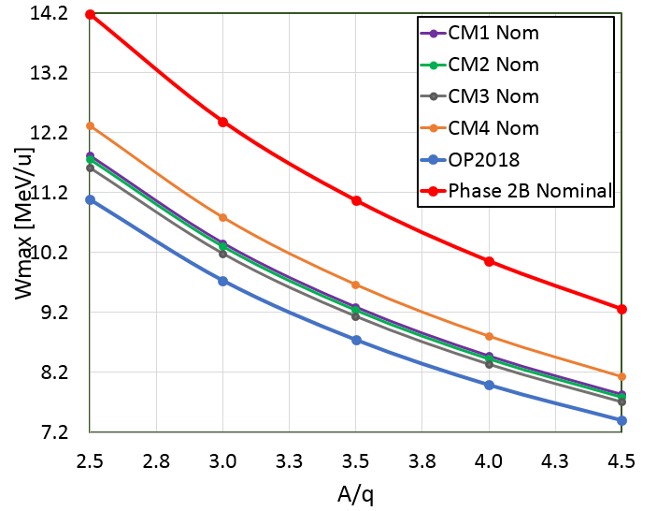
Improvements after LS2: Repair of CM4
SRF cavities operating at 74.5 % of nominal gradient
  CM4 uninstalled and sent back to SM18
  Cavity SRF18 repair
  Replacement of the two worse performing cavities
  by the best two spares
  Testing in bunker of SM18
  Transport back to ISOLDE and installation
→ Done
→ Done
Decided not to exchange
(Niobium residue found on water)
→ Preparation of the bunker infrastructure on-going
→ Scheduled for Jan. 2020
Operational gradient for each SRF cavity during the 2018 campaign [MV/m]
 | CM1 | CM2 | CM3 | CM4
CAV. 1 | 5.0 | 4.0 | 5.5 | 4.2
CAV. 2 | 5.0 | 4.5 | 5.5 | 4.2
CAV. 3 | 5.0 | 5.5 | 5.5 | 0.0
CAV. 4 | 5.0 | 4.0 | 5.5 | 4.5
CAV. 5 | 2.0 | 5.0 | 5.5 | 4.0
Average | 4.4 | 4.6 | 5.5 | 3.4
After LS2 (with SRF18 and the rest of the couplers in CM4 repaired and with additional conditioning of some of the other cavities), we hope we will be able to reach ~ 7.8 MeV/u for beams with A/q = 4.5 or ~10.4 MeV/u for A/q = 3.0 (~ 80 % nominal gradient)
J.A. Rodriguez – ISOLDE Solenoidal Spectrometer Workshop – 2019/08/27

Slide 15
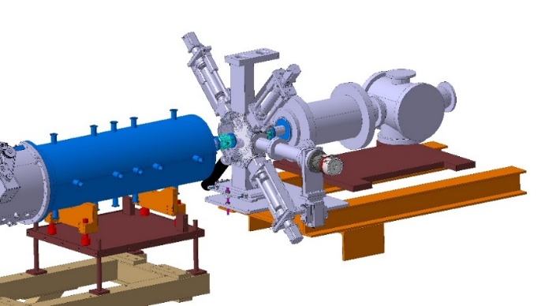
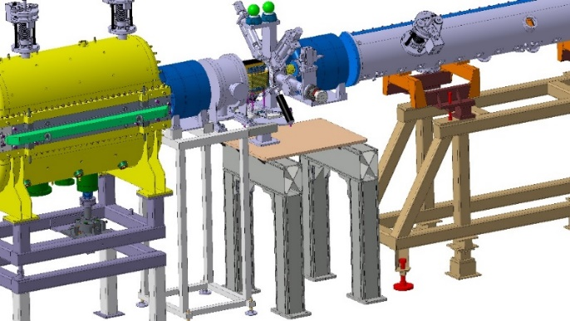
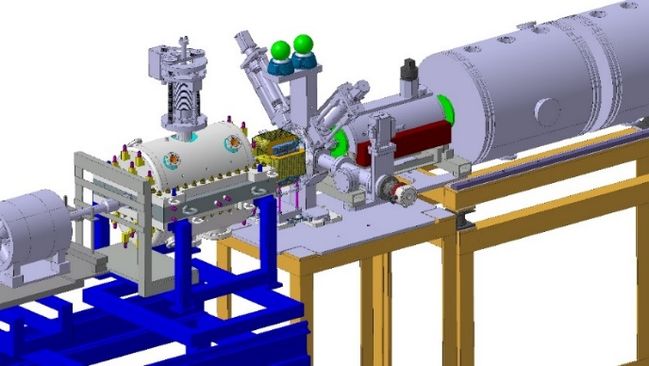
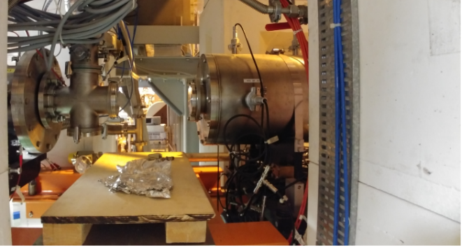
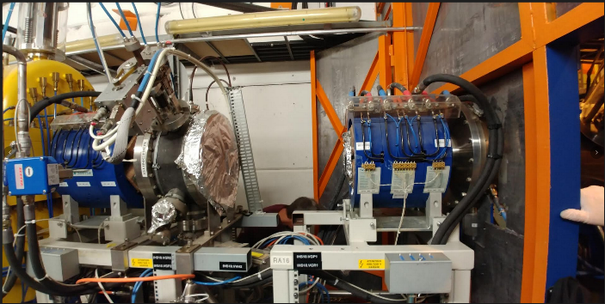
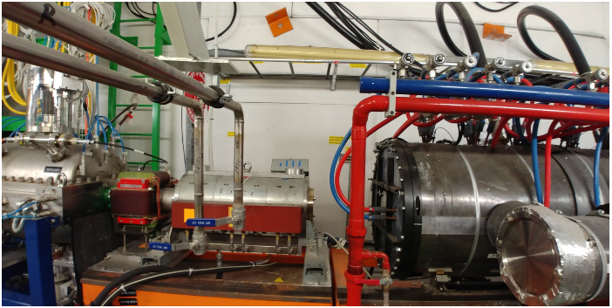
Improvements after LS2: Additional diagnostics
Not understood beam losses (15-20 %)
  Aperture check between REX separator and CM1
  Additional diagnostics and steerers in the REX linac
  Additional (automatic) machine checkout tests
  Additional beam commissioning time 2020 requested
  Automatic beam optimizer
→ Done
→ Scheduled for the beginning of 2020
→ Prototype software under development
→ Waiting for formal approval by LS2 committee
→ Software ready
J.A. Rodriguez – ISOLDE Solenoidal Spectrometer Workshop – 2019/08/27

Slide 16
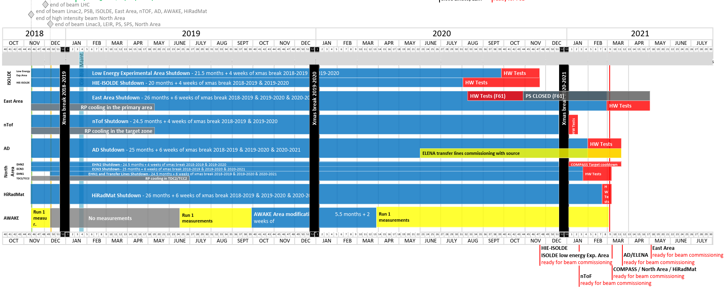
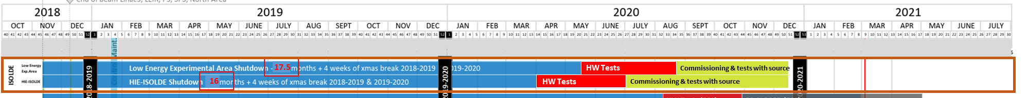
Improvements after LS2: Additional diagnostics
Not understood beam losses (15-20 %)
  Aperture check between REX separator and CM1
  Additional diagnostics and steerers in the REX linac
  Additional (automatic) machine checkout tests
  Additional beam commissioning time 2020 requested
  Automatic beam optimizer
→ Done
→ Scheduled for the beginning of 2020
→ Prototype software under development
→ Waiting for formal approval by LS2 committee
→ Software ready
Request for schedule change made to the LS2 committee
J.A. Rodriguez – ISOLDE Solenoidal Spectrometer Workshop – 2019/08/27

Slide 17
Improvements after LS2: REX-EBIS electron gun
REX-EBIS electron gun cathode degradation faster than anticipated
  Three approaches being pursued in parallel to address this problem:
  Understanding and solving or mitigating the problem with the present cathode
    Less risky option since there would be no major design changes
    Spare cathodes available. Cathode replacement could potentially be scheduled
    Discussions with the manufacturer on-going
  New immersed gun solution
    New cathode provider identified
    Electron beam gun simulations on-going
    Technical design will follow and it take 2-3 months
    Manufacturing of the pieces will need to be outsourced (CERN main workshop busy with LS2) and will take several months
  New MEDeGUN Brillouin gun solution
    Currently being tested at the TwinEBIS
    Working well but very complex design and no long-term performance data available
    (most risky option)
    Current design will need to be adapted for REX-EBIS
    Discussions with the manufacturer on-going
J.A. Rodriguez – ISOLDE Solenoidal Spectrometer Workshop – 2019/08/27

Slide 18
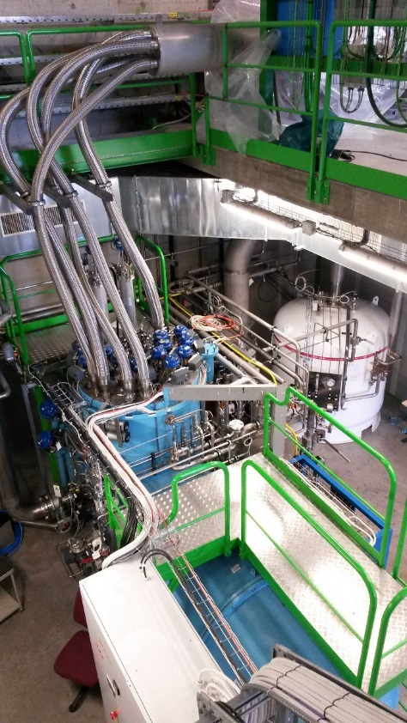
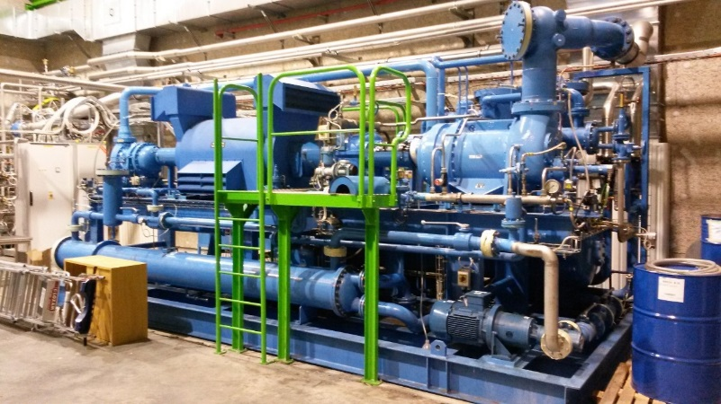
Improvements after LS2: Cryo system and SRF cavities
Trips of SRF cavities after instability of the cryo system
  Maintenance of the cryo-plant on-going
  Setup of automatic controls for transient modes on-going
  Additional time for restart and recommissioning of cryo available
  (cost of early restart ~ 15 kCHF/month)
  Additional time for recommissioning of SRF systems available
→ Will be completed by Dec. 2019
→ Will be completed by Dec. 2019
Waiting for formal approval by LS2 committee
Waiting for formal approval by LS2 committee
J.A. Rodriguez – ISOLDE Solenoidal Spectrometer Workshop – 2019/08/27

Slide 19
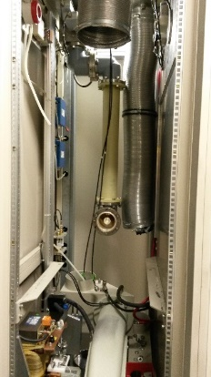
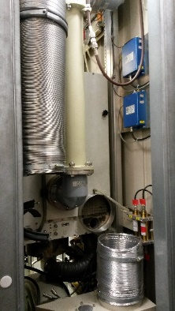
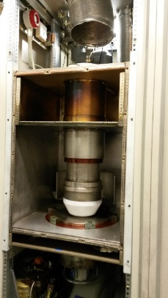
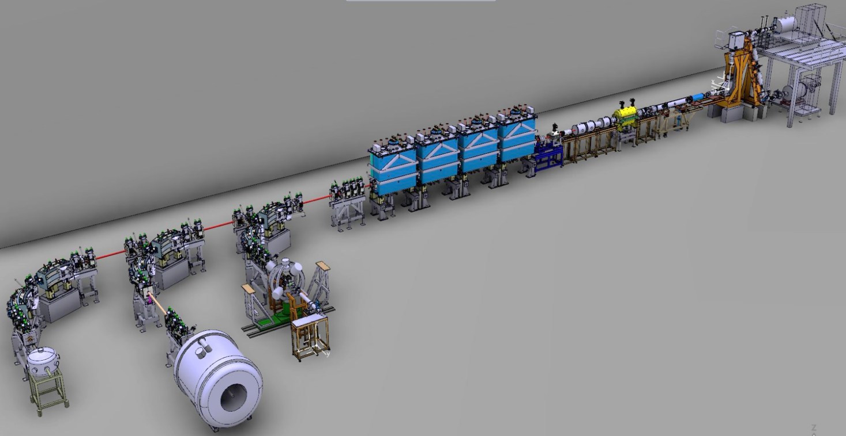
Improvements after LS2: Hardware and beam optics
Major refurbishment of REX RF amplifiers
  Several sources of problems identified and fixed
  Better power and gradient calibrations
  Higher peak powers available (90 kW)
  New cooling for the IH structure
  Potentially more reliable operations and less down time
New silicon detectors will be installed between the two
dipoles in XT02 and XT03
  Beam energy measurements possible in the three HEBT lines
  Reduction in set-up time for beams to ISS and Scattering Chamber
  Energy loss measurements after stripping foils possible
  Redundancy in case one of them fails
After LS2
Before LS2
X-ray monitors for each of the cryomodules
  Better diagnostics on the field emission of the SRF cavities
  Potential gains in cavity gradients
Validation of beam optics models
  Important time investment during the recommissioning in 2020
X-ray detectors after LS2
J.A. Rodriguez – ISOLDE Solenoidal Spectrometer Workshop – 2019/08/27

Slide 20
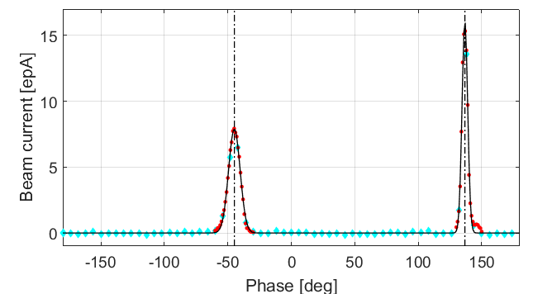
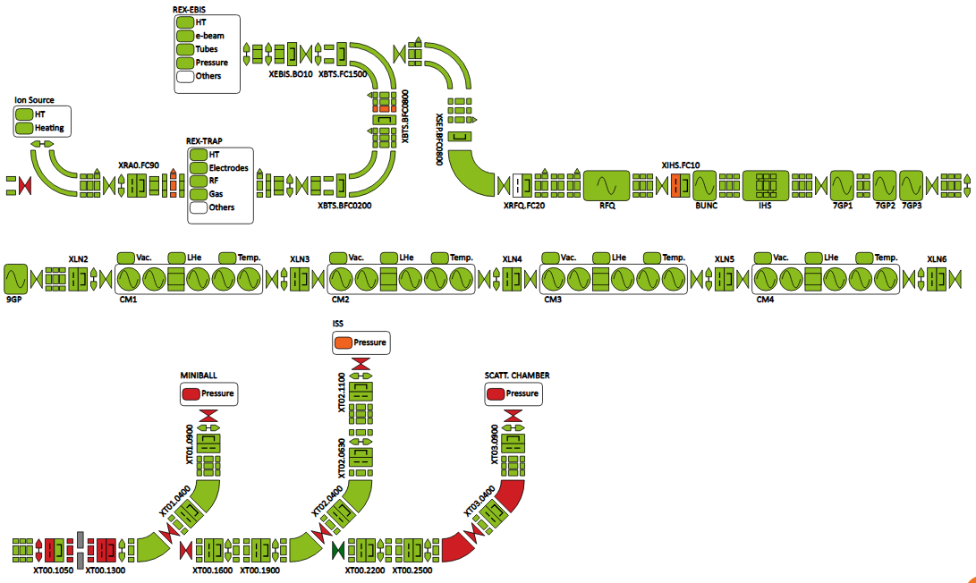
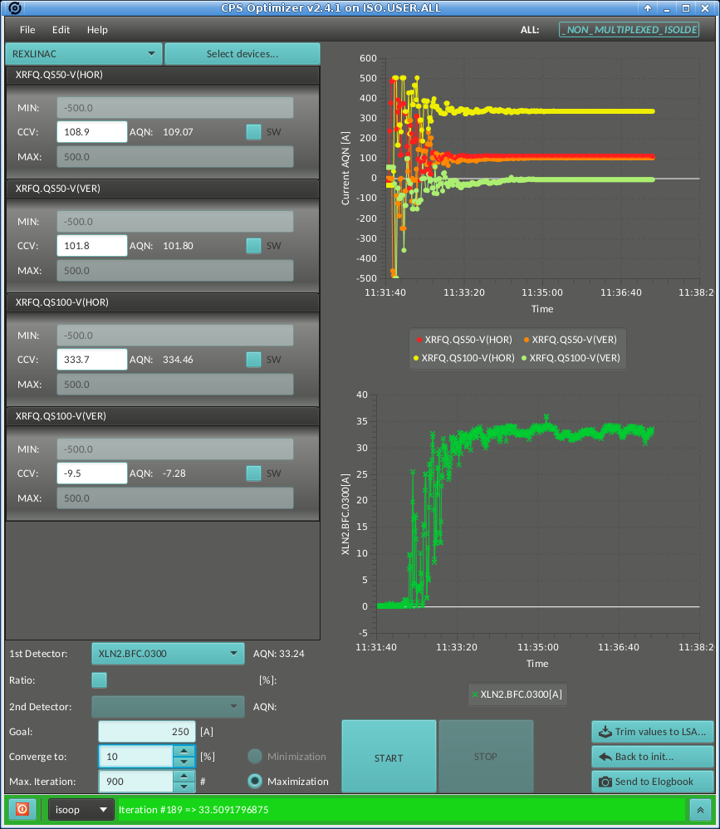
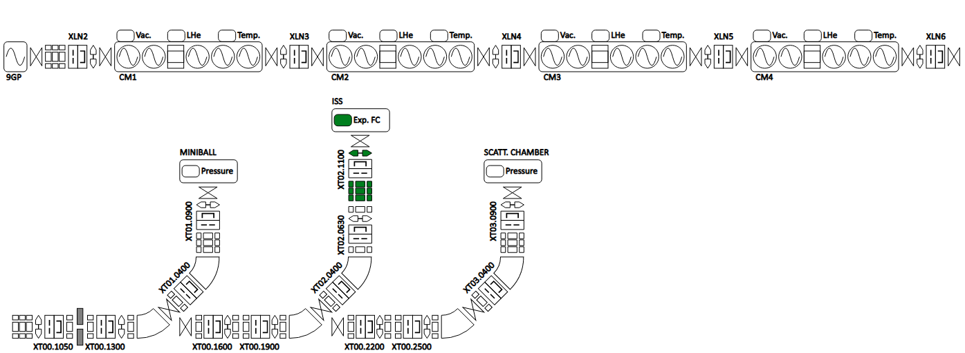
Improvements after LS2: Software and controls
Semi-automatic phasing of SRF cavities
  Additional reference set-ups at the beginning of the Physics campaign
  Less set-up time needed if problems with one SRF cavity appear
New version of the Fast Beam Investigation (FBI)
  Full integration of C2MON and Grafana
  More functionalities and additional views will be available
Beam optimizer to improve the injection into the experimental stations
  Automatic scans of optic elements to maximize beam current at the FCs
New dedicated server to pass information between technical and general networks (not approved yet)
  FBI views of the experimental stations
  Beam optimizer will be able to use the detectors and devices of the experimental stations
J.A. Rodriguez – ISOLDE Solenoidal Spectrometer Workshop – 2019/08/27

Slide 21
Outline:
Introduction
REX/HIE-ISOLDE before LS2
Improvements after LS2
Summary
J.A. Rodriguez – ISOLDE Solenoidal Spectrometer Workshop – 2019/08/27

Slide 22
Summary:
Phase 2B of the HIE-ISOLDE project (the last one funded) completed in 2018
Reasonably successful high energy Physics campaigns in 2016, 2017 and 2018
Main issues during these years:
  Problems with the production of molecular beams
  SRF cavities operating at 75 % of nominal gradient and not always stable
  Not understood beam losses (15-20 %)
  Degradation of the cathode of the electron gun REX-EBIS
Main activities during LS2:
  CM4 has been partially repaired
  Additional time will be allocated for the re-commissioning of the cryoplant and the SRF systems
  Additional beam diagnostic boxes and a steerer will be install in REX
  Additional time will be allocated for the beam commissioning and validation of beam optics models
  REX RF amplifiers have been refurbished
  Additional hardware will be installed and new software will be developed
Hopefully, these investments will result in better quality beams for experiments at ISS
On behalf of all the CERN’s technical teams working at REX/HIE-ISOLDE,
thank you for your support during these years!
J.A. Rodriguez – ISOLDE Solenoidal Spectrometer Workshop – 2019/08/27

