Slide 1
WP1: Status and Plans
Francisco Sanchez Galan (EN-EA-PE)
Liam Dougherty (EN-ACE-INT)
06 June 2019
FASER LS2 work coordination meeting

Slide 2
Work done from 17 May to 6 June
The cable tray in UJ12 was successfully lowered (Great work from Maria and Yann → THANKS!!!)
SAS contract signed (Aymeric)
EN-EL-EIC investigation of HV cable in UJ12 and proposal for the lighting and power arrangement in TI12 (Yann and Cedric). Tbc by EN/HE
Gangway manufactured with HSE modifications, (Liam, Michel, Marco) planned to be installed on the 1st of July
Currently in the process of updating the layout database with the new positions of the FIP boxes, to be completed by September (Liam, Anne-Laure)
EDMS structure created (Claudio)

Slide 3
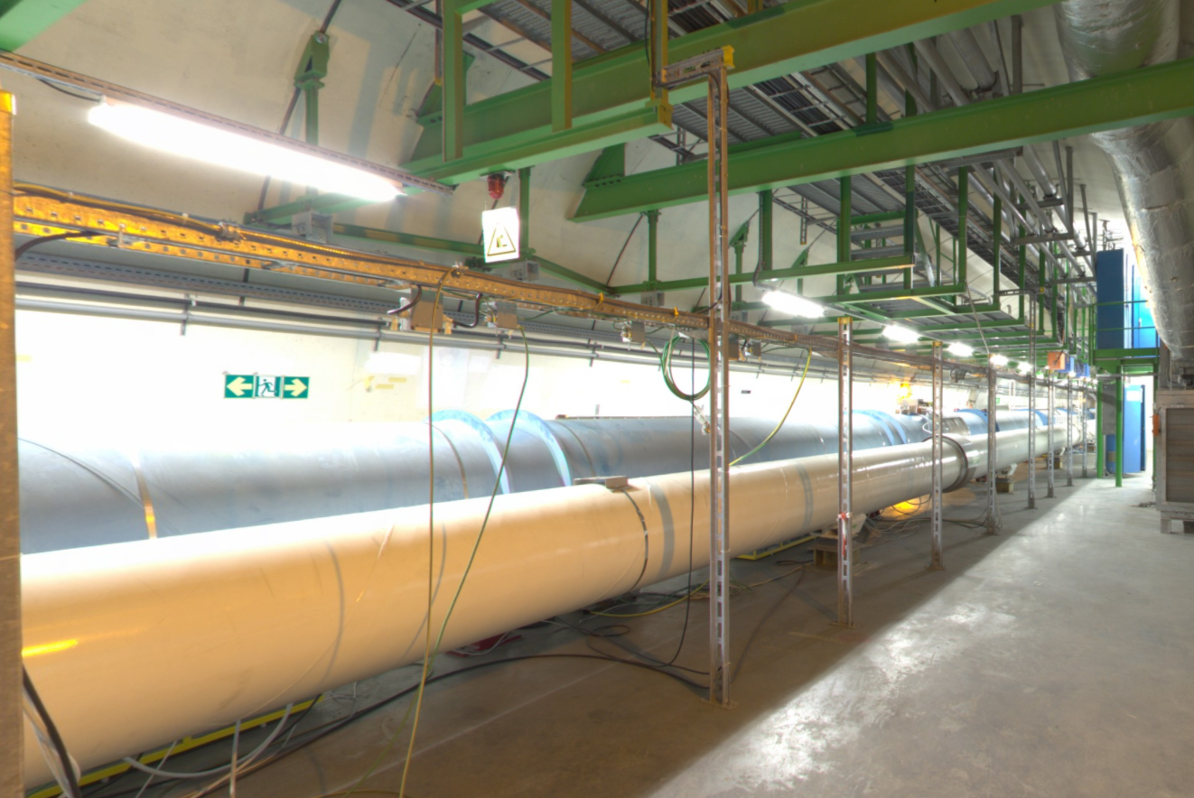
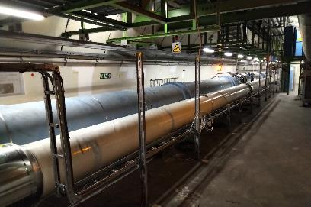
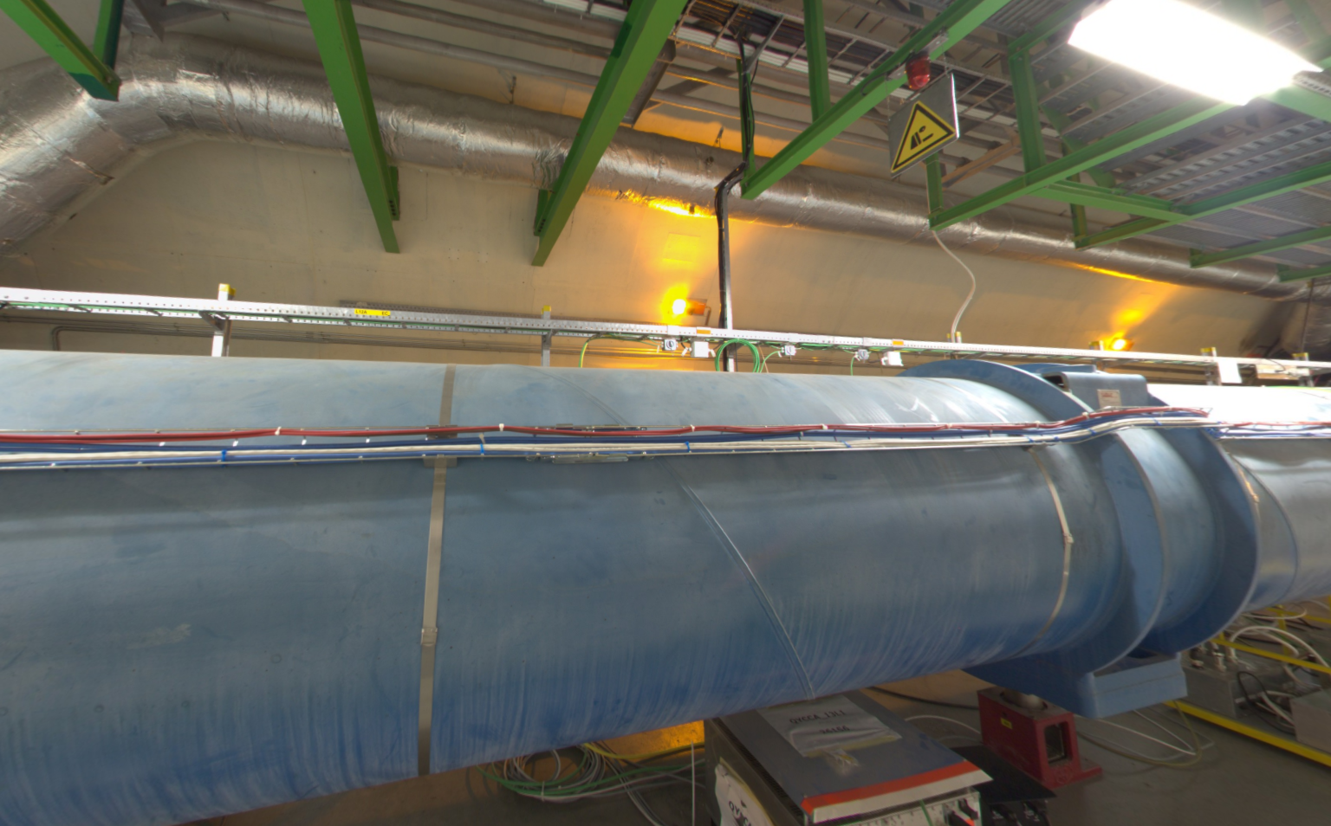
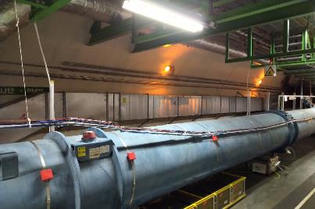
UJ12 Cable Tray

Slide 4
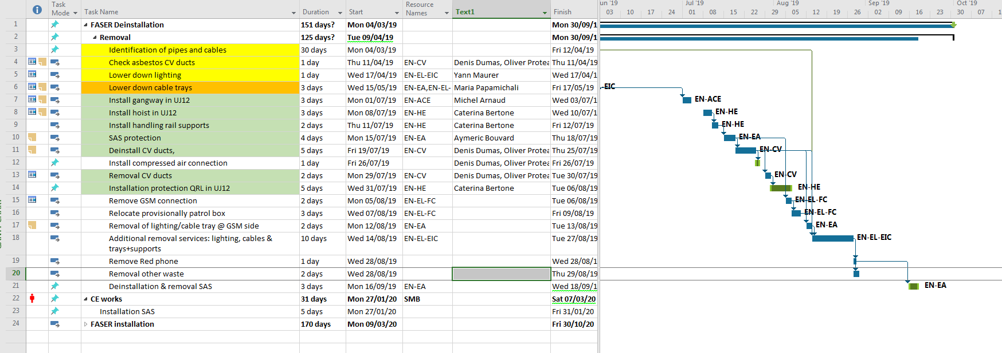
Planning consolidation
BASELINE: avoid coactivity
SAS installation date advanced
Proposal: Start EN-HE 8 july (agreed with Caterina). 8/7: occupation du tunnel pendant toute la journée en heures ouvrables Clarified (Marzia/Caterina): the passage in UJ12 is not interrupted but perturbed. This means that the evacuation must be possible at any moment; the activity will appear in any case as constraint.
Proposal start CV work on the 15th or the 22nd of July
>1 month contingency

Slide 5
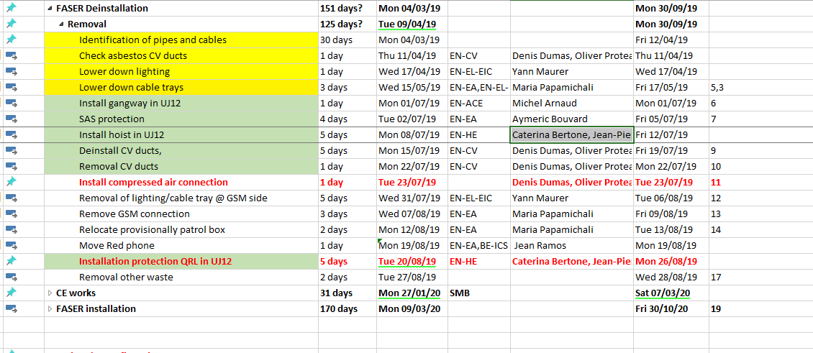
Planning V1
BASELINE: avoid coactivity
Please, confirm dates

Slide 6
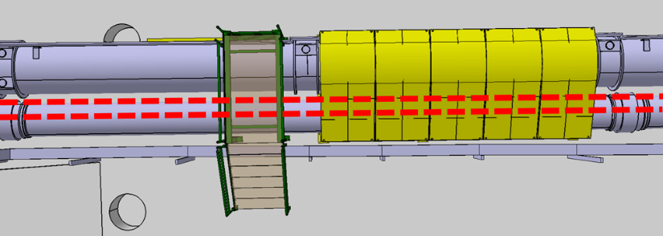
To do
Confirm if anchor bolts required for the middle support legs of the QRL protection ? (Ideally no drilling because of HV cable in the floor)
ECR WP1- Dismantling activities in UJ12/TI12 for FASER

Slide 7
To do
Integration FASER/ LS2 schedules (DISMAC ok?)
Preparation VIC for EN/HE hoist installation (Jean-Pierre (?)).
Continue integration, work preparation, etc…

