Slide 1
DFX Detailed Design
W.Bailey and Y. Yang (SOTON)
Funded by CER/STFC HL-LHC-UK(1)
Supported by Y. Leclercq, R.Betemps, J.Fleiter, I.Falorio
S.Claudet, V.Parma, A.Ballarino, (CERN)
HL-LHC - WP6a
20 June. 2019

Slide 2
Outline
Concept evolution since CDR
Summary of functional fulfilment
Detailed schematics of DFX sections
Modes of operations and provisions
Design studies
Manufacturing, QA, testing and delivery
Assembly sequences

Slide 3
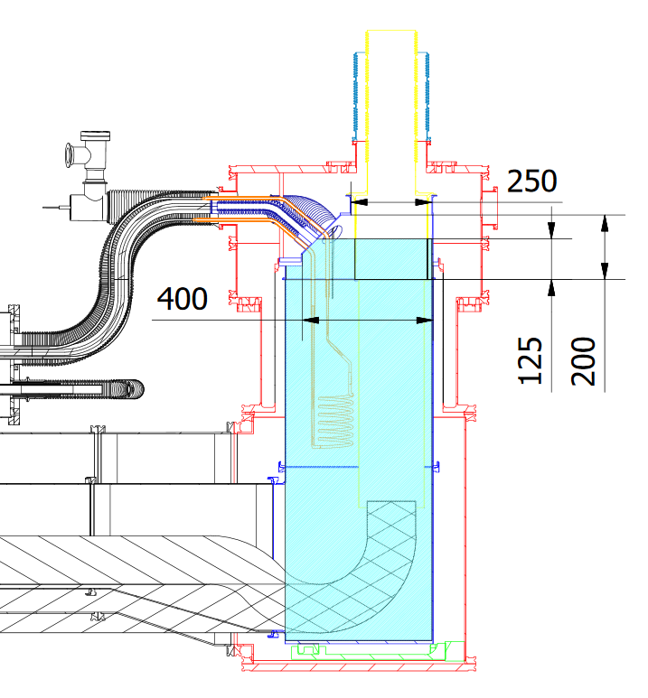
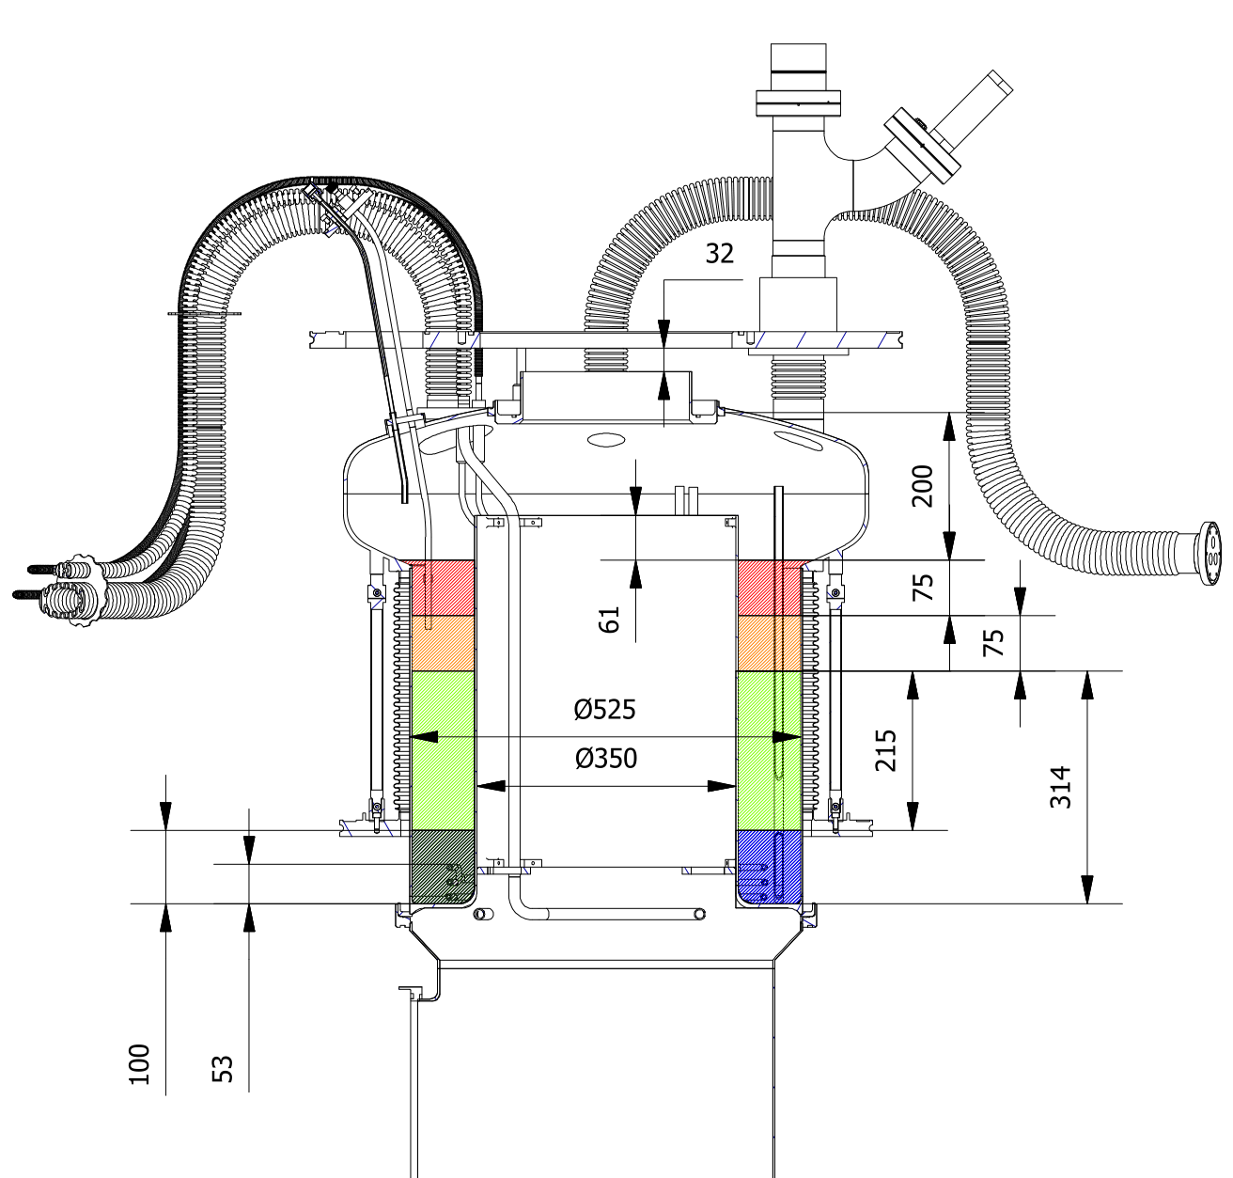
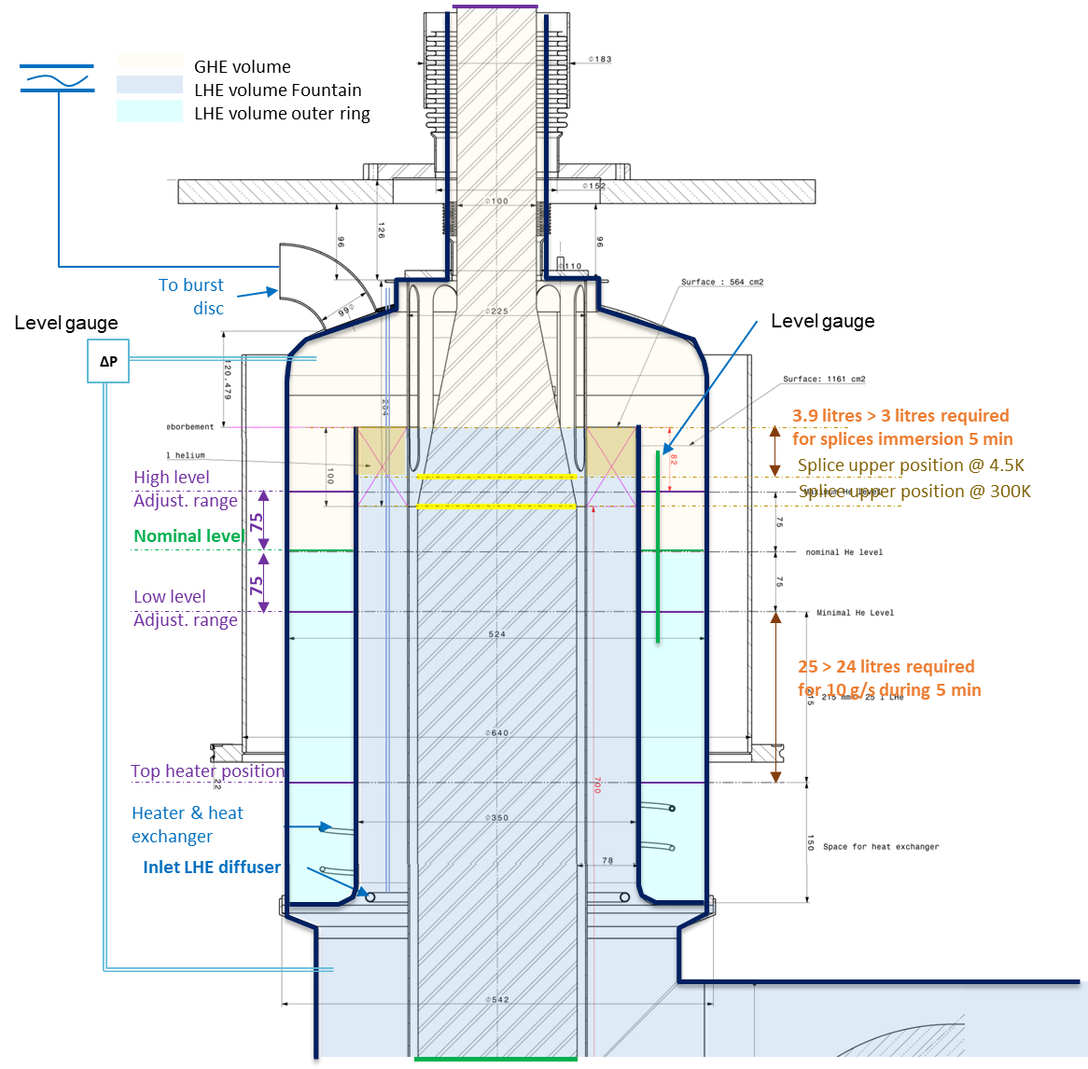
Design Evolution since CDR:
Increased He Vapour Space and Avoiding Liquid Entrainment
Initial concept 30 Jan 2019
Revised concept 12 Feb 2019
Detailed design 20 June 2019

Slide 4
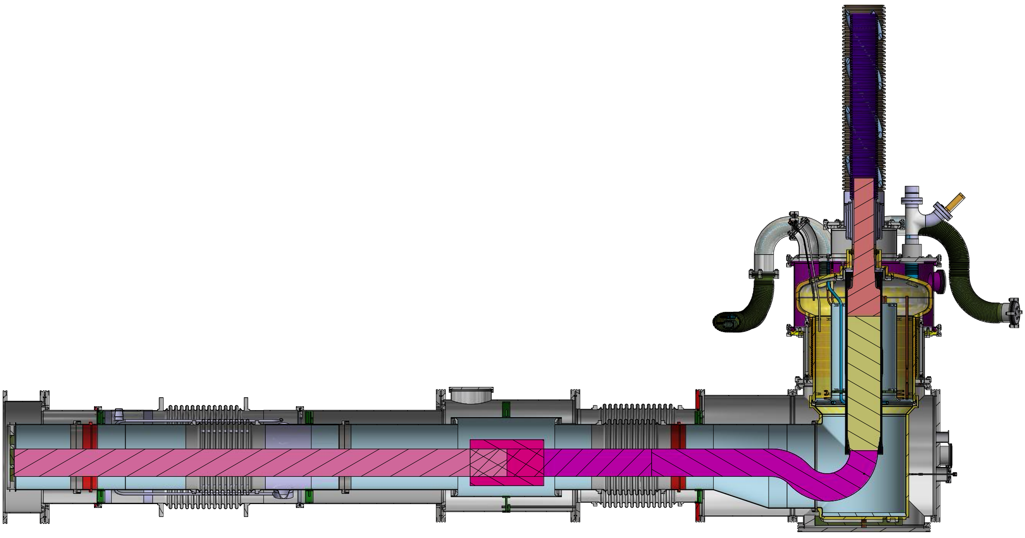
Fulfilment of DFX Functions
  Instrumentation
  backup
  Instrumentation level
  Safety
Integration of SC-Link
  Intervention and repairs
  Cryogenic supplies
  Instrumentation IFS
  Splices
  Integration of Plug
  Safety
  Cryogenic controls
  Vacuums

Slide 5
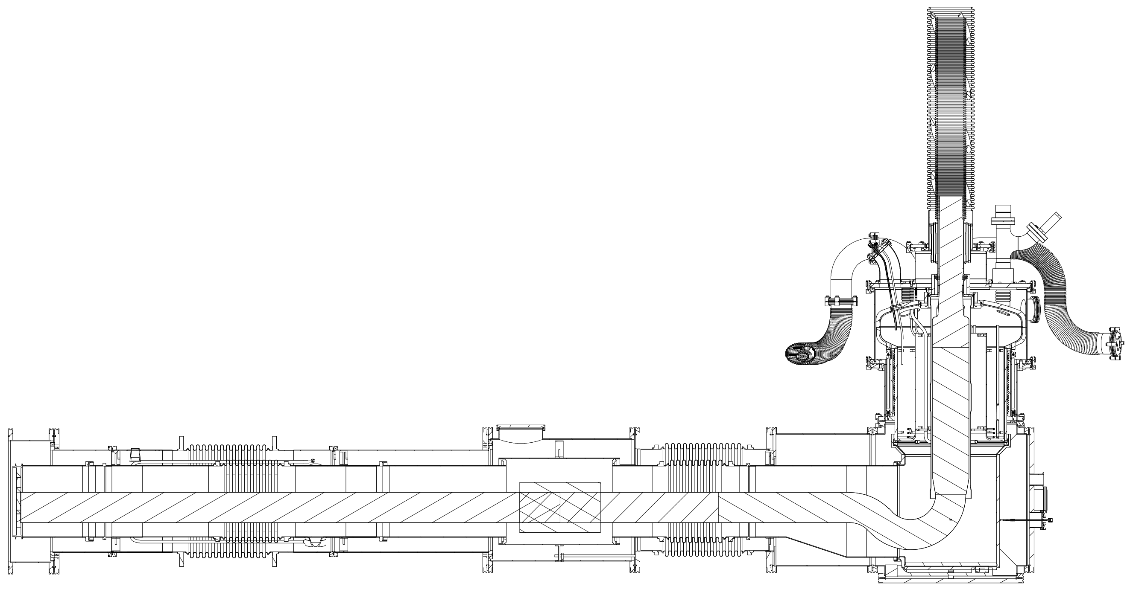
Fulfilment of DFX Functions
  Instrumentation level
  Instrumentation
  backup
Integration of SC-Link
  Safety
  Intervention and repairs
  Cryogenic supplies
  Instrumentation IFS
  Splices
  Integration of Plug
  Safety
  Cryogenic controls
  Vacuums

Slide 6
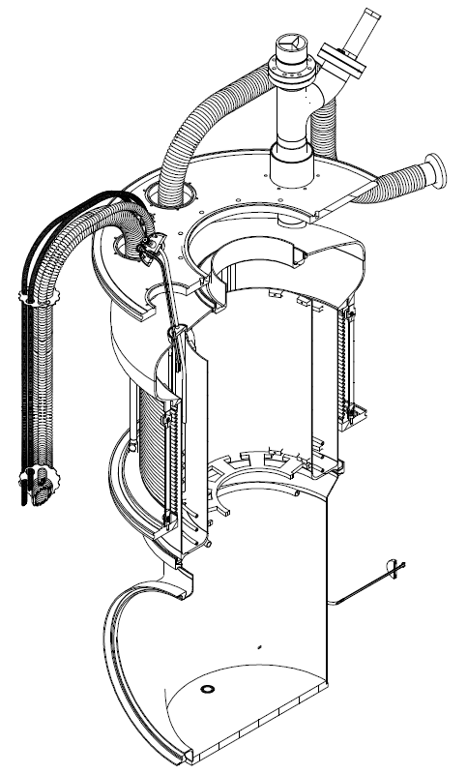
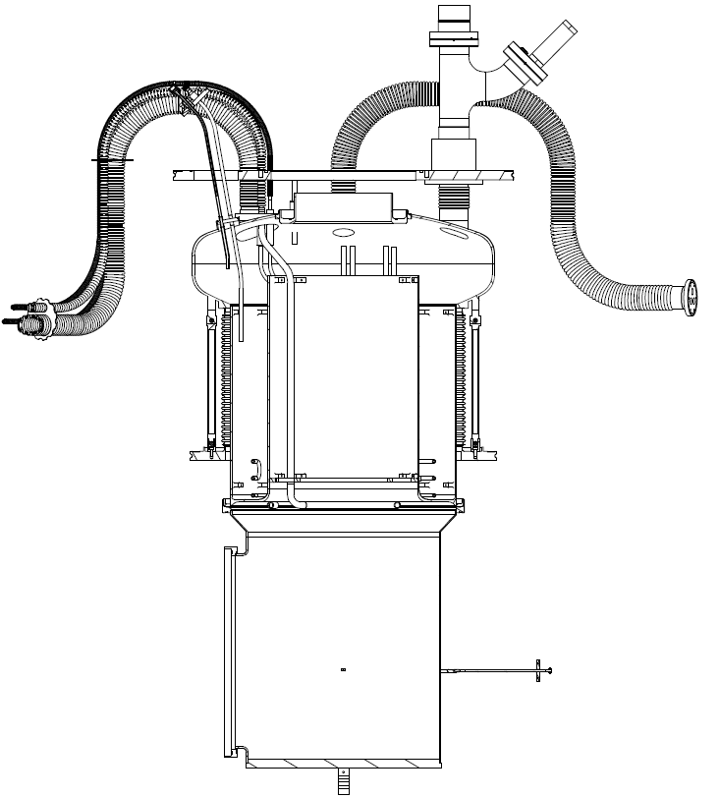
Detailed DFX Schematics: Vertical Inner Overview
Level sensors and pressure gauge tap (vapour)
Safety relief valve and burst disc assembly
4 lines in cryogenic jumper flexible coupling
Flexible port for instrumentation backup
Vacuum barrier
Pressure gauge tap (liquid)
Elbow section

Slide 7
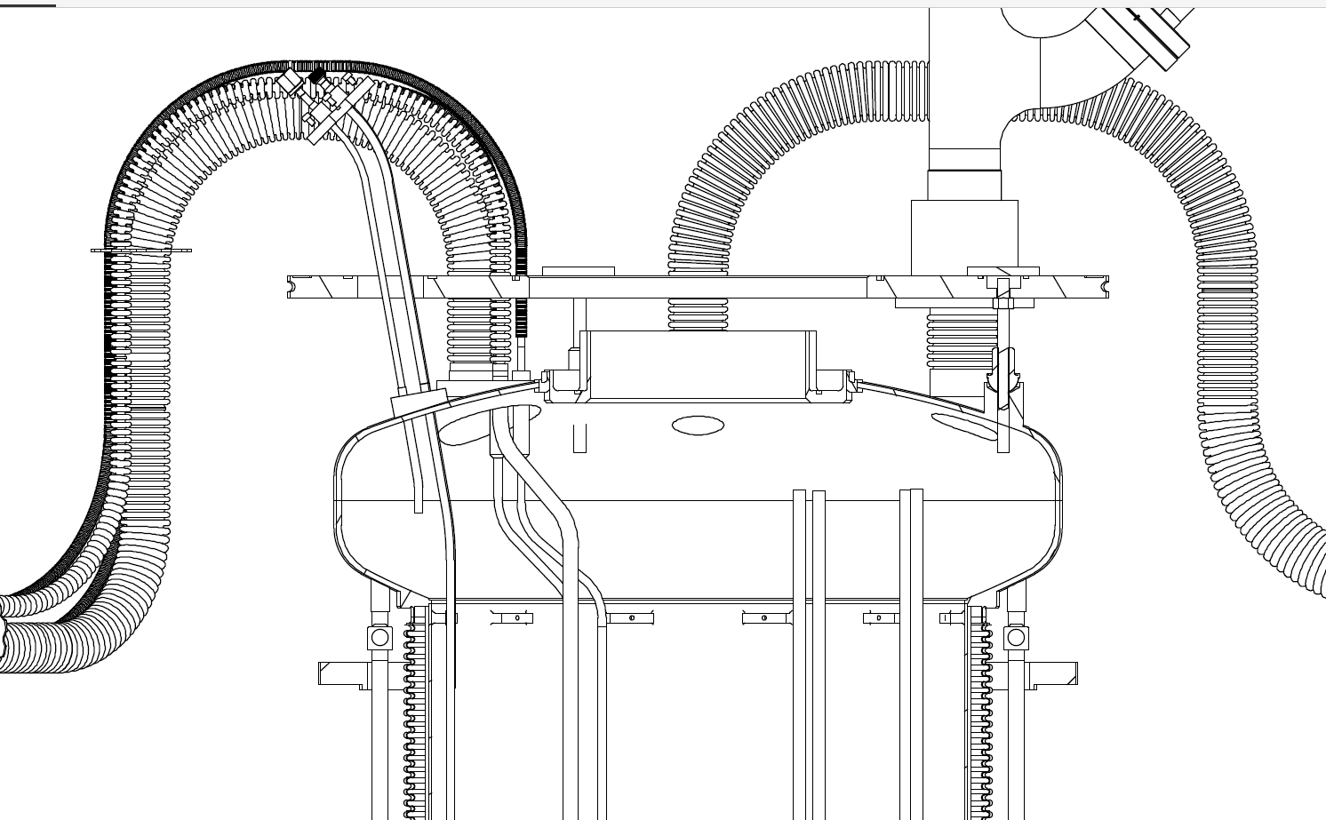
Detailed DFX Schematics: Vertical Inner Dome
Weld ring for accepting the cold flange of DSH (SC-Link)
Alignment pins
Inverted flange on safety device port for decoupling to enable sliding
Stainless-to-copper transition of gas heater lines

Slide 8
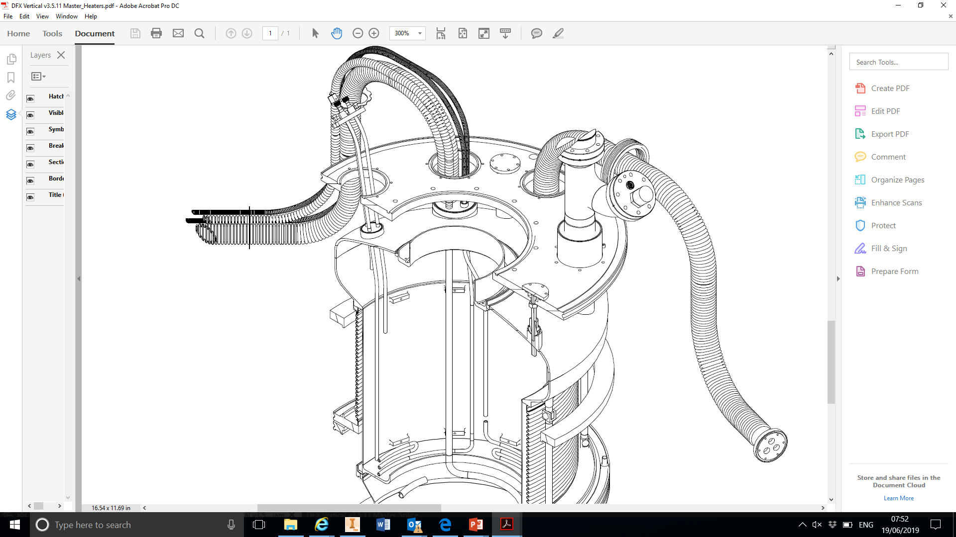
Detailed DFX Schematics: Vertical Inner Interfaces
LHe Line C
Gas heater in/out
Removable mechanical link for alignment between dome and top flange
Vent to Line D
Top pressure tap
Instrumentation backup routed through the top flange via DN50 long hose
2 levels sensors
Gas heater

Slide 9
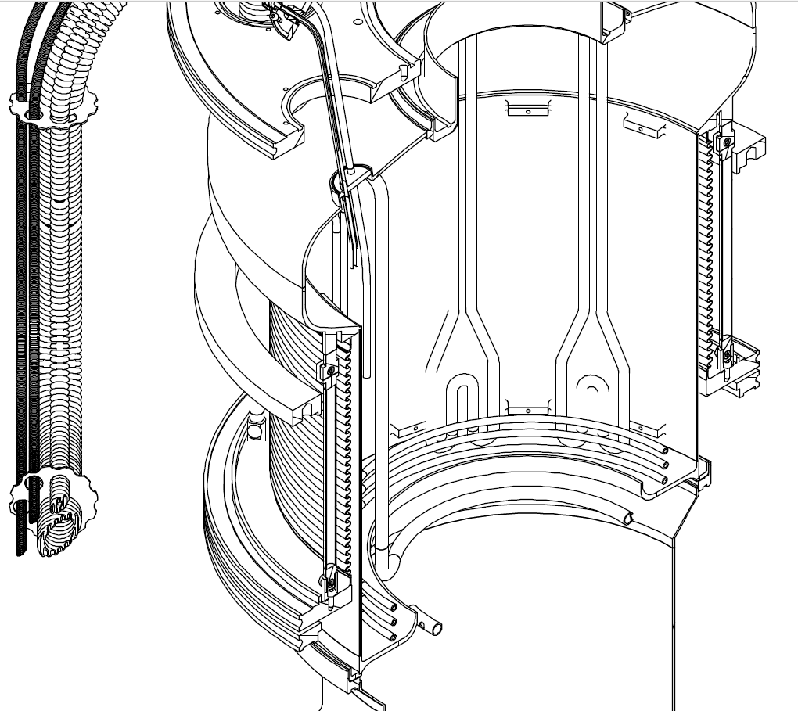
Detailed DFX Schematics: Vertical Inner LHe Fill and Heater Details
2 Electrical heaters
Gas heater coil
Liquid inlet diffusing ring

Slide 10
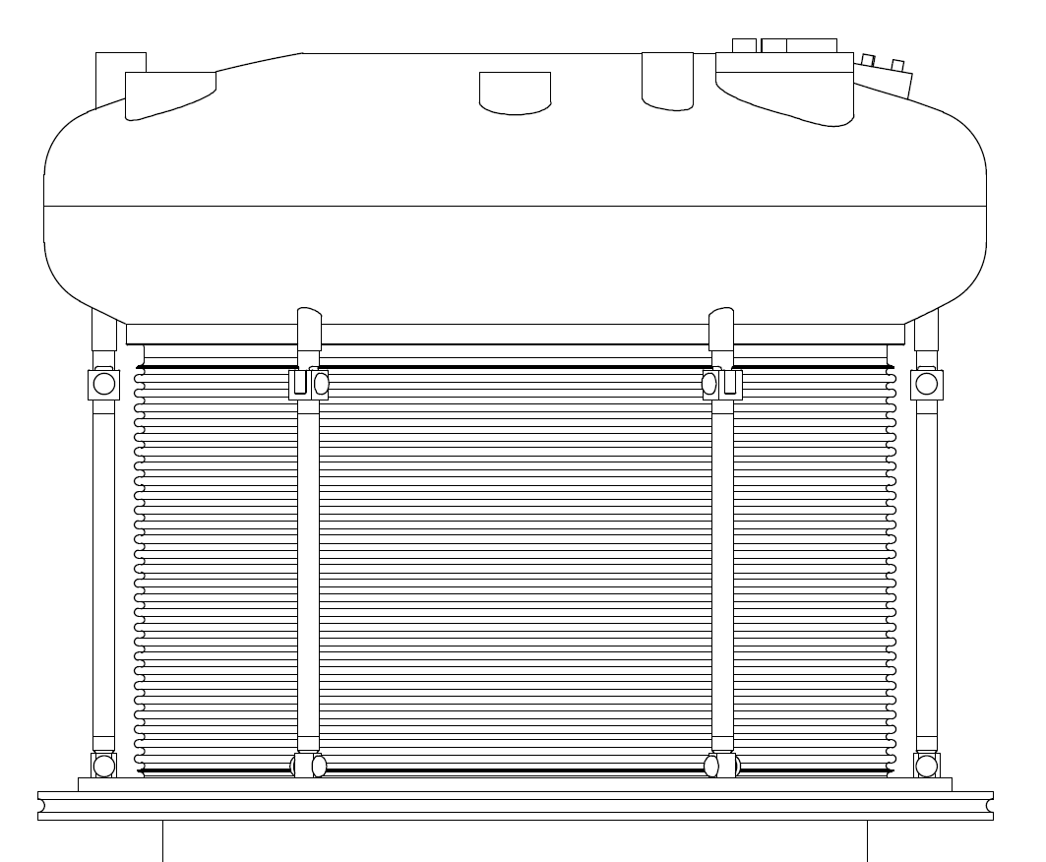
Detailed DFX Schematics: Vacuum break
Due to the shortening of the mid-section of DFX vertical, the length of the vacuum break also shorten, impacting on its contribution to the total heat load
Because it has a large outer diameter (~560 mm), reducing its wall thickness made it subject to buckling
A convoluted profile was adopted to
Increase the effective length whilst increasing its thickness
Pillars give the assembly additional rigidity forming a “cage structure” with minimal cost on heat load
Cylindrical pinned joints for installation and absorbing contraction
Convoluted wall 0.5 mm

Slide 11
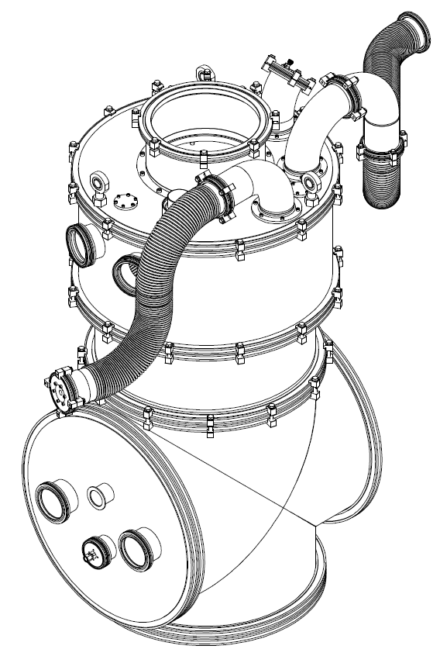
Detailed DFX Schematics: Vertical Outer – Vacuum envelope
Top hat for mounting flange for receiving the DSH outer flexible flange
Rigid elbows to define the maximum height of DFX and to initially support flexible inner hoses.
All outer sleeves of service lines can be removed
X2 DN100 ports on SC-Link side of vacuum
Sliding upper outer vacuum wall
X2 DN100 ports on DFX side of vacuum

Slide 12
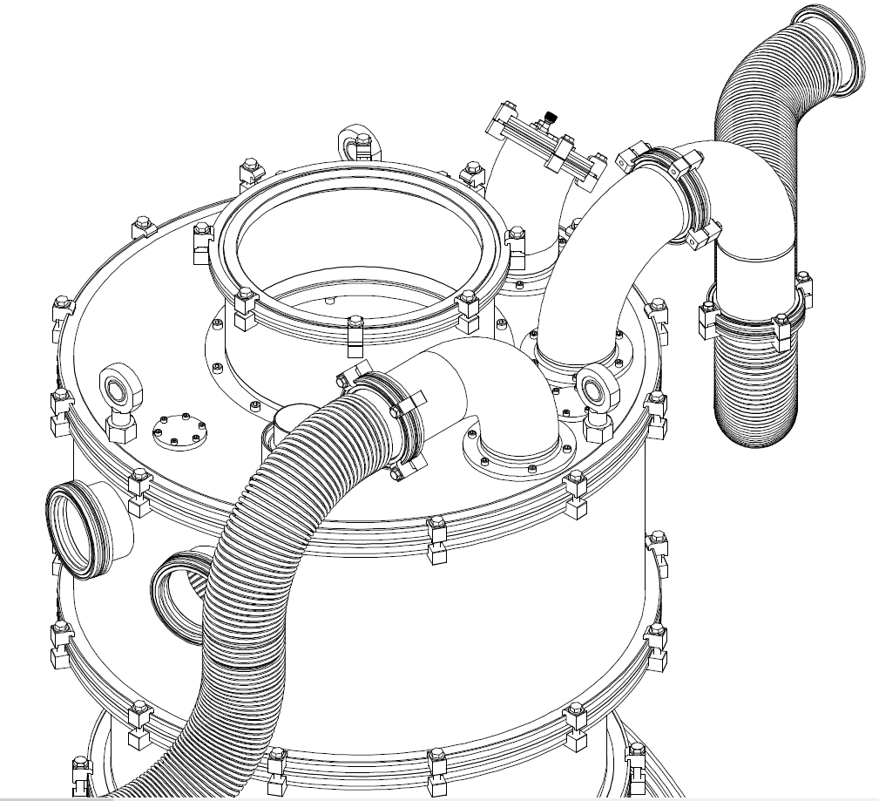
Detailed DFX Schematics: Vertical Outer Interfaces
Top hat for mounting flange for receiving the DSH outer flexible flange
Rigid elbows to define the maximum height of DFX and to initially support flexible inner hoses.
All outer sleeves of service lines can be removed
X2 DN100 ports on SC-Link side of vacuum
Sliding upper outer vacuum wall

Slide 13
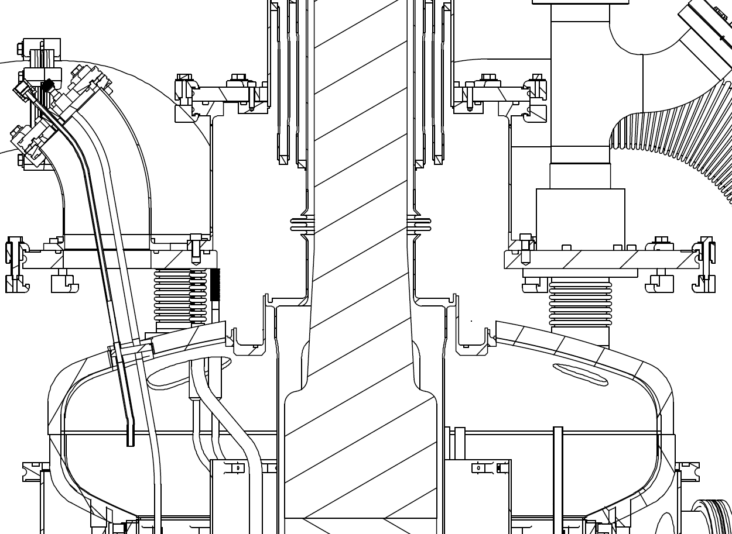
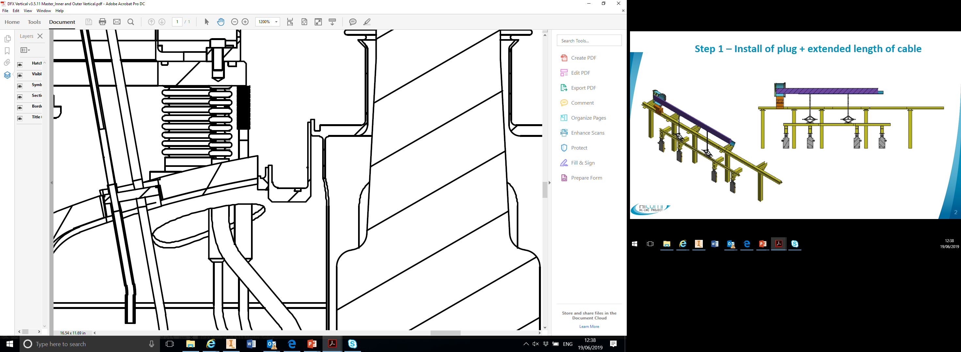
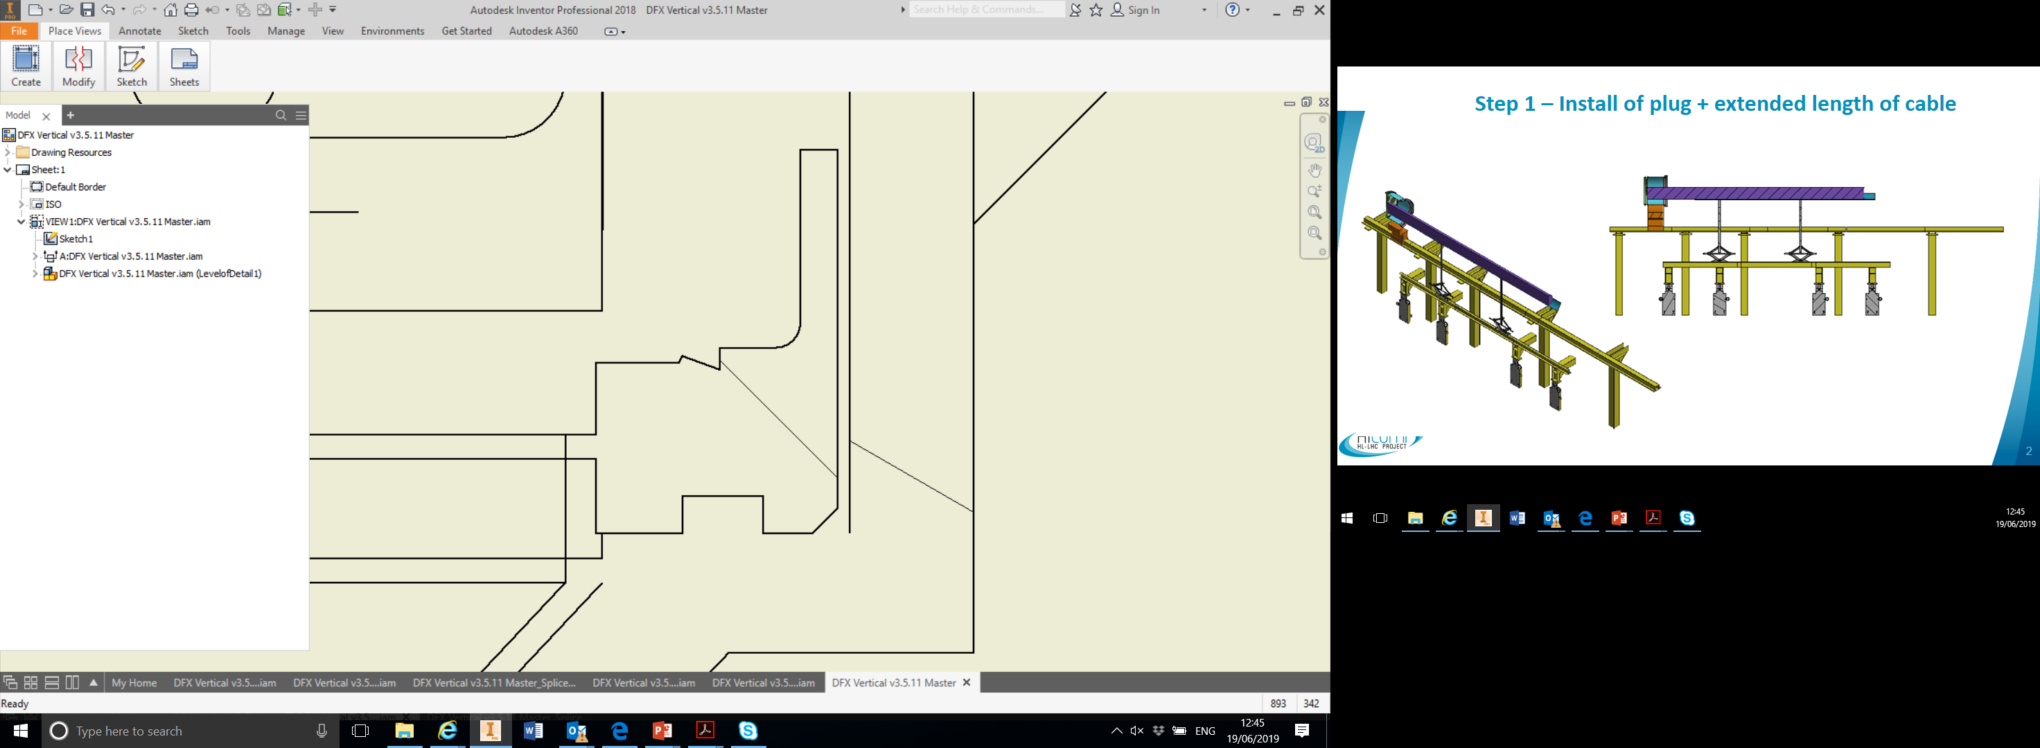
Detailed DFX Schematics: Vertical inner to SC-Link
Lip weld [#W3]
Weld prep for cutting
Knife edge feature to bolt and seal copper gasket

Slide 14
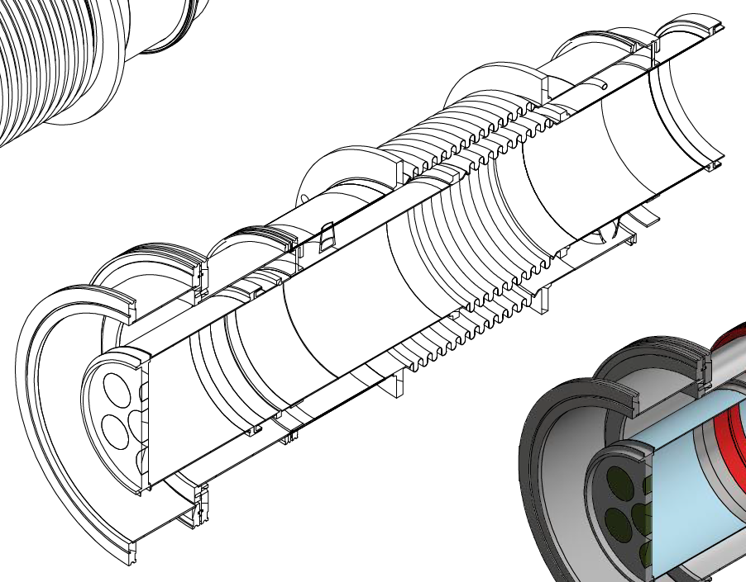
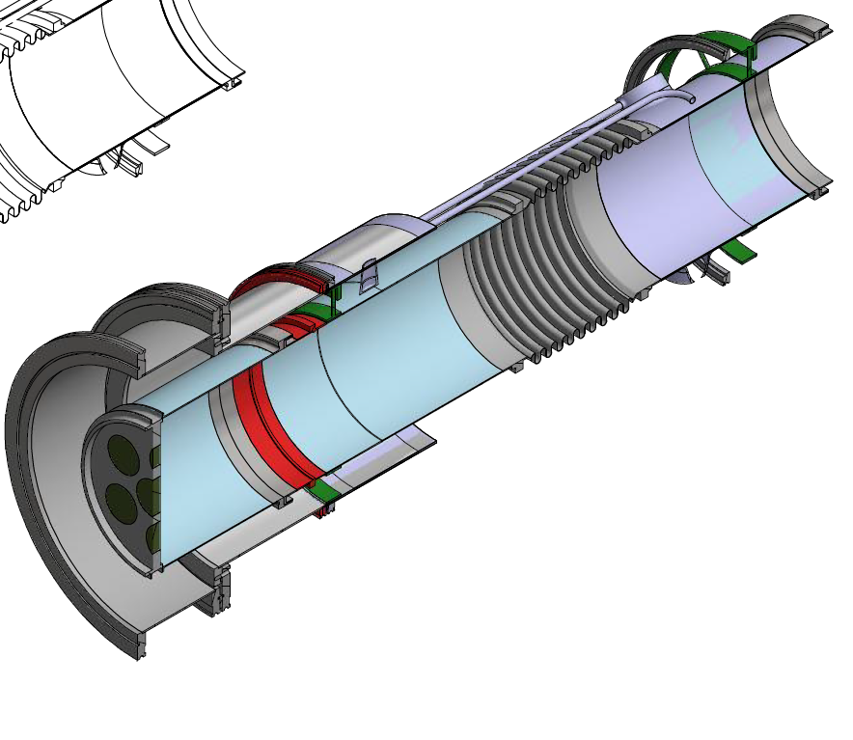
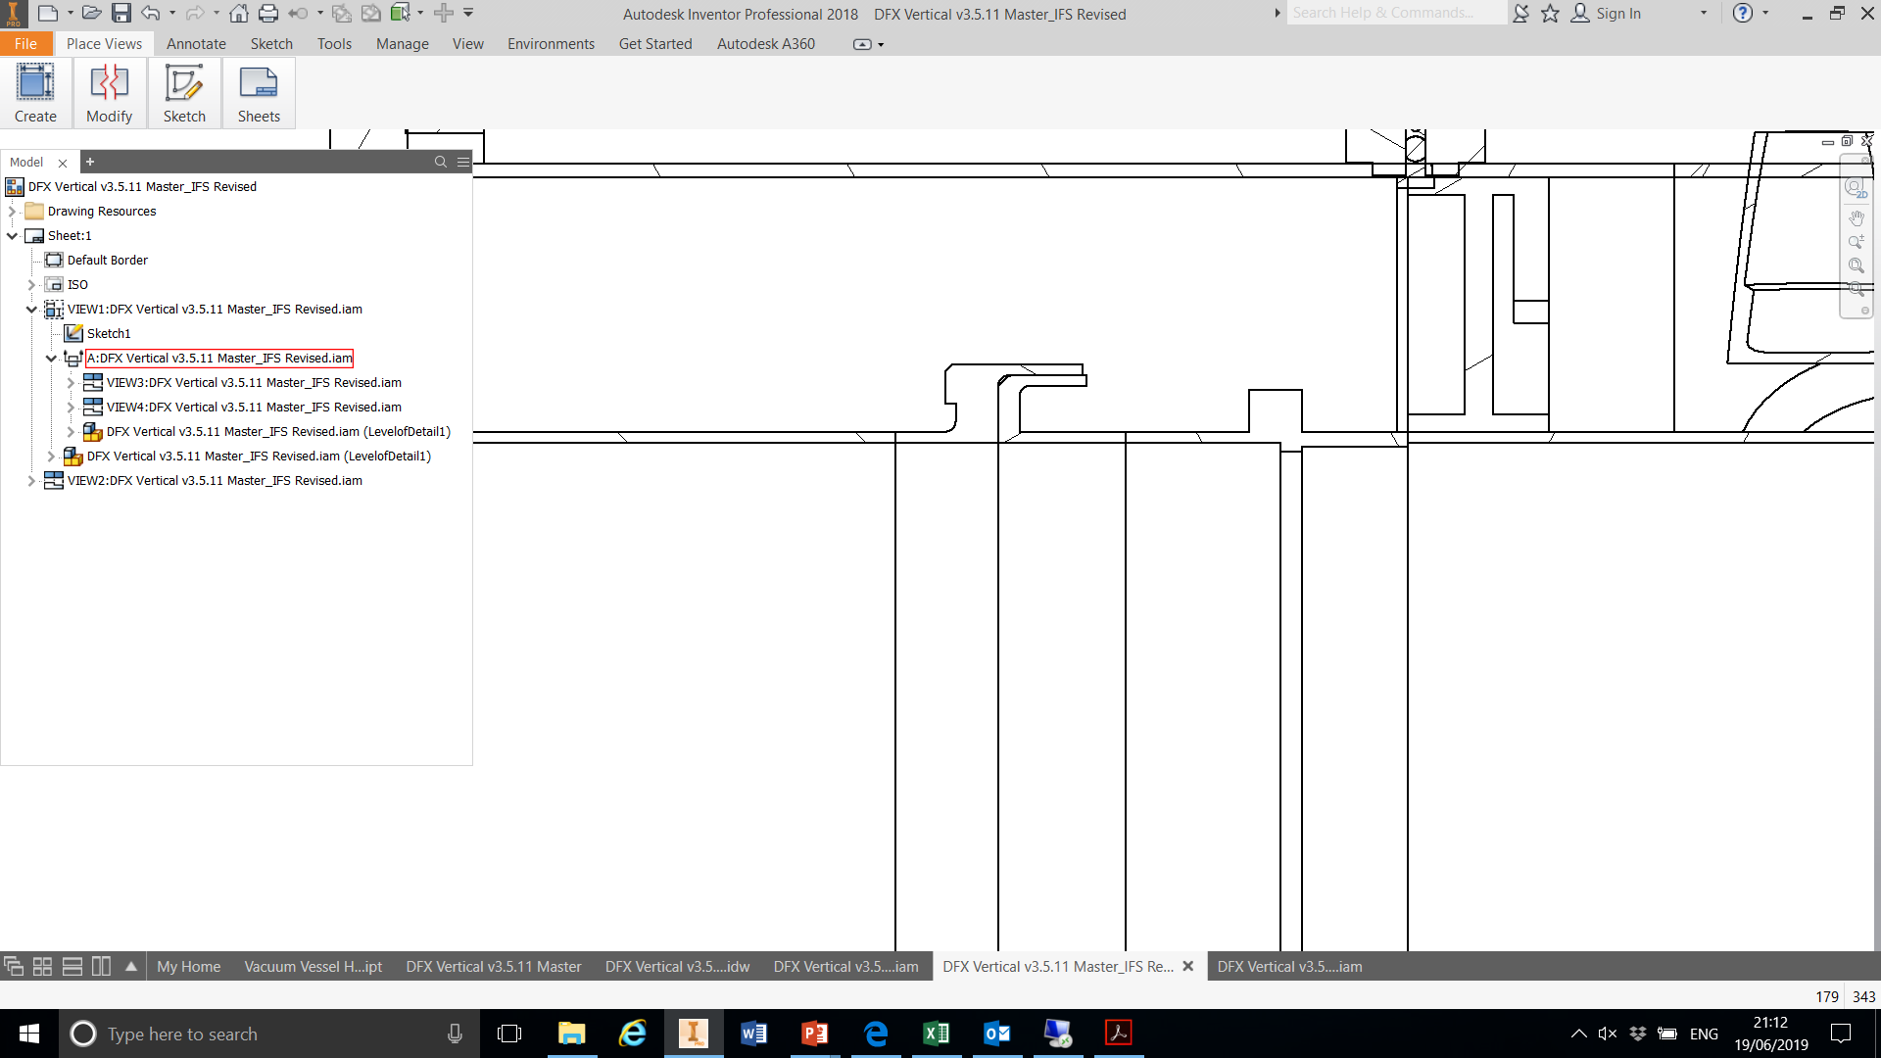
Detailed DFX Schematics: Horizontal Section 1 – IFS sub-assembly and plug
Serpentine tubes to create long thermal path for cold instrumentation
Bellows
Spoked support
Plug
Sliding section towards plug to enable IFS sub-assembly to be assembled and installed as one part
(i.e. inner and outer)
Lip weld example

Slide 15
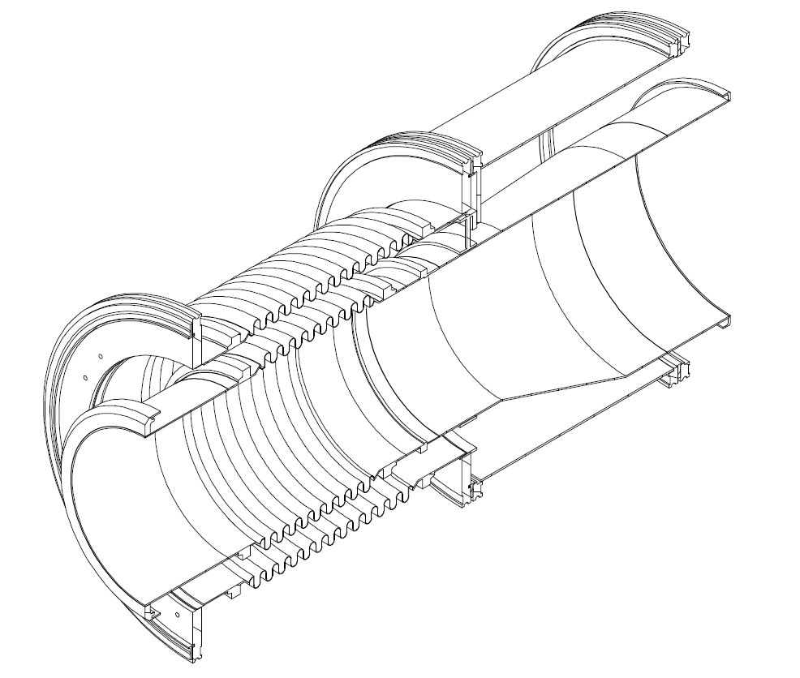
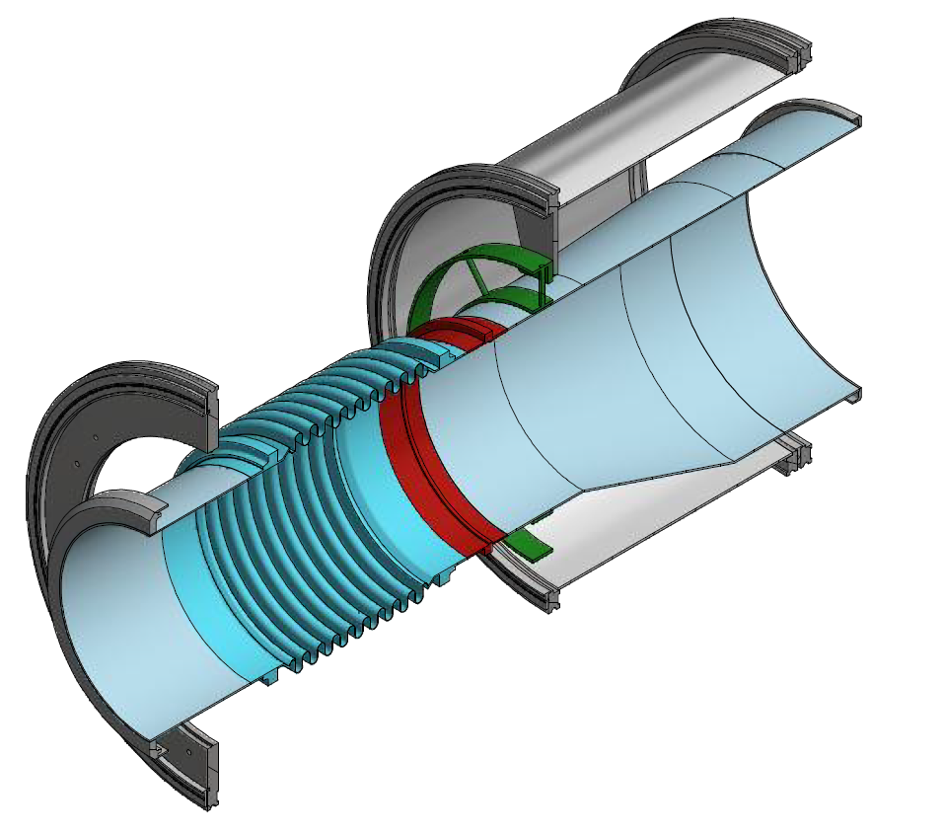
Detailed DFX Schematics: Horizontal Section 2 at SC-Link End
Eccentric cone section to reduce the elbow opening to the nominal bore of the horizontal section of 350 mm
Radial spoke support fixed against vacuum wall but allows sliding of the inner tube
Bellows

Slide 16
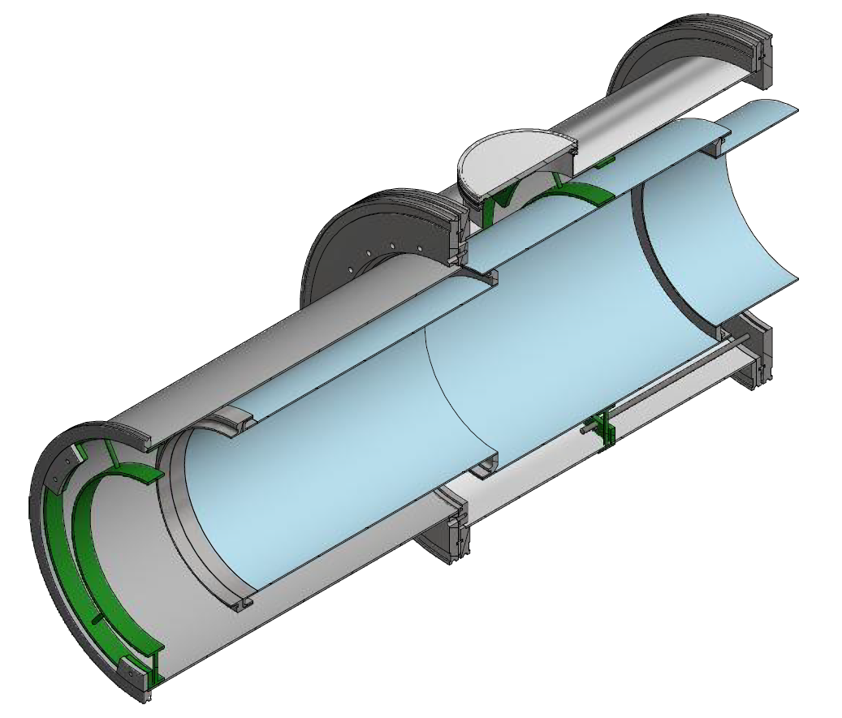
Detailed DFX Schematics: Horizontal Section 3 – Splice box
Standard DN200 vacuum overpressure plate
Fixing “ears” to support the splices in this located within the bore of the neighbouring tubes sections
Floating flange arrange to allow decoupling and sliding of the vacuum wall
Red dashed zone = reservation for splice
ID = 425mm
length 500mm
Reservation for parking tubes when splices exposed
Radial spoke support required to support the additional weight of the splices and fixed to the flange on the side opposite to sliding direction via studs

Slide 17
Modes of Operations and Safety
Commissioning:
  Differential pressure of 1atm across the vacuum barrier
  Venting of GHe from DFX to Line D in cooling down
Nominal operations
  1.3bar LHe feed from Line C
  Nominal currents in SC-Link, plug, and LTS bus-bars
Controls
  GHe flow rate into DSH for DFH splice temperature and current lead temperature
  LHe level
Abnormal conditions
  Stop of LHe supply for 10min at 5gs⁻¹ or 5min at 10gs⁻¹
  Safety device triggered at 2.5bar in liquid vessel

Slide 18
Design Studies
Mechanical
  Vacuum scenarios
  Pressure scenarios
  Differential thermal contraction
  Static loads
Thermal
  Conduction heat loads
  Radiation heat load

Slide 19
Design Studies: Vacuum Scenarios
The feature most susceptible to collapse under different vacuum conditions is the vacuum break; thus required further study
Eigenvalue buckling function deployed in ANSYS to inspect behaviour in under 2 conditions to obtain the load factor
External pressure 1 bar, (i.e. Loss of vacuum in SC-Link side, whilst preserving the vacuum in DFX side)
Internal pressure 1 bar, (i.e. Loss of vacuum in DFX side, whilst preserving the vacuum in SC-Link side)
Vacuum break consist of fully convoluted wall to add inherent stiffness, whilst providing licence to reduce the wall thickness to manage heat leak

Slide 20
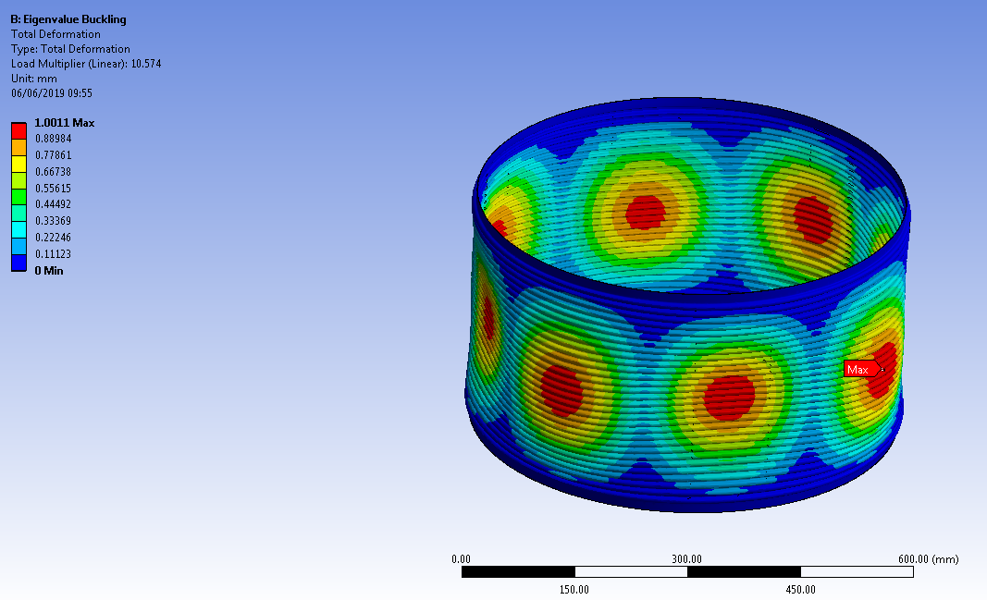
Design Studies: Vacuum Scenarios
A convoluted 0.5mm thick vacuum membrane is able to withstand the pressure differential with a satisfactory load factor
Conditions and parameters
External pressure = 1 bar
Thermal conditions = +22 ºC
Wall thickness of convolutions = 0.5 mm
Rigidly at both ends
LOAD FACTOR = 10.57 = Safe

Slide 21
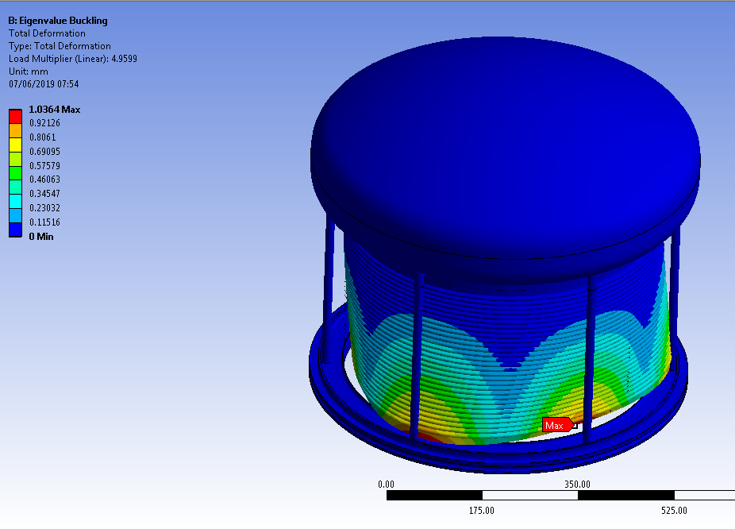
Design Studies: Vacuum Scenarios
Integration of vacuum break with real flanges and domes
Rigid studs between the dome and the room temperature flange do not provide a sufficient load factor for the 0.5 mm convoluted vacuum membrane
Conditions and parameters
External pressure = 1 bar
Thermal conditions = +22 ºC
Wall thickness of convolutions = 0.5 mm
Stainless steel pillars = 12 mm OD x 2 mm wall
LOAD FACTOR = 4.96 = on the limit
LOAD FACTOR 5 = lower limit

Slide 22
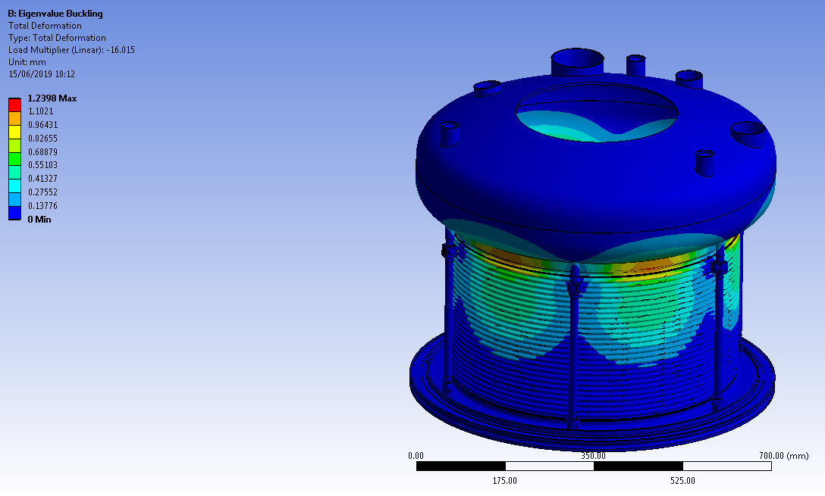
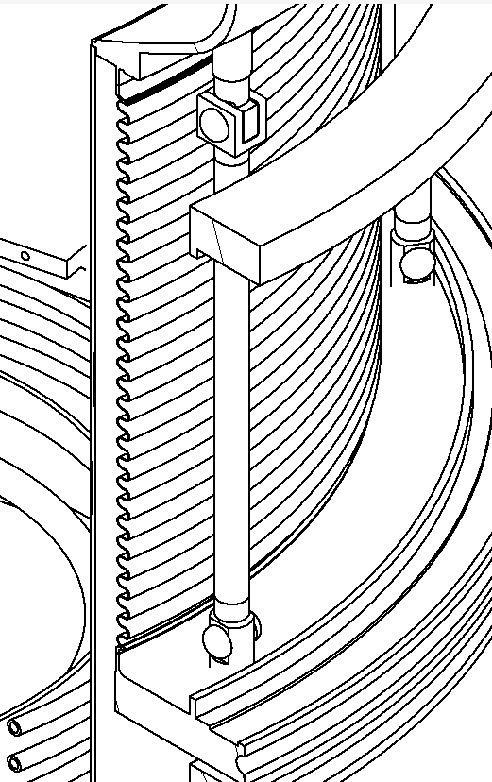
Design Studies: Vacuum Scenarios
Use of cylindrical pin joints increases the load factors to a satisfactory level
Conditions and parameters
External/internal pressure = 1 bar
Thermal conditions = -269 ºC
Wall thickness of convolutions = 0.5 mm
Stainless steel pillars = 16 mm OD x 1.2 mm wall
LOAD FACTOR = 14.7 = external pressure
LOAD FACTOR 16.0 = internal pressure

Slide 23
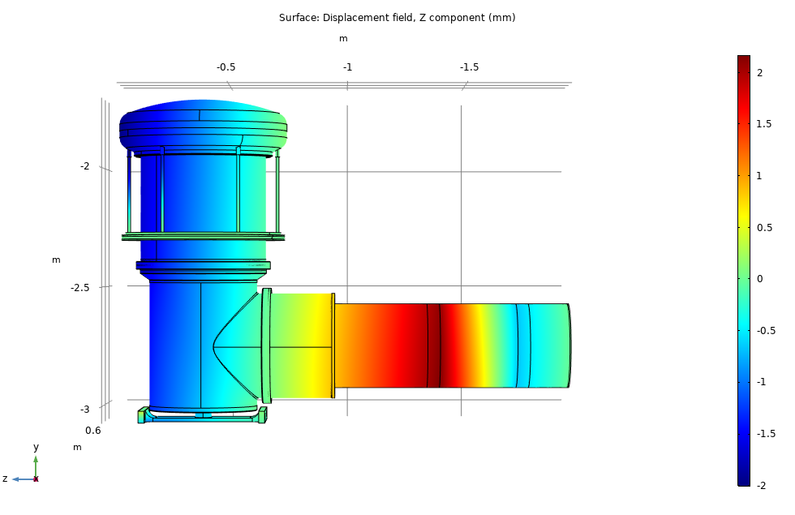
Design Studies: Thermal Contraction
The longitudinal contraction of the horizontal section are taken up by the bellows (90N/mm)
Horizontal support for the vertical section located symmetrically without imposing differential constraints
The outer boundary of the vertical vessel contracts 1.3mm in the horizontal direction
Fixed at room temperature
Fixed via supporting spokes
Fixed at room temperature

Slide 24

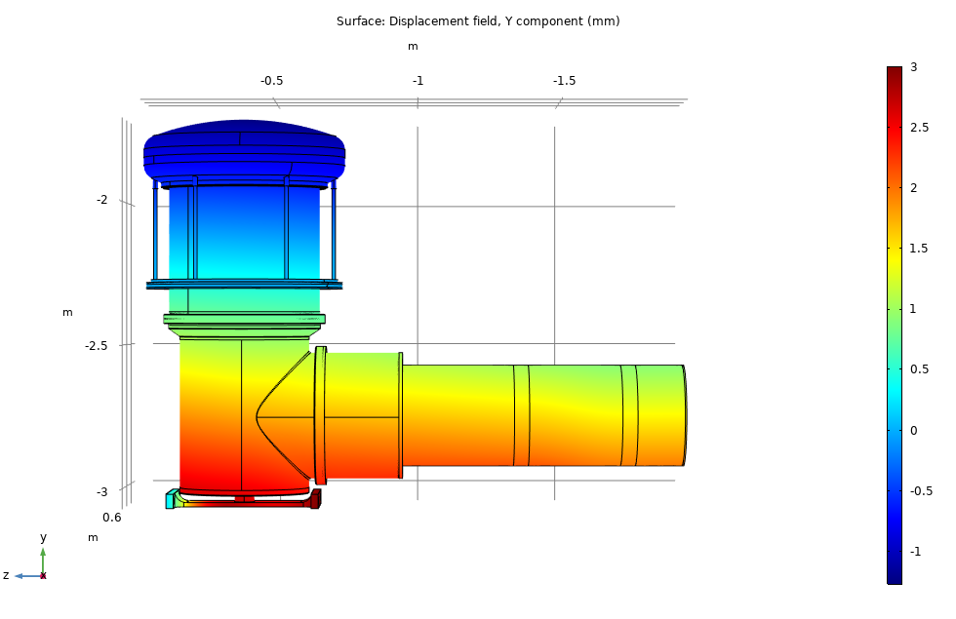
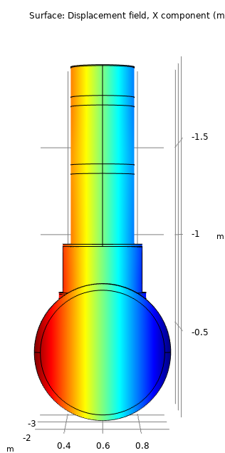

Design Studies: Thermal Contraction
The vertical section contracts 3mm vertically towards the room temperature plane of the vacuum break
The vertical section contracts 1mm in the transverse horizontal direction towards the longitudinal axis
Fixed at room temperature
Fixed via supporting spokes
Fixed at room temperature

Slide 25
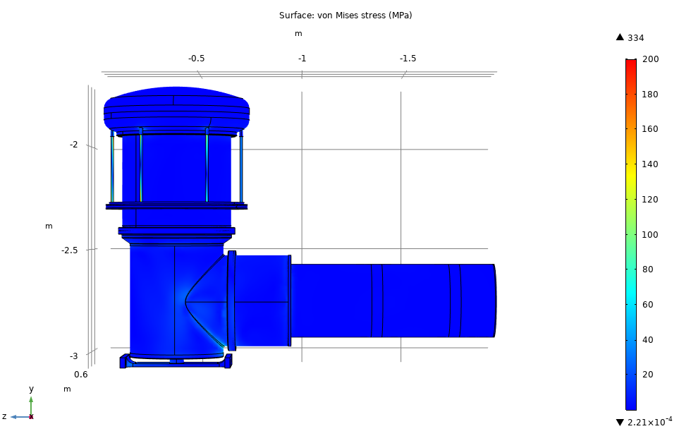
Design Studies: Thermal Contraction
Stress not an issue
Fixed at room temperature
Fixed via supporting spokes
Fixed at room temperature

Slide 26
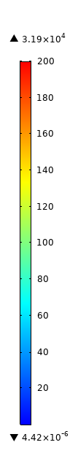

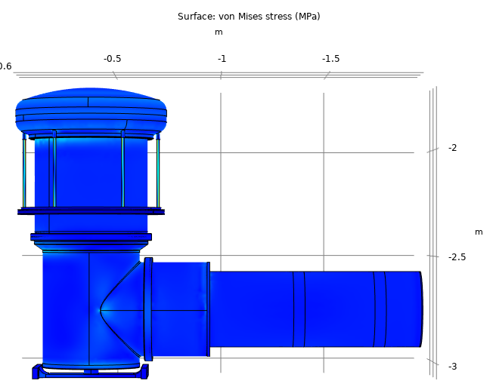
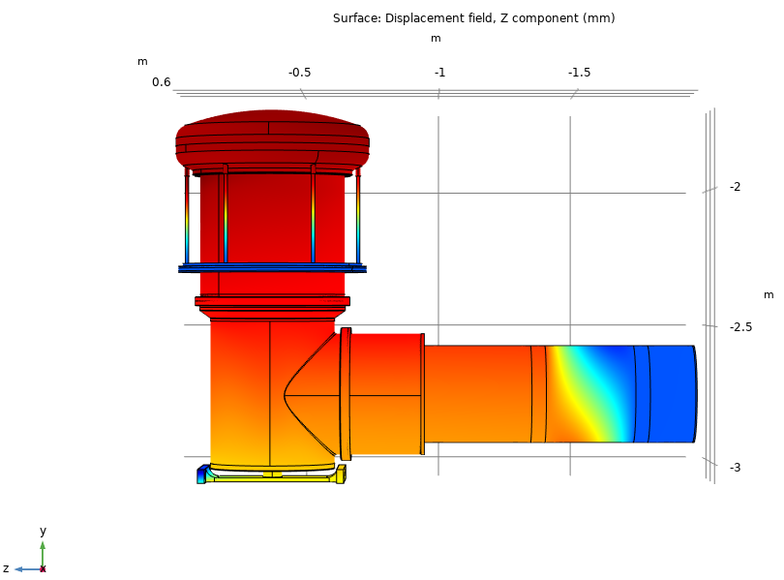
Design Studies: Pressure Scenarios: 1.3bara
At the nominal working pressure of 1.3bara and with the horizontal support, the bellow results in a longitudinal expansion of ~1.3mm at the outer border of the vertical section, which almost compensates the thermal contraction perfectly
Stress well contained

Slide 27

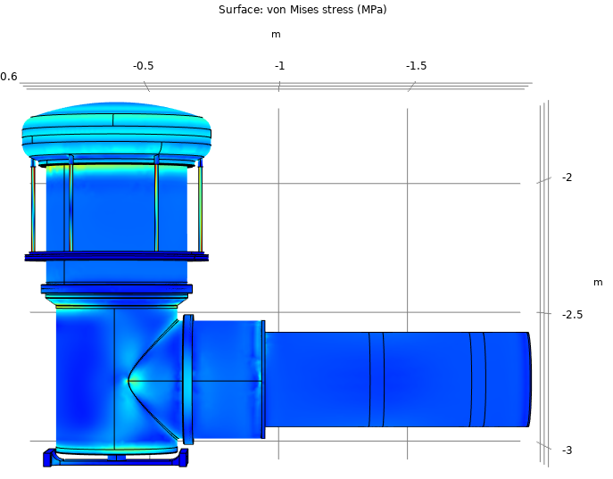
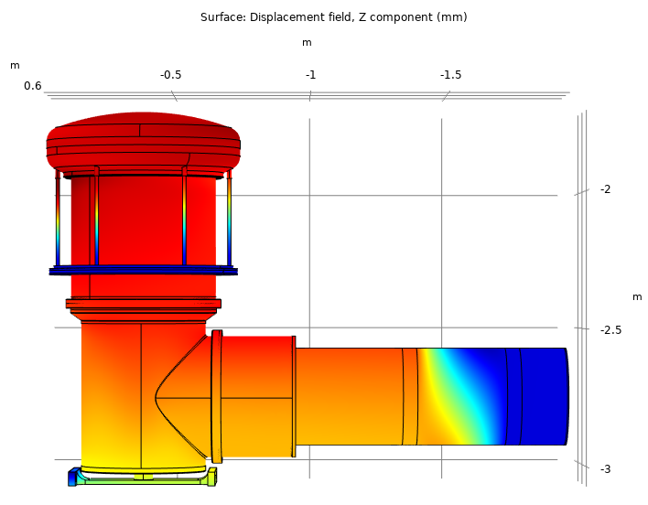

Design Studies: Pressure Scenarios: 3.5bara
At the PED test pressure of 3.5bara, the vertical vessel needs a buffer to limit the bending moment by stopping the longitudinal expansion at 2mm. The buffer is fixed on the vacuum vessel with a nominal clearance of 2mm, which will be confirmed by the mock-assembly test
Mostly bending stress and kept within 130MPa with the buffer
buffer

Slide 28
Design Studies: Heat Loads
Structural
  Heat conduction by the vacuum break: 3.7W
  Heat conduction by supporting studs: 2.8W
Mechanical Support:
  Heat conduction by spokes 1.4W
  Heat conduction by horizontal support: 2.3W
Instrumentations:
  Heat conduction1-3W
Radiation (<10m²) cold area
  <15W
Total: <30W

Slide 29
Manufacturing
Materials: SS316L for Co<0.1%
Components
  Mostly tube sections with welded flanges
  Elbows
  Domes
  Bellows
Sub-assemblies
  Vertical upper vessels (inner and outer)
  IFS sub-assembly

Slide 30
QA Plan
Pressure qualification at required level (3.5bar) of all the parts and components of the DFX liquid helium vessel as a part of component procurement QA. The parts include all the cold tube sections with welded flanges required for integration.
Pressure qualification at the required level for the DFX sub-assemblies (upper vertical inner vessel and IFS) as a part of the sub-assembly procurement. The sub-assemblies covers all the welded interfaces including the cryolines, safety devices, guiding tubes for level sensors, IFS etc. The interfaces to the SC-Link and lower vertical elbow will be blanked.
Cryogenic shock test, vacuum tightness test, and pressure verification of mock assembled DFX module. The welding to be performed by CERN during LHC tunnel integration will be clamped via metal O-rings.
Independent welding method qualification for the welding to be performed in situ by CERN in the LHC tunnel. Sample welding will be made according the mechanical design approved by CERN. The welded samples will be pressured tested and cut, if necessary re-welded and retested.

Slide 31
Testing and Delivery
Cold vessels assembled by clamping together the metal gasket provisions
Contained in the fully assembled vacuum vessels
Vacuum tightness test, cryogenic shock test, and pressure test at 3.5bara in the cold vessel
Mechanical and displacement measurements for the management of thermal contraction and pressure load

Slide 32
Assembly in Five Stages
Stage 1: Assembling the horizontal section at the plug end
Stage 2: Assembling the vertical DFX and integrating of the SC-Link
Stage 3: Assembling the horizontal section at the SC-Link end
Stage 4: Splicing LTS bus-bars
Stage 5: Finishing the assembly with the splice window closed

Slide 33
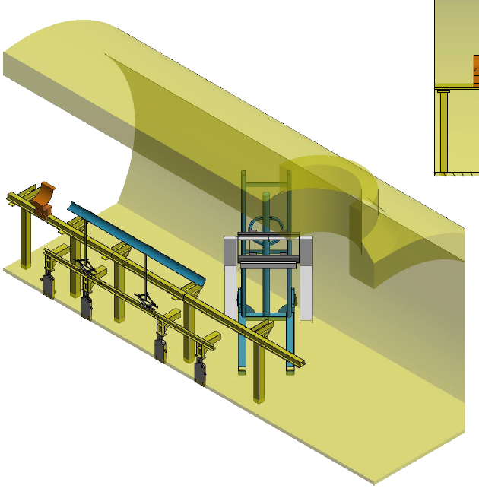
Stage 1. Tunnel environment – Preparation for installation
No beamline in position
Lifting and support frame work indicatively illustrated in this sequence and to be studied further by CERN.

Slide 34
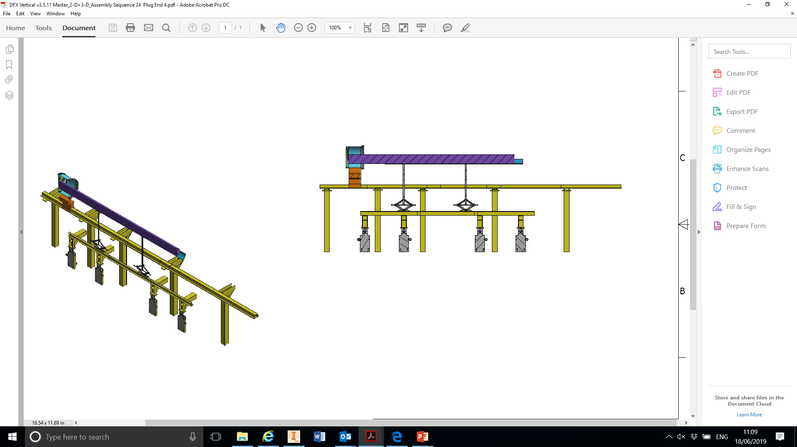
Stage 1 – Assembling the horizontal section at the Plug End
Starting position assuming the installation of the cold diode module with the plug prior to the integration of the SC-Link
2.7m long LTS bus-bar from plug supported on the frame
Cold diode module
Adapted not to interfere with the diode module

Slide 35
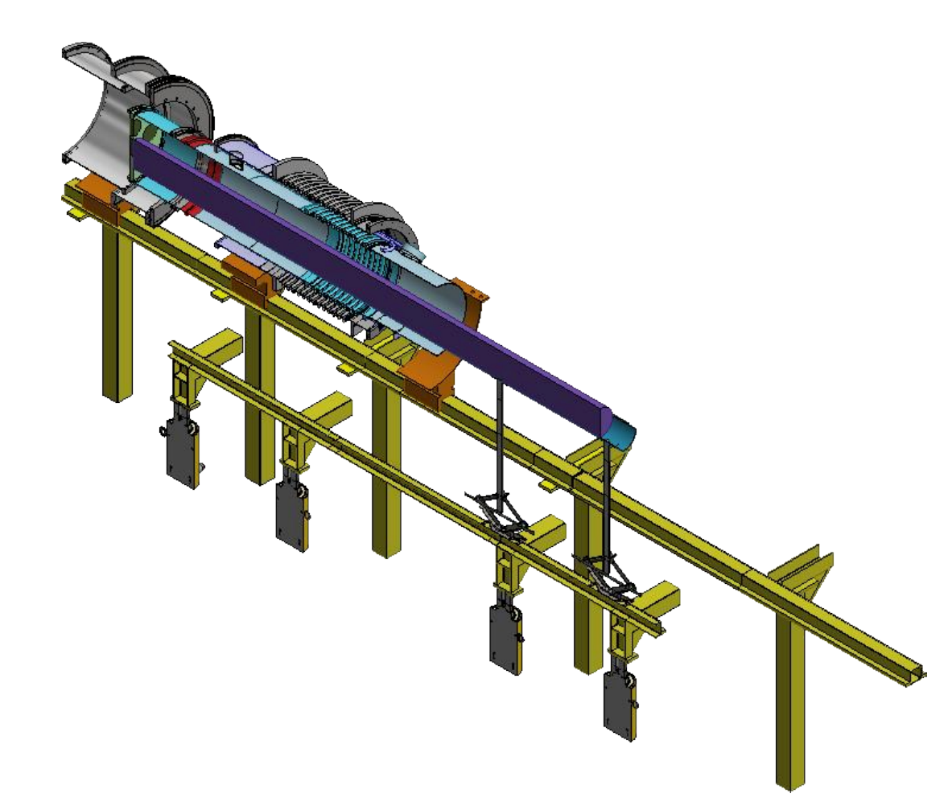
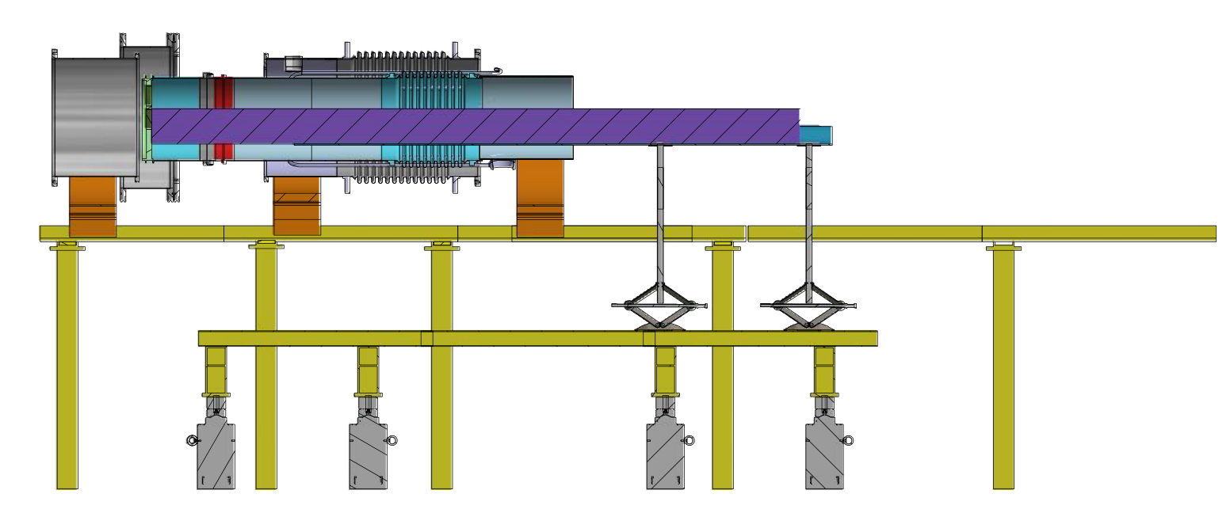
Stage 1.1 – Installation of the IFS sub-assembly to the plug
1. Plug vacuum vessel parked over the diode module
3. Weld in situ #W1
2. Insertion of the IFS sub-assembly

Slide 36
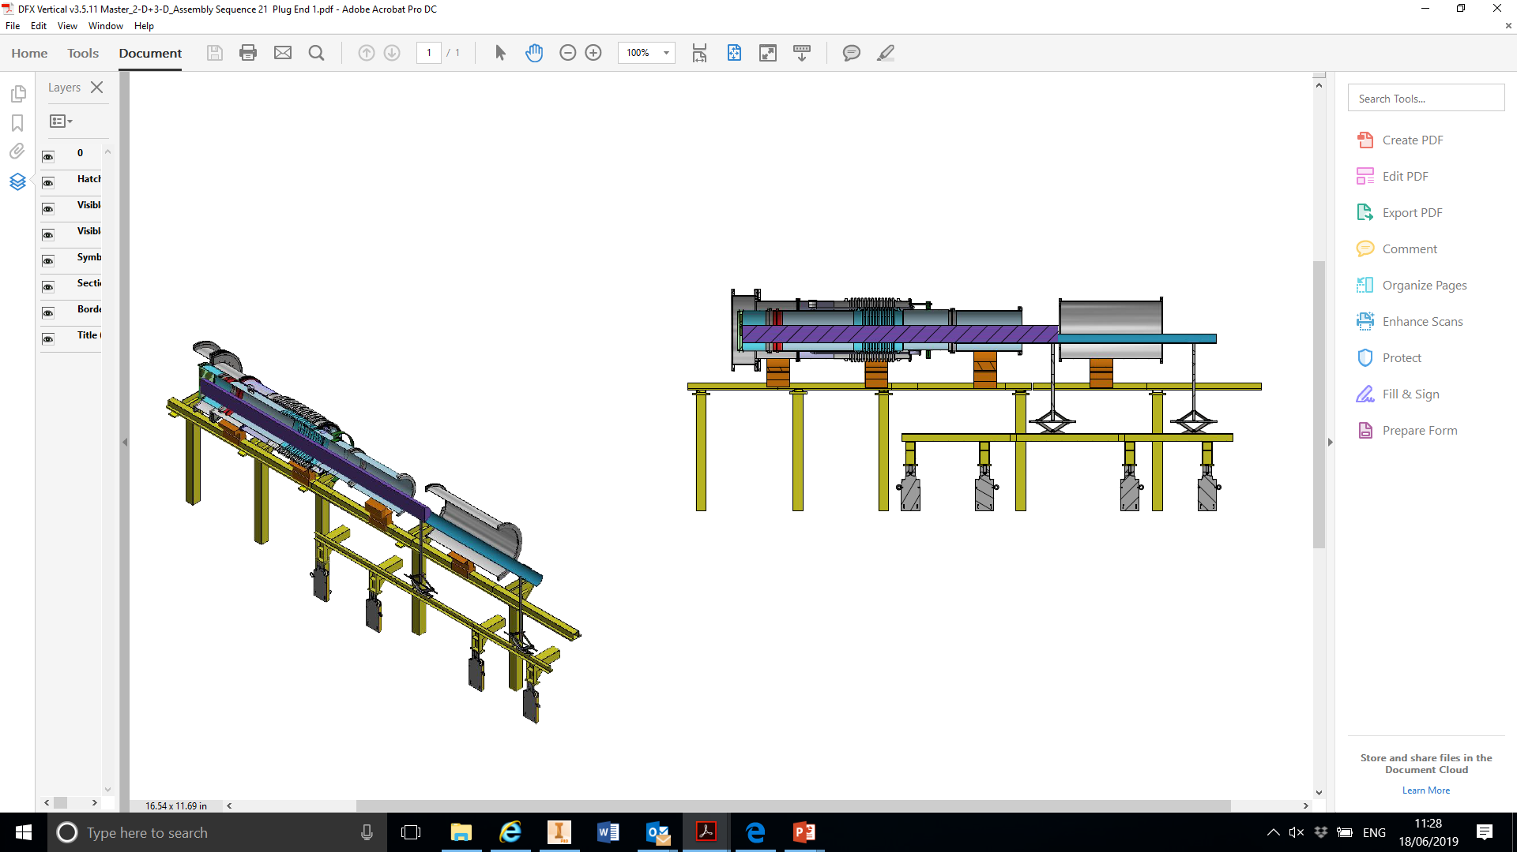
Stage 1.2 – Installation of the parking extension for parking the sliding splice section
1. Sliding the plug vacuum vessel back in position and completion of the IFS installation
3. Weld in situ #W2
2. Insertion of the parking extension

Slide 37
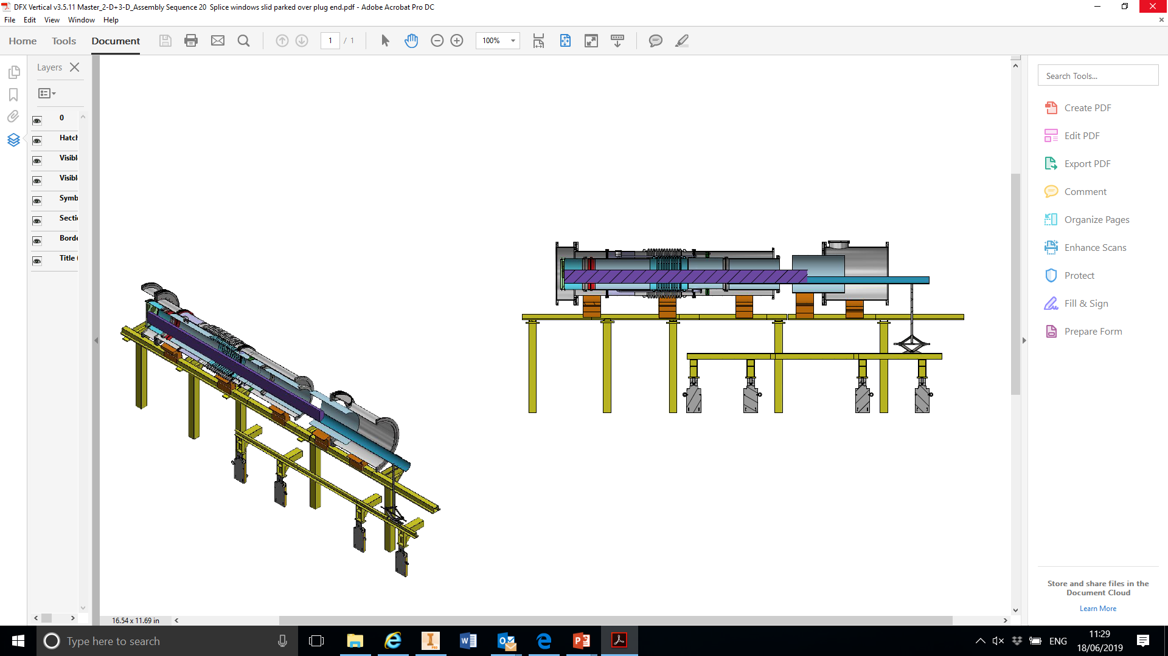
Stage 1.3 – Parking of the sliding splice section
1. The parking extension for the splice section installed
2. Insertion of the sliding splice section

Slide 38
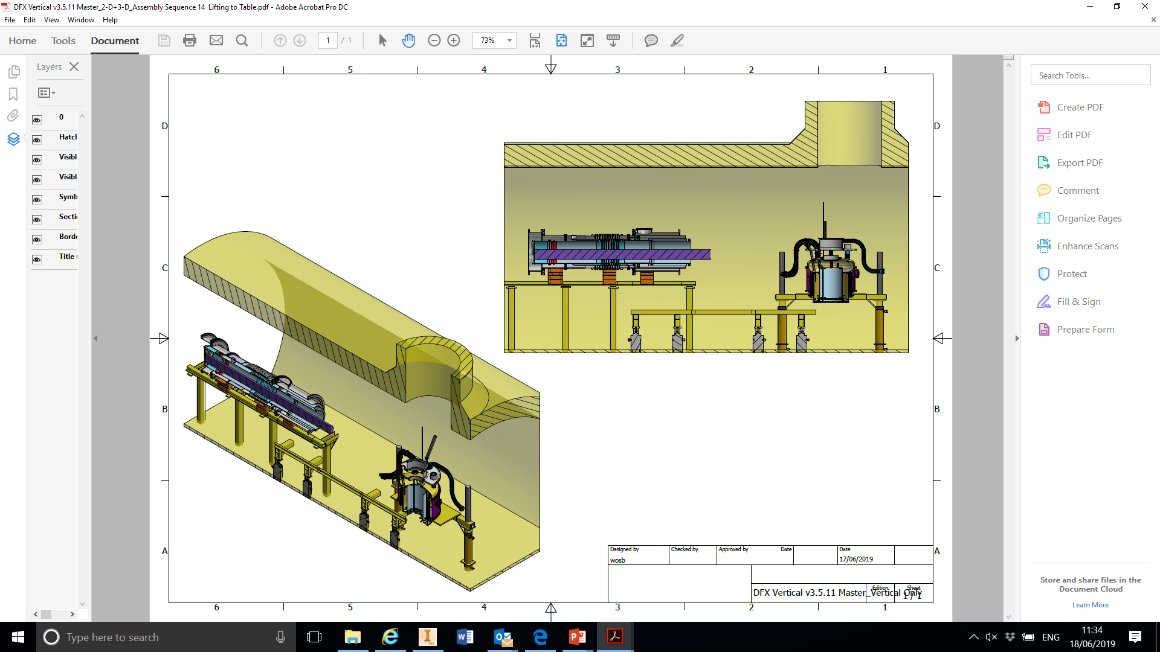
Stage 2 Assembling the vertical DFX and integrating of the SC-Link
1. Horizontal section at the plug end installed
2. Load the pre-assembled vertical DFX upper section on the supporting frame

Slide 39
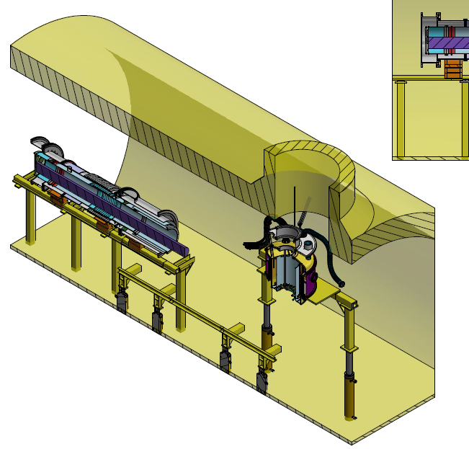
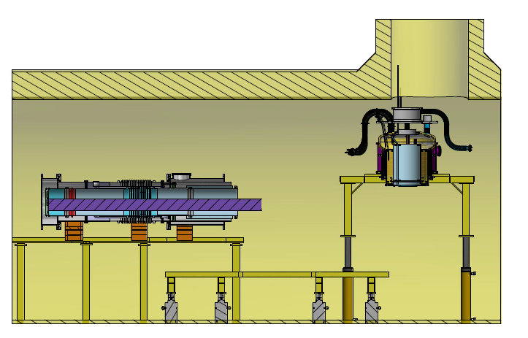
Stage 2.1 Fix the top flange to CERN defined interface position
2. Fix the top flange using supporting mechanisms installed on the shaft by CERN. This is the installation interface defined by CERN
1. Raise the vertical upper sub-assembly and maneuverer the top flange to position

Slide 40
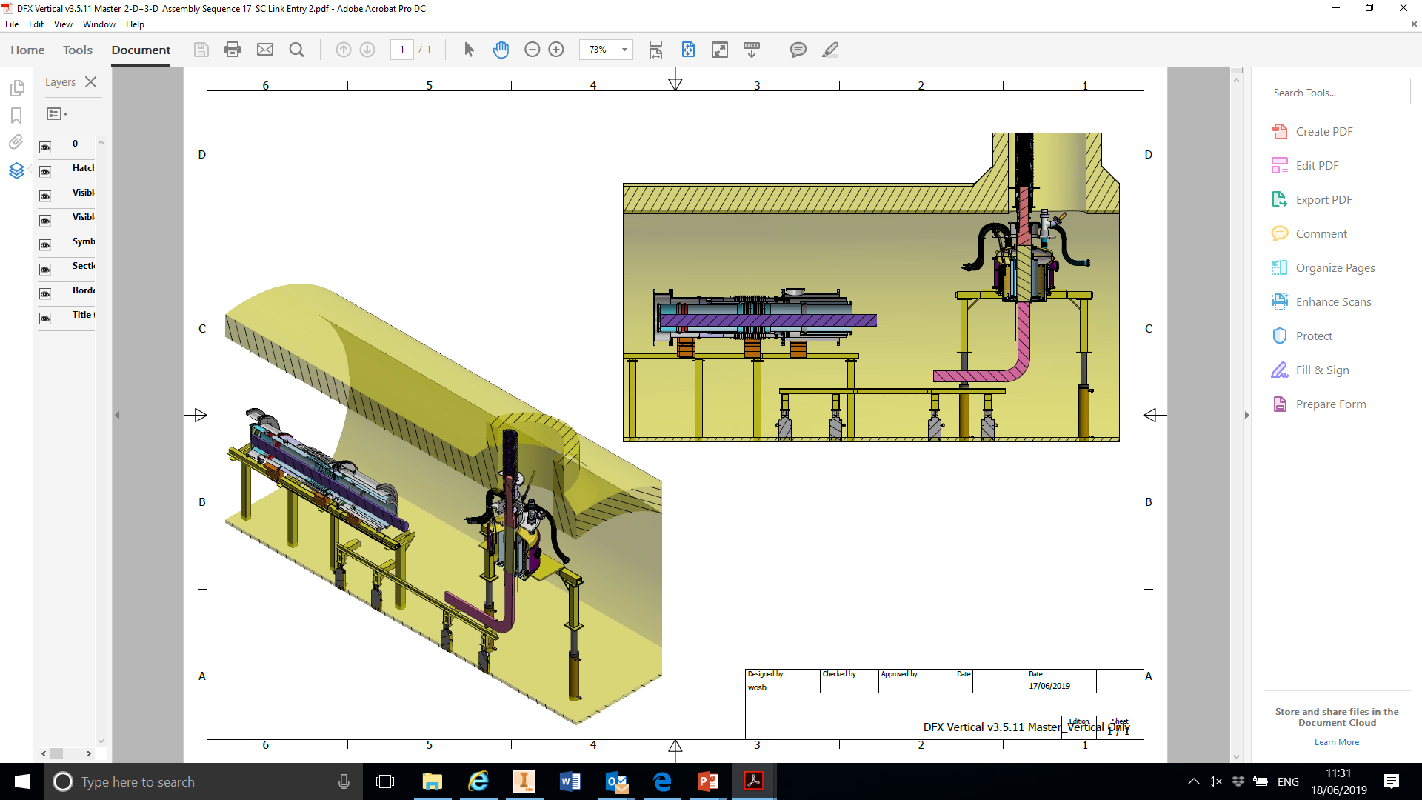
Stage 2.2 Insertion of SC-Link and integration with the vertical DFX upper section
3. Position the top of the rigid splice section for welding to the vertical DFX upper inner welding flange
4. Weld in situ #W3
1. Insertion of SC-Link with DFH from the shaft
2. Guide LTS bus-bar with support for a moderate bending radius, likely resting on the floor

Slide 41
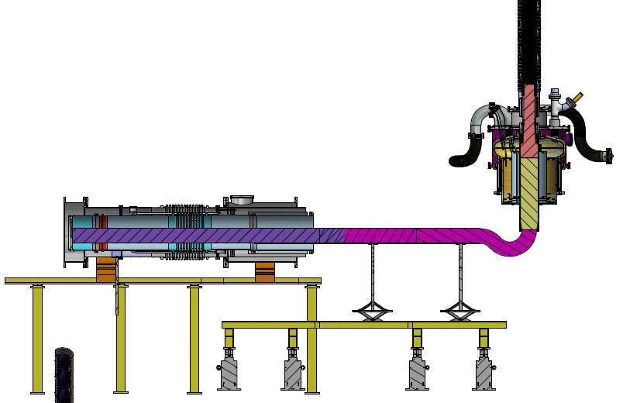
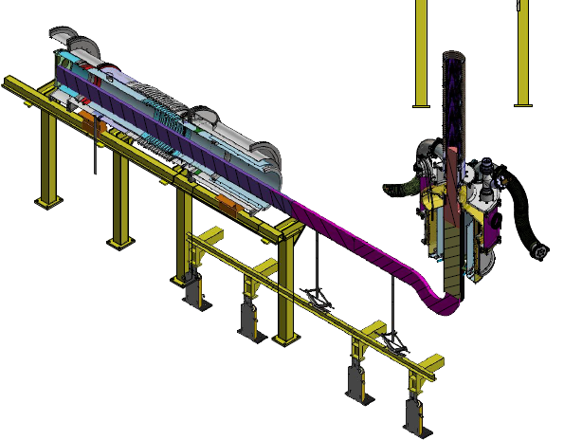
Stage 2.3 Completion of vertical DFX upper assembly and shaping the LTS bus-bar
Move the inner vessel up 80mm towards the top flange into the final position
Close the vacuum vessel of the upper and mechanically link the inner to the outer via the vacuum break
Remove the supporting frame and transfer the mechanical support to the top flange
Shape and support the LTS bus-bar for
further DFX installation steps

Slide 42
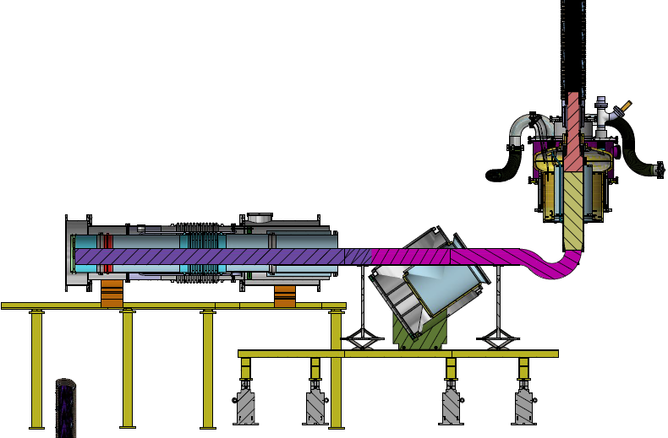
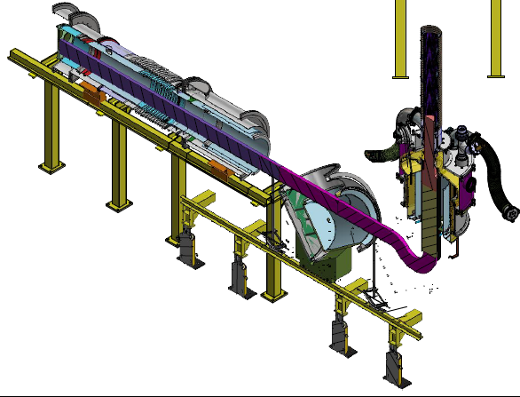
Stage 2.4 Insertion of the vertical DFX lower elbows
The inner elbow inserted and position in the outer elbow
Sliding insertion at a predefined angle on the rail
Shuffling the LTS bus-bar support while inserting

Slide 43
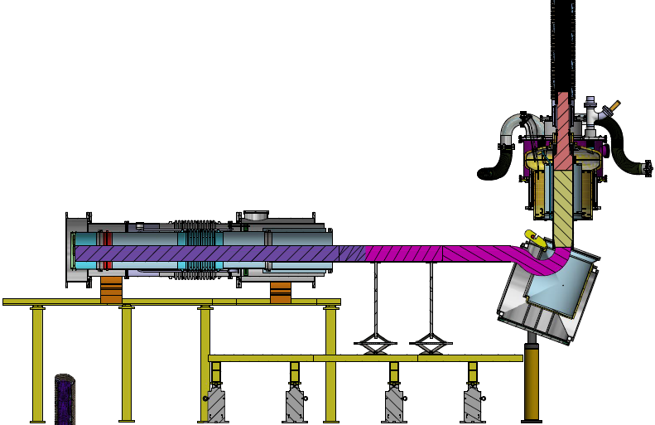

Stage 2.5 Swing the elbows into vertical position
Engage the elbows to a pre-installed pivot via a suitable arm at the end of sliding
Swing the elbow vertical and transfer support to a frame in the next step

Slide 44


Stage 2.6 Welding of the inner elbow
The inner and outer elbows independently supported by the platform
Outer elbow lowered to allow 92mm clearance for the welding of the inner elbow to the upper inner vessel
Weld in situ #W4

Slide 45


Stage 3 Assembling the horizontal section at the SC-Link end
Sliding in the rest of the horizontal inner and outer sections and expose the welds to be made
Shuffle the outer elbow to expose the weld provision between the inner elbow and the horizontal transition cone for the clearance indicated
Weld the cone in situ (#W5) to the inner elbow
Move the horizontal inner bellow section to position and weld in situ (#W6) to the narrow end of the cone

Slide 46

Stage 4 Splicing LTS bus-bars
Move the outer elbow back and clamp to the upper vacuum vessel
Move the horizontal vacuum tubes/bellows to position and clamp together and to the elbow
The splice window fully expose for joining the LTS bus-bars
Making interconnections to the IFS
Final electrical tests of all instrumentations/voltage-taps

Slide 47


Stage 5 Closing the splice window to complete the DFX assembly and SC-Link/Plug integration
Weld in situ #W7 and #W8

Slide 48
Thank you for your attention

Slide 49



Detailed DFX Schematics: Lowering and raising
Fully assembled
Top flange raised
Inner vessel lowered

Slide 50



Detailed DFX Schematics: Lowering and raising
Fully assembled
Top flange raised
Inner vessel lowered

Slide 51
Detailed DFX Schematics: Lowering and raising
Fully assembled
Top flange raised
Inner vessel lowered

