Slide 1

Design and integration of safety equipment and safety aspects in the LHC tunnel
(cryogenic safety only)
Vittorio Parma (vittorio.parma@cern.ch),
Th.Otto (TE DSO and HL LHC Safety Officer)
CERN, Technology Department
DFX Detailed Design Review, CERN 20 June 2019

Slide 2
Contents
System description
Cryogenic safety
  Updated figures wrt CDR
  Risk assessment and sizing of safety
Summary
Disclaimer: the following presents an updating of the cryogenic safety devices only. For more details on safety approach please refer to CDR presentation: https://indico.cern.ch/event/783116/

Slide 3
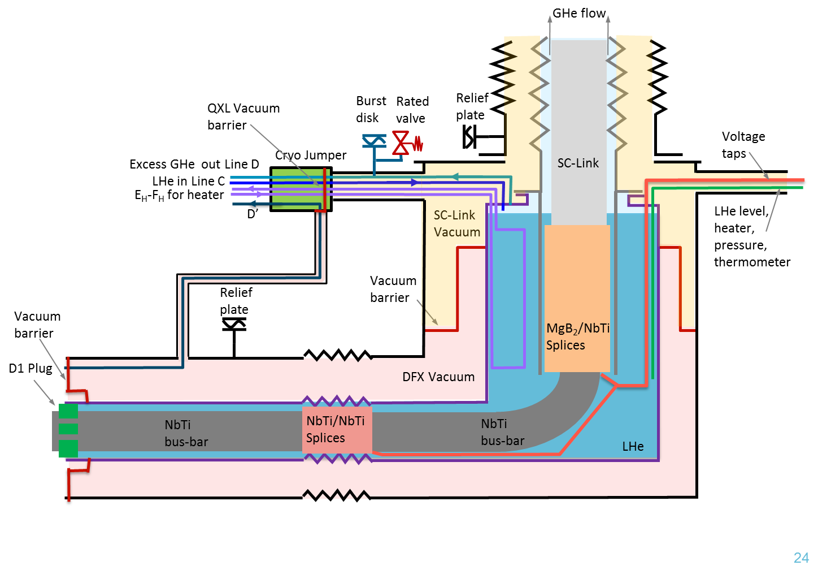
DFX schematic description
For the safety assessment
we consider this connection to the SC link
as closed
Within scope of
this presentation
Sketch not up to date, only for illustration of volumes and safety devices

Slide 4
DFX Volumes and Cold Surfaces:
(update wrt CDR)
Based on Model v3.5.9 (W.Bailey, SOTON)
 | (CDR | Values)
 | 568
 | 212
 | 780
 | 21
 | 1’293
 | 7.6
 | 1.2
Volumes and surface areas |  | Units
Horizontal Section - Cold Volume | 379 | Litres
Horizontal Section - Conductor Volume Removed | 296 | Litres
Vertical Section - Cold Volume | 277 | Litres
Vertical Section - Conductor Volume Removed | 223 | Litres
DFX Total Cold Volume | 656 | Litres
DFX Total Cold Volume (Conductor Volumes Removed) | 519 | Litres
DFX Helium Vapour Space (nominal conditions) | 75 | Litres
DFX Annular Volume (between 2 vacuum barriers) | 637 | Litres
Cold Surface Area (Plug side to barrier) | 6.6 | m²
Cold Surface Area (SC Link side to barrier) | 1.7 | m²
Helium inventory reduced (-16%) → OK
Insulation vacuum reduced (-50%)
Overall cold surfaces slightly reduced (-6%) → OK

Slide 5
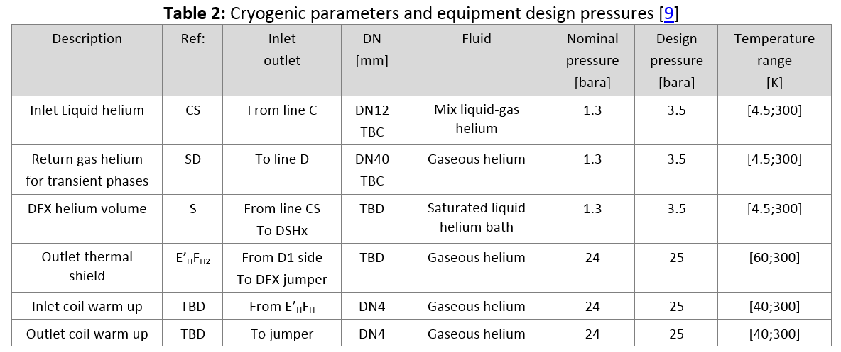
Helium envelopes
(DFX specification, EDMS1905633)
2.5 bara
Change of Design Pressure of He vessel: reduced from 3.5 to 2.5 bara (-28%) to align to the Design Pressure of SC link (an incorrect value was assumed up to the CDR!)

Slide 6
Updated Scale of pressures, helium vessel
bar(a)
Ptest: Test pressure
3.5 bar(a) (1.43 x Ps); 4.6 bar(a) in atm.
Ps: Design pressure
2.5 bar(a)
Pt: burst disk set press.
≤ 2.5 bar(a) (1.5 barg)
Pn Nominal pressure
1.3 bar(a)

Slide 7
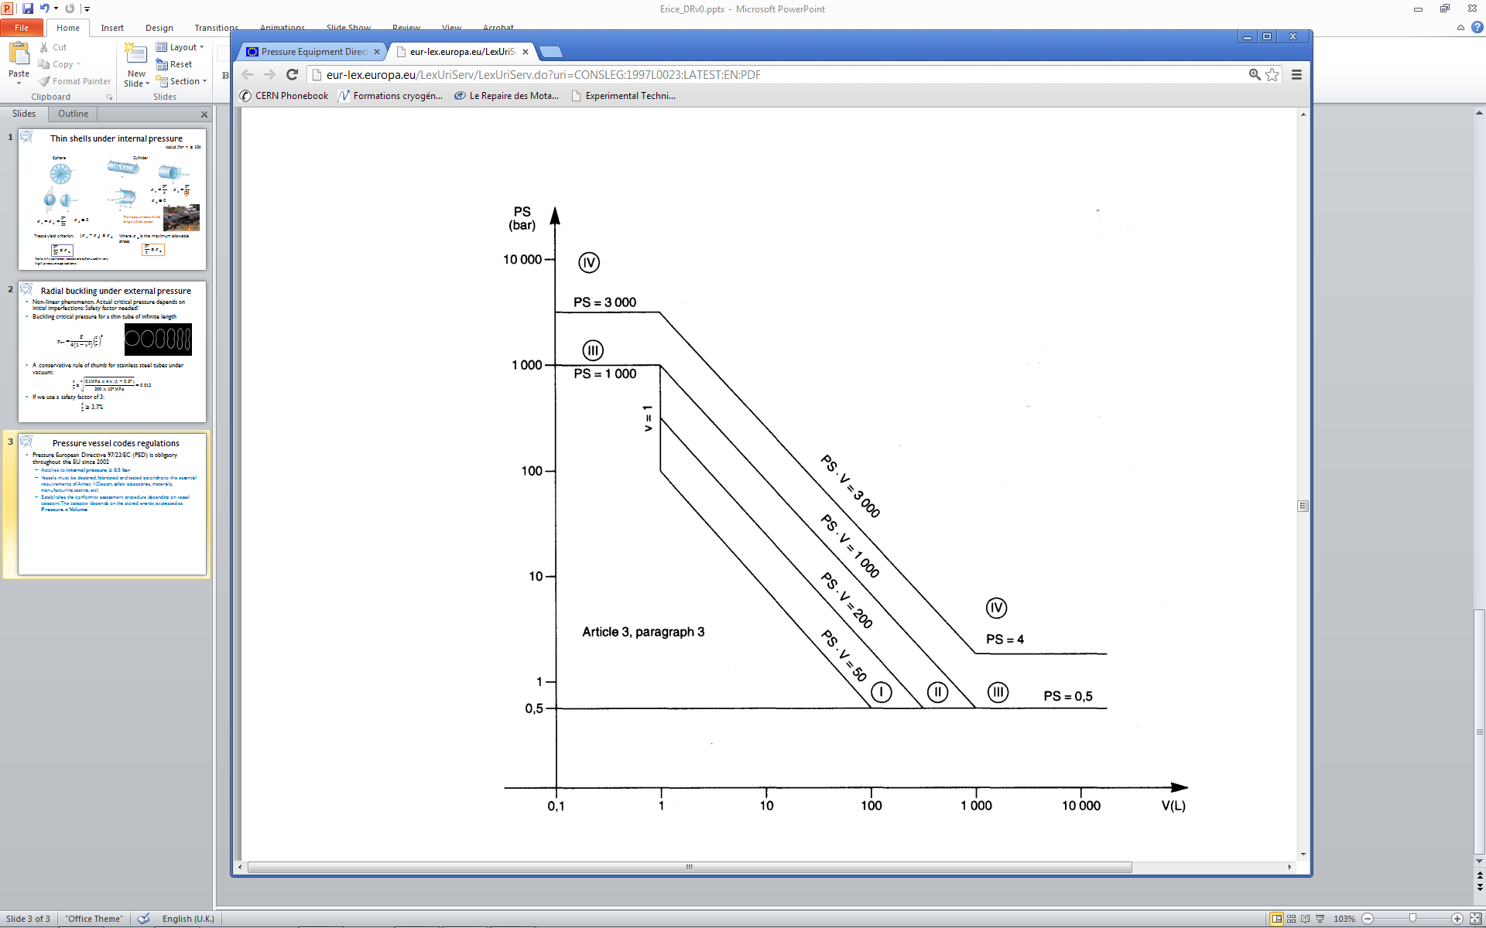
PED category
Ps x V = 1640 bar.L
With updated figures from CDR we are still in Cat.3
2.5
Article 4, paragraph 3
656

Slide 8
Pressure vessel codes regulations
Pressure European Directive 2014/68/EC (PED) is a legal obligation in the EU since 2002 and CERN’s Safety Unit (HSE) requests to comply with it:
  Applies to internal pressure ≥ 0.5 bar gauge
  Vessels must be designed, fabricated and tested according to the requirements defined
  Establishes the conformity assessment procedure depending on the vessel category, which depends on the stored energy, expressed as Pressure x Volume in bar.l
→ CE marking and notified body required from and above cat II
Category | Conf. assessment module | Comment
SEP | None | The equipment must be designed and manufactured in accordance with sound engineering practice. No CE marking and no involvement of notified body.
I | A | CE marking with no notified body involvement, self-certifying.
II | A1 | The notified body will perform unexpected visits and monitor final assessment.
III | B1+F | The notified body is required to approve the design, examine and test the vessel.
IV | G | Even further involvement of the notified body.
Pressure vessels
Article 4, paragraph 3
Vacuum vessels
For vessels with non-dangerous gases, Group 2, (cryogenic liquids are treated as gas)

Slide 9
Risk assessment matrix (unchanged wrt CDR)
 | High Risk
 | Medium Risk
 | Low Risk:
Remarks:
causes of excessive pressure are considered to be unrelated (single jeopardy theory) unless cause/effect exists

Slide 10
Retained pressure hazards
A) Accidental air venting of insulation vacuum with sudden condensation on cold surfaces, helium boil-off and pressure build-up → sizing of burst disk
C) Accidental release of cryogenic fluid from helium vessel to insulation vessel due to arc bursting helium envelope, helium pressurized at burst disk pressure, spill of helium inventory to vacuum vessel → sizing of vacuum vessel relief plate

Slide 11
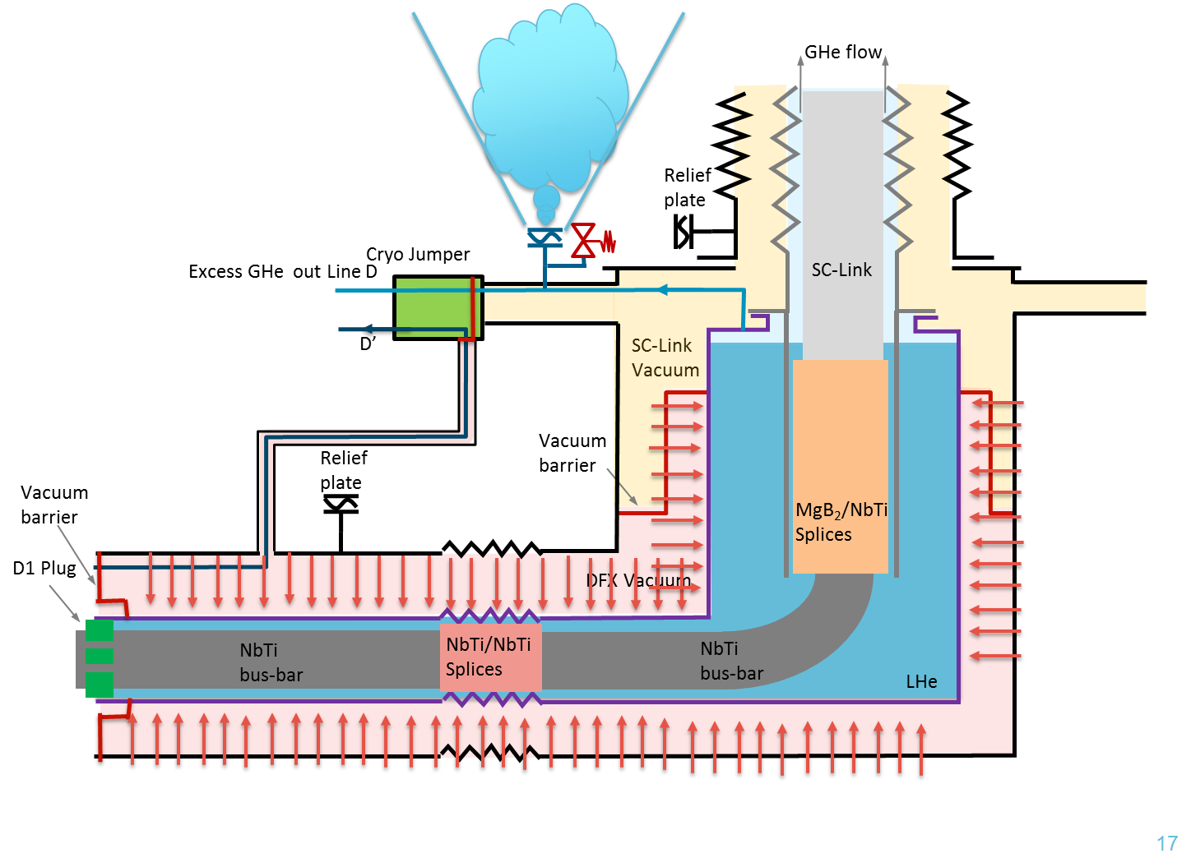
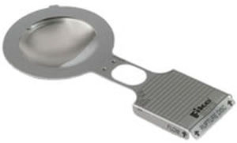
Hazard A
A) Accidental air venting of insulation vacuum with sudden condensation on cold surfaces, helium boil-off and pressure build-up → sizing of burst disk
DN63
Preliminary sizing:
Heat power density (10 effective MLI layers): 6.2 kW/m2
Heat flux: 54 kW
Bust disk rupture pressure Pt: 2.5 bara (1.5 barg)
Safety device sizing (EN13648-3; EN4126-6 Annex C): supercritical He at ~6.2 K:
  Qm = 3.5 kg/s
  DN > 45 mm → DN63, and equivalent burst disk
Example of DN50-mm bust disk
Thanks to Y.Leclercq for his calculation spreadsheet!

Slide 12
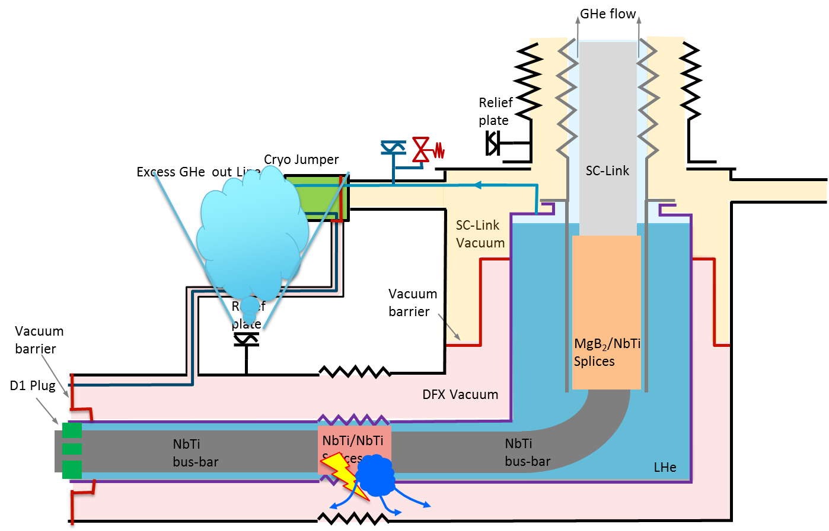
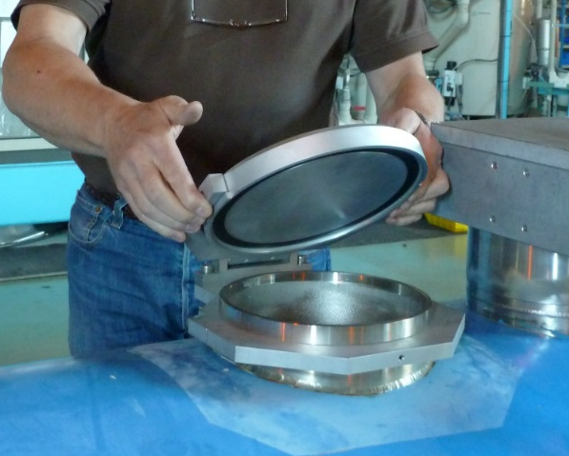
Hazard C
C) Accidental release of cryogenic fluid from helium vessel to insulation vessel due to arc bursting helium envelope, helium pressurized at burst disk pressure, spill of helium inventory to vacuum vessel → sizing of vacuum vessel relief plate
DN100
DN200
Preliminary sizing:
Assume orifice: DN50
Pt= 2.5 bara; Pb=0 bara; Trel= ~5 K
  Qmvessel = ~5 kg/s to the vac.vessel
Relief plate to limit ΔP to 0.5 barg (opens at 1.5 bara)
Assuming continuity of mass relief (conservative): Qmvessel = Qmrelief
  → ~DN100 → having space we choose DN200 for the horizontal section and DN100 for the vertical section
Example of DN200-mm relief plates,
(also exists in DN90,100, 160, 230)

Slide 13
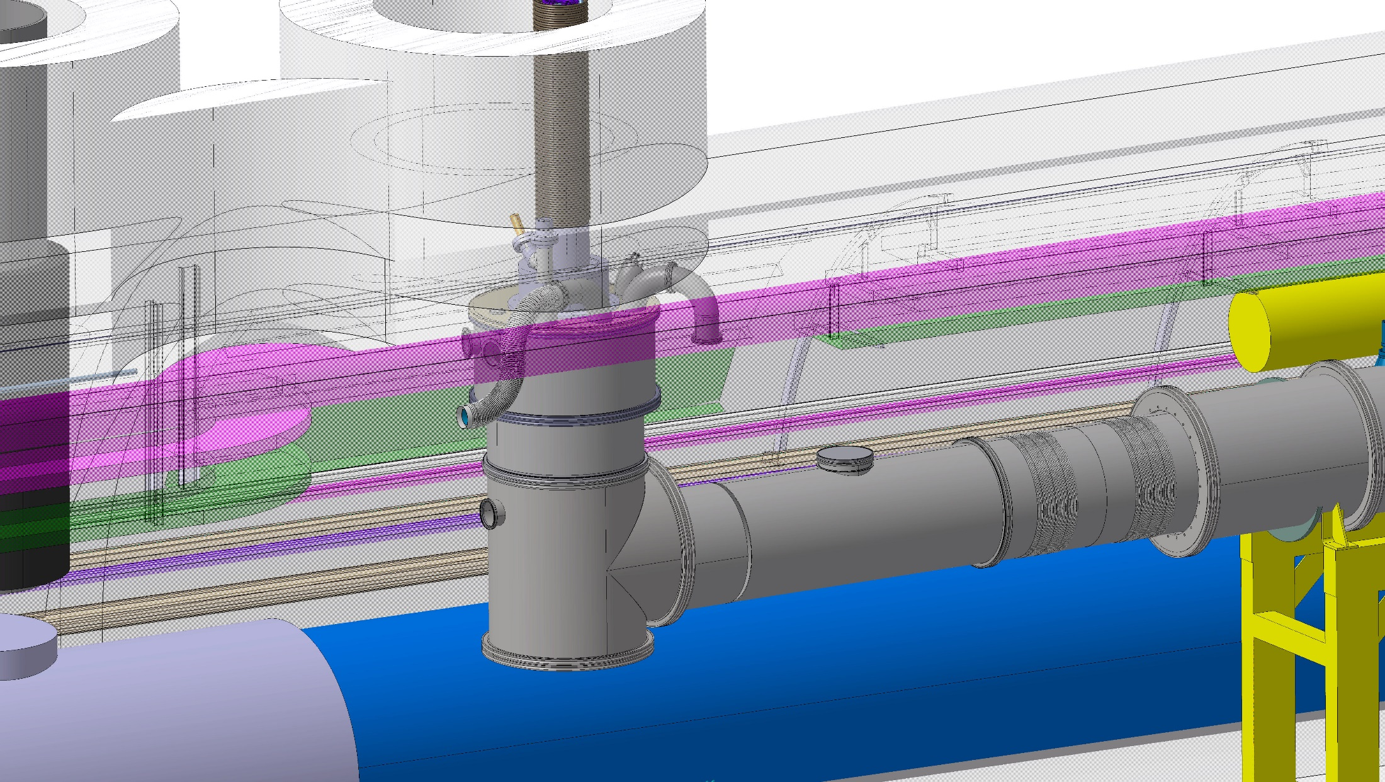
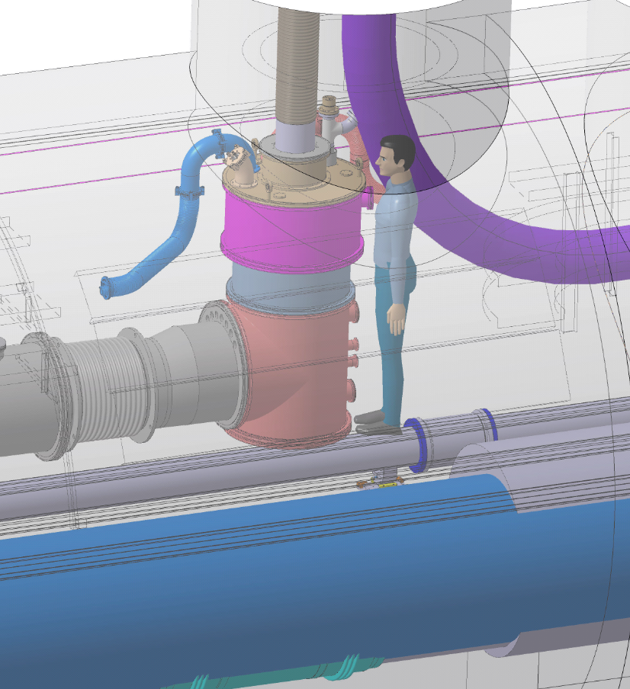
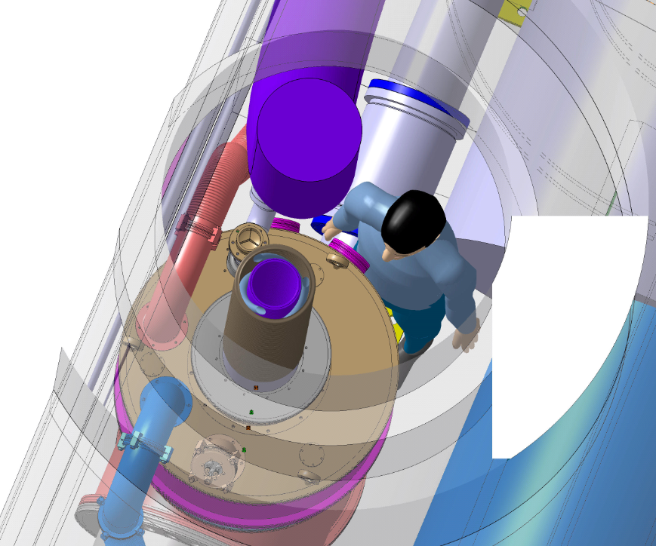
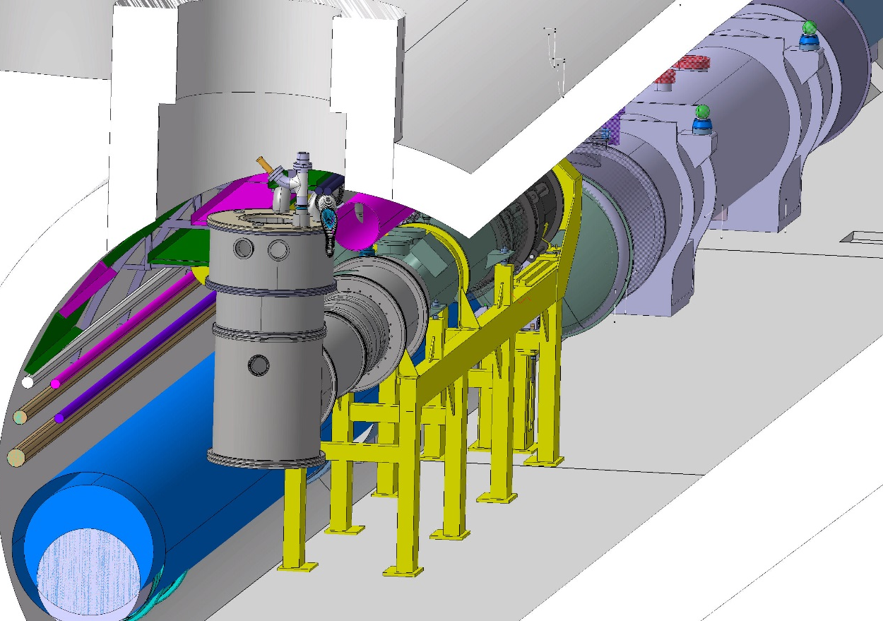
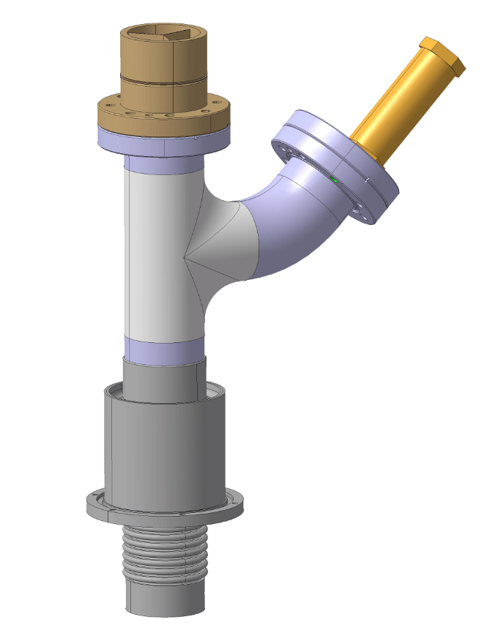
Locations of safety device
DN100
Relief plate
DN63 burst disk
+rated valve
DN200
Relief plate
Integration/maintainability to be carefully studied with WP15
Need for re-routing outside of the tunnel? Additional p drop ? (but we have contingency)

Slide 14
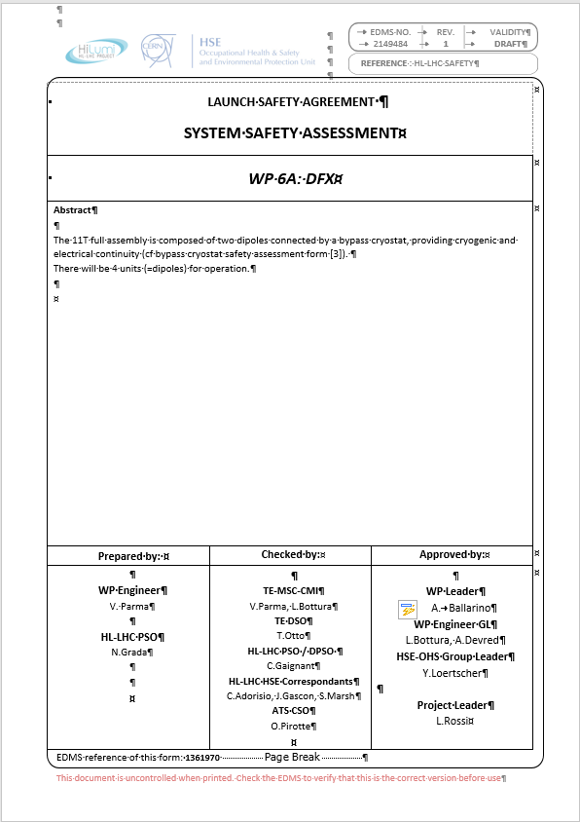
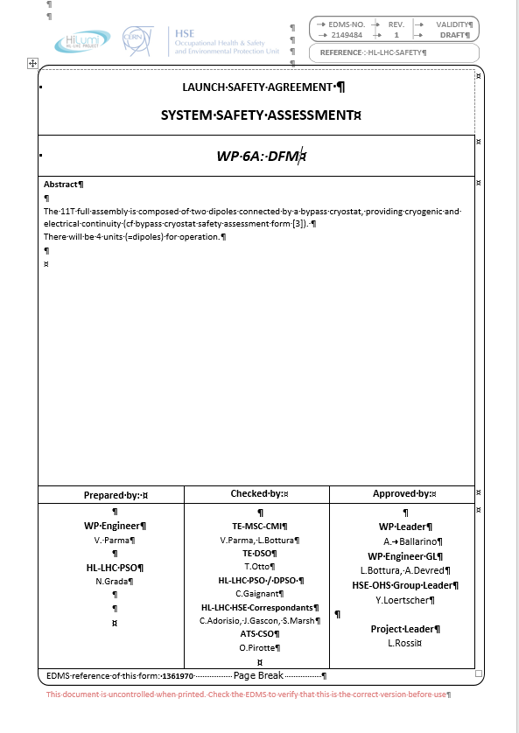
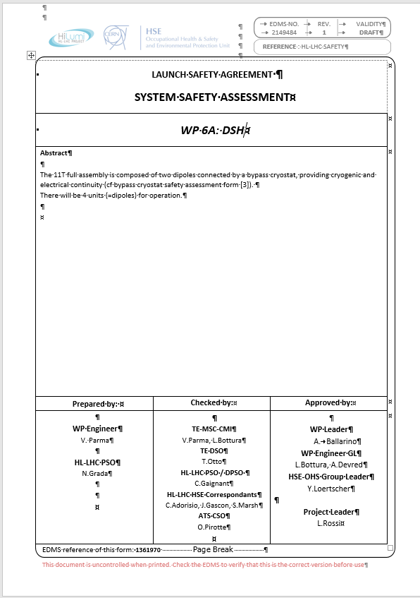
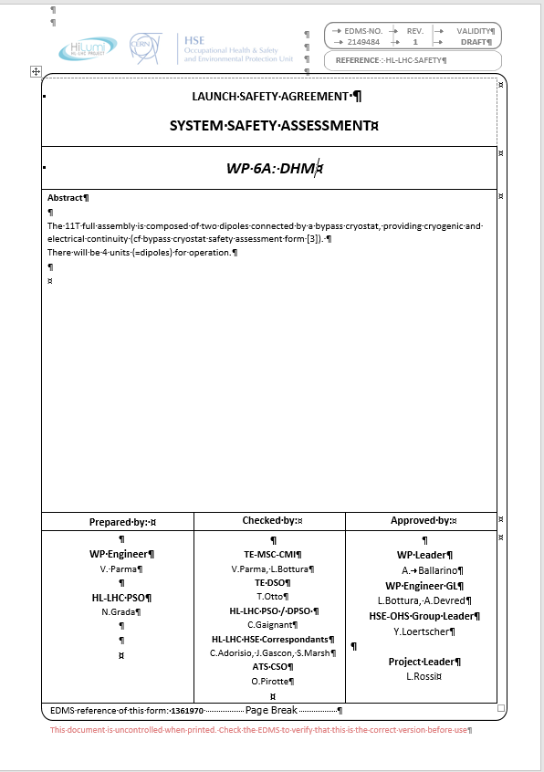
Safety Assessment
Based on work breakdown structure of WP, Project Safety Officers conduct “System Safety Assessment” (SSA):
  (Sub-)system description
  Hazard register
  Definition of mitigation measures
  Risk assessment, where required
  Safety clearance
(T.Otto, TE Dept.)

Slide 15
Safety Assessment – HSE Involvement
The SSA document for all (sub-) systems are submitted to HSE for comments
Mitigation measures agreed upon by HSE are implemented under project control
Design, fabrication, testing and installation of equipment with “major Safety implications”(mSi) are followed closely by HSE
Pressure vessels without CE mark are mSi
HSE defines in a “Memorandum of Safety Checks”
  Which controls it will make
  Which supporting documentation it expects from the manufacturer
When all HSE requirements met → Safety Clearance
(T.Otto, TE Dept.)

Slide 16
Summary
Since the CDR, the evolution of the design has not brought and major change in the cryogenic safety assessment
Even with a reduced design pressure of 2.5 bara, the safety devices can be kept to their original size
The equipment remains under Cat.3 of the PED
The locations of the vacuum insulation safety devices is similar to the ones of the LHC; the need for deflectors will be assessed as a result of the integration study
The location of the burst disk/rated valve assembly is positioned in the vertical shaft and the accessibility for maintenance needs to be confirmed as part of a complete integration study
Procedure for Safety Clearance presented

Slide 17
Thank you !
Q/A

