Slide 1
Mechanical interfaces of the DFX to the SC Link, DCM, and the cryogenic equipment
Y.Leclercq on behalf of the DF development team WP6a
20 June 2019
Detailed design review of the DFX

Slide 2
Interfaces overview
Tunnel Vault
SCLink
Tunnel, supports & Beam
SCLink interface
  Leads + Instru
  Jackets flanges
DCM interface
  Leads + Instru
  Jackets flanges
QXL interface
  Vacuum jacket flange
  Cryogenic lines
Instrumentation
  Sensors supports + IFS
  Splices + bus bars support
External services
  Vacuum equipment
  Pressure relief devices
DFX interfaces
  Outer & Inner jackets
  Cryogenics
  Supports
  External services
  Instrumentation & cables/splices
He Safety device
Jumper
Cryogenic lines
V
Vacuum equipment
IFS
NbTi leads
DCM
NbTi leads
Splice
T&H
Beam reservation

Slide 3

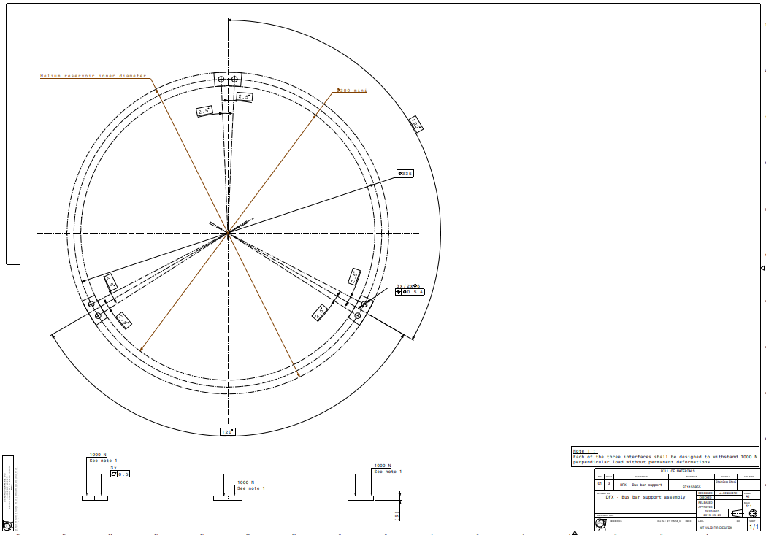
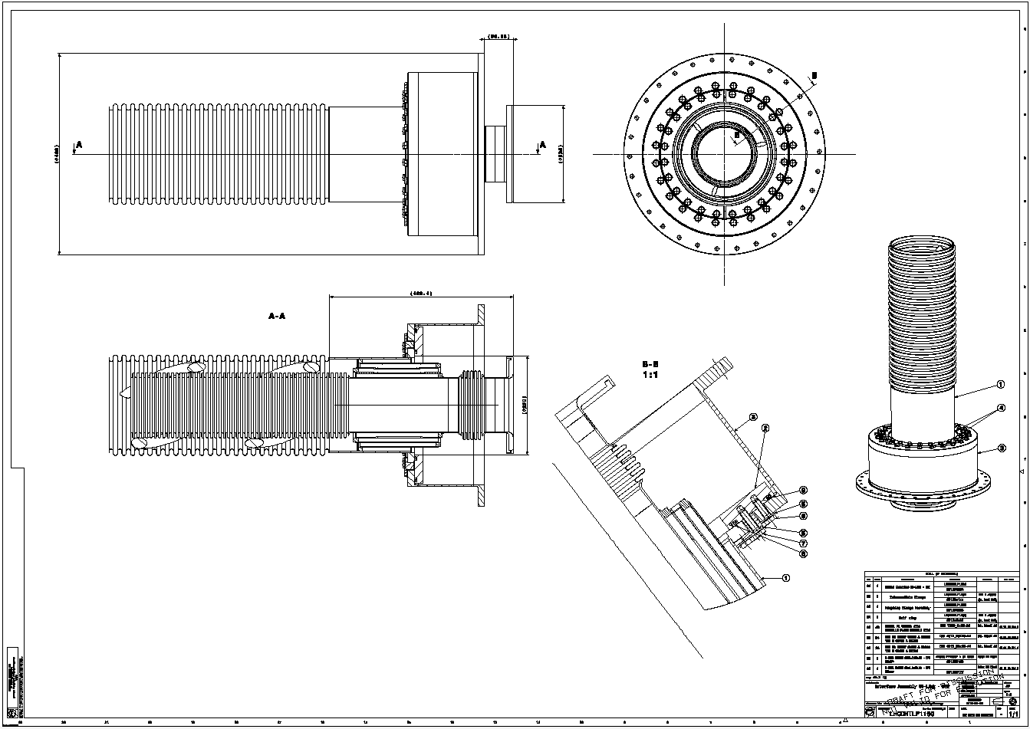
SCLink interfaces
Vacuum & Helium jackets
  LHCDHTLP1190
Helium jacket end
  Ø200 x 700 mm + NbTi bus bars
Bus bars
  Design of supports between bus bars de-scoped from prototype deliverables
  DFX shall present mechanical interfaces in helium vessel
    LHCLDQD_0003
NbTi-NbTi splices
  Fixed to helium vessel mechanical interfaces
    LHCLDQD_0003
SCLink Vacuum Jacket flange
Bolted to DFX vacuum vessel
SCLink Helium Jacket flange
Welded to DFX He vessel
Ø 200
700
MgB2-NbTi
rigid protection
NbTi
bus bars
Ø 150

Slide 4
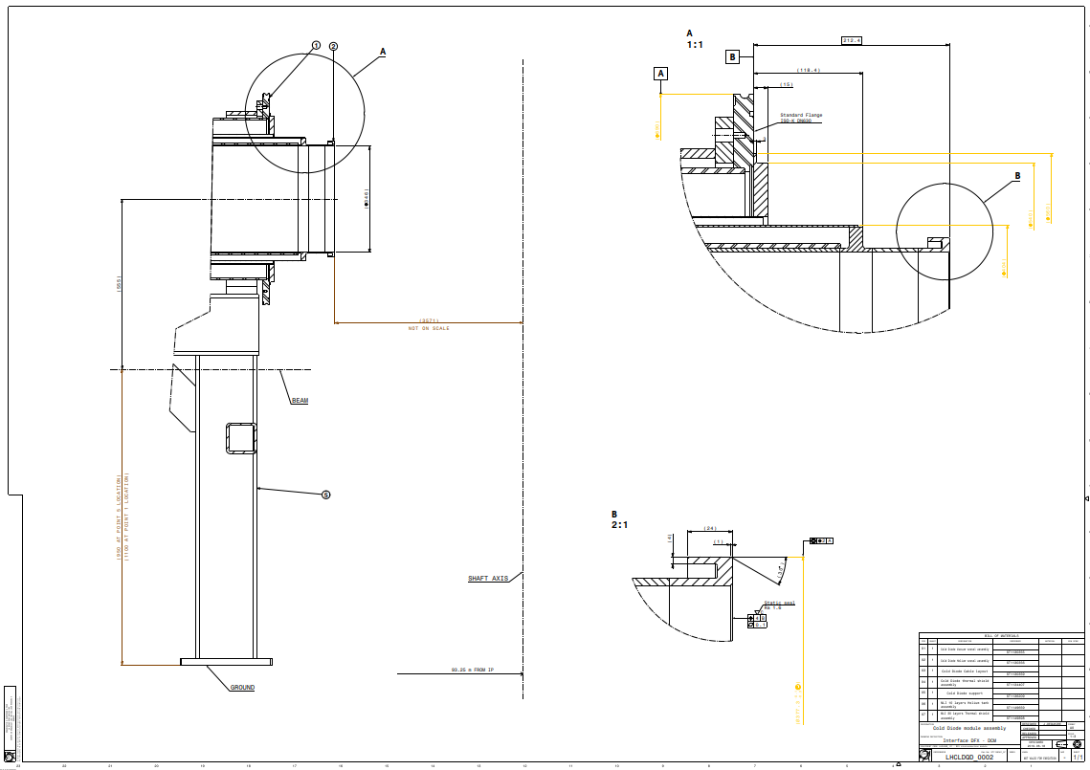
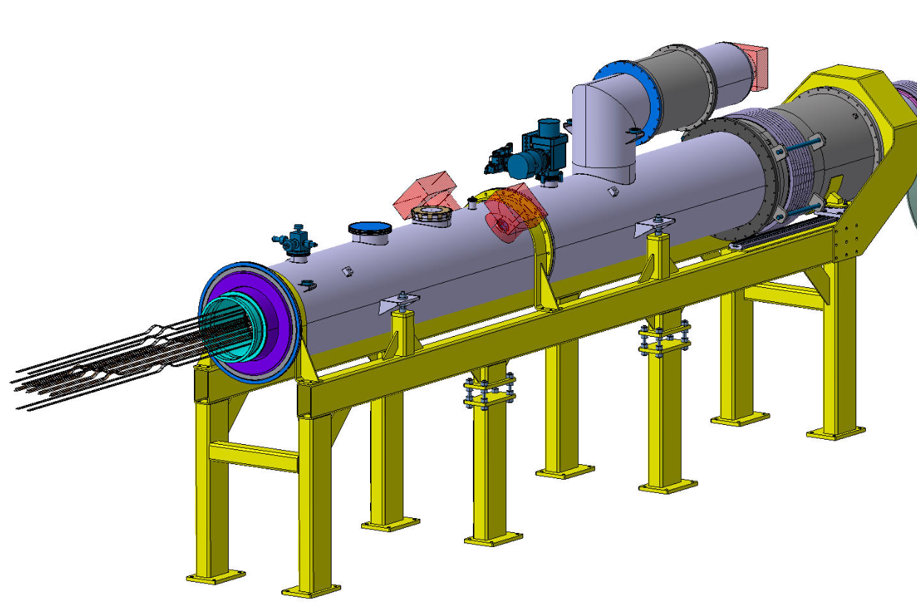
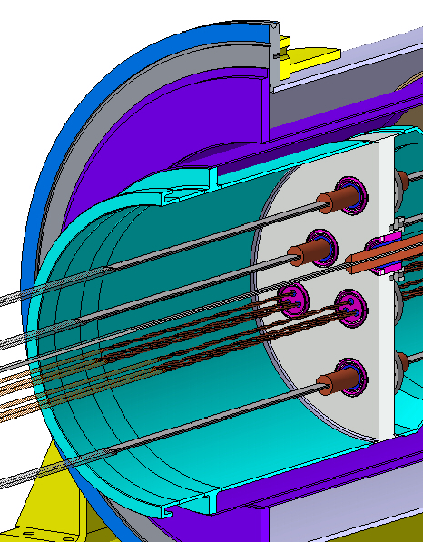
DCM interface
Core
axis
D1-DFX Connection Module (DCM)
Vacuum & Helium Jackets
  ISOK-DN630 with standard O-ring
  Lip weld
  Interface Drawing: LHCLDQD_0002
Bus bars
  De-scoped from prototype
3.6 m
555

Slide 5
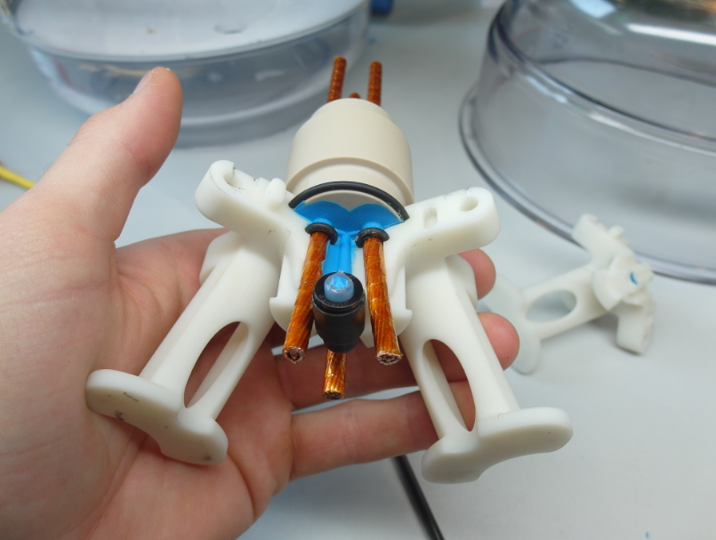
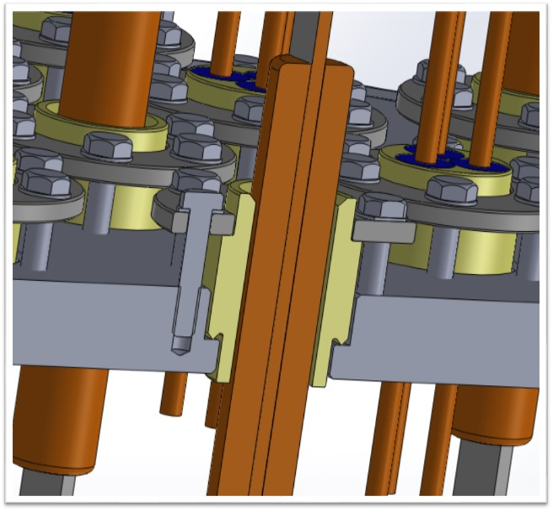
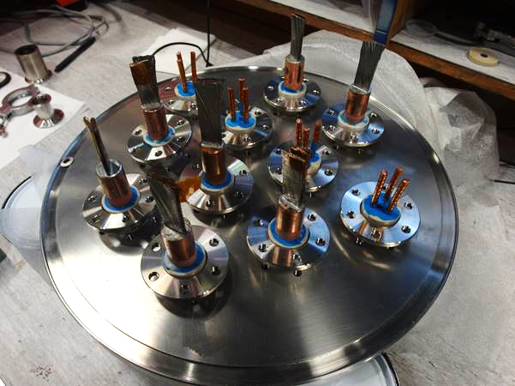
DCM interface : Lambda Plate
 |  |  | Cable type
 | I_{cable} [kA] | N_{cables} | Triplet side | Plug | DFX side
MQXF | 18 | 2 | 18 kA Nb-Ti round | 2 x MQXF leads | See J.Fleiter talk Round
MBXF (D1) | 18 | 2 | 13 kA Nb-Ti flat
Trims | 7 | 3 | 18 kA Nb-Ti round
MCBXF% | 2 | 12 | 6 kA Nb-Ti round | LHC 6 kA | See J.Fleiter talk Round
Bus bars overview (see dedicated talk)
Λ-Plate design based on LHC experience:
    ∆P=20 bar
    Nominal operation 1.9K
    Thermal cycle : 50
    Insultation @ RT : 4.6 kV
    Overall leak rate @ RT : 1.10⁻⁴mbar.l.⁻¹
R&D activities:
  Demonstrator completed
      6 kA type plug manufacturing R&D complete
      18 kA similar type plug being qualified
  Plug Lab complete
      Plasma treatment machine
      Soldering post
Thermo-mechanical results
  100% 6 kA plugs @ 1.10⁻¹⁰ mbar.l.s⁻¹ after 10 Thermal cycle and Pressure test (electrical qualification pending)
  80% 18 kA demo plug @ 1.10⁻¹⁰ mbar.l.s⁻¹ after 5 Thermal cycles
Final configuration in progress
  6 kA manufacturing procedure complete
  MQXF cable plug being developed
  Manufacturing & qualification procedures being finalised
  Final qualification with current during System test 2020
Courtesy S.Donche & E.Andrews

Slide 6
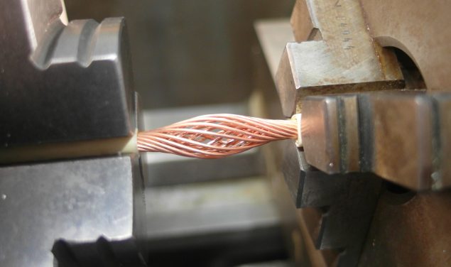
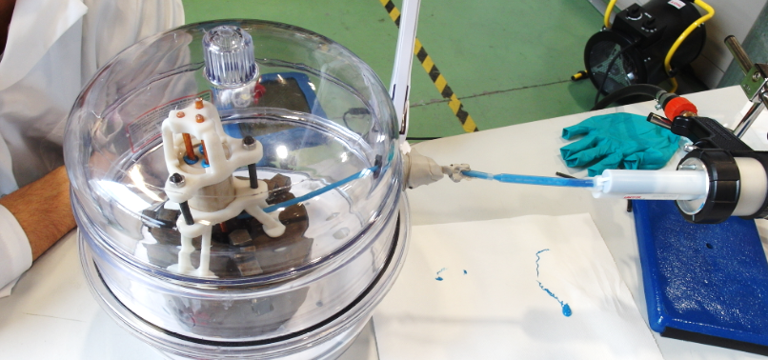
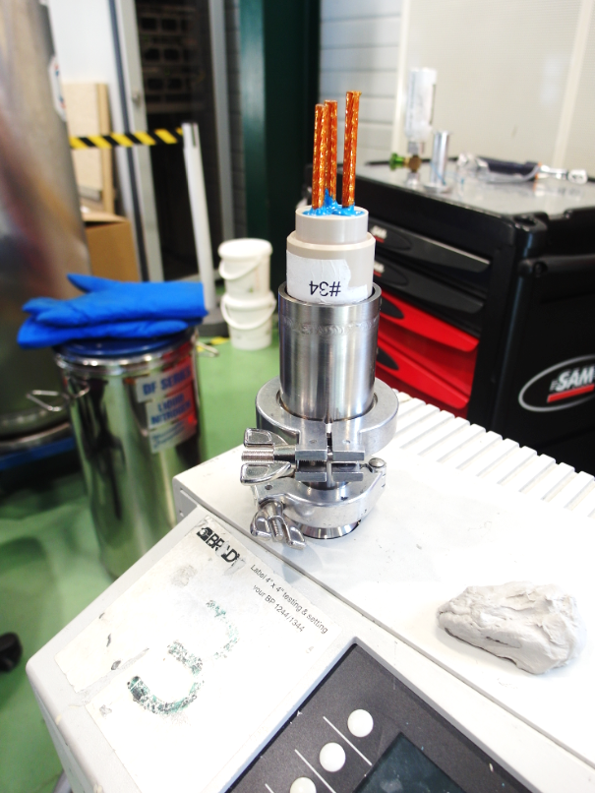
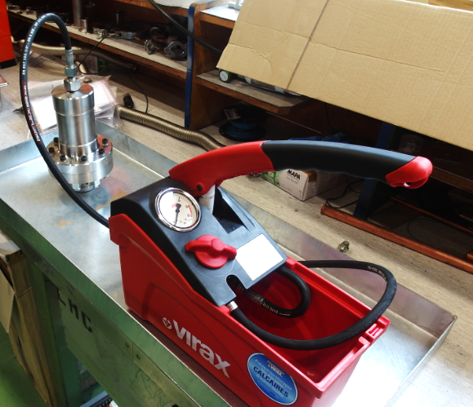
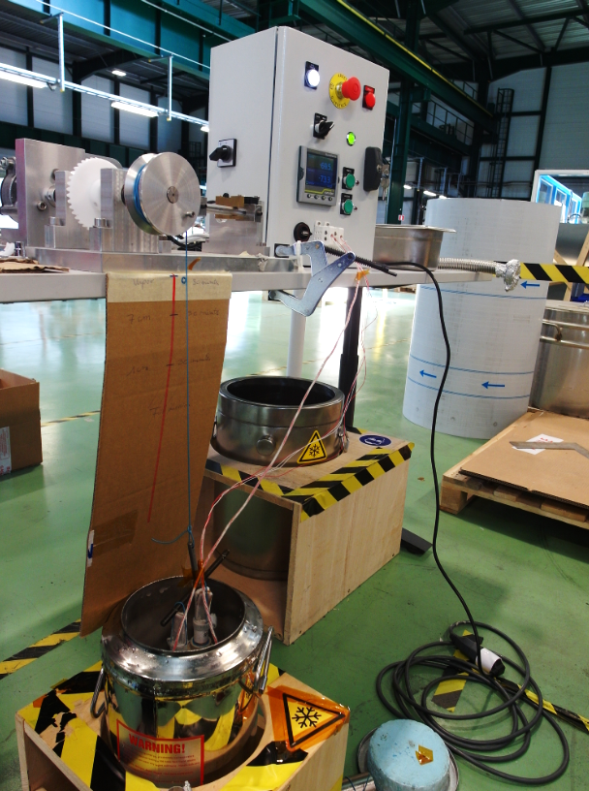
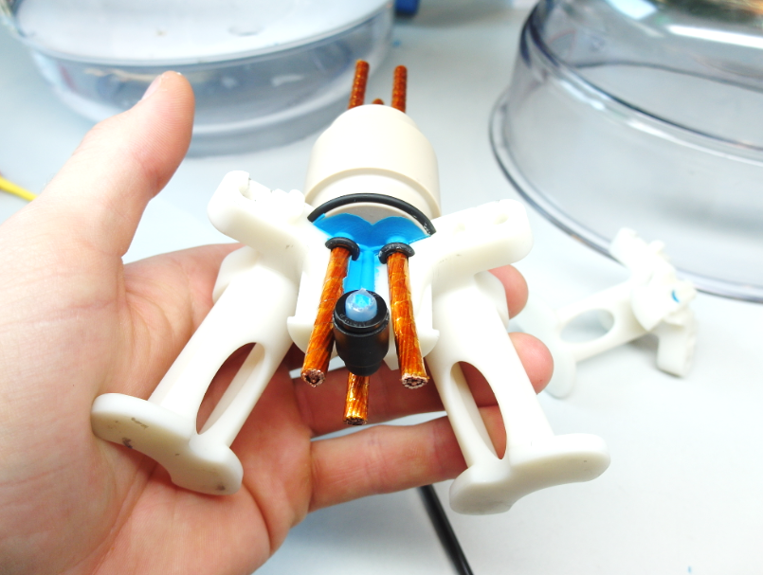
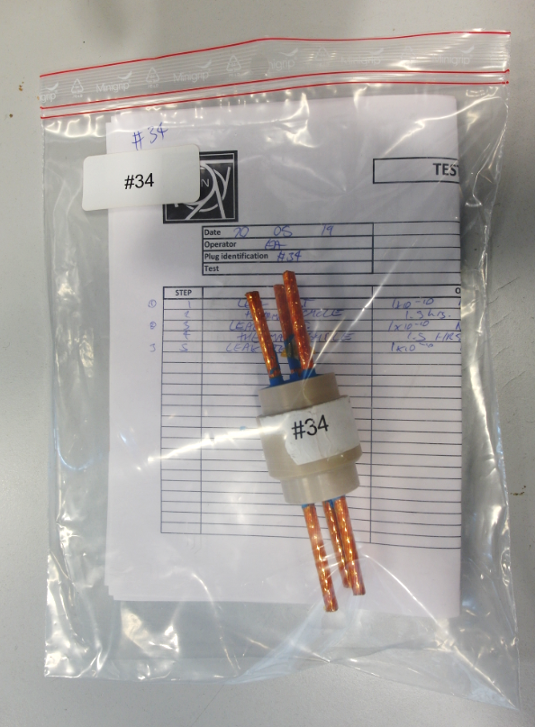
DCM interface : Lambda Plate
Cable opening
Cleaning
Plasma treatment
Status:
  Plug prototype production is up and running (procedures, tooling & equipment)
  Integration constraints shall now be studied
    Up to 6m long leads
    MQXF cable (proto with 13 kA LHC cable)
  Qualification procedures for series to be finalised
    Individual follow-up & results archiving in place
    Manufacturing procedures uploaded to EDMS
Production Plan
  Prototype expected by end of 2019
  Injection moulds, Peek & SS parts sub-contracted
  Assembly & qualification (thermo-mechanical + insulation) at CERN
Injection (800 mbar)
under vacuum (<1mbar)
of pre-heated parts (40°C)
Leak test
<1.10⁻⁸mbar.l.s⁻¹
Pressure test
1 h at 30 bara
Thermal cycles
X10 to 77K
Traceability
Demoulding
Courtesy S.Donche & E.Andrews

Slide 7
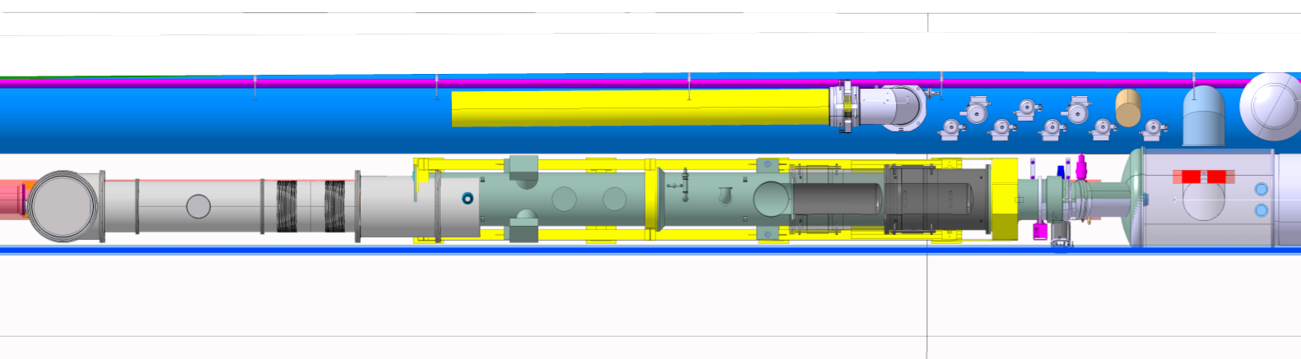
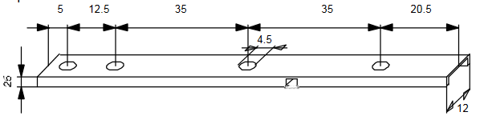
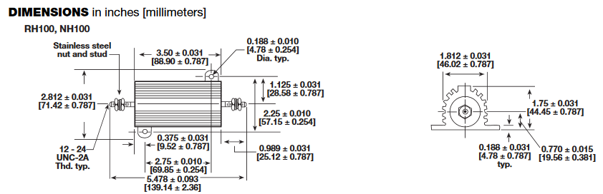
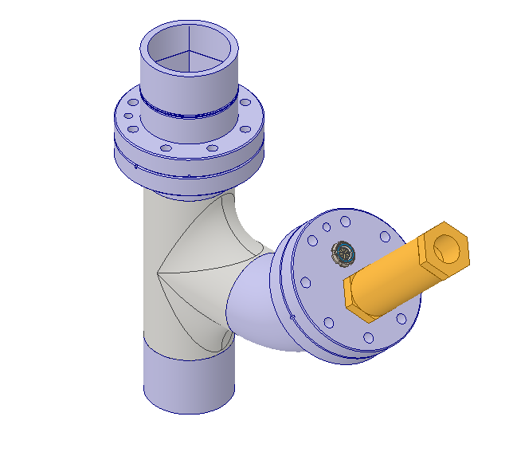
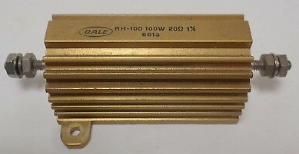
Cryogenics interfaces
Jumper interfaces
  Cryogenic lines defined for DFX
  Still discussions on DCM new module TS line
  Jumper location above the QXL
  DN250, longitudinal position TBC
Temperature sensors supports
  Interface long CERNOX
Heaters Vishay® RH100 interfaces
Level gauges interfaces
DeltaP gauge pneumatic fittings to be agreed
Pressure relief devices
  See safety dedicated talk
On going work for Jumper location

Slide 8
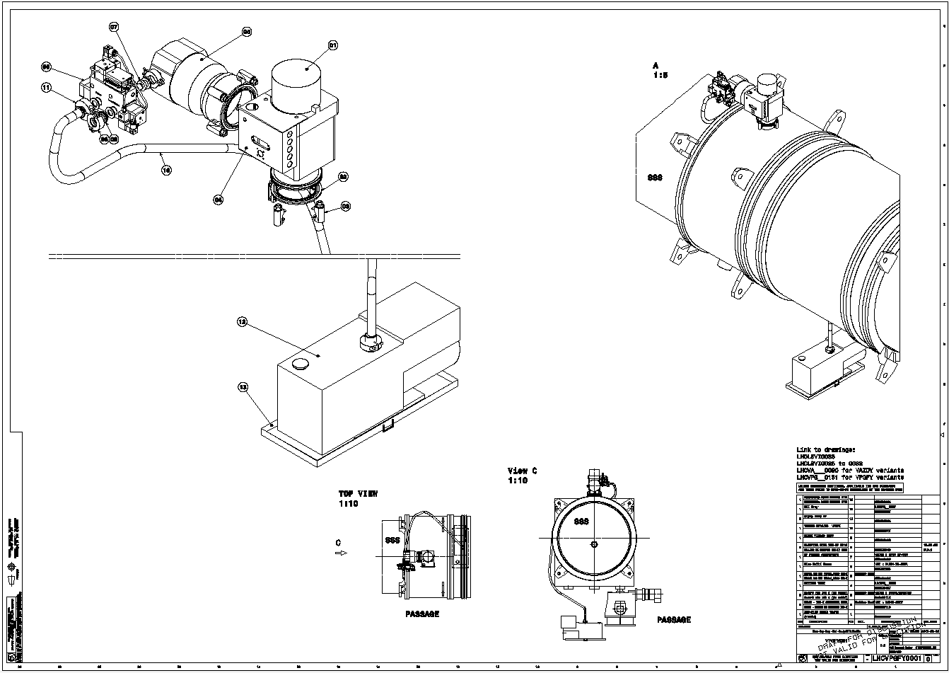
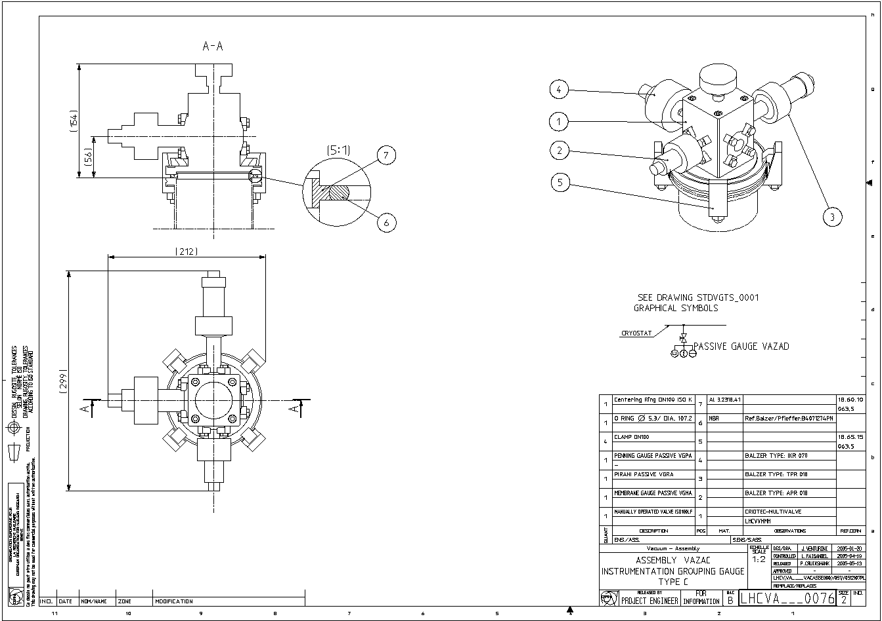
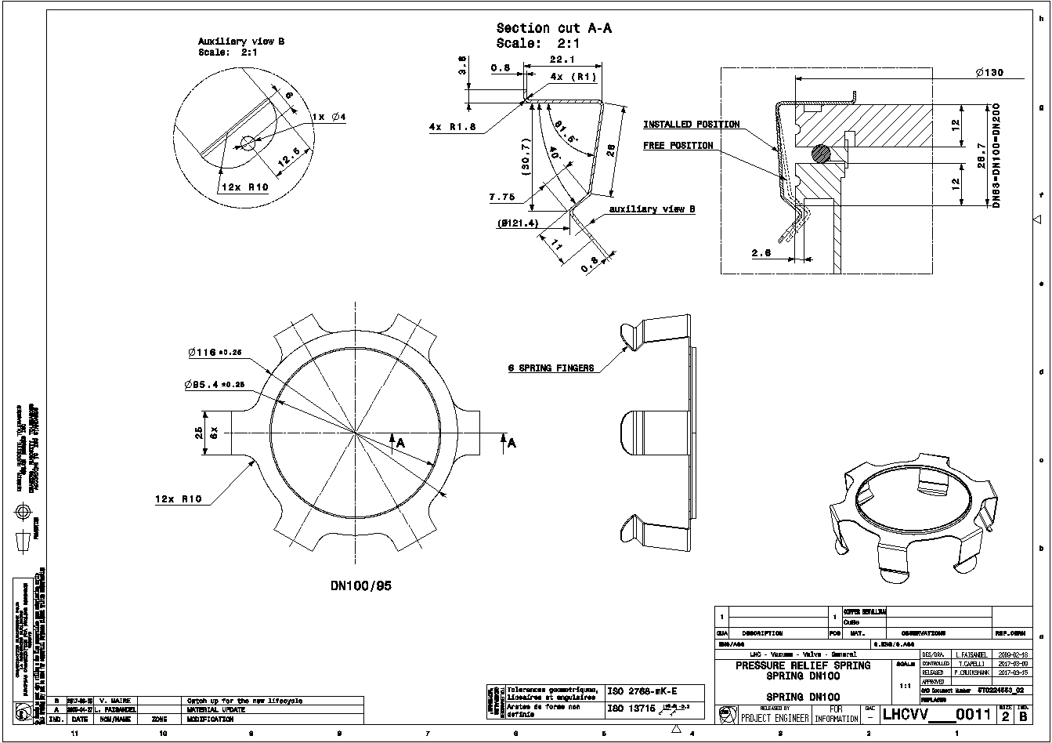
Insulation vacuum interface
SCLink insulation vacuum volume
  Pumping equipment :
    valve + turbopump + primary pump
    LHCVPGFY0001
  Gauges interface
    3 gauges on one ISO DN100
    LHCVA___0076
  Relief plate interface
    ISO-K DN100
    LHCVV___0011
DFX insulation vacuum volume
  Pumping equipment
    Valve + Turbopump + Primary Pump
    LHCVPGFY0001
  Gauges interface
    3 gauges pn pne DN100
    LHCVA___0076
  Relief plate interface
    ISO-K DN200
    ST0705009_01

Slide 9
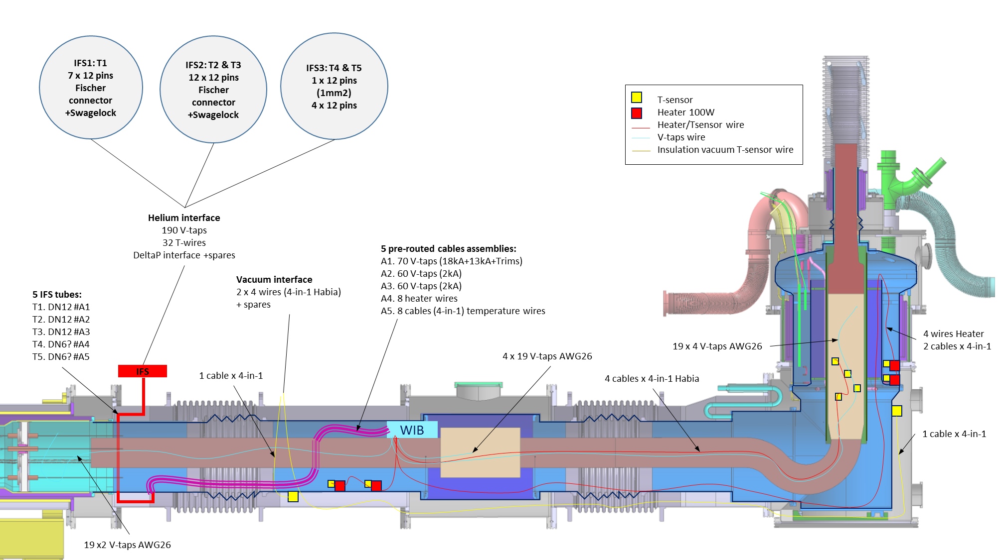
Instrumentation interface
Mechanical supports
Wire Instrumentation Box (WIB)
IFS
  (CERN design & supply)
  3 Flanges
  5 tubes sorted by functions
    190 V-taps
    32 T-wires
    8 power wires
Vacuum instrumentation feedthrough ISO DN100
Instrumentation Layout Proposal
9

Slide 10
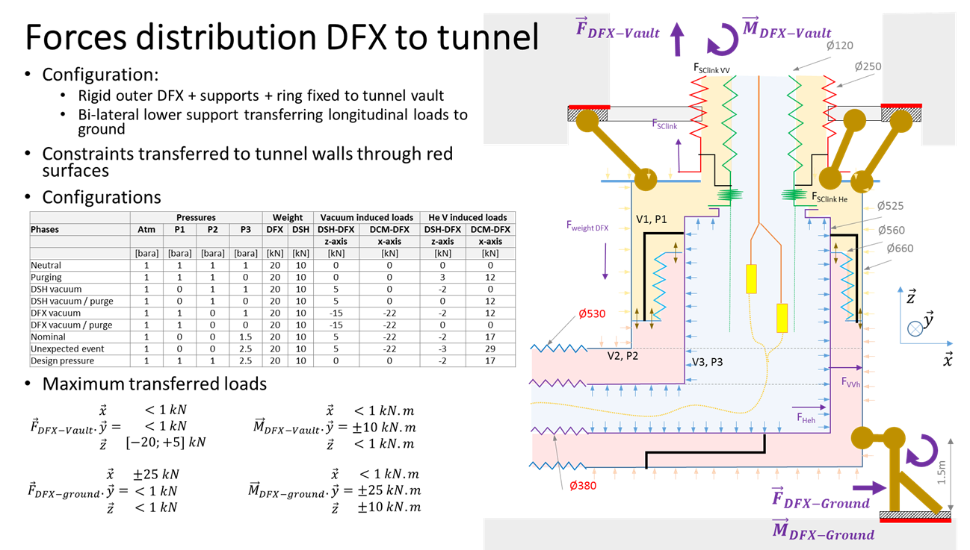
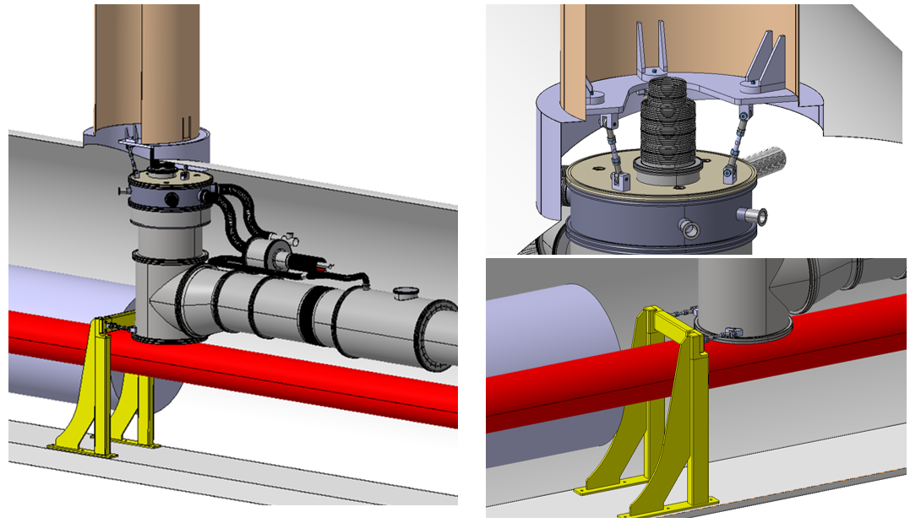
Civil Engineering & Transport Interfaces
CERN responsible for supports design to ground/ceiling in the tunnel
Conceptual proposal to ceiling and ground being discussed at CERN
DFX interfaces
  Civil engineering : threaded blocks
  Transport : adequate lifting points compliant with design
  Tooling not defined today
On going studies for load transfer to civil engineering
10

Slide 11
Summary
Mechanical interfaces are mostly defined
Some interfaces require more work (jumper, IFS)
Bus-bars supports de-scoped from prototype, DFX shall present mechanical interfaces

