Slide 1
Transport and installation of DFX in the LHC underground areas
R.Betemps, EN-MME
Y.Leclercq, V.Parma, TE-MSC
With input from SOTON (Y.Yang, W.Bailey) and WP15 (M.Amparo, P.Fessia)
Detailed Design Review of the DFX, CERN 20 June 2019

Slide 2
Preamble
The following slides show the main steps of the assembly of the DFX according to the design by SOTON, but projected into the tunnel environment according to the study by the integration team under WP15. It does not include tools for transport, handling, positioning, nor the special tools for welding, leak detection and other QC means. This work will be done by CERN in the next future and the first assembly need will be for installation in SM18 (for the system test and for the String) which will provide an opportunity for validating procedures, tools and QC.
The intention of these slides is to illustrate the environment and space limitations in the LHC tunnel in IR5L.

Slide 3
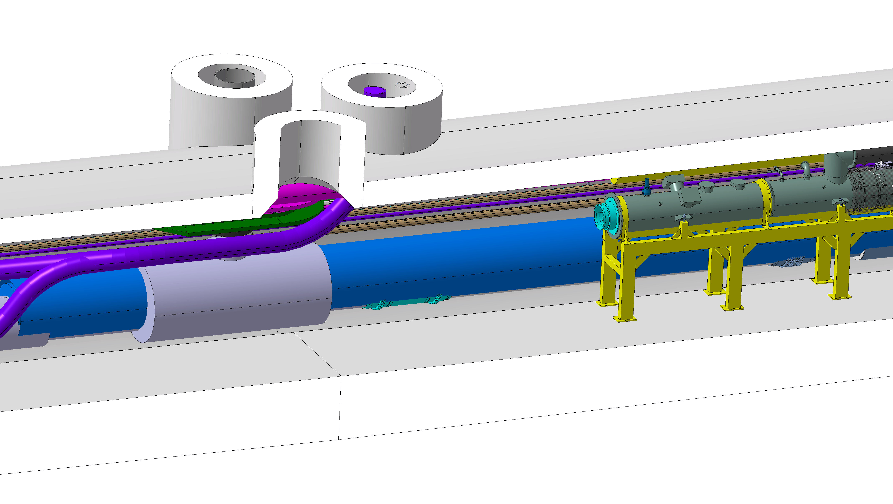
Tunnel configuration at DFX installation
SC link for DFM/D2
(space occupation, size is smaller)
DCM
D1
QXL

Slide 4
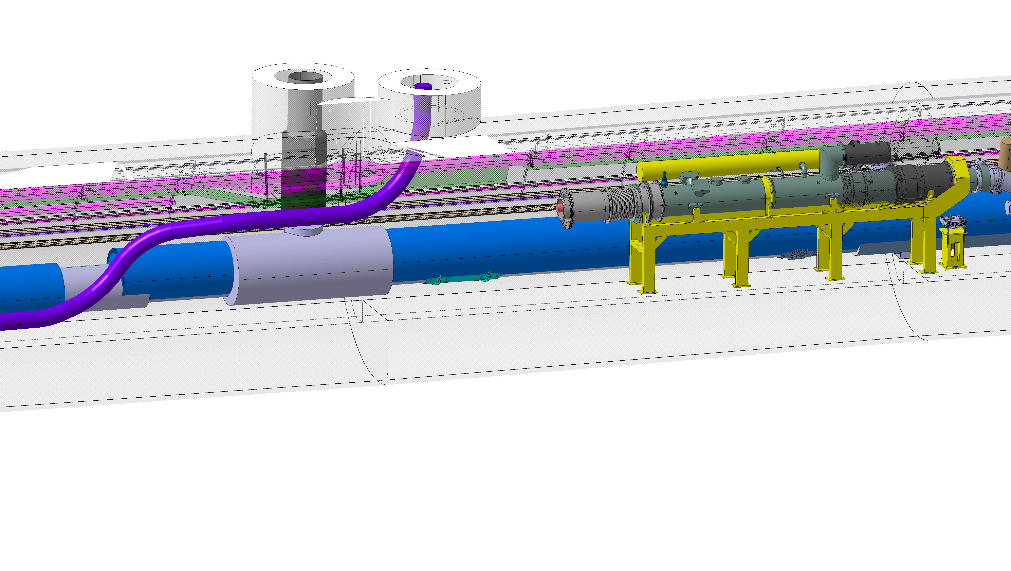
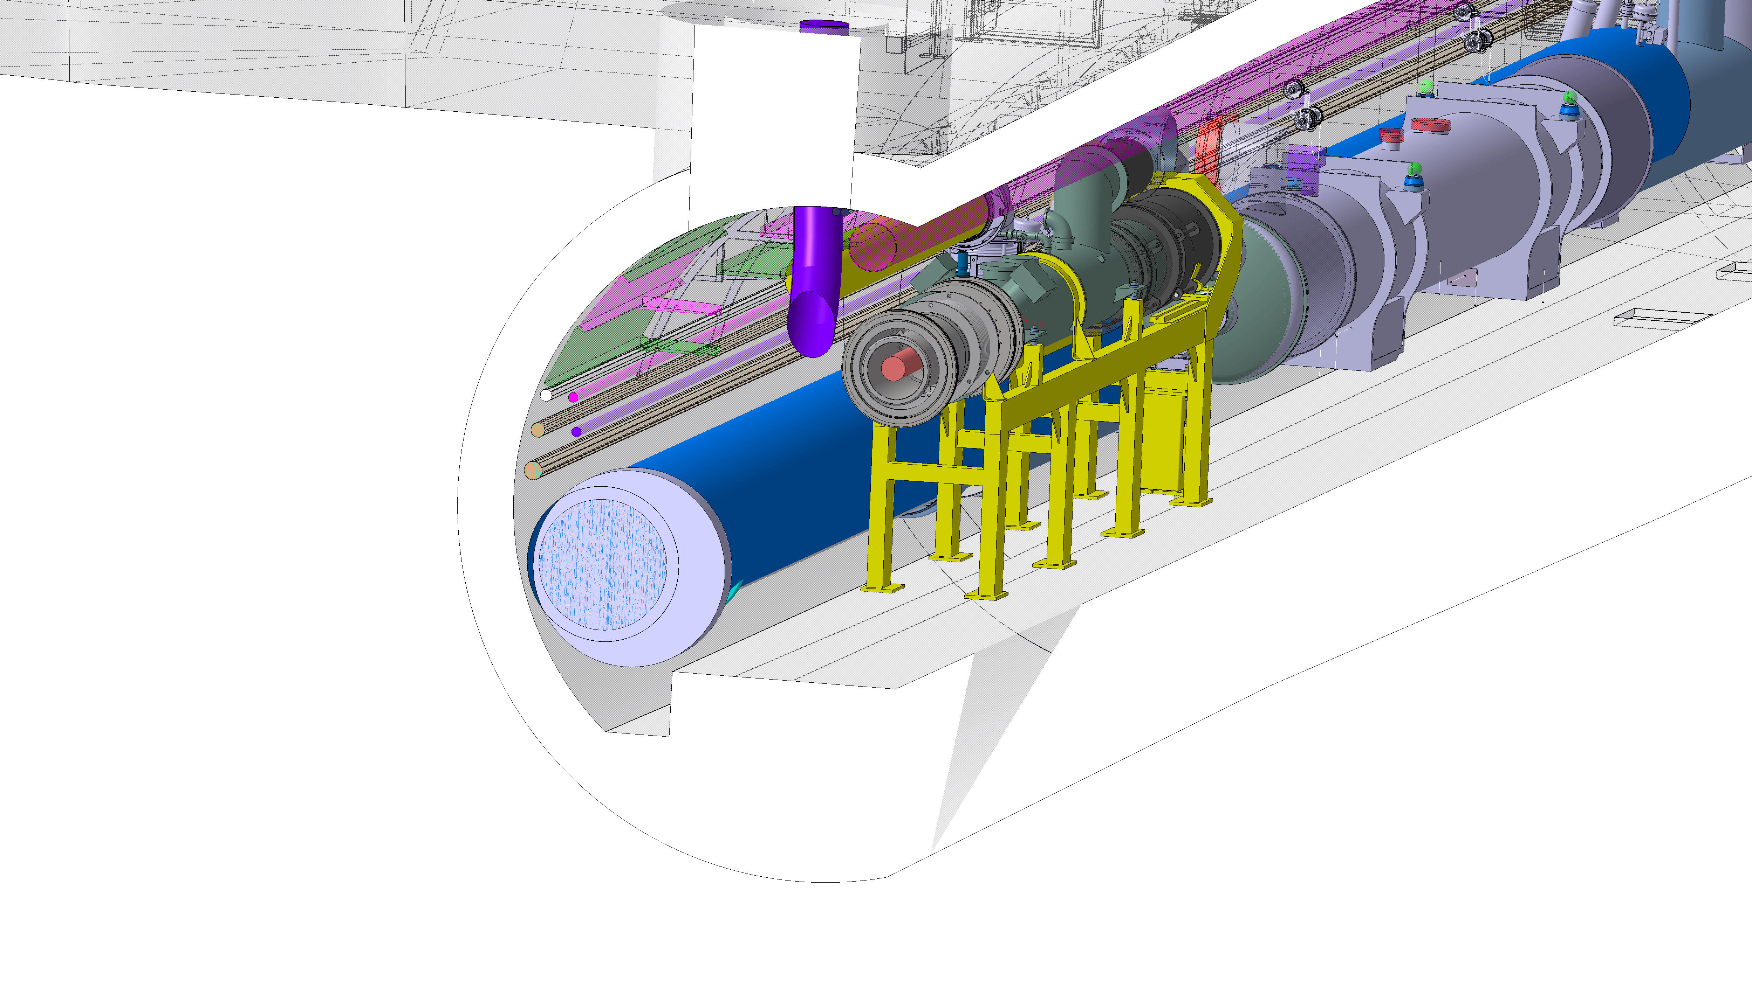
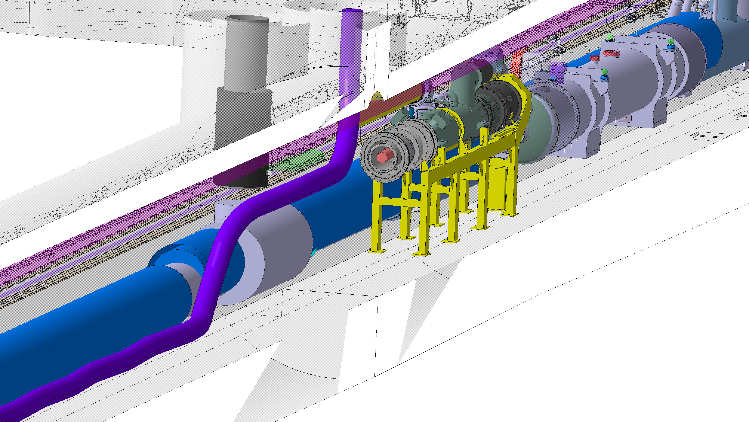

DFX machine assembly
SC link
(space occupation)
DCM
IFS assy.
Plug now part of DCM, with LTS bus bars
Assembly of IFS assy. to DCM
Plug install with LTS

Slide 5
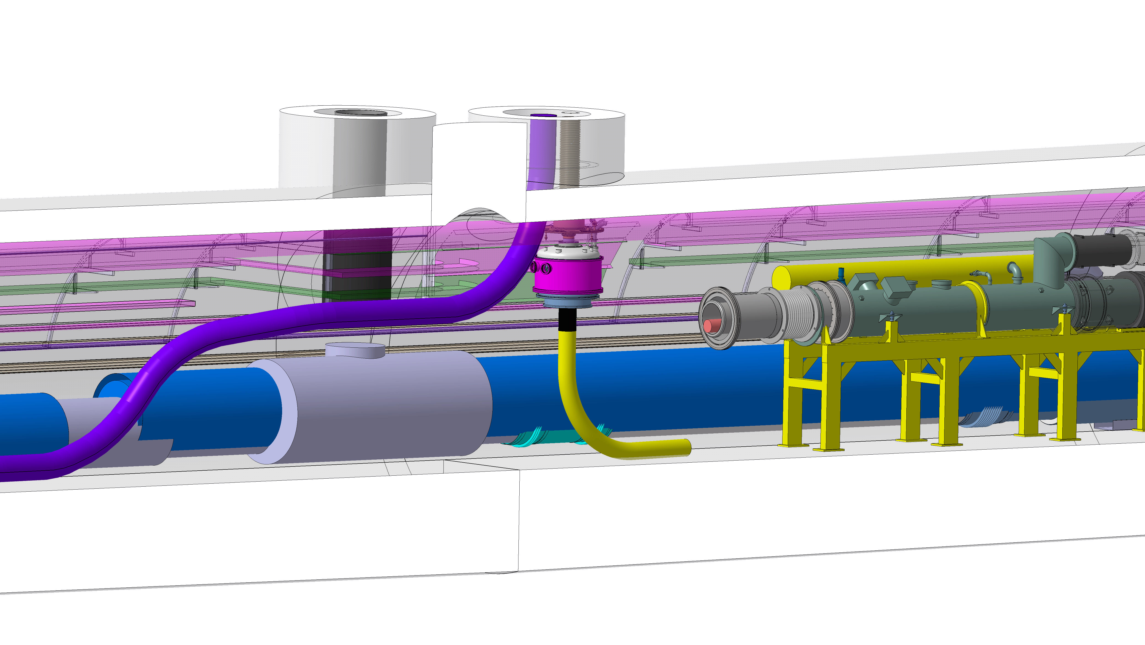
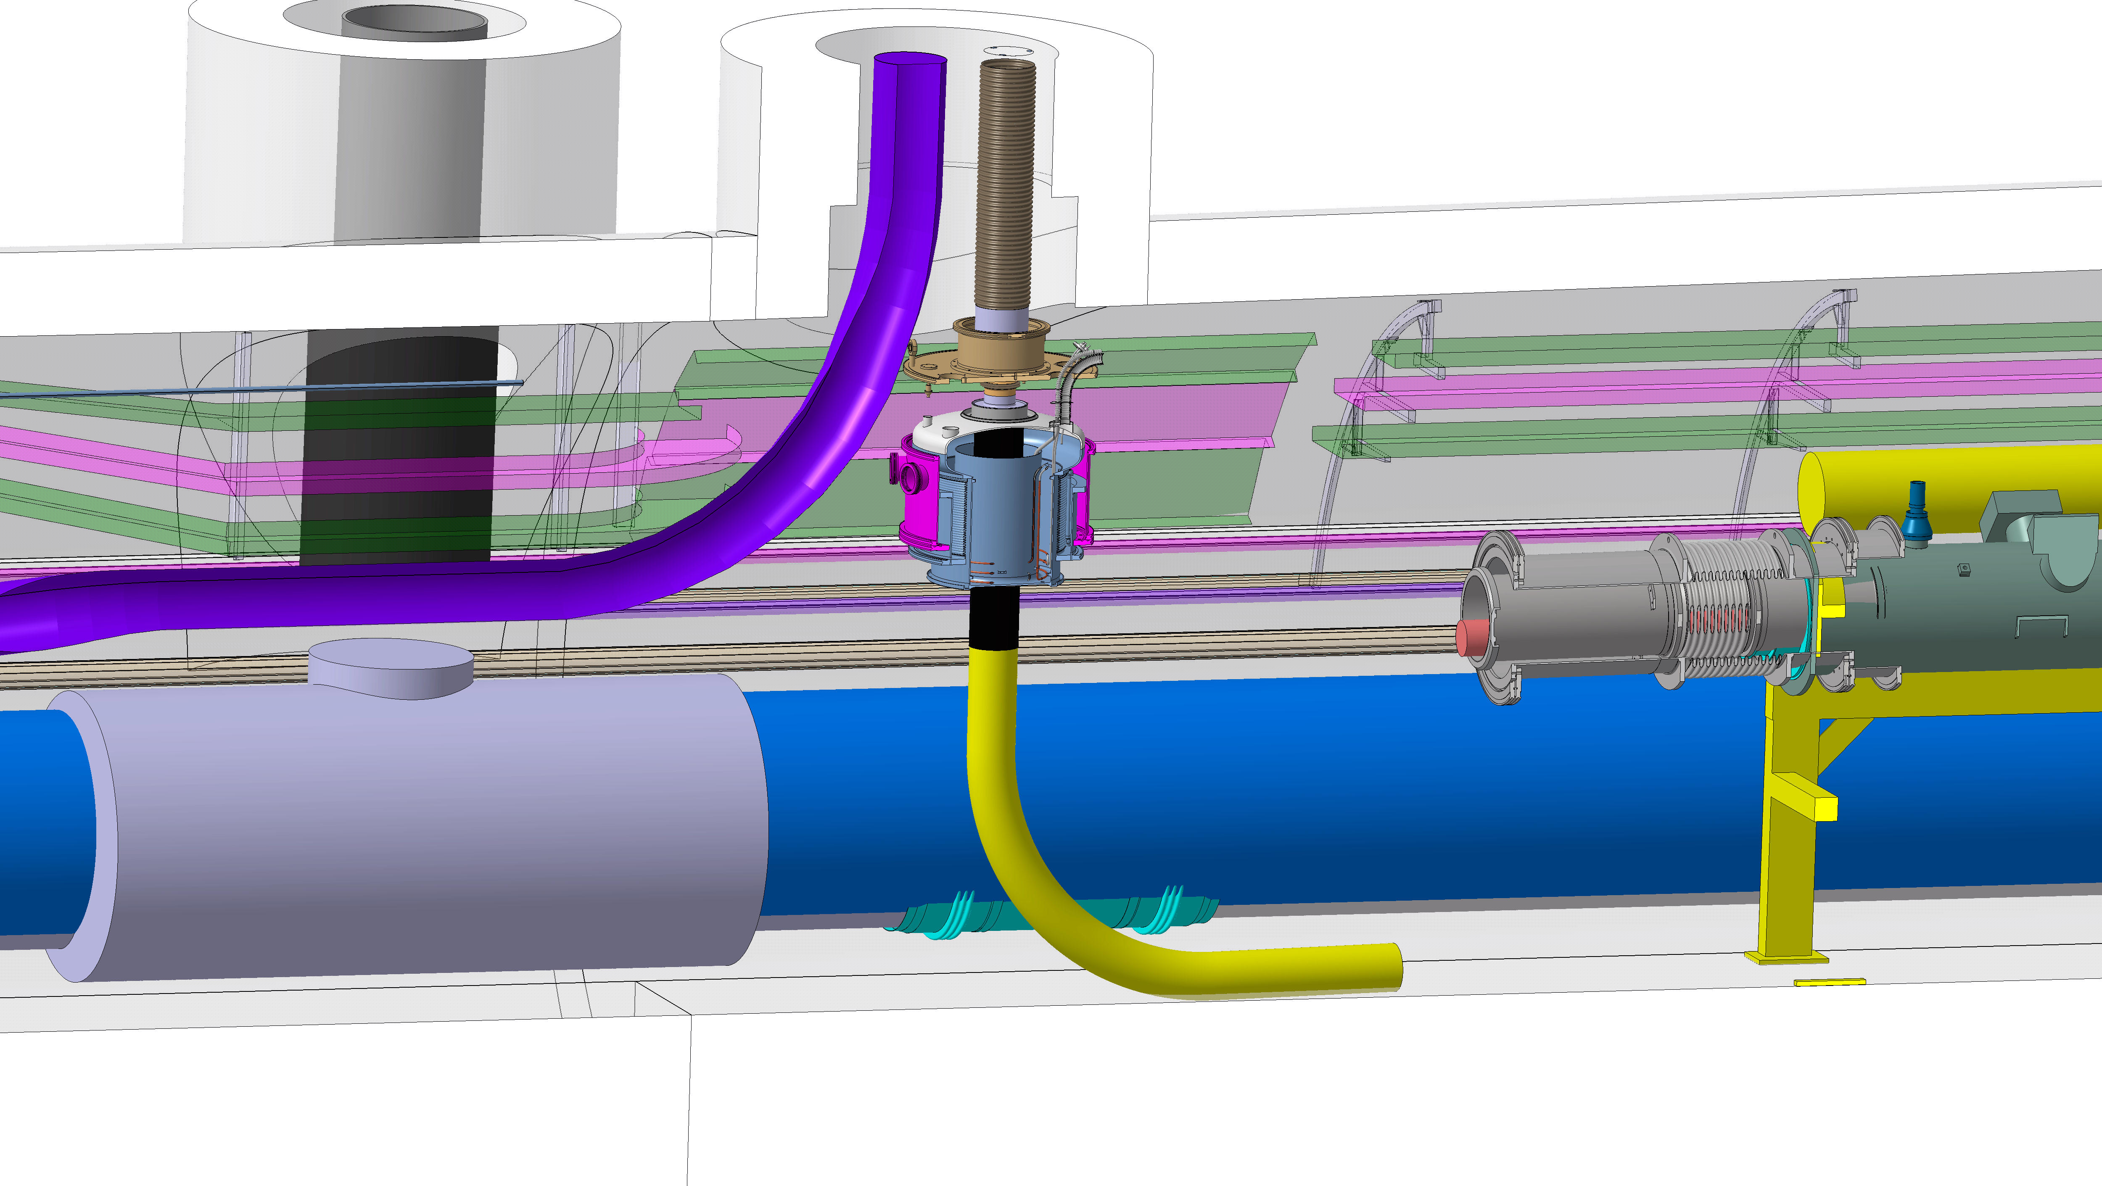
DFX machine assembly
1. Top Flange and DFX tank in prepared position
2. Link Down +100 mm with LTS
3. Weld of the flange, weld inspections and leak checks

Slide 6
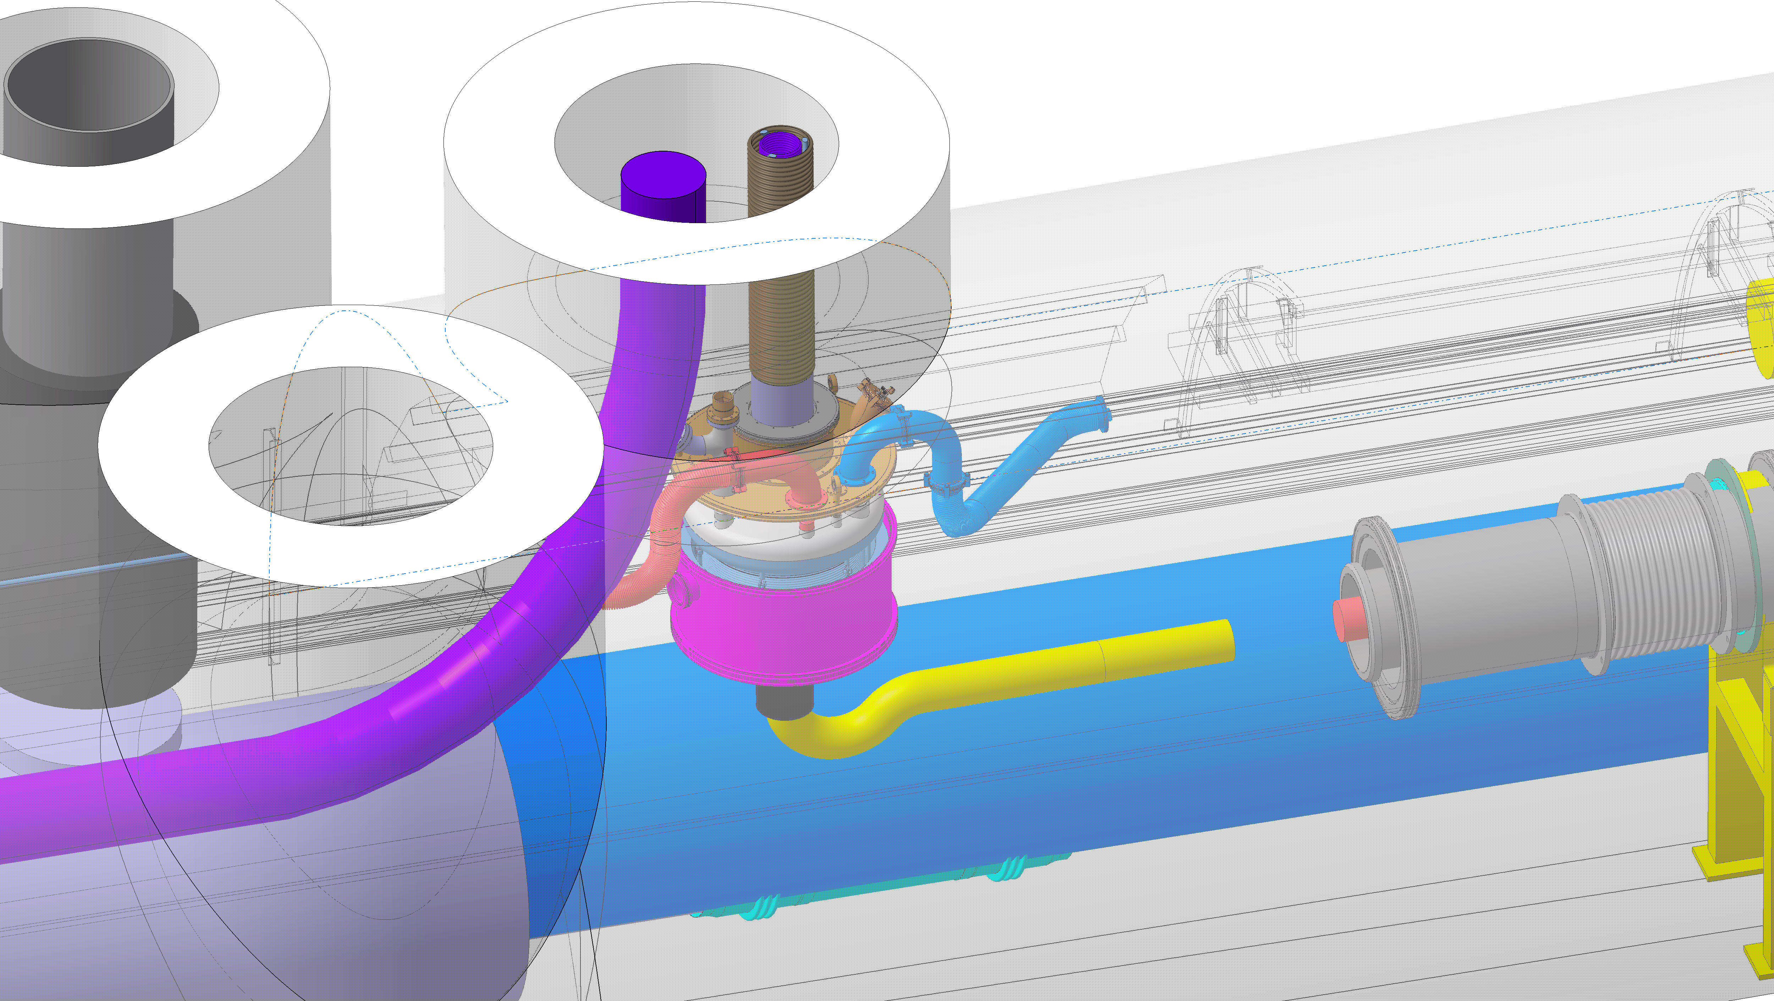
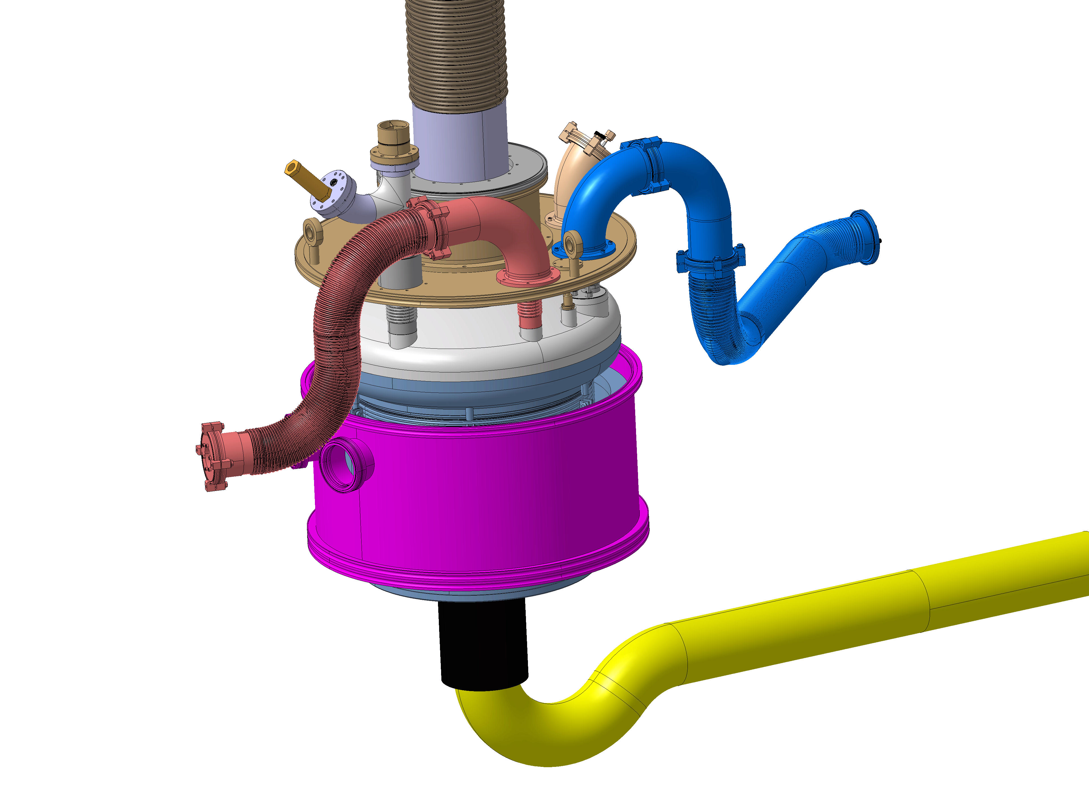
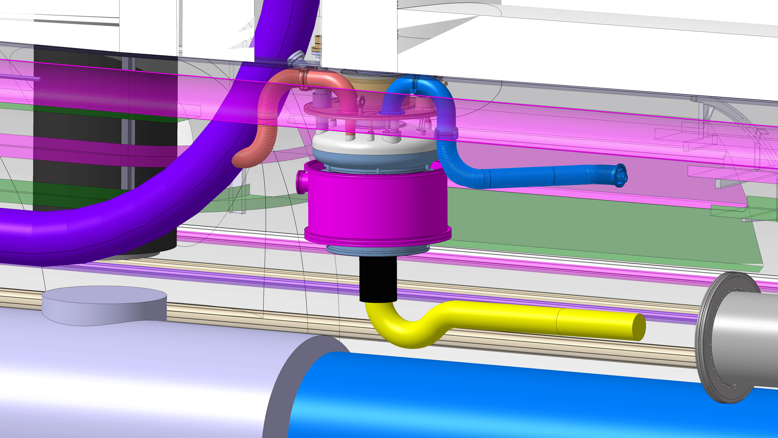
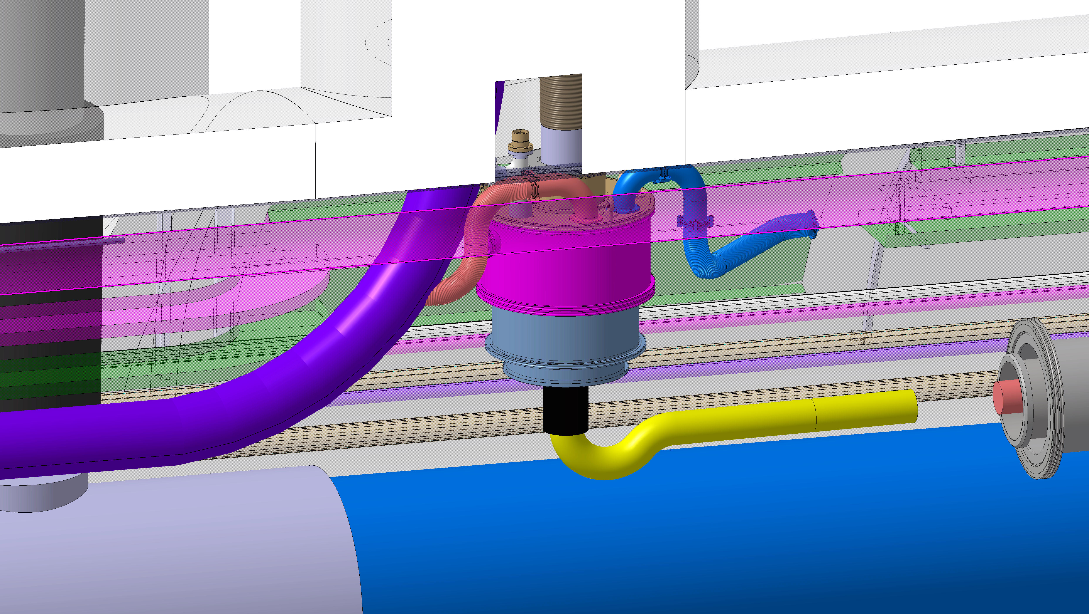
DFX machine assembly
(Burst disk mounted
only after Pt)
Move the He tank and link 100 mm up
Equipment of the top flange
LTS extension shaped for threading of horizontal segments

Slide 7
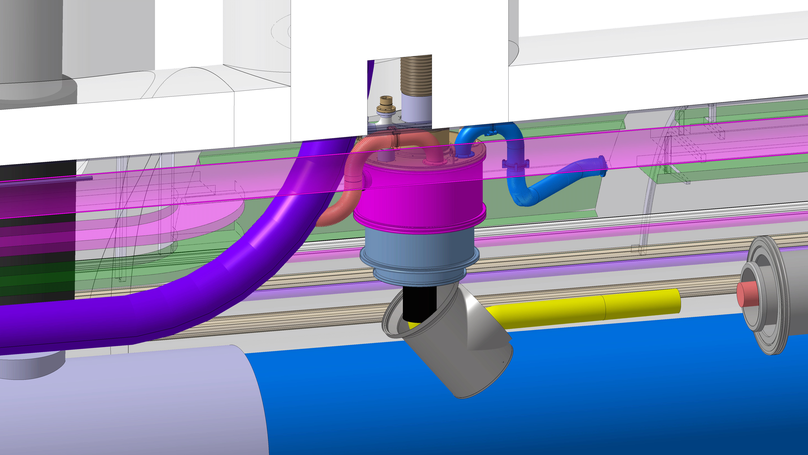
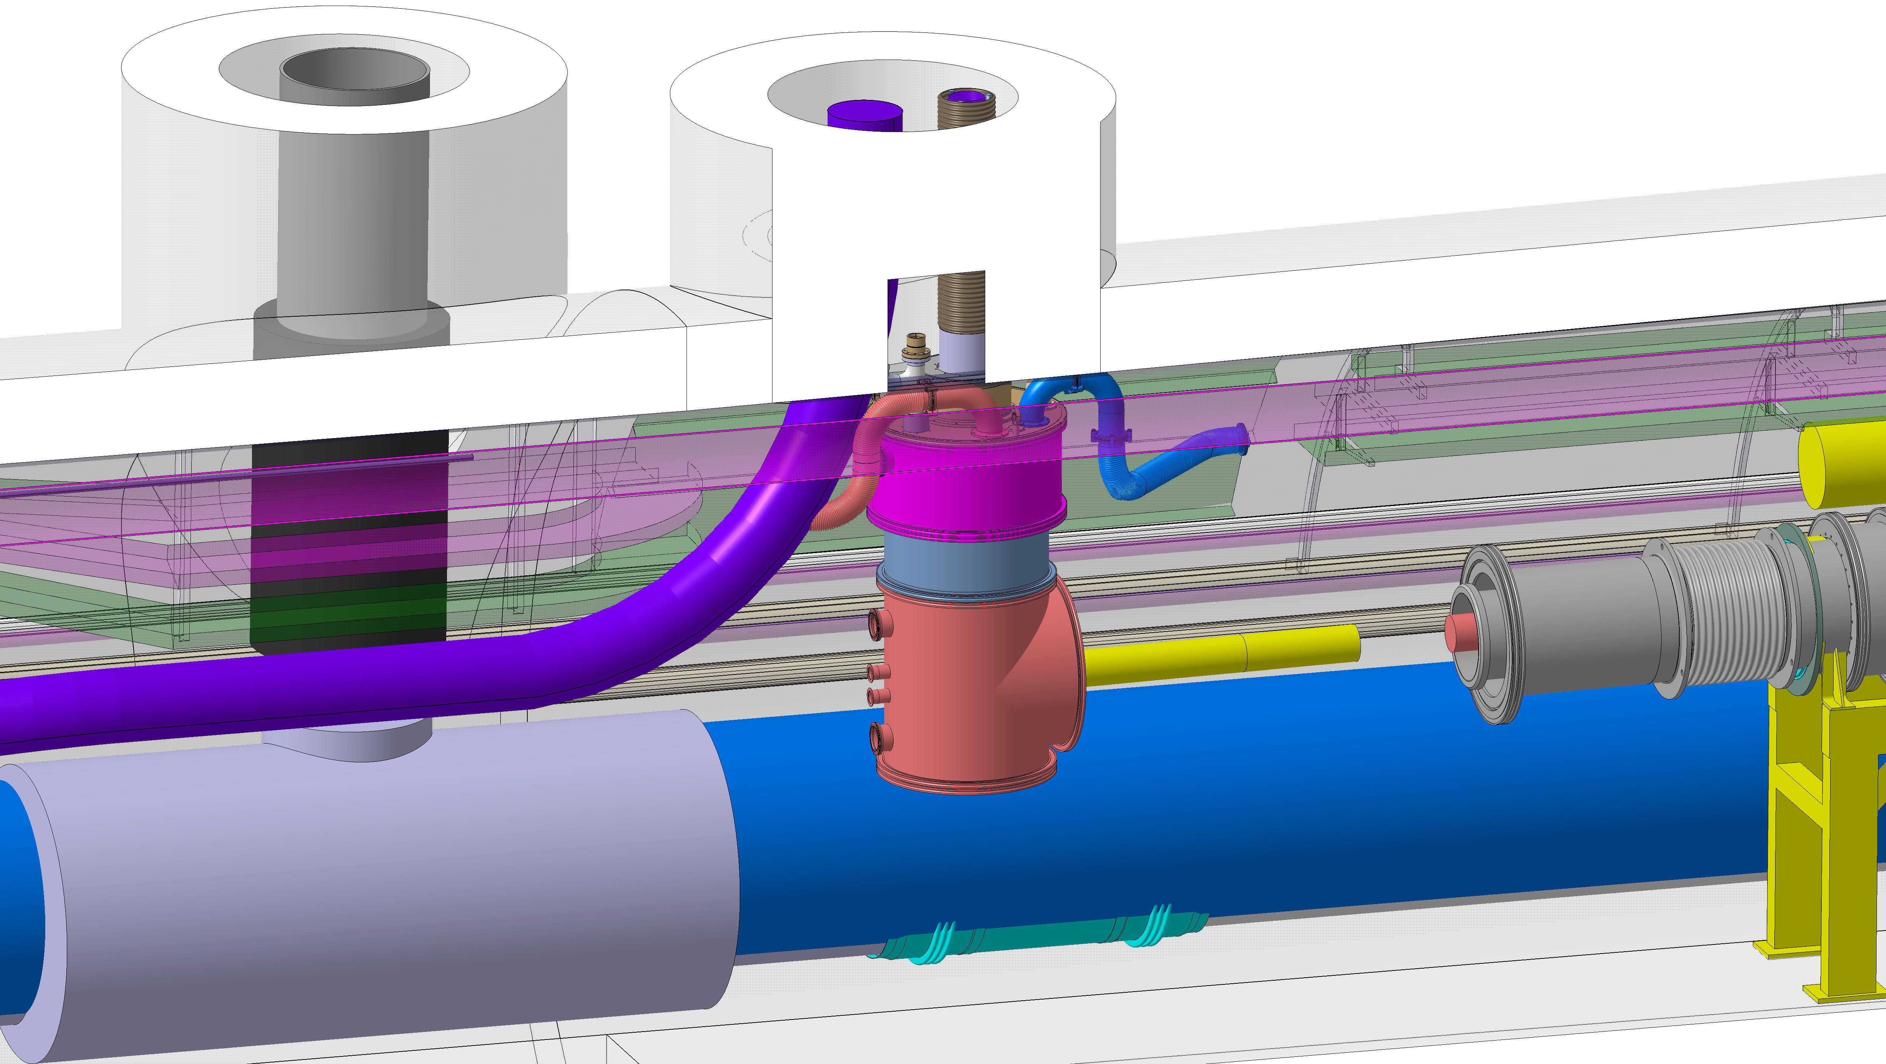
DFX machine assembly
Threading of helium & vacuum chamber in place (will be helped with a side bend of the LTS cable)
Welding, weld inspections and leak checks

Slide 8
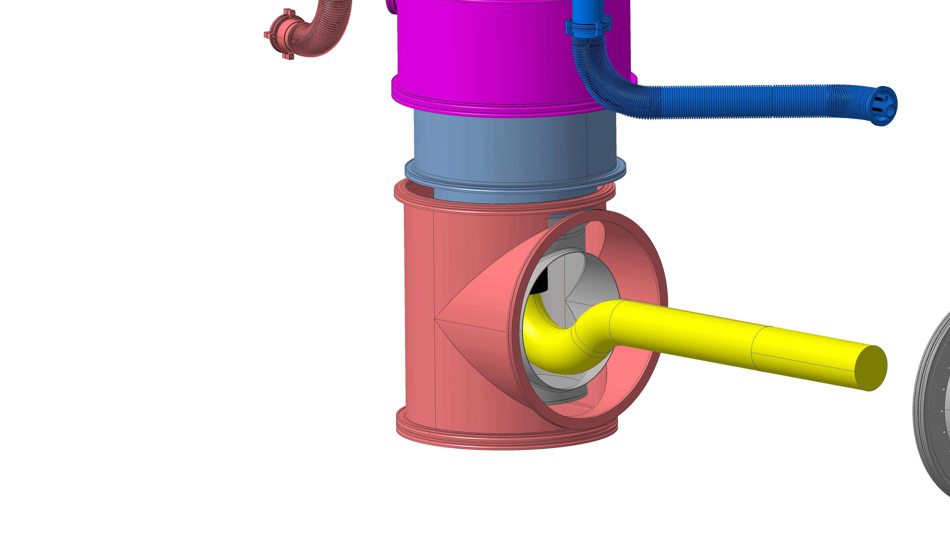
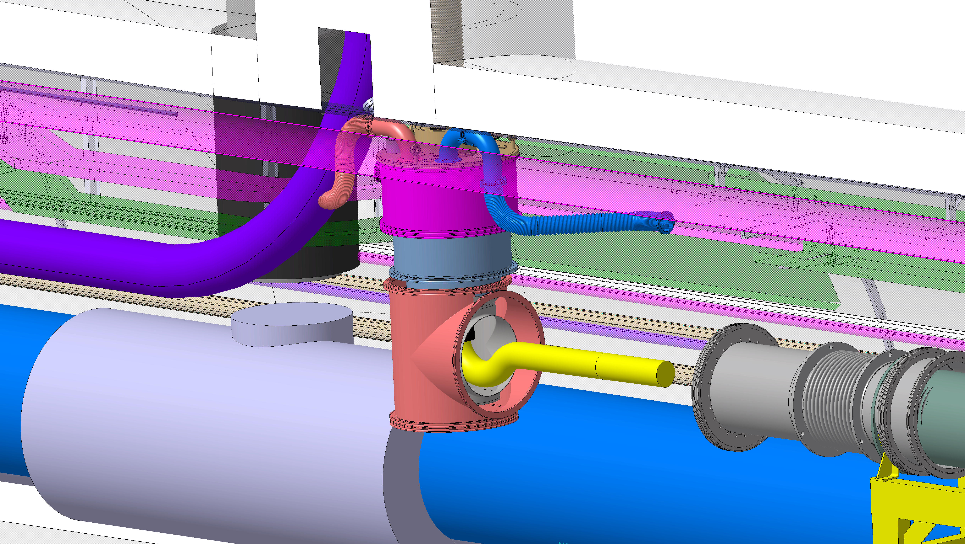
DFX machine assembly
Vacuum chamber move to allow the weld with the horizontal section

Slide 9
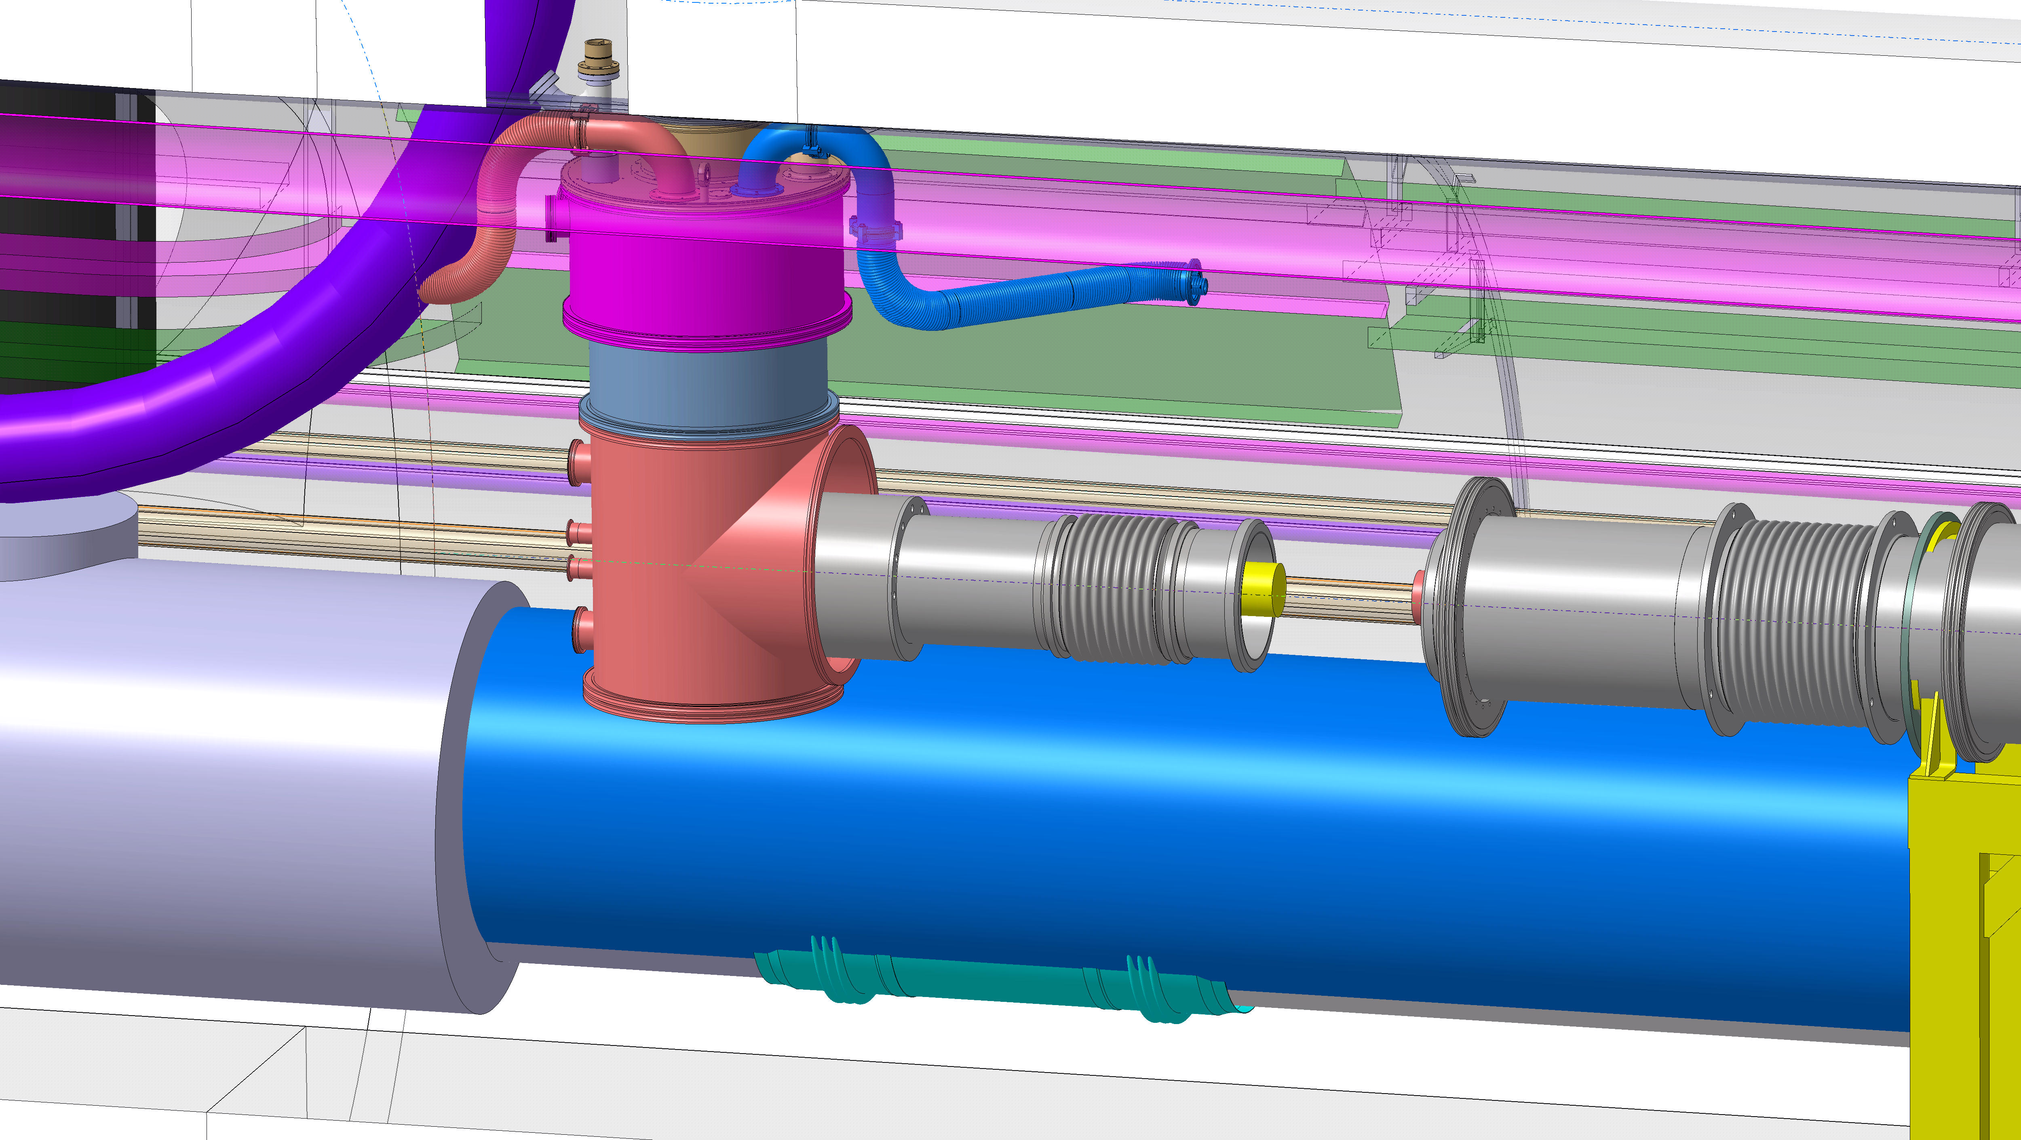
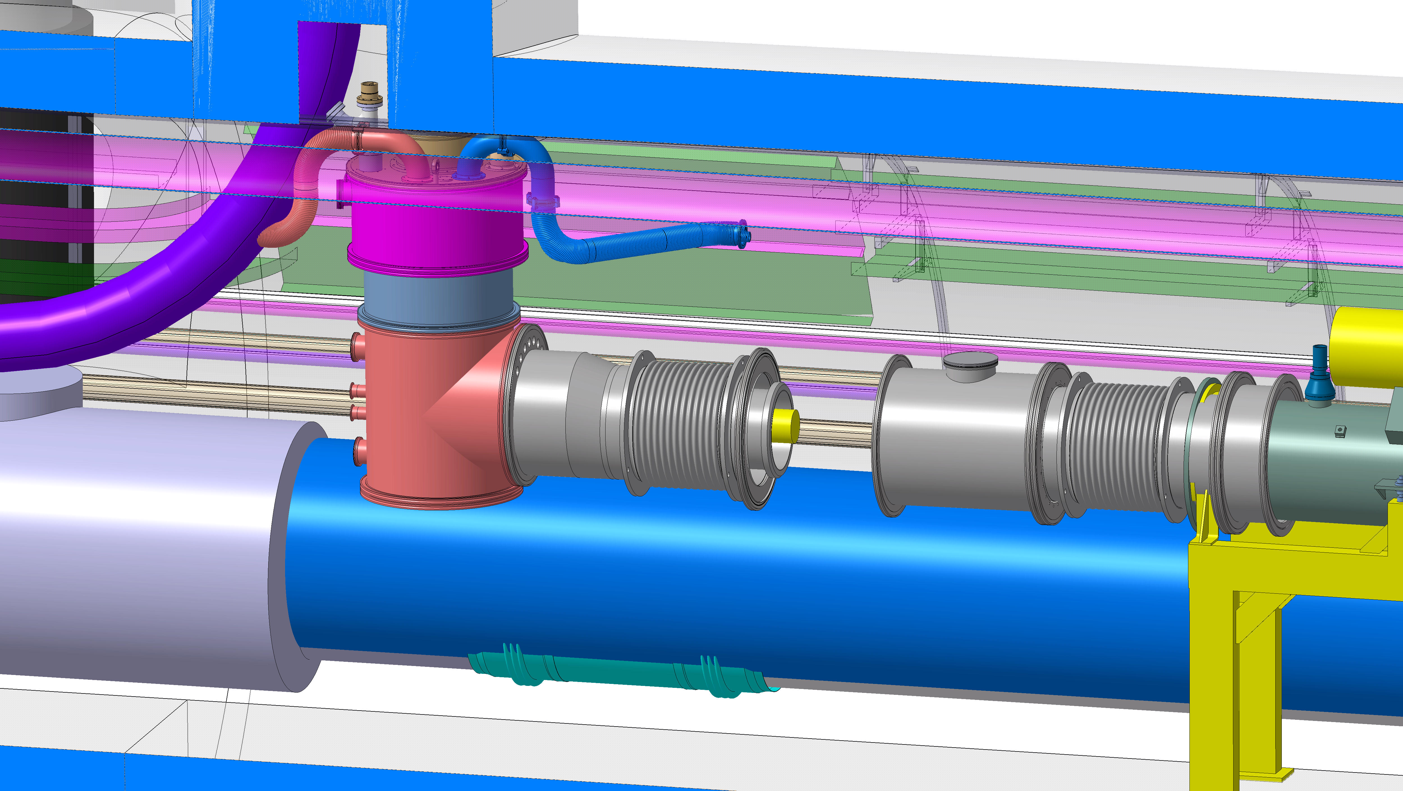
DFX machine assembly
Helium & vacuum vessel segments
Welding, weld inspections and leak checks

Slide 10
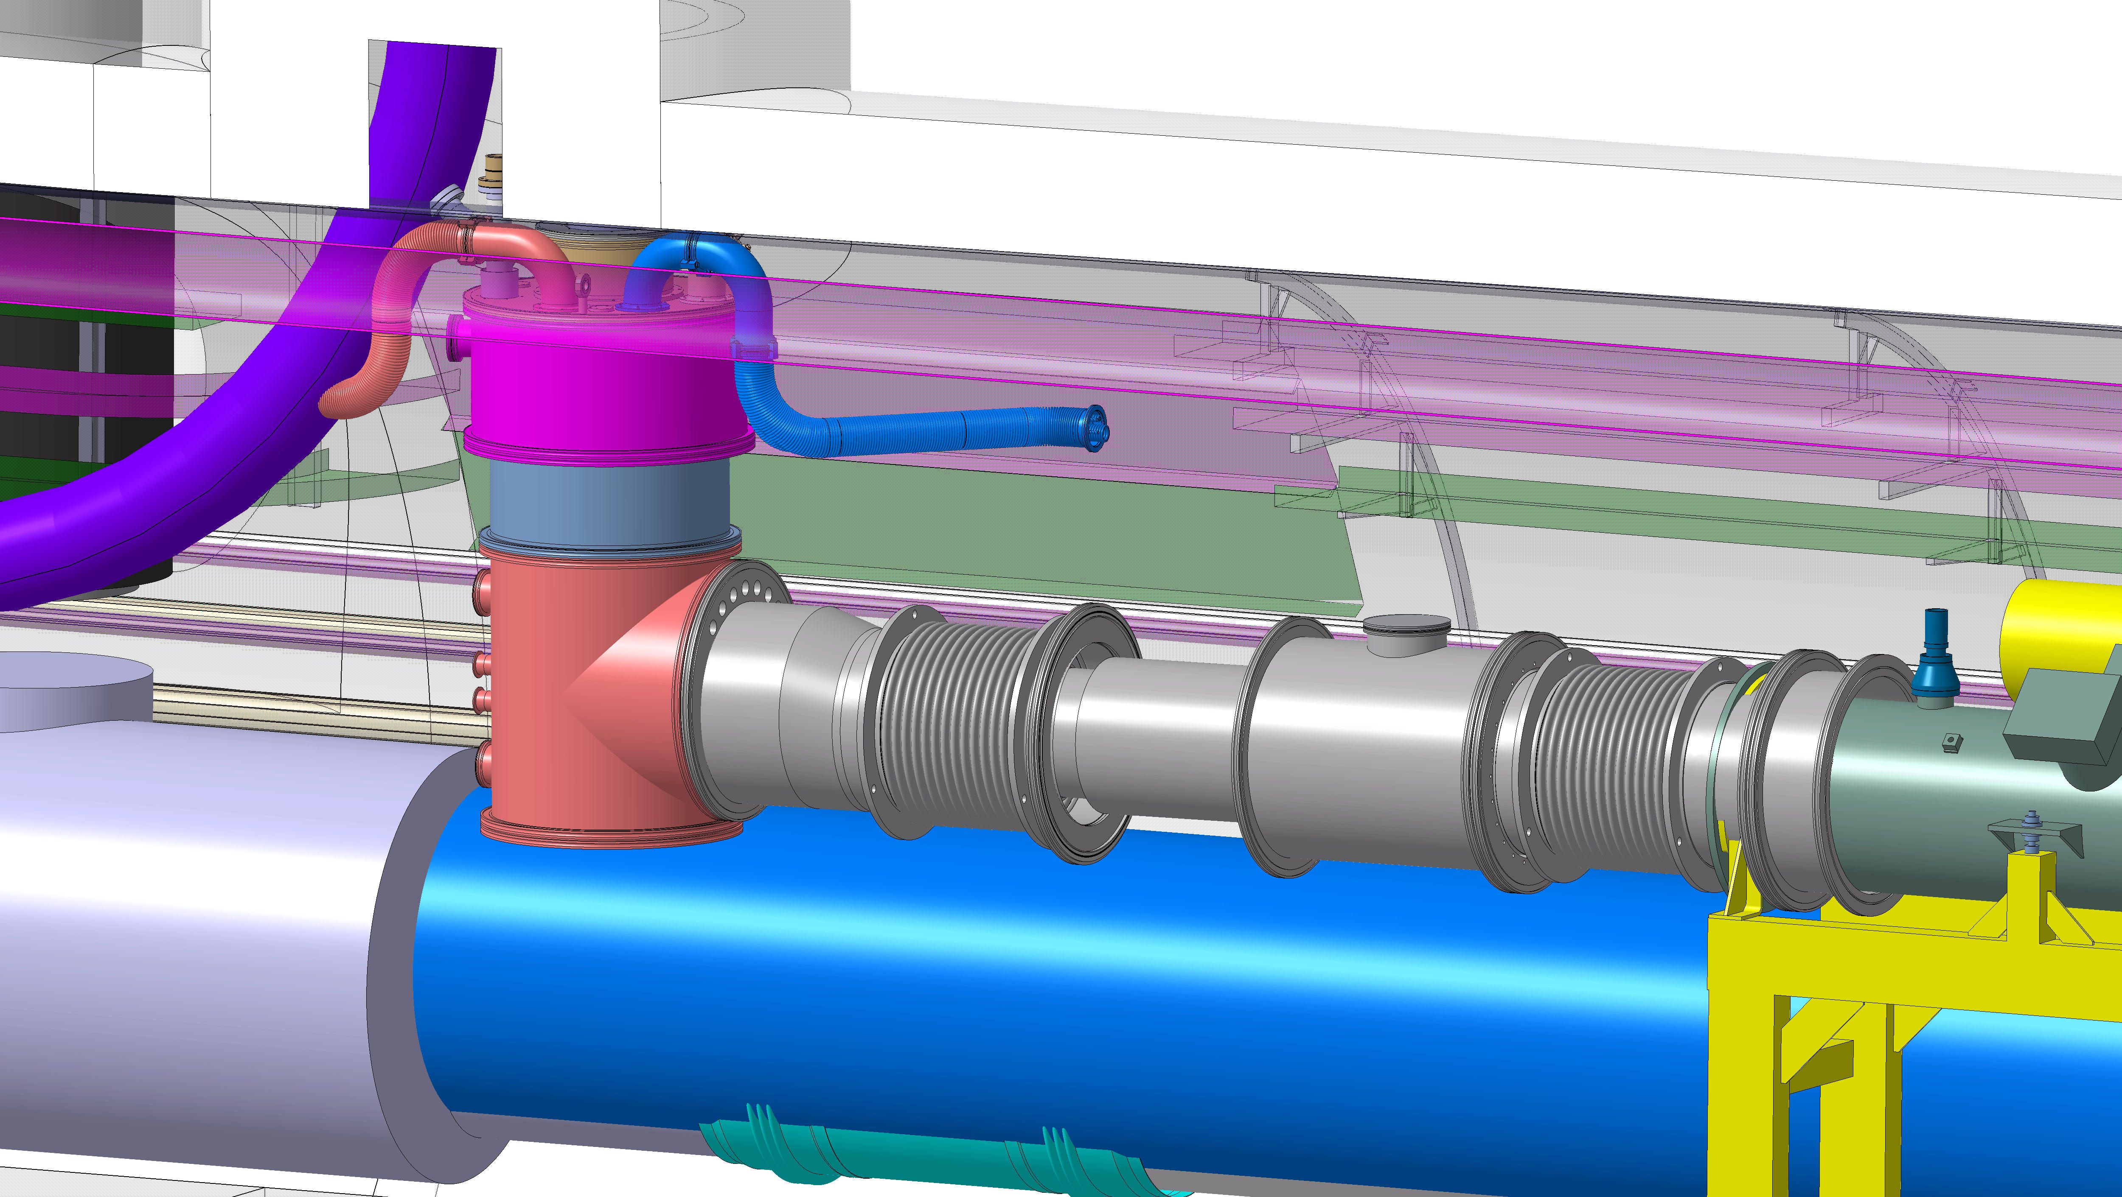

DFX machine assembly
Cryogenic line flexible)
Splices, instrumentation wires connections, electrical checks
Final welding helium chamber (+checks)
Close the vacuum chamber
Connection of cryogenic lines flexible to QXL (not shown)

Slide 11
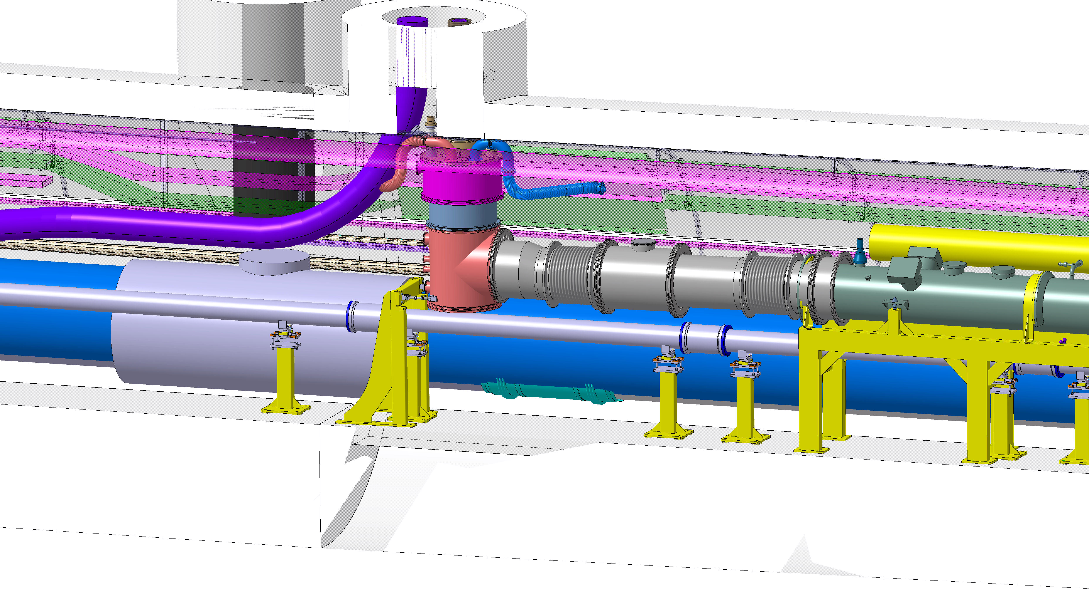
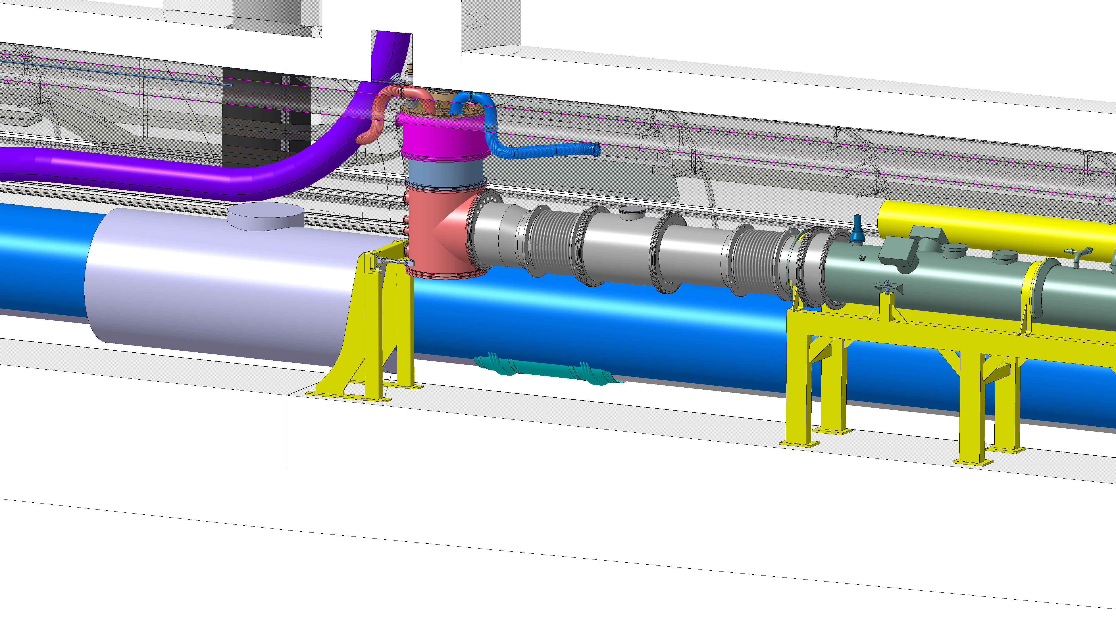
DFX machine assembly
Add the DFX longitudinal force frame
Ins. vacuum pumping and global leak check possible
…

Slide 12
Summary
From this preliminary study we learn about the space limitations for the DFX assembly in the tunnel providing the play ground for developing handling, positioning and assembly tooling
Once the 3D models are finalized, a structured assembly study work should be carried out to define assembly procedures, and QC checks
This study is planned to be closely followed in WP15

Slide 13
Thank you for your attention
Q&A?

