Slide 1
DFX Functional Specification
Y.Leclercq on behalf of the DF development team WP6a
20 June 2019
Detailed design review of the DFX

Slide 2
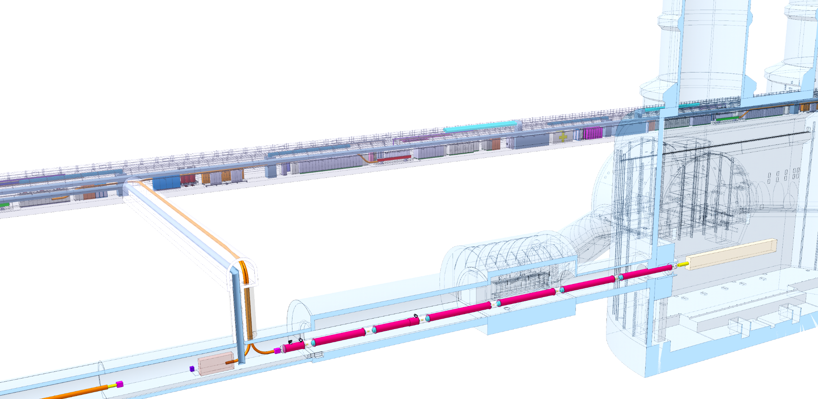
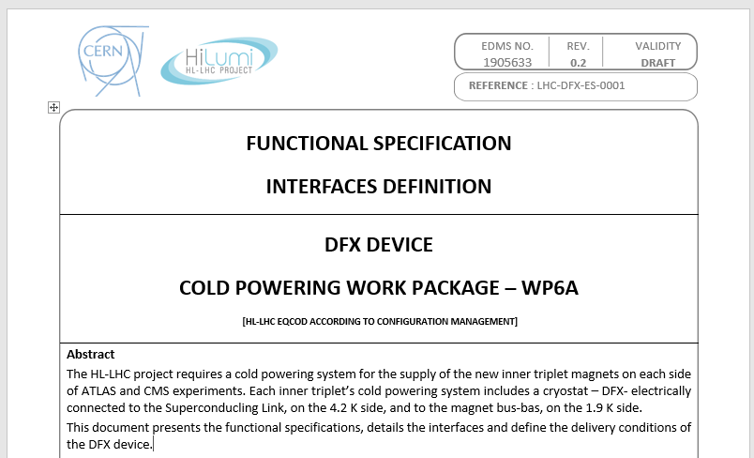
DFX in Cold Powering System
Each IP1 and IP5 sides equipped with a cold powering chains of cryostats
Triplet insertion : DFHx – SC Link (DSH) – DFX
DFX basic functions:
Electrical interface between SC Link and superconducting magnets
Supply cryogenics to the SCLink
System Interfaces
DFX functional specification : Inputs for design EDMS1905633
DFHx2
DFHx1
Power converters
Service tunnel
DSHx
Transverse tunnel
Q1
IP
≈50m
Q2b
Q2a
≈8m
Q3
D1
CP
≈45m
DFX
≈80m
LHC tunnel
DFX functional specification EDMS 1905633
DF system interfaces
Cryogenics
Triplet Magnet
Transport
Installation
Integration
DFX design
Maintenance
Insulation Vacuum
SCLink
Test

Slide 3
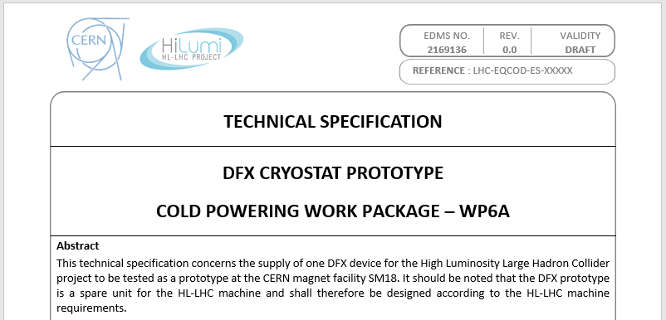
General functional requirements
DFX prototype installed in LHC machine as spare
Applicable rules and standards defined in the Technical Specification (see dedicated talk and dedicated document)

Slide 4
Electrical main specifications
DFX shall ensure the electrical connectivity between the SCLink and triplet cables
SCLink cables layout:
  19 MgB2 conductors in SCLink
  NbTi extensions soldered to MgB2 in protective rigid cylinder
  Only NbTi extensions are accessible in DFX
Magnet cables layout: 19 NbTi conductors from magnet side through Lambda Plate
  (details on bus bars, Lambda plate, see dedicated talks)
The NbTi extensions shall be routed and connected to the NbTi bus coming out from the plug
Instrumentation shall be routed to feedthroughs on a dedicated patch panel at the level of the vacuum vessel interface (no cold feedthroughs, see dedicated talk)
Magnet
Rigid protection of MgB2-NbTi splices
DFX
SCLink
Splice
Plug
NbTi bus from Plug
NbTi bus from SCLink
MgB2 cables

Slide 5
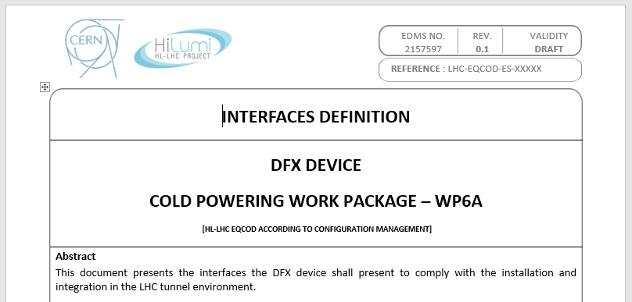
Mechanical interfaces
Mechanical interfaces : dedicated talk and document EDMS2157597
Functional requirements for interfaces:
  DFX shall be assembled / disassembled up to 5 times
  SCLink
    Vacuum & Helium flanges fixed to DFX
    Only NbTi extensions access the DFX He volume
  Magnet mechanical interface
    Plug fixed to ground
    DFX shall present flexible elements
    Access to NbTi-NbTi splices granted during installation and maintenance
  Cables thermal contractions
    NbTi-NbTi splices fixed to DFX He vessel
    DFX covers internal contractions 3.5 mm/m
    DFX shall allow NbTi extensions to move 50 mm into the splices protection
NbTi-NbTi splices
fixed to He vessel
DFX
Magnet
MgB2-NbTi splices
SCLink
Plug
50 mm
3.5 mm/m

Slide 6
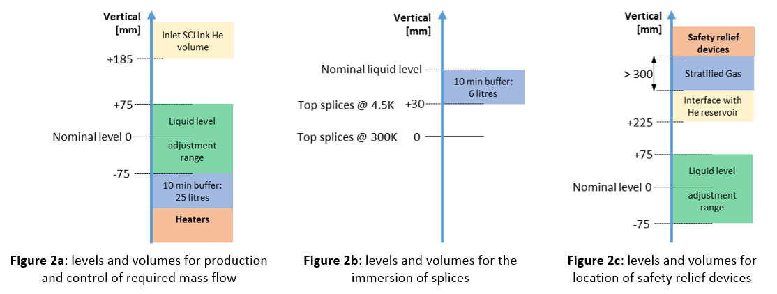
Cryogenics requirements
SD : GHe Out
(for transient)
Superfluid @ 1.9K
Liquid He @ 4.5 K
Gaseous He
Heater
MgB2
NbTi
Splice
CS : LHe In
Heat exchanger 40K
Dedicated presentations on Cryogenic scheme, operation, safety
Layout:
Hydraulic plug separates triplet magnet & DFX-SCLink He volumes
Dedicated DFX jumper
Electrical performance:
NbTi cables & MgB2-NbTi splices immersed in LHe
Cryogenic lines:
LHe in, Ghe out, heat exchanger, Outlet Magnet line (in discussion)
Operation configuration
Heaters (electrical & heat exchanger) vaporises helium
  Nominal : 5 g.s⁻¹ , design 10 g.s⁻¹
Ghe gaseous mass flow through the SCLink
Design pressure : 2.5 bara (nominal 1.3 bara)
Instrumentation:
Level gauges, Temperature sensors, Pressure gauge as defined in Instrumentation Talk
Design requirements:
Heat loads to LHe < 30 W
No condensation on external surfaces and feedthroughs
Electrical heaters at lowest position for LHE vaporisation during WU
> 10 min of nominal supply GHE in case of liquid supply stop
> 10 min of immersion of splices in case of liquid supply stop
Constant slope between coldest point and LHE-GHE interface
Safety relief devices to protect DFX+SCLink
Access to safety relief devices, instrumentation interfaces shall be granted for inspection and maintenance
E’_{H}F_{H2}
PT
DFX
Magnet
SCLink
MgB2-NbTi splices
10 min margin
5 g.s⁻¹
Plug
Electrical W
DFX nominal configuration
Detailed levels, volumes and dimensions requirements §3.3.5

Slide 7
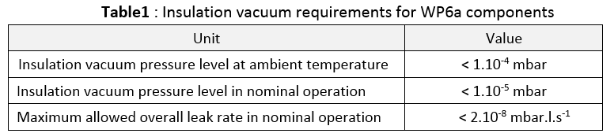
Insulation vacuum
The DFX insulation vacuum shall be compatible with the General WP6a insulation vacuum layout EDMS 2048016
The DFX insulation vacuum is independent to:
  Allow local maintenance & leak detection
  Minimise inter-dependence between helium volumes
➔ DFX presents vacuum barriers with:
  The cryolines (not part of DFX)
  The SCLink (part of the DFX)
  The triplet cryostat (not part of SCLink)
Interfaces see dedicated talk
Unit | Value
Insulation vacuum pressure level at ambient temperature | < 1.10⁻⁴ mbar
Insulation vacuum pressure level in nominal operation | < 1.10⁻⁵ mbar
Maximum allowed overall leak rate in nominal operation | < 2.10⁻⁸ mbar.l.s⁻¹
SCLink :
Pumping, gauge, safety port
PT
Magnet
DFX
SCLink
Plug

Slide 8
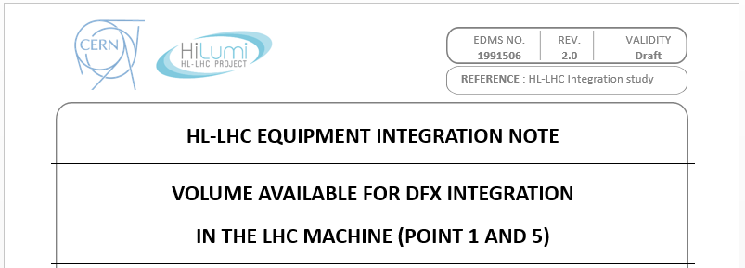
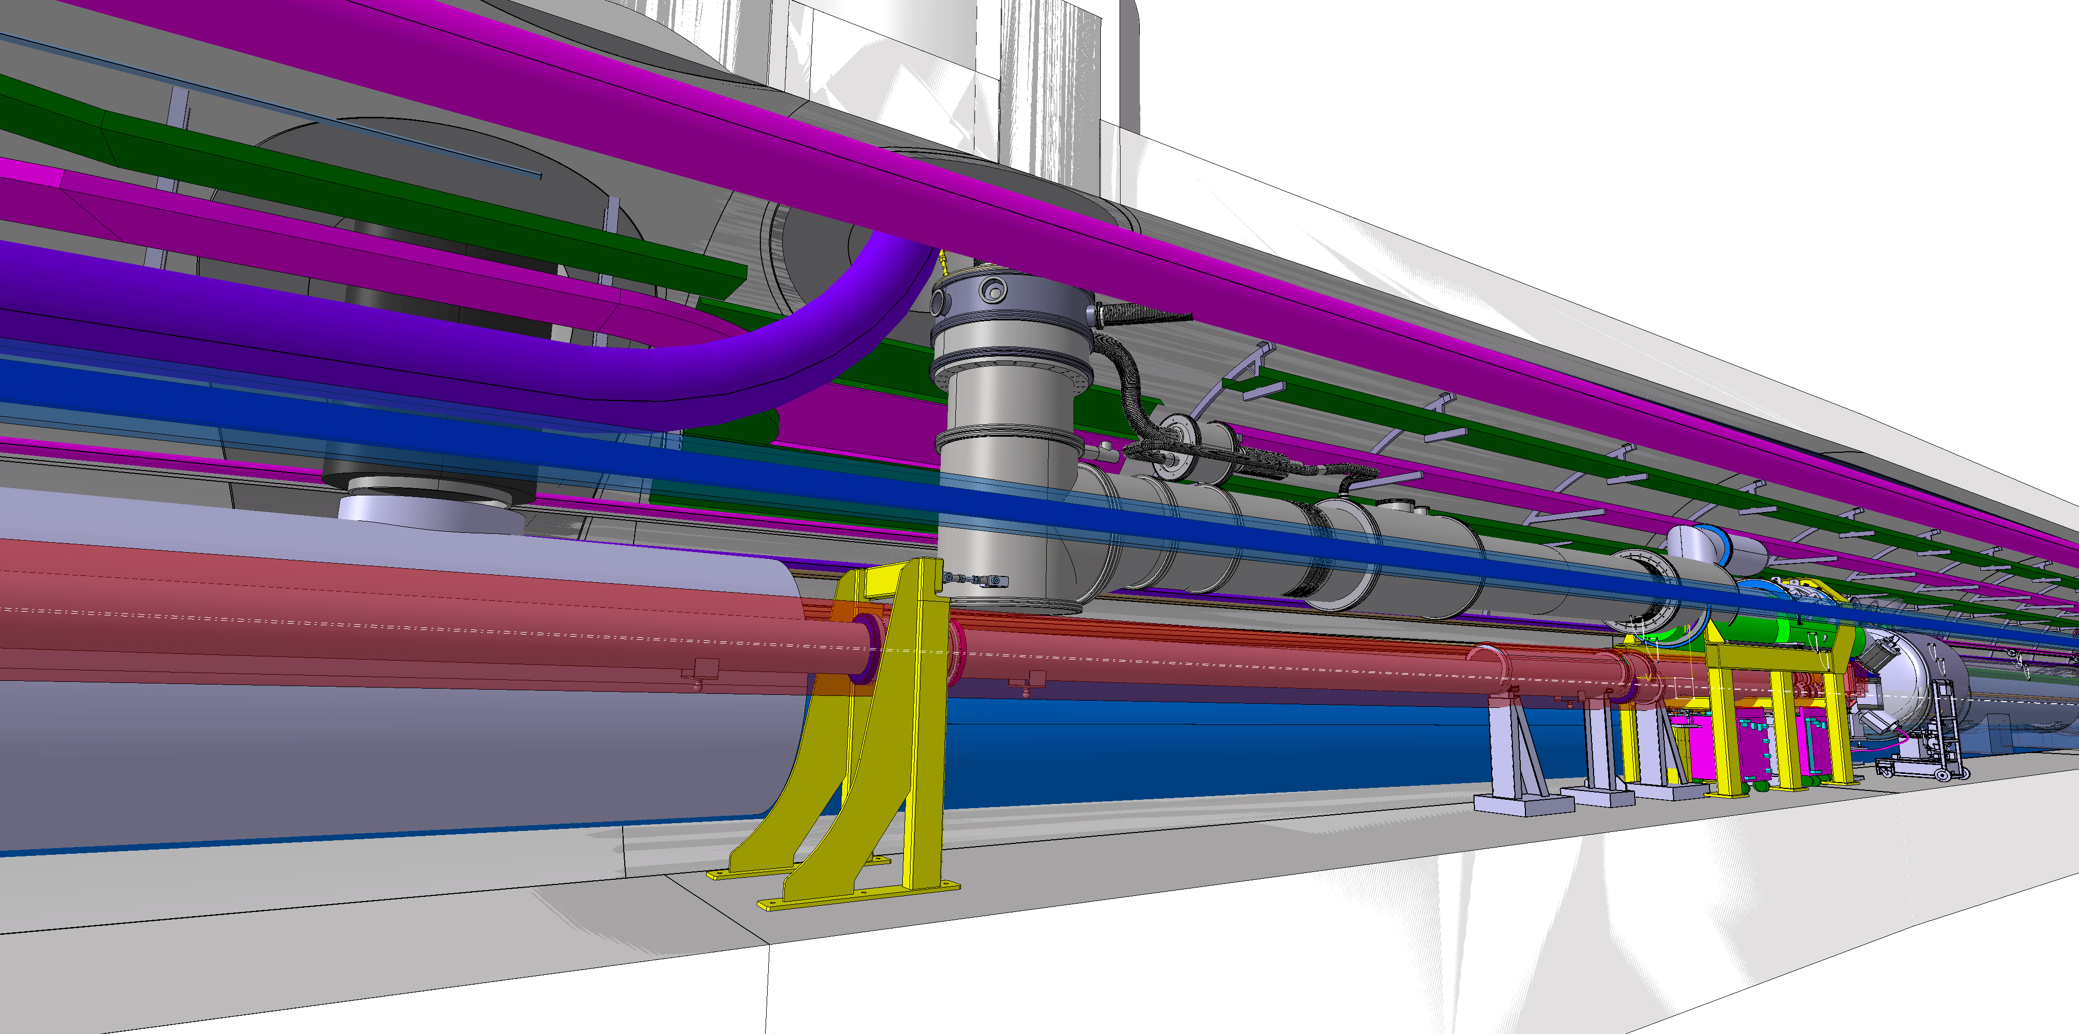
Integration specification
EDMS 1991506
Recommendation from CDR to integrate known boundaries in the functional specification
  ➔ key inputs included and detailed
    §3.5 Integration & installation
      3.5.1 Tunnel environment
      3.5.2 Accessibility during installation and maintenance
      3.5.3 Access limitations in the tunnel
      3.5.4 Mechanical interfaces
  ➔ document from WP15 remains the reference document concerning integration volumes
Tunnel integration : See dedicated talk
Mechanical interfaces : See dedicated talk
Conceptual DFX in integration model
Courtesy WP15 M.Gonzalez

Slide 9
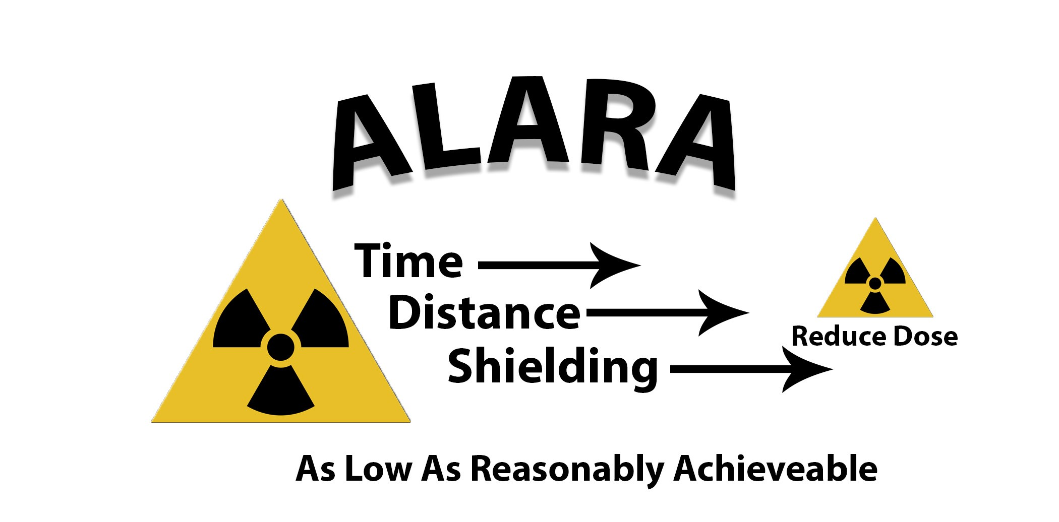
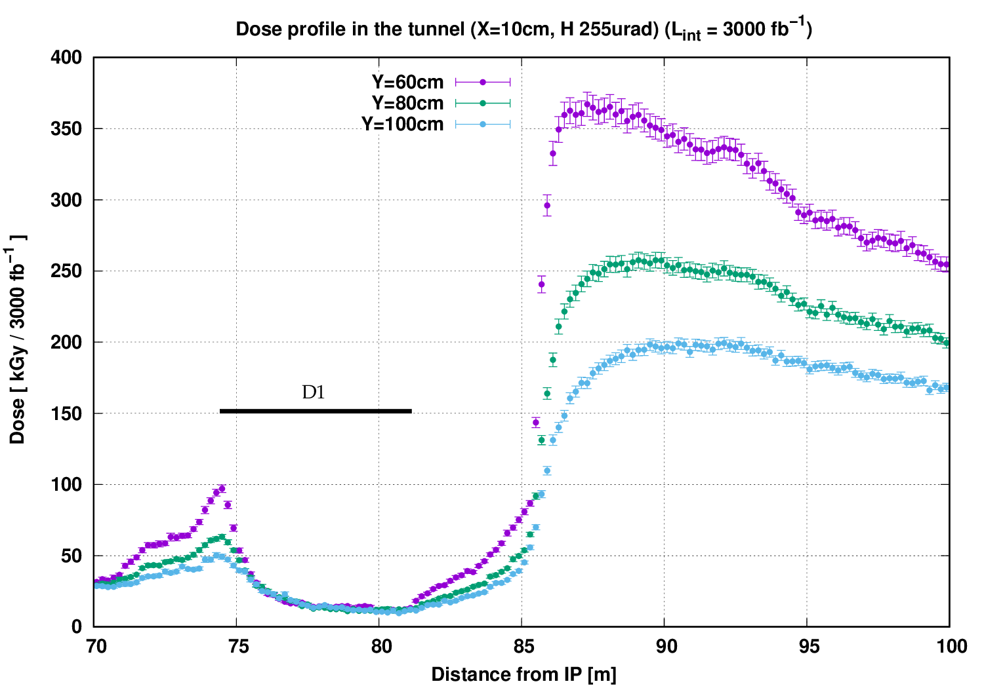
Preventive maintenance and repairs
All operations shall be designed from the ALARA point of view:
  Minimise intervention time (access, automatic operation)
Interventions
  Unscheduled interventions for inspections and light work during Technical Stops (e.g. for electrical checks on patch panel)
  Planned interventions for routine maintenance requiring warm up during YETS (e.g. replacement of burst disks)
  Unscheduled medium repair work interventions requiring warm up during YETS (e.g. Nb-Ti/Nb-Ti repair)
  Unscheduled heavy repair work interventions requiring warm up during EYETS or unscheduled extended machine stop (e.g. MgB2/Nb-Ti repair, plug replacement)
DFX area
See : R.Garcia : LHC and HL-LHC: Present and future radiation environment in the high-luminosity collision points and RHA implications

Slide 10
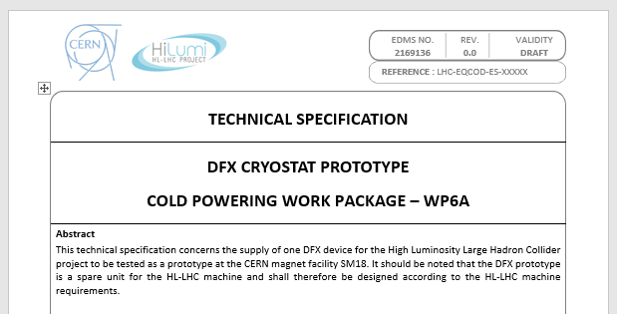
Manufacturing & Inspections
Moved to dedicated Technical Specification document
See dedicated talk

Slide 11
Summary
Functional specification updated
Manufacturing, qualification requirements moved to dedicated technical specification
Interfaces moved to dedicated Interface specification

