Slide 1

DFX in WP6a, Master Plan
A. Ballarino
DFX Detailed Design Review, CERN, 20/06/2019

Slide 2
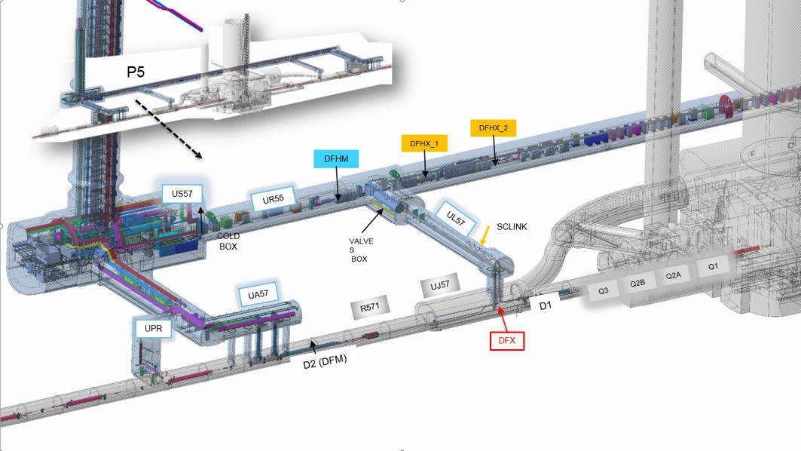
DFX Cryomodule in WP6a
DFX
Interface between SC Link and Diodes Cold Module
of the HL-LHC Inner Triplets

Slide 3
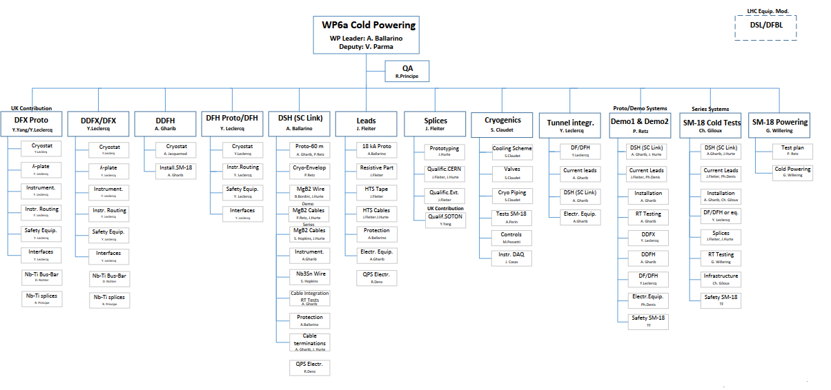
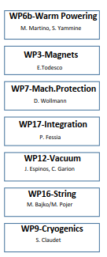
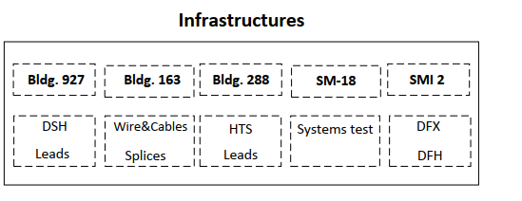
Organogram WP6a
Interfaces
DDFX in Demo 1
Tests in Dec 2018 and March 2019

Slide 4
Changes from Conceptual Design Review
Interfaces
λ-plate in DCM (moved to WP3)
ECR in preparation

Slide 5
Prototype DFX
Construction of one DFX prototype, via UK1 contribution to HL-LHC, by Southampton University (SOTON). Design carried out by SOTON, with regular exchanges with CERN (direct coordination by Y. Yang, SOTON, and since CDR V. Parma, CERN).
Delivery of prototype to CERN in March 2020 (UK1 deliverable)
This DFX prototype is also a spare unit for HL-LHC

Slide 6
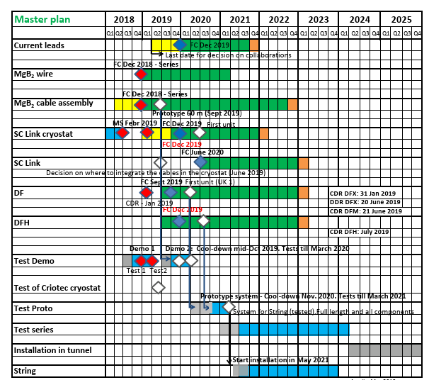
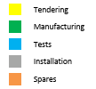

WP6a Master Plan
DFX Proto March 2020 (UK1 Contr., SOTON)
Proto WP6a full System Test
String

Slide 7
Thanks for your attention !

