Slide 1
DFX Technical Specification status and QA/QC aspects
Y.Leclercq on behalf of the DF development team WP6a
20 June 2019
Detailed design review of the DFX

Slide 2
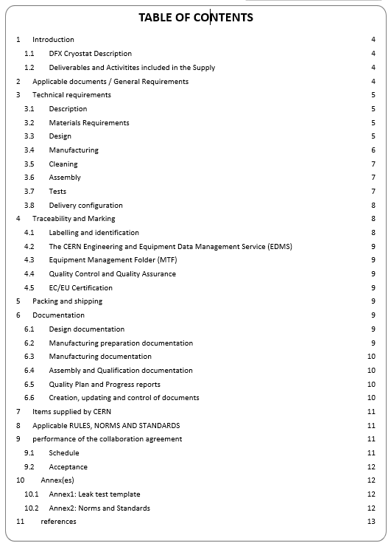
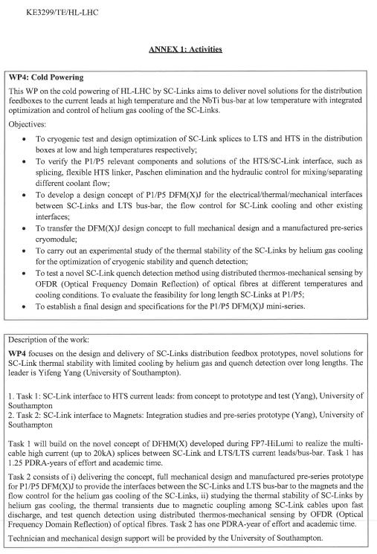
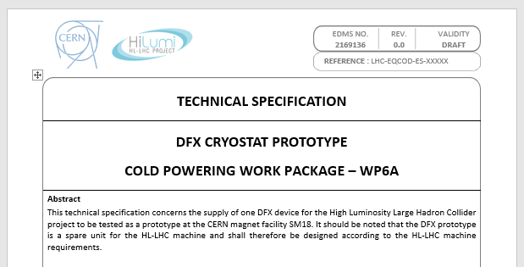
Document overview
The description of activities (KE3299 Annex1) are further detailed in a dedicated technical document (draft version)
Technical requirements based on HL-LHC cryostats requirements
Reference document for the DFX prototype requirements
  Requires to fulfil the performance specified in the functional specification
    Which refers to the interfaces specification
    Which refers to the WP15 Integration document
  Defines applicable standards
  Defines deliverables
  Defines manufacturing and qualification requirements
  Defines Items supplied by CERN
KE3299/TE/HL-LHC
Annex1: Activities
EDMS 2169136

Slide 3
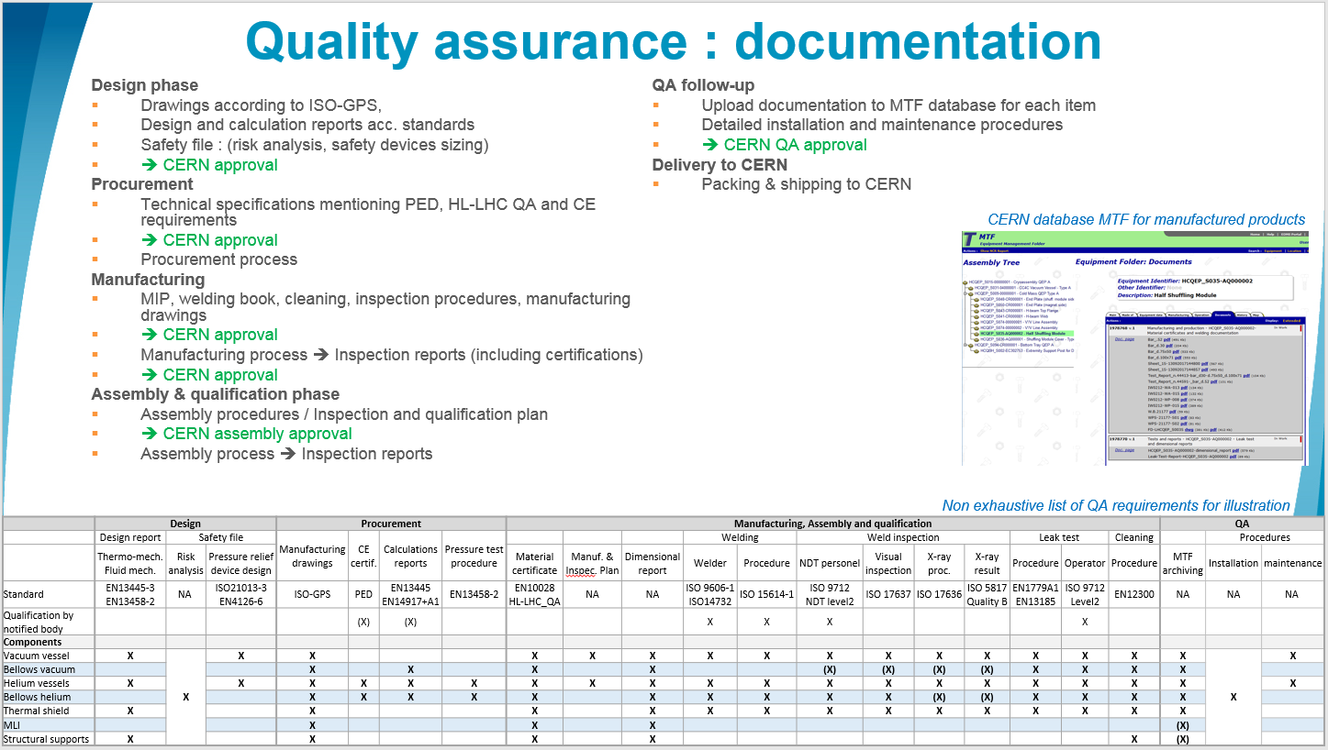
§2 Applicable Documents / General Requirements
DFX prototype installed in LHC machine (spare unit)
  ➔ Comply with CERN rules
      CERN Safety Rules
      GSI-M-4 - Cryogenic equipment :
  ➔ European directives
      Pressure Equipment Directive 2014-68-EU
  ➔ HL-LHC QA requirements
      ALARA principle
      Material requirements
      Documentation & MTF
GSI-M4: “The manufacture […] by collaborating institutions, of all new cryogenic equipment shall comply with the applicable CERN Safety Rules, European directives and harmonised standards”.
HL-LHC documentation requirements
Details in spare slide

Slide 4
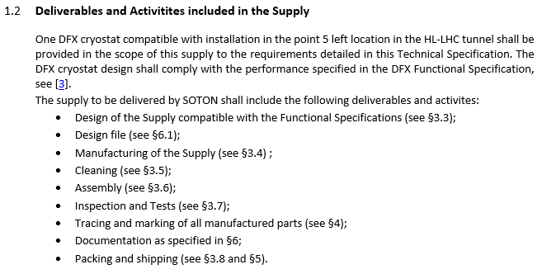
Deliverables & Activities
Deliverables:
  One qualified prototype DFX compatible with 5L
  Documentation
Activities:
  Design
  Manufacturing
  Cleaning
  Tracing
  Qualification testing
  Reporting & Archiving

Slide 5
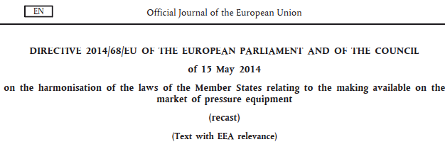
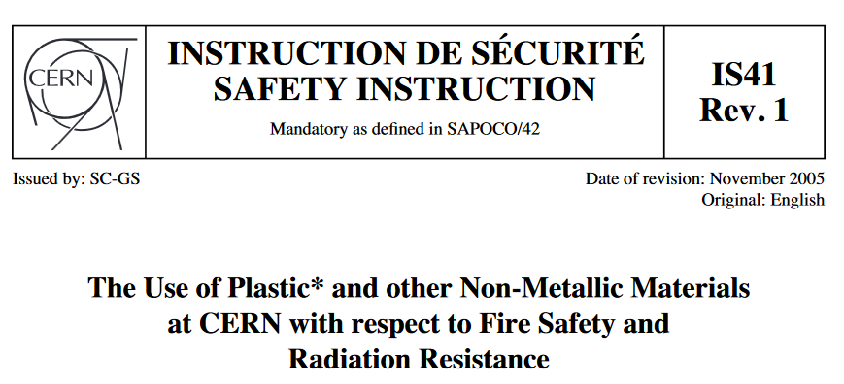
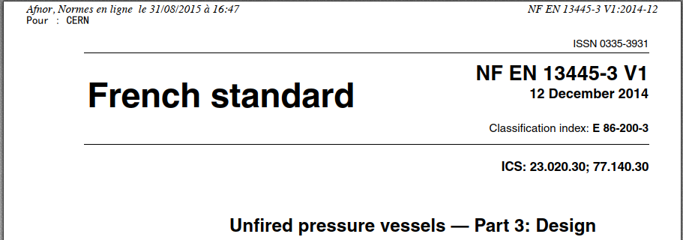
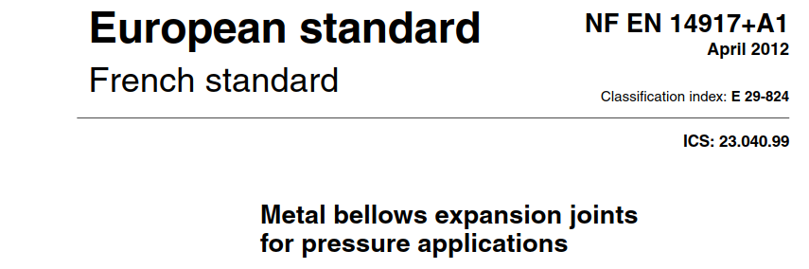
§3 Technical Requirements
Materials requirements:
  Compatible with PED category in operation & HL-LHC QA
  Traceability ensures from initial certificate to upload to MTF
  Specific requirements (Cobalt content, CERN spec. N°510-Ed.5, Radiation and Fire resistance)
Design
  Compliant with Functional, Interface Specifications and European Standards
  Verified by calculations (according to PED)
  Documented in a design report
  Specific requirements (bellows design, vacuum vessels as PED-Cat.1)

Slide 6
§3 Technical Requirements
Manufacturing
  Compatible with PED category in operation
    Materials, Welding procedures, Welders qualifications and inspections
  Traceability ensures from start to upload to MTF
  Specific requirements (bellows welding, 3D forged flanges, vacuum vessels as PED-CAT 1)
Cleaning to EN12300
Assembly : Instrumentation supplied (assembled) by CERN
Non exhaustive list of QA requirements for illustration
 | Design |  |  | Procurement |  |  |  | Manufacturing, Assembly and qualification |  |  |  |  |  |  |  |  |  |  |  | QA
 | Design report | Safety file |  | Manufacturing drawings | CE certif. | Calculations reports | Pressure test procedure |  |  |  | Welding |  | Weld inspection |  |  |  | Leak test |  | Cleaning |  | Procedures
 | Thermo-mech. Fluid mech. | Risk analysis | Pressure relief device design |  |  |  |  | Material certificate | Manuf. & Inspec. Plan | Dimensional report | Welder | Procedure | NDT personel | Visual inspection | X-ray proc. | X-ray result | Procedure | Operator | Procedure | MTF archiving | Installation | maintenance
Standard | EN13445-3 EN13458-2 | NA | ISO21013-3 EN4126-6 | ISO-GPS | PED | EN13445 EN14917+A1 | EN13458-2 | EN10028 HL-LHC_QA | NA | NA | ISO 9606-1 ISO14732 | ISO 15614-1 | ISO 9712 NDT level2 | ISO 17637 | ISO 17636 | ISO 5817 Quality B | EN1779A1 EN13185 | ISO 9712 Level2 | EN12300 | NA | NA | NA
Qualification by notified body |  |  |  |  | (X) | (X) |  |  |  |  | X | X | X |  |  |  |  | X
Components
Vacuum vessel | X | X | X | X |  |  |  | X | X | X | X | X | X | X | X | X | X | X | X | X | X | X
Bellows vacuum |  |  |  | X |  | X |  | X |  | X |  |  | (X) | (X) | (X) | (X) | X | X | X | X
Helium vessels | X |  | X | X | X | X | X | X | X | X | X | X | X | X | X | X | X | X | X | X |  | X
Bellows helium |  |  |  | X | X | X | X | X |  | X | X | X | X | X | (X) | (X) | X | X | X | X
Thermal shield | X |  |  | X |  |  |  | X |  | X | X | X | X | X | X | X | X | X | X | X
MLI |  |  |  | X |  |  |  | X |  | X |  |  |  |  |  |  |  |  |  | (X)
Structural supports | X |  |  | X |  |  |  | X |  | X |  |  |  |  |  |  |  |  | X | (X)

Slide 7
§3 Production and Acceptance tests
See dedicated talk
  Acceptance based on calculations
  Acceptance based on testing
    Production test to PED
    Performance qualification
  Documentation acceptance (see dedicated slide)

Slide 8
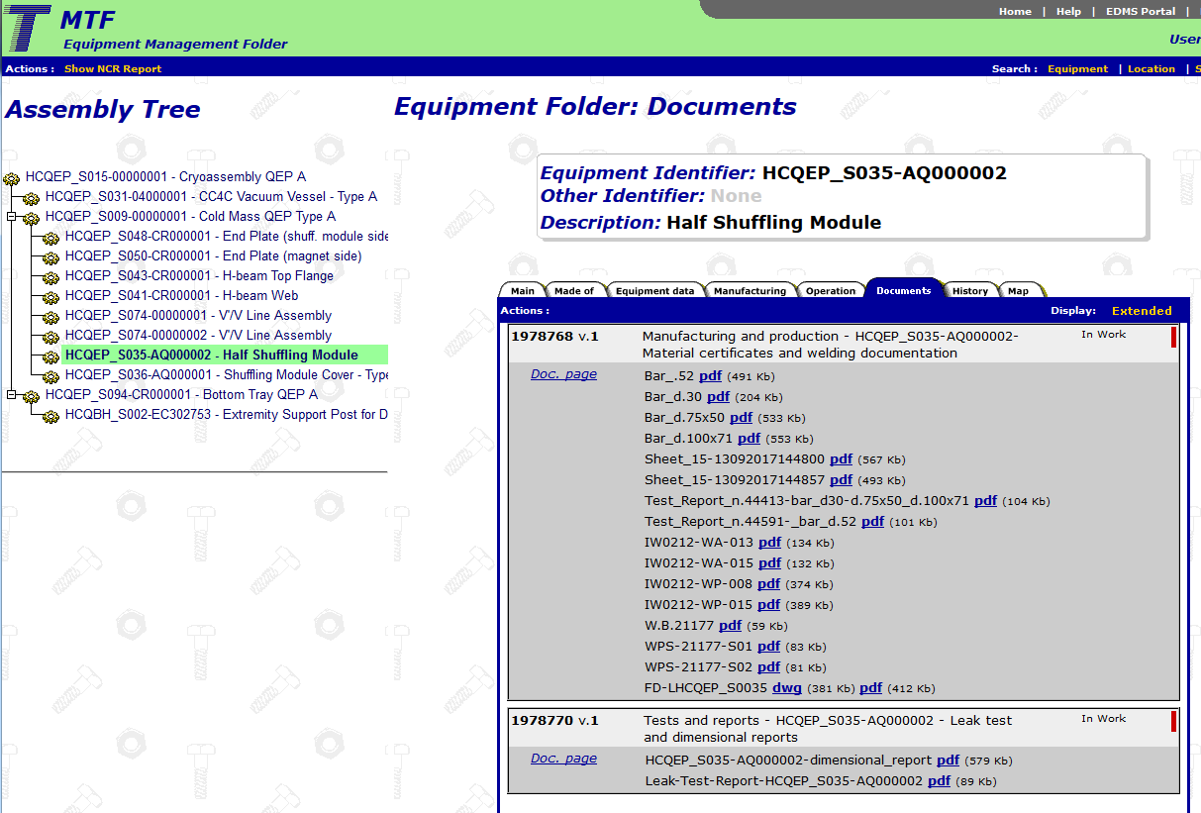
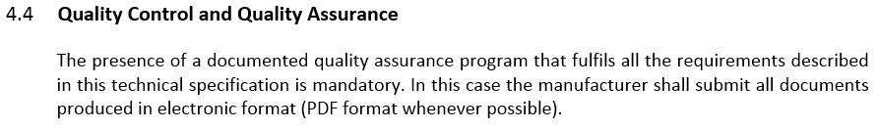
§4 Traceability & shipping
Traceability & Marking
  Individual labelling and identification of each part
    “All manufactured parts […] shall be individually […] marked. […] It shall be possible to identify each material batch used in the manufacturing.[…] The identification system shall ensure that all the material have been subjected to the required level of inspection”
  QA system to ensure materials, NC, tests follow-up
  HL-LHC QA : upload all information to EDMS/MTF database
EC/EU Certification (TBD)
Shipping
CERN database MTF for manufactured products

Slide 9
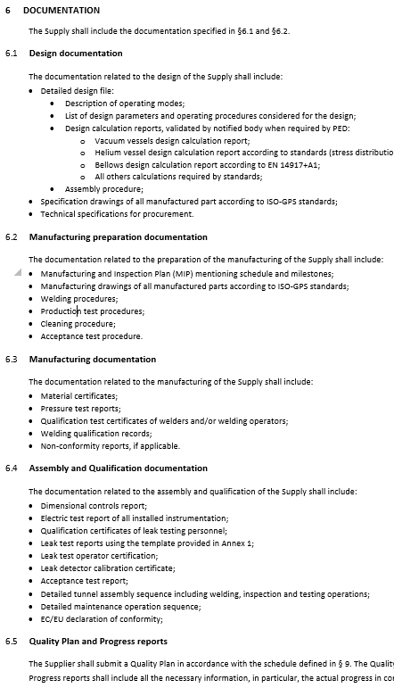
§6 Documentation
Documentation compliant with PED Category III (for component part of the helium volume)
  Design calculation reports
  Material certificate to standard acc. to application
  Welds:
    Welding procedures
    Welders qualifications
    Welds inspections reports
    Weld inspectors qualification
  Pressure test, procedure and report
Documentation for performance qualification and QA aspects
  Design documentation
  Manufacturing preparation
  Manufacturing
  Assembly & qualification

Slide 10
§7 Items supplied by CERN
Insulation vacuum:
  O-rings for vacuum flanges;
  Pumps, valves and pressure transducers (for the machine installation, installed at CERN directly);
  Pressure relief plate;
Cryogenics:
  Instrumentation & hardware:
    Temperature sensors mounted on supports and equipped with wires
    Level gauges equipped with wires
    Pressure transducers if required
    Electrical heaters
    Electrical feedthroughs
  Safety relief pressure devices (installed at CERN)
Survey:
  External survey targets if needed.
Cold Instrumentation routing & feedthroughs:
  IFS tubes equipped with instrumentation wires
  IFS feedthrough

Slide 11
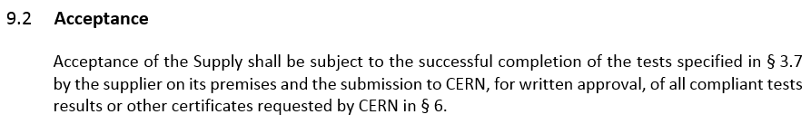
§9 Performance of the collaboration agreement
Design Phase
      (design calculations, operating modes, assembly sequence, specification drawings)
    ➔ CERN’s approval via DDR
Manufacturing preparation
      (Manufacturing drawings, MIP, manufacturing & testing procedures)
    ➔ CERN’s approval via PRR
Manufacturing phase
      (Manufacturing, cleaning)
Assembly and qualification phase
      (qualification campaign, reporting)
    ➔ CERN’s approval of documentation
Delivery to CERN

Slide 12
Summary
The Technical specification is being finalised
Qualification according to PED where applicable
Quality requirements in line with HL-LHC cryostats requirements
Milestones and Acceptance criteria defined in the document

