Slide 1

Electrical requirements of DFX components: specification and tests
A. Ballarino
DFX Detailed Design Review, CERN, 20/06/2019

Slide 2
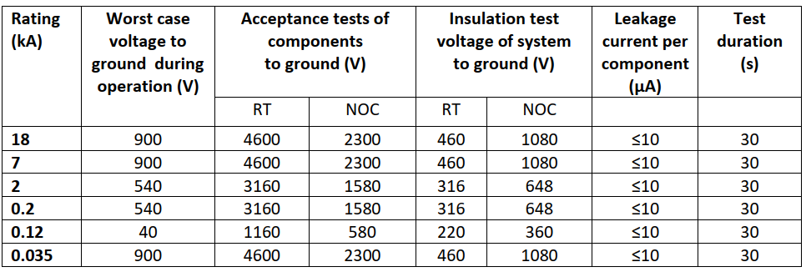
Electrical components in DFX- Electrical Insulation
Electrical components:
Nb-Ti bus-bar from SC Link
Nb-Ti bus-bar from the λ-plate
Instrumentation signals (see next presentation)
Instrumentation connectors
System includes electrical splices (Nb-Ti to Nb-Ti done in the tunnel)
EDMS 1821907
Validated by MCF
DFX
RT → Room Temperature
NOC → He gas @ RT, 1 bar

Slide 3
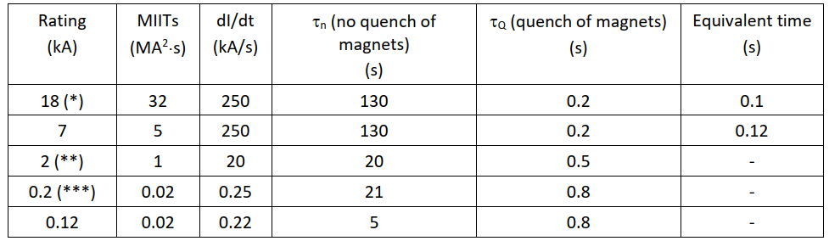
Electrical components in DFX Electrical Transients
EDMS 1821907
DFX
- Nb-Ti superconducting cables AC losses will be measured at Univ. of Twente
on short (few meters long) cables with final design (contract being placed).
- Full system validation, including Nb-Ti cables, with prototype system test in the SM-18 (Oct 2020)

Slide 4

Protection
https://indico.cern.ch/event/643197/timetable/#20170703
MgB₂
Nb-Ti
Nb-Ti
Splice
Splice
EDMS 1951502
Nb-Ti bus-bar
Monitoring of splices
Protection of bus-bar
International Review Cold Powering, July 2017
EDMS 1951503
Cu stabilizer in Nb-Ti bus-bar limiting Tmax to < 100 K during transients
Redundancy of all signals

Slide 5
Instrumentation connectors
Definition of connectors being discussed within MCF as part of a global strategy for HL-LHC
For the DFX:
Large amount of signals to be extracted from the DFX
Each connector grouping voltage taps from the same circuit
Insulation of pins to ground according to table in slide 1
Insulation between pins < 500 V in NOC

Slide 6
Thanks for your attention !

