Slide 1

Instrumentation in the DFX:
Requirements and Routing
Electrical Protection and Cryogenic Sensors
J. Fleiter, S. C. Hopkins, A. Ballarino
Internal Review of DFX Detailed Design, 20th June 2019 (Indico 821876)

Slide 2
Outline
Cold Powering Instrumentation Specification
DFX Instrumentation:
  Electrical Protection of Circuits
  Cryogenics
  Feedthroughs
  Vacuum

Slide 3
Specification
A functional specification documenting the instrumentation requirements of the Cold Powering System of the Inner Triplets has been discussed and prepared ¹
  DFX instrumentation represents a subset of that specification
A draft DFX instrumentation list was presented at the DFX conceptual design review, 31st Jan 2019 ². Since then:
  No change to the voltage taps
  Addition of two heaters for the warm-up phase and four temperature sensors for monitoring the heaters
  Addition of ΔP LHe level gauge for level monitoring in LHe fountain
¹ J. Fleiter, EDMS 2087413
² J. Fleiter, DFX Instrumentation Requirements, Indico 783116

Slide 4
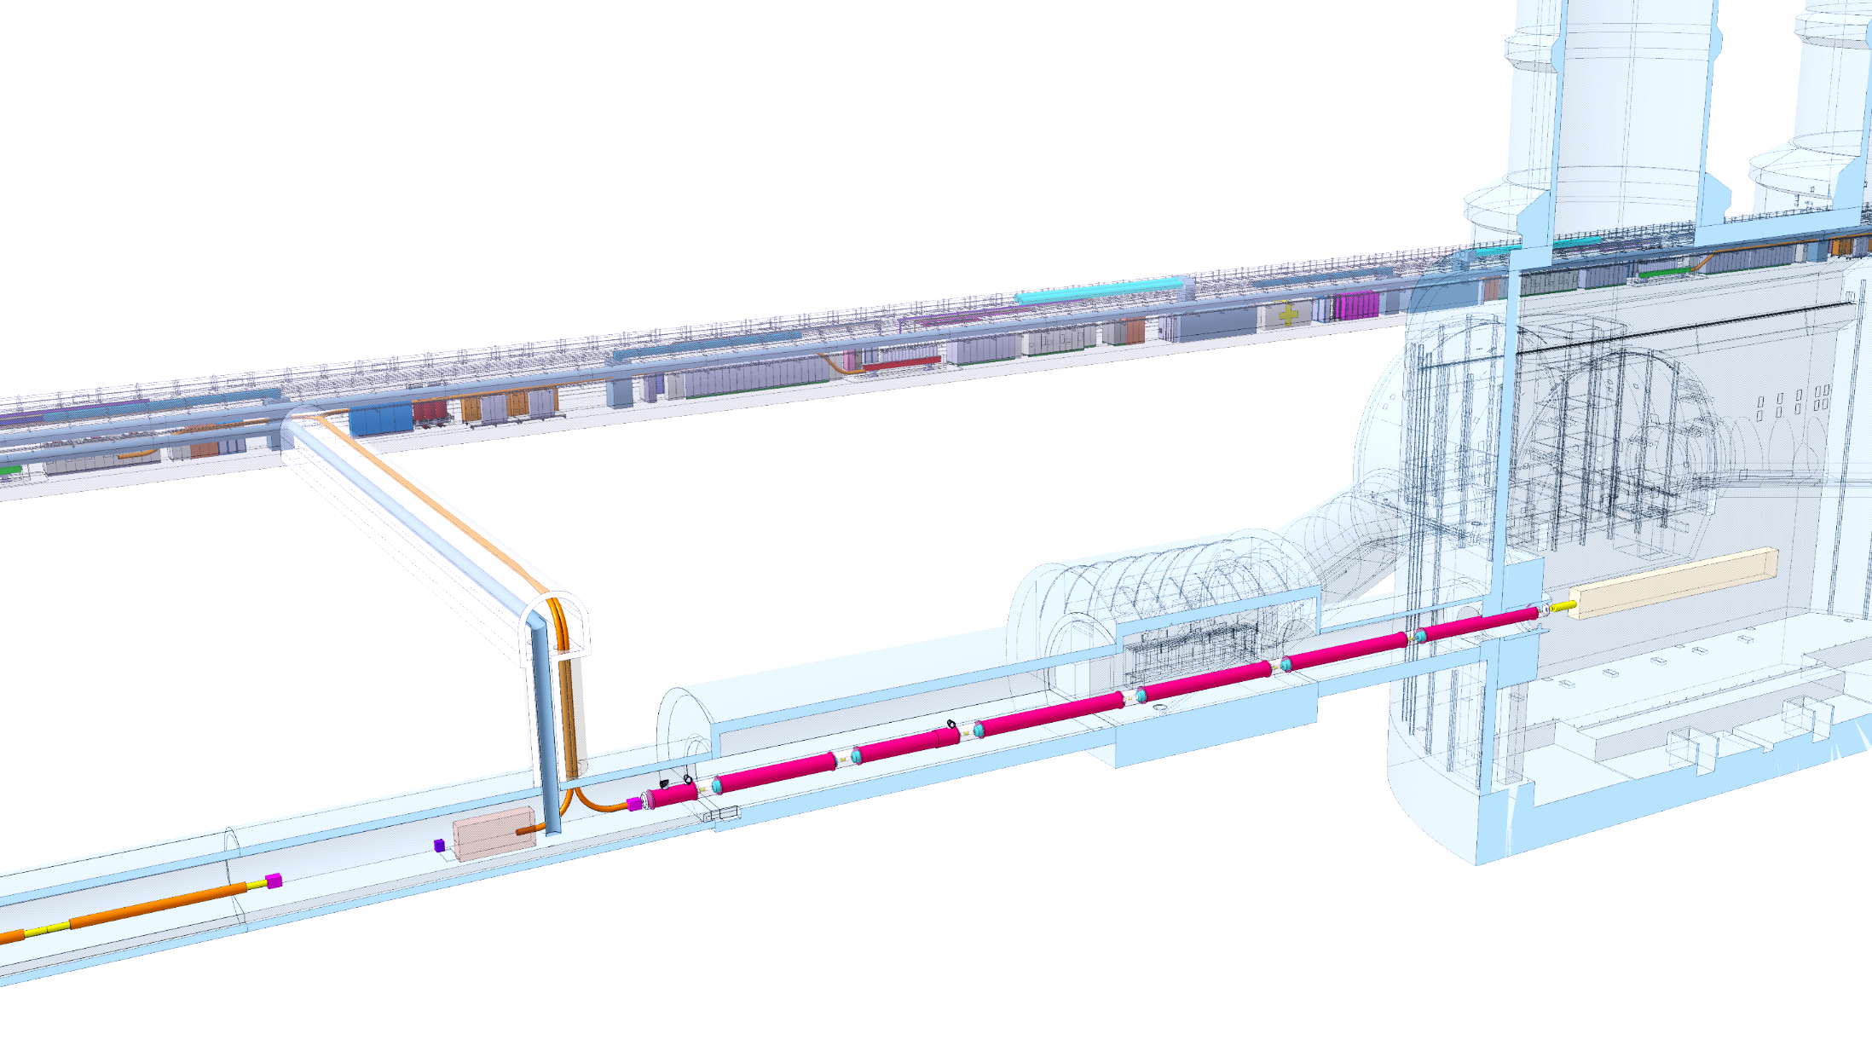
Overview of Electrical Circuits
The cold powering system of the inner triplets consists of:
  2 × 18 kA MQXF main circuit
  3 × 7 kA MQXF trims
  2 × 13 kA D1 circuit
  12 × 2 kA MCBXF circuit
A total of 19 circuit branches will be routed through the DFX:
  The DFX hosts Nb-Ti/Nb-Ti splices between Nb-Ti bus bars and the Nb-Ti extensions of the SC Link.
DFHx1
DFHx2
Service tunnel
DSHx
Power converters
DFX
Q1
IP
Q2b
Q2a
CP
Q3
D1
LHC tunnel
≈80m

Slide 5
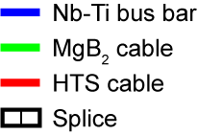
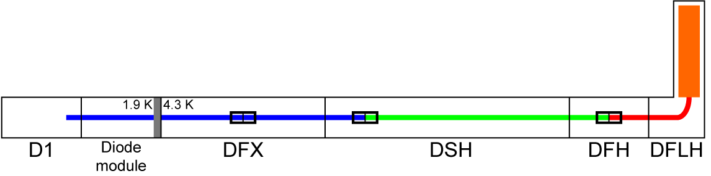
Overview of Electrical Circuits
Each circuit branch consists of:
  SC cables
    Nb-Ti bus bar passing through the plug (~3.5m in DFX)
    Nb-Ti bus bar extension connected at the surface to the MgB₂ cables (~1.5 m)
    MgB₂ cable (~100 m long)
    HTS cable (~3-5 m long)
  Splices
    Nb-Ti/Nb-Ti
    MgB₂/Nb-Ti
    HTS/MgB₂
Present Scope
Nb-Ti/Nb-Ti
Splice
MgB₂/Nb-Ti
Splice
HTS/MgB₂
Splice

Slide 6
Electrical Protection Requirements
Requirements for circuit protection were presented in the cold powering review, July 2017 ¹:
  Active protection of SC cables and current leads.
  Monitoring of individual splices:
    MgB₂/HTS, MgB₂/Nb-Ti and Nb-Ti/Nb-Ti.
  Redundancy of voltage taps.
Active protection shall be implemented with a dedicated Quench Detection/Protection System that:
  Detects any quench or detached voltage taps, and
  Triggers the discharge of the circuit.
¹ A. Ballarino, Requirements for the protection of the SC links components, Indico 643197

Slide 7
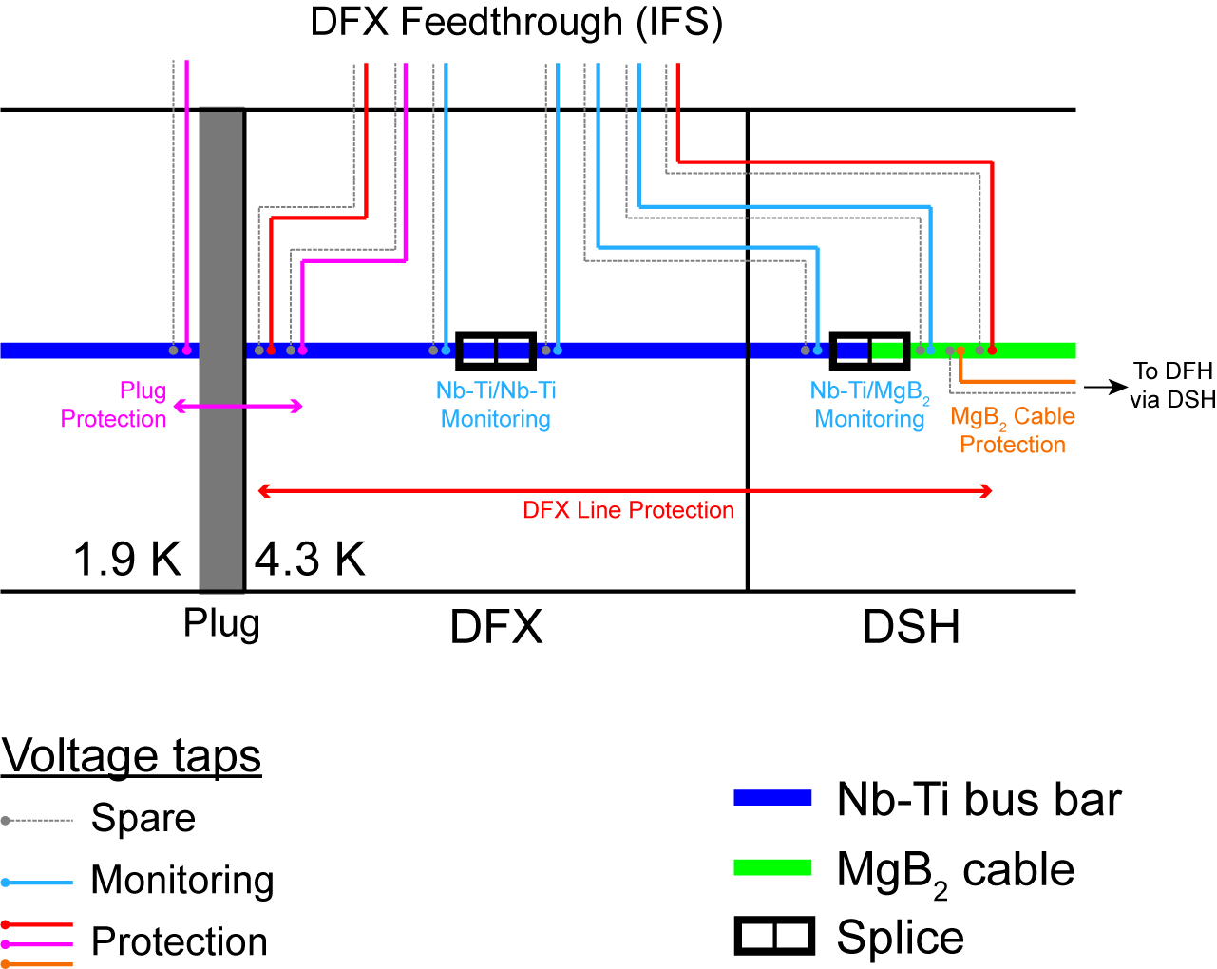
Instrumentation for Circuit Protection
Each circuit branch will be equipped with voltage taps:
  1 pair within the DFX cold mass to monitor the Nb-Ti/Nb-Ti splice
  1 pair routed via the DFX to monitor the Nb-Ti/MgB₂ splice
  1 pair to protect the line inside the DFX
  1 pair to protect the Nb-Ti bus through the plug (1 wire from the DFX, 1 from the cold diode module)
  One spare for each of the above
  →14 wires per circuit branch to route out from the DFX
Wire for voltage taps:
  Polyimide insulated Cu wire, AWG 26 (used for magnet instrumentation) ¹
¹ Axon HH2619, EDMS 2030599
Enlarge

Slide 8
Cryogenic Requirements of the DFX
Immersion of Nb-Ti/MgB₂ splices and Nb-Ti bus bars in saturated LHe bath at 1.3 bar:
  LHe level regulation required
Generate a GHe mass flow from the LHe bath to:
  Maintain the MgB₂ cable assembly within the SC Link at below 17 K
  Maintain all the MgB₂/HTS splices (DFH box) below 17 K
  Thermalize the cold terminal of the heat exchanger of each current lead to 50 K

Slide 9
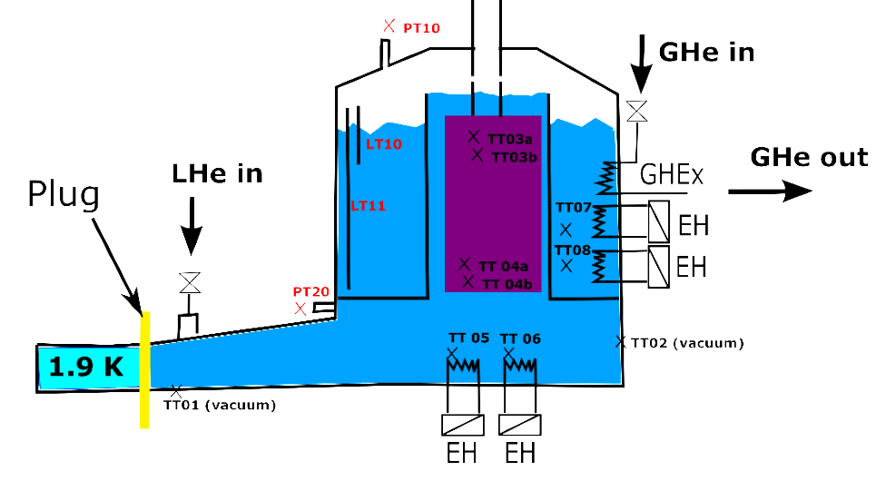
General Cryogenic Layout of the
SC Link for the Triplets
General cryogenic instrumentation layout of SC Link elaborated with S. Claudet
Wiring of cryo instrumentation of DFX routed via the DFX feedthrough
No routing of cryo instrumentation of DFH and current leads via the DFX
➔ Focus on DFX in this presentation

Slide 10
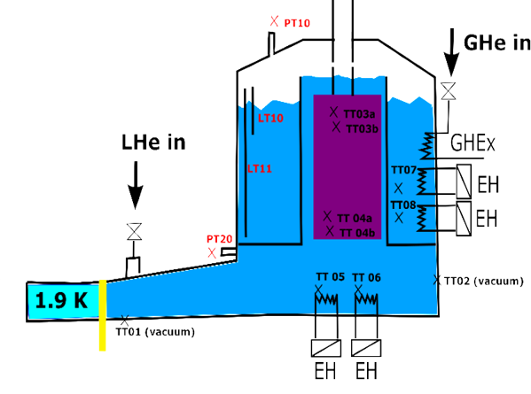
Cryogenic Instrumentation of the DFX
10 temperature transducers (TT):
  Two in vacuum attached to He tank (Cernox): mutual spares
  4 in the splice box (He tank) (Cernox)
  4 temperature sensors attached to the resistive heaters
4 resistive heaters and 1 heat exchanger:
  1 GHe/LHe heat exchanger
  2 resistive heaters in external bath (includes 1 spare)
  2 resistive heater in the lower bath
2 pressure gauges:
  1 He pressure gauge located on the helium gas return
  line in the QXL
  1 ΔP gauge to measure level of liquid in the fountain
2 LHe level transducers
Cryo valves: part of cryo jumper
Splice box (MgB₂/Nb-Ti)

Slide 11
Cryogenic Instrumentation of the DFX
Temperature transducer wiring:
  4 wires per probe
  2 probes in vacuum → 8 wires at vacuum feedthrough:
    >1 m long wires, no thermalization required
    Manganin wires, AWG 36 ¹
  8 probes in LHe → 32 wires at DFX cold mass instrumentation feedthrough:
    Cu wires, AWG 32 ¹
LHe level transducer:
  2 probes (wires part of the probe)
    Easily replaceable for unscheduled repair work interventions (by design of DFX)
Electrical heater wiring:
  2 wires per heater → 8 wires (Cu, cross-sectional area to be confirmed)
¹ LHC-Q-GN-0009, EDMS 320597

Slide 12
Feedthroughs for DFX Voltage Taps and Cryogenic Instrumentation (1)
Two types of feedthrough for instrumentation installed in DFX cold mass:
  Voltage taps (at least two units)
    Must meet insulation voltage requirements, to ground and between circuits, during acceptance tests of components, insulation tests of the system and operation
    Instrumentation wires grouped by circuit, considering voltage ratings
  Temperature probes and resistance heaters (one unit)
Feedthrough based on the concept of the Instrumentation Feedthrough System (IFS) of LHC cryo magnets
  IFS constructed as components tested on the surface and then assembled in the DFX

Slide 13
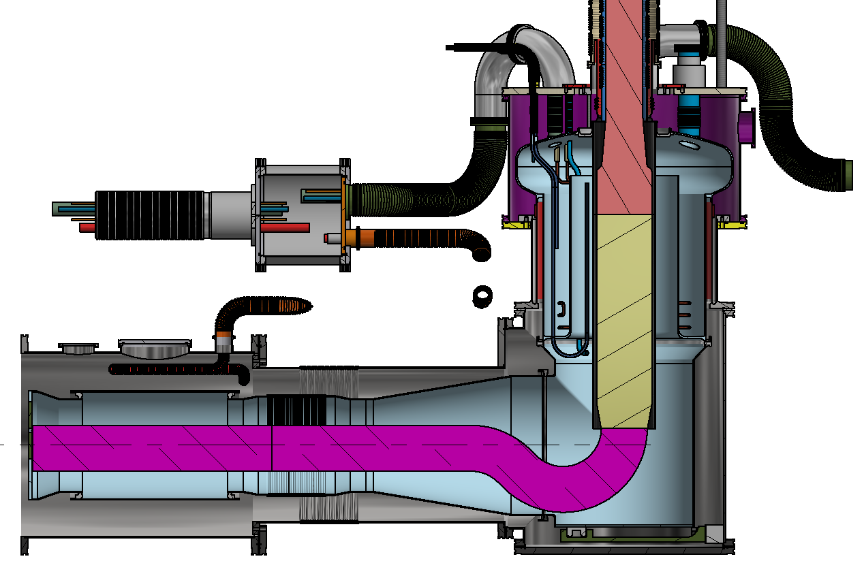
Feedthroughs for DFX Voltage Taps and Cryogenic Instrumentation (2)
Cold mass instrumentation wiring (voltage taps, temperature, heater) connected to IFS wiring in a Wiring Interconnection Box (WIB)
WIB located next to Nb-Ti/Nb-Ti splice box to allow access for repairs
Design and procurement of IFS performed by CERN
IFS to provide spare capacity of at least 5%
Instrumentation Feedthrough System
IFS
Wiring Interconnection Box
WIB
Nb-Ti/Nb-Ti Splice Box

Slide 14
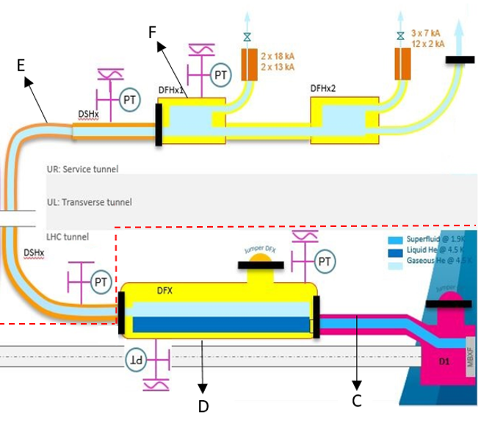
Vacuum Instrumentation of the DFX
The cold powering chain of the inner triplet comprises three vacuum volumes ¹:
  DFX, DSH and DFH
The DFX vacuum vessel will be equipped with ports to connect pumping units and vacuum instrumentation ²
All the vacuum instrumentation (Pirani, Penning
and membrane gauge) will be external to the
DFX vacuum vessel
→ no wiring is required in the vessel for
vacuum instrumentation
¹ G. Riddone et al., EDMS 1824906; Y. Leclercq, EDMS 2019348
² Y. Leclercq, DFX Interfaces, EDMS 2157597

Slide 15
Summary
Instrumentation in the DFX:
  Protection:
    Electrical protection requirements implemented using ~200 voltage taps over the 19 circuit branches for monitoring and protection
  Cryogenics:
    8 temperature probes, + 2 in vacuum *
    2 level gauges *,
    2 pressure gauges,
    1 GHe/LHe heat exchanger,
    4 resistive heaters
  Vacuum: no vacuum instrumentation routed in the vessel
Instrumentation wires routed to room temperature via Instrumentation Feedthrough Systems (IFS) on the DFX
(except those marked * above)

Slide 16
Extra Slides

Slide 17
Enlargement of Voltage Tap Configuration

Slide 18
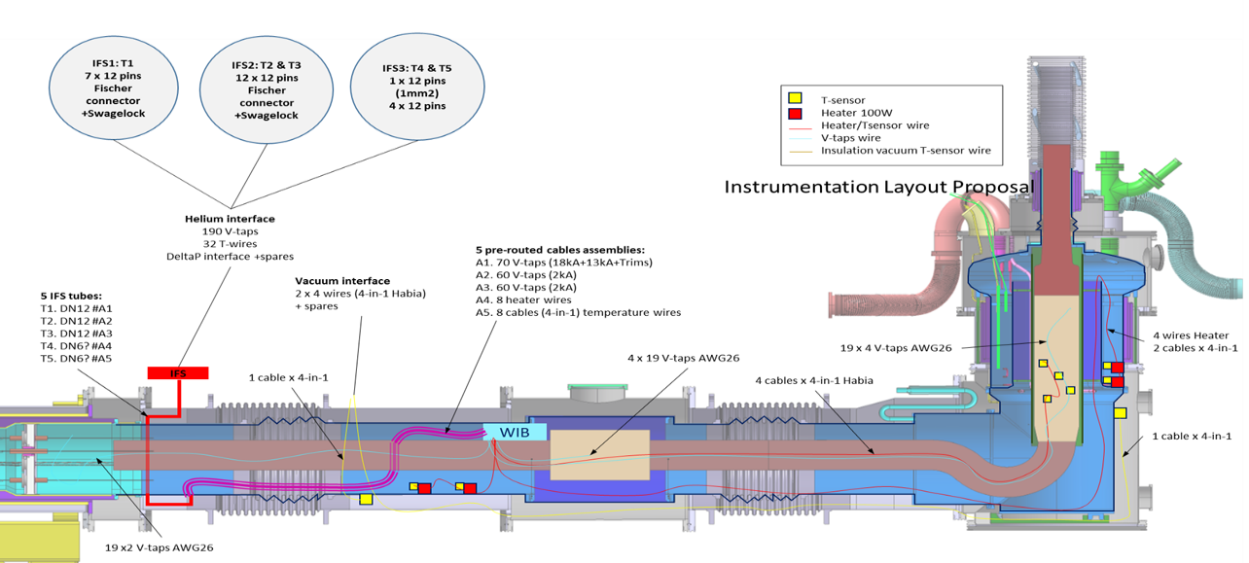
DFX Instrumentation Layout Proposal
Sketch from Y. Leclercq

