Slide 1

DFM in WP6a, Master Plan
A. Ballarino
DFM Detailed Design Review, CERN, 21/06/2019

Slide 2
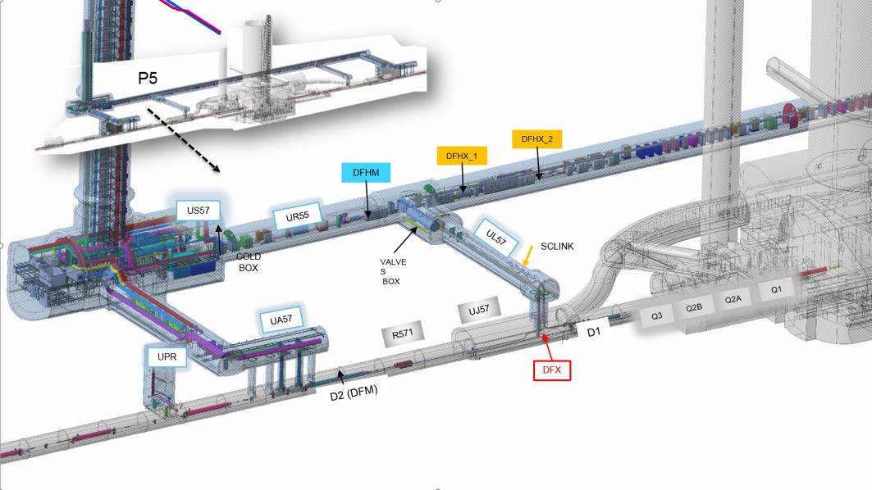
DFM Cryomodule in WP6a
DFM
Interface between SC Link and D2. It provides the powering
of the HL-LHC Matching Sections (D2 and its correctors)

Slide 3
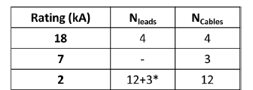
Powering the Matching Sections
Matching Sections
D2 and its correctors
Triplets
Rating (kA) | N_{leads} | N_{cables}
13 | 2 | 2
0.6 | 8 | 8

Slide 4
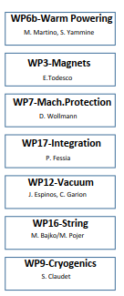
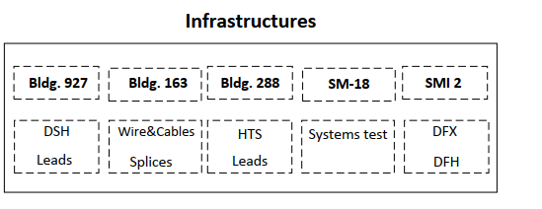
DFM in WP6a Organogram
Interfaces
λ-plate in D2 cold mass

Slide 5
DFM
Baseline: construction of five DFM cryo-modules, via UK 2 contribution to HL-LHC, by Southampton University (SOTON). Design carried out by CERN, in collaboration with SOTON (direct coordination by Y. Leclercq, CERN, and Y. Yang, SOTON).
Five cryo-modules: one pre-series unit (also spare for HL-LHC) and four series units.
No DFM test in nominal cryo/electrical conditions is planned (we rely on the experience with the Cold Powering System for the HL-LHC Triplets. The SC Links and the HTS Current Leads for the HL-LHC Matching Sections will be tested.

Slide 6
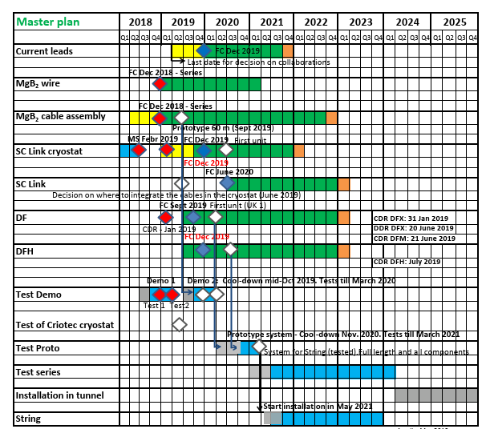
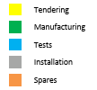

WP6a Master Plan
DF FC Sept 2019 (UK2 Contr., SOTON)
Pre-series unit
Series production to be completed by March 2023

Slide 7
Thanks for your attention !

