Slide 1
DFM Functional specification
Y. Leclercq on behalf on WP6a DFM team development
CDR DFM 21 June 2019

Slide 2
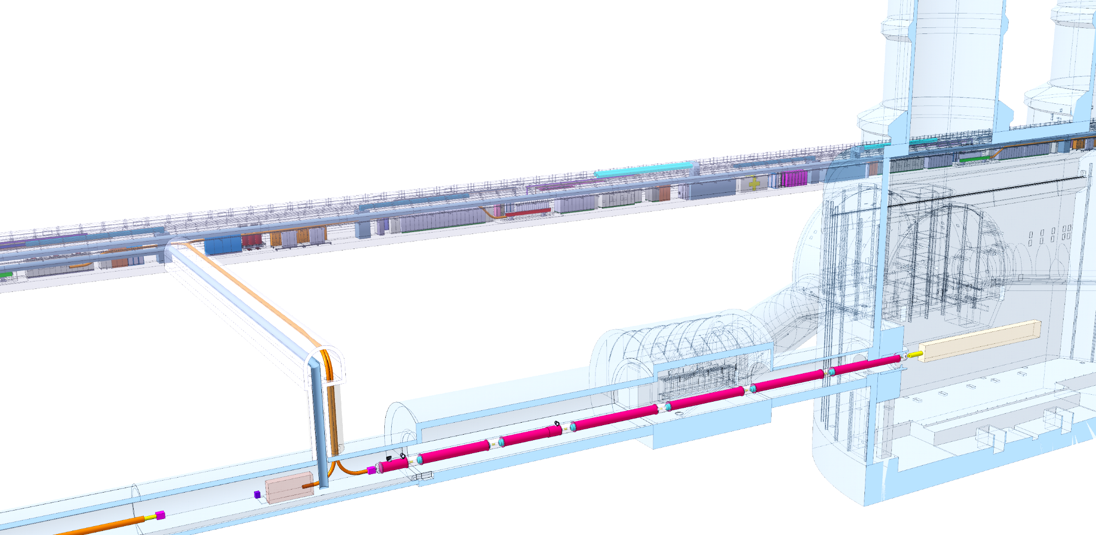
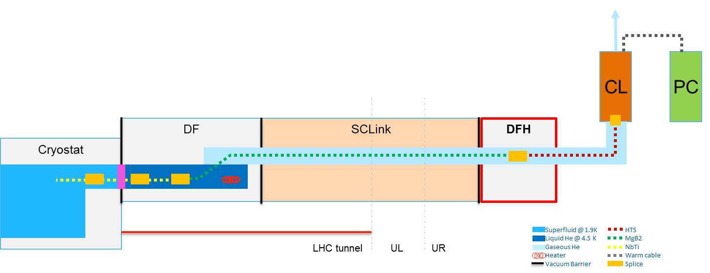
Context : DF boxes key functions
Each IP1 and IP5 sides equipped with 2 cold powering chains of cryostats
  Matching sections : DFHm – SC Link - DFM
DFM basic functions:
  Electrical interface between SC Link and superconducting magnets
  Supply cryogenics to the SCLink
DFM functional specification and interface definition EDMS 2052614
DFHx2
DFHx1
DFHM
Power converters
Service tunnel
DSHx
Transverse tunnel
DSHm
Q1
IP
≈50m
≈8m
Q2b
Q2a
CP
Q3
≈45m
DFX
D1
≈80m
LHC tunnel
DFM
D2
DF system interfaces
1. Basic concept
Cryogenics
CL / Magnet
Transport
Installation
Integration
DF design
Maintenance
Insulation Vacuum
SCLink
Test

Slide 3
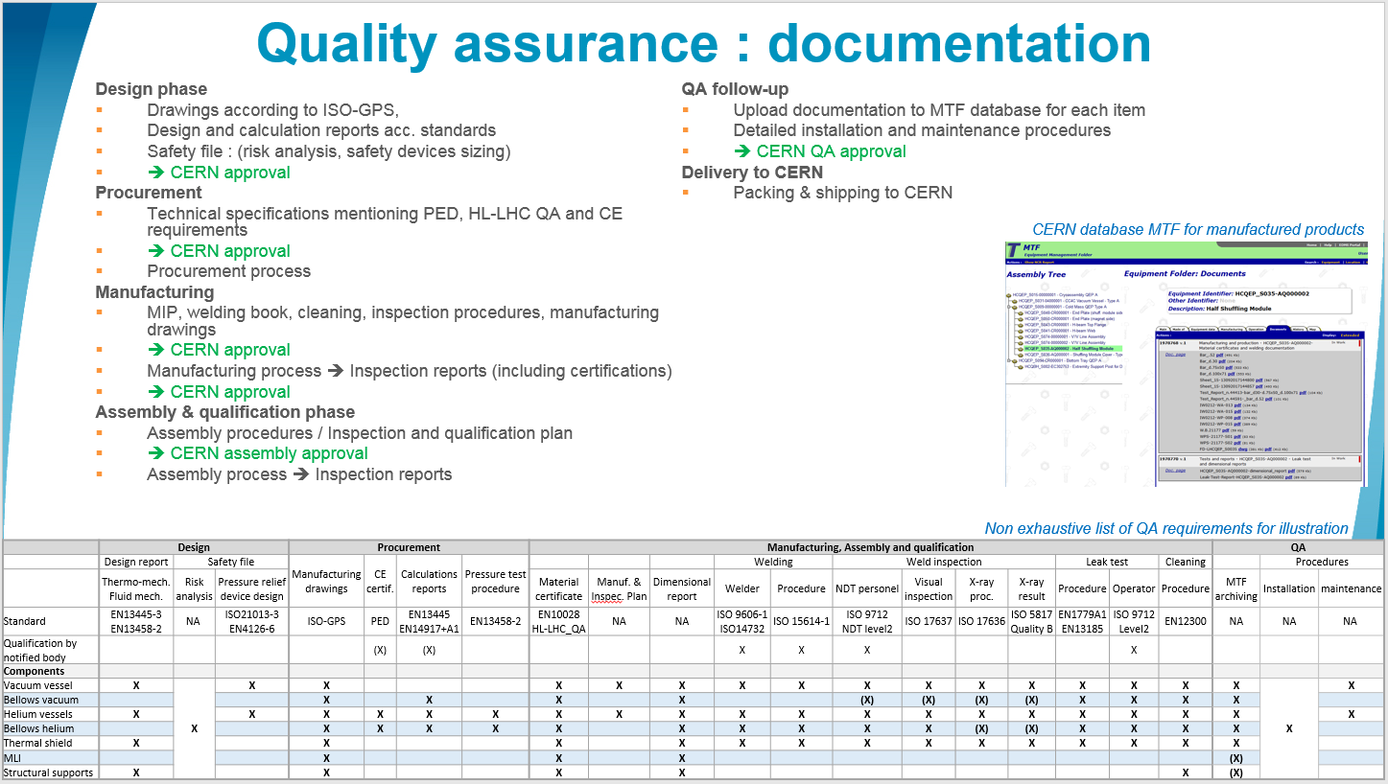
General requirements
DFM installed in LHC machine
  ➔ Comply with CERN rules
      CERN Safety Rules
      GSI-M-4 - Cryogenic equipment :
  ➔ European directives
      Pressure Equipment Directive 2014-68-EU
  ➔ HL-LHC QA requirements
      ALARA principle
      Material requirements
      Documentation & MTF
GSI-M4: “The manufacture […] by collaborating institutions, of all new cryogenic equipment shall comply with the applicable CERN Safety Rules, European directives and harmonised standards”.
HL-LHC documentation requirements
Details in spare slide

Slide 4
Electrical main specifications
DFM shall ensure the electrical connectivity between the SCLink DSHM and D2 cables
SCLink cables layout:
  10 MgB₂ conductors in SCLink
  NbTi extensions soldered to MgB2 in protective rigid cylinder
  Only NbTi extensions are accessible in DFM
Magnet cables layout: 10 NbTi conductors from magnet side
The NbTi extensions shall be routed and connected to the NbTi bus coming out of from the plug
Instrumentation shall be routed to feedthroughs on a dedicated patch panel at the level of the vacuum vessel interface (no cold feedthroughs)
Magnet
Side
Rigid protection of MgB2-NbTi splices
DFM
SCLink
Splice
Plug
NbTi bus from Plug
NbTi bus from SCLink
MgB2 cables

Slide 5

Mechanical interfaces
SCLink mechanical interface
  Two independent flexible when installed
  Vacuum & helium jacket flanges fixed to DFM
  MgB2-NbTi splices contained in rigid protection fixed to He jacket flange
  Only NbTi extensions access the DFM He volume
Magnet mechanical interface
  Plug fixed to ground
  DFM fixed to He/vacuum interfaces with bellows
  Access to NbTi-NbTi splices granted during installation and maintenance
Cables thermal contractions
  NbTi-NbTi splices fixed to DFM He vessel
  DFM covers internal contractions 3.5 mm/m
SCLink Vacuum Jacket flange
Bolted to DFM vacuum vessel
SCLink Helium Jacket flange
Welded to DFM He vessel
Ø 200
600
MgB2-NbTi
rigid protection
NbTi
bus bars
Ø 150
NbTi-NbTi splices
fixed to He vessel
DFX
Magnet
MgB2-NbTi splices
SCLink
Plug
3.5 mm/m

Slide 6
Cryogenics requirements
SD : GHe Out
(for transient)
Superfluid @ 1.9K
Liquid He @ 4.5 K
Gaseous He
Heater
MgB2
NbTi
Splice
CS : LHe In
Heat exchanger 40K
Dedicated presentations on Cryogenic scheme, operation, safety
Layout:
Hydraulic plug separates triplet magnet & DFX-SCLink He volumes
Dedicated DFX jumper
Electrical performance:
NbTi cables & MgB2-NbTi splices immersed in LHe
Cryogenic lines:
LHe in, Ghe out, Outlet Magnet line, heat exchanger
Operation configuration
Heaters (electrical & heat exchanger) vaporises helium
  Nominal : 2 g.s⁻¹ , design 3 g.s⁻¹
Ghe gaseous mass flow through the SCLink
Design Pressure : 2.5 bara
Instrumentation:
Level gauges, Temperature sensors, Pressure gauge
Design requirements:
Heat loads to LHe < 20 W
No condensation on external surfaces and feedthroughs
> 10 min of nominal supply GHE in case of liquid supply stop
Constant slope between coldest point and LHE-GHE interface
Safety relief devices to protect DFM+SCLink
Access to safety relief devices, instrumentation interfaces shall be granted for inspection and maintenance
E’_{H}F_{H2}
PT
DFM
Magnet side
SCLink
MgB2-NbTi splices
5 min margin
2 g.s⁻¹
Plug
100 W
DFM nominal configuration

Slide 7
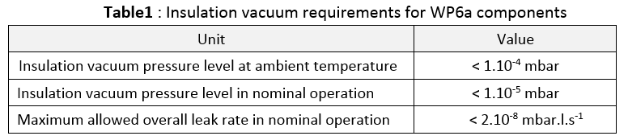
Insulation vacuum
The DFM insulation vacuum shall be compatible with the General WP6a insulation vacuum layout EDMS 2048016
The DFM insulation vacuum is independent to:
  Allow local maintenance & leak detection
  Minimise inter-dependence between helium volumes
➔ DFM presents vacuum barriers with:
  The cryolines (not part of DFM)
  The SCLink (part of the DFM)
  The Connection to the D2 cryostat (not part of DFM)
Interfaces:
  Standard type flanges with elastomer seal
  Ports for pumps and instrumentation for both DFM & SCLink
  Pressure relief plate
Unit | Value
Insulation vacuum pressure level at ambient temperature | < 1.10⁻⁴ mbar
Insulation vacuum pressure level in nominal operation | < 1.10⁻⁵ mbar
Maximum allowed overall leak rate in nominal operation | < 2.10⁻⁸ mbar.l.s⁻¹
SCLink :
Pumping, gauge, safety port
PT
Magnet
DFM
SCLink
Plug

Slide 8
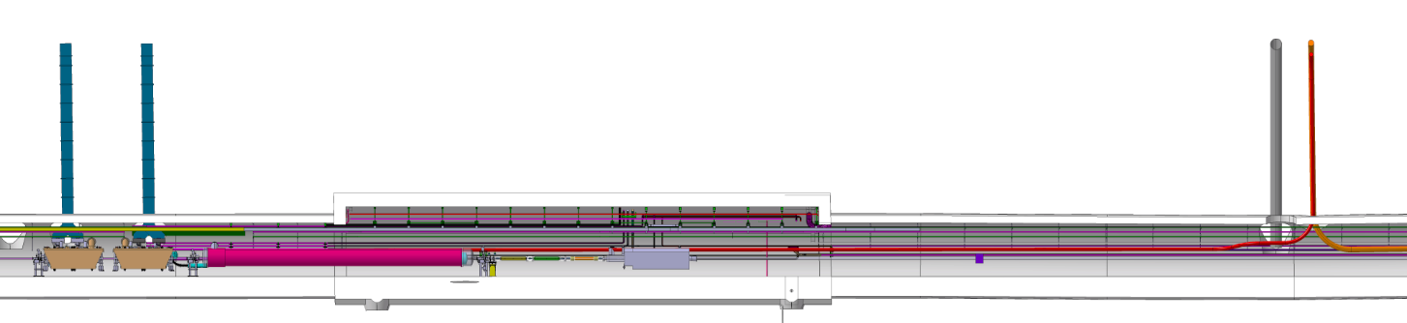
Integration specification
On-going study to define Integration specifications
Weekly meeting started under WP15 (Friday 10am) to define inputs leading to integration study.
1st Meeting on June 14.
Preliminary studies led with DFX environment (see next talk)
≈45 m
≈1.5 m
DSHm
CC
CC
DFM
D2
D2

Slide 9

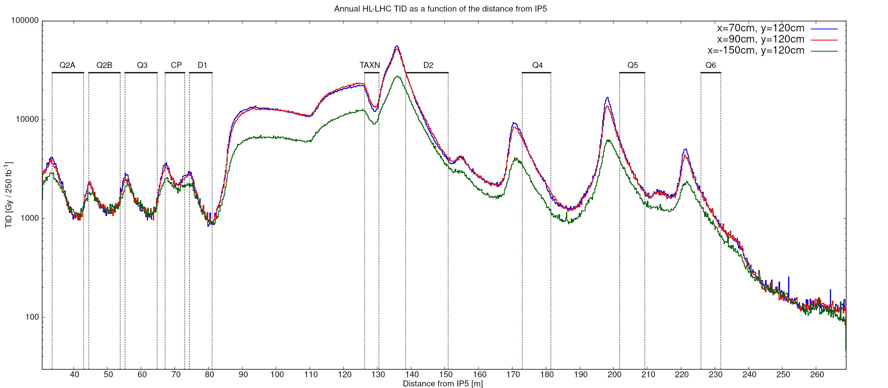
Preventive maintenance and repairs
Dose up to 1 MGy over HL-LHC life time at D2 end, Neutron f. ≈ > 1.10¹⁵ cm⁻², up to 25 mSv/h
All operations shall be designed from the ALARA point of view:
  Minimise intervention time (access, automatic operation)
Interventions
  Unscheduled interventions for inspections and light work during Technical Stops (e.g. for electrical checks on patch panel)
  Planned interventions for routine maintenance requiring warm up during YETS (e.g. replacement of burst disks)
  Unscheduled medium repair work interventions requiring warm up during YETS (e.g. Nb-Ti/Nb-Ti repair)
  Unscheduled heavy repair work interventions requiring warm up during EYETS or unscheduled extended machine stop (e.g. MgB2/Nb-Ti repair, plug replacement)
DFX Area
DFM Area
Annual HL-LHC TID at various location for illustration only.
Courtesy G.Lerner

Slide 10
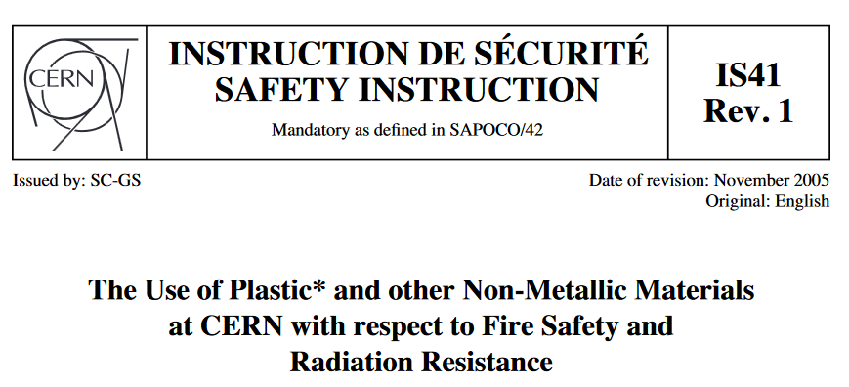
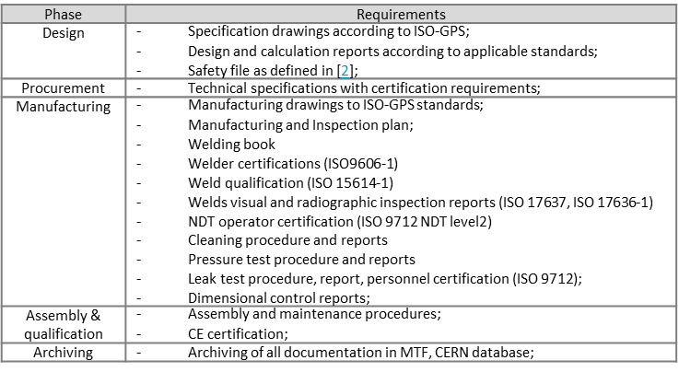
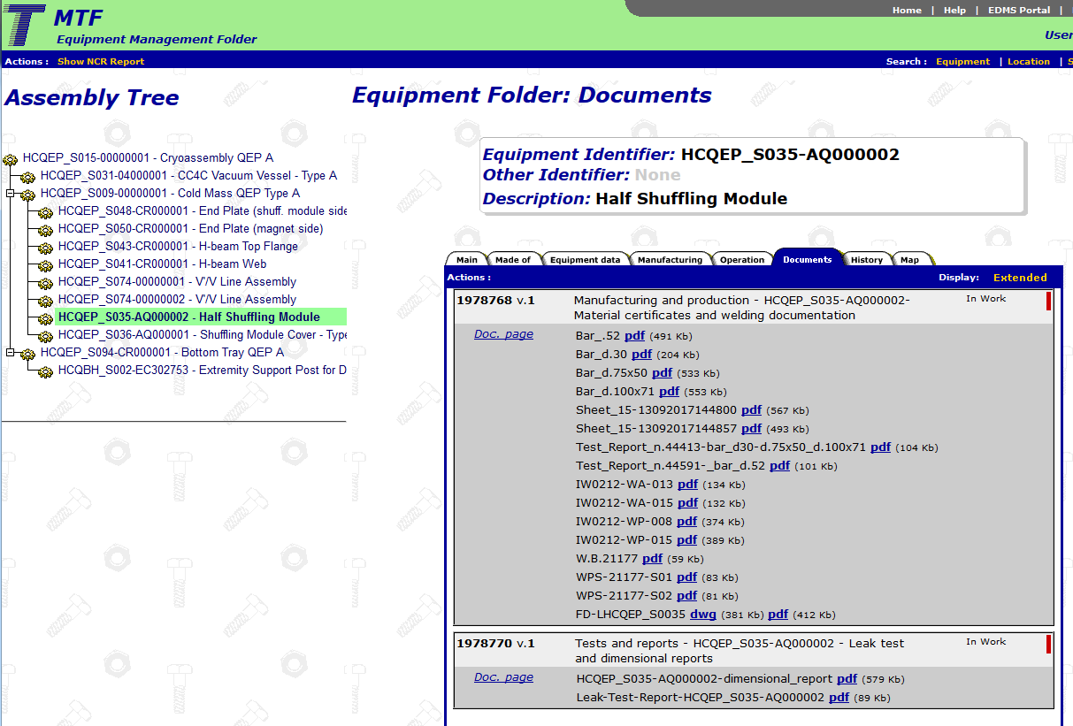
Manufacturing & Inspections
Manufacturing & Inspections according to
  Pressure Equipment Directive (PED)
  HL-LHC QA requirements (see spec)
    Materials & Manufacturing specific requirements:
      Compatible with Dose level over HL-LHC project period:
      Cobalt content for stainless steel < 0.1%
      Polymers according to IS41 EDMS335806
      Vacuum vessel as PED CATI
      Bellows specific welding interfaces
    Inspections and certifications
      Welding and welders
      Leak tightness level, procedure and operators
      Pressure testing according to PED
    Documentation
      Manufacturing procedures & qualifications
      Inspection reports
      CE certification
      Upload into CERN database MTF
CERN database MTF for manufactured products

Slide 11
Summary
Cryogenics, Electrical, insulation vacuum operating functional specifications are defined
Integration and transport specifications still to be defined. Specific weekly meeting in place under WP15.
Detailed technical and interfaces specifications to be studied (cryogenics connection, Electrical protection)

