Slide 1
DFM Conceptual Design
Y. Leclercq, A.Kolehmainen on behalf on WP6a DFM team development
CDR DFM 21 June 2019

Slide 2
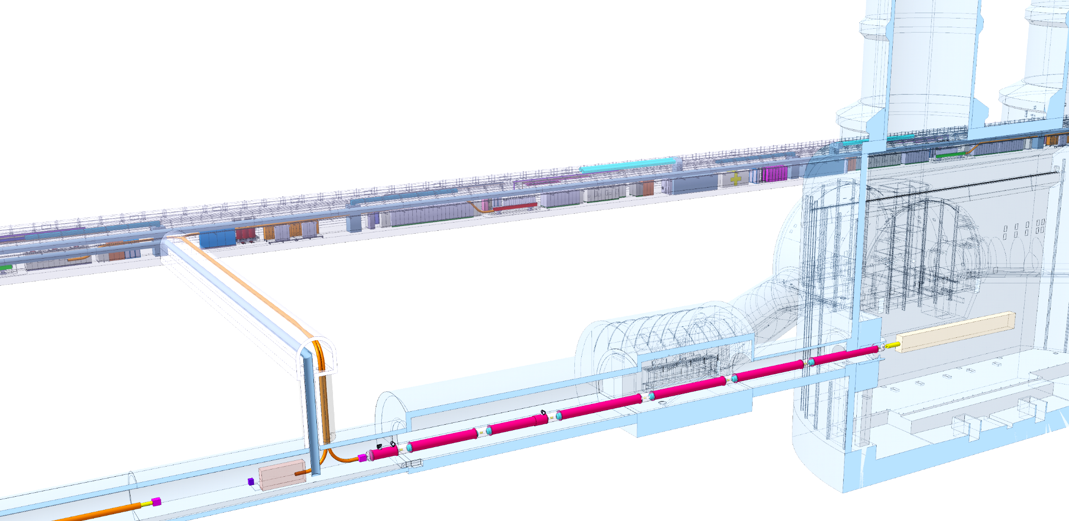
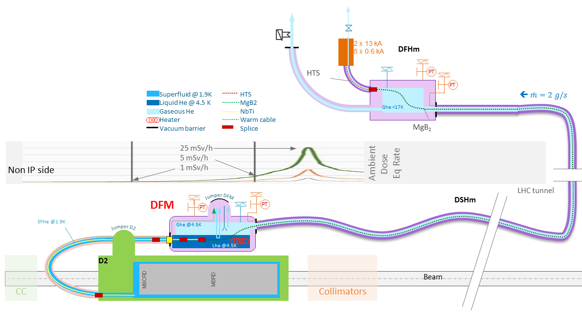
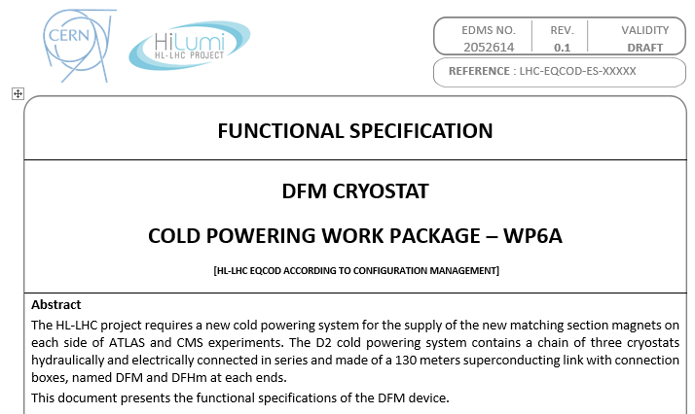
Cold Powering of the D2 cryostat
Chain of cryostats :
DFHM-DSHM-DFM-Interlink D2/DFM-D2
D2 cryostat
  5 Magnets : MBRD + 4 x MCBRD
  Superfluid helium @ 20 bar design pressure
DFM basic functions:
  Electrical interface between SC Link and superconducting magnets
  Supply cryogenics to the SCLink
DFM conceptual design based functional specification EDMS 2052614
DFHx2
DFHx1
DFHM
Power converters
Service tunnel
DSHx
Transverse tunnel
DSHm
Q1
IP
≈50m
≈8m
Q2b
Q2a
CP
Q3
≈45m
DFX
D1
≈80m
LHC tunnel
DFM
D2

Slide 3
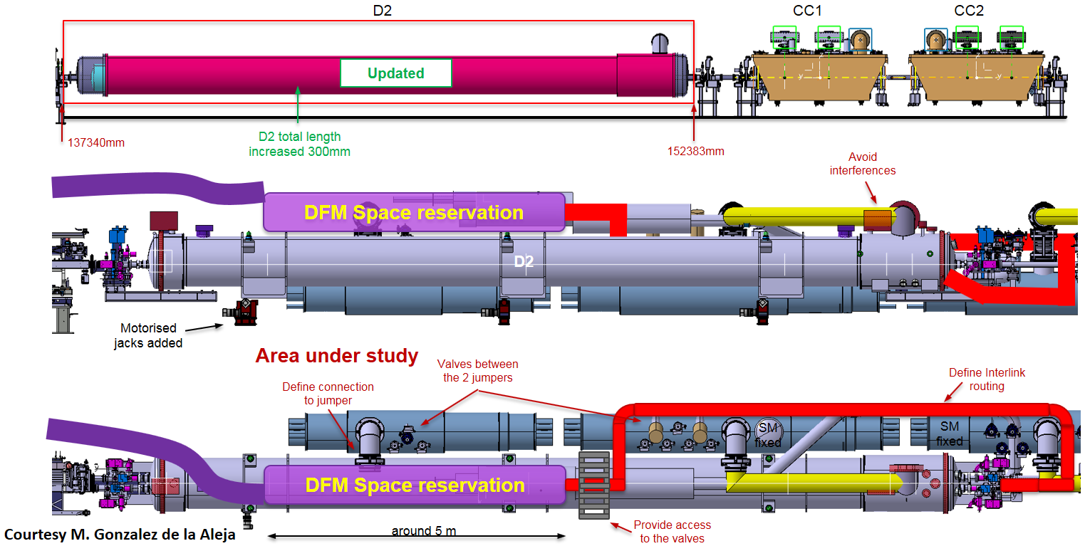
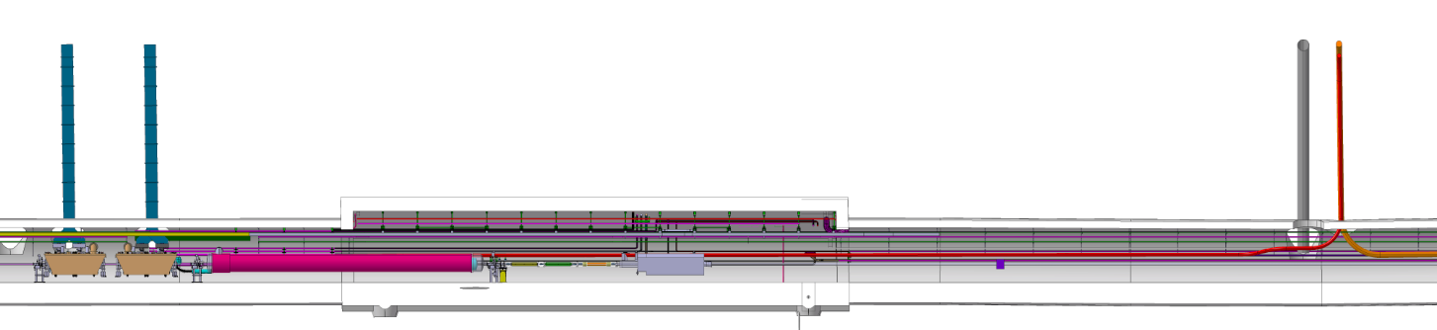
Environment overview
D2 located between Crab Cryomodules and Collimators
Connect to D2 via Interlink
Connect to cryogenic lines with dedicated jumper
DFM located above D2
≈45 m
≈1.5 m
DSHm
CC
CC
DFM
D2
D2

Slide 4
Concept : key items
Items
  D2 cryostat :
    MBDR + 4 x MCBDR magnets
  Interlink D2-DFM equipped with plug
  DFM : insulation vacuum and helium volumes
  SCLink – DSHM
  Jumpers : 1 for D2 + 1 for DFM
DFM Jumper
Superfluid @ 1.9K
Liquid He @ 4.5 K
Gaseous He
Heater
Vacuum barrier
HTS
MgB2
NbTi
Warm cable
Splice
DFM : insulation vacuum volume
DFM : Helium volume
Interlink D2-DFM
Plug
DFM
D2 Jumper
SCLink
DSHM
D2
MCBRD
MCBRD
MBRD
MCBRD
MCBRD

Slide 5
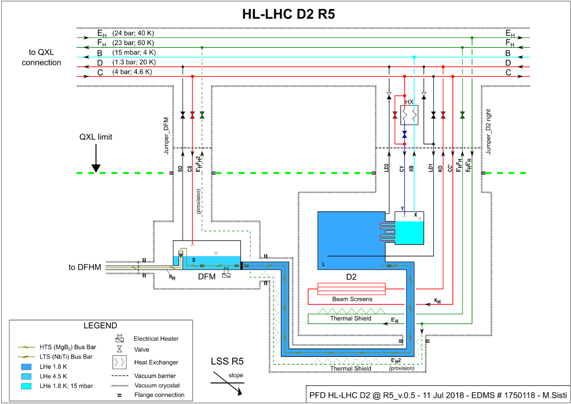
Concept : DFM Cryogenic layout
Cryogenics
  Superfluid helium phase up to the plug
  Superfluid volume actively shielded (return line through DFM Jumper)
  Saturated liquid @ 1.3 bara in DFM (nominal)
  GHE from 4.5K to 17K in SCLink
  Hardware + Instrumentation
    Operation device doubled
    Heater for operation and liquid vaporisation during WU
  Pressure relief devices
    One burst disc (safety relief device)
    One pressure relief device sized to static heat loads
Superfluid @ 1.9K
Liquid He @ 4.5 K
Gaseous He
Heater
Vacuum barrier
HTS
MgB2
NbTi
Warm cable
Splice
Saturated liquid bath
@ 1.3 bara
Design pressure : 2.5 bara
CS : LHE inlet
SD : GHE return
Plug
Heat Exchanger
EhEh’2
PT
Ghe mass flow
3 g.s⁻¹ design
Superfluid helium @1.9K
Design Pressure : 25 bara
DFM
EDMS1750118
E’_{H}F_{H}
E_{H}E’_{H}
D2
Cold mass
MCBRD
MCBRD
MBRD
MCBRD
MCBRD
Note cryogenics lines & equipment for D2 not shown

Slide 6

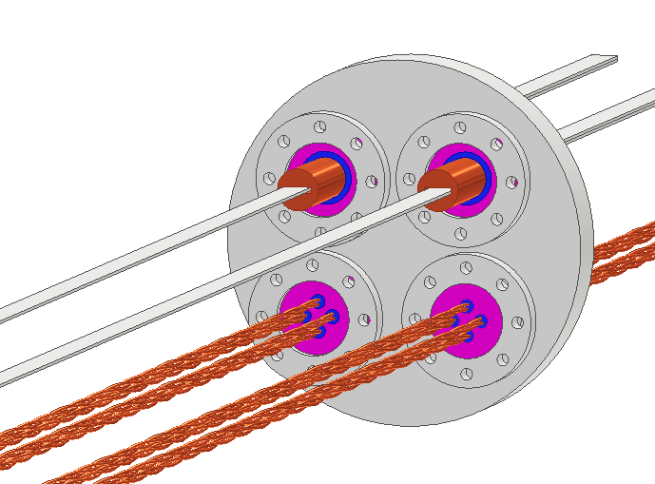
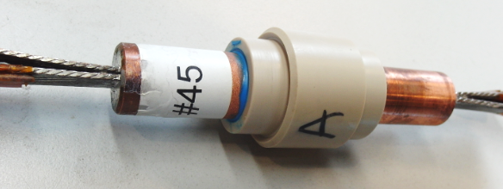
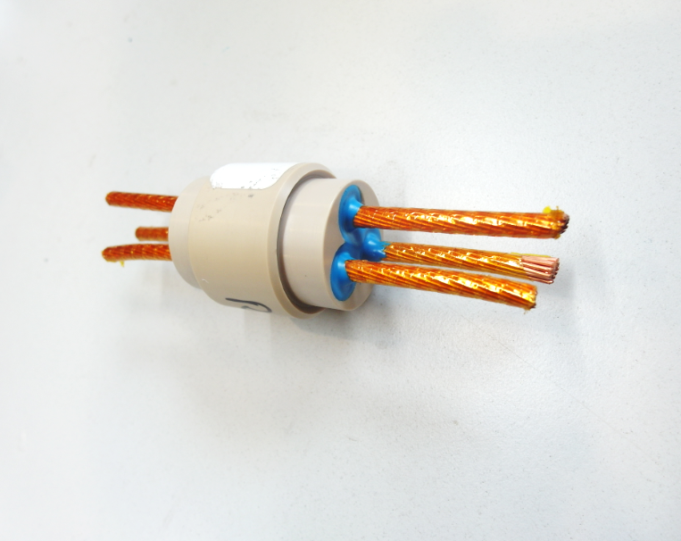
Concept : Electrical
Leads requirements in DFM
  Splices & NbTi leads immersed in liquid
Leads characteristics
  SCLink : MgB₂ : 3 x 18 kA + 12 x 0.6 kA
  SCLink extensions : NbTi : TBD
  Plug leads : NbTi : 2 x (2xMQXF) + 8 x 0.6 kA (LHC)
  Interlink : NbTi : 2 x 18kA round + 8 x 0.6 kA LHC
  D2 cryostat : 2 x 13 kA LHC + 2 x 4x0.6 kA LHC
Circuit protection proposal in DFM
  As for DFX (10 V-taps/lead = 100 V-taps) (TBC)
Courtesy MSC-SCD
Superfluid @ 1.9K
Liquid He @ 4.5 K
Gaseous He
Heater
Vacuum barrier
HTS
MgB2
NbTi
Warm cable
Splice
Plug
DFM
D2
2x13kA LHC
+ 2 x (4x0.6 kA LHC)
Cold mass
MCBRD
MCBRD
MBRD
MCBRD
MCBRD
DFM-D2 plug proposal
Based on DFX development
Courtesy S.Donche
2x18kA Round
+ 8 x LHC 0.6 kA

Slide 7
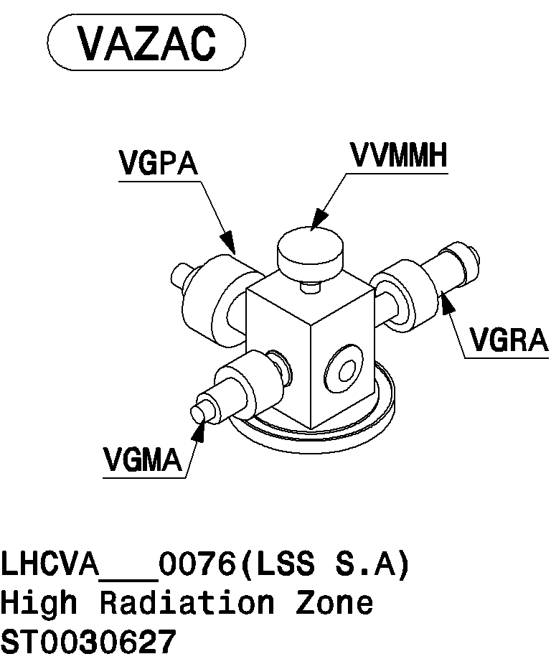
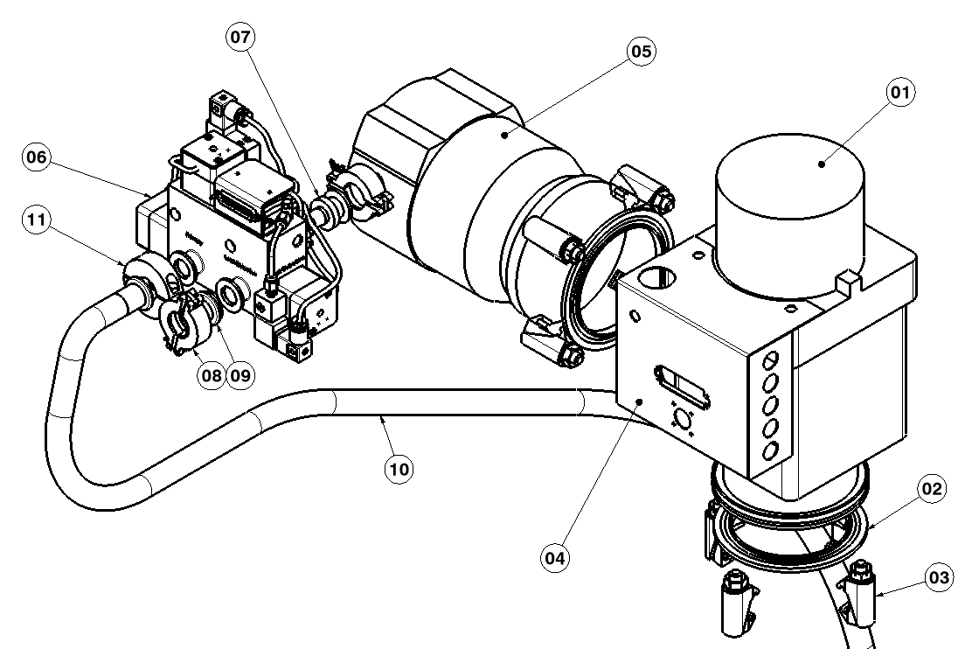

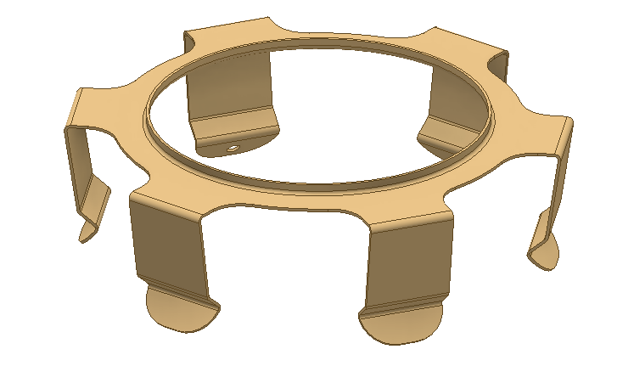

Concept : Insulation vacuum DFM
Vacuum barrier layout EDMS 2048016
Interlink insulation vacuum shared with D2
Pumping & instrumentation interfaces on DFM + SCLink volumes (ISODN100)
Pressure relief plate (ISODN100)
Superfluid @ 1.9K
Liquid He @ 4.5 K
Gaseous He
Heater
Vacuum barrier
HTS
MgB2
NbTi
Warm cable
Splice
PT
PT
DFM
CERN standard models (gauges/pumps/ISO100 spring) : proposal
E’_{H}F_{H}
E_{H}E’_{H}
D2
Cold mass
MCBRD
MCBRD
MBRD
MCBRD
MCBRD
Note Insulation vacuum equipment for D2 not shown

Slide 8
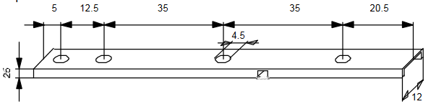
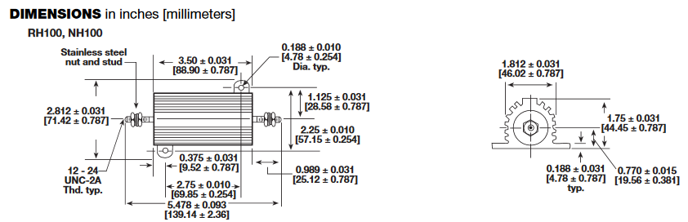
Concept : Instrumentation & Hardware layout
Heaters:
  For operation & transient
  2 x 100 W (RH100)
  Protected by T-sensor (TBC)
Level gauges:
  CERN standard type
  Replaceable
  Radiation resistant wires
  1 long over filling height
  1 short gauge around nominal range
Temperature sensors
  CERNOX for He vessel temperature monitoring
  CERNOX for MgB₂-NbTi splices monitoring
  TBD for heaters
V-Taps (TBD)
Interfaces:
  One insulation vacuum feedthrough
  One IFS with separated tubes by functions (T-signals / power)
Note: Interlink requirements TBD
Superfluid @ 1.9K
Liquid He @ 4.5 K
Gaseous He
Heater
Vacuum barrier
HTS
MgB2
NbTi
Warm cable
Splice
P gauge (TBC)
On SD return line
Level gauges access
Insulation Instru.
IFS
DFM
E’_{H}F_{H}
E_{H}E’_{H}
D2
Cold mass
MCBRD
MCBRD
MBRD
MCBRD
MCBRD

Slide 9
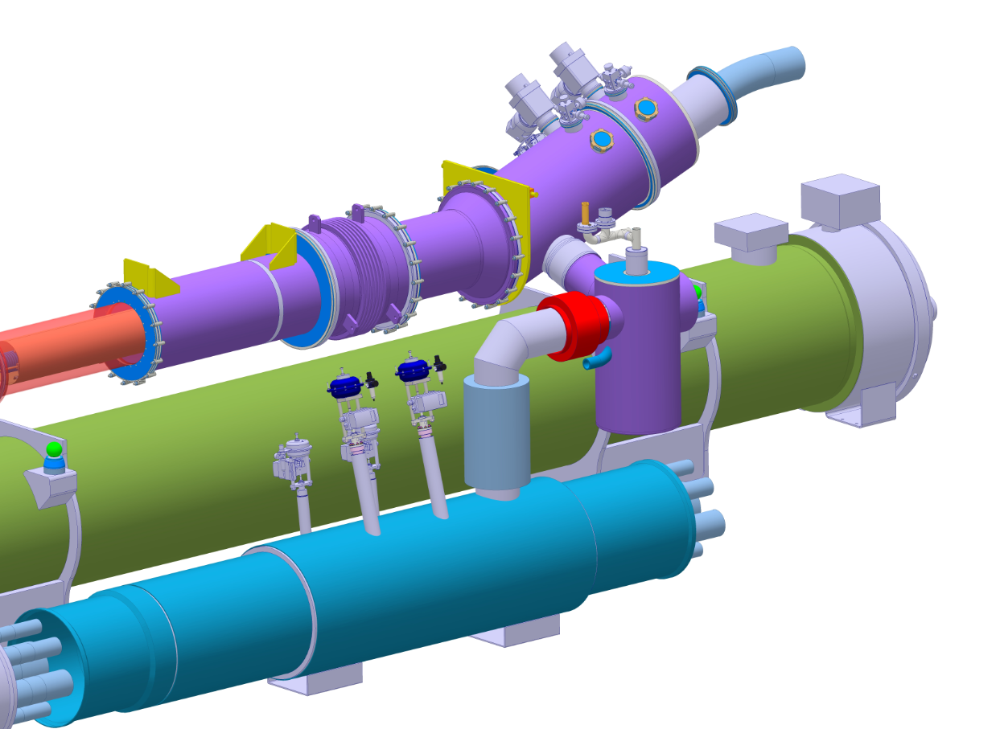
Proposal overview
Key components denomination and interfaces
  DSHm (SCLink D2): from DFHM to DFM
  DFM cables module: electrically connect Interlink to SCLink
  DFM vaporisation module: create the helium gaseous mass flow
  D2-DFM interlink: connect leads from D2 to DFM leads
  DFM Jumper: connect to cryolines (for illustration)
DSHm
DFM – Cables Module #2
D2-DFM interlink
DFM : insulation vacuum volume
DFM Jumper
DFM : Helium volume
Interlink D2-DFM
Plug
DFM
D2 Jumper
SCLink
DSHM
D2
DFM #1
Vaporisation Module
QXL & Jumper for illustration only

Slide 10
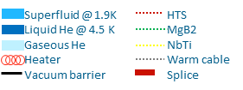
DFM concept
Key design features
  Inclined design to perform Liquid – Gas separation
  Dedicated vessel for vaporising LHE (allow to control the nominal level with more margin) :
  ➔ DFM Vaporisation module
Basic concept
  Lhe injection in splice volume
  Level flows in side reservoir by gravity
  Heater vaporises liquid (based on DFHm needs)
  Level gauge control LHE inlet to ensure level
SCLink DSHM
Interlink D2-DFM
Interlink D2-DFM
Plug
LHe Inlet
D2

Slide 11
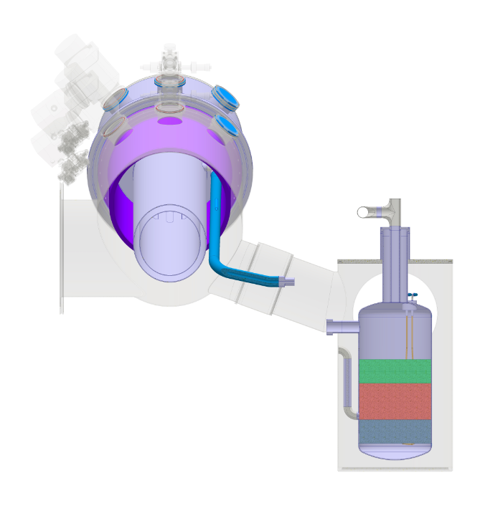
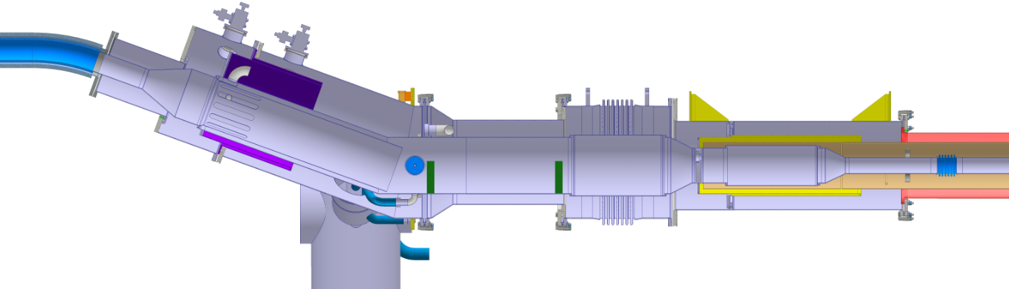
DFM configuration
Electrical:
  MgB₂-NbTi Splices protected
  NbTi-NbTi splices on either side of plug
Cryogenics:
  Superfluid in interlink
  Splices immersed in LHE
  Fountain principle
  10 min buffer at nominal conditions
Insulation vacuum
  Vacuum barrier in DFM
  Vacuum barrier at plug level
Thermal contraction proposal
  Main vessel : 1 fixed point
  Side vessel : suspended from 300K top
Instrumentation layout proposal
  Level gauges + V-taps + T-sensors + heaters + P gauges
Fill reservoir
MgB2-NbTi
Splices
Cold inst.
Vac. Inst.
14 litres
1020
100
+50mm
Nominal level
-50mm
Inlet reservoir
10 litres
10 min @ 2g.s⁻¹
100
Heaters volume
← SCLink
to DFHm
∆P
Vac. Inst.
Cold inst.
Fill reservoir
IFS
16 min @ 20 W
8 litres
Top splices
Ø250 x 600
MgB₂-NbTi splices
Plug
Interlink
To D2 ➔
LHe inlet
Electrical Heater
T-sensor
L-gauge
20°

Slide 12
Nominal configuration proposal
Electrical
  Monitored by V-taps
  Bus-bars supported together toward Lorentz forces
Cryogenics operating proposal:
  DFH (inlet Gas, Splice) & Current leads controls power dissipated in the heaters
  Level gauge controls inlet valve
Insulation vacuum
  Static vacuum
MgB2-NbTi
Splices
Cold inst.
+50mm
Nominal level
-50mm
← SCLink
to DFHm
Cold inst.
IFS
Ø250 x 600
MgB₂-NbTi splices
Plug
Interlink
To D2 ➔
LHe inlet
Electrical Heater
T-sensor
L-gauge

Slide 13
DFM transient configuration
Cool down
  Inject through LHE inlet
  Monitored by T-sensors to 4.5K
  Thermal contractions covered by bellows and lyras
  Filling up monitored by ∆P and long level gauge
Warm Up
  Liquid vaporisation with electrical heaters (both volumes)
  Monitoring with ∆P and long level gauge
  Warm up to ambient with static heat loads
Unexpected events
  Heaters temperature monitored by T-sensors (TBC)
  Helium vessel over pressure relieved through burst disc + relief pressure
  Helium envelope rupture protected by Vacuum vessel relief plates
Redundancy
  Operation instrumentation doubled
MgB2-NbTi
Splices
Cold inst.
Vac. Inst.
← SCLink
to DFHm
∆P
Vac. Inst.
Cold inst.
IFS
Ø250 x 600
MgB₂-NbTi splices
Plug
Interlink
To D2 ➔
LHe inlet
Electrical Heater
T-sensor
L-gauge

Slide 14
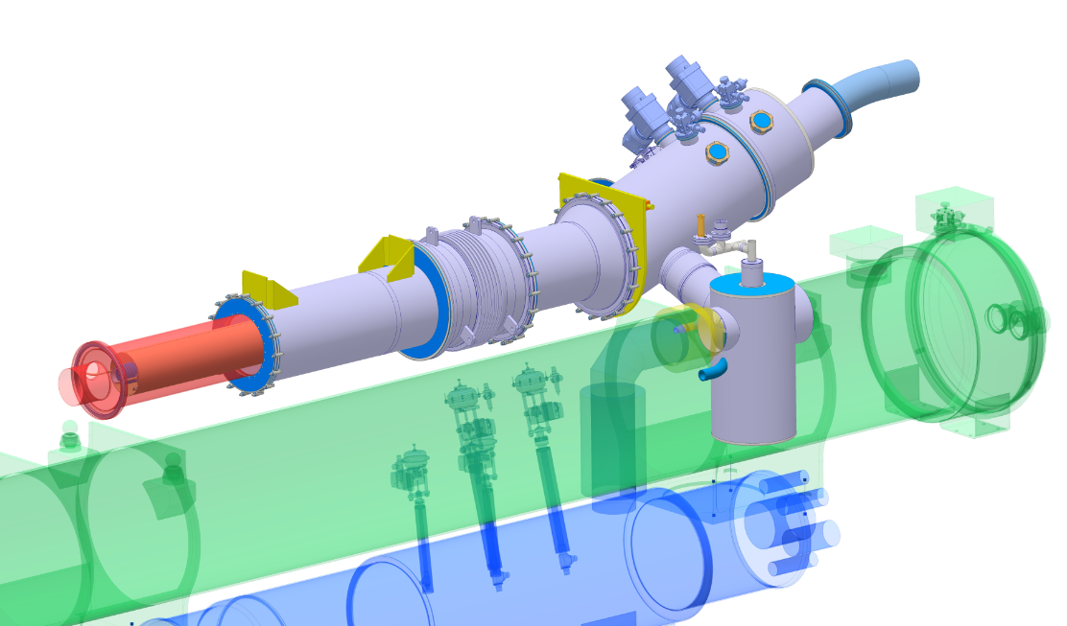
DFM Interfaces & maintenance
Vacuum gauges
DFM SCLink
Insulation vacuum
Relief plates
DFM SCLink
Inspection
Instr. ports accessible from transport area
Except Vap. module TBC
Preventive maintenance
Burst disc replacement not optimised
Medium repair
NbTi-NbTi repair from transport area
Heavy repair
MgB₂-NbTi repair reward assembly sequence
Pumping eq.
SCLink
DFM
Instrumentation
ports
SCLink
Support
interfaces
He volume
Safety relief device
Instru. port
Plug
Splices
D2-DFM interlink
D2
Volume
for illustration
DFM Vap. module
QXL
Connection to Jumper
14

Slide 15
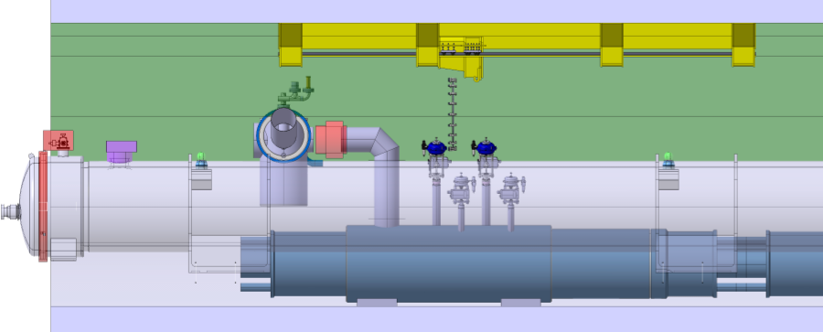
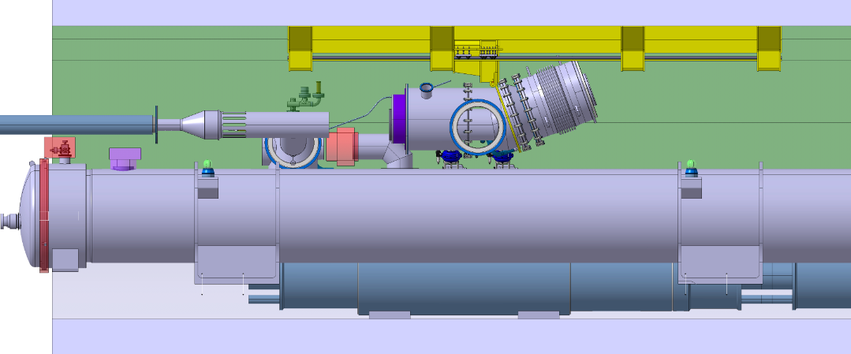
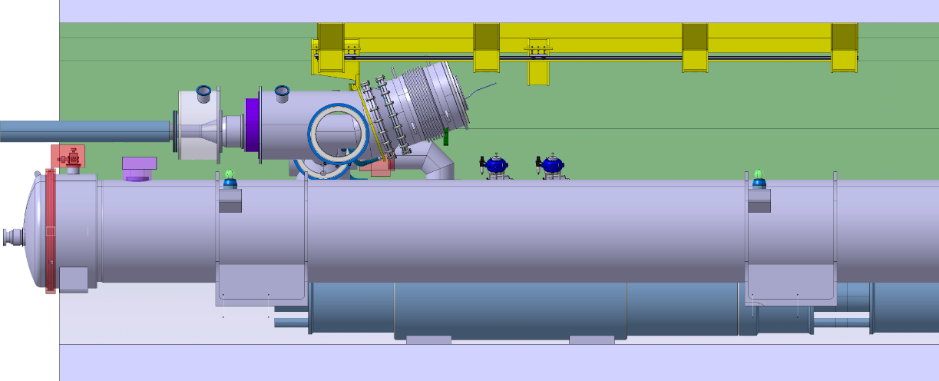
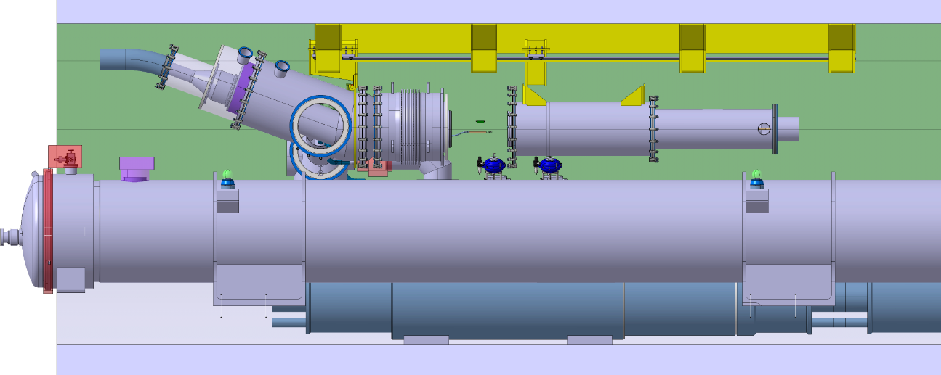
Preliminary assembly sequence
Initial configuration:
  Services, tooling, QXL, D2 installed
  D2-DFM interlink partly installed
DFM vaporisation module #1 to jumper connection and test
DFM transported above D2
DFM cables module #2 located toward non IP
SCLink horizontal
DFM #2 slided around SCLink
SCLink to DFM connections & test
DFM #2 rotated
DFM #1 to DFM#2 connection and test
D2-DFM interlink connected and test
Splices operation and sleeves closure and qualification
1-2
3-4-5
6-7
8-9-10-11
15

Slide 16
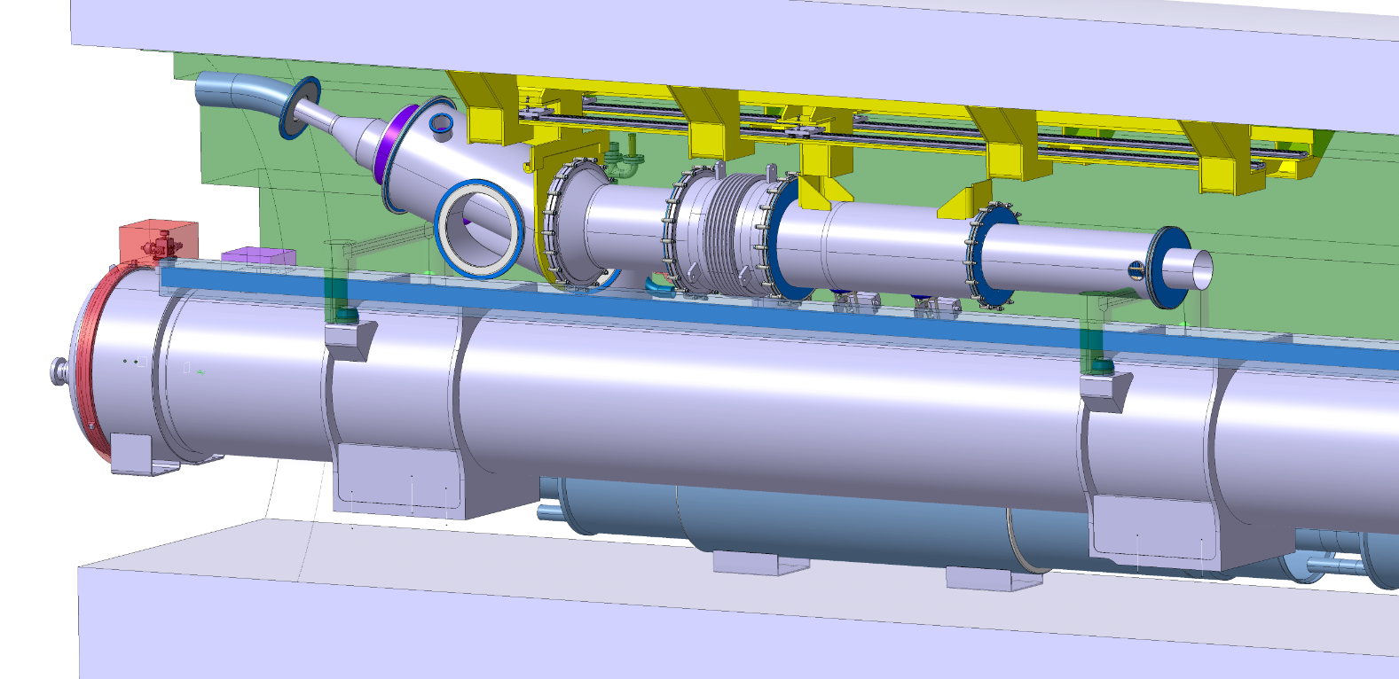
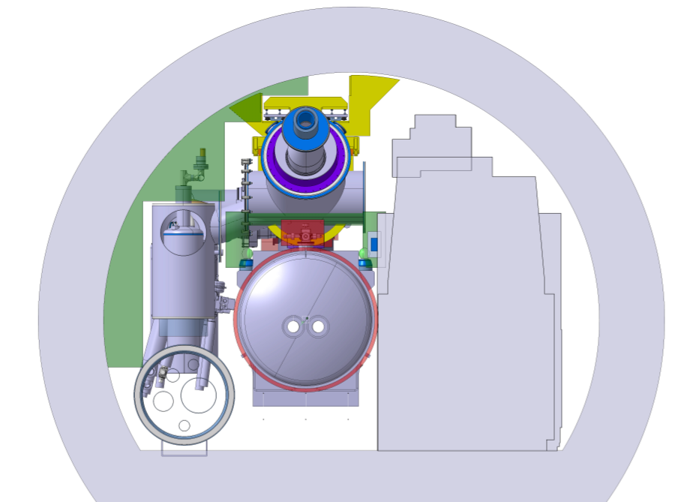
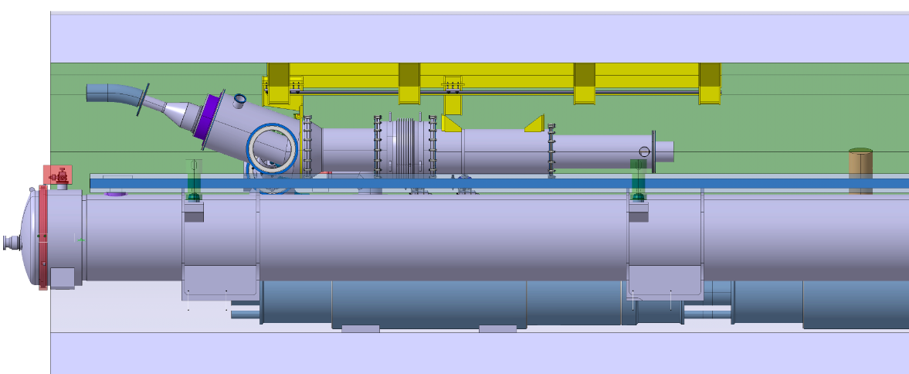
Pre-integration study
Preliminary interference study with basic DFX environment on going
  Service, , Transport, QXL
  Tunnel infrastructure (model)
  Interferences already detected to be studied
Integration study to be led
  Services, Survey, Transport, SCLink, Interlink, D2 installation, close services maintenance
Survey
reservation
Services
D2
Transport
area
QXL
16

Slide 17

Transport and Installation
Transport:
  Dimensions need to be verified
  Transition from transport area to final configuration may present interferences
  ➔ work starting
Installation specifications
  Shall be independent from D2 Assembly-Disassembly
  Shall minimise the SCLink handling
  Shall comply with reserved volumes (survey, transport, services)
Work in progress
  List of actions:
    Interferences identification
    Iterations with transport within WP15
    Iterations with survey, services interfaces (under WP15 supervision)
  Weekly meeting under WP15 started (Friday 10 am)

Slide 18
Functional spec:
Electrical requirements:
  Route NbTi leads from SCLink to splice with Rmin>125mm ✓
  Route Plug leads to splice ✓
  Provide access for splices performance ✓
  Provide supports to splices and leads in He vessel Pending
Cryogenics aspects:
  Immerse splices and NbTi leads ✓
  Produce 3 g.s⁻¹ GHE mass flow to SCLink ✓
  Connect to cryogenic lines In progress
  Release over pressure ✓
  Limit heat loads to 20 W ✓
  Slope from coldest point to LHE-Ghe interface ✓
  Respect instrumentation requirements TBC
  Respect levels, volumes ✓
Insulation vacuum
  Provide required interfaces ✓
Thermo-mechanical aspects:
  Allow thermal-contractions (500 cycles) ✓
Integration
  Connect to Jumper In progress
  Respect reservations TBC
Installation
  Do not impose bending radius to SCLink < 1.5m ✓
  Be independent from D2 installation TBC
Transport Pending
Unexpected events
  10 min nominal operation in case of LHE supply stop ✓
  Energy deposition in LHE volume ✓
  He envelope rupture to insulation vacuum ✓
Maintenance
  Vacuum equipment access TBC
  Valves & instrumentation access TBC
  Safety relief devices access TBC
  NbTi-NbTi repair ✓
  MgB₂-NbTi splices extraordinary repair TBC

Slide 19
Summary
A conceptual design proposal has been developed
Some upcoming work on cryogenics and integration interfaces expected
Iterations with interfaces have started (under WP15)
Detailed design to be started in parallel

Slide 20
Spare slides

Slide 21
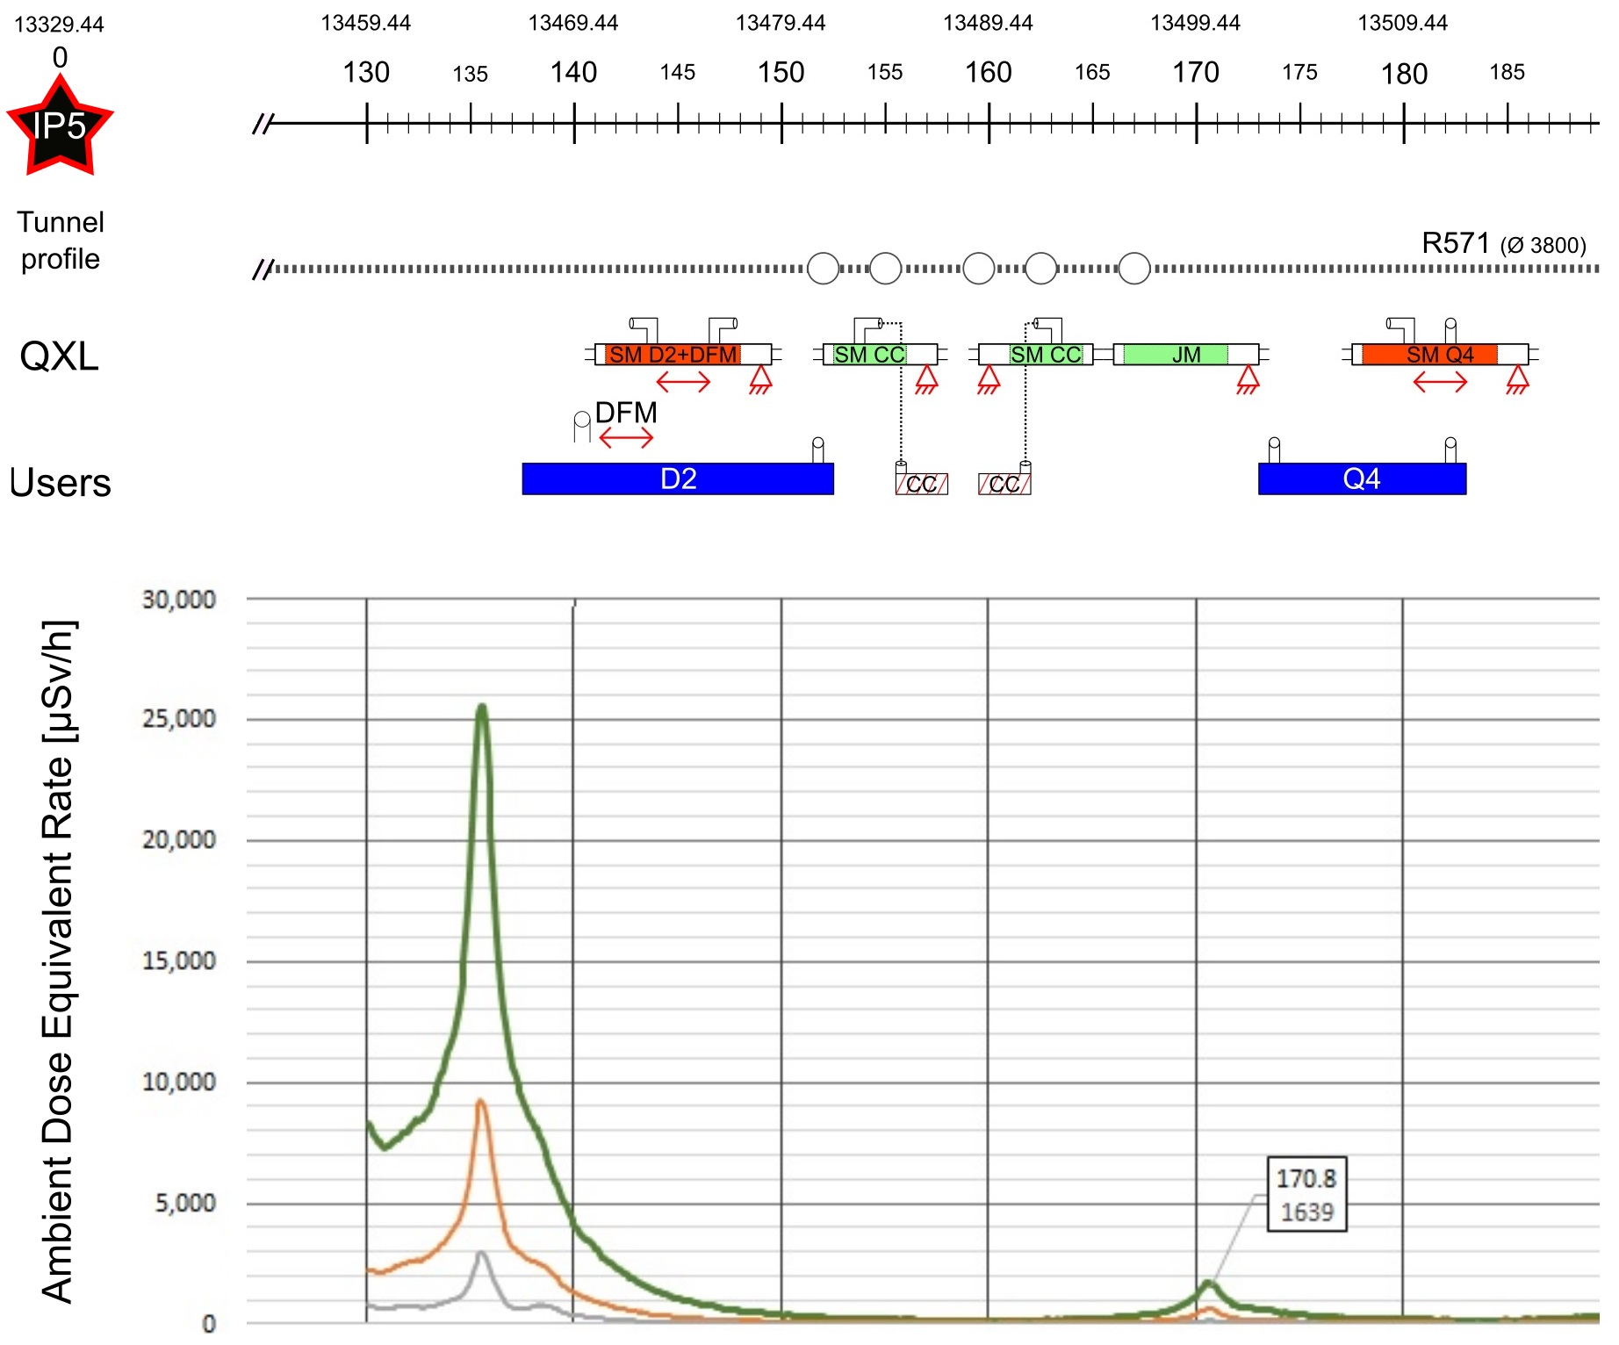


Cold Powering of the D2 cryostat
D2 cryostat:
  5 Magnets : MBRD + 4 x MCBRD
DFM basic functions:
  Electrical interface between SC Link and superconducting magnets
  Supply cryogenics to the SCLink
DFM functional specification and interface definition EDMS 2052614
DFHx2
DFHx1
DFHM
Power converters
Service tunnel
DSHx
Transverse tunnel
DSHm
Q1
IP
≈50m
≈8m
Q2b
Q2a
CP
Q3
≈45m
DFX
D1
≈80m
LHC tunnel
DFM
D2
2 x 13 kA
8 x 0.6 kA
DFHm
2 x 18 kA
2 x 13 kA
3 x 7 kA
3 x 7 kA
12 x 2 kA
HTS
PT
DFHx1
PT
DFHx2
Superfluid @ 1.9K
Liquid He @ 4.5 K
Gaseous He
Heater
Vacuum barrier
HTS
MgB2
NbTi
Warm cable
Splice
PT
⬅ $\dot{m}=2 g/s$
➔ $\dot{m}=5 g/s$
PT
Ghe <17K
Ghe <17K
MgB₂
DSHx
UR: Service tunnel
25 mSv/h
5 mSv/h
1 mSv/h
Ambient
Dose
Eq Rate
Non IP side
UL: Transverse tunnel
PT
IP side
DSHm
LHC tunnel
Ghe @4.5K
DFM
PT
Jumper DFM
PT
Jumper DFX
SFHe @1.9K
Ghe @4.5K
Splice
NbTi
Jumper D2
DFX
PT
Jumper D1
Lhe @4.5K
Lhe @4.5K
CC
D2
Collimators
SFHe @1.9K
MBCRD
MBRD
Beam
D1
MBXF

