Slide 1
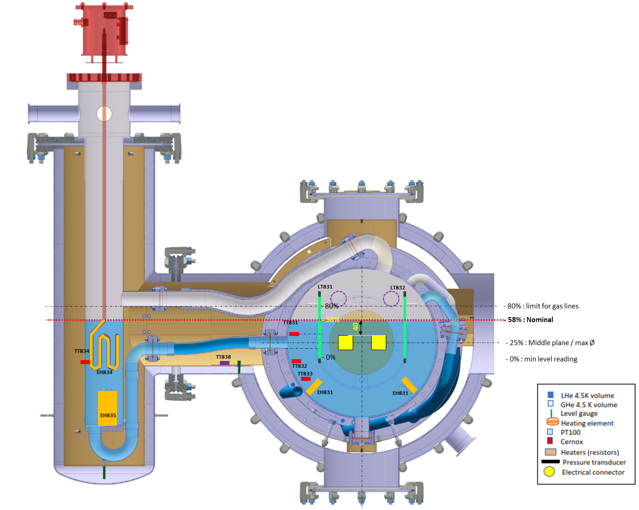
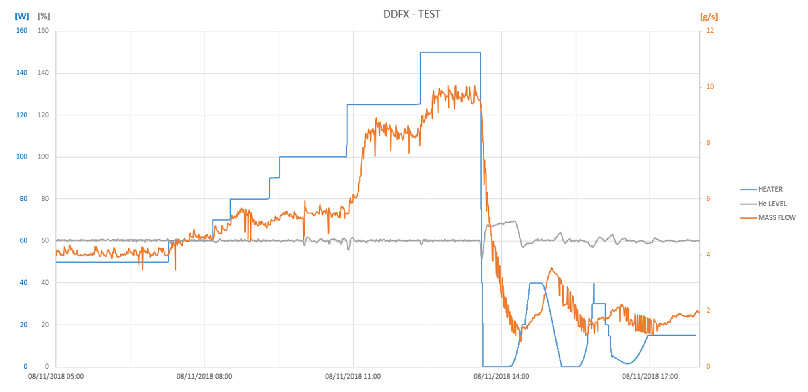
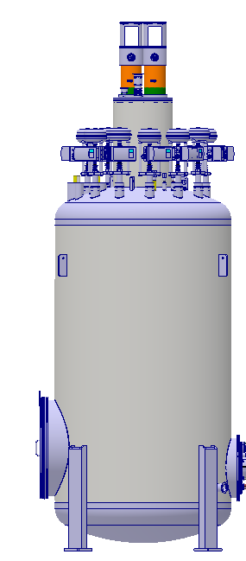
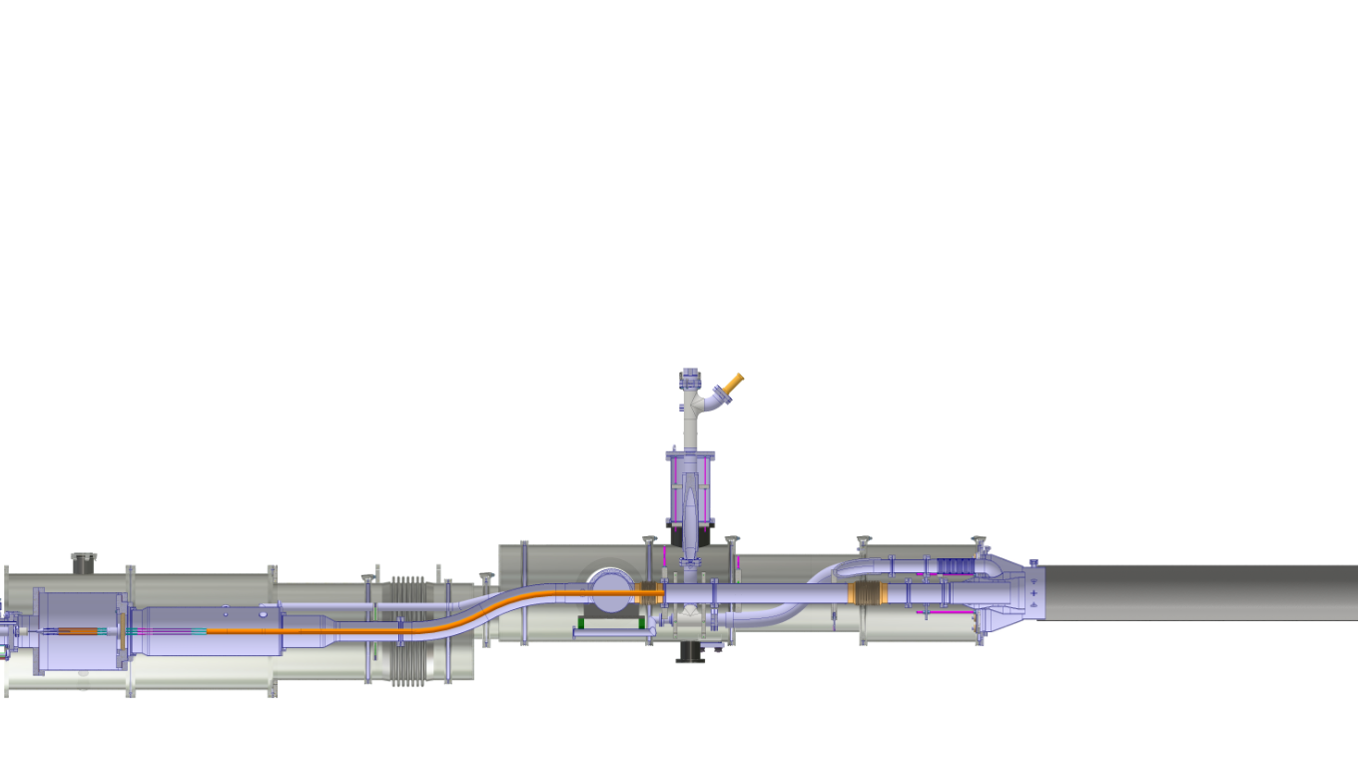
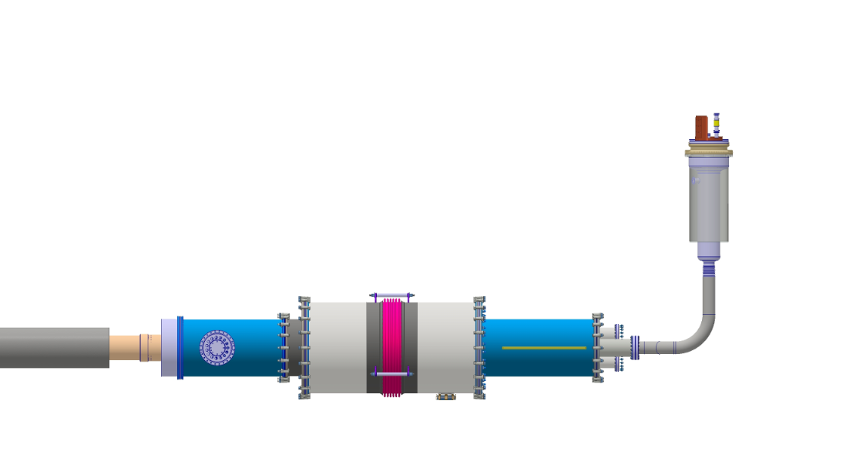
DDFX test @ SM18
Power dissipated by the heater
30 min for stabilisation
150W
10 g/s
Liquid level
+ -
Thursday 8 Nov. 5.00 am to 5.00 pm
Mass flow
outlet
Return gas
MgB₂ Cables
NbTi Cables
Cryogenic
feedbox
Splice CFB
module
DDFX

Slide 2
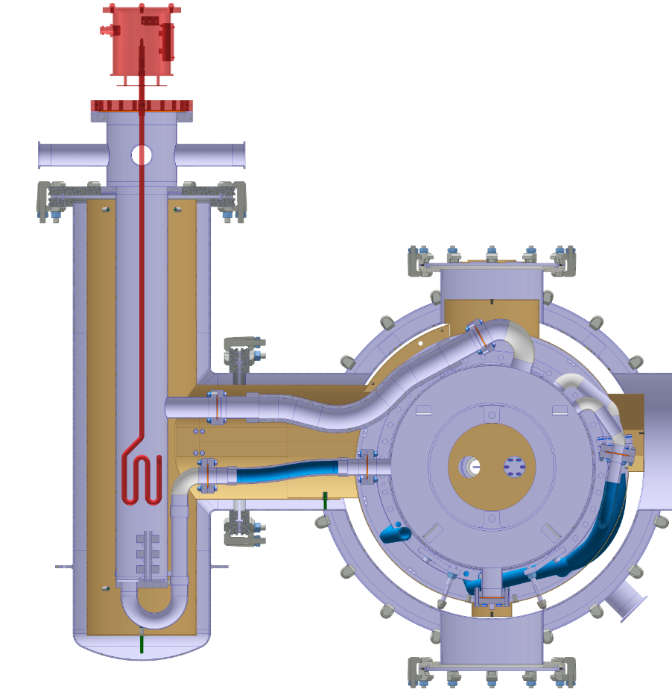
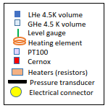
LT831
LT832
- 80%
- 80% : limit for gas lines
TT831
- 58%
40
- 58% : Nominal
TT834
- 25% : Middle plane / max Ø
TT838
TT832
- 0%
- 0% : min level reading
EH834
TT833
EH831
EH831
EH835

