Slide 1

DFM Safety aspects
(cryogenic safety only)
Y.Leclercq, V.Parma, TE-MSC
Th.Otto (TE DSO and HL LHC Safety Officer)
CERN, Technology Department
DFM Conceptual Design Review, CERN 21 June 2019

Slide 2
Contents
DFM configuration
Cryogenic safety
  Risk assessment and sizing of safety
Summary

Slide 3
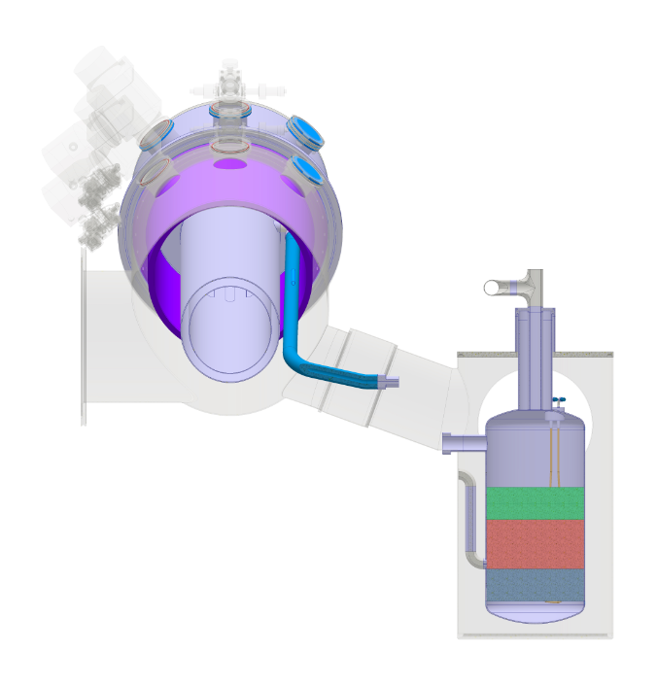
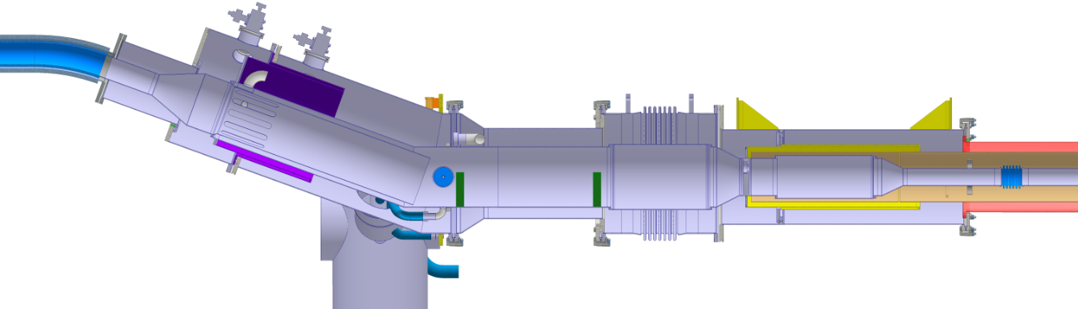
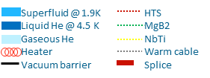
DFM configuration and cryo safety parameters
Helium vessel protection:
Pressure relief devices
    One burst disc (safety relief device)
    One pressure relief device sized to static heat loads
Vacuum vessel protection:
2 Pressure relief plates (on either side of VB)
Helium cold volume (V): 360 litres
Helium cold surface: 3.5 m2
PS = 2.5 bara
Pt = 3.5 bara
PSxV900 → PED Cat.2.
Fill reservoir
MgB2-NbTi
Splices
Cold inst.
Vac. Inst.
1020
14 litres
100
+50mm
Nominal level
10 litres
-50mm
Inlet reservoir
10 min @ 2g.s⁻¹
100
Heaters volume
← SCLink
to DFHm
VB
plug
∆P
Vac. Inst.
Cold inst.
Fill reservoir
IFS
16 min @ 20 W
8 litres
Ø250 x 600
MgB₂-NbTi splices
Top splices
Plug
Interlink
To D2 ➔
LHe inlet
Electrical Heater
T-sensor
L-gauge
20°

Slide 4
Scale of pressures, helium vessel
bar(a)
Ptest: Test pressure
3.5 bar(a) (1.43 x Ps); 4.6 bar(a) in atm.
Ps: Design pressure
2.5 bar(a)
Pt: burst disk set press.
≤ 2.5 bar(a) (1.5 barg)
Pn Nominal pressure
1.3 bar(a)

Slide 5
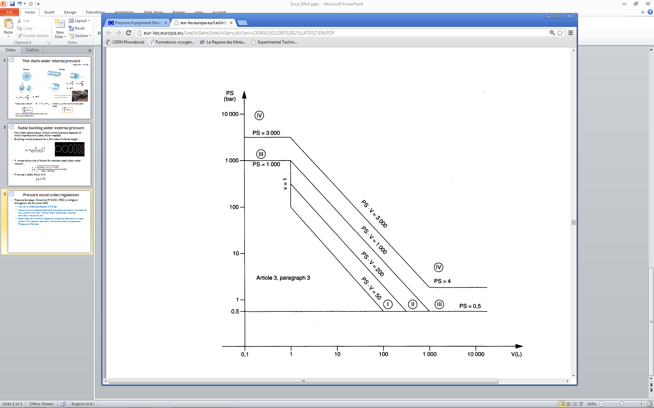
PED category
Ps x V = 900 bar.L
With updated figures from CDR we are still in Cat.2
2.5
Article 4, paragraph 3
360

Slide 6
Risk assessment matrix (as for DFX)
 | High Risk
 | Medium Risk
 | Low Risk:
Remarks:
causes of excessive pressure are considered to be unrelated (single jeopardy theory) unless cause/effect exists

Slide 7
Retained pressure hazards (same as for DFX)
A) Accidental air venting of insulation vacuum with sudden condensation on cold surfaces, helium boil-off and pressure build-up → sizing of burst disk
C) Accidental release of cryogenic fluid from helium vessel to insulation vessel due to arc bursting helium envelope, helium pressurized at burst disk pressure, spill of helium inventory to vacuum vessel → sizing of vacuum vessel relief plate

Slide 8
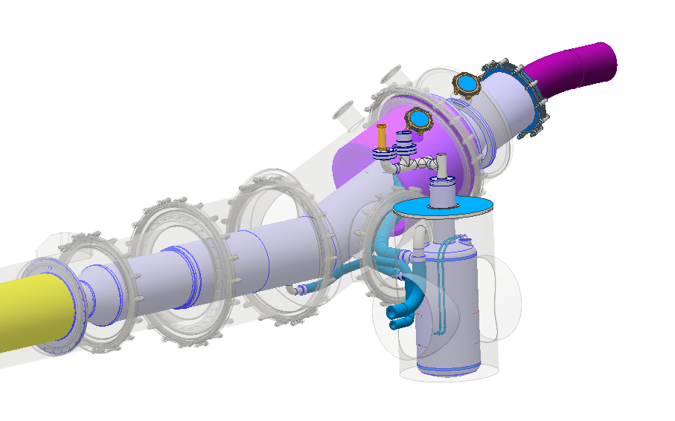
Safety relief devices sizing for DFM
Helium vessel burst disk:
Data:
  Cold surfaces exposed to Vacuum : 3.5 m² (2.2 m² wet surface)
  30 layers MLI on helium vessel
  Design Pressure = 2.5 bara
  Saturated liquid in nominal configuration
  Helium volumes in nominal operation : 210 litres liquid + 150 litres gaseous
Inputs:
  Vacuum break on 10 MLI layers : 6.2 kW/m²
  Power dissipated in liquid : 21 kW
Relief device sizing according to ISO21013-3
  ISO21013-3 ➔ Qm = 1.4 kg/s
  EN4126-6 ➔ D_{relief} > 28 mm
Insulation vacuum relief plates:
Preliminary sizing:
Assume orifice: DN50
Pt= 2.5 bara; Pb=0 bara; Trel= ~5 K
  Qmvessel = ~5 kg/s to the vac.vessel
Relief plate to limit ΔP to 0.5 barg (opens at 1.5 bara)
Assuming continuity of mass relief (conservative): Qmvessel = Qmrelief
  → ~DN100 → 2 DN100 on either side of VB

Slide 9
Summary
The equipment is Cat.2 of the PED
Preliminary sizing of burst disks and relief plates done
The location of the burst disk/rated valve and relief plates needs to be confirmed by the integration study with WP15

Slide 10
Thank you !
Q/A

