Slide 1
DFM Production Plan
Y. Leclercq on behalf on WP6a DFM team development
CDR DFM 21 June 2019

Slide 2
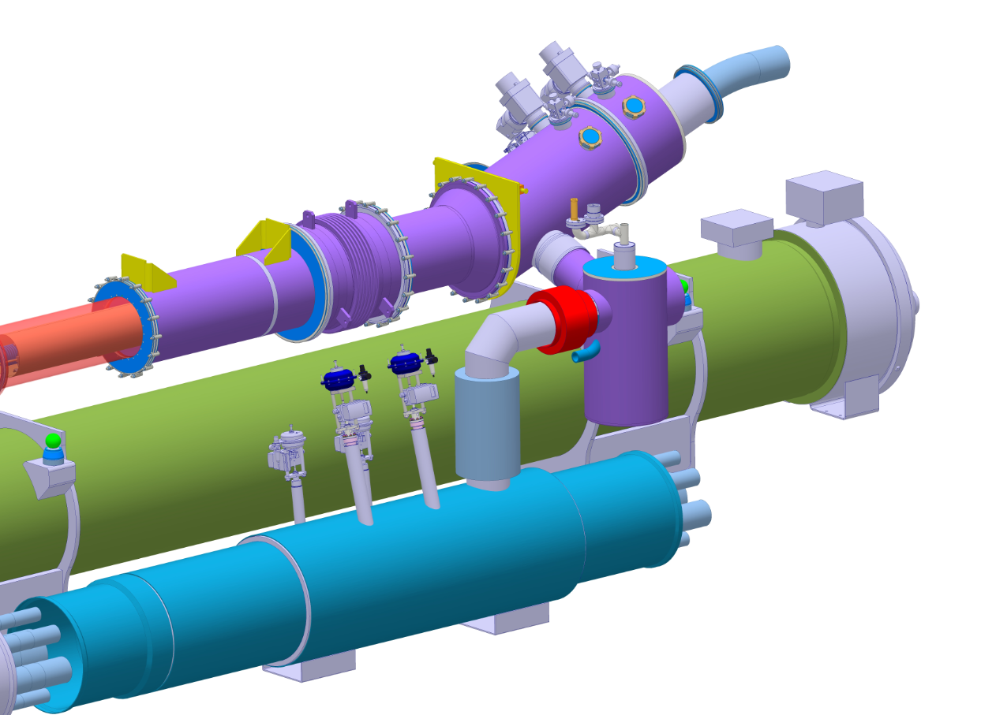
Production Plan
Design Phase (CERN)
  CERN deliverables
    3D Design
    Design file
    Specification drawings
    Technical specification
    Assembly procedure
  ➔ to be approved by DDR
Manufacturing Preparation phase (SOTON)
  Southampton University deliverables
  ➔ to be approved by PRR
Manufacturing phase (SOTON)
  Manufacturing of 5 Units
  Qualification
    Documentation
    Production tests
    Performance qualification tests
  ➔ to be approved by CERN
Delivery to CERN
Installation in LHC tunnel
  Only basic testing before installation (electrical tests, visual inspection, dimension control)
  Final qualification after installation in tunnel
Same QA requirements as for DFX
DSHm
DFM – Cables Module
D2-DFM interlink
DFM
Vaporisation Module
QXL & Jumper for illustration only

Slide 3
Required qualifications for acceptance
Same requirements and qualification
test proposal as for DFX
Proposal of qualification sequence
Required qualifications to comply with PED, operation and CERN QA requirements
Qualifications based on calculation reports
  Respect of heat loads budget
  LHE vaporisation rate
  Helium buffer volumes in case of LHE supply stop
Production inspections and qualifications
  Weld inspections (visual + NDT acc. to standards)
  Dimensional controls
  Pressure test according to PED for application CAT III
DFM device qualifications by testing
  Assemblability of the complete DFM
  Thermo-mechanical design (all operation modes)
  Leak tightness levels after pressure test and thermal cycle of structures and cold welds
Phase | Steps | 2. Dim. | 3. P-test | 4. Assy. | 5. Struct. | 6. Leak T
Initial Configuration | Assemble full DFX | X |  | X
 | Pump vacuum Vol. P < 10⁻⁴ mbar
Thermal cycle | LN2 filling |  |  |  | X | X
 | Warm up to 300K
Pressure and leak tests | Leak test vacuum volume |  |  |  |  | X
 | Pressurised He volume to P_{test} |  | X
 | Leak test He volume |  |  |  |  | X
Reporting | Document
Acceptance leak tightness levels for tests performed acc. to harmonised standards to PED
 | Unit | Helium volumes | Insulation vacuum
Maximum allowed leak rate at RT | [mbar.l.s⁻¹] | 1.10⁻¹⁰ | 2.10⁻⁸

Slide 4
Summary
Design performed by CERN up to specification drawings
South Hampton University in charge of manufacturing and qualification
Ready for installation at delivery to CERN
Same qualification requirements as for DFX
Finance Committee : September 2019
Detailed design Review : Nov/Dec 2019

Slide 5
Spare slides

Slide 6
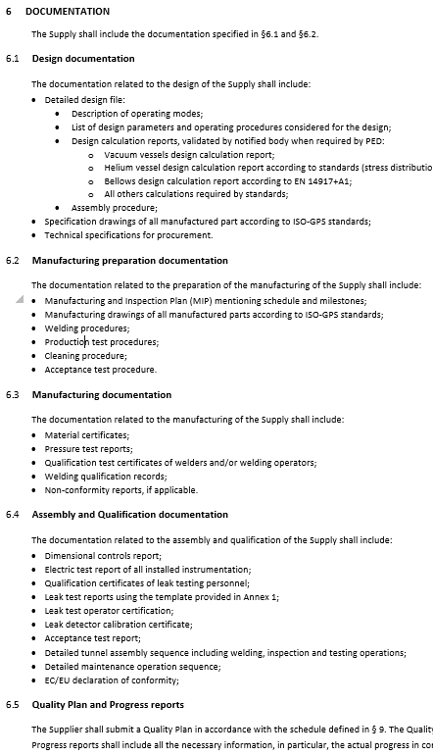
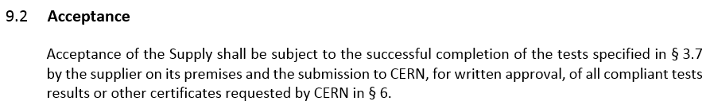
Acceptance criteria : documentation
Documentation compliant with PED Category III operation
  Design calculation reports
  Material certificate to standard acc. to application
  Welds:
    Welding procedures
    Welders qualifications
    Welds inspections reports
    Weld inspectors qualification
  Pressure test, procedure and report
Documentation for performance qualification
  Design reports
  Assembly procedure
  Dimensional controls report
  Electric test (instrumentation) report
  Leak test procedure, qualifications and reports

Slide 7
§9 Performance of the collaboration agreement
Design Phase
      (design calculations, operating modes, assembly sequence, specification drawings)
    ➔ CERN’s approval via DDR
Manufacturing preparation
      (Manufacturing drawings, MIP, manufacturing & testing procedures)
    ➔ CERN’s approval via PRR
Manufacturing phase
      (Manufacturing, cleaning)
Assembly and qualification phase
      (qualification campaign, reporting)
    ➔ CERN’s approval of documentation
Delivery to CERN

