Slide 1

CERN Deployments Scenarios
Technical Details
Evangelos Motesnitsalis
Technical Coordinator
ARCHIVER Open Market Consultation Event
23 May 2019, London Stansted Airport

Slide 2
Contents
Introduction to High Energy Physics Deployment Scenarios
The BaBar Experiment
CERN Digital Memory
CERN Open Data
Volumes, Ingest Rates, and Retention Period
Summary and Next Steps

Slide 3
Introduction to
High Energy Physics Deployment Scenarios
Notes:
So enough with who I am let’s move on to the next important question.
What is CERN?
Do you guys know what CERN is?
Do you know what the LHC is?
No worries, if you don’t know, I am going to explain everything in the next slide.

Slide 4



Introduction to HEP Deployment Scenarios
  In all three Deployment Scenarios, users do not need to have access directly to the Archiving Service
  The volume of data is between 1.5 to 2 PBs for each Deployment Scenario
  In all three Deployment Scenarios, data need to be recalled within a “reasonable time window” (<24h)

Slide 5
OAIS Reference Model
Relevant Standards
  Preservation: ISO 14721/16393, 26324 and related standards
  Storage/Basic Archiving/Secure backup: ISO 27000, 27040, 19086

Slide 6
FAIR Principles
Findable
Accessible
Interoperable
Re-Usable
Accurate and relevant description
Data usage license and detailed
provenance
Global, unique identifiers
Rich Metadata, indexes, search
capabilities
Qualified reference to other data
Formal, shared and broadly applicable
knowledge representation standards
Retrievable with free protocols
Accessible metadata even after
deletion
https://www.go-fair.org/

Slide 7



High Energy Physics Deployment Scenarios
  The BaBar Experiment
  CERN Digital Memory
  CERN Open Data

Slide 8
The BaBar Experiment
Notes:
So enough with who I am let’s move on to the next important question.
What is CERN?
Do you guys know what CERN is?
Do you know what the LHC is?
No worries, if you don’t know, I am going to explain everything in the next slide.

Slide 9
The BaBar Experiment – Problem Definition
In 2020 the BaBar Experiment infrastructure at SLAC will be decommissioned. As a result, the 2 PB of BaBar data can no longer be stored at the host laboratory and alternative solutions need to be found. Currently a copy of the data is being held by CERN IT.
We want to ensure that a complete copy of Babar data will be retained for possible comparisons with data from other experiments.

Slide 10
The BaBar Experiment –Workflow Characteristics
The Service Manager [SM] will access the Archiving Service
The SM will trigger the data ingestion
The SM should have the ability to do “partial recalls”:
  On a file
  On a subset of a file
The SM should have the ability update the data
Data will be rarely recalled
Personal data do not exist in this use case
The cost is estimated to be below 100K per year [50K per PB per year]

Slide 11
The BaBar Experiment – Interface Needs
Basic API functionalities that enables:
  Ingestion/retrieval of data
  Getting fixity checks
    automate reporting of fixity and errors
    an anti-corruption mechanism every time the data is touched
  Restart capabilities due to high volume of data

Slide 12
CERN Digital Memory
Notes:
So enough with who I am let’s move on to the next important question.
What is CERN?
Do you guys know what CERN is?
Do you know what the LHC is?
No worries, if you don’t know, I am going to explain everything in the next slide.

Slide 13
CERN Digital Memory – Problem Definition
We want to archive the ~1.5 PB of CERN Digital Memory, containing digitized analog documents produced by the institution in the 20th century as well as the digital production of the 21st century, including new types like web sites, social medias, emails, etc.

Slide 14
CERN Digital Memory – Workflow Characteristics
The Service Manager [SM] will access to the Archiving Service
The SM will trigger the data ingestion
The SM should have the ability to do “partial recalls”:
  On a file
  On a subset of a file
  e.g. download only one photo out of an album or only one part of a video recording
The SM should have the ability update the data
  e.g. replace/delete only one photograph in an album
Data will be rarely recalled
Personal data do exist in this use case

Slide 15
CERN Digital Memory – Data Characteristics
Currently the CERN Digital Memory is fragmented in various information systems and different storage solution which are not OAIS compliant
There are no universal standards for the contents
We want to introduce specific standards and formats in order to ensure long-term preservation
The existence of personal and confidential data increases the complexity of the user access requirements for this scenario
  e.g. the service manager should not have access to the audio file of a CERN Council Meeting

Slide 16
CERN Digital Memory – Interface Needs
API functionalities:
  Automated SIP transfers
  Automated metadata handling
  Access to converted files and checksums
  Detailed Error information
Web Interface:
  Dashboard with browsing/searching capabilities
  An audit log where details of all actions can be accessed

Slide 17
CERN Open Data
Notes:
So enough with who I am let’s move on to the next important question.
What is CERN?
Do you guys know what CERN is?
Do you know what the LHC is?
No worries, if you don’t know, I am going to explain everything in the next slide.

Slide 18
CERN Open Data
The CERN Open Data portal disseminates close to 2 PBs of primary and derived datasets from partical physics as they were released by LHC Collaborations and is being used for both education and research purposes. The CERN Open Data Service Managers seek an easy-to-use, easy-to-achieve independent archiving and backup for its holdingse based on SIPs [Submission Information Packages] with intelligent and reliable disaster recovery mechanisms.

Slide 19
CERN Open Data – Workflow Characteristics
The Service Manager [SM] will access to the Archiving Service
The SM will trigger the data ingestion
The SM should have the ability to do “partial recalls”:
  On a file
  On subset of a file
The SM should have the ability update the data
  e.g. replace/delete only one file of a dataset
Data will be rarely recalled
Personal data do not exist in this case
Data ingestion is based on “release campaings” (3x / year)
Data are publicly available – they can even be crawled

Slide 20
CERN Open Data – Data Characteristics
The CERN Open Data Portal contains:
  10.000 bibliographical records
  600.000 files
  2 PB in total
Typical dataset size: ~3 TB
Typical File Size: 1-4 GB
Metadata in custom JSON Schema
  inspired by W3C DCAT Standard

Slide 21
CERN Open Data – Interface Characteristics
API functionalities:
  Automated transfers (e.g. HTTP)
  Automated metadata handling
  Validation of the integrity of the deposited material both for data and metadata
  Periodic fixity checks
Web Interface:
  Dashboard with browing/searching capabilities
  An audit log where details of all actions can be accessed

Slide 22
CERN Open Data – added value features
The CernVM File System provides a scalable and reliable software distribution service for the LHC experiments as a POSIX read-only file system.
  Files and directories are hosted on standard web servers and mounted in the universal namespace /cvmfs.
As CernVM-FS can use S3 protocol for storage, we want to explore two possibilities:
  The first is to install CernVM-FS in external infrastructure
  The second is to transfer CernVM-FS in an external service (for example, cvmfs.cloud.com)
This service will be added on top of the archiving solution as a Software Reproducability Layer, in order to run example Physics analyses using non-CERN/LHC infrastructure.

Slide 23
Volumes, Ingest Rates, and Retention Period
Notes:
So enough with who I am let’s move on to the next important question.
What is CERN?
Do you guys know what CERN is?
Do you know what the LHC is?
No worries, if you don’t know, I am going to explain everything in the next slide.

Slide 24
Dataset Characteristics
 | Deployment Scenario | Data Volumes
 | CERN Digital Memory | 1.4 PB
 | The BaBar Experiment | 2 PB
 | CERN Open Data | 2+ PB
 | Deployment Scenario | Retention Period
 | CERN Digital Memory | 10+ years
 | The BaBar Experiment | 10+ years
 | CERN Open Data | 10+ years
 | Deployment Scenario | Ingest Rates
 | CERN Digital Memory | 1 GB/s
 | The BaBar Experiment | 1 GB/s
 | CERN Open Data | 1 GB/s – 10 GB/s

Slide 25
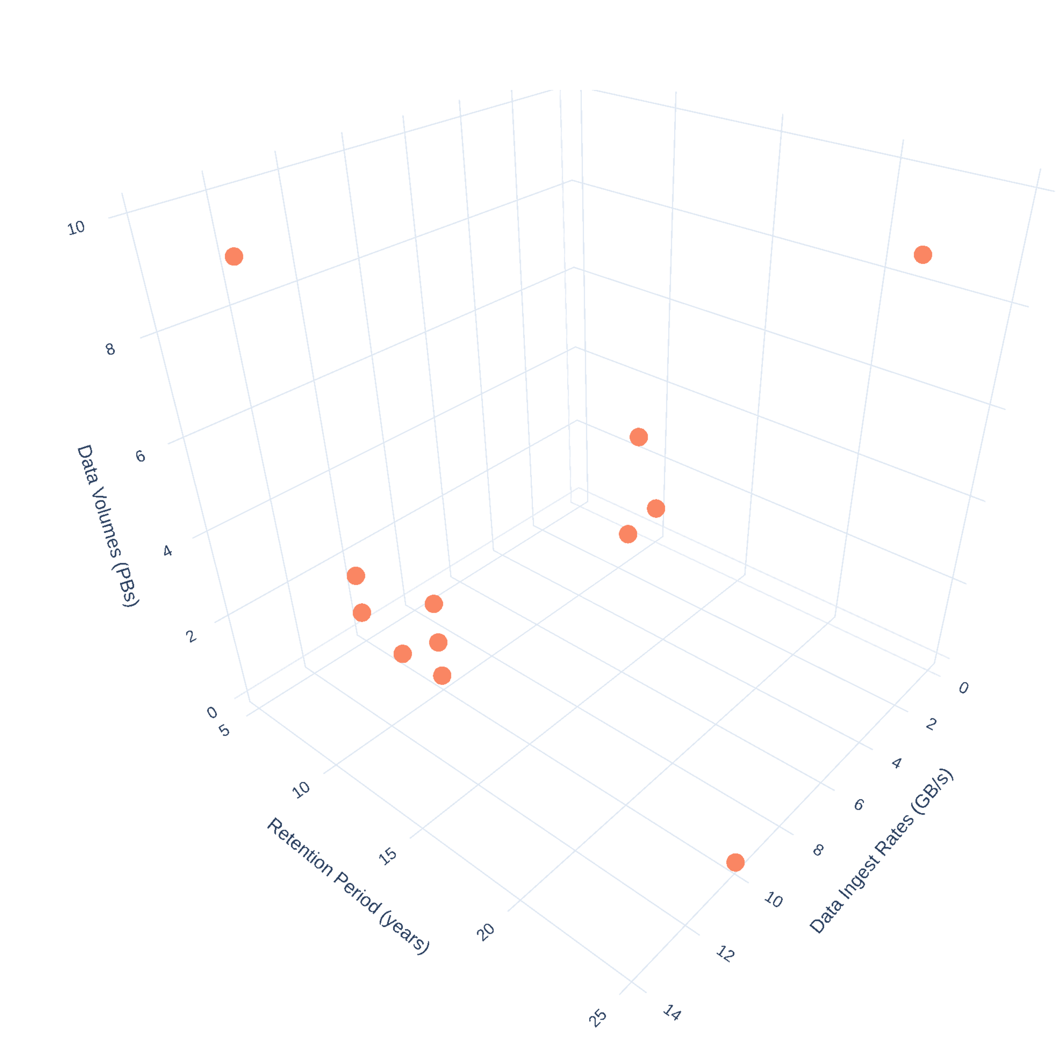
Overview
The BaBar Experiment
CERN Digital Memory
CERN Open Data

Slide 26
Summary
Notes:
So enough with who I am let’s move on to the next important question.
What is CERN?
Do you guys know what CERN is?
Do you know what the LHC is?
No worries, if you don’t know, I am going to explain everything in the next slide.

Slide 27

Summary and Next Steps
The primary goal for the CERN Deployment Scenarios is the preservation and long-term archiving of data. However, all the scenarios would benefit greatly from an added Software Reproducability Layer on top of the archiving solution.
These deployment scenarios have many similarities but they also exhibit important differences that make each one unique.
  e.g. Personal data for CERN Digital Memory
We welcome your feedback on the draft of the “Functional Specifications” documents which have been released on the project website
At the next OMC Event in CERN, we are going to present the first version of the test plan which will be co-designed and co-developed by the Buyers Group and the Suppliers
  The plan will be based on the outcome of the Design Phase, the Functional Specifications document, and the Deployment Scenarios needs
  The test assessment will be a deciding factor to qualify solutions to the subsequent phases
  The tests will focus on basic functionality capabilities during the prototype phase and performance, efficiency, and scalability during the pilot phase

