Slide 1
Overleaf @CERN
Usecase: CLIC
Markus Aicheler
03.07.2019

Slide 2
First some words about me:
I work (mostly) for CLIC on the CLIC module
Background is engineering and material science
I used LaTeX first for my PhD in 2010 (MikTeX and JabRef) so I thought I was a pretty ok LaTeX user...

Slide 3

CLIC Conceptual Design Report 2012:
Approx. 800 pages + 600 References
Editorial team of 3
Local MikTex installations
Versioning with CERN´s SVN
References offline with JabRef
Approx. 80 ”contributions” of which 40 Word...
Editing time until final version 4-6 months
Bad experience:
Collaborative editing (SVN caused problems)
References: had to do some major work
Local installations needed some harmonisation in terms of setup
Simply inefficient: sending around files via email...

Slide 4
Then I grew older and wiser...
One of my PhD students used Overleaf for an article and I got curious...
Clicked around Overleaf and really liked it -> very positive first contact, but though this was quite limited (remembering how much LaTex gymnastics I was doing during my PhD in 2010)
Did not have a case where I could really give this a try...

Slide 5
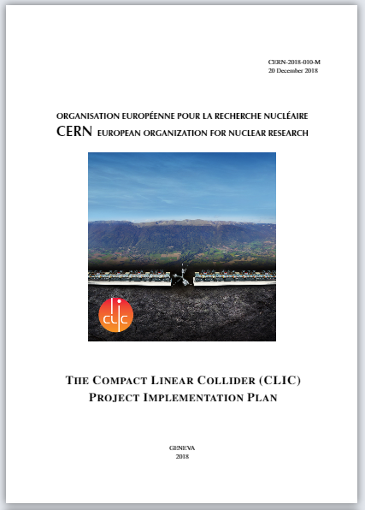
CLIC Project Implementation Plan 2018:
Approx. 280 pages + 400 References
Editorial team of 2,5
Overleaf V1
Git pull for references and offline with JabRef
Approx. 10 ”contributions” of which 3 Word...
Chapter Responsibles collected material and some provided us Overleaf projects of their chapters
Editing time until final version 2 months
Bad experience:
References: did NOT provide a proper template, so people made bibitems...
Sometimes the git interaction produced some unexpected errors...
For full compilations (with new .aux files) timeout...

Slide 6
Then I grew even older and (a tiny bit) wiser...
After CLIC PIP exploring some possibilities for enhancing workflow with Overleaf V2. Specifically: references
Discovered Mendeley and Zotero implementation and made some trials and comparisons
At the same time explored some templates from the CLICdp group which have very advanced use of LaTex (preconfigured virtual machines and quite neat and powerfull templates regularly updated)
... This is where I realized that I am still a LaTeX rookie compared to the CLICdp guys

Slide 7
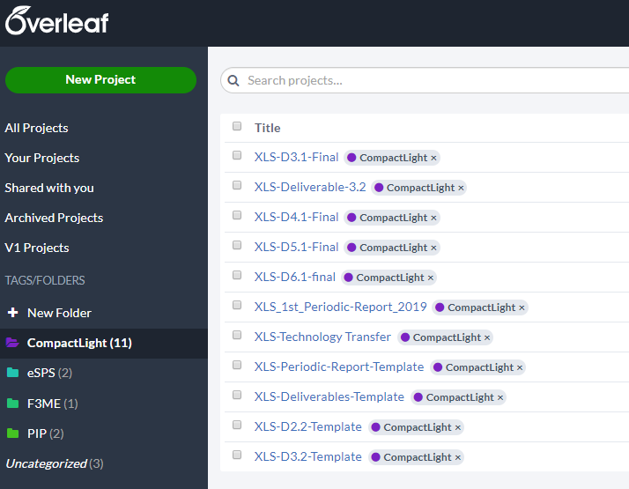
CompactLight Project:
25 partner institution worldwide in project with approx 120 persons total
Currently 6 deliverables (30-100 pages each) with 5 written in Overleaf
Editorial team of 0.5
Overleaf V2 + Mendeley
Mendeley group 17 members with 420 references
Final Deliverable end of 2020: full CDR
Editing time until final version: in parallel

Slide 8
Positive experience (Overleaf&Mendeley combo)
After having provided very nice, neat and simple Overleaf template projects for the individual work packages the community recieved really well the workflow
Mendeley database is already now very impressive and a lot of people contributed
The hope is that all the prework we are doing for the deliverables is paying off when writing the CDR
Workflow entirely nullifies local files and versioning problems!

Slide 9
Negative experience (Overleaf&Mendeley combo)
Importing .bib file from Mendeley changes reference keys!
  Known issue and work around found from 2014
  https://tex.stackexchange.com/questions/473516/citation-key-changes-when-syncing-mendeley-with-overleaf
Only the person who linked the .bib file to the corresponding Mendeley group can refresh (manually!)
Sometimes people put entries manually into Mendeley and make copy paste mistakes...
  Imported an open bracked into the overleaf .bib file and that broke all Deliverables 4 days prior to submission deadline
  I would love to see a (simple) sanity check in Overleaf when synching from Mendeley
Project ownership cannot be transfered... annoying

Slide 10
Upcoming projects for me:
More deliverables for CompactLight (2019 and 2020)
CDR Compact light (2020)
CDR eSPS (end of 2019)
Thanks for listening and Thanks for Overleaf!
... If I had known ”Overleaf” 10 years ago I would have had much less sleepless nights during my PhD

