Slide 1
Overleaf Use Case:
BioLEIR Yellow Report
July 3rd, 2019
SILVIA SCHUH
BE-ABP-HSL

Slide 2
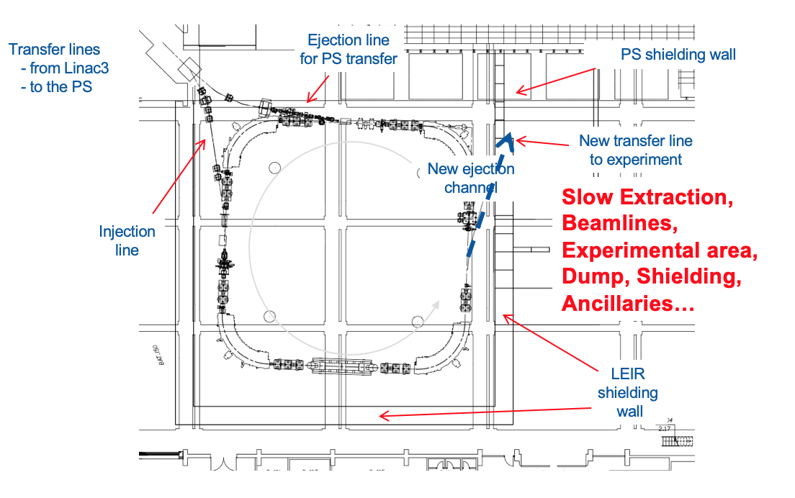
BioLEIR Study Context
2016: ATS-wide Study Group, Mandate (F. Bordry) 4/2016
  Determine a coherent set of beam parameters, based on requirements from med community
  Perform a feasibility design study with enough detail to:
    List and define all necessary interfaces, stumbling blocks, and open questions/issues
    Outline potential challenges
    Identify required further R&D
    Arrive at high-level cost and resource estimates
    Establish a preferred installation scenario
Scope
  170 pages
  Very short timeline: < 1 year
Context
  CERN study group concentrating on technical facility aspects
5 departments, ~20 groups, ~50 people involved
Full yellow report delivered by 3/2017: 10 months
S. Schuh, Overleaf Workshop, July 3, 2019

Slide 3
BioLEIR: Collaborative, parallel Editing
Need for
  Maximum control over layout, choice of LaTeX (instead of Word)
  versioning control
  collaborative platform (to meet a very challenging deadline, parallel work on chapters desired)
  CHOICE for collaborative online editing platform Overleaf
Cost: Material
ATS Director, CMASC
Responsibility for overall document editing/project management
Cost: People
Overall Project Aspects
Risk Evaluation
Equipment Groups
EL, CV, EPC, STI, VC, CO, EA
Installation Planning
Overarching Roles
OP, RP, ABT, Safety, Machine Protection, ICS, Civil Engineering, Handling
Points Flagged
S. Schuh, Overleaf Workshop, July 3, 2019

Slide 4
BioLEIR: Collaborative, parallel Editing
Decision for 3 project phases
  Phase 1: 5 months of parallel work, independent editing of chapters by corresponding experts
  Phase 2: 3 months of pulling the chapters together to arrive at a common document with correct cross-references
  Phase 3: freezing of individual chapter contents, 2 months of editing the overall document by the editors – for coherence of level, language and style
S. Schuh, Overleaf Workshop, July 3, 2019

Slide 5
BioLEIR: special document structure for phase 1+2
Setup of a special project structure specifically for the BioLEIR need
  Common structure with subdirectories and nomenclature for all 18 individual chapters
  From the start, one overall main file would be including each chapter using the linked-file feature such that
    We could compile the current full document with all chapters dynamically
    While each chapter could compile individually as a standalone document, using a main file that would include only its chapter
  Full editorial access was limited to chapter contributors, read-access to full document given via the above structure such that cross-referencing and control of content coherence was possible for chapter editors
  Updating of linked files could happen whenever a chapter editor would deem the chapter stable enough
  Overleaf provided a special feature within the project area that would allow all linked files to be updated simultaneously if desired, rather than one-by-one.
S. Schuh, Overleaf Workshop, July 3, 2019

Slide 6
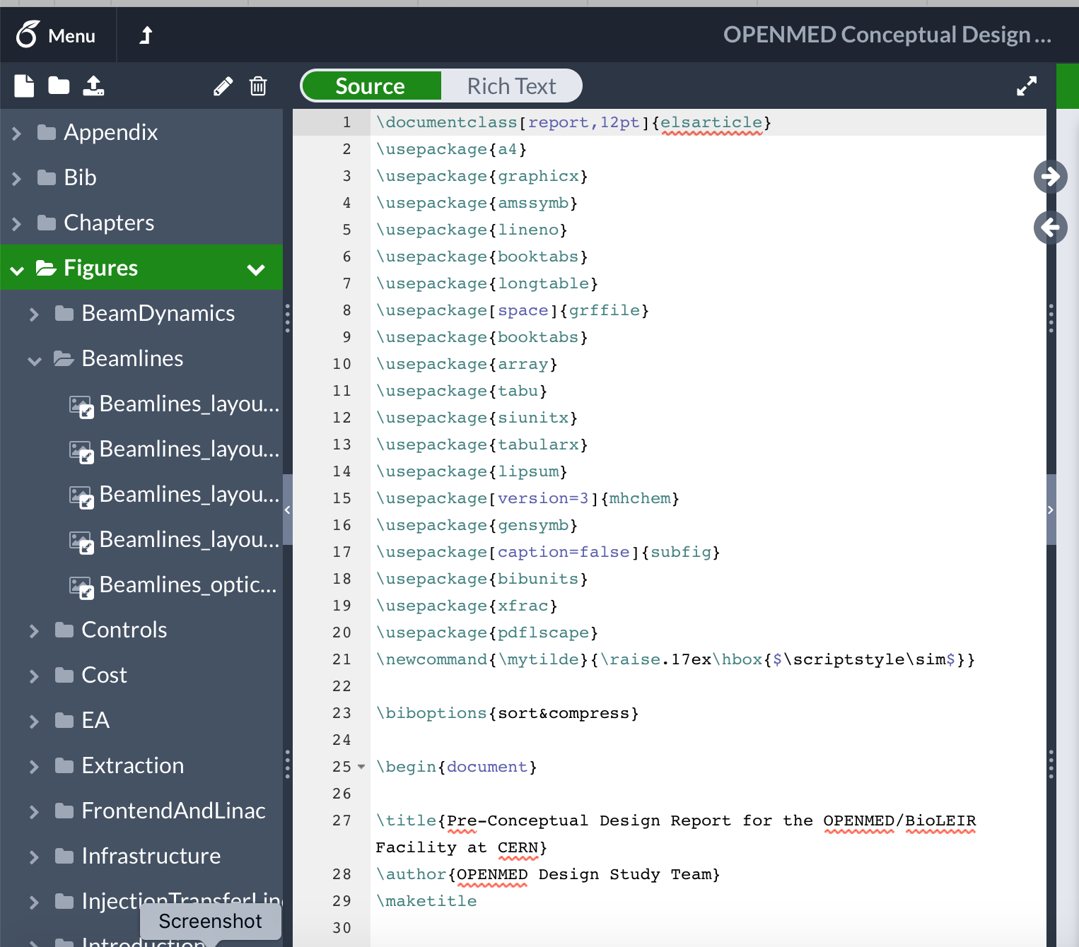
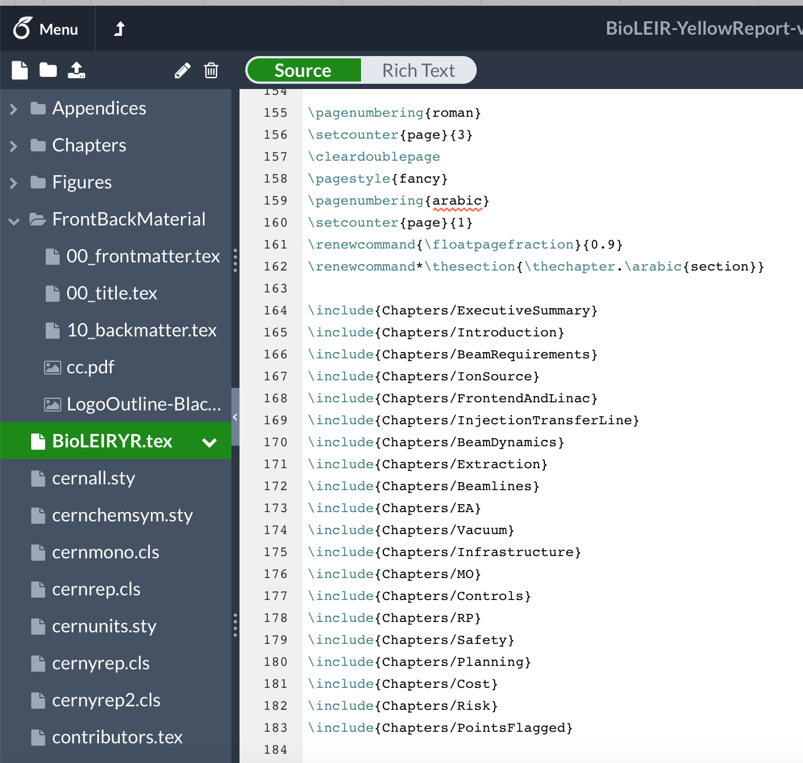
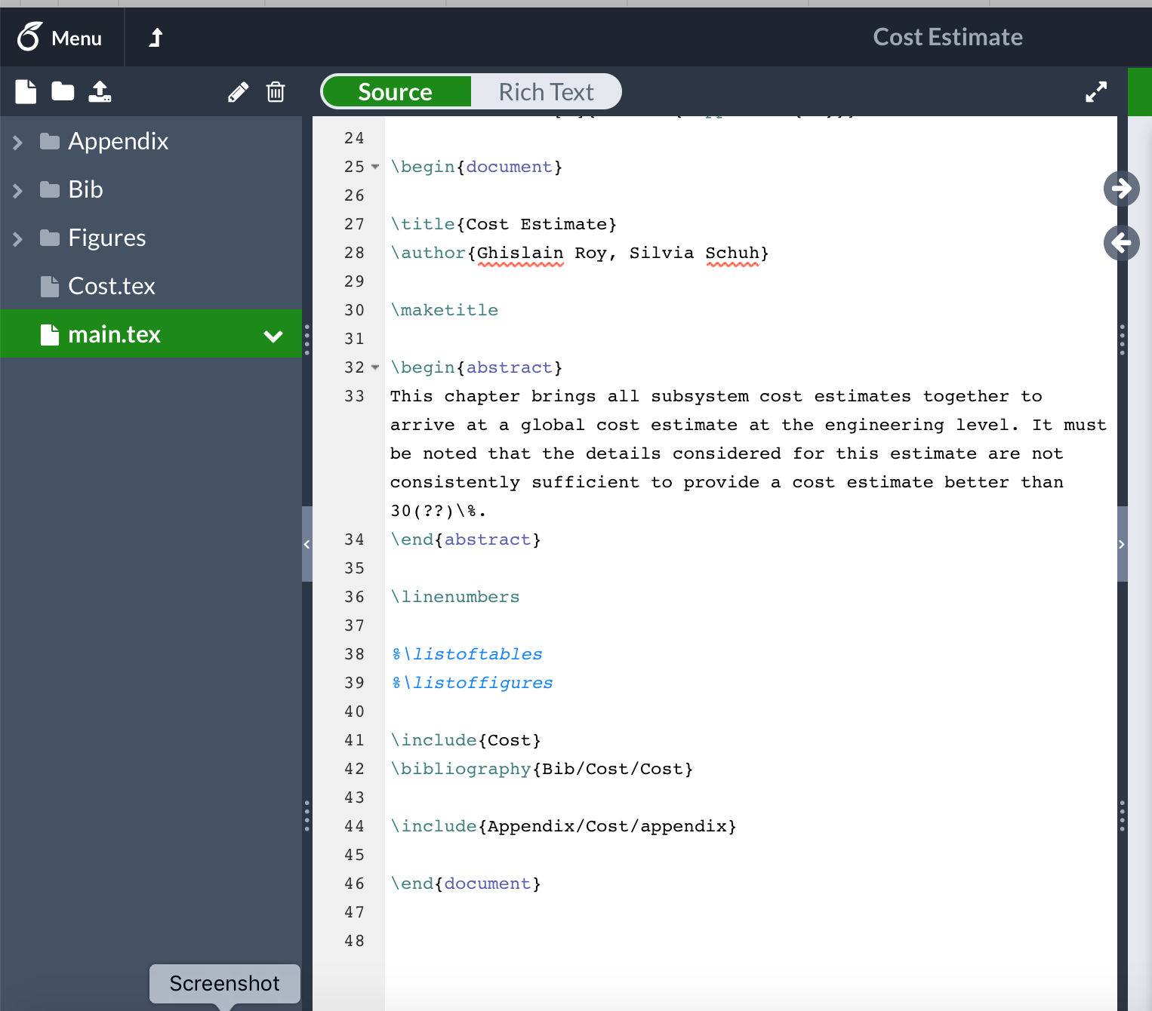
BioLEIR: phase 3
Freezing all content and pulling it together
  Make all links static
  Build one common Bib directory
S. Schuh, Overleaf Workshop, July 3, 2019

Slide 7
BioLEIR: experience from phase 3
BioLEIR project setup: now a CERN use-case
  Setup Overleaf structure for Physics Beyond Collider-report, provision of tutorial and Overleaf advisor
Content coherence: pulling it together
  The way that we had set up the project initially was key in allowing the proper editing of the final document to be done in very little time (10 weeks)
180 pages with good level and quality of detail
delivery of a very good quality CERN yellow report ON TIME
  Small editorial team during 10 weeks (record time?)
S. Schuh, Overleaf Workshop, July 3, 2019

Slide 8
BioLEIR Yellow Report – some feedback from the field
How did we like working with Overleaf?
  We loved it – and ended up using the tool also for writing simple conference/research papers, as the collaborative editing was made so simple
  Once we adopted Overleaf as tool, we also received timely and concrete help from Overleaf staff
    We discussed our specific needs and adoption of the overall structure as a project with linked files was following advice from them
    A special “update all linked files” button was implemented specifically for us
    When we had some complex LaTeX issues at the last stage of pulling the project together, the Overleaf LaTeX experts helped extremely quickly and efficiently
Word-Users adaptability
  Despite resistance to use LaTeX, importing of Word documents and personal ’hand-holding’ efforts resulted in Word-users appreciating the advantages of LaTeX and the ease of collaborative editing
S. Schuh, Overleaf Workshop, July 3, 2019

