Slide 1
XLS Periodic Report M1-M18
Regina Rochow, Frascati 05/03/2019

Slide 2
grant agreement: reporting & payments
reports and payment requests
“Under Article 19 and Article 20 of the grant agreement (GA), the coordinator must submit to the Commission technical and financial reports, including requests for payment - specifically:
deliverables identified in Annex 1
periodic report (both technical and financial) within 60 days of the end of each reporting period (including the final one), including requests for payment ...
[H2020 online manual]
29 August 2019
text & data parts
ready on:
15 July 2019
financial parts
ready on:
25 July 2019

Slide 3
participant portal: reporting platform
reporting functionalities
“Continuous reporting functionality in the Participant Portal:
it is activated at the time the project starts and it is continuously open for the beneficiaries to submit deliverables, to report on progress in achieving milestones, to follow up of critical risk, ethics issues, publications, communications activities, and the answers to the questionnaire on horizontal issues.
Periodic reporting functionality in the Participant Portal:
following the end of each reporting period the functionality of periodic reporting will be activated. While the periodic reporting session is open in the grant management system, each participant will be able to:
complete on-line their own Financial Statement (and the financial report of their Third Parties, if any) including the explanations on the use of resources
upload the narrative, free text part (part B) of the periodic technical report as a pdf document”
[H2020 online manual]

Slide 4
report structure: periodic report m18
part a1: structured tables
from continuous reporting section:
summary (context & objectives)
work performed & main results
progress beyond state of the art & expected potential impact
website
part b: free text
explanations of the work carried out by each beneficiary and third party
overview of the progress towards the project objectives, justification of any deviation from the planning
integrated in a single pdf document
part a2: forms and lists
from continuous reporting section:
deliverables (with comments if delayed)
milestones
ethical issues (if applicable)
critical risks & mitigation
dissemination & exploitation
impacts on SMEs (as partners)
open research data (DMP)
gender
part c: financial report - structured forms
individual financial statements by each beneficiary and third party (annex 4 to the GA)
each beneficiary: explanation of the use of resources, subcontracts & in-kind contributions by third parties
periodic summary financial statement & request for interim payment by LP

Slide 5
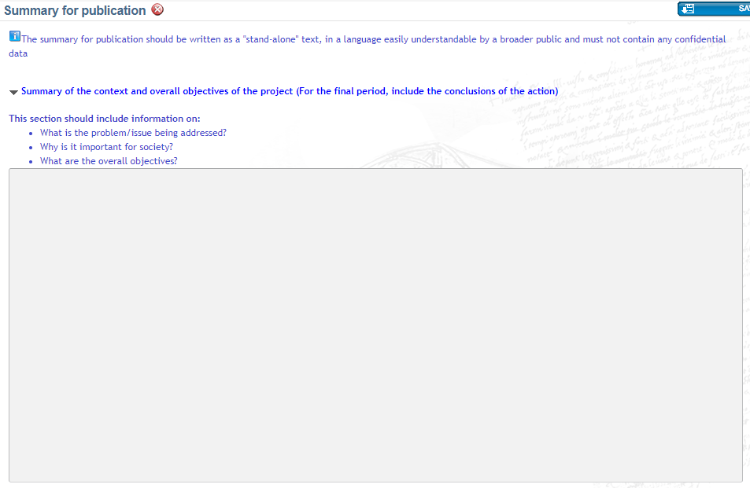
EU portal: part a1- structured tables
lead partner:
will prepare a draft to be discussed
with the project coordination office
max. 7480 characters

Slide 6
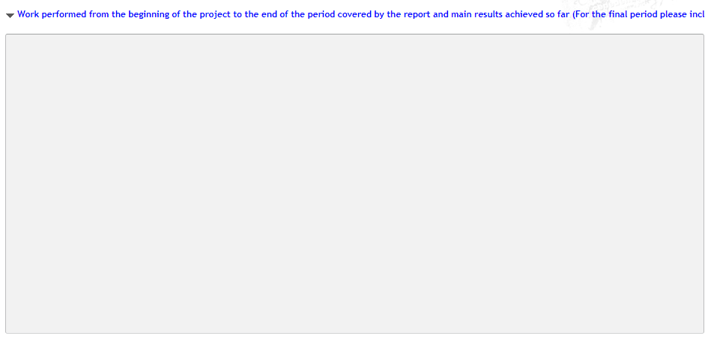
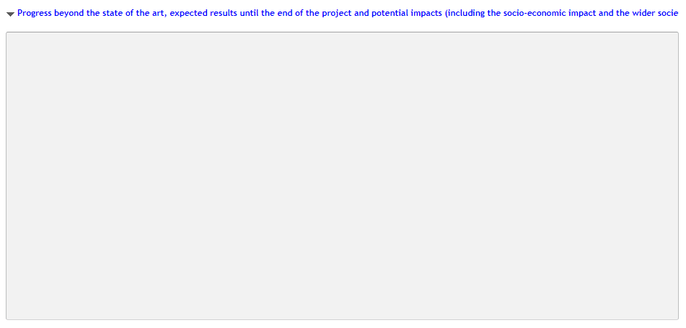
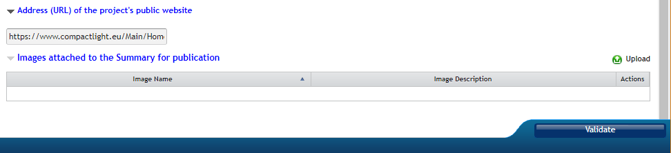
EU portal: part a1- structured tables
project coordination office:
prepare and agree on drafts to be
discussed with the partners
max. characters ?

Slide 7
EU portal: continuous reporting
part a2: other parts
deliverables (comment if delayed) wp leaders
milestones lead partner
ethical issues (if applicable) lead partner
critical risks & mitigation wp leaders
dissemination & exploitation lead partner wp leaders
impacts on SMEs (as partners) lead partner
open research data (DMP) lead partner wp leaders
gender each partner
how to:
data for single partner: each partner fills out the requested information
data on wp basis: wp leaders collect data from all wp partners
data on whole project: each partner sends his data to LP for integration
see next pages!

Slide 8
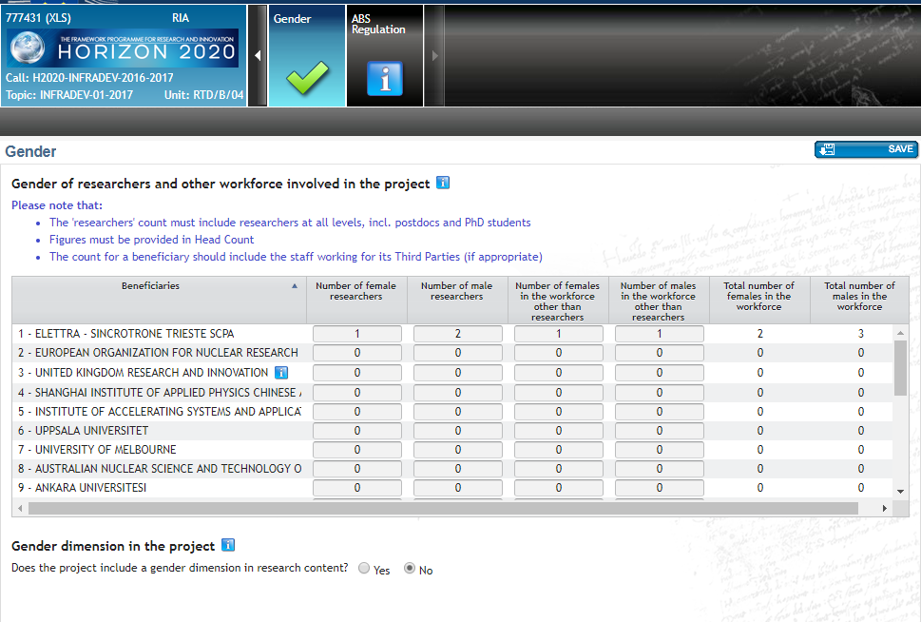
part a2: gender survey
partners:
please fill out this table !!

Slide 9
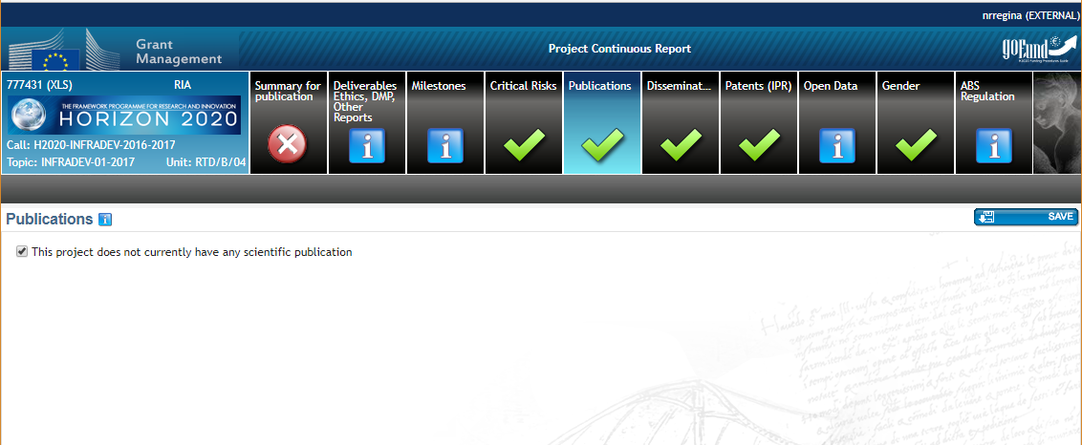
part a2: publications
lead partner:
will collect dissemination
data from each partner
wp leaders:
please collect papers & IPR
for your wp & send to LP

Slide 10
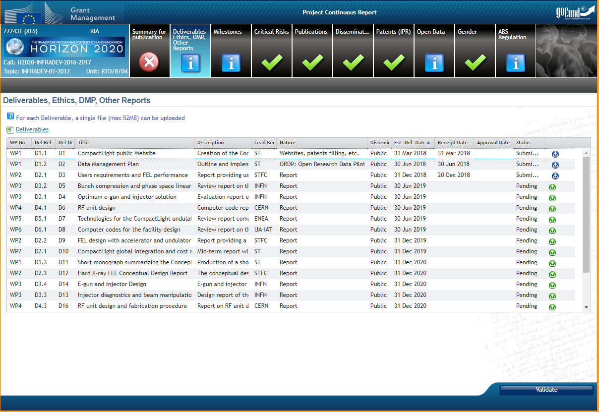
part a2: deliverables
due date
wp leaders:
upload deliverables here!!
max. 52 mb

Slide 11
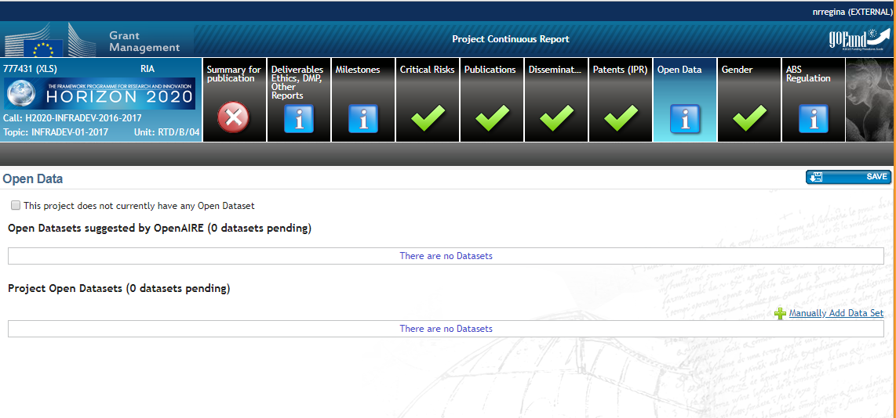
part a2: open data
joint decision of data owners
managed by data management team
need procedure for decision
need DMP update
all kind of data from XLS
wp leaders:
please collect generated data
for your wp & inform LP

Slide 12
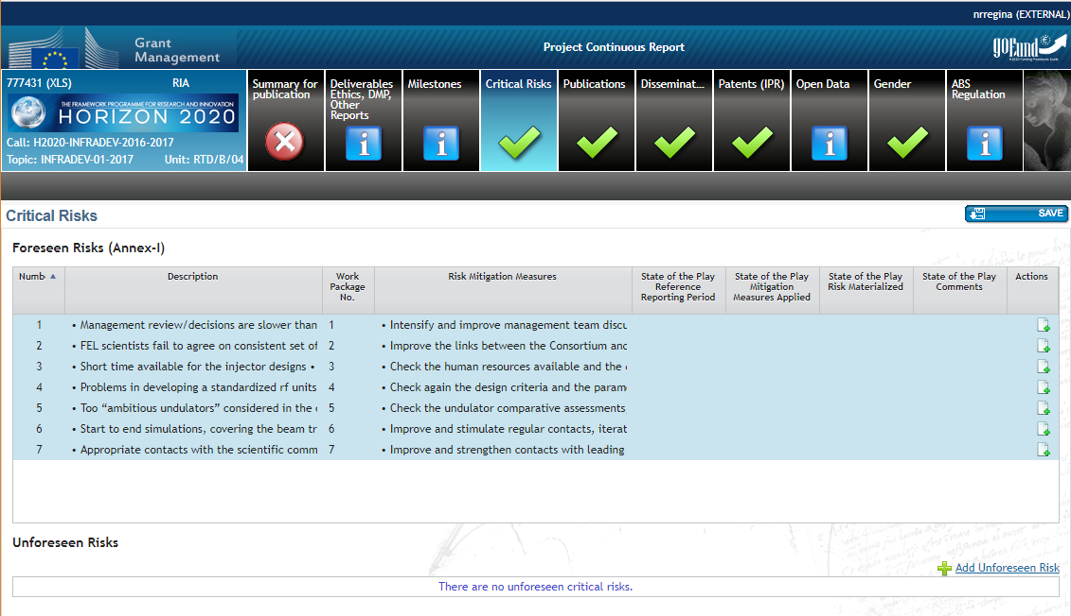
part a2: critical risks
wp leaders:
need to comment
here on current state
with respect to risks
project coordination office:
discuss and decide about
possible new risks to add to list

Slide 13
EU portal: continuous reporting
part a: structured tables and other parts
“The information in the continuous reporting is automatically compiled to create part A of every periodic technical report, at the moment the coordinator and beneficiaries finish the preparation of the periodic report in the grant management system.
The technical report (both parts) is first 'locked for review' by the coordinator before being officially submitted. Any entries into the continuous reporting you make after this point will not be included in this periodic report.”
[H2020 template]
Important: complete periodic reporting first!!

Slide 14
part b: periodic report - free text
part b: free text structure & procedure
explanation of the work carried out by each beneficiary (and their third party, if any) and overview of the progress (see H2020 template for more details)
update of the plan for exploitation and dissemination of result (if applicable)
update of the data management plan (if applicable)
follow-up of recommendations and comments from previous review(s) (if applicable)
deviations from annex 1 and annex 2 (if applicable)
how to:
single partner: each partner prepares their work description for each wp, in which they are involved
work package: work package leaders integrate the work description for their work package, contribution of the single partners must be evident
project level: lead partner and project coordination office integrate all contributions and prepare general parts

Slide 15
EU portal: periodic report - accounting
part c: financial report – structured forms
individual financial statements by each beneficiary and third party (annex 4 to the GA)
each beneficiary: explanation of the use of resources, subcontracts & in-kind contributions by third parties
lead partner: periodic summary financial statement & request for interim payment
how to:
individual financial statements: each partner fills out their own form and the form for their third party (if any)
report on use of resources: each partner prepares a report on the use of their own resources and those of their third party (if any)
periodic summary financial statement: lead partner prepares the documents

Slide 16
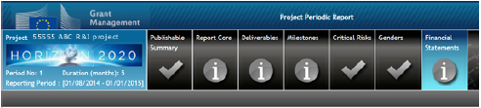
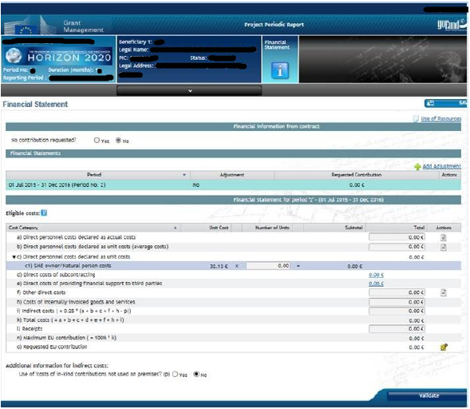
part c: financial statements
partners and 3rd parties:
the forms for individual
financial statements will be
available here

Slide 17
periodic report: next activities
lead partner:
send information and excel tables for data collection
send reporting structure and information
prepare reporting platform
prepare project abstract for general public for discussion by PCO
coordinate update of DMP and preparation of communication plan
wp leaders & PCO:
collect data from wp partners
discuss and decide on open data
discuss and decide on risks
coordinate reporting on their wp
single partners:
complete gender data in continuous reporting section
communicate required data to wp leaders & lead partner
prepare own work description for all relevant wps
URGENT!!

Slide 18
periodic report: timing
 | what | who | deadline | remark
a1 | project abstract for general public ready | PCO | 31 March
 | “work performed & main results” ready | PCO | 27 June | for Helsinki
 | “progress made & expected impacts” ready | PCO | 27 June | for Helsinki
a2 | tables to be filled out directly by single partners | each partner | 30 April
 | excel templates for data collection sent | LP | 15 March
 | excel template completed & sent back | each partner | 31 May
 | wp based data collected & sent to LP | wp leaders | 31 May
 | list of open research data prepared & agreed | PCO | 15 June | for Helsinki
 | data management plan updated | DM team | 27 June | for Helsinki
 | communication plan prepared and agreed | commun. group | 27 June | for Helsinki
 | list of critical risks + mitigation prepared & agreed | PCO | 15 June | for Helsinki
 | “impact on SMEs” part prepared | LP + SMEs | 15 June | with Kyma, VDL ETG
 | data integrated & filled in continuous reporting system | LP | 21 June | for Helsinki
b | report structure & request for contributions sent | LP + wp leaders | 19 March | to all partners
 | collaborative text editor made available | LP | 15 April
 | partner contributions filled into text editor | each partner | 31 May
 | text integration and general parts ready in text editor | PCO | 27 June | for Helsinki
 | final integrations & review done and agreed | PCO | 15 July | after Helsinki
c | partners’ financial forms & reports ready | each partner | 25 July | if possible … (verify!!)
 | summary statement and payment request prepared | LP | 25 July
 | report submitted | LP | 26 July | EC deadline: 29 August

