Slide 1
ITEMS FOR A COST MODEL FOR THE XLS-XFEL
Evangelos Gazis/IASA,
Theodoros Apostolopoulos/AUEB
A great thank to CARLO ROSSI/CERN for his wonderful file and his generous support
29 May 2019

Slide 2
XLS EDMS Structure
RF Gun System
Injector Linac
Main Linac
Undulator System
Mechanical Support System
Main Dump System
Infrastructure and Services
Machine Control and Operational Infrastructure
Note: Any item in green color is added to the initial file

Slide 3
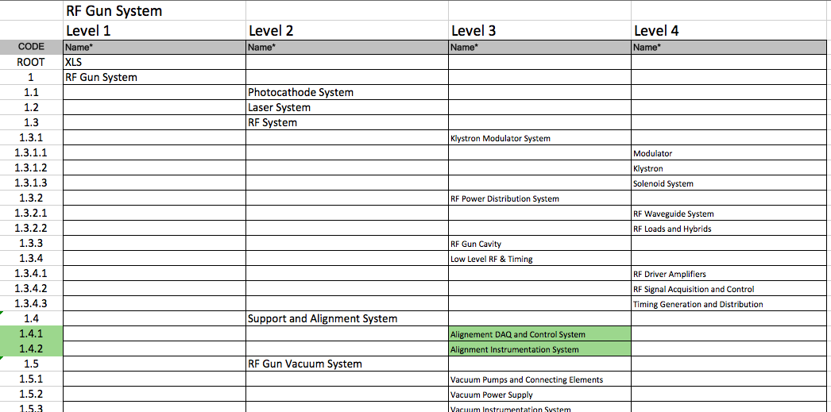
1. RF Gun System

Slide 4
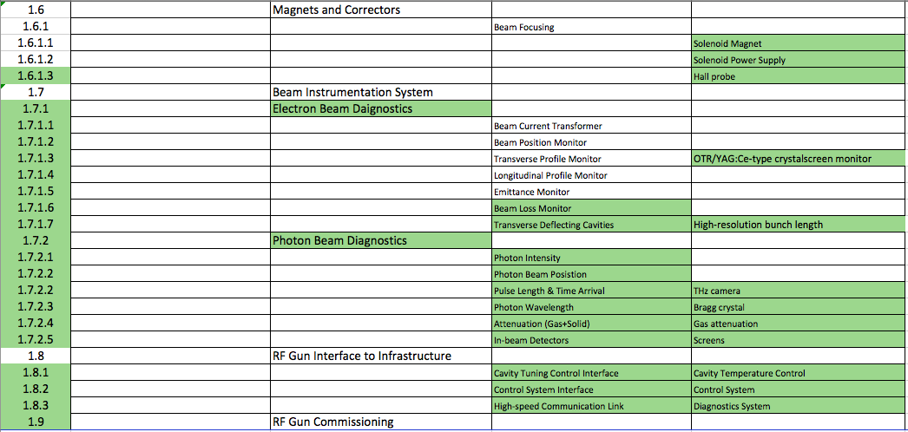
1. RF Gun System, continued

Slide 5
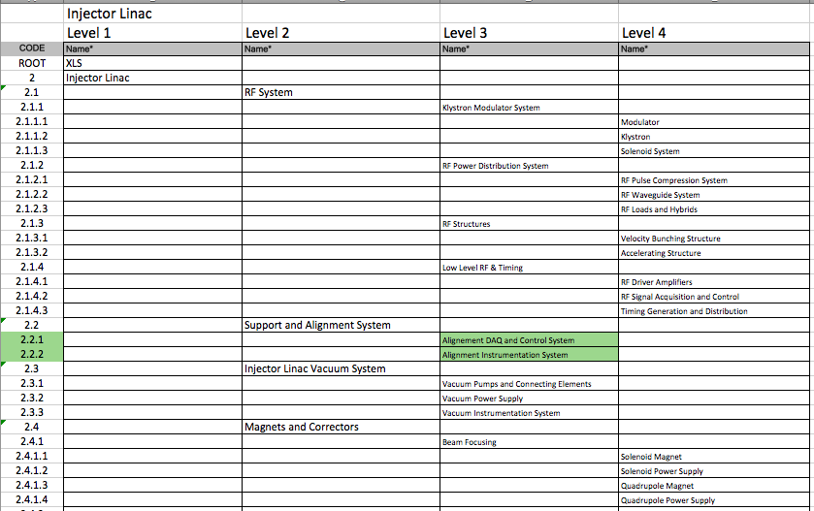
2. Injector Linac

Slide 6
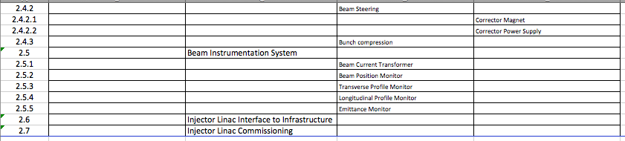
2. Injector Linac, continued

Slide 7
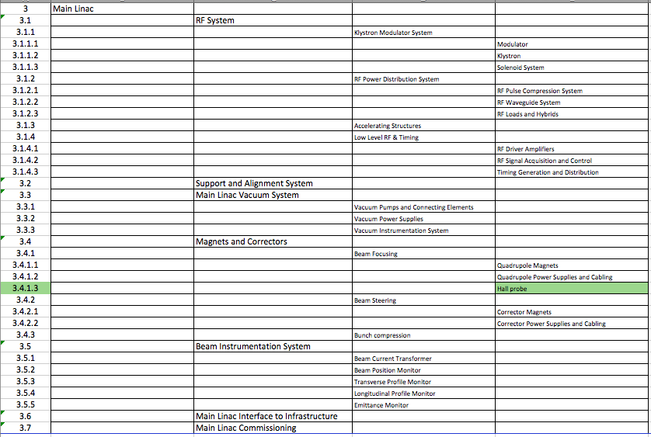
3. Main Linac

Slide 8
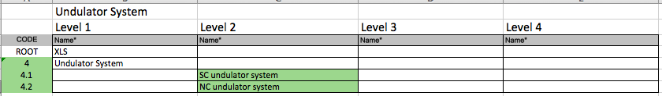
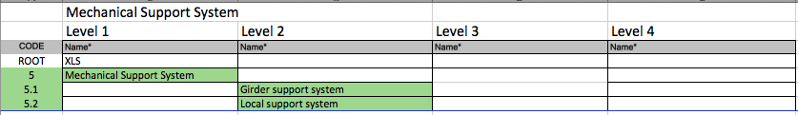
4. Undulator System
5. Mechanical Support System

Slide 9
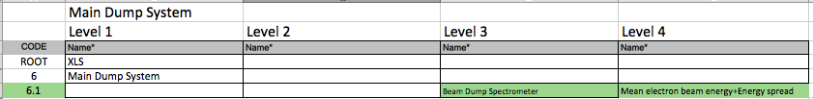
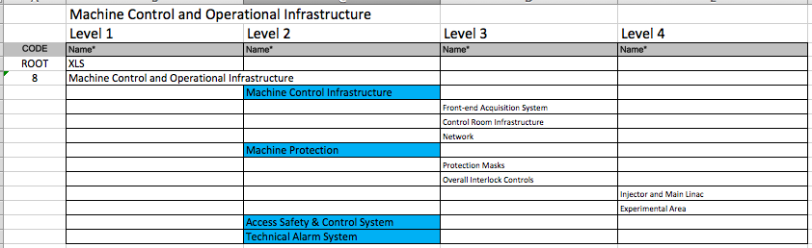
6. Main Dump System
8. Machine Control and Operational Infrastructure

Slide 10
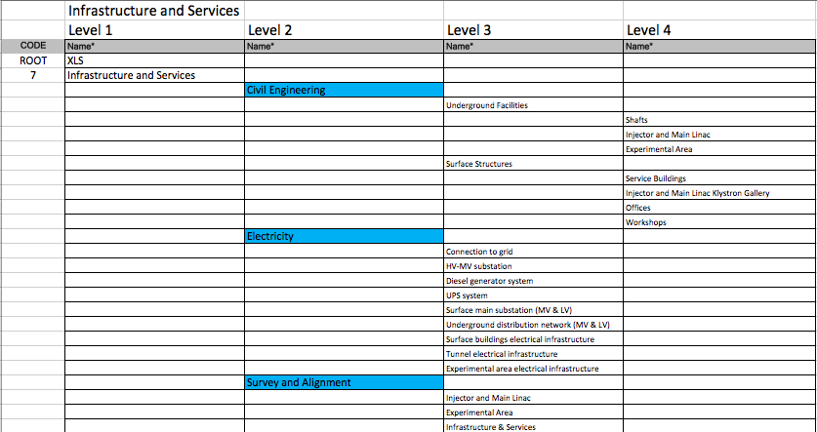
7. Infrastructure and Services

Slide 11
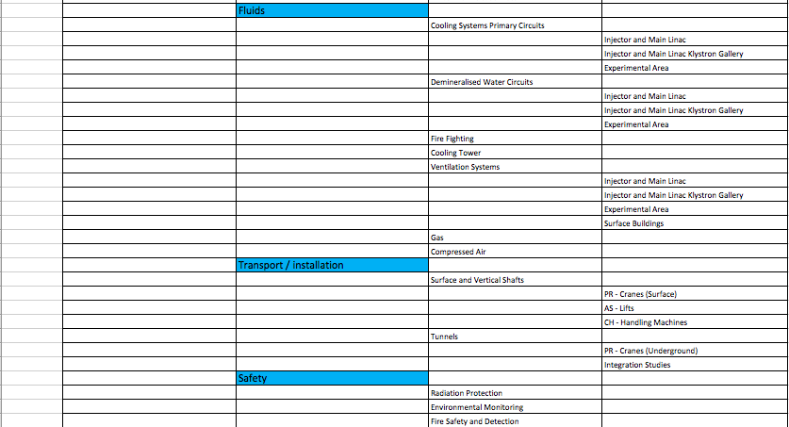
7. Infrastructure and Services, c’nued

Slide 12
Conclusions
Carlo’s proposal file has significantly changed the profile of the XLS index structure
1st Target: The detailed description of the elements for the basic parts of the accelerator and its operation
2nd Target: The feedback of the WP leaders and collaborators on the accelerator structure, i.e. correction, completion, etc. are welcomed
3rd Target: The finalization of the XLS structure will guide smoothly to the cost estimation of the project with good precision

