Slide 1
Action Plan for Technology Use
Regina Rochow, WP7 Vidyo Meeting, 29/05/19

Slide 2
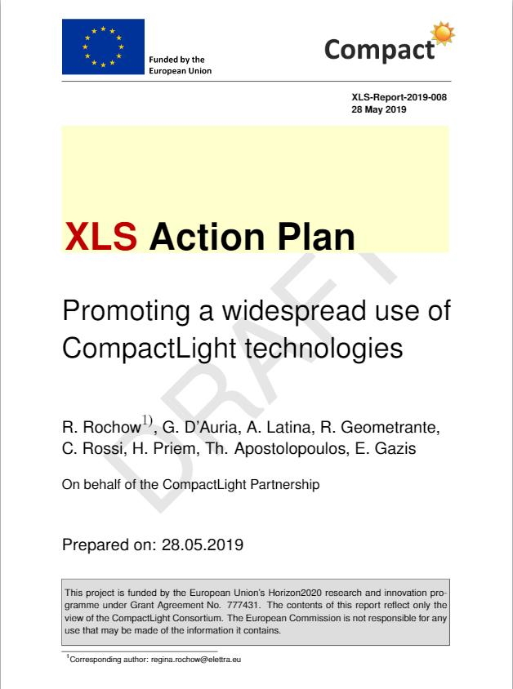
Task 7.4 – Technology Transfer
Involved Partners:
ST, CERN, IASA, VDL ETG, Kyma, ALBA-CELLS
Aim:
Support the use of CompactLight
technologies by:
Describing expected benefits
Identifying potential users
Defining and organizing activities
to raise awareness of users
Planning and implementing
measures to support use
Collecting and documenting all
kind of achieved results

Slide 3
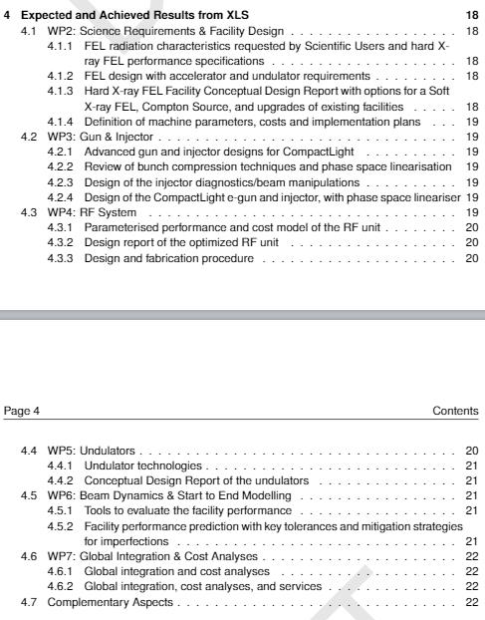
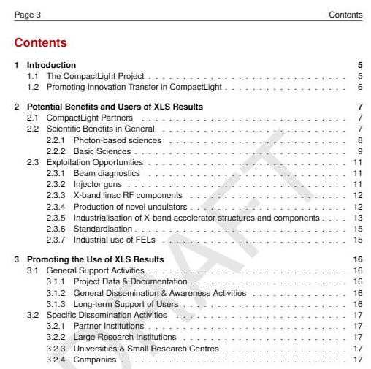
Draft Action Plan - Contents

Slide 4
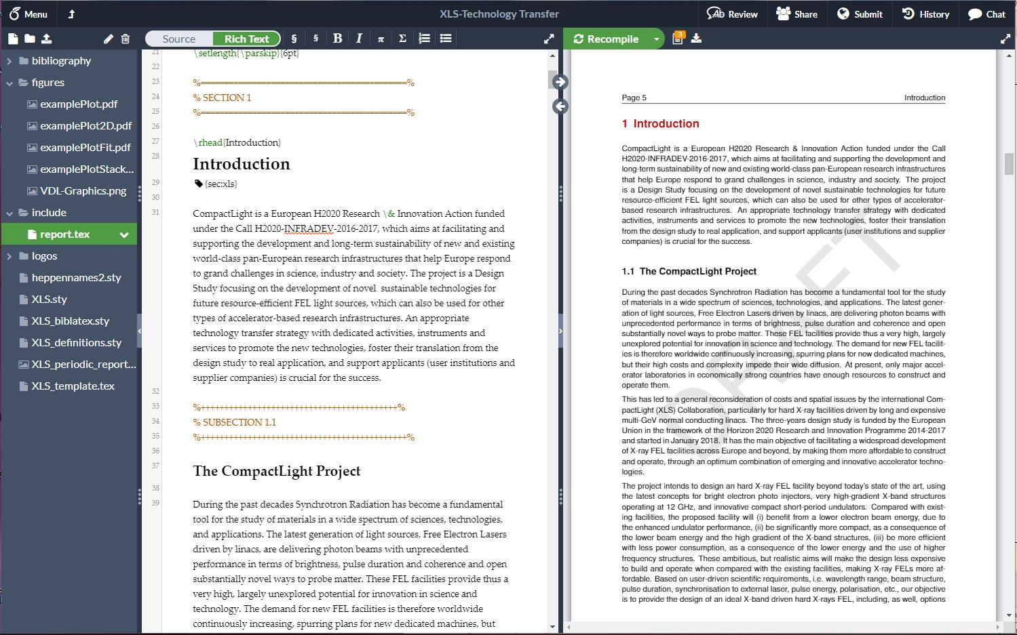
Action Plan – Joint Preparation
by Task 7.4 Partners
switch between source and rich text modes
recompile to see formatted document
link will be sent …
for support contact:
Andrea Latina
Regina Rochow
use this document

