Slide 2

Visit CERN:
Mission Impossible?
François Briard
Visitors and Local Engagement, IR-ECO group

Slide 3
Visit CERN
2 permanent exhibitions:
  Microcosm
  Universe of Particles
Passport to the Big Bang bicycle trail
Public events:
  Globe Conferences
  Workshops: Girls in ICT, Devoxx4Kids, …
  Researchers Night
  Open Days
Guided Tours
Free,
Freely accessible,
Rarely full,
Multilingual !
Hey wait...
What about this?
Conclusion:
NOT impossible!

Slide 4
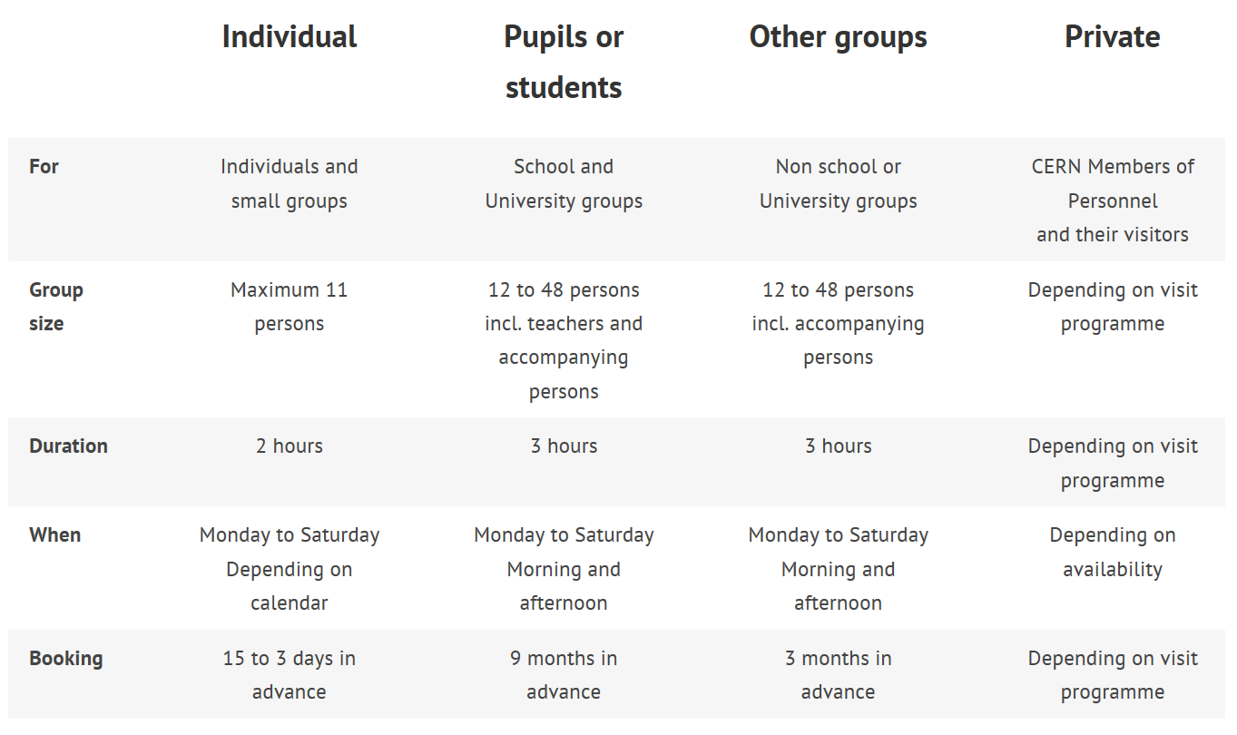
Guided tours offer

Slide 5
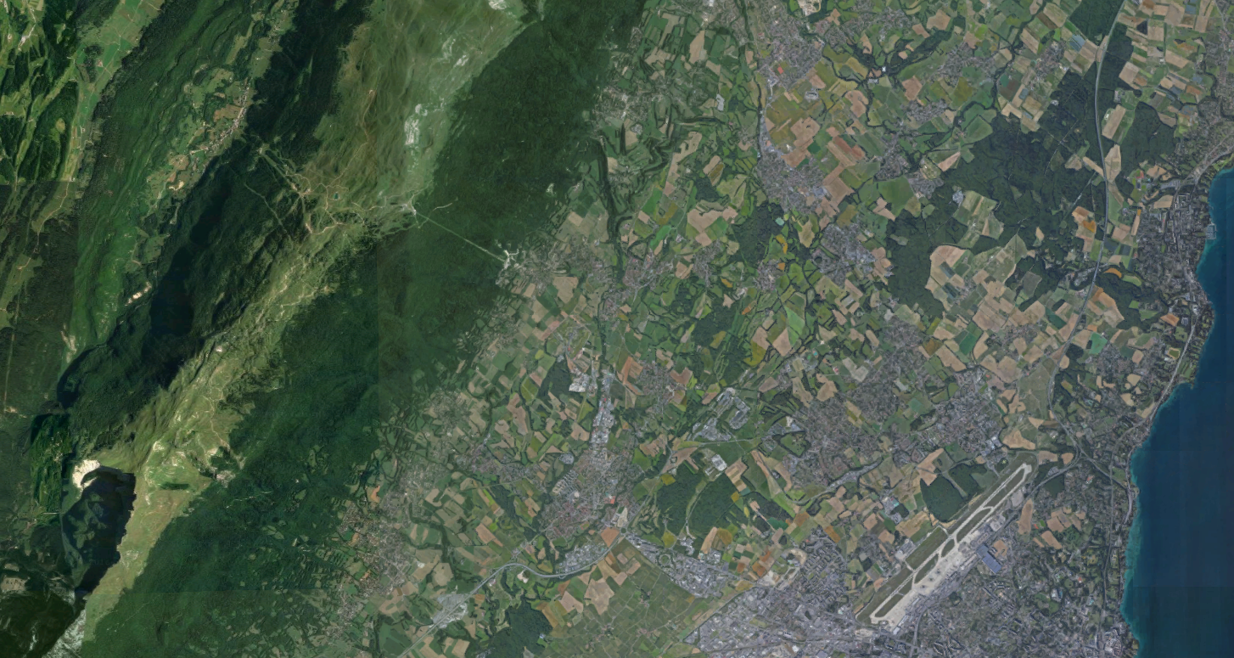

Visit sites
20 itineraries
visit.cern

Slide 6
CERN official guides
We have trained 192 new guides in 2018
1573
1098
104
717
Official guides
Have guided at least 1 tour last year
Have guided at least 1 non private tour last year
Have guided at least 20 tours last year

Slide 7
Group tours requests in 2018
Total: 22 347
Total: 280 770

Slide 8

The main constraints
 Visit sites capacity
 Visit sites availability
 Visit sites accessibility
 Requested language
 Guides trainings
 Guides languages
 Guides availability (budget!)
 Transport (budget!)
 Programme diversity
 Specific requests
 Competing visits services
 Last minute requests

Slide 9
Which criteria are used to accept groups?
Capacity available
Country (quota - fairness)
Language (quota - based on our experience of guides availability)
Availability of guides
Background checking (tour operators, paid tours etc)
Has the group a transport ?
Group size

Slide 10
Individual tours requests in 2018
No precise stats as booking form only accessible if there is space available
48 tickets / day are gone in seconds every morning at 08:30 a.m.
We receive hundred of mails complaining about our buggy system
Let’s check what YouTube tells us about our booking system…

Slide 11
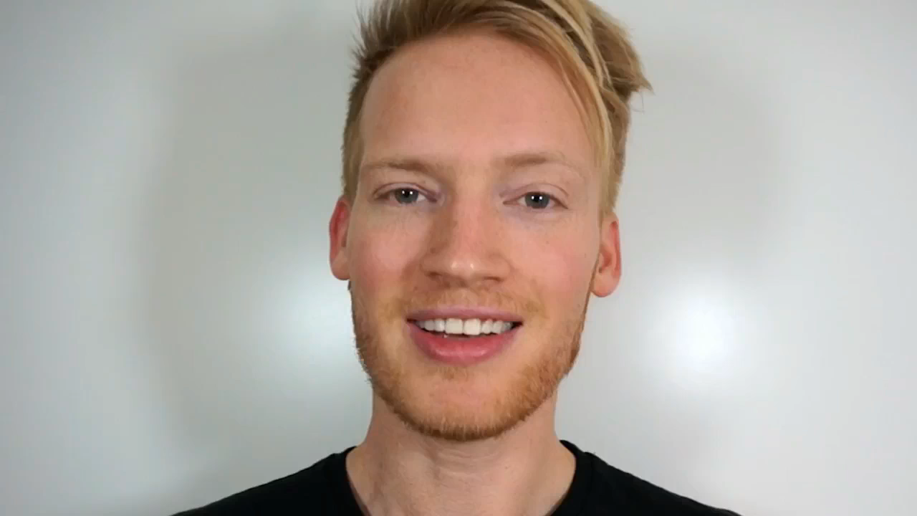

Slide 12
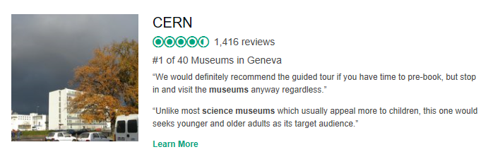
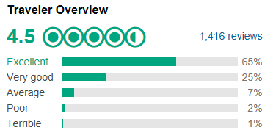
TripAdvisor
Let’s have a look at 3 of these 11 reviews

Slide 13
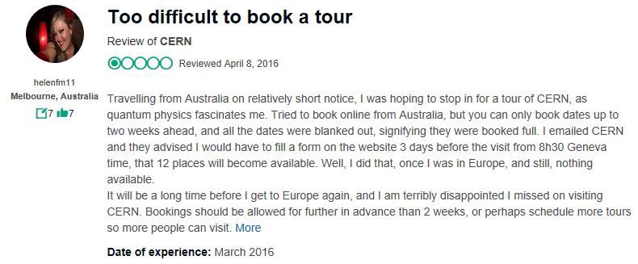
TripAdvisor

Slide 14
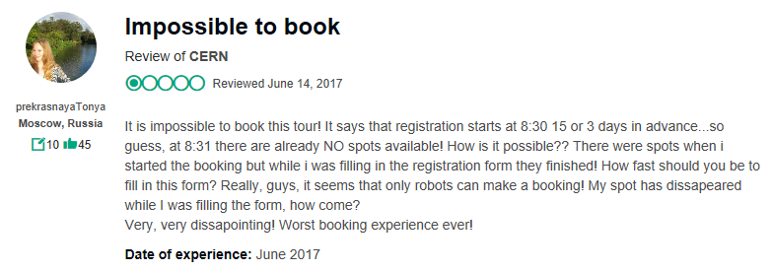
TripAdvisor

Slide 15
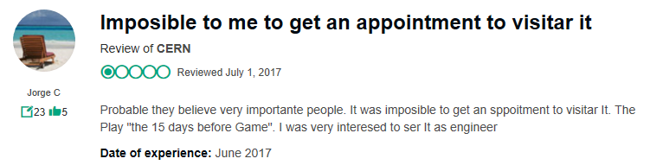
TripAdvisor

Slide 16
Bonus: private visits (2500/year)
Principles: use what’s available, short term
"We organize a conference at CICG and we have announced the CERN tour. The 2’500 attendees are thrilled since they learnt it. How do we proceed from now? "
"Yes, I have seen the form. But I think it would be easier if I explain you what I need as it seems complicated to fill in."
"We have a very important visitor coming to CERN. Can you arrange some tour for us? Undergound of course."
" I have already arranged an ATLAS underground visit, then a Data Centre visit. Can you please add a visit to SC between 14:30 and 14:45? Oh and I have no guide."

Slide 17
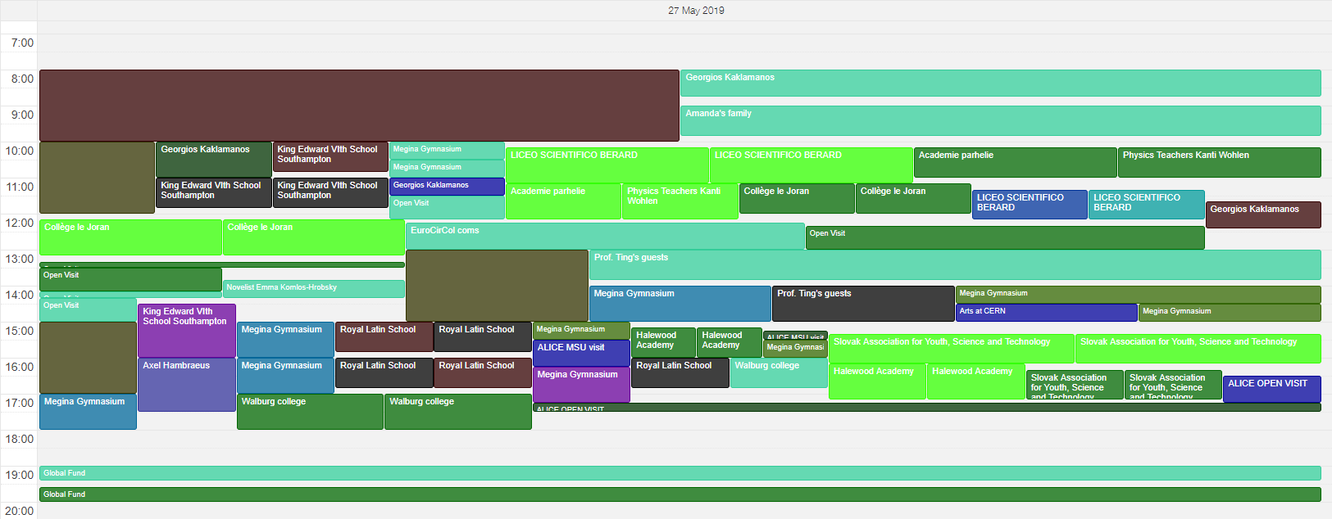
A typical guided tour day at CERN

Slide 18
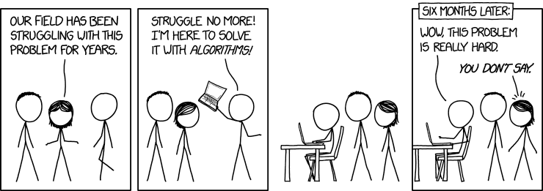
Solutions?

Slide 19
1. Extend existing sites availability
Pros
Extend what exists, do not reinvent the wheel
Cons
Visit sites have operational constraints
Workers on visit sites do not always want to see more visitors in their work environment
Some collaborations / Departments want to keep control of their outreach sites
Adding more tours per days has impact on budgets

Slide 20
2. Develop new visit sites
Pros
Legacy sites are very interesting for our visitors (SC, LINAC2)
New projects are interesting too (HL-LHC, CLIC, LINAC4)
Cons
Developing a new visit site needs resources and they are limited
Bringing visitors to a working site brings extra safety requirements
Adding a visit point to future venues is not yet part of our culture

Slide 21
3. Train more (MPe) guides
Pros
Bigger reserve of guides
Less problems to find suitable and available guides
Cons
Training guides needs time and resources
Having more guides means less tours per guide > less experience
Heavy programme of work in Departments. Are they ready to share resources?

Slide 22
4. Create predefined visit programmes
E.g.
Tour A: SC + AVC
Tour B: Data Centre + AD
Pros
Simpler administration
Guarantee of visit programme for visitors
Cons
Does not cope well with
  Unexpected operational issues (one site not accessible)
  Flexiblity and last minute or specific requests

Slide 23
5. Improve booking system
Currently
Students groups can book 9 months in advance
Other groups can book 3 months in advance
Group bookings share the same quota: used by schools mostly
Individual tours very limited, opened for booking 15 and 3 days in advance
Proposal
Differentiated quota for students and other groups
Same delay for all visits (e.g. 9 months)
Status: awaiting development by FAP-BC

Slide 24
6. Get systematic feedback on visits
Pros
Might help tailoring the offer
Identify what expectations and experience are on various offers
Help to make a better use of your visit points
Cons
Needs to be developed and followed: planned end of 2019

Slide 25
7. Integrate permanent exhibitions
Pros
Use what exists
Positive feedback on our exhibitions from Geneva Tourism
No transport to be organised
Cons
Visitors expect to see the real CERN
Exhibitions have limited capacity too

Slide 26
8. Visit virtually
Pros
No visitors come to CERN…
24 / 7 offer
LHC collaborations have already developed this offer
Cons
Visitors want to see the real CERN
LHC collaborations have already developed this offer… difficult to integrate

Slide 27

9. Science Gateway
Pros
Expand the exhibition / labs / show offer
Cons
Does not extend guided tour offer
Will be there in 2022 at best

Slide 28
Conclusion

Slide 29
It is not impossible to visit CERN!
It is very difficult to get a guided tour…
Consider our permanent exhibitions offer
Visit virtually
Increase your chances to get a guided tour:
  Make a group of 12
  Organize your own transport
  Be flexible for your visit programme
  Find your guides
Wait for Science Gateway
Become a CERN guide!

Slide 30
Additional slides

Slide 31
2018 tours by average age

Slide 32
2018 tours by language

Slide 33
2018 tours by country

Slide 34
2018 tours by reason

