Slide 1
Containers in the ESS integrated control system
Karl Vestin
www.europeanspallationsource.se
2019-09-18

Slide 2
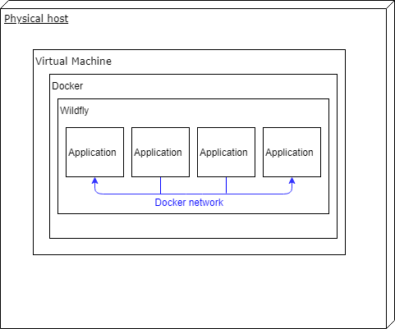
Container technology choices
ESS Integrated Control System Division uses the Docker 19.03 community editions containerization platform
Containerization is not used for the controls (IOC’s) themselves
Container technology has rapidly gained foothold within infrastructure and software tools
The containerization platform is primarily used for web applications
The Docker deployment is facilitated using Ansible playbooks
Docker deployments are done using a dedicated Ansible role
Notes:
KRISTINA

Slide 3
Containerized applications
Current approximately 30 different web applications are deployed in Docker containers
Docker Compose allows controlled start-up of containers, mitigating race conditions and intra-container dependencies
Examples:
The ESS Channel Finder application.
  Simple application with few dependencies
  Moderate gain from Docker based deployment
The ESS Recsync server.
  The recsync server is a complex application with many dependencies
  Significant gain from Docker based deployment
Software tools: ESS Naming service, ESS Cable database, ESS IOC factory, ESS Role Based Access Control (RBAC), Controls Configuration Database (CCDB)
Infrastructure tools: AWX, Artifactory, Vivado, Gitlab CI runners
Notes:
KRISTINA

Slide 4
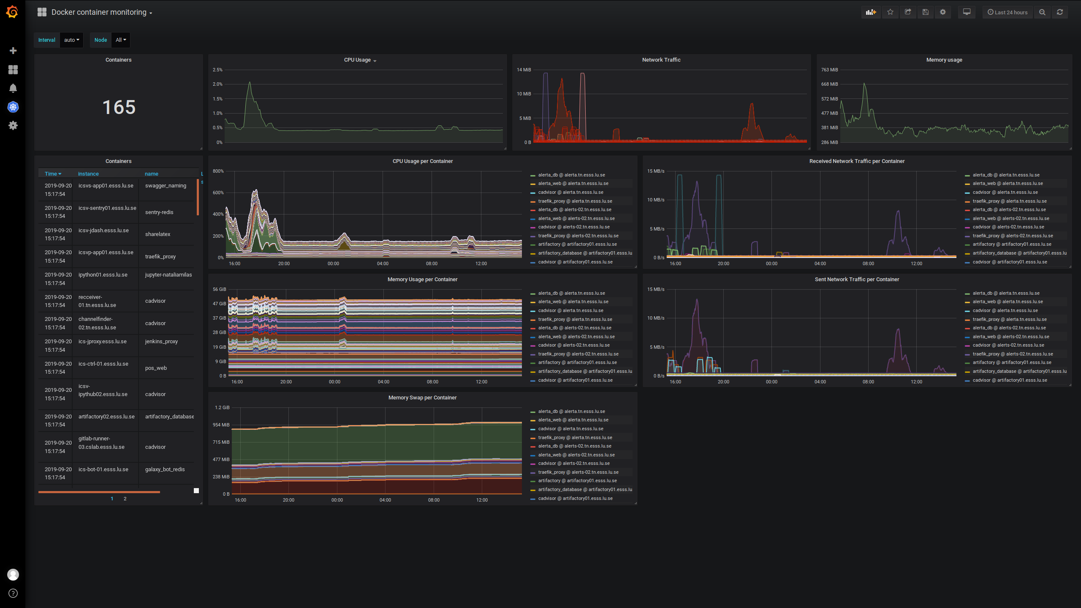
Grafana – Monitoring Docker containers
Notes:
KRISTINA

Slide 5
Positive experiences
During development the Docker containers are useful for creating a contained and controlled development and test environment
The clear separation of the container and the application code it contains simplifies management of component ownership.
The containerization reduces effort required for host administration
Containerized software simplifies continuous integration by creating an isolated and well-defined environment for the build slave. We no longer have to worry about versions of Java, Maven etc.
The containerization of software tools has expanded rapidly from nothing 18 months ago to more or less full containerization of software infrastructure today.
Notes:
KRISTINA

Slide 6
Negative experiences
Understanding and accepting the concept of containerization is associated with a certain learning threshold
Each container requires storage space on the host system. Procedures for cleaning up old containers is recommended.
Accessing network devices outside the Docker network requires specific configuration
The Docker container is associated with a performance loss on Windows machines. No noticeable performance loss on Linux.
Notes:
KRISTINA

Slide 7
Possibilities for the future
Moving from Ansible based deployment of Docker containers to Kubernetes for host cluster management. Potential advantages:
  Host redundancy
  Reliability
  Further reductions in host administration effort
Moving to container based management of control room workstations is a topic for potential future exploration. Could offer advantages in term of management and re-deployment, but is assessed to be associated with technical challenges to containerize using Docker.
Notes:
KRISTINA

