Slide 1
Status of the PSB IST
LIU Commissioning Coordination Committee
31st May 2019
Work done by A. Akroh, F. Chapuis
Presented by G.P. Di Giovanni

Slide 2
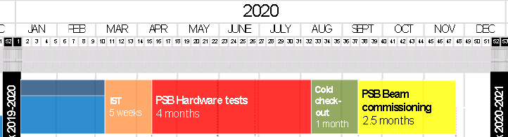
PSB IST
  Goal: Collect information for scheduling, including safety aspects.
    Type of test, sequence, duration, prerequisites, risk and compensatory measurements.
    Deadline: end June 2019.
  The PSB HW commissioning coordinators worked to gather the necessary information and presented the current list at the LIU-PSB TCM, https://indico.cern.ch/event/813464/
    Validated the list of tests and made sure that no test was overlooked.
5 weeks: from Monday 09/03/2020 to Friday 09/04/2020

Slide 3
PSB IST
IST Inventory
Equipment Group | Systems | Comment
BE-BI | All | Waiting feedback
BE-CO | FEC - Middleware | Local OASIS cable connection
 | External Conditions | Local test
 | SIS | No IST. Done in HW Comn.
BE-ICS | Booster Safety Chain | Software test
BE-RF | Finemet | Fence the tested area
 | Transverse FeedBack | Local test. No access tunnel.
EN-STI | Beam Stoppers | New Beam Stoppers
TE-ABT | Kickers / Septa / Bumpers / Distrib. /Strip. Foil | Earlier start for SF and BT.SMV
TE-EPC | Auxiliairy Pow. Conv. | Detailed planning. Anticipate tests as much as possible
 | POPS-B - BR.MPS | No IST. Tests in B245 with dummy load from B237
TE-MPE | BIC | Loca test
 | WIC | Tests will follow EPC schedule
TE-MSC | Magnet | Follow EPC schedule or HW commissioning
 | B-Train | Local test. No coativity
TE-VSC | Vacuum | No IST

Slide 4
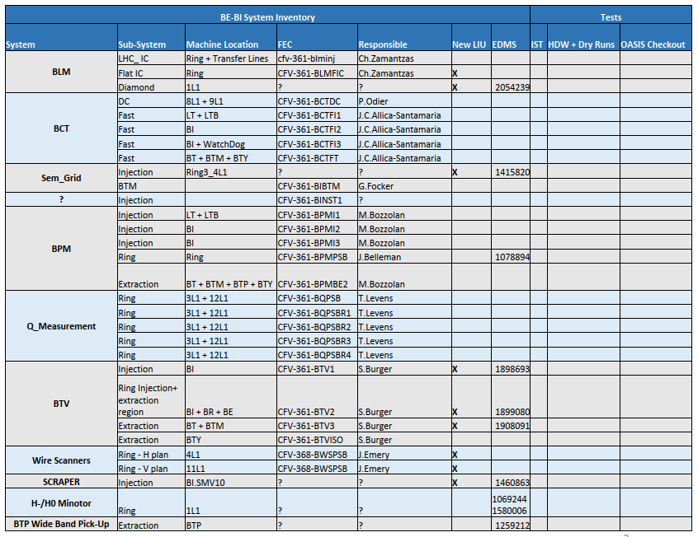
PSB IST
IST Inventory
Equipment Group | Systems | Comment
BE-BI | All | Waiting feedback
BE-CO | FEC - Middleware | Local OASIS cable connection
 | External Conditions | Local test
 | SIS | No IST. Done in HW Comn.
BE-ICS | Booster Safety Chain | Software test
BE-RF | Finemet | Fence the tested area
 | Transverse FeedBack | Local test. No access tunnel.
EN-STI | Beam Stoppers | New Beam Stoppers
TE-ABT | Kickers / Septa / Bumpers / Distrib. /Strip. Foil | Earlier start for SF and BT.SMV
TE-EPC | Auxiliairy Pow. Conv. | Detailed planning. Anticipate tests as much as possible
 | POPS-B - BR.MPS | No IST. Tests in B245 with dummy load from B237
TE-MPE | BIC | Local test
 | WIC | Tests will follow EPC schedule
TE-MSC | Magnet | Follow EPC schedule or HW commissioning
 | B-Train | Local test. No coativity
TE-VSC | Vacuum | No IST
BE-BI will provide the necessary information to
assemble the list of IST and HW tests beg. June

Slide 5
PSB IST
IST Inventory
Equipment Group | Systems | Comment
BE-BI | All | Waiting feedback
BE-CO | FEC - Middleware | Local OASIS cable connection
 | External Conditions | Local test
 | SIS | No IST. Done in HW Comn.
BE-ICS | Booster Safety Chain | Software test
BE-RF | Finemet | Fence the tested area
 | Transverse FeedBack | Local test. No access tunnel.
EN-STI | Beam Stoppers | New Beam Stoppers
TE-ABT | Kickers / Septa / Bumpers / Distrib. /Strip. Foil | Earlier start for SF and BT.SMV
TE-EPC | Auxiliairy Pow. Conv. | Detailed planning. Anticipate tests as much as possible
 | POPS-B - BR.MPS | No IST. Tests in B245 with dummy load from B237
TE-MPE | BIC | Local test
 | WIC | Tests will follow EPC schedule
TE-MSC | Magnet | Follow EPC schedule or HW commissioning
 | B-Train | Local test. No coativity
TE-VSC | Vacuum | No IST
Prerequisite for tests is that the Rack Power Supply (CANALIS) must be powered.
[Expected 13/01/2020]
BE-ICS: Connection of new EIS.f to PSB Safety Chain and
PASS program update
3 days without Access in the machine
(from 24/02/2020 to 20/03/2020)

Slide 6
PSB IST
IST Inventory
Equipment Group | Systems | Comment
BE-BI | All | Waiting feedback
BE-CO | FEC - Middleware | Local OASIS cable connection
 | External Conditions | Local test
 | SIS | No IST. Done in HW Comn.
BE-ICS | Booster Safety Chain | Software test
BE-RF | Finemet | Fence the tested area
 | Transverse FeedBack | Local test. No access tunnel.
EN-STI | Beam Stoppers | New Beam Stoppers
TE-ABT | Kickers / Septa / Bumpers / Distrib. /Strip. Foil | Earlier start for SF and BT.SMV
TE-EPC | Auxiliairy Pow. Conv. | Detailed planning. Anticipate tests as much as possible
 | POPS-B - BR.MPS | No IST. Tests in B245 with dummy load from B237
TE-MPE | BIC | Local test
 | WIC | Tests will follow EPC schedule
TE-MSC | Magnet | Follow EPC schedule or HW commissioning
 | B-Train | Local test. No coativity
TE-VSC | Vacuum | No IST
High-Level Finemet tests start during LS2 (mid November 2019)
  Demi water and electrical network required.
  Access should be possible.
  Fence the tested area.
Low-Level RF experts tests will follow the testing done for the HLRF.
TFB:
  Check-up cables connection and length with a network analyser.
  Amplifier commissioning in local.

Slide 7
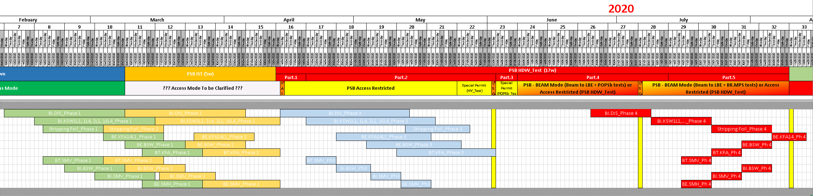
PSB IST
IST Inventory
Equipment Group | Systems | Comment
BE-BI | All | Waiting feedback
BE-CO | FEC - Middleware | Local OASIS cable connection
 | External Conditions | Local test
 | SIS | No IST. Done in HW Comn.
BE-ICS | Booster Safety Chain | Software test
BE-RF | Finemet | Fence the tested area
 | Transverse FeedBack | Local test. No access tunnel.
EN-STI | Beam Stoppers | New Beam Stoppers
TE-ABT | Kickers / Septa / Bumpers / Distrib. /Strip. Foil | Earlier start for SF and BT.SMV
TE-EPC | Auxiliairy Pow. Conv. | Detailed planning. Anticipate tests as much as possible
 | POPS-B - BR.MPS | No IST. Tests in B245 with dummy load from B237
TE-MPE | BIC | Local test
 | WIC | Tests will follow EPC schedule
TE-MSC | Magnet | Follow EPC schedule or HW commissioning
 | B-Train | Local test. No coativity
TE-VSC | Vacuum | No IST
TE-ABT detailed commissioning organised in 4 Phases.
IST needed for Phase 2 and possibly Phase 1 (tbc).
Starts earlier for some equipment such as Stripping Foil,
BT.SMV (04/03/2020)
Pulse the system in local mode at Low Voltage.

Slide 8
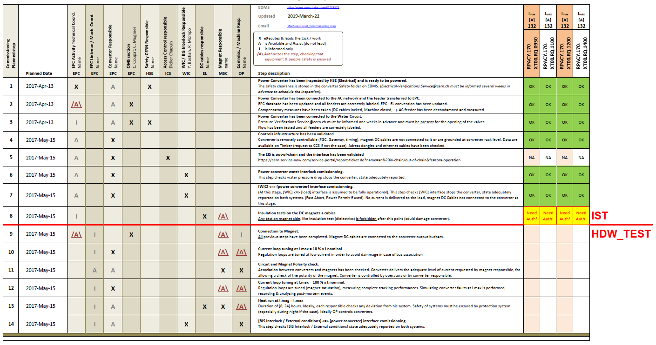
PSB IST
TE-EPC commissioning follows a check-list of 14 steps!
Two batches of tests:
  Step 1 to 8: not connected to magnet → IST
  Step 9 to 14: connected to magnet → HW Commissioning
LT / LTB commissioning scheduled in 2019 during LBE Run.
BI/BR/BE/BT/BTM/BTP and BTY.BVT101 commissioning during the IST period.
  Electrical Hazard. May require closed access.
IST Inventory
Equipment Group | Systems | Comment
BE-BI | All | Waiting feedback
BE-CO | FEC - Middleware | Local OASIS cable connection
 | External Conditions | Local test
 | SIS | No IST. Done in HW Comn.
BE-ICS | Booster Safety Chain | Software test
BE-RF | Finemet | Fence the tested area
 | Transverse FeedBack | Local test. No access tunnel.
EN-STI | Beam Stoppers | New Beam Stoppers
TE-ABT | Kickers / Septa / Bumpers / Distrib. /Strip. Foil | Earlier start for SF and BT.SMV
TE-EPC | Auxiliairy Pow. Conv. | Detailed planning. Anticipate tests as much as possible
 | POPS-B - BR.MPS | No IST. Tests in B245 with dummy load from B237
TE-MPE | BIC | Local test
 | WIC | Tests will follow EPC schedule
TE-MSC | Magnet | Follow EPC schedule or HW commissioning
 | B-Train | Local test. No coativity
TE-VSC | Vacuum | No IST

Slide 9
PSB IST
IST Inventory
Equipment Group | Systems | Comment
BE-BI | All | Waiting feedback
BE-CO | FEC - Middleware | Local OASIS cable connection
 | External Conditions | Local test
 | SIS | No IST. Done in HW Comn.
BE-ICS | Booster Safety Chain | Software test
BE-RF | Finemet | Fence the tested area
 | Transverse FeedBack | Local test. No access tunnel.
EN-STI | Beam Stoppers | New Beam Stoppers
TE-ABT | Kickers / Septa / Bumpers / Distrib. /Strip. Foil | Earlier start for SF and BT.SMV
TE-EPC | Auxiliairy Pow. Conv. | Detailed planning. Anticipate tests as much as possible
 | POPS-B - BR.MPS | No IST. Tests in B245 with dummy load from B237
TE-MPE | BIC | Local test
 | WIC | Tests will follow EPC schedule
TE-MSC | Magnet | Follow EPC schedule or HW commissioning
 | B-Train | Local test. No coativity
TE-VSC | Vacuum | No IST
For information: POPS-B and BR.MPS are scheduled during the HW commissioning from 02/06/2020 to 10/07/2020.
BIC modification to be tested beginning 2020: Local test
with no interference to shutdown activities; missing
input will be tested during HW commissioning. Still plan
to integrate in the planning.
TE-VSC specialist commissioning scheduled during
Jan. 2020 and depending on equipment availability.

Slide 10
Summary
  List of ISTs prepared and discussed with equipment experts.
  Three systems flagged to require safety regulation:
    Finemet cavities (BE-RF).
    Beam transfer equipment (TE-ABT).
    Auxiliary power converters (TE-EPC).
  The PSB HW commissioning coordinators have prepared a similar template used for the Linac4 LBE run.
    Still outstanding is the list for BE-BI. To be finalized beginning June.

Slide 12
