Slide 1
Impact of flux jumps on orbit stability
D. Gamba, L. Fiscarelli, M. Martino, J. Coello de Portugal
150th HiLumi WP2 – 11 June 2019

Slide 2
MBH HYBRID - Residuals and differential voltage
MBH HYBRID
Current shows peaks related to voltage spikes σ = 0.3 units.
The difference of current minus flux shows changes σ = 0.2 units.
Gradient (up/dw) shows changes σ = 0.14 units.
σ is computed in the interval [2kA, 4kA]
Flux jumps seems to be concentrated at “low energy”
From L. Fiscarelli– 144th WP2 Meeting (indico)

Slide 3
Lucio’s conclusions
  We have tested many short models and we have data for the first full-size aperture (MBH HYBRID)
At the field levels (2-4 T) where there is more activity from flux jumps and during ramps at nominal ramp-rate (10 A/s) we see:
  fluctuations of the current (σ = 0.2 units)
  changes on the main field not related to the current (σ = 0.2 units)
  changes of the up-down gradient (σ = 0.15 units)
The spectral density of the flux jumps is mainly concentrated in the interval 0.1-10 Hz
From circuit point of view, we consider “linearity” and “Short term stability – 20 min” as boundary of “tracking” performance
This is the contribute of flux jumps according to Lucio
In this range PC don’t have a detailed specification!
-> still under discussion how to use “Noise”
From L. Fiscarelli– 144th WP2 Meeting (indico)

Slide 4

Inductance Jump Model – O/C Voltage Loop
$$σ=6.04 ppm$$
I guess this value is computed in the 0.1 – 100 Hz range
11T Trim
From M. Martino – 144th WP2 Meeting (indico)

Slide 5


Inductance Jump Model – O/C Voltage Loop
$$pk−pk <0.1 ppm$$
$$σ=0.0084 ppm$$
Main dipoles circuit
From M. Martino – 144th WP2 Meeting (indico)

Slide 6
Putting numbers together (11T)
flux jumps given in unit – worst case (in equivalent ppm) at top energy
PC specs given in ppm of I_{rated} – worst case at injection
Impact of PCs in units computed as [ppm] * 10⁻² * I_{PC rated}/I_{dipoles(inj./nom.)}
 | 11T Magnet/Trim | Main Dipoles
PC class | 3 | 1
I_{rated} [A] | 600 | 13000
I_{injection} [A] | (0) | 728
I_{nominal} [A] | (250) | 11850
Short term stability [r.m.s. ppm] | 1 | 0.2
Linearity [r.m.s. ppm] | 4.6 | 1.2
Flux jump -> PC -> circuit [rms ppm] | 6.04 | 0.01
Flux jump [rms units of 1e-4] | 0.2 | -
Tot. PC [rms units] inj. / nom. | 0.063 / 0.004 | 0.217 / 0.013
Concerns here: flux jump on itself has an about 50 times bigger effect than PC stability at top energy
Comparable values!
performance dominated by short term stability and linearity

Slide 7
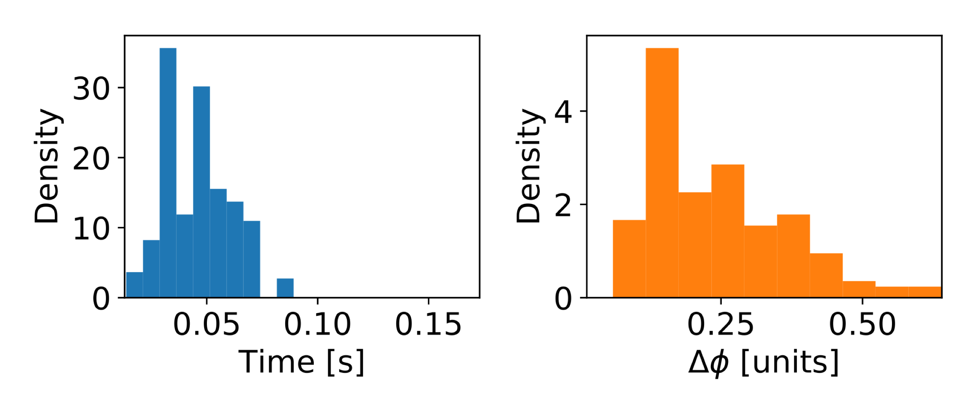
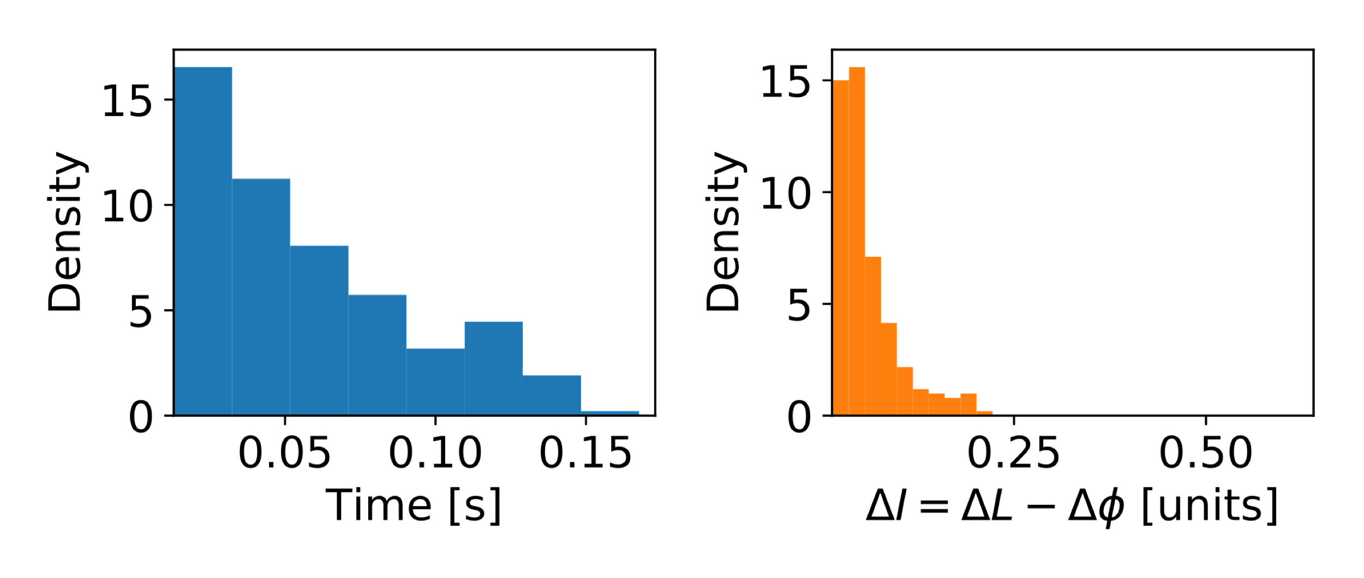
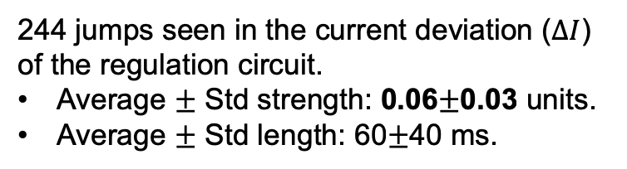
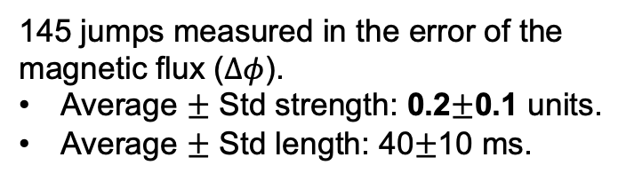
Comparison: flux jumps statistics for RQX
From a manual selection. Very probably biased towards larger strengths (easier to spot…).
MBH measured flux jumps
145 jumps measured in the error of the magnetic flux ($Δφ$).
Average $±$ Std strength: 0.2$±$0.1 units.
Average $±$ Std length: 40$±$10 ms.
MQX regulation response simulation
244 jumps seen in the current deviation ($ΔI$) of the regulation circuit.
Average $±$ Std strength: 0.06$±$0.03 units.
Average $±$ Std length: 60$±$40 ms.
Comparable effect as 11T trim
(due to comparable inductances?)
From J. Coello de Portugal – 147th WP2 Meeting (indico)

Slide 8
Putting numbers together (Triplet)
Impact of PCs in units computed as [ppm] * 10⁻² * I_{PC rated}/I_{RQX(inj./nom.)}
 | RQX | RTQX1/3 | RTQXA1
PC class | 0 | 2 | 4
I_{rated} [A] | 18000 | 2000 | 60
I_{injection} [A] | 1059 | (0) | (0)
I_{nominal} [A] | 16470 | (1647) | (35)
Short term stability [r.m.s. ppm] | 0.2 | 0.6 | 2.5
Linearity [r.m.s. ppm] | 1.2 | 2.9 | 5.2
PC Short + Lin. [rms units] inj. / nom. | 0.207/0.013 | 0.056/0.004 | 0.003/ <0.001
Flux jump -> PC -> circuit [rms units] | 0.06/ <0.06? | ??? | ???
Tot. PC [rms units] inj. / nom. | 0.22/ <0.06? | ??? | ???
Circuit performance still dominated by PC stability (at least for RQX)
Values to be compared with 0.2 units flux jump expected in each single magnet, independently
  Comparable at injection for RQX circuit

Slide 9
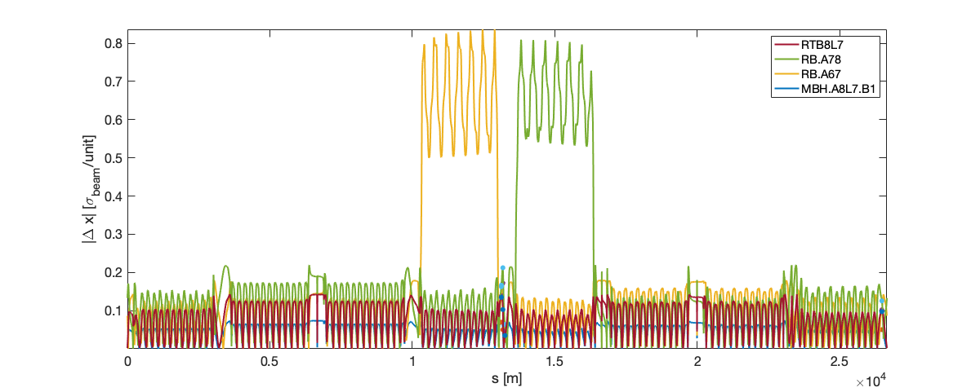
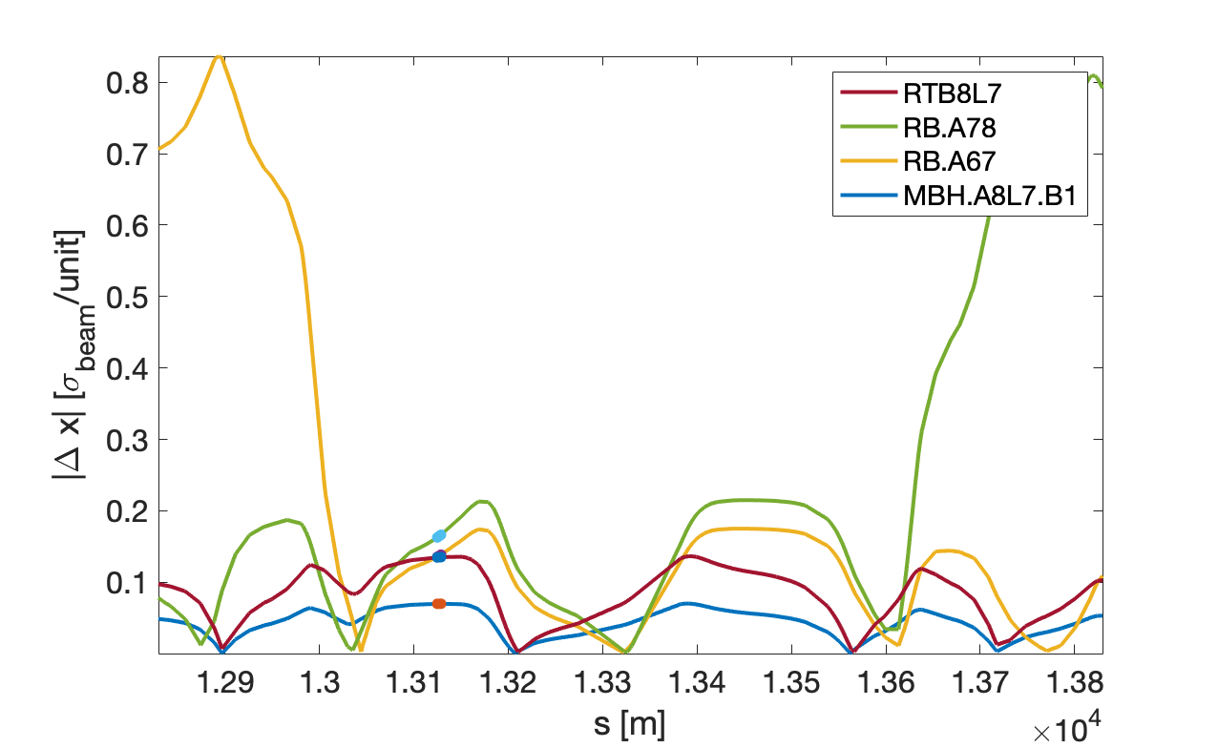
11T: impact on B1 orbit at 15 cm β*, 7 TeV
x4 wrt injection
Main dipole circuits
P7
Main observation:
< 0.2 σ_{beam}/unit @ TCPs
Main dipoles have a stronger local impact
same result for 40 cm β* at top energy
At injection:
Not very different behavior
  Optics around P7 is basically constant
about x4 less sensitive due to scaling of beam size with energy
TCPs

Slide 10
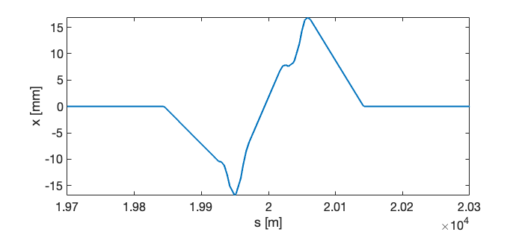
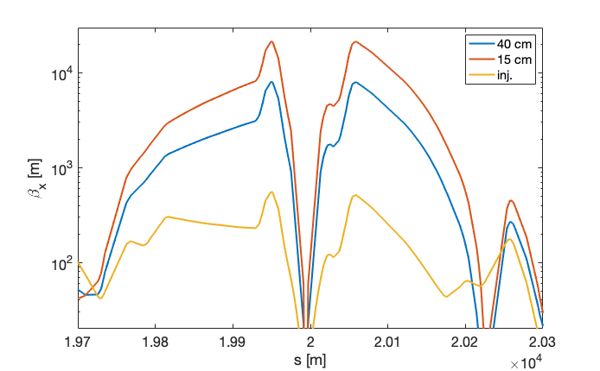
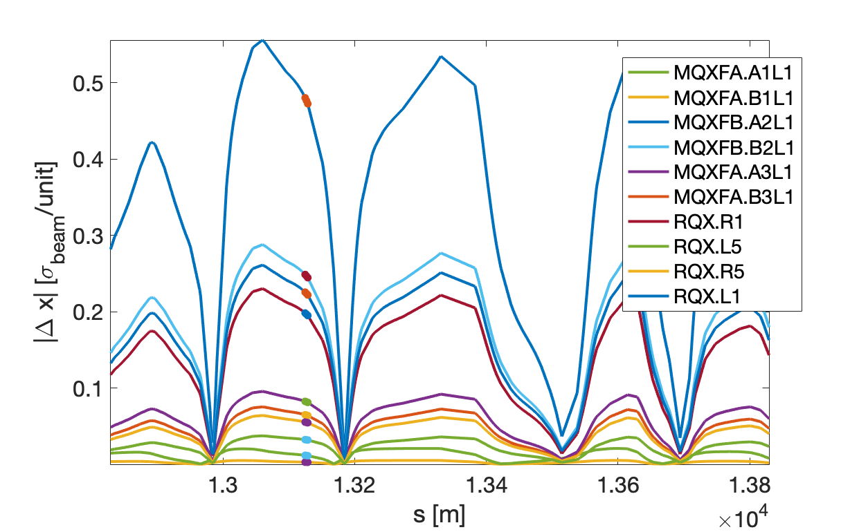
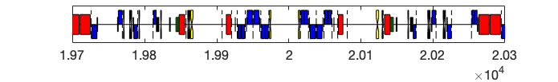
Feed-down from IR1/5 triplet: impact on orbit
Beam 1
Point 1
Assuming pessimistic case of 295 urad half-crossing for all optics
  Kick linear with crossing angle
The lower the β* the most sensitive to ”jumps”
  Kick goes like sqrt(β) in the quadrupole
  40 cm β* is x1.6 less sensitive than 15 cm β*
Dominated by Q2.L1 (for B1)
  ~0.25 σ_{beam}/unit @ TCPs
    per Q2L magnet!
  (~0.15 σ_{beam}/unit @ TCPs per Q3R magnet)
B1 - 15 cm β*
RQX.L1
MQX.2L1
RQX.R1
TCPs
Notes:
MQXFA.B3R1 with 15 cm beta*
TCP.D6L7.B1 (s=1.31e+04 [m] betx=1.47e+02 bety=7.21e+01 dx=6.68e-01): 1.81e-01
TCP.C6L7.B1 (s=1.31e+04 [m] betx=1.39e+02 bety=7.60e+01 dx=6.49e-01): 1.51e-01
TCP.B6L7.B1 (s=1.31e+04 [m] betx=1.32e+02 bety=8.02e+01 dx=6.30e-01): 1.46e-01
TCPCV.A6L7.B1 (s=1.32e+04 [m] betx=3.35e+01 bety=2.55e+02 dx=1.63e-01): 1.44e-01
TCPCH.A4L7.B1 (s=1.33e+04 [m] betx=3.42e+02 bety=6.49e+01 dx=-5.10e-01): 1.44e-01
TCP.6L3.B1 (s=2.65e+04 [m] betx=1.31e+02 bety=1.46e+02 dx=2.08e+00): 1.42e-01

Slide 11
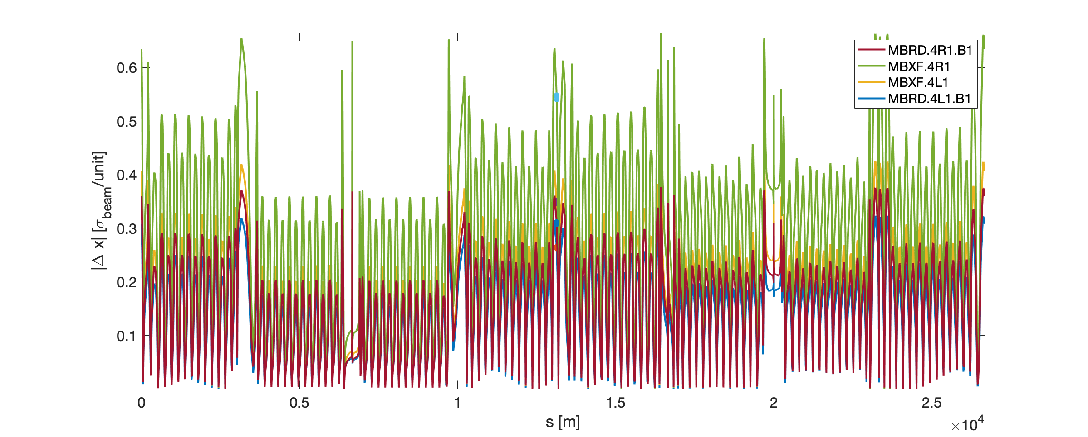
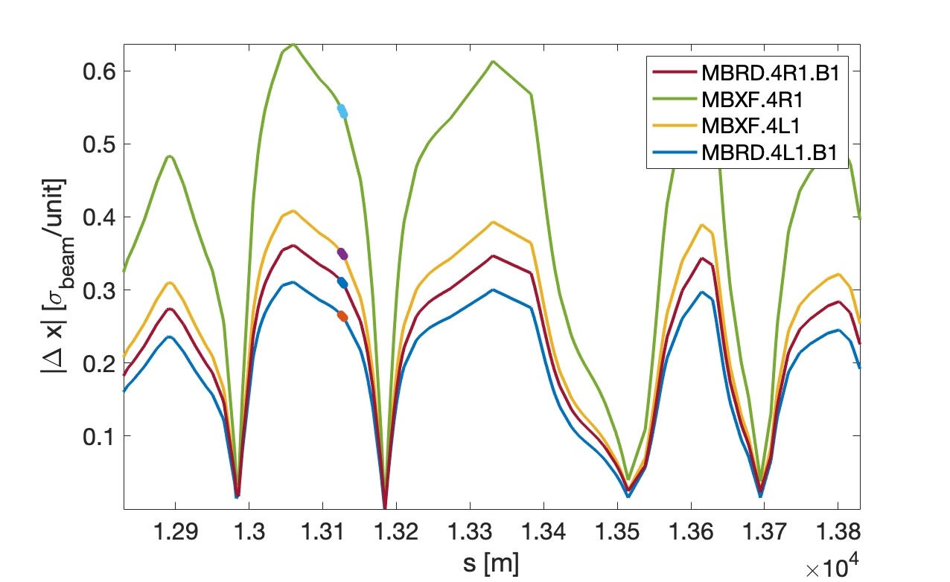
D1/D2: impact on B1 orbit at 15 cm β*, 7 TeV
P7
D1/D2 other main players for orbit stability
Based on Ni-Ti technology
  No flux jumps expected
Class 0 PC; 13 kA I_{rated}
  Basically, same performance as RQX
TCPs

Slide 12
Conclusion: impact on orbit at TCP @ inj / 15 cm β*
 | TCP orbit var. from optics [σ_{beam}/unit] | Expected jitter [rms units] | Expected TCP orbit var. [rms e-3 σ_{beam}]
11T magnet (flux jump) | 0.02 / 0.07 | 0.2 | 4 / 14
11T trim circuit | 0.04 / 0.14 | 0.063/0.004 | <1 / <1
RB.A78 circuit | 0.06 / 0.21 | 0.217/0.013 | 13 / 3
Q1 single magnet | <0.01 / 0.06 | 0.2 | <2 / 12
Q2 single magnet | 0.01 / 0.28 | 0.2 | 2 / 56
Q3 single magnet | <0.01 / 0.18 | 0.2 | <2 / 36
RQX main circuit | 0.01 / 0.48 | 0.22 / <0.06? | 2 / 29*
Q1 trim circuit | <0.01 / 0.10 | ~0.056? / ~0.004? | < 1? / < 1?
Q3 trim circuit | 0.01 / 0.33 | ~0.056? / ~0.004? | < 1? / 1?
D1/D2 circuit | 0.02 / 0.63 | 0.205 / 0.013 | 4 / 8
The impact of flux jump at top energy for a 15 cm β* with 295 urad half crossing can reach up to 5.6% σ_{beam} (MQX2) or 1.4% σ_{beam} (MBH)
At injection energy dominated by main dipole PC (1.3% σ_{beam})
  in this case it should be a slow variation (<< 1 Hz), which can be corrected by orbit feedback, while a flux jump is a sudden variation (a few Hz)!
* Note: during stable beam, PC “linearity” should not play a role, i.e. about x6 better stability.
Thanks for your questions and comments!

Slide 13
Appendix

Slide 14
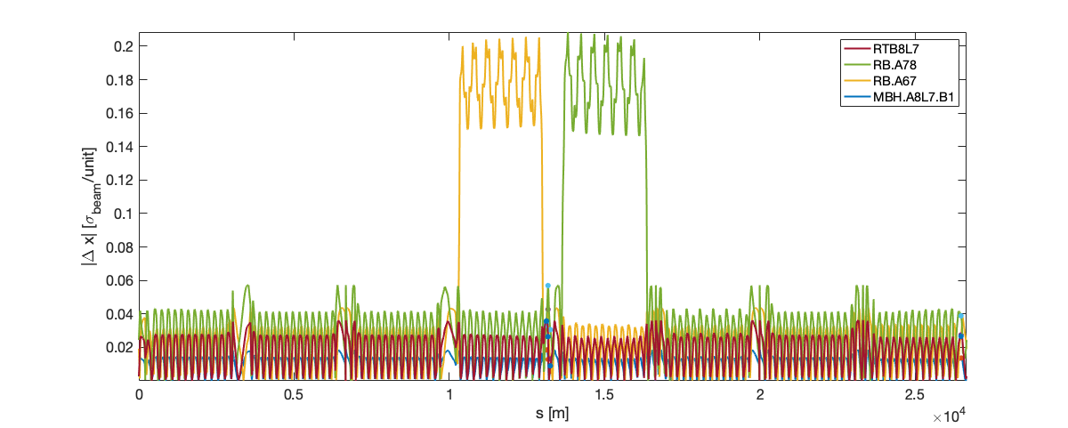
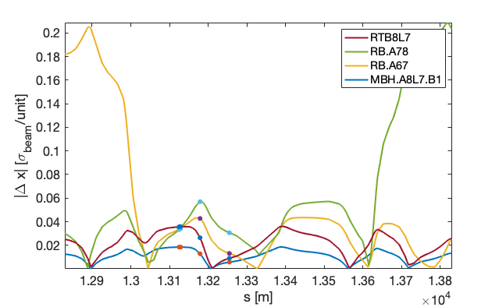
11T: impact on B1 orbit at injection
P7
Assuming 1 unit variation on RTB8L7 circuit (2x11T magnets), RB.A78 and RB.A67 circuits, single MBH.A8L7 magnet
Impact on orbit at TCPs within factor 2 to 4 for a given amplitude.
TCPs

Slide 15
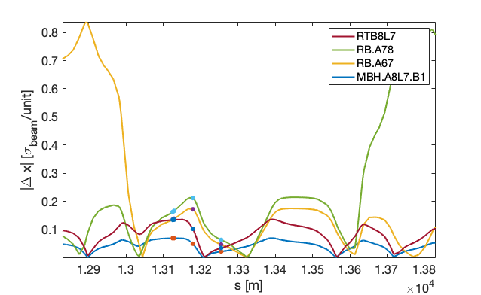
11T: impact on B1 orbit at 15 cm β*, 7 TeV
x4 wrt injection
P7
Not very different behavior than at injection
about 4 times more sensitive due to smaller beam size
TCPs

Slide 16
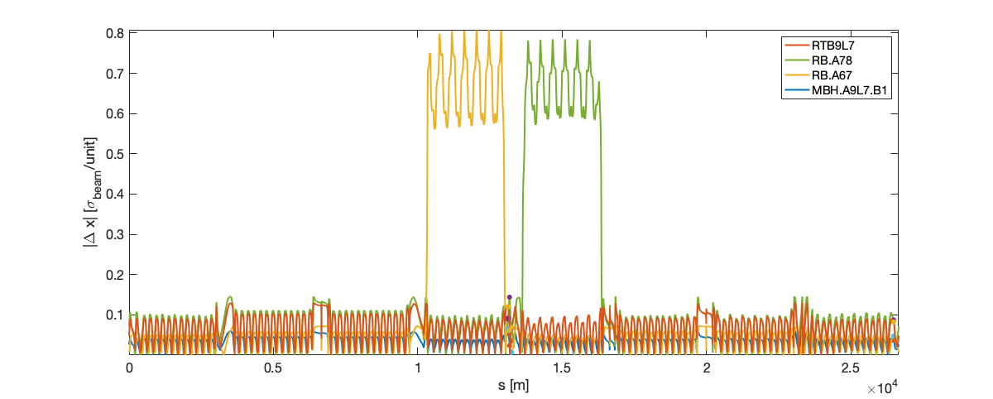
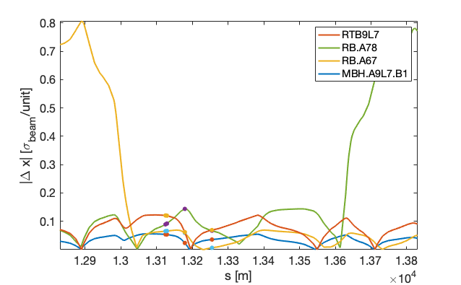
11T: impact on B1 orbit at 40 cm β*, 7.5 TeV
x4 wrt injection
P7
Computed on more recent optics with 11T in cell 9 instead of cell 8
No major differences wrt 15 cm β*
(In all cases, optics is the same around P7)
TCPs

Slide 17
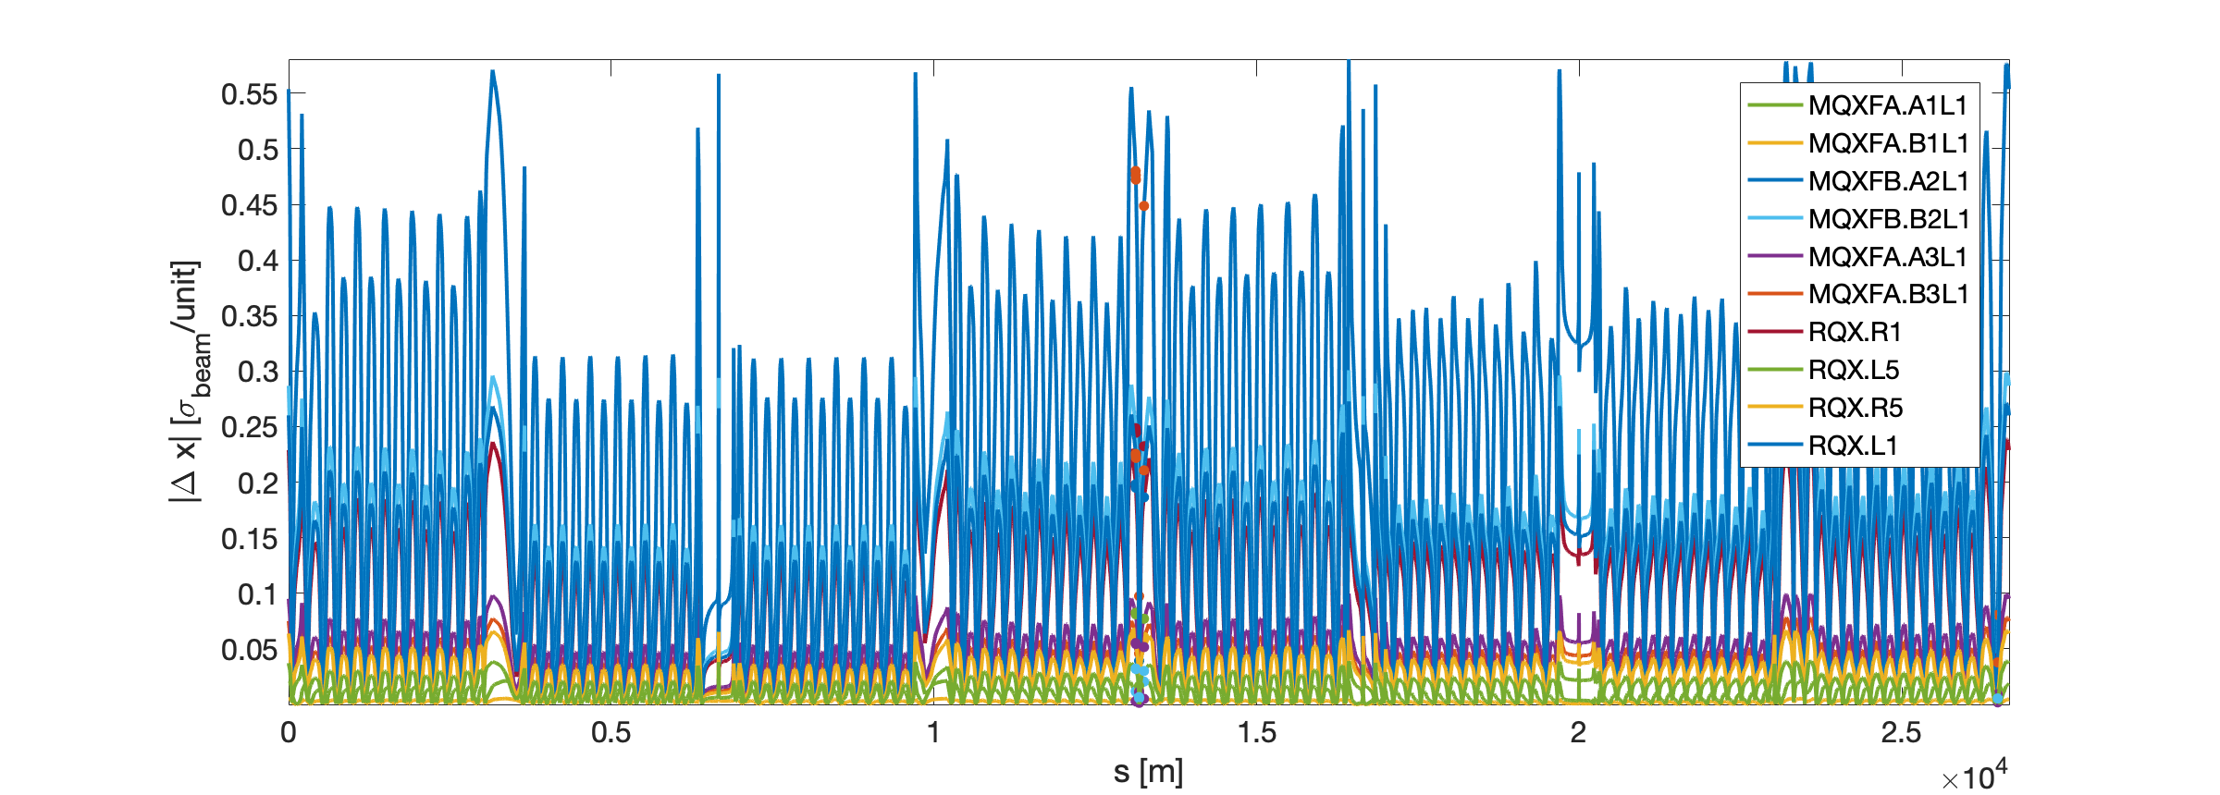
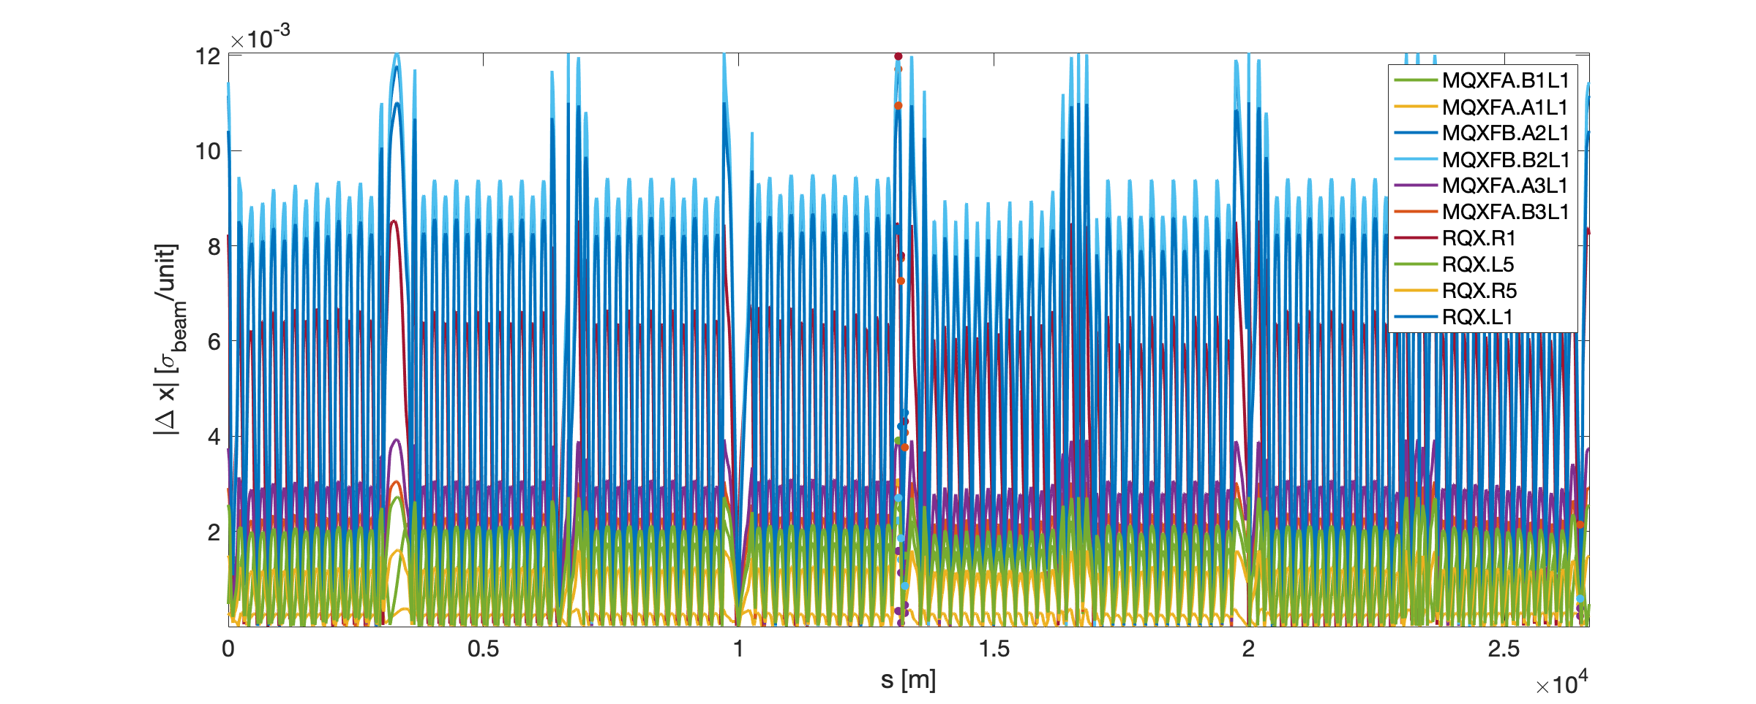
Feed-down from IR1/5 triplet (295 urad xing)
15 cm β*
Injection

Slide 18
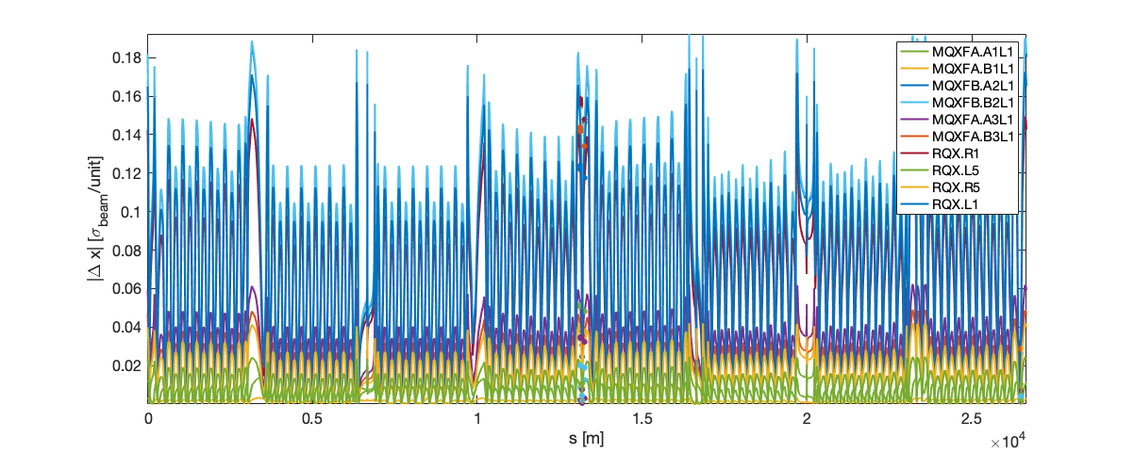
Feed-down from IR1/5 triplet (295 urad xing)
15 cm β*
40 cm β* - 7.5 TeV

Slide 19
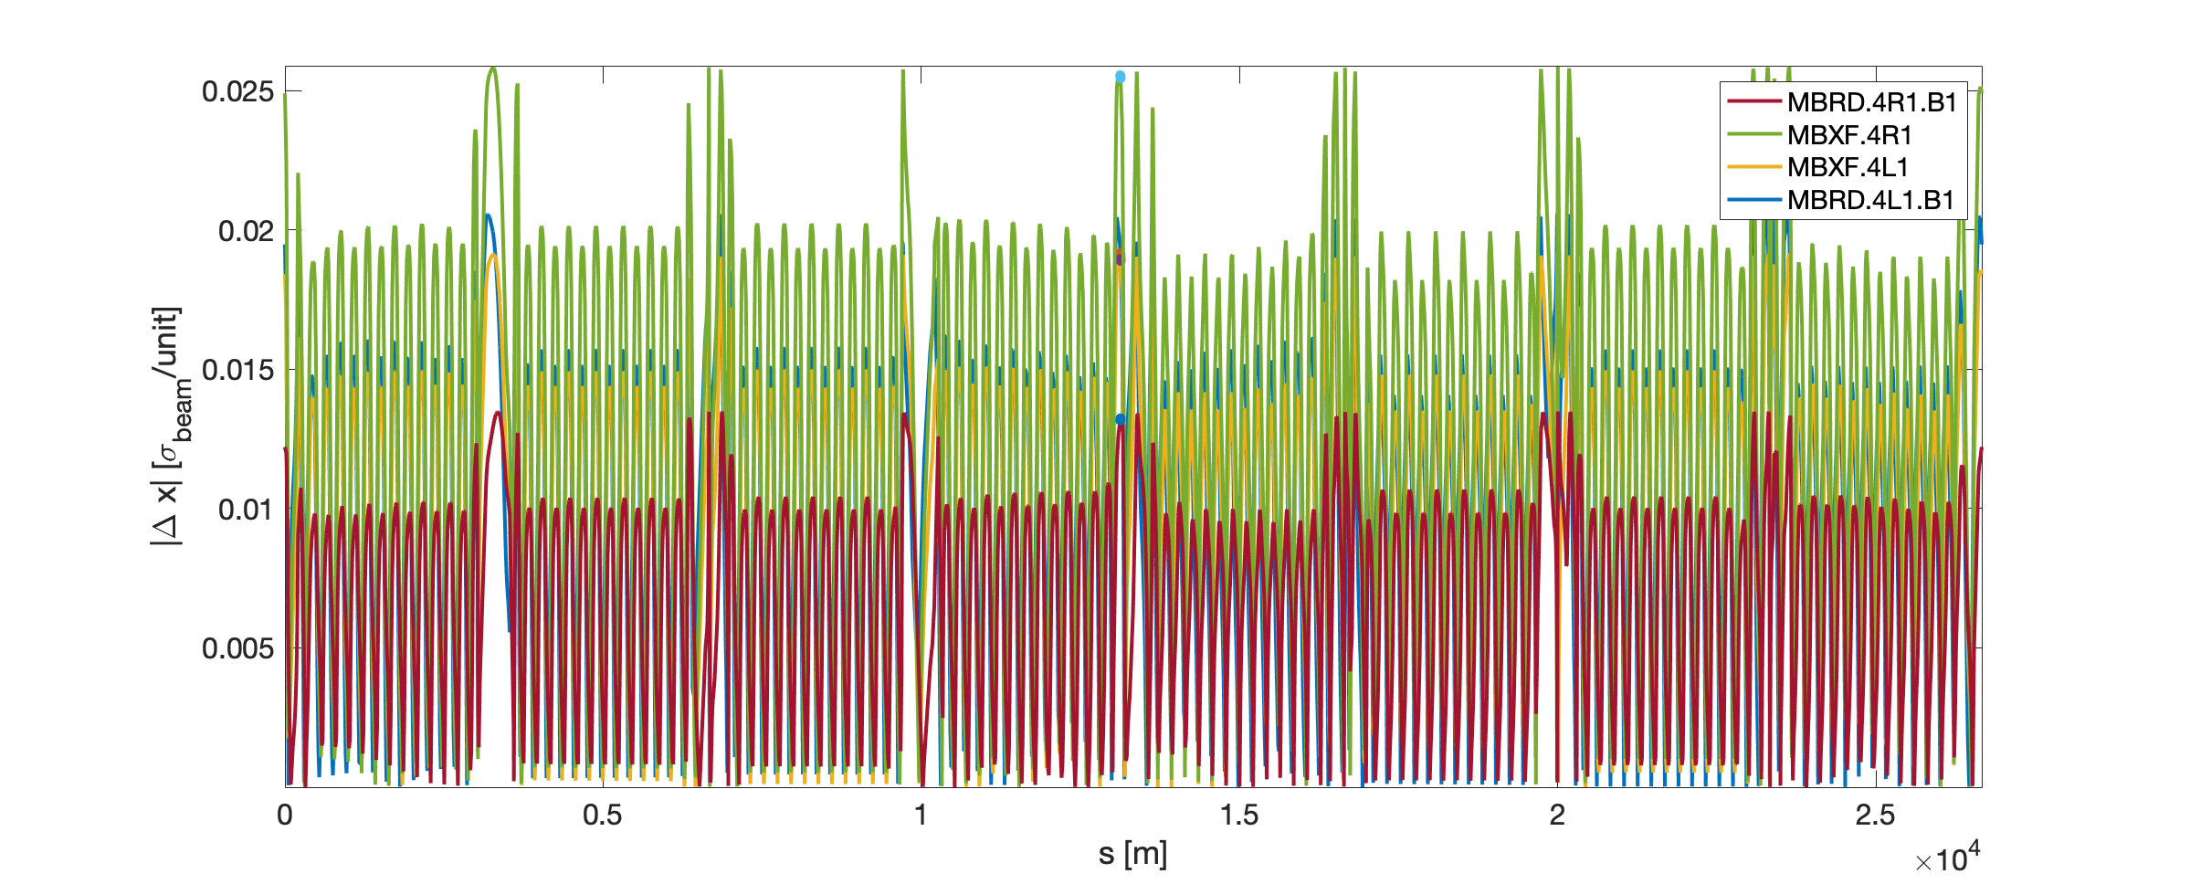
Impact of D1/D2 elements
15 cm β*
Injection

