Slide 1
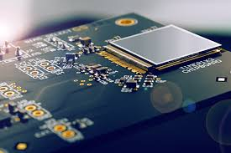
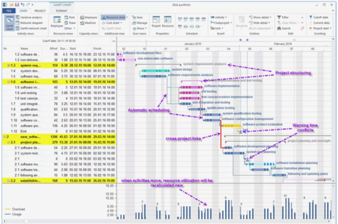
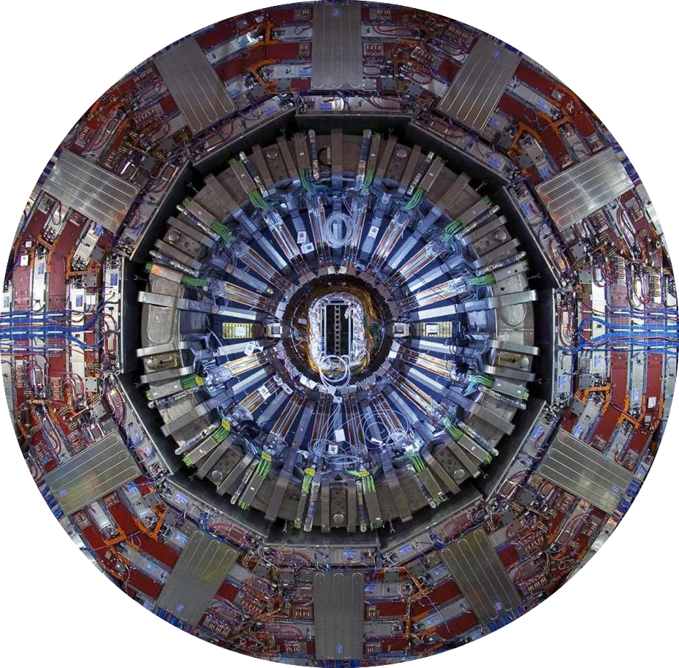
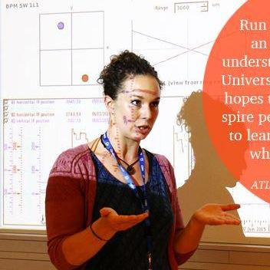
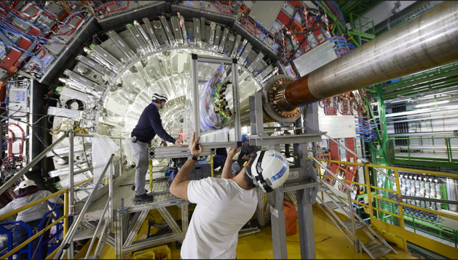
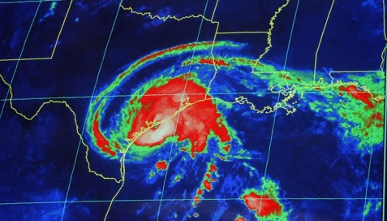
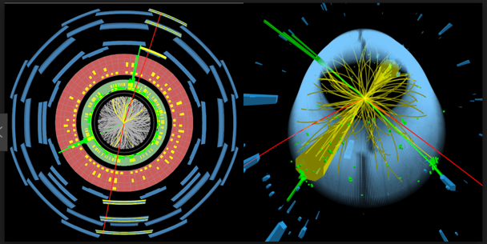



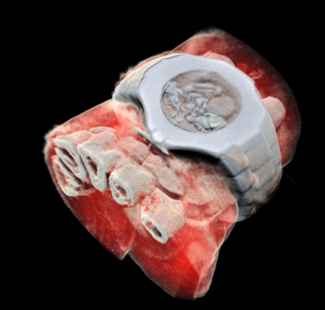






Particle physicists are sought after in every domain
The skill set is unique – “a new value” creation: Multidimensional Growth
Particle Physics is a vehicle
Technical Coordination
Safety
Electronics
R&D
Coordination
Multidisciplinarity
Sensor
Detector
R&D
Gas and Fluid Design
A Creative Period
Project Management
Project
Production
Installation
Commissioning
Physics
Coordination
Detector/Sensor Development
Prototyping
Online Software
Offline
Software
Data
Analysis
Outreach
Education
Meteorology
Execution Period
Monitoring
Physics Discovery !
Industrial Applications
Exploitation Period
Big Data Analytics
Medical
Imaging
Machine Learning
Artificial intelligence
Astrophysics
Cosmology
Space
Science
Financial Management
Risk Management
29
© Archana Sharma
CERN 2018
ALBA Synchrotron Barcelona - July 19-20, 2018
17
Mechanical Engineering

