Slide 1
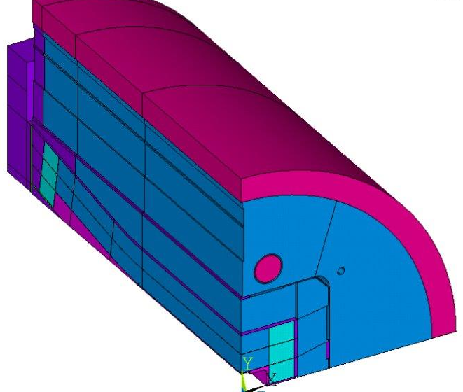
HEPDipo
15 T block type magnet for EPFL-SPC test facility
Status of the design
D. Martins Araujo, P. Ferracin, G. De Rijk, L. Bottura, E. Ravaioli (CERN)
P. Testoni, L. Reccia, F. Cau, A. Portone (F4E)
X. Sarasola, P. Bruzzone (EPFL-SPC)
I. Pong, G. Sabbi (LBL)
06/06/19 - D. Martins Araujo

Slide 2
Agenda
Goals and constraints
Baseline design and comparaison
3D models and results
06/06/19 - D. Martins Araujo

Slide 3
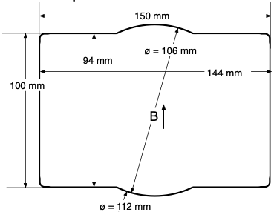
Goals and constraints
15 T in a rectangular aperture
Homogenous field length of 1000 mm
Rectangular aperture
Operation at 4.5 K
85% of SS
06/06/19 - D. Martins Araujo

Slide 4
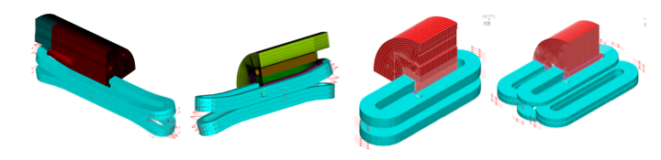
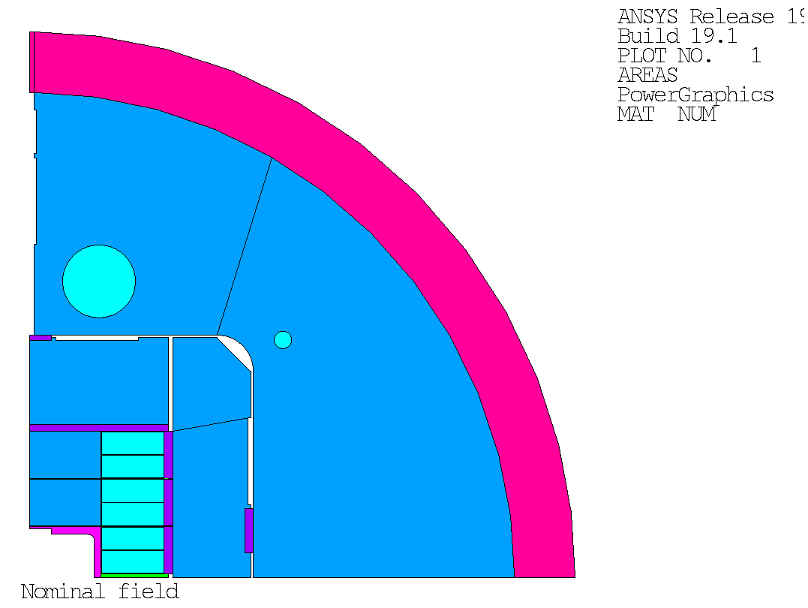
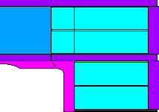
Structures studied
« Window frame »
Fresca2-like
Symmetric 3
double layered
2 double layered
Racetracks
Multiple
racetracks
06/06/19 - D. Martins Araujo

Slide 5
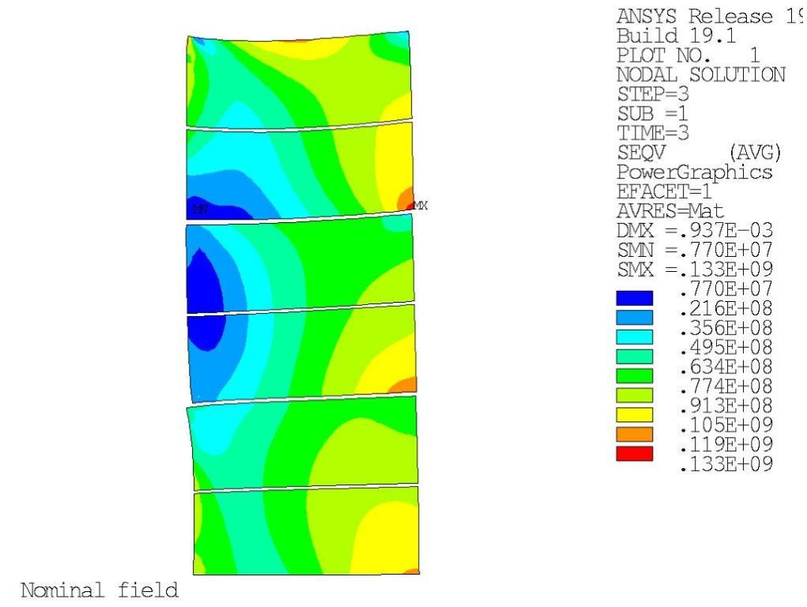
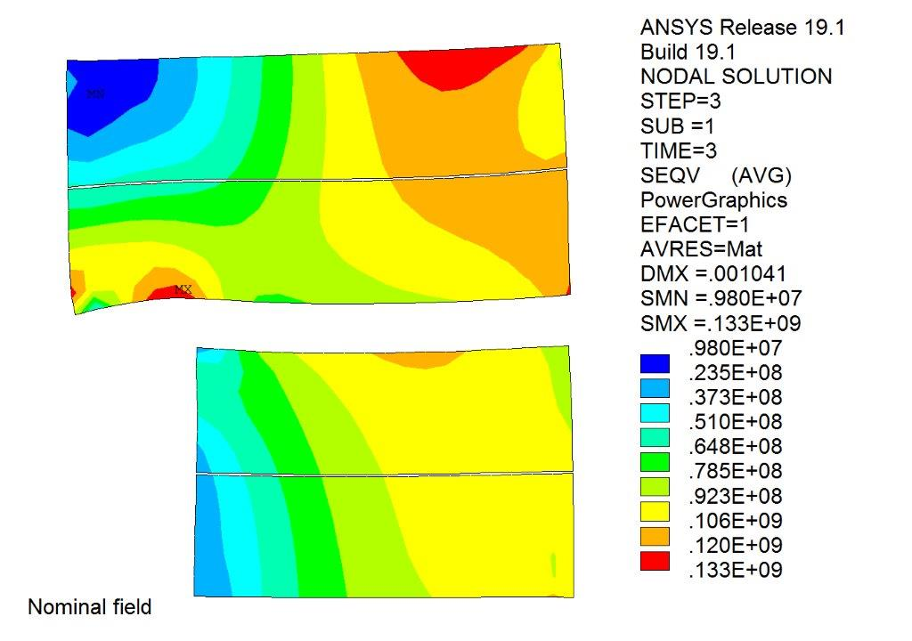
Window frame vs 3 double layered structure
Peak stress on the high field area
9% more superconductor
06/06/19 - D. Martins Araujo

Slide 6
Agenda
Goals and constraints
Baseline design and comparaison
3D models and results
06/06/19 - D. Martins Araujo

Slide 7
Baseline: 3 double layered structure
Cable data
d_strand | 1.1 mm
number of strands | 44
thickness | 2.25 mm
width | 26.5 mm
SC:Cu | 1:1
Baseline
Following the FCC proposal
06/06/19 - D. Martins Araujo

Slide 8
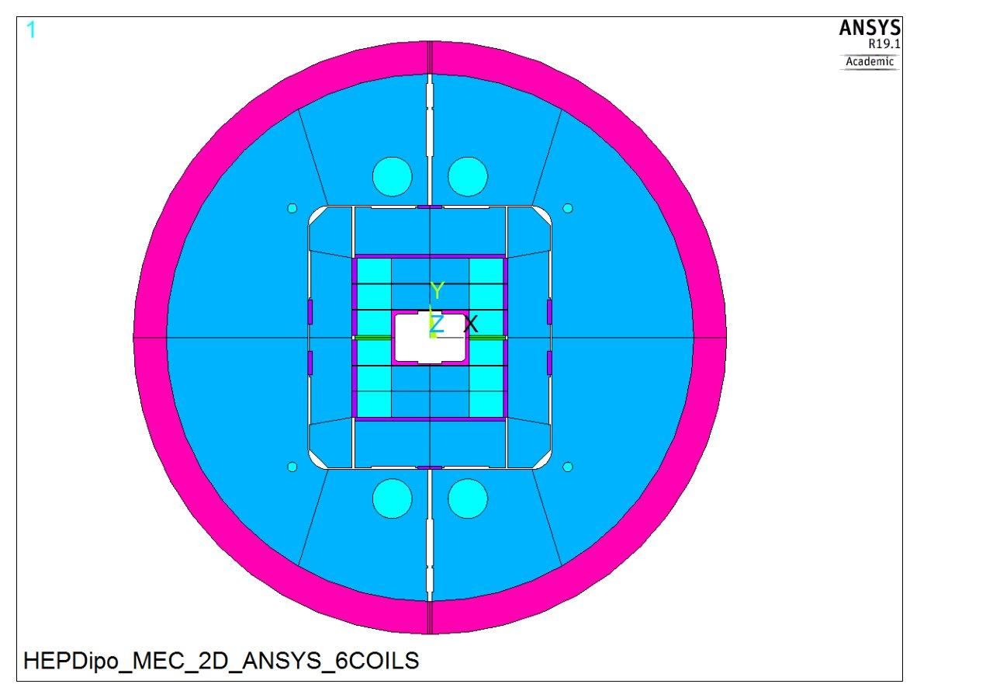
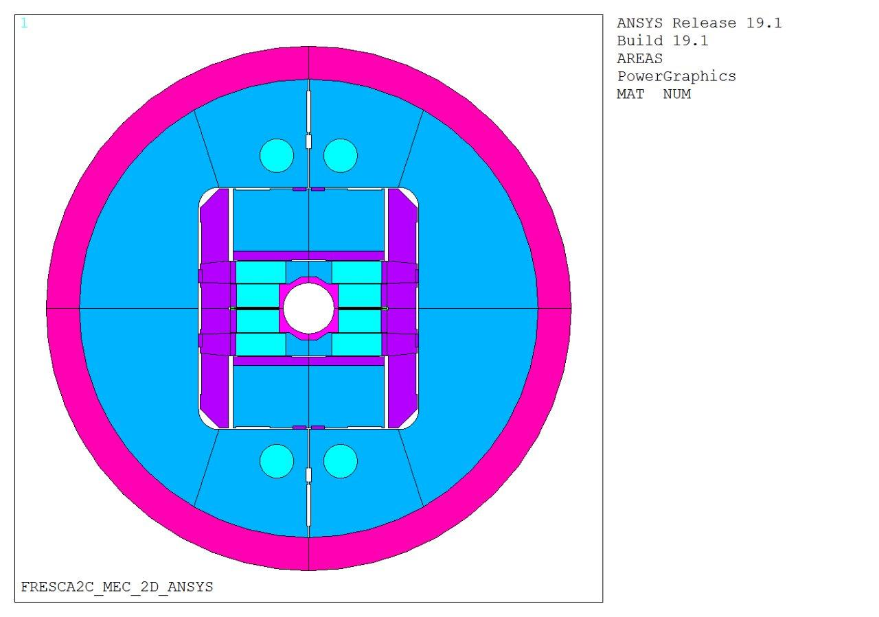
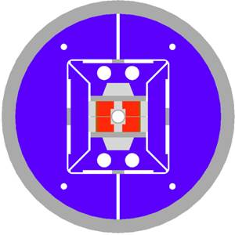
A few block-type magnets
HEPdipo
FRESCA2
HD2
36 mm
704 mm
100 mm
1030 mm
Aperture: 100 x 150 mm
External dia: 1260 mm
06/06/19 - D. Martins Araujo

Slide 9
A few block-type magnets (4.5 K)
HEPdipo
FRESCA2
HD2
15 T (85%) ?
d_strand | 1.1 mm
n of strands | 44
thickness | 2.25 mm
width | 26.5 mm
Cu/SC | 1
13.9 T (83%)
d_strand | 1.0 mm
n of strands | 40
thickness | 1.89
width | 21.32 mm
Cu/SC | 1.3
13.8 T (87%)
d_strand | 0.8 mm
n of strands | 51
thickness | 1.4 mm
width | 22 mm
Non Cu % | 51, 54%
06/06/19 - D. Martins Araujo

Slide 10
Agenda
Goals and constraints
Baseline design and comparaison
3D models and results
06/06/19 - D. Martins Araujo

Slide 11
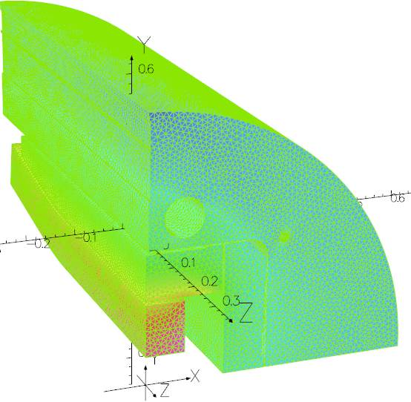
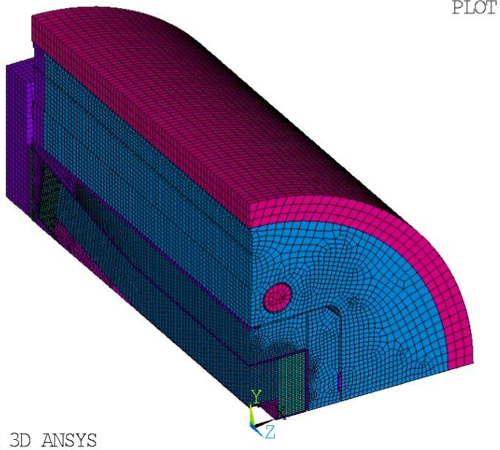
Models
2D Mechanical: Ansys
2D Magnetic: Ansys, Opera and Roxie
3D Mechanical: Ansys
3D Magnetic: Ansys, Opera
06/06/19 - D. Martins Araujo

Slide 12
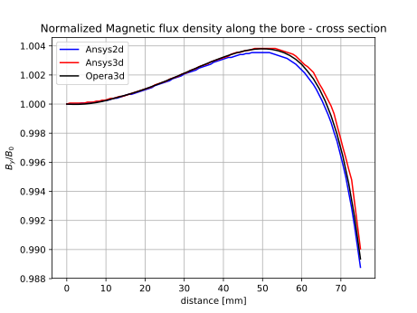
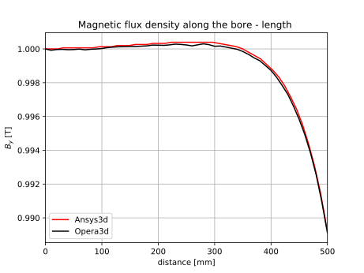
Homogeneity - 2D vs 3D magnetic models Ansys and Opera - I = 14.157 kA
1% of homogeneity in 75 mm
B(0,0) = 15.2 T (3D result)
~1 % of homogeneity in 500 mm
06/06/19 - D. Martins Araujo

Slide 13



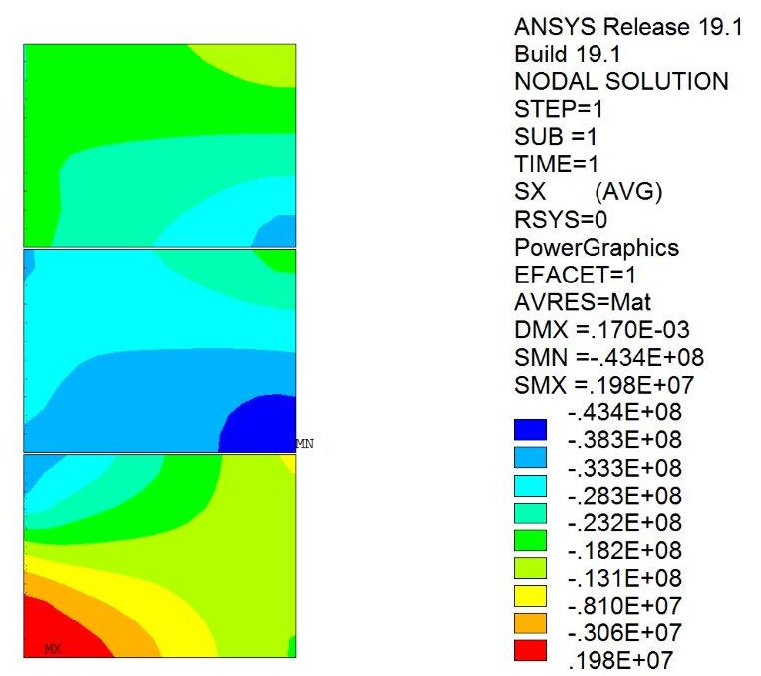
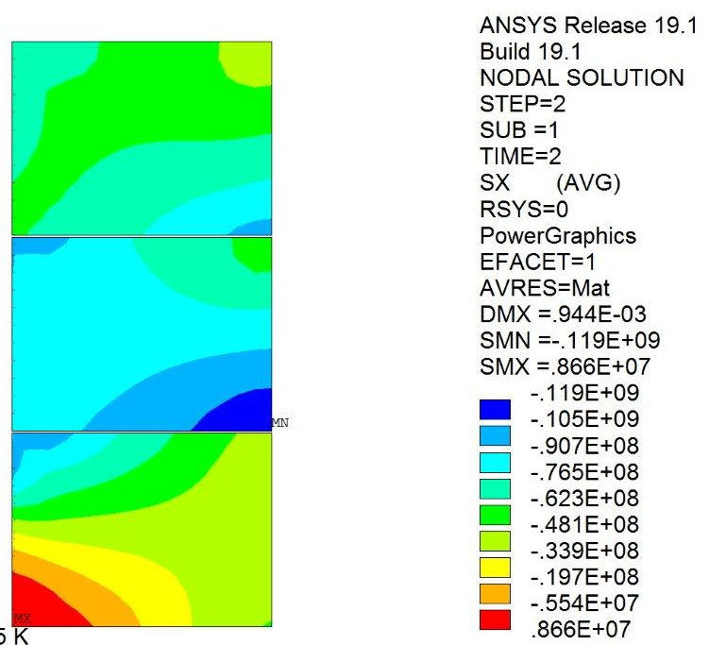
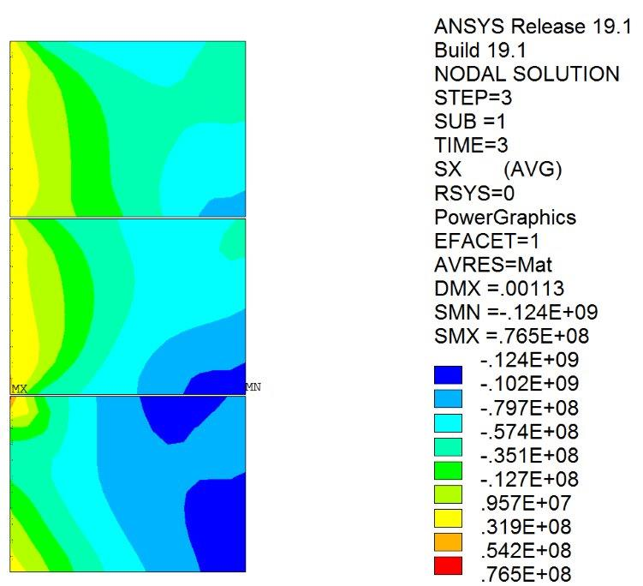
3D Mechanical Ansys
Pre-load
At cold
Nominal Field
Peak stress of
-43.4 MPa
Peak stress of
-119 MPa
Peak stress of
-124 MPa
06/06/19 - D. Martins Araujo

