Slide 1
EDIPO Re-building Cable Trial Plan
Ian Pong (ipong@lbl.gov)
6th of June, 2019

Slide 2
Outline
Cable Parameters
“Tuning” Plan
Requested Information

Slide 3
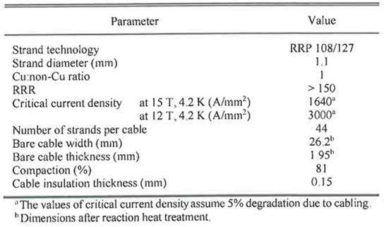
Cable Parameters
Courtesy of D M Araujo

Slide 4
Cable Parameters
RRR
  Incoming wire quality very important
  Depends on definition (e.g. V-tap distance, XS edge vs. SS, R_{20K} vs IEC)
  Assessment takes ~1 month after cabling
Cable dimensions
  We need unreacted bare cable dimensions for tuning and spec
  Preferably eventually also a tolerance limit
  Note: if CME cannot measure, an alternative QC plan is needed

Slide 5
Design “Tuning” Plan
Make cables with slightly different target thickness, e.g. +0.01 mm, nominal, -0.01 mm
Based on facet size / metallography, adjust twist pitch if necessary to accommodate the width compaction
Based on residual twist, adjust planetary ratio or add static twist (not preferred) if necessary
In severe cases, modify to a two-pass process with intermediate annealing (HT tbd, cable dimension needs revision, extra rollers likely needed)

Slide 6
Fabrication Tuning Plan
Mandrel shape
Tension on individual strands
Turkshead offset

Slide 7
Requested Information
Unreacted dimensions
Target tolerance of key parameters (“allowed limits” for tuning)
QC methods, e.g.
  residual twist weight at 12.2 kg, 24 kg, angle per metre
  10-stack pressure
Sample length

Slide 8
Extra Slides

Slide 9
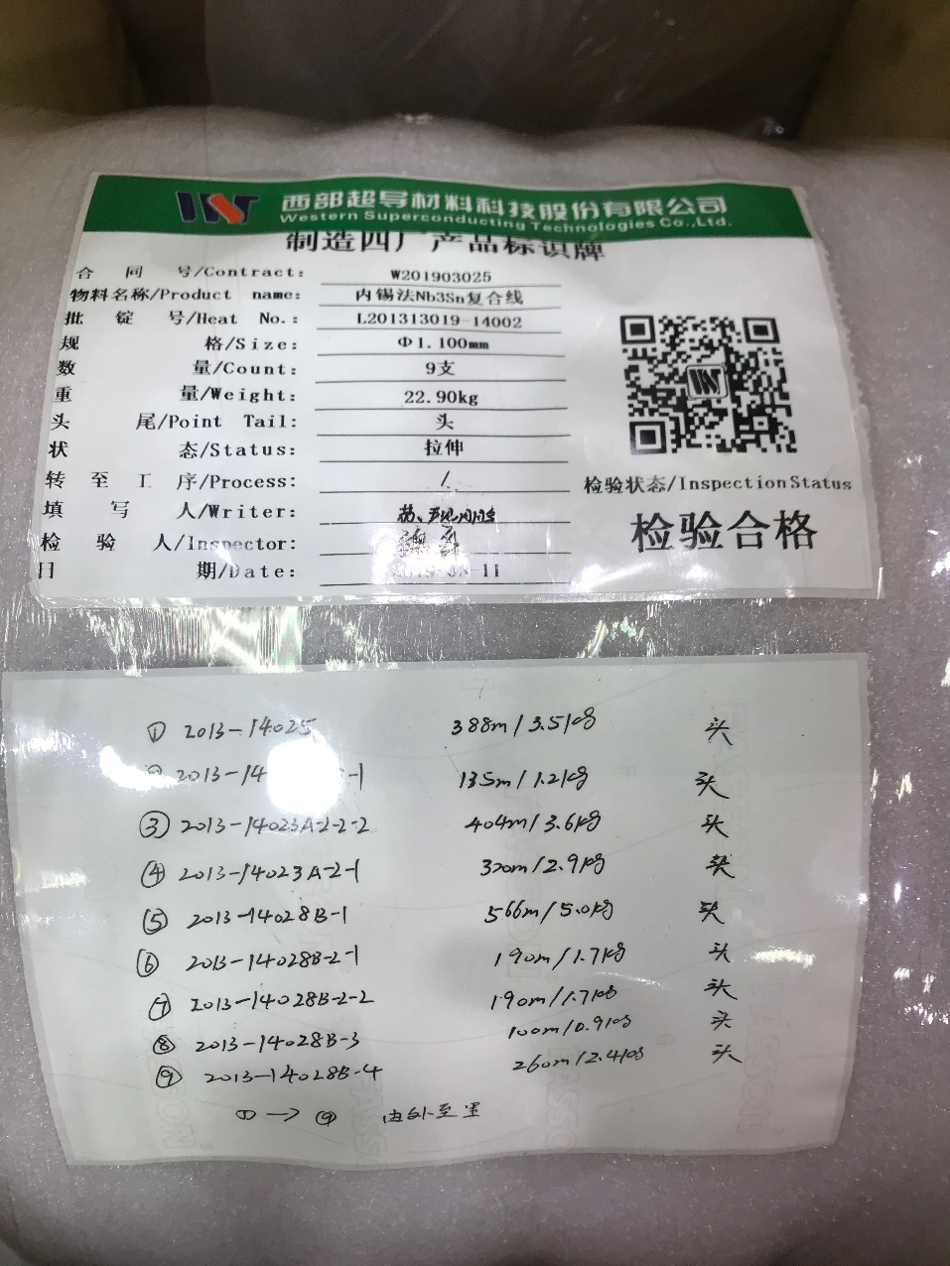
Wire ID
WW11S14025A01U
WW11S14023A01U
WW11S14023B01U
WW11S14023C01U
WW11S14028A01U
WW11S14028B01U
WW11S14028C01U
WW11S14028D01U
WW11S14028E01U

