Slide 1
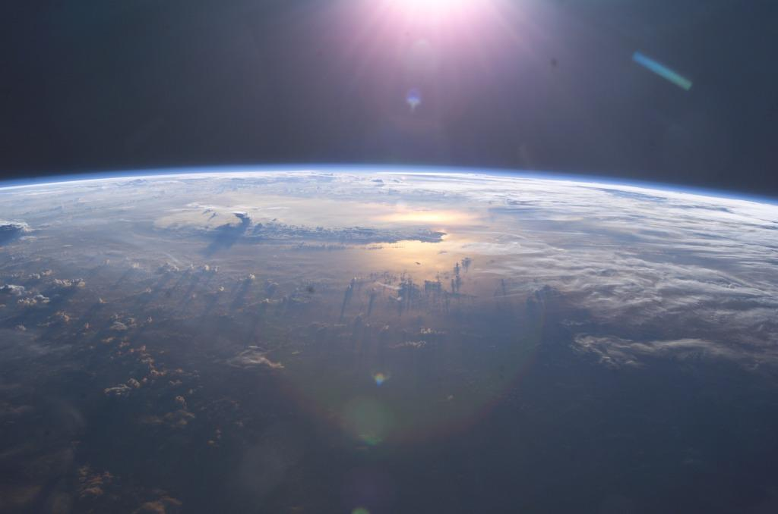
The CLOUD experiment
Cosmics Leaving Outdoor Droplets
Hanna Manninen, PhD
CLOUD Run Coordinator
Studies the influence of
galactic cosmic rays on aerosols and clouds,
and their implications for climate
Photo: NASA ISS007E10807
Notes:
https://cds.cern.ch/record/2154271
https://www.youtube.com/watch?v=sDo7saKaEys&feature=youtu.be
https://www.youtube.com/watch?v=msSVQ903T8k
https://home.cern/about/accelerators

Slide 2
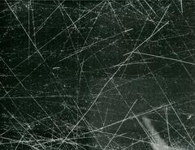
Notes:
How did your cloud/fog chambers succeed at S’Cool LAB? And who remembers the explanation why you saw the cloud chamber tracks?

Slide 3
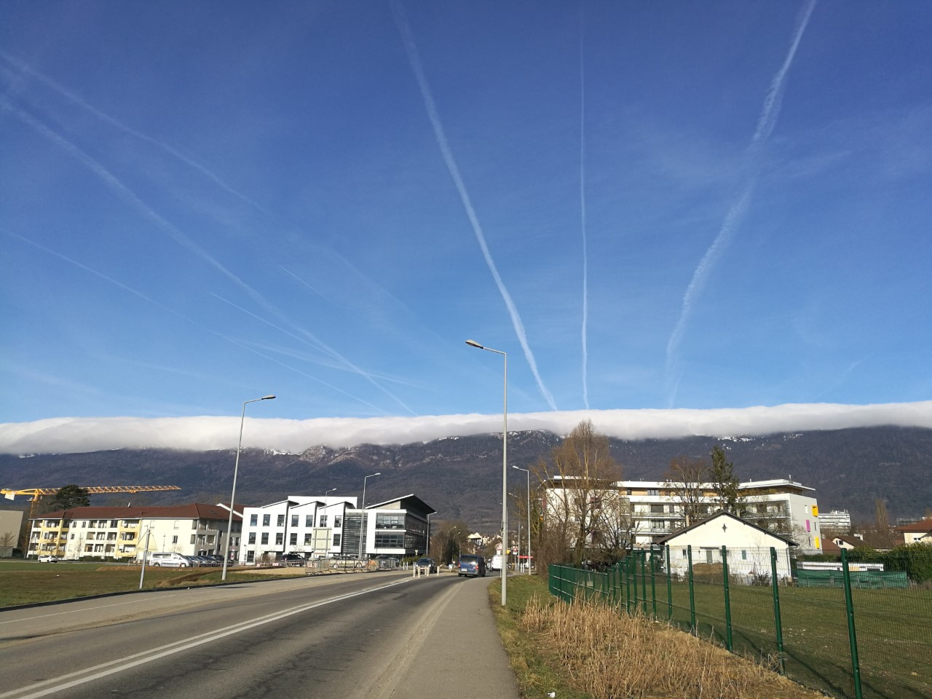
What is in common with the cloud chamber tracks and the air plane contrails?

Slide 4

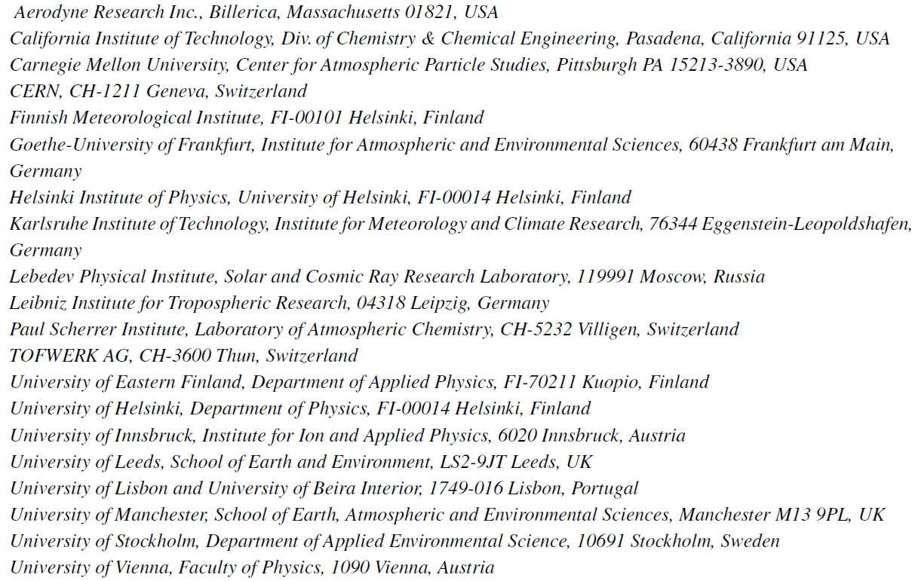
The collaboration is atmospheric scientists… and CERN:
Notes:
CLOUD experiment sharpens climate predictions
27 Oct 2016 – Measurements of the production rates of atmospheric aerosol particles by CERN’s CLOUD experiment put global climate projections on more solid ground.
CERN experiment sheds new light on cloud formation
16 May 2014 – CLOUD experiment shows that biogenic vapours emitted by trees and oxidised in the atmosphere have significant impact on formation of clouds

Slide 5
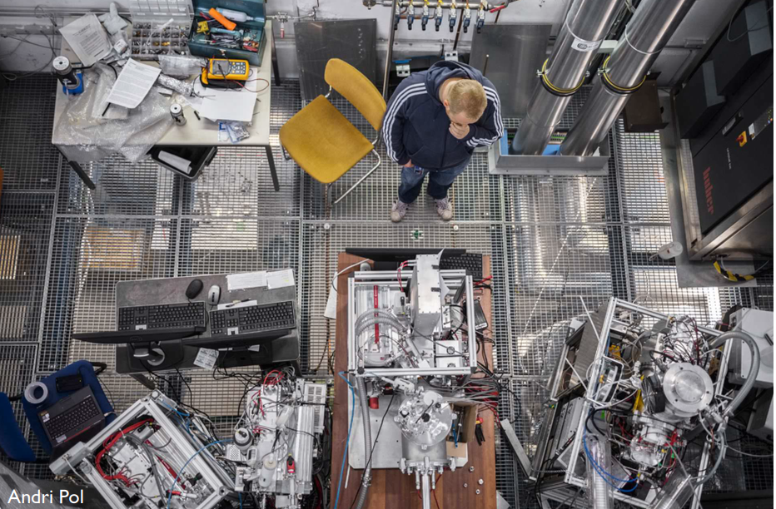
CLOUD with the measurement instruments and their users during a campaign
Why do atmospheric scientists come to CERN?
Notes:
The contents of the chamber are continuously analysed by instruments connected to sampling probes that project 0.5m into the chamber. A central data acquisition (DAQ) system controls the operating conditions of the experiment, collects and backs up the data from the instruments, provides multiuser access for monitoring the performance of the instruments and chamber, and provides real-time physics analysis using the combined data from multiple instruments.

Slide 6
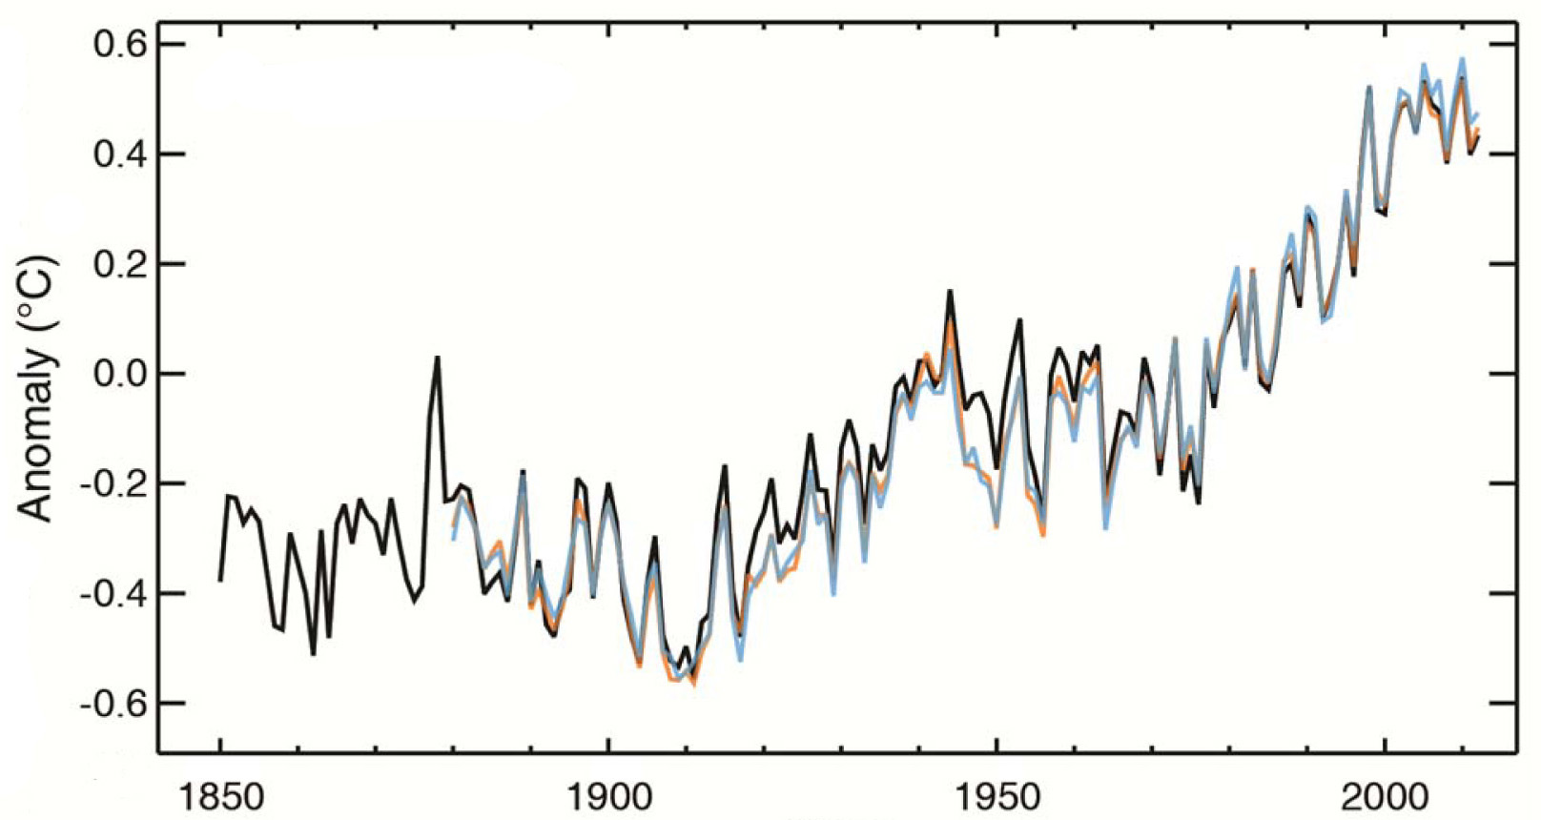
Climate is already changing: global surface temperature change since 1850
ΔT = 0.8ºC
Year
Source: IPCC, Summary for Policymakers, 2013
WHAT WILL HAPPEN WITHIN NEXT 40-50 YEARS?
Notes:
Details of the modern climate record are known through the taking of measurements from such weather instruments as thermometers, barometers, and anemometers during the past few centuries. The instruments used to study weather over the modern time scale, their known error, their immediate environment, and their exposure have changed over the years, which must be considered when studying the climate of centuries past.
Global mean surface temperature change since 1850!! The term temperature anomaly means a departure from a reference value or long-term average. A positive anomaly indicates that the observed temperature was warmer than the reference value, while a negative anomaly indicates that the observed temperature was cooler than the reference value.

Slide 7
Motivation: cosmic rays, aerosols and clouds
Notes:
The CLOUD experiment investigates the formation of new aerosol particles in the atmosphere via nucleation of trace gas molecules. The particular focus is on the effect of ions from cosmic rays on this process.

Slide 8
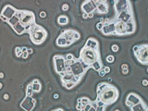
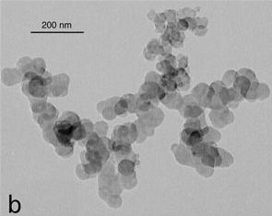
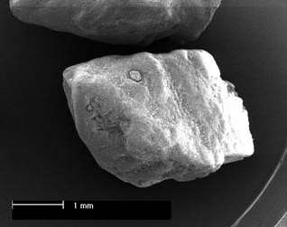
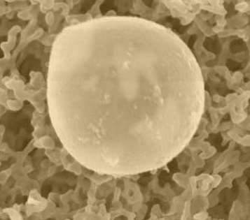
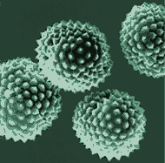
Aerosol particles: what are they?
Definition: Suspension of small (liquid or solid) particles in a gas
Ammonium sulphate: 10 - 100 nm
Diesel soot: ca. 100 nm
Sea salt: 0.2 - 10 μm
Mineral dust: 0.2 - 10 μm
Pollen: 10 - 100 μm

Slide 9
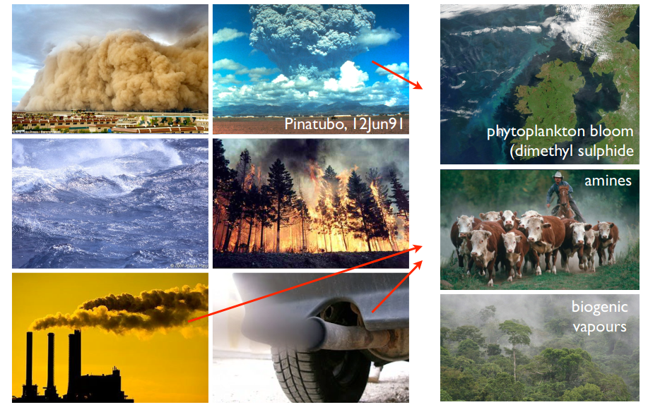
PRIMARY (directly produced)
ATMOSPHERIC AEROSOLS
SECONDARY AEROSOLS (indirectly produced, gas-to-particle conversion i.e. nucleation)
ammonia
About half of climate-relevant particles

Slide 10
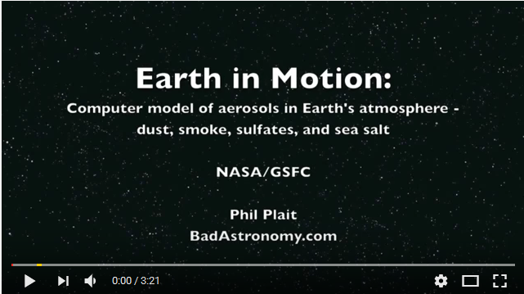
Primary particles are emitted globally: https://www.youtube.com/watch?v=YtJzn8A725w
Blue: sea salt blown by the wind
Green: Carbon from fires (black carbon i.e. soot)
White: sulfates from fossil fuels and vulcanos (antropogenic vs. natural)
Orange/red: dust
Notes:
Blue: sea salt blown by the wind
Green: Carbon from fires (black carbon = soot)
White: sulfates from fossil fuels and vulcanos (antropogenic vs natural source)
Orange/red: dust

Slide 11
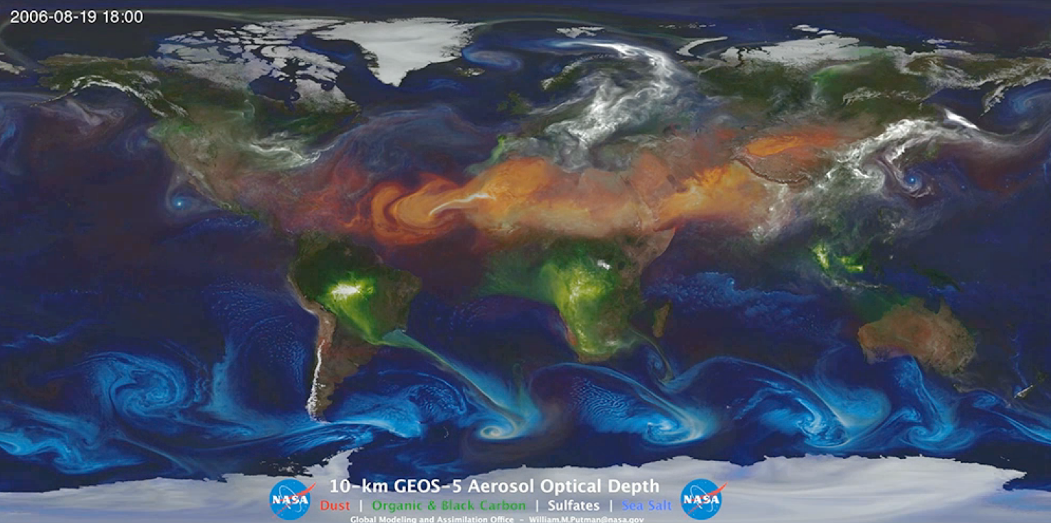
Primary aerosol production:
direct emissions
Blue: sea salt blown by the wind
Green: Carbon from fires (black carbon i.e. soot)
White: sulfates from fossil fuels and vulcanos (antropogenic vs. natural)
Orange/red: dust
https://www.youtube.com/watch?v=YtJzn8A725w
Notes:
Computer model of aerosols in Earth’s atmosphere by NASA.
Primary particles are emitted globally:
https://www.youtube.com/watch?v=YtJzn8A725w
The Goddard Earth Observing System Model, Version 5 (GEOS-5) model consists of a group of model components that can be connected in a flexible manner in order to address questions related to different aspects of Earth Science.

Slide 12
Secondary aerosol source: gas to particle conversion
Aerosol-cloud interaction: studying new particle formation due to its cooling effects
Gas phase precursors
Particle formation by nucleation
Enhanced growth by condensation and coagulation
Aerosol-cloud interaction:
eg. N₂, O₂, H₂O
eg. H₂SO₄, NH₃
eg. HSO₄⁻(H₂SO₄)_{n}, H₂O-H₂SO_{4,} VOCs
Gas
Molecules
Cluster ions and neutral clusters
Particles
Cloud condensation nuclei (CCN)
< 1nm
~1-3 nm
> 3 nm
> 100 nm
Notes:
ATMOSPHERIC AEROSOL PARTICLES: FROM MOLECULAR CLUSTERING TO GLOBAL Climate: We are interested to get the information on the first steps of the New Particle Formation (NPF). In atmospheric particle formation, we study the transition from gas phase to liquid or solid phase, i.e. the nucleation of stable liquid or solid phase clusters from gas phase precursors. Atmospheric nucleation can happen via molecular clustering, and it is followed by cluster activation for enhanced growth. Freshly-formed particles grow by condensation when different vapors condense onto the particle surfaces or the particles collide and stick together, in a process called coagulation. When aerosol particles grow further to sizes where they can act as cloud condensation nuclei, they start to have effect on climate.
For simplicity, they are assumed to be spherical, and their diameter is used as the measure of size. While typical gas molecules in the atmosphere have diameters below 1 nm (10-9 m), aerosol particle diameters range from 1 nm up to around 100 μm (10-4 m). Ionisation of air molecules (N2 and O2 constitute 78 % and 21 %, respectively, of air composition) produces primary air ions, i.e. positive ions and free electrons. Primary ions undergo rapid chemical reactions, getting neutralised and charged again, and become small ions in less than a second from their formation. The newly formed particles have been observed to grow into cloud condensation nuclei (CCN) sizes (e.g. Laaksonen et al., 2005; Wiedensohler et al., 2009) and ultimately to participate in cloud droplet activation.
All this makes aerosol particles extremely difficult to measure. The very small size of these particles causes several difficulties in sampling and analysis.

Slide 13
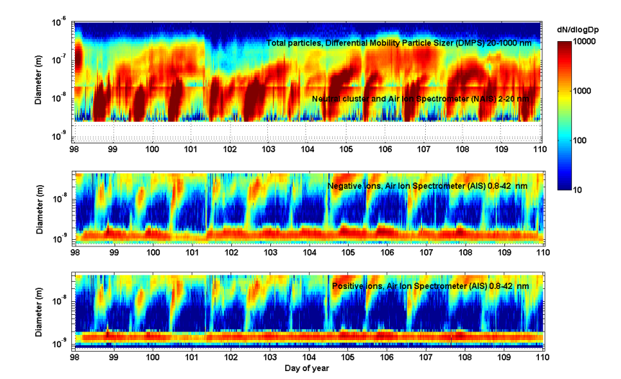
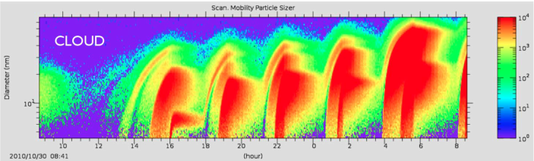
CLOUD simulates real atmosphere
12 consecutive particle formation event days 8–19 April 2007 in Hyytiälä, Finland
ATMOSPHERE
Boreal forest, Finland
CLOUD, CERN

Slide 14
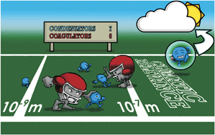
Thermodynamics and kinetics of atmospheric aerosol particle formation and growth
Hanna Vehkamäki and Ilona Riipinen, 2012

Slide 15
These natural aerosols i.e. secondary particles are formed via new particle formation.
Newly formed particles need to grow all the way to cloud droplets to affect global climate.

Slide 16
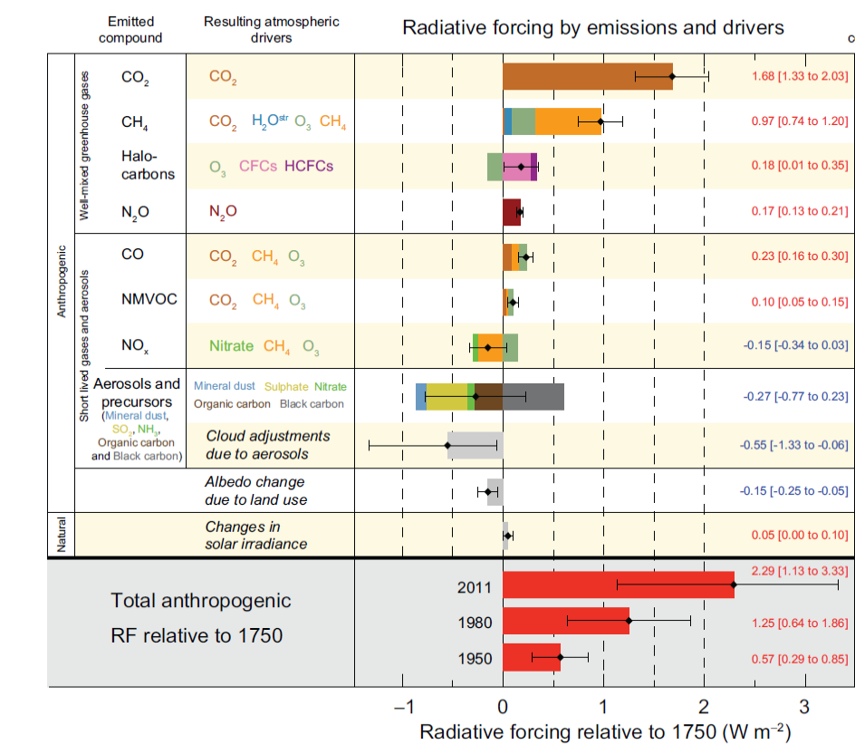
Scientific understanding of climate radiative forcing in Industrial Age
A. Anthropogenic aerosol forcing are poorly understood.
B. Natural part is very small.
Is there a missing natural forcing?
Is that from varying cosmic ray flux, modulated by sun?
Source: IPCC, Summary for Policymakers, 2013
A + B → The CLOUD experiment
Notes:
Radiative forcing or climate forcing is defined as the difference of insolation (sunlight) absorbed by the Earth and energy radiated back to space. Typically, radiative forcing is quantified at the tropopause in units of watts per square meter of the Earth's surface. A positive forcing (more incoming energy) warms the system, while negative forcing (more outgoing energy) cools it. Causes of radiative forcing include changes in insolation and the concentrations of radiatively active gases, commonly known as greenhouse gases and aerosols.
Radiative forcing can be used to estimate a subsequent change in equilibrium surface temperature (ΔT_{s}) arising from that forcing via the equation:
Δ T s = λ Δ F {\displaystyle \Delta T_{s}=~\lambda ~\Delta F} where λ is the climate sensitivity, usually with units in K/(W/m²), and ΔF is the radiative forcing.^{[5]} A typical value of λ is 0.8 K/(W/m²), which gives a warming of 3K for doubling of CO₂.

Slide 17
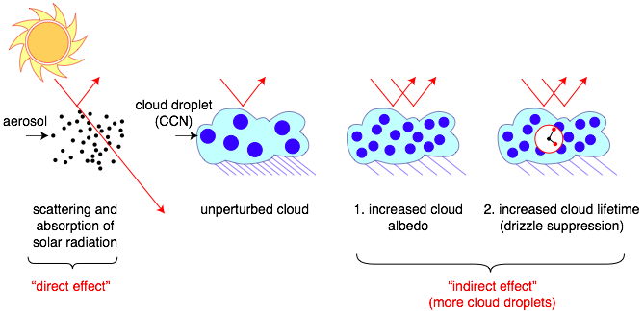
Role of aerosols on Sun’s radiative forcing
All cloud droplets form on aerosol “seeds” known as cloud condensation nuclei - CCN
Cloud properties are sensitive to number of droplets
More aerosols/CCN:
  Brighter clouds, with longer lifetimes
Sources of atmospheric aerosols:
  Primary (dust, sea salt, fires)
  Secondary (gas-to-particle conversion)
See youtube: “No particles no fog” https://www.youtube.com/watch?v=EneDwu0HrVg

Slide 18
CLOUD in a bottle
Cool Science Experiment:
https://www.youtube.com/watch?v=msSVQ903T8k

Slide 19
CLOUD Experiment: Concept, methods, results
Notes:
https://cds.cern.ch/record/2154271
https://www.youtube.com/watch?v=sDo7saKaEys&feature=youtu.be
https://www.youtube.com/watch?v=msSVQ903T8k

Slide 20
Why are we at CERN?
Secondary beam of pions from the CERN PS (3.5 GeV/c ); spanning the galactic cosmic-ray intensity range from ground level to the stratosphere
Study the effect of cosmic rays on aerosols and clouds, under precisely controlled laboratory conditions.
Notes:
CLOUD is designed to study the effects of cosmic rays on aerosols, cloud droplets and ice particles, under precisely controlled laboratory conditions. The chamber can be exposed to a 3.5 GeV/c secondary beam from the CERN Proton Synchrotron, spanning the galactic cosmic-ray intensity range from ground level to the stratosphere. The beam is defocused to a transverse size of about 1.5X1.5 m2 at the chamber.
The experiment has several unique aspects, including precise control of the ‘cosmic ray’ beam intensity from the CERN Proton Synchrotron, the capability to create an ion-free environment with an internal electric clearing field, precise and uniform adjustment of theH2SO4 concentration by means of ultraviolet illumination from a fibre-optic system, and highly stable operation at any temperature between 300 and 183 K.

Slide 21
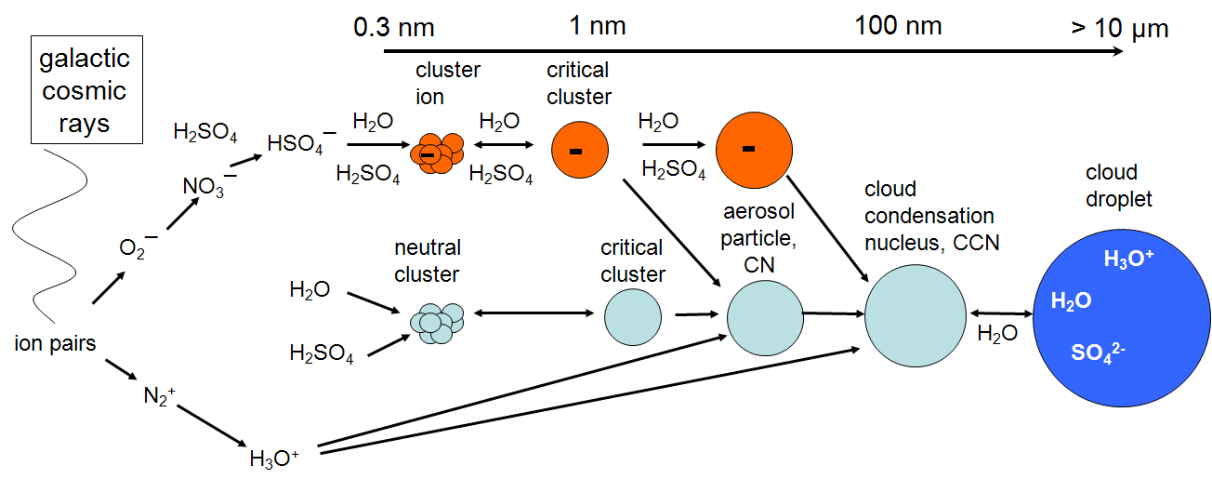
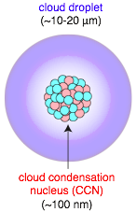
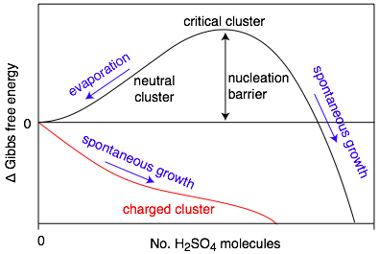
Ions enhance aerosol nucleation and growth: how much?
Solar wind modulates
Trace condensable vapour → CN → CCN
But contributing vapours and nucleation rates poorly known
H2SO4 is thought to be the primary condensable vapour in atmosphere (sub ppt)
Ion-induced nucleation pathway is energetically favoured but limited by the ion production rate and ion lifetime

Slide 22
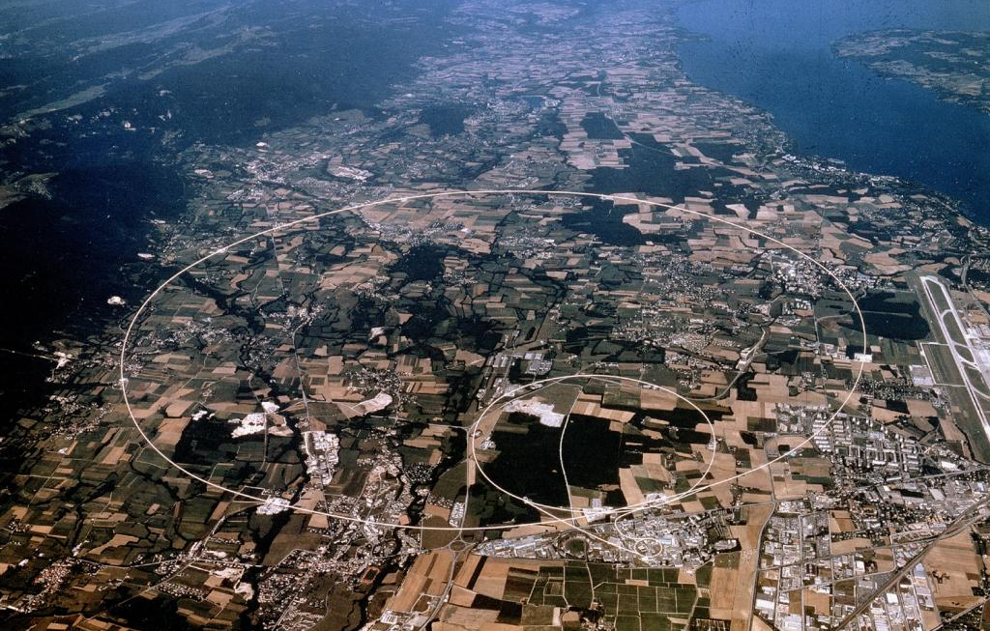
CLOUD is using CERN Proton Synchrotron
PS-T11 beam
Here!
Notes:
Control of the ‘cosmic ray’ beam intensity from the CERN Proton Synchrotron: https://home.cern/about/accelerators

Slide 23
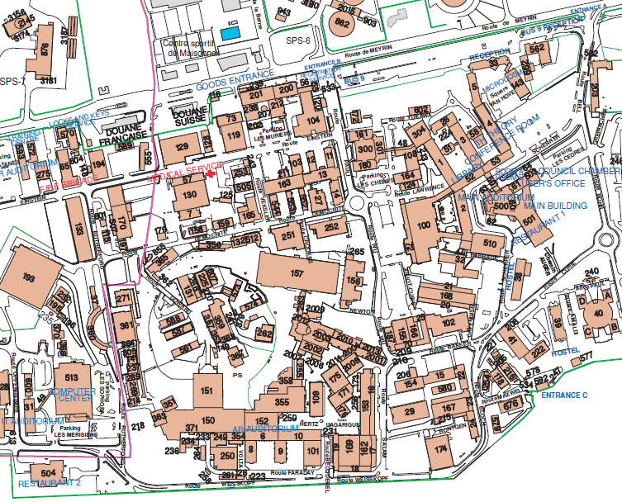
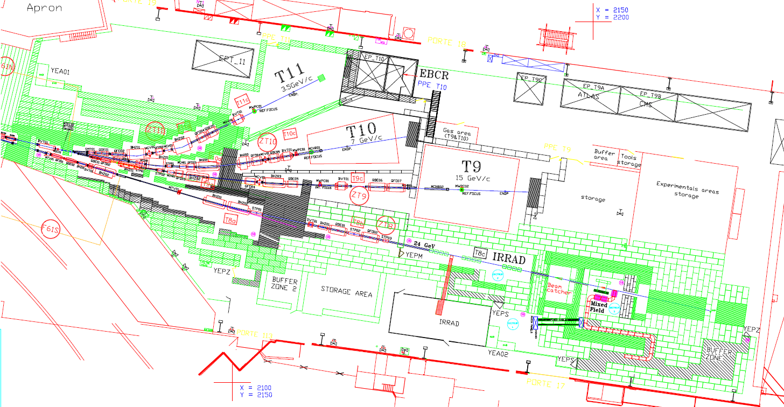
CERN PS-T11: control of the ‘cosmic ray’ beam intensity
PS East Hall
T11 beam area
(3.5 GeV/c)
Proton Synchrotron (PS) accelerator,
first operation in 1959
Notes:
The chamber is the world’s cleanest laboratory for studies of atmospheric particle formation, and has unique capabilities for replicating atmospheric ion concentrations via the PS beam.

Slide 24
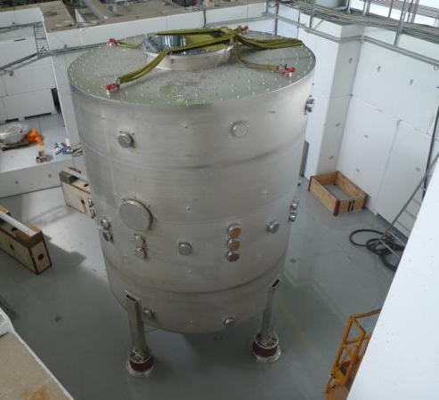
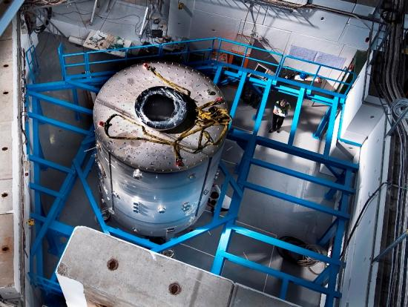
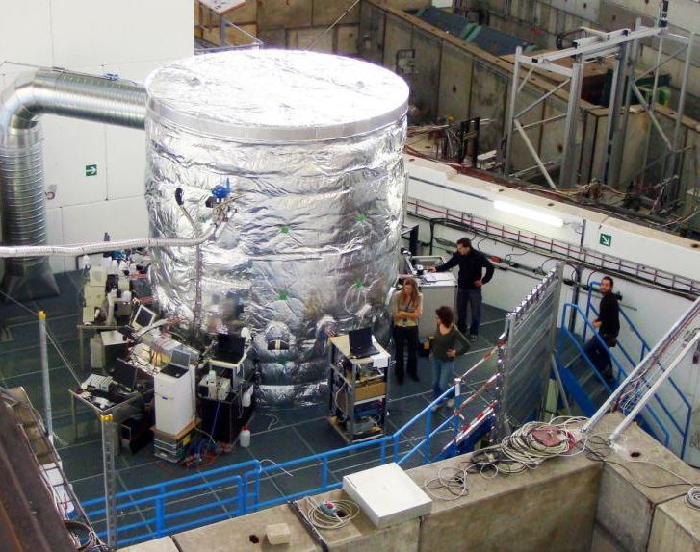
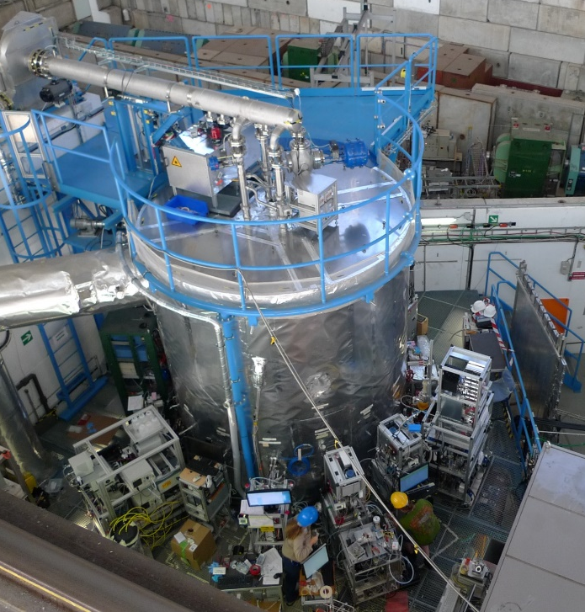
CLOUD chamber was build in 2009 and is located in T11 beam area:
July 2009
September 2009
September 2016
November 2009

Slide 25
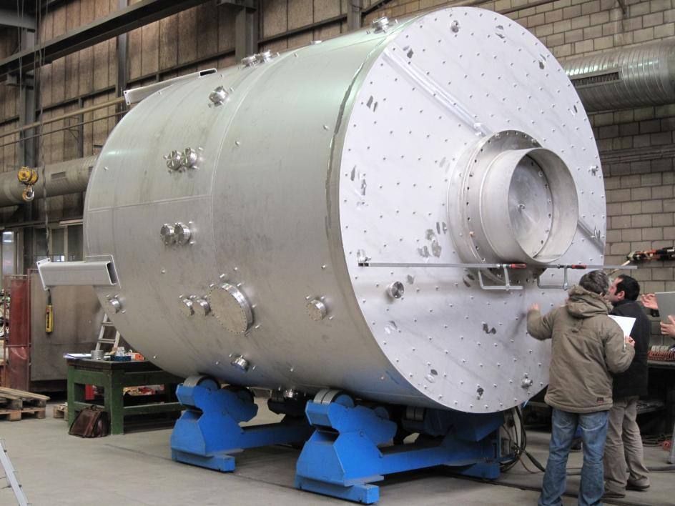
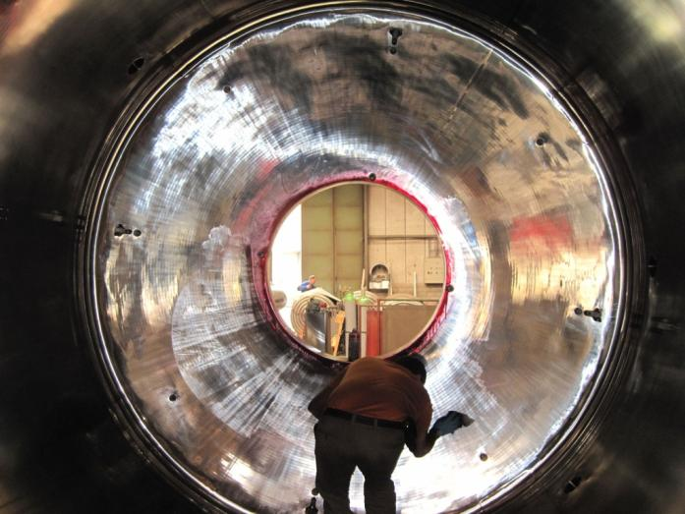
The core of the experiment is a stainless steel chamber (26m³) filled with synthetic air
Pressure: Atmospheric ± 0.3 bar
Only metallic seals
Electropolished inner surfaces

Slide 26
World’s cleanest laboratory for studies of atmospheric particle formation
CLOUD is run under precisely controlled
laboratory conditions:
temperature stability: <0.1°C
temperature range: -90°C to +30°C; cleaning at +100°C
surface cleanliness: <10 pptv^{*)} organics contamination,
stainless steel (and gold), no teflon, no O-rings
ultrapure gas supplies
UV system: negligible heat load by use of fibre optics.
field cage 30 kV/m
Unique and highly advanced aerosol chamber already as such!
*) pptv = part per trillion, 1 / 10¹²
Notes:
Its design and construction also allow regulation of temperatures within the chamber to achieve a stability of around 0.01K and uniformity of a few times 0.1K, while permitting experiments at temperatures as low as –65C.
CLOUD is run under precisely controlled
laboratory conditions

Slide 27
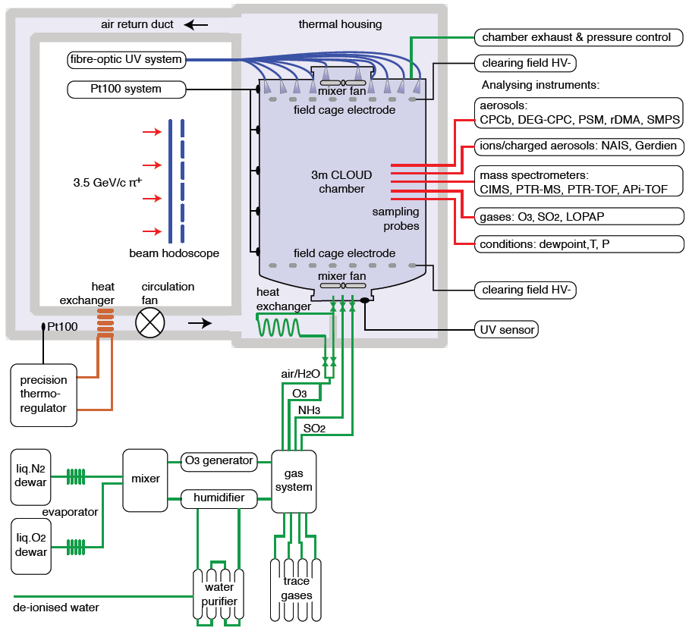
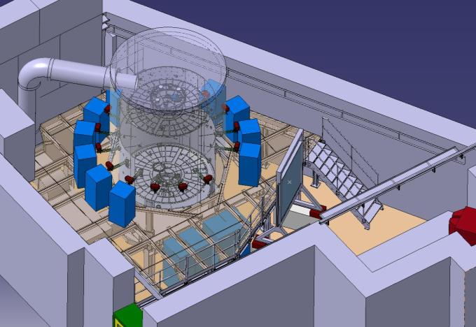
CLOUD set-up: instruments connected to sampling probes
Notes:
The chamber instrumentation for the results reported here comprise a chemical ionization mass spectrometer (CIMS) for H2SO4 concentration, an atmospheric pressure interface time-of-flight (APi-TOF) mass spectrometer for molecular composition of positive and negative ions up to 2,000 Th (thomson units; 1 Th51Da/e)35, a condensation particle counter (CPC) battery at 2.5–12-nm thresholds (mobility diameters), a di-ethylene glycol CPC (DEG-CPC) at 2.0nm threshold36, a scanning particle size magnifier (PSM) in the threshold range 1.3–2nm37, a radial differential mobility analyser (rDMA) in the size range 2–10nm38, a scanning mobility particle sizer (SMPS) in the size range about 10–100 nm, a neutral cluster and air ion spectrometer (NAIS)39, a small-ion counter (Gerdien counter), trace gas analysers (O3 and SO2), a proton transfer reaction time-of-flight (PTR-TOF) mass spectrometer for organic vapour concentrations40, two instruments for NH3 measurements (a long-path absorption photometer (LOPAP) and a proton transfer reaction mass spectrometer (PTR-MS)41), and instruments to measure chamber conditions (dewpoint, ultraviolet intensity, temperature and pressure).A central data acquisition (DAQ) system controls the operating conditions of the experiment, collects and backs up the data from the instruments, provides multiuser access for monitoring the performance of the instruments and chamber, and provides real-time physics analysis using the combined data from multiple instruments.

Slide 28
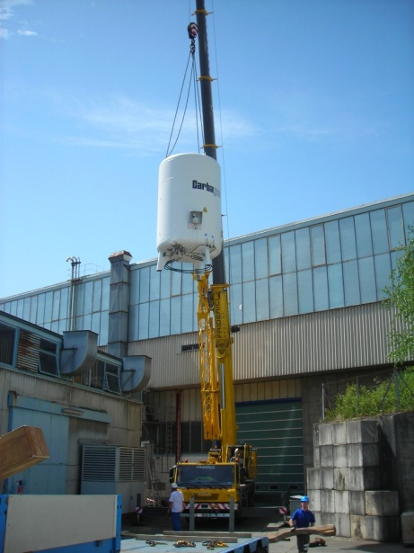
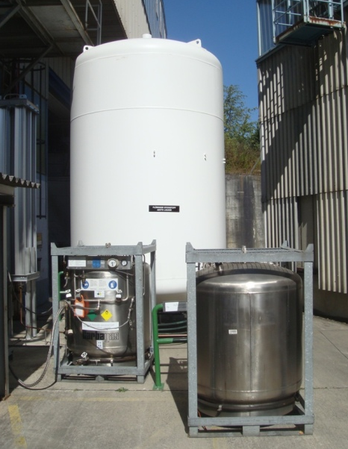
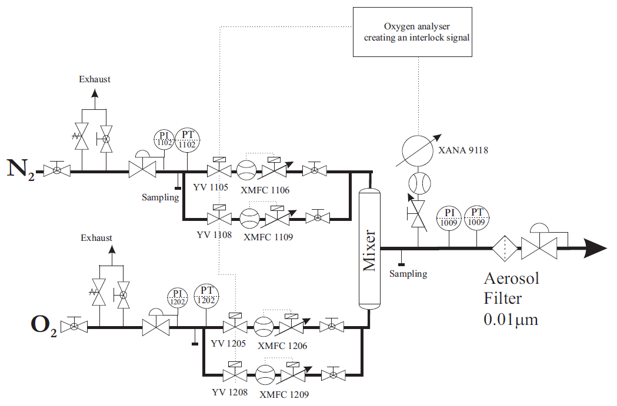
Ultra-pure air: synthetic air made from liquid nitrogen and liquid oxygen

Slide 29
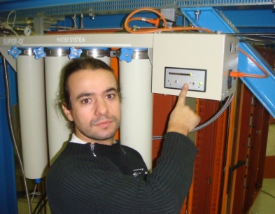
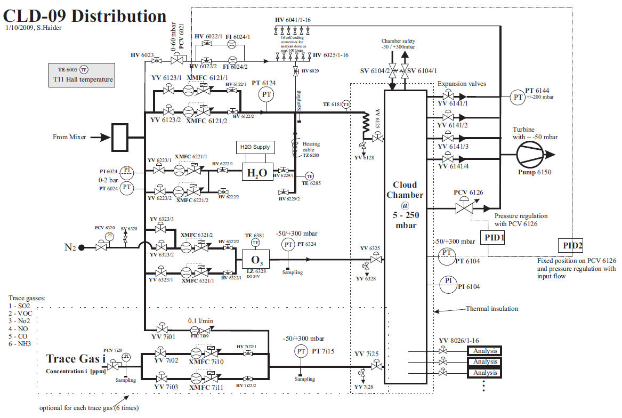
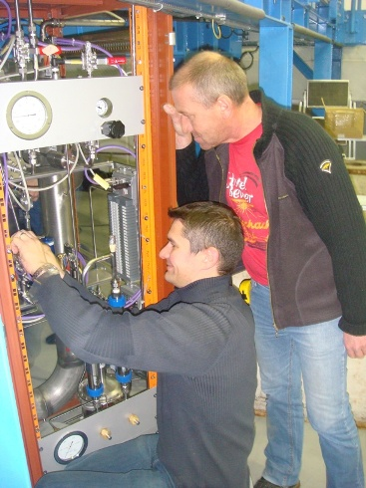
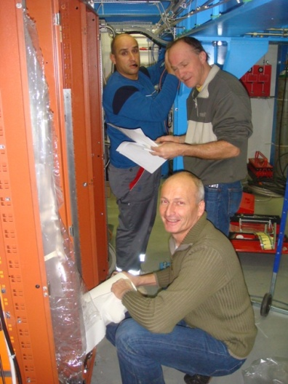
Gas system built to the highest technical standard of performance
Notes:
Gas system has been built to the highest technical standards of cleanliness and performance

Slide 30
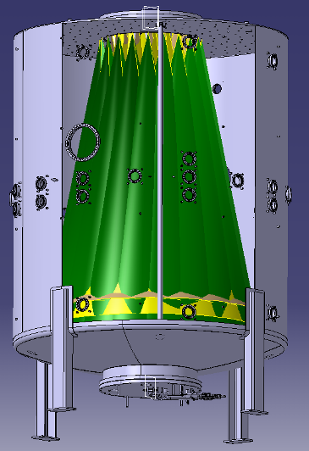
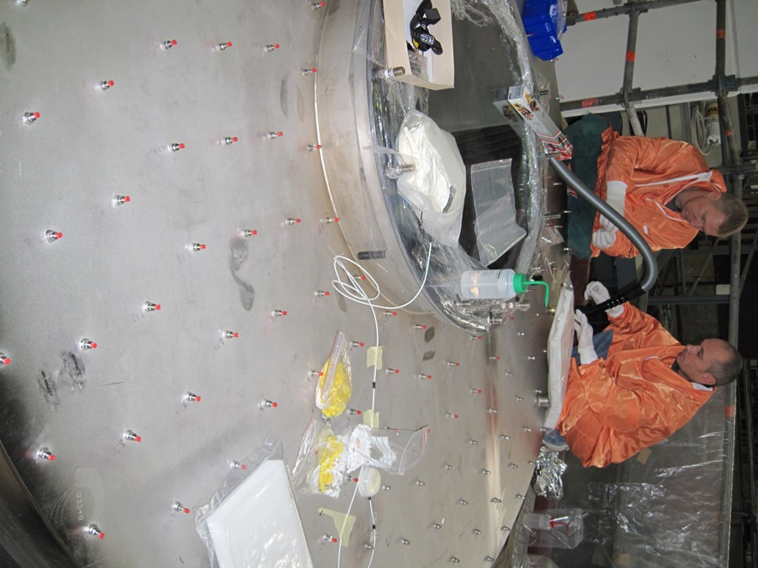
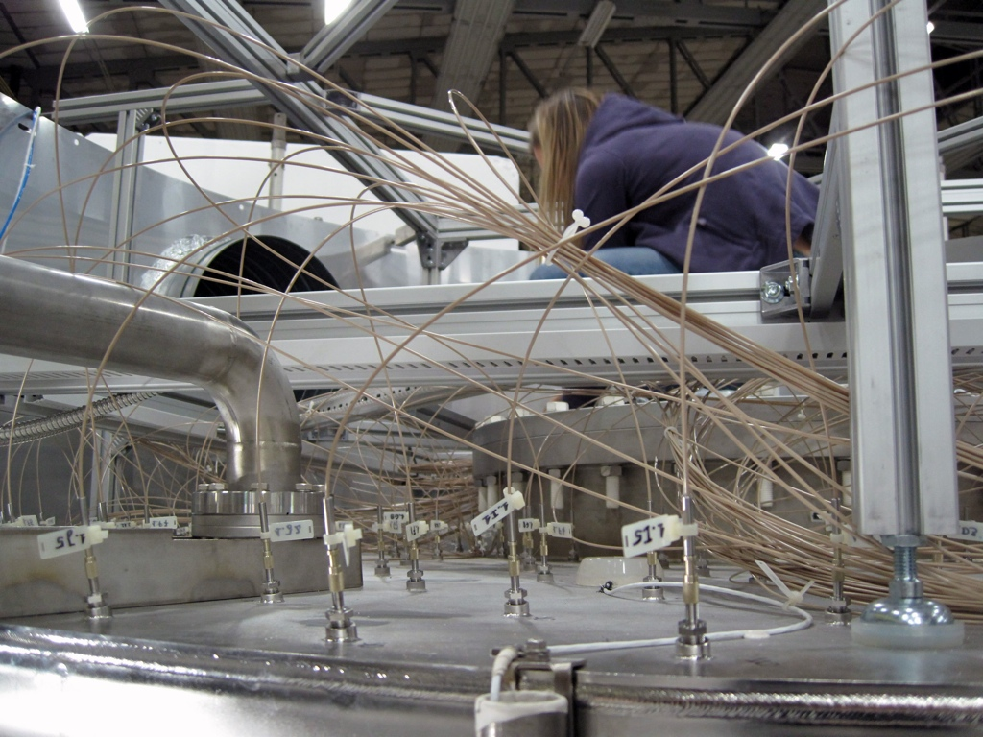
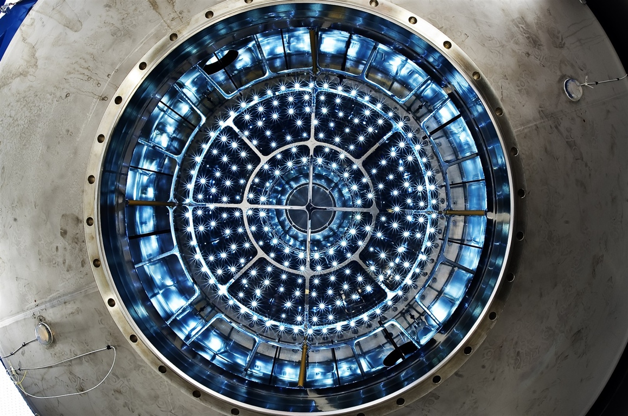
UV illumination from a fibre-optic system
Precise and uniform adjustment of the H2SO4 concentration by means of UV laser system for the homogeneous, in-situ generation of the precursor gases
Notes:
The atmospheric photolysis of ozone is replicated with a UV laser system (new in 2015) for the homogeneous, in-situ generation of the precursor gases for nucleation.
Precise and uniform adjustment of the H2SO4 concentration by means of ultraviolet illumination from a fibre-optic system.

Slide 31
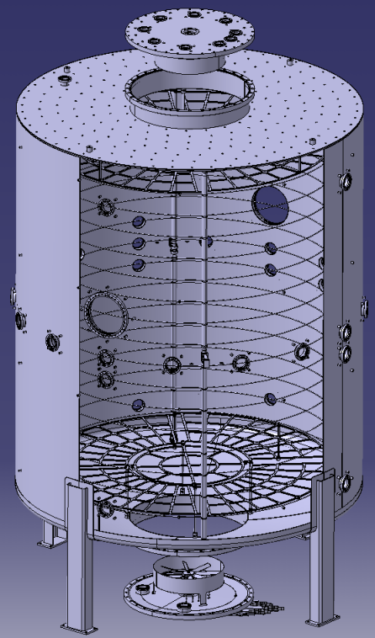
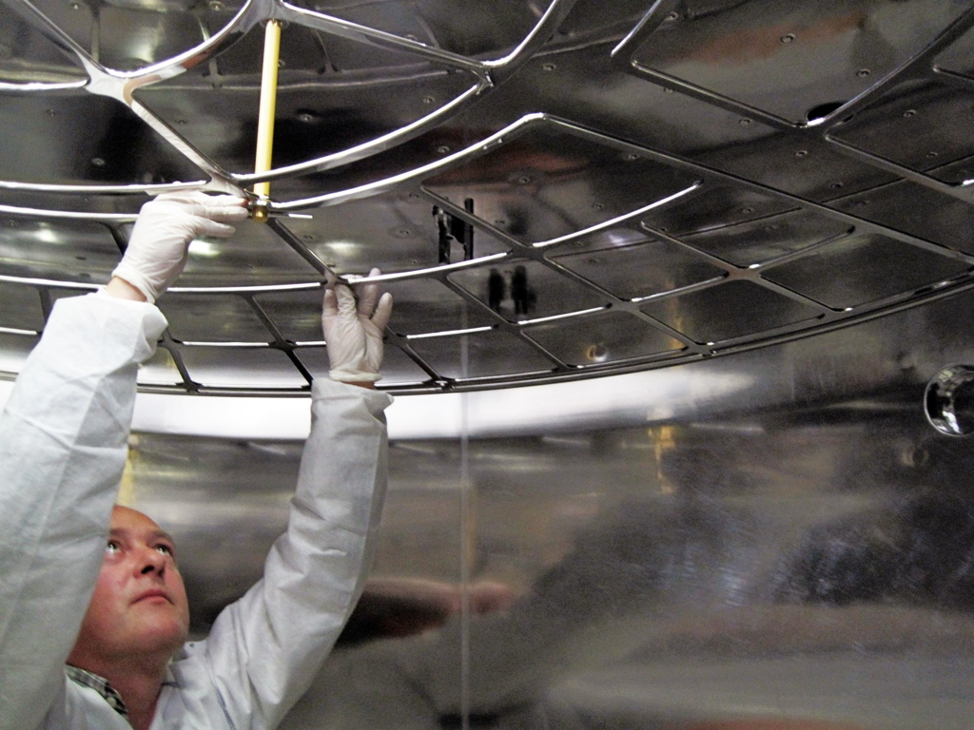
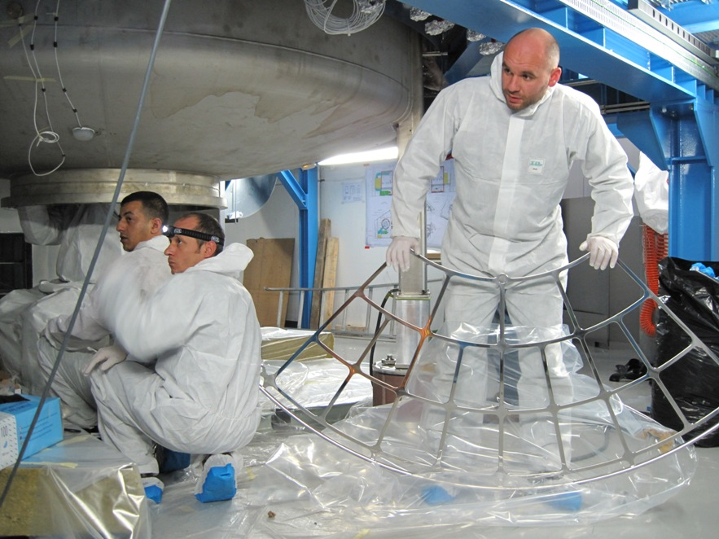
Ion-free conditions with a HV field cage
To study neutral nucleation, the beam is turned off and an internal electric field of up to 20 kV/m is applied by means of two transparent field cage electrodes. This rapidly (in about 1 s) sweeps out the background ions produced by galactic cosmic rays.
Notes:
Capability to create the ion-free environment with an internal electric clearing field. To study neutral nucleation, the beam is turned off and an internal electric field of up to 20 kVm21 is applied by means of two transparent field cage electrodes. This rapidly (in about 1 s) sweeps out the background ions produced by galactic cosmic rays. The electrodes are supported on partly conducting ceramic insulators to eliminate surface charges and stray electric fields when the high voltage is set to zero.

Slide 32
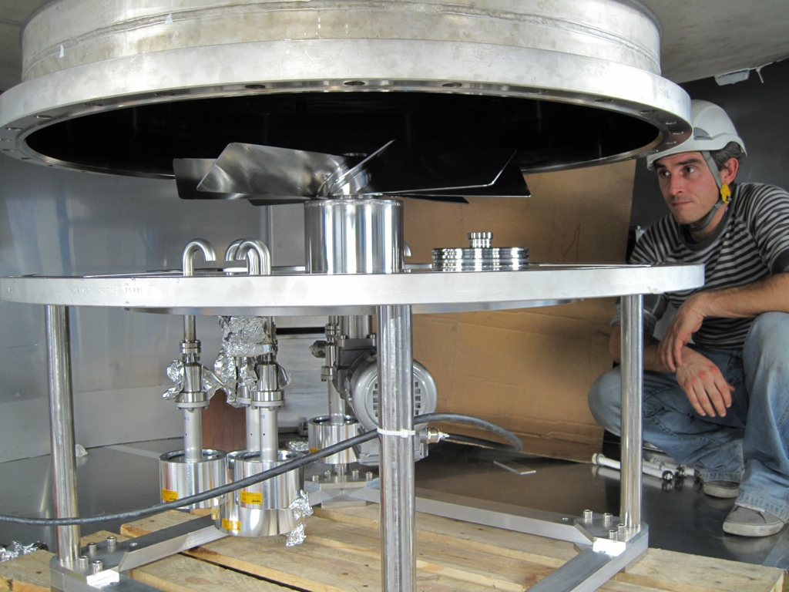
Metallic fan mixing rapidly the fresh gas and ions generated by the pion beam
The fans produce a counter-flow inside the chamber, and ensure good uniformity.
Notes:
Two stainless steel fans are mounted inside the chamber, and coupled magnetically to flexible drives connected to
motors located outside the thermal housing. The fans produce a counter-flow inside the chamber, to rapidly mix the fresh gases and the ions generated by the pion beam, and ensure good uniformity.

Slide 33

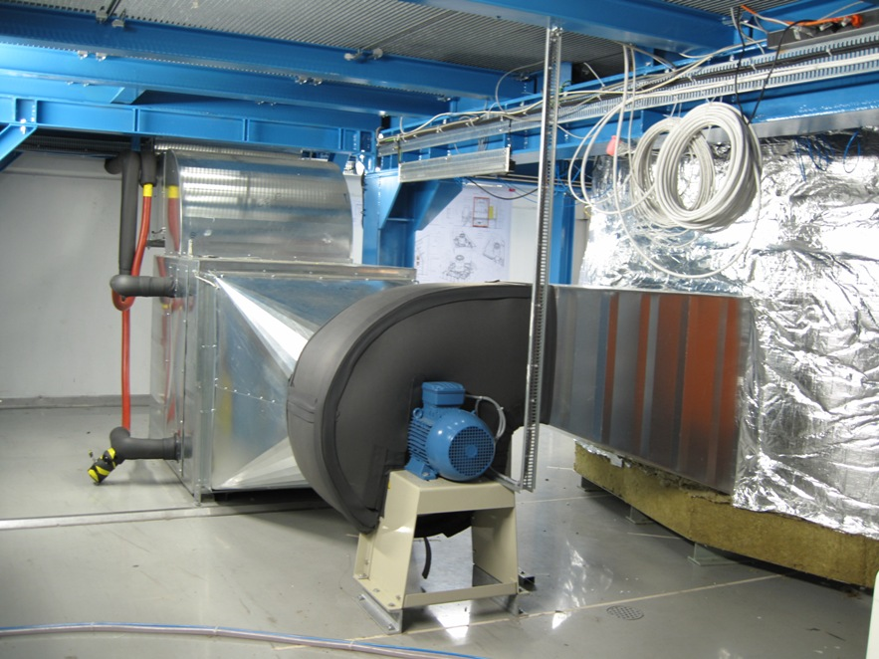
Thermal system enables highly stable operation at any temperature (300-183 K)

Slide 34
How to build up a CLOUD run?
1. Fill chamber with
clean air
+ water vapour
7. Carefully flush the chamber and clean the chamber walls between experiments
2. Set temperature and pressure
6. Repeat experiment (typically some hours), possibly with varying parameters
CHAMBER
Controlled experimental ‘sample’ of Earth’s atmosphere
3. Add trace gases,
condensable species
in atmospheric, extremely low concentrations
~1 molecule in 10¹² air molecules
5. Observe
Particle growth size distribution
Electrical charge distribution
Cloud droplet/ice particle concentrations,
etc.
4. Expose to ionizing beam,
and possibly to UV-light
Notes:
The core of the experiment is a stainless steel chamber of 26m³ volume filled with synthetic air made from liquid nitrogen and liquid oxygen. The chamber atmosphere and pressure is being measured and regulated by various instrumentations. The aerosol chamber can be exposed to an adjustable particle beam simulating GCRs at various altitude or latitude. UV illumination allows photolytic reaction. The chamber contains an electric field cage to control the drift of small ions and charged aerosols.^{[1]} The ionisation produced by cosmic rays can be removed with a strong electric field. Besides, humidity and temperature inside the chamber can be regulated, allowing for fast adiabatic expansion for artificial clouds (compare cloud chamber) or experiments on ice microphysics. According to Kirkby "the level of cleanliness and control in a laboratory experiment is at the limit of current technology, and CERN know-how has been crucial for CLOUD being the first experiment to achieve this performance."

Slide 35
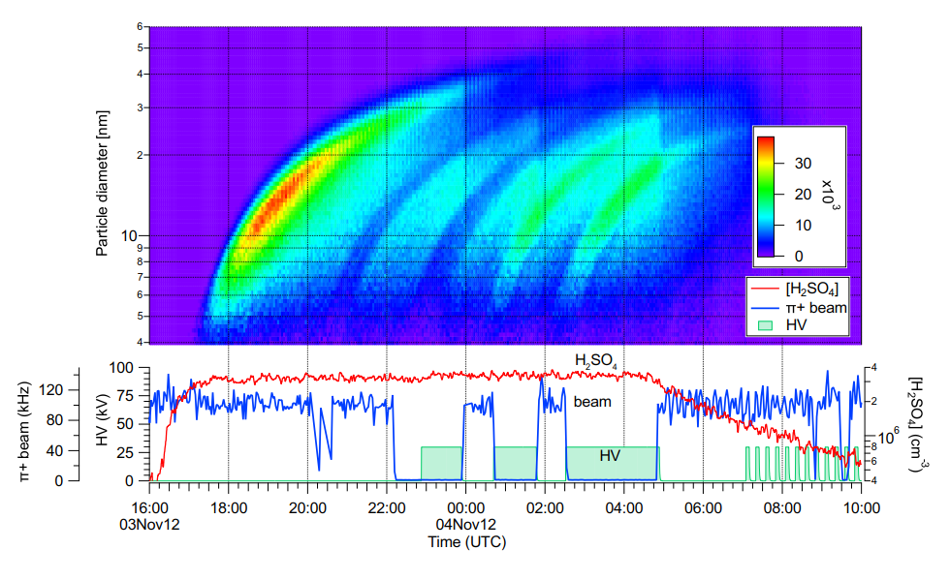
CLOUD run: instruments sampling from chamber and recording continuously

Slide 36

Further results available in:
Role of sulphuric acid, ammonia and galactic cosmic rays in atmospheric aerosol nucleation,
nature, 24 August 2011,
doi:10.1038/nature10343

Slide 37

Importance of biogenic aerosol particles
Huge discovery that biogenic vapours emitted by trees and oxidised in the atmosphere have a significant impact on the formation of clouds, thus helping to cool the planet
Addition DMA into system brings the nucleation rate into the range of atmospheric observations
Nearly all nucleation throughout the present-day atmosphere involves ammonia or biogenic organic compounds, in addition to sulfuric acid
Notes:
Boundary layer nucleation cannot be explained either by binary (H2SO4-H2O) or by ternary nucleation with ammonia
Even with ion enhancement, ternary NH3-H2SO4-H2O is too low by a factor 10-1000
Addition of just a few ppt (5-10) of DMA brings the nucleation rate into the range of atmospheric observations.
But: amines are only important close to sources (bind strongly to aerosol particles).
It made a huge discovery when it showed that biogenic vapours emitted by trees and oxidised in the atmosphere have a significant impact on the formation of clouds, thus helping to cool the planet.

Slide 38

Global importance of nucleation using global aerosol models
Parametrizations of nucleation from H2SO4/NH3 + H2SO4/Biogenic + Pure biogenic + ions experiments
Pre-industrial nucleation fraction
Present day nucleation fraction
65% of climate-relevant aerosol particles in the preindustrial atmosphere come from nucleation, and 55% today
Gordon et al. Causes and importance of new particle formation in the present-day and preindustrial atmospheres, JGR 2017
65% (45-84%)
55% (39-66%)
Notes:
In addition, CLOUD is pioneering an innovative synergistic approach in which the model simulations guide the experiments as well as exploit the experimental results. This is a big step forward in the reliability of models to describe climate interactions.
New particle formation has been estimated to produce around half of cloud-forming particles in the present-day atmosphere, via gas-to-particle conversion. Here we assess the importance of new particle formation (NPF) for both the present-day and the preindustrial atmospheres. We use a global aerosol model with parametrizations of NPF from previously published CLOUD chamber experiments involving sulfuric acid, ammonia, organic molecules, and ions. We find that NPF produces around 67% of cloud condensation nuclei at 0.2% supersaturation (CCN0.2%) at the level of low clouds in the preindustrial atmosphere (estimated uncertainty range 45–84%) and 54% in the present day (estimated uncertainty range 38–66%). Concerning causes, we find that the importance of biogenic volatile organic compounds (BVOCs) in NPF and CCN formation is greater than previously thought. Removing BVOCs and hence all secondary organic aerosol from our model reduces low-cloud-level CCN concentrations at 0.2% supersaturation by 26% in the present-day atmosphere and 41% in the preindustrial. Around three quarters of this reduction is due to the tiny fraction of the oxidation products of BVOCs that have sufficiently low volatility to be involved in NPF and early growth. Furthermore, we estimate that 40% of preindustrial CCN0.2% are formed via ion-induced NPF, compared with 27% in the present day, although we caution that the ion-induced fraction of NPF involving BVOCs is poorly measured at present. Our model suggests that the effect of changes in cosmic ray intensity on CCN is small and unlikely to be comparable to the effect of large variations in natural primary aerosol emissions.

Slide 39
How is the experimental data from CLOUD connected to our daily lives?
Within the CLOUD experiment both measurements and modelling are needed for assessing connection between aerosols, clouds and climate
Us
Experimental measurements
Mathematical equations
Model to describe climate system
Climate prediction
Advice to climate policy makers
You
Notes:
As temperatures warm, plants release gases that help form clouds and cool the atmosphere. Higher temperatures lead to an increase in concentrations of natural aerosols that have a cooling effect on the atmosphere.
The results can also be used in regional and global models, and thereby also provide new useful information for policy makers. Models are capable of detecting changes and investigate what happens in the future.
Climate models describe the climate system for the mathematical equation. The equations are formed on the basis of the laws of physics. Models include the atmosphere, oceans, and soil simulate parts. Go throught all the steps takes years.
-----
Tuloksia voidaan myös hyödyntää alueellisissa ja globaaleissa malleissa ja myös sitä kautta tarjoamme uutta hyödyllistä tietoa poliittisille päättäjille. Mallintamalla pystytään havaitsemaan muutoksia ja tutkimaan sitä, mitä tulevaisuudessa tapahtuu.
Ilmastomallit kuvaavat ilmastojärjestelmää matemaattisten yhtälöitten avulla. Yhtälöt muodostetaan fysiikan lakien perusteella. Malleissa ovat mukana ilmakehää, valtameriä sekä maaperää simuloivat osat.
https://ilmasto-opas.fi/fi/ilmastonmuutos/ilmio/-/artikkeli/8d4dfda0-b3c0-4a0a-b578-8f2432f4c09b/mallinnuksella-tietoa-ilmastosta.html
https://ilmasto-opas.fi/fi/datat/mennyt-ja-tuleva-ilmasto#DoubleMapTimelinePlace:vertailu

Slide 40

CLOUD with the measurement instruments and their users during a campaign
Notes:
The contents of the chamber are continuously analysed by instruments connected to sampling probes that project 0.5m into the chamber. A central data acquisition (DAQ) system controls the operating conditions of the experiment, collects and backs up the data from the instruments, provides multiuser
access for monitoring the performance of the instruments and chamber, and provides real-time physics analysis using the combined data from multiple
instruments.

Slide 41
State-of-the-art gas and aerosol analysis instruments from collaborating institutes:
PS Beam,
Hodoscope
CERN
DewPoint
CERN
NAIS, Gerdien
CERN / Helsinki
API-tof-MS, PTRMS (VOC)
Frankfurt,
Innsbruck, Helsinki
CIMS
Frankfurt
CPC, SMPS, Snapper, AMS
Vienna, Frankfurt
CCNC, HTDMA
Kuopio
Original slide courtesy of J.Kirkby
Notes:
The experiment consists of a chamber facility at CERN that hosts state-of-the-art gas and aerosol analysis instruments from collaborating institutes.

Slide 42

Results from CLOUD
First major publication
5 years after CLOUD approved in CERN programme,
2 years after first run
CLOUD now “in production”. Examples of the produced results:
J. Almeida et al., Molecular understanding of amine-sulphuric acid particle nucleation in the atmosphere, Nature, 2013
H. Keskinen et al., Evolution of particle composition in CLOUD nucleation experiments, Atmospheric Chemistry and Physics, 2013
S. Schobesberger et al., Molecular understanding of atmospheric particle formation from sulfuric acid and large oxidized organic molecules, PNAS, 2013
F. Riccobono et al., Oxidation Products of Biogenic Emissions Contribute to Nucleation of Atmospheric Particles, Science, 2014
F. Bianchi et al., Insight into acid-base nucleation experiments by comparison of the chemical composition of positive, negative and neutral clusters, PNAS, 2014
J. Kirkby et al., Ion-induced nucleation of pure biogenic particles, Nature, 2016
J. Tröstl et al., The role of low-volatility organic compounds in initial particle growth in the atmosphere, Nature, 2016
E. Dunne et al., Global particle formation from CERN CLOUD measurements, Science, 2016

Slide 43

Further information on the CLOUD experiment:
https://home.cern/about/experiments/cloud
Thank you for your attention!

Slide 44
Extra slides:

Slide 45



Example of on-going CLOUD measurements:
Recreating of boreal forest conditions, to understand the observed aerosol particle nucleation and growth.
CERN, Switzerland
Similar instrument set-up used in field as well (direct atmospheric measurements)!!
Hyytiälä, Finland

Slide 46
See youtube:
“No particles no fog”
https://www.youtube.com/watch?v=EneDwu0HrVg

Slide 47

how would you make a big cloud UP in the air?
What's Up with Clouds - Today I Found Out. We look at them every day, but few of us realize what they are made of.
www.todayifoundout.com/index.php/.../whats-up-with-clouds/

Slide 48
Researcher’s work day at CLOUD campaign on a morning shift at 07:00-15:00:
06:00 Wake-up and morning coffee
07:00 To CLOUD: updates from last shift and checking the instruments
07:00-14:00 Starting new run: operators present and others monitoring remotely their instruments or fixing their instrument if needed
12:00-13:00 Lunch break
12:00-15:00 Analysis and plotting of the experimental data
15:00-17:30 Daily meeting: quick-look to the data and planning next runs
18:00-22:00 Instrument calibrations and preparation/modifications for nights and next day’s experimental runs
During the CLOUD campaign we work in 3 shifts (07:00-15:00, 15:00-23:00, 23:00-07:00). Two operator present all times.
Notes:
This all accomplished wiht hard work. As last aquick view to our normal working day at Jämjärvi within the Zeppelin campaign. Naturally we love what we do, so we are happy do the job.

Slide 49



Air pollution control and decreasing new particle formation may lead to strong climate warming
Notes:
Air pollution control and decreasing new particle formation lead to strong climate warming.
Modifications to cloud droplet concentrations lead to aerosol indirect effects, namely the cloud albedo effect (Twomey, 1974) and cloud lifetime effect (Albrecht, 1989). The potential effect of nucleation on aerosol indirect effects has been shown with global climate models (Wang and Penner, 2009; Kazil et al., 2010).
The number concentration of cloud droplets determines several climatically relevant cloud properties. A major cause for the high uncertainty in the indirect aerosol forcing is the availability of CCN, which in turn is highly sensitive to atmospheric new particle formation (Makkonen et al. 2012 ACP).

Slide 50

Aerosol particles have a net cooling effect on the global climate (IPCC, 2013):
IPCC 2013, 5th assessment report
cooling
warming
Notes:
In aerosol physics, the main objective is to contribute to the reduction of scientific uncertainties concerning global climate change issues, particularly those related to aerosol cloud interactions (IPCC 2013).
In climate science, radiative forcing or climate forcing, is defined as the difference of insolation (sunlight) absorbed by the Earth and energy radiated back to space. Typically, radiative forcing is quantified at the tropopause in units of watts per square meter of the Earth's surface. A positive forcing (more incoming energy) warms the system, while negative forcing (more outgoing energy) cools it. Causes of radiative forcing include changes in insolation and the concentrations of radiatively active gases, commonly known as greenhouse gases and aerosols.

Slide 51

Warming-induced increase in aerosol number concentration likely to moderate climate change
Feedback on increasing air temperature relation to aerosol-cloud interactions:
Relationship between air temperature and the number concentration and burden of CCN-sized aerosol particles
Paasonen et al., Nature Geo.Sci. 2013
Notes:
Feedback on increasing air temperature relation to aerosol-cloud interactions:
The relationship between air temperature and the number concentration and burden of CCN-sized aerosol particles. Warming-induced increase in aerosol number concentration likely to moderate climate change.
Our results confirm a negative feedback mechanism between the continental biosphere, aerosols and climate: aerosol cooling effects are strengthened by rising biogenic organic vapour emissions in response to warming, which in turn enhance condensation on particles and their growth to the size of cloud condensation nuclei. This natural growth mechanism produces roughly 50% of particles at the size of cloud condensation nuclei across Europe.
We conclude that biosphere–atmosphere interactions are crucial for aerosol climate effects and can significantly influence the effects of anthropogenic aerosol emission controls, both on climate and air quality.

Slide 52




Atmospheric aerosol particles:
why so diverse and complex?
Aerosol is a mixture of gas, and solid or liquid particles floating in the gas
Diameters ~10⁻⁹ – 10⁻⁴ m
Concentrations ~10⁰ – 10⁵ cm⁻³ (10⁻¹ – 10² μg m-3)
Sources and sinks of aerosols: particles constantly interact physically, chemically and dynamically with gases and each other
Notes:
Aerosol particles are solid or liquid particles suspended in air. Aerosol particles exist everywhere in the atmosphere, they are diverse and complex, and they are in a constant movement and interaction with their surroundings.
The most important properties of atmospheric aerosol particles are their size, chemical composition and concentration (number concentration, mass concentration).
Primary particles are directly released into the atmosphere by wind, combustion processes, or anthropogenic sources. Secondary particles are those that form in the atmosphere via phase transition of atmospheric vapors.
Aerosol particles have global effects on Earth’s climate and regional effects on air quality. Sources of aerosols are both natural and anthropogenic.

Slide 53


Key steps of clustering process occur in the sub–2 nanometer (nm) size range via neutral pathways
Direct size-segregated observations have not been possible until very recently
Measurements started in Hyytiälä:

Slide 54

Direct observations on atmospheric “cluster by cluster” growth rates with novel instrumentation
Detection of sub-3 nm atmospheric clusters and particles with newly developed novel instrumentation
DMPS
NAIS
PSM
Notes:
Detection of freshly formed atmospheric clusters and particles with newly developed novel instrumentation.

Slide 55
Feedback loops on biosphere-atmosphere interaction with increasing CO₂:
Increasing atmospheric CO₂ concentration, changes GPP associated with carbon uptake, SOA formation in the atmosphere, and transfer of a) both diffuse and global radiation in cloud-free air, b) cloud cover.
b)
a)
Kulmala et al. Boreal Envin. Res. 2014
Notes:
The two feedback loops associated with the COBACC feedback. Here GPP is gross-primary production, CS is the condensation sink, A_{tot} and V_{tot} are the total aerosol surface area and volume concentrations, respectively, and R is the ratio between diffuse and global radiation. BVOC refers to biogenic volatile organic compounds, SOA to secondary organic aerosol, GR_{org} to the particle growth rate caused by the compounds resulting form BVOC oxidation, CCN to cloud condensation nuclei, and CDNC to cloud droplet number concentration.
Gross primary production (GPP) is the total amount of energy produced by vegetation; some of that energy is used for cellular respiration i.e. for the growth and development of the plant.

Slide 56

Why to study changes in Earth’s climate?
Past vs. future climate
Source: U.S. National Science Foundation, 2008
Notes:
Paleoclimatology is the study of past climate over a great period of the Earth's history. It uses evidence from ice sheets, tree rings, sediments, coral, and rocks to determine the past state of the climate. It demonstrates periods of stability and periods of change and can indicate whether changes follow patterns such as regular cycles.
A climate oscillation or climate cycle is any recurring cyclical oscillation within global or regional climate, and is a type of climate pattern. These fluctuations in atmospheric temperature, sea surface temperature, precipitation or other parameters can be quasi-periodic, often occurring on inter-annual, multi-annual, decadal, multidecadal, century-wide, millennial or longer timescales. They are not perfectly periodic and a Fourier analysis of the data does not give a sharp spectrum.
Climate is the statistics of weather, usually over a 30-year interval. It is measured by assessing the patterns of variation in temperature, humidity, atmospheric pressure, wind, precipitation, atmospheric particle count and other meteorological variables in a given region over long periods of time. Climate differs from weather, in that weather only describes the short-term conditions of these variables in a given region.

Slide 57

Suggested Solar → Cosmic ray → Climate mechanism??
?
Higher solar activity → reduced GCRs → reduced cloud cover → warmer climate
Satellite observations not yet settled:
Significant GCR-cloud correlations reported by some (Svensmark, Laken...) and weak or excluded by others (Kristjansson, Wolfendale...)
Notes:
Since starting operation, CLOUD has made a substantial contribution to our understanding of particle formation in the atmosphere during eleven experimental runs, each lasting a few months. Atmospheric aerosol particles and aerosol-cloud interactions play a major role in regulating Earth’s radiative balance, and thus the results obtained by CLOUD have potential to help us understand past and future changes in climate.

Slide 58



Aerosol particles have an effect on human health
REGIONAL, GLOBAL
Notes:
Aerosol particles have an effect on human health.

Slide 59

Aerosol particles have a regional effect on air quality and visibility
REGIONAL
Helsinki August 2006, Piia Anttila FMI
Notes:
In addition to aerosol particles have global effect on Earth’s climate. They have regional effect on air quality.
Primary particles: particles that are introduced directly into the atmosphere Secondary particles: particles that are formed by chemical reactions in the atmosphere (e.g. gas-to-particle conversion)

Slide 60



Run list at CLOUD11 campaign: nucleation with pure organics
Soup = mixture of organic gases; AP= alphapinene; BCY = betacaryophyllene; IP = isoprene; CS = condensation sink; J = particle formation rate

Slide 61








Primary Aerosol Sources: natural vs human-made
Natural sources:
Sea spray
Mineral dust
Volcano ► Sulfates,
dust
Human-made sources:
Traffic emissions ► Soot
Biomass burning ► Organics
Industrial Emissions
Notes:
Primary Aerosol sources, meaning particles are directly emmitted into the atmosphere either from biogenic sources
Click
Or antrophogenic sources…
Actually there is a small misstake on the slide Volcanos don‘t emmit Sulfates, They emmit large amounts of SO2 emmitted as a gas which gets oxidized in the atmosphere to sulfuric acid which then forms particles.
Next slide

Slide 62

CLOUD line beam area just before the CLOUD11 runs at September 2016:

Slide 63
Role of aerosols on Sun’s radiative forcing
All cloud droplets form on aerosol “seeds” known as cloud condensation nuclei - CCN
Cloud properties are sensitive to number of droplets
More aerosols/CCN:
  Brighter clouds, with longer lifetimes
Sources of atmospheric aerosols:
  Primary (dust, sea salt, fires)
  Secondary (gas-to-particle conversion)
See youtube: “No particles no fog” https://www.youtube.com/watch?v=EneDwu0HrVg

Slide 64

France
Spain
http://visibleearth.nasa.gov/
Notes:
Freshly generated soot aerosols are initially hydrophobic and unlikely to act as cloud condensation nuclei (CCN). However, during combustion many low vapor pressure gas products are formed that may then condense on existing soot aerosols. Additionally, soot particles may acquire coatings as they age, such as acids, salts, and oxygenated organics. An understanding of this aging process and its effect on soot hygroscopicity is necessary to address the potential of soot to act as a CCN.
The ability of BC to act as CCN or IN is the focus of this work.
Mesure IR
Additionally we know from particles that they reduce the visibility of the air. The brown haze or dust absorbs sunlight and reduces the amount of light reaching the earth's surface. In some regions of our world aerosol emissions are so strong that there are regional climate impacts. Transport emissions contribute to this. Particles induces also cloud formation, which has a major impact on the climate system. We will dedicate another chapter to the climate impacts of particles.
Particle impacts on our environment are numerous. One example is the impact of additional cloud formation, from condensation trails of airplanes as well as from ship tracks.
Image source: adopted from NASA Earth science division
An unusually high number of ship tracks were visible in the clouds off of the coasts of France and Spain in these true- and false-color images from the Moderate Resolution Imaging Spectroradiometer (MODIS) on the Aqua satellite on January 27, 2003. Ship tracks form when very small, airborne particles emitted in the exhaust of large ships (and airplanes) attract water molecules, acting as “seeds” for clouds. These seeds are called cloud condensation nuclei. Continued accumulation of droplets on the cloud condensation nuclei forms the thin, streaky clouds pictured in these images. As the ships moved about the East Atlantic, they left a visible, though impermanent, record of where they have recently been. Generally speaking, the faster the ship, the narrower, longer, and less diffuse the ship track will be. Slower ships will leave shorter, wider, and more diffuse ship tracks. Ship tracks often reflect the direction and speed of the wind as much as the direction and speed of the ship.
The false-color cut-aways show two properties of clouds that influence the heat and energy balance of the atmosphere and, as a result, the climate. One is cloud optical thickness, which describes how much light is able to pass through a cloud. The other characteristic is cloud particle radius, which is the estimated size of the radius of the particles making up the clouds.
These images reveal an important difference between clouds formed from natural cloud condensation nuclei (like dust or sea salt) and those formed from particles in ship exhaust. First, the ship track clouds contain greater amounts of smaller liquid water particles (shown in yellow) than surrounding natural clouds (shown in red). The optical thickness of the ship track clouds is different as well, showing up as dark orange streaks.
Why are these characteristics important? A cloud’s optical thickness determines how much sunlight reaches the Earth’s surface and how much is reflected or absorbed by the clouds, factors that influence global temperatures. The size of cloud particles is important, too. In general, smaller particles produce brighter, more reflective clouds, which bounce light from the sun back into space and cool the planet. If that sounds like a good way to combat global warming, consider this: when particles are small, they are less likely to collide with one another often enough to produce raindrops. Indeed, in some parts of the world, increasing, persistent air pollution appears to be contributing to drought.

Slide 65

Indirect effect of carbonaceous particles: Ship tracks
France
Spain
Ship tracks on the East Atlantic
Aerosol particles emitted by ships (soot particles with a high sulfur content) act as CCN and form clouds and enhance cloud reflectivity
http://visibleearth.nasa.gov/
Notes:
Freshly generated soot aerosols are initially hydrophobic and unlikely to act as cloud condensation nuclei (CCN). However, during combustion many low
vapor pressure gas products are formed that may then condense on existing soot aerosols. Additionally, soot particles may acquire coatings as they age, such as
acids, salts, and oxygenated organics. An understanding of this aging process and its effect on soot hygroscopicity is necessary to address the potential of
soot to act as a CCN.
The ability of BC to act as CCN or IN is the focus of this work.
Mesure IR
Additionally we know from particles that they reduce the visibility of the air. The brown haze or dust absorbs sunlight and reduces the amount of light reaching the earth's surface. In some regions of our world aerosol emissions are so strong that there are regional climate impacts. Transport emissions contribute to this. Particles induces also cloud formation, which has a major impact on the climate system. We will dedicate another chapter to the climate impacts of particles.
Particle impacts on our environment are numerous. One example is the impact of additional cloud formation, from condensation trails of airplanes as well as from ship tracks.
Image source: adopted from NASA Earth science division
An unusually high number of ship tracks were visible in the clouds off of the coasts of France and Spain in these true- and false-color images from the Moderate Resolution Imaging Spectroradiometer (MODIS) on the Aqua satellite on January 27, 2003. Ship tracks form when very small, airborne particles emitted in the exhaust of large ships (and airplanes) attract water molecules, acting as “seeds” for clouds. These seeds are called cloud condensation nuclei. Continued accumulation of droplets on the cloud condensation nuclei forms the thin, streaky clouds pictured in these images. As the ships moved about the East Atlantic, they left a visible, though impermanent, record of where they have recently been. Generally speaking, the faster the ship, the narrower, longer, and less diffuse the ship track will be. Slower ships will leave shorter, wider, and more diffuse ship tracks. Ship tracks often reflect the direction and speed of the wind as much as the direction and speed of the ship.
The false-color cut-aways show two properties of clouds that influence the heat and energy balance of the atmosphere and, as a result, the climate. One is cloud optical thickness, which describes how much light is able to pass through a cloud. The other characteristic is cloud particle radius, which is the estimated size of the radius of the particles making up the clouds.
These images reveal an important difference between clouds formed from natural cloud condensation nuclei (like dust or sea salt) and those formed from particles in ship exhaust. First, the ship track clouds contain greater amounts of smaller liquid water particles (shown in yellow) than surrounding natural clouds (shown in red). The optical thickness of the ship track clouds is different as well, showing up as dark orange streaks.
Why are these characteristics important? A cloud’s optical thickness determines how much sunlight reaches the Earth’s surface and how much is reflected or absorbed by the clouds, factors that influence global temperatures. The size of cloud particles is important, too. In general, smaller particles produce brighter, more reflective clouds, which bounce light from the sun back into space and cool the planet. If that sounds like a good way to combat global warming, consider this: when particles are small, they are less likely to collide with one another often enough to produce raindrops. Indeed, in some parts of the world, increasing, persistent air pollution appears to be contributing to drought.

Slide 66

Notes:
Air quality across the Great Lakes and Mid-Atlantic regions of the United States is less than ideal in late June 2002. Much of the pollution is likely smoke from forest fires in the West and fires in Canada’s prairie provinces to the north. Since the dominant weather patterns across the country move air from west to east, it is not uncommon for air quality along the East Coast to be affected by fires out West.
This series of images from the Moderate Resolution Imaging Spectroradiometer (MODIS) shows hazy skies over over the East during late June and early July. Several eastern fires (red dots) are contributing to the haze as well

Slide 67

Notes:
The skies over Northern India are filled with a thick soup of aerosol particles all along the southern edge of the Himalayan Mountains, and streaming southward over Bangladesh and the Bay of Bengal. Notice that the air over the Tibetan Plateau to the north of the Himalayas is very clear, whereas the view of the land surface south of the mountains is obstructed by the brownish haze. Most of this air pollution comes from human activities. The aerosol over this region is notoriously rich in sulfates, nitrates, organic and black carbon, and fly ash. These particles not only represent a health hazard to those people living in the region, but scientists have also recently found that they can have a significant impact on the region's hydrological cycle and climate (click to read the relevant NASA press release).
This true-color image was acquired on December 4, 2001, by the Moderate-resolution Imaging Spectroradiometer (MODIS), flying aboard NASA’s Terra satellite. It is interesting to compare the image above with this earlier MODIS image over the region, acquired on October 23, 2001. Notice the difference in the clarity of the air over the region in the earlier image.
Under the thick plume of aerosol, the Brahmaputra (upper right) and Ganges Rivers are still visible. The many mouths of the Ganges have turned the northern waters of the Bay of Bengal a murky brown as they empty their sediment-laden waters into the bay. Toward the upper lefthand corner of the image, there appears to be a fresh swath of snow on the ground just south of the Himalayas.

Slide 68

Notes:
On November 3, 2001, MODIS collected this image of Western Europe. Starting at the lower-left corner of the image and moving clockwise are the countries of Spain, France, Germany, Austria, Italy, and Switzerland.
The Alps, the crescent-shaped mountain range running from the center to the right side of the image, span a length of 750 miles and cover and area of 80,000 square miles. In this image, a gray cloud of aerosols, predominantly from Italy's northwestern region of Lombardy, are corralled by the massive heights of the Alps. One large source of aerosols is the city of Milan. Home to numerous international and local industrial plants, Milan is faced with many of the same air quality problems as other large metropolitan areas.
Also visible in the image is a phytoplankton bloom in the Bay of Biscay (left), at the confluence of the Garonne and Dordogne rivers. The rivers form the Gironde Estuary, which is saturated with sediment that provides necessary nutrients for the phytoplankton.

Slide 69

Notes:
Direct aerosol effect is clearly seen from space

Slide 70

Notes:
In these images from late 2002 and early 2003, air pollution blankets a large region of central China. The pollution gets packed into valleys between mountain ranges and along rivers, and is so thick that in places it completely obscures the surface from the satellite’s view. These images were acquired by the Moderate Resolution Imaging Spectroradiometer (MODIS) on the Aqua and Terra satellites

Slide 71
What is in common with the cloud chamber tracks and the air plane contrails?

