Slide 1



Procedures (fabrication and inspection)
Michinaka Sugano
KEK
Production Readiness Review for D1 Yoked Magnet, CERN & KEK, October 3, 2019

Slide 2
Organization: KEK, CERN, Hitachi
Project Manager
T. Nakamoto
WP3
WPL: E. Todesco (CERN)
WPE: A. Musso (CERN)
Head of Cryogenics Science Center
T. Ogitsu
Design Team
M. Sugano
Quality Control Team
T. Nakamoto
Contract Section
Test Team
K. Suzuki
Technical supervision
Technical
transfer
Manufacturer (Hitachi)
A. Horikoshi (PM)
T. Chiba (GL)
Outside supplier

Slide 3
Contents
Fabrication processes in 2 m-long model magnets
Preparation for constructing 7 m-long yoked magnet
Technical transfer from KEK to Hitachi
EIQA withstand voltage test

Slide 4
Fabrication processes in 2 m-long
model magnets

Slide 5
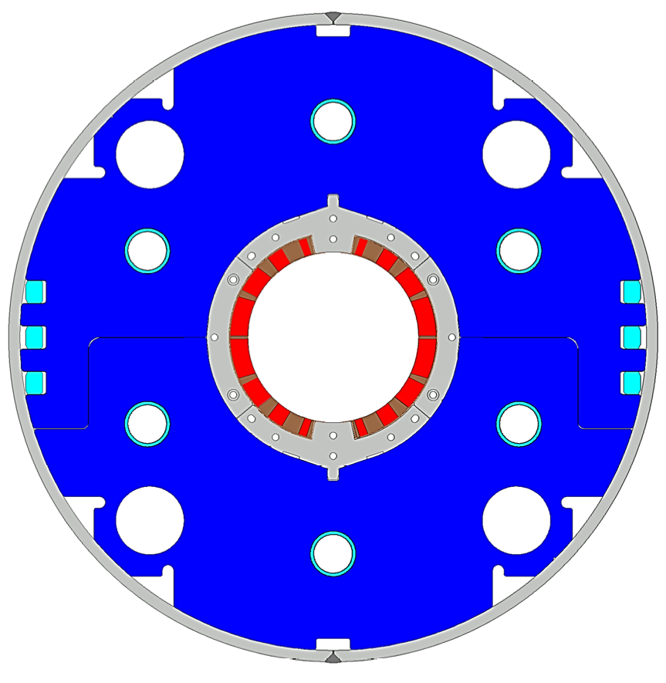
Flow of fabrication processes to yoked magnet
Coil winding
Collar
Nb-Ti/Cu coil
Electrical test
GFRP
wedge
Shell
Curing
Electrical test
Coil size measurement
Instrumentation (Only for model magnets)
Electrical test
Yoke
QPH
Insulation
Brass shoe
Preparation before QPH wrapping
QPH, Ground insulation wrapping
Brass shoe assembly
Collaring
Electrical test
Yoking
Electrical test

Slide 6
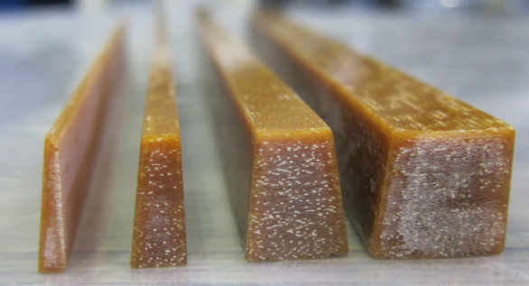
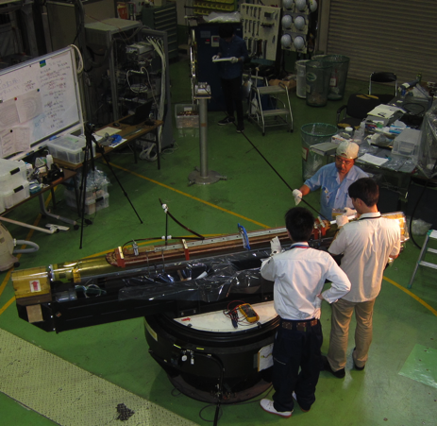
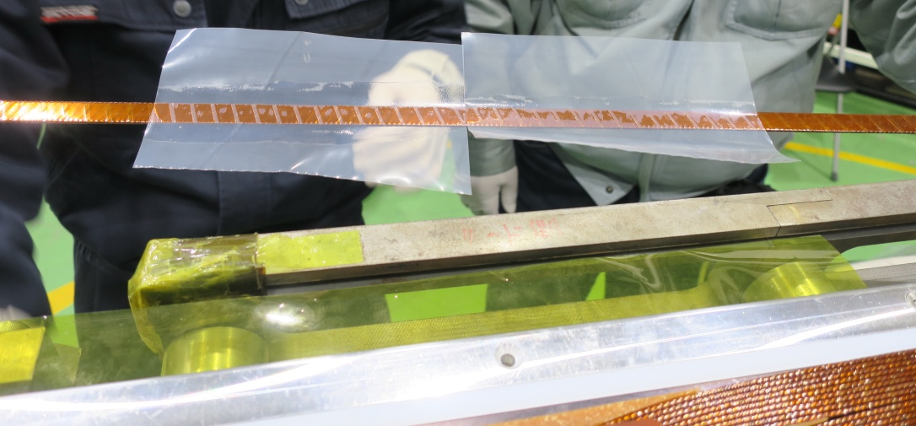
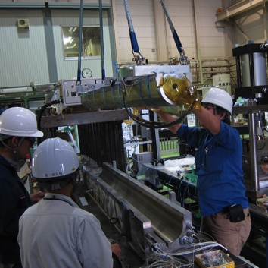
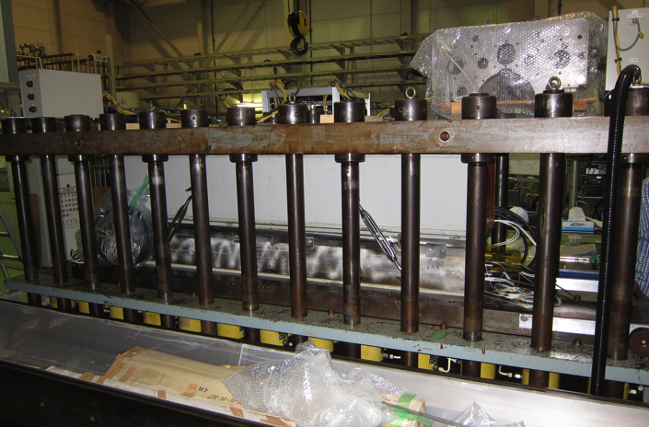
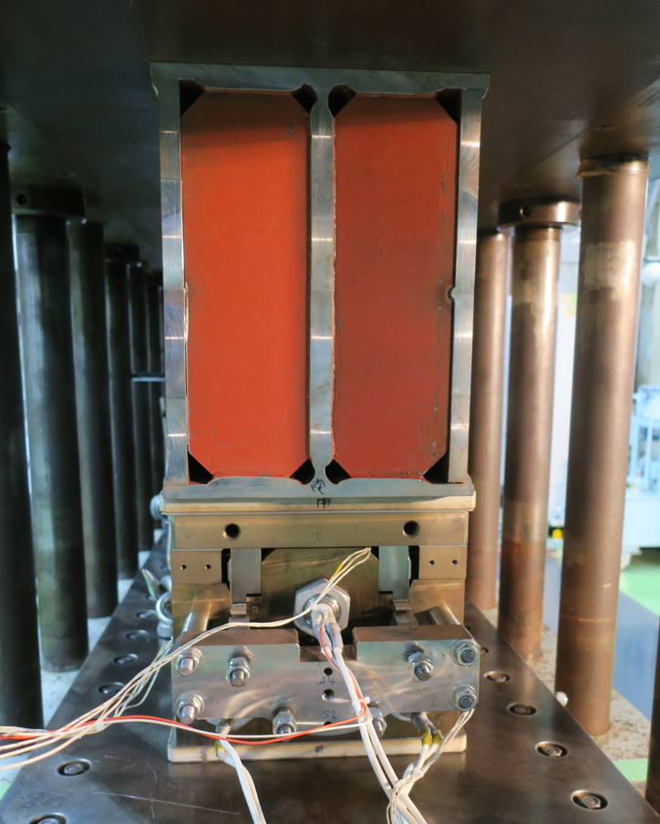
Coil winding ~ Curing
All the model magnets (MBXFS1–3)
were fabricated and tested at KEK.
Feeder
Tensioner
Coil winding
Cu/Nb-Ti cable
GFRP wedges
Wet-winding applied to coil end
Winding mandrel
Turn table
Curing
Pushing a coil into curing mold
Pressing and heating for coil forming

Slide 7
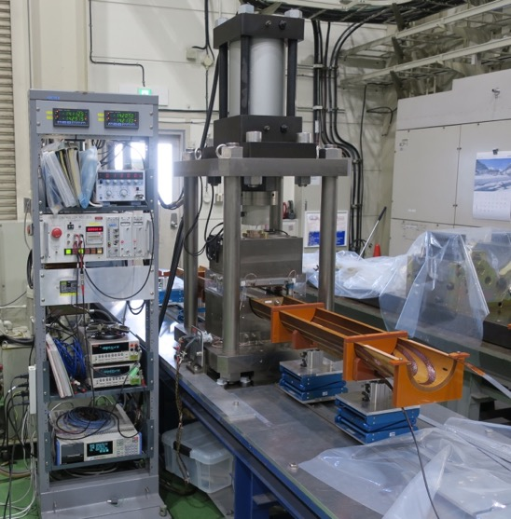
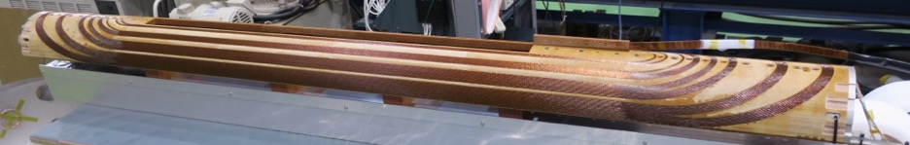
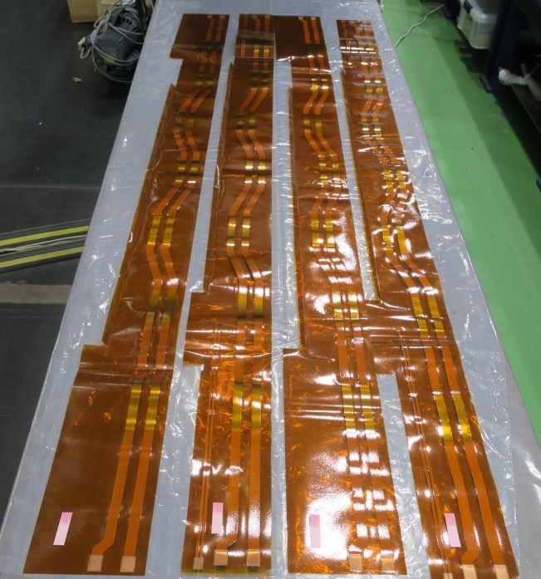
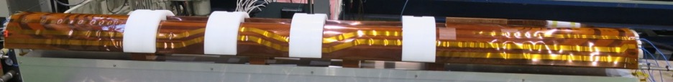
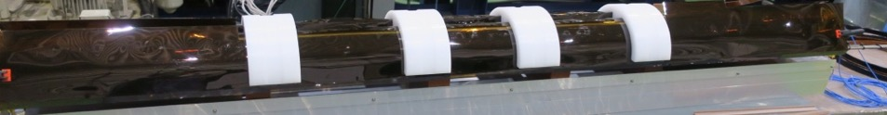
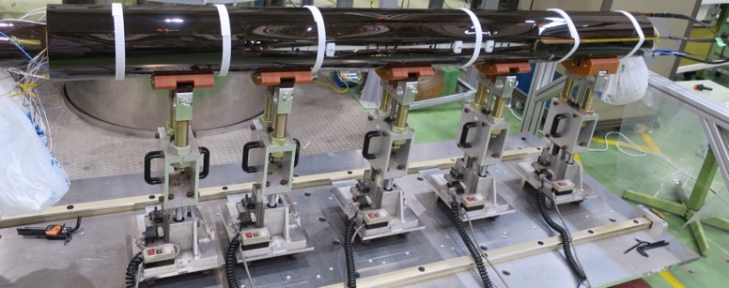
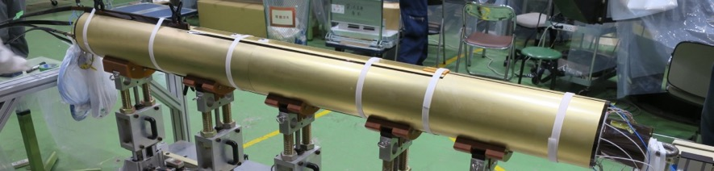
Coil size measurement ~ QPH, insulation wrapping
Coil size measurement
Coil is compressed to a certain size to evaluate azimuthal coil size
QPH, ground insulation wrapping
QPH composed of SUS strips sandwiched by polyimide insulations
Four layers of ground insulations
Brass shoe assembly

Slide 8
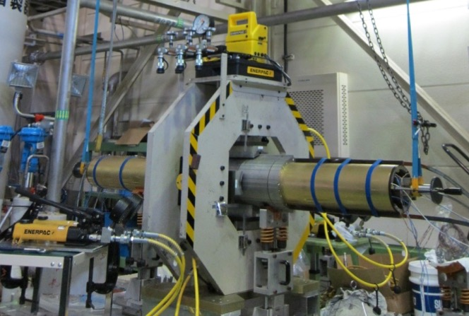
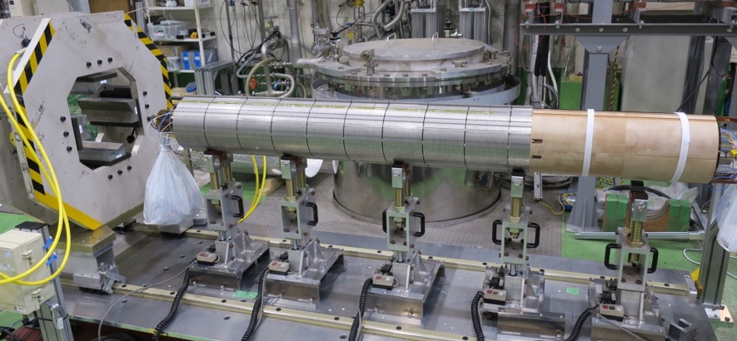
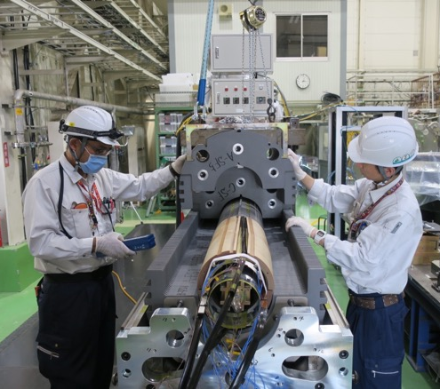
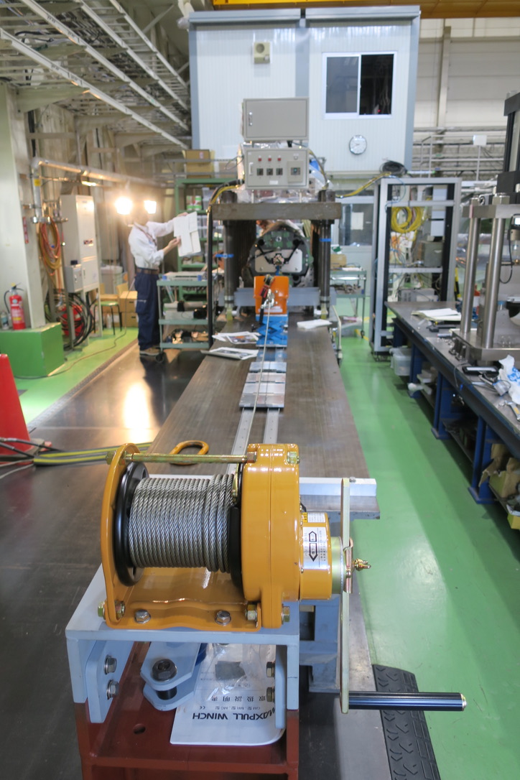
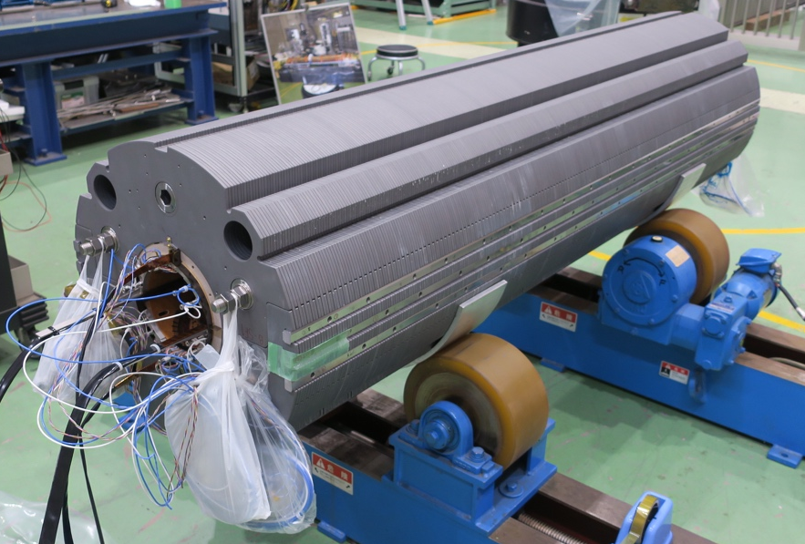
Collaring ~ Yoking
Collaring
SUS collar assembly by pressing
Yoking
Yoke assembly and key insertion
Coil pre-stress is mainly applied in yoking process
Removing collapsible collaring mandrel

Slide 9
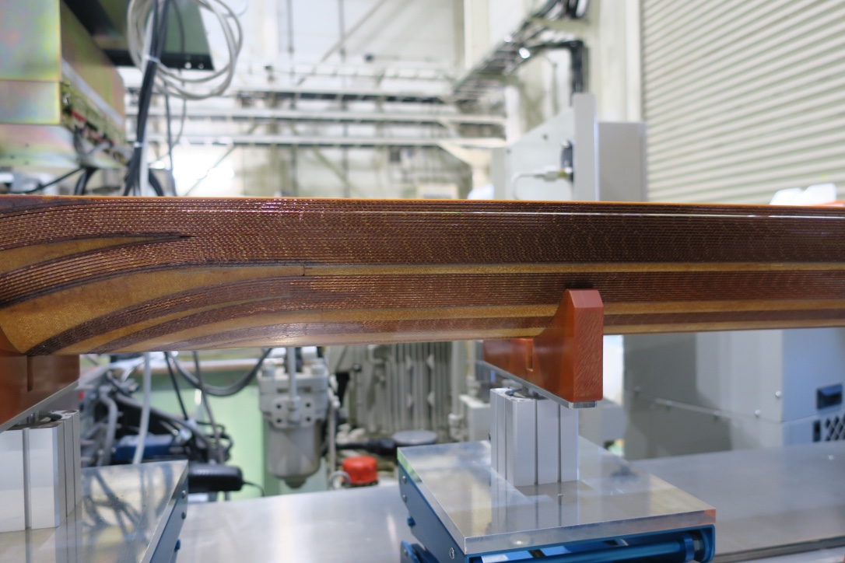
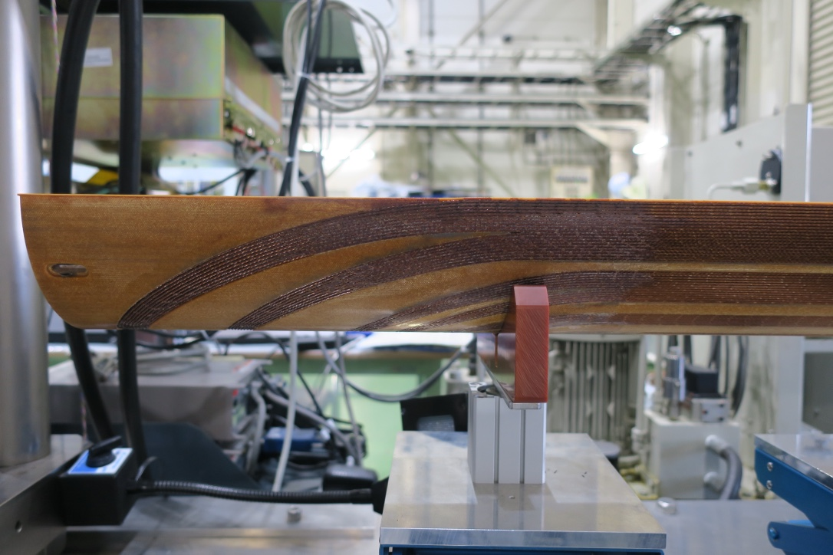
Feedback from model magnet development to prototype construction
ex. Consideration of curing condition in the second model magnet
Detachment
Different loading cycle
No detachment
Modified process
Shorter duration
time
Some issues have been solved through model magnet development.
The modified processes will be applied to prototype construction.

Slide 10
Electrical test
 | Coil resistance | Coil inductance | QPH resistance | Energy deposition test of QPH | Surge test | Hi-pot* test
After Coil winding
After curing
After instrumentation
Before QPH, GI wrapping
Before collaring
After collaring
After yoking w/o collaring mandrel
The condition of Hi-pot test was in compliant with EDMS2187266.

Slide 11
Measurements and inspections other than electrical test
Coil winding
Visual inspection of cable surface, longitudinal cable position and cable angle, longitudinal position of end spacers
Curing
Curing press: Vertical gap between pressing jigs, ground fault check by a multimeter, coil resistance, displacement by longitudinal loading, azimuthal coil pressure at MP by Fuji-paper test
Curing: Temperature monitor
Cured coil: Longitudinal position of end spacers, coil length
Collaring
Thickness of collar substacks
Collaring press: Coil resistance, ground fault check by a multimeter, azimuthal coil stress by strain gauges
Meas. after collaring: Outer diameter and length of collared coil, relative position of coil end w.r.t collar
Yoking
Thickness of yoke substacks
Yoking press: Vertica gap between pressing jigs, ground fault check by a multimeter, coil resistance, azimuthal coil stress by strain gauges
Meas. after yoking: Outer diameter and length of yoked magnet, relative position of coil and collar w.r.t yoke
The same measurements and inspections will be
performed in fabrication of a prototype

Slide 12
Preparation for constructing
7 m-long yoked magnet

Slide 13
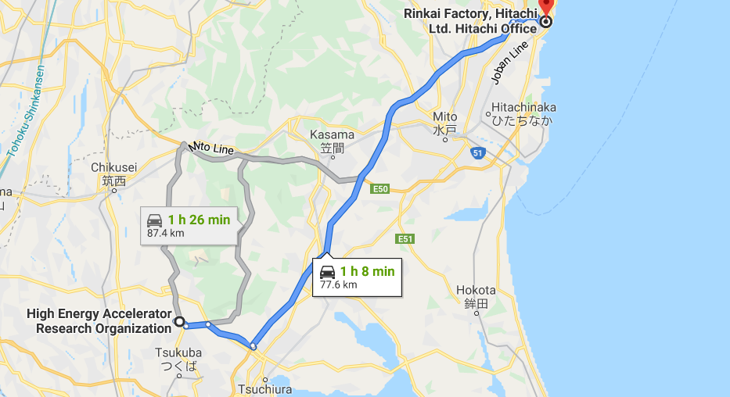
Manufacturing site
Distance between KEK and Hitachi, Ltd. is about 80 km
Total transportation distance until final delivery to KEK is
about 240 km (3 times for 1 magnet).

Slide 14
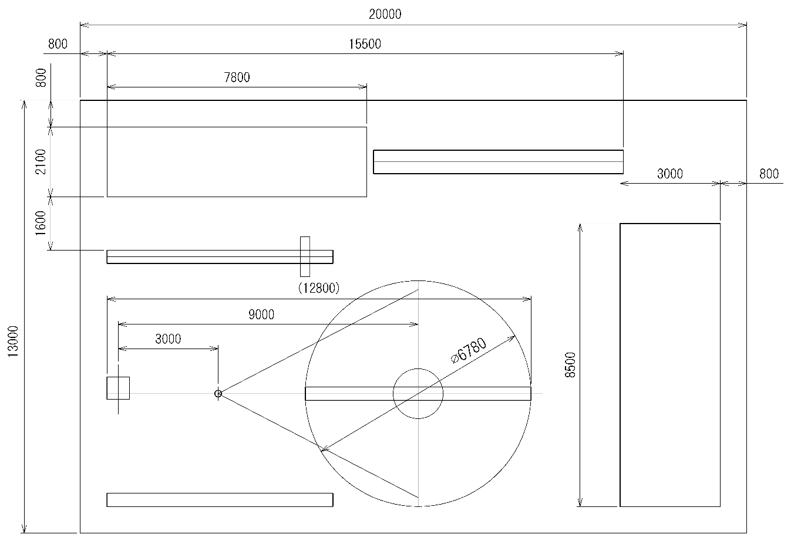
Layout of manufacturing site for a prototype
Unit: mm
Vinyl house, dust rejection & air conditioner
Preparation table of Yoking
Curing & Yoking press
Coil assembly and collaring
Winding
Welding area
Preparation of Curing/
Insulation

Slide 15
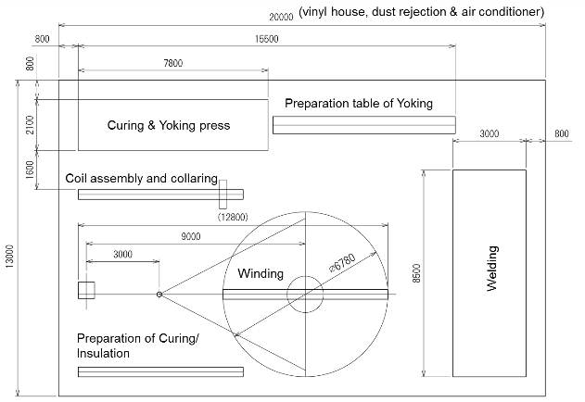
Layout of manufacturing site for series production
Unit: mm
Working area for yoking and welding will be moved to another building to keep cleanness necessary for coil winding.
Working area 1: 20m×13m
> Winding
> Curing
> Insulation
> Collaring
Vinyl house, dust rejection
& air conditioner
Working area 2: 24m×9m
> Parts storage
> Welding
> Yoking
> Pressurization test

Slide 16
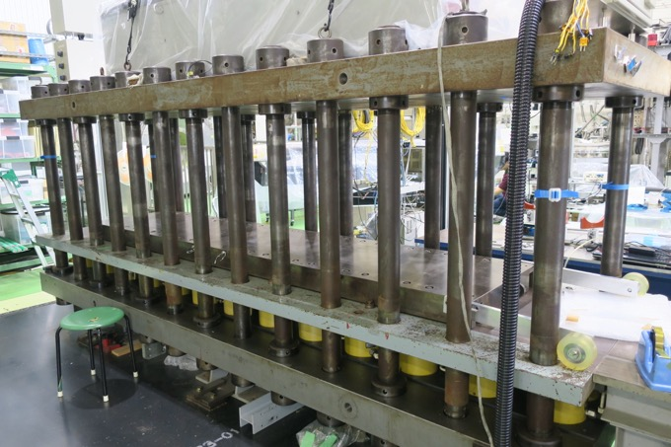
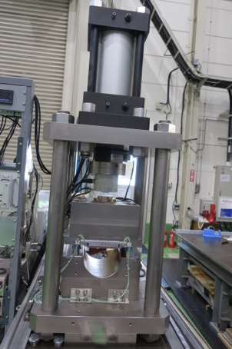
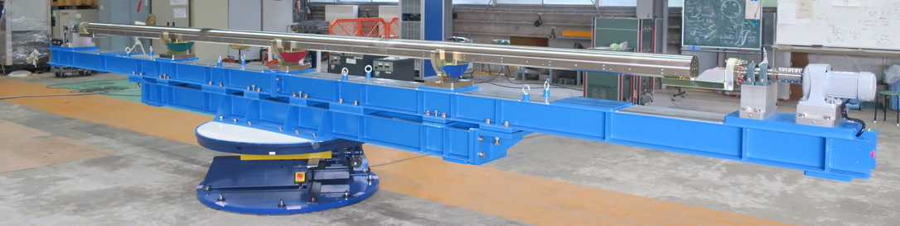
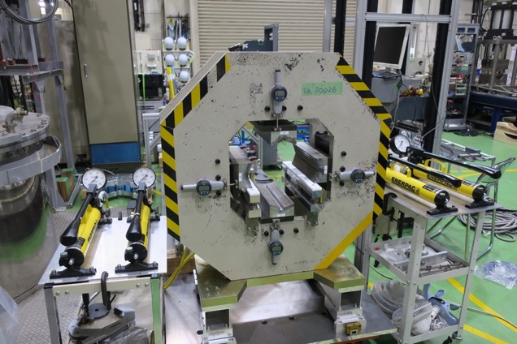
Preparation for toolings
Toolings provided from KEK to Hitachi
Winding machine
Curing press
Coil size measurement apparatus
Collaring press
Yoking press (same as curing press)
Toolings prepared by Hitachi
Forming blocks
Yoking jigs
Collaring mandrel

Slide 17
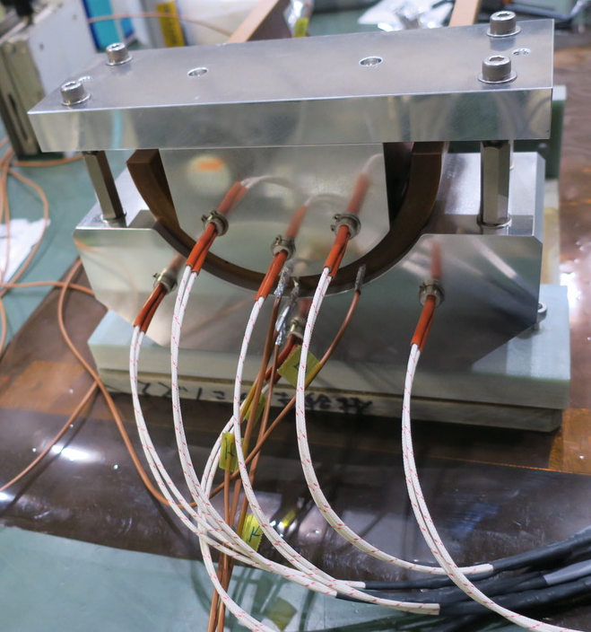
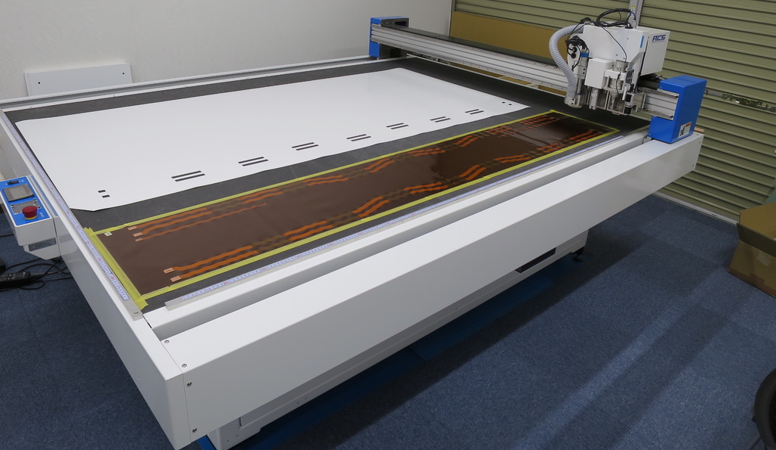
Technical updates from model magnets to a prototype
Coil winding
The winding machine for a 7 m-long coil has been installed and basic operation test was completed by KEK.
Resin sheet for wet-winding → under development by Hitachi
Curing
Gap filling with radiation resistant resin
→ R&D of new resin is ongoing by a company in collaboration with KEK.
QPH, insulations
Cutting 7 m-long QPH and ground insulations
→ Cutting by an automatic cutting machine was proposed by KEK to Hitachi
7 m-long winding machine
QPH cutting
R&D of resin

Slide 18
Procedure manuals
ex. Procedure manual and check list for curing
Check when this work
has been done
Date
Worker
Caution for safety
Caution to avoid
non-conformity
issue
Procedure manual and check list were prepared by KEK for fabrication of model magnets.
Similar documents will be prepared by Hitachi for manufacturing a prototype.
These documents will be written in Japanese and stored as applicable documents referred in MIP. As for the inspection reports, English language version shall prevail.

Slide 19
MTF
MTF for MBXFS3 (3rd model magnet)
BOM for a prototype
In model magnet fabrication, KEK uploaded material data sheets, inspection report and measurement results to MTF.
MTF for a prototype is now being prepared by CERN based on BOM.
The documents will be uploaded to MTF by KEK.

Slide 20
Technical transfer
from KEK to Hitachi

Slide 21
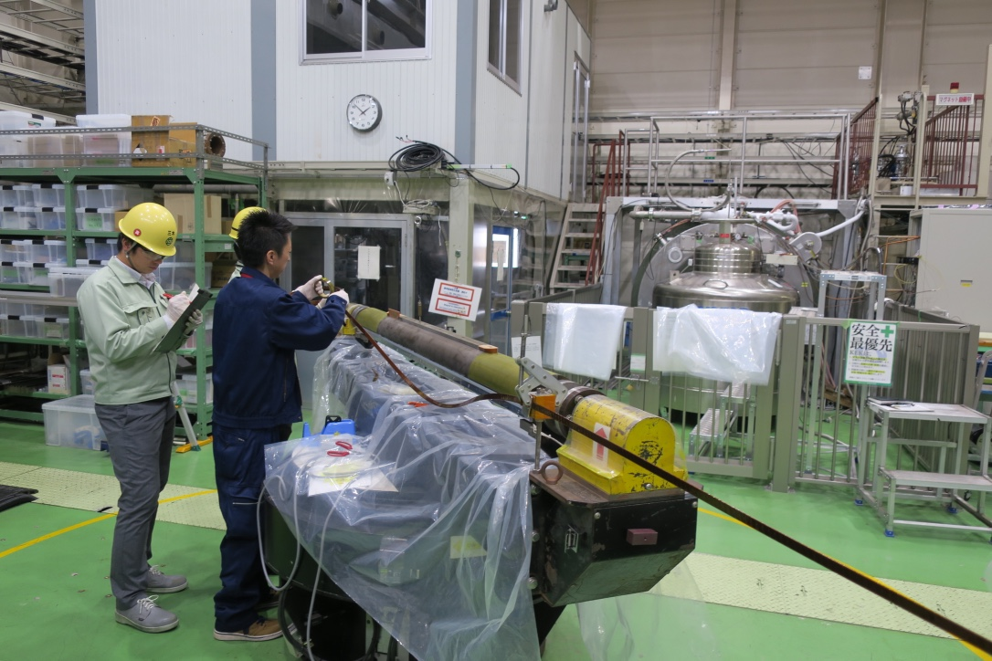
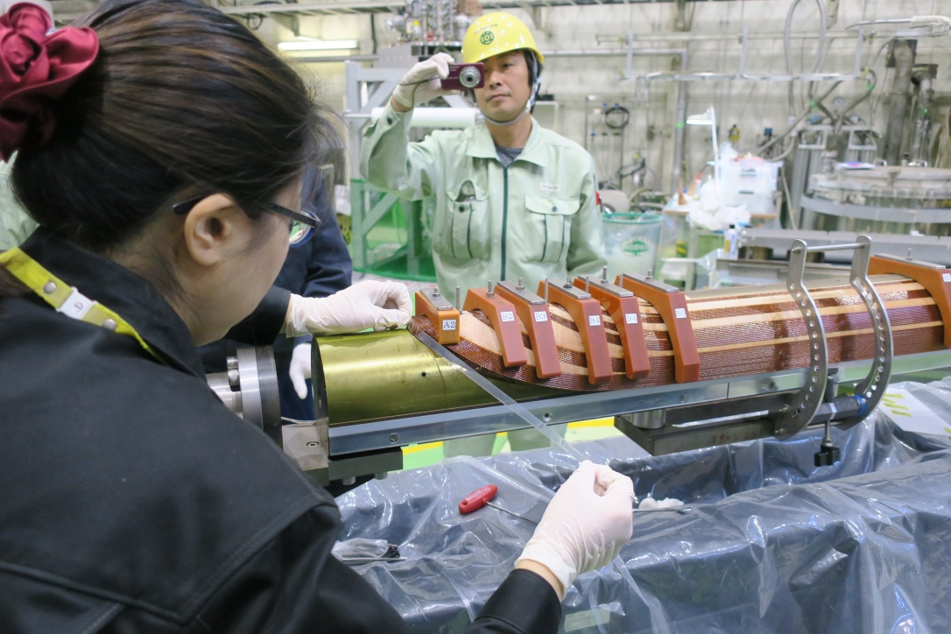
Hitachi’s experience in mode magnet fabrication
Hitachi started the cooperative research with KEK from Oct. 2016.
Through this research, Hitachi acquired detailed knowledge about model magnets including manufacturing.
Because Hitachi didn’t take part in the actual manufacturing of model magnets, technical transfer from KEK is necessary.

Slide 22
Drawings
All the drawings prepared for 2-m long model magnets have been provided from KEK to Hitachi. Design of collar and yoke will not be changed from the third model magnet, MBXFS3.
Coil cross-section will be changed from MBXFS3 to a prototype to improve field quality. The final drawings for coil wedges and end spacers is under preparation by KEK and provided to Hitachi soon.
The drawings of forming blocks and collaring mandrel were prepared by KEK and provided to Hitachi to save time.
Reference assembly drawings and drawings of toolings for a prototype have been also provided from KEK to Hitachi. Hitachi will make all the drawings for ordering.
After KEK’s approval of the drawings from Hitachi, parts and toolings will be placed an order. The final drawings will be uploaded to CDD.

Slide 23
Examples of drawings prepared by KEK
Coil
Ground insulations
Collared coil
Yoked magnet
Most of the parts used in model magnets can be applied to a prototype.
Assembly drawings of a prototype as a reference were also provided from KEK so that Hitachi can make necessary modifications easily.

Slide 24
Dry run of coil winding
A dry run of coil winding will be performed at KEK at the end of October before the winding machine is transported to Hitachi.
Purposes: Validation of winding machine in terms of workability and safety
Technical transfer to Hitachi’s worker
Items to be checked:
Winding machine: Rotating speed, braking distance, safety
Toolings: Workability to remove and attach the support jigs, cable support in the straight section

Slide 25
Fabrication of a 7 m-long test coil
A 7-m long test coil with the same cross-section as a prototype will be wound and cured at Hitachi with KEK.
Purposes:
Technical transfer from KEK to Hitachi
Validation of winding tools, wet-wining with resin sheets
Validation of curing
Practice for quality assurance: Electrical test, measurement during winding
Test of curing cycle: Temperature profile and homogeneity, pressure
Validation of coil handling tools: jigs for coil rotation and hanging
Coil size measurement
The cutouts from the straight section will be used for mechanical short model assembly

Slide 26
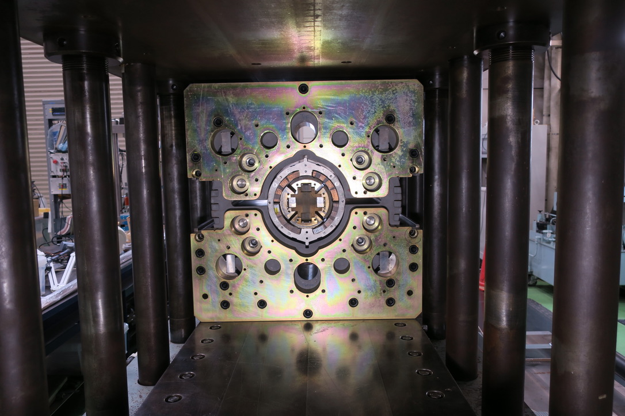
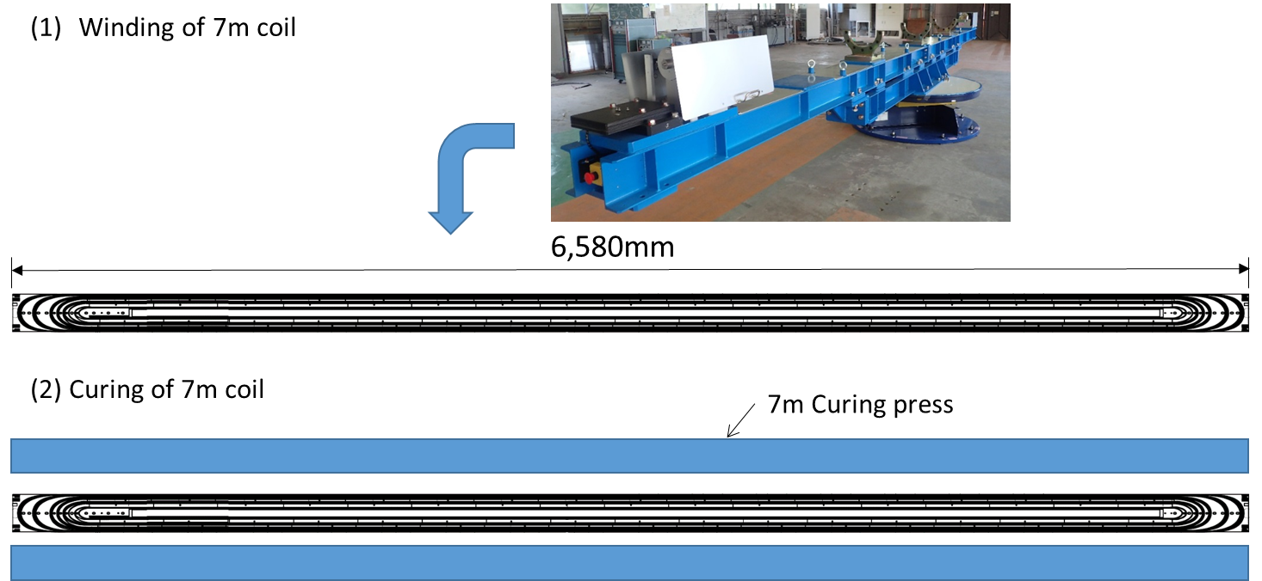
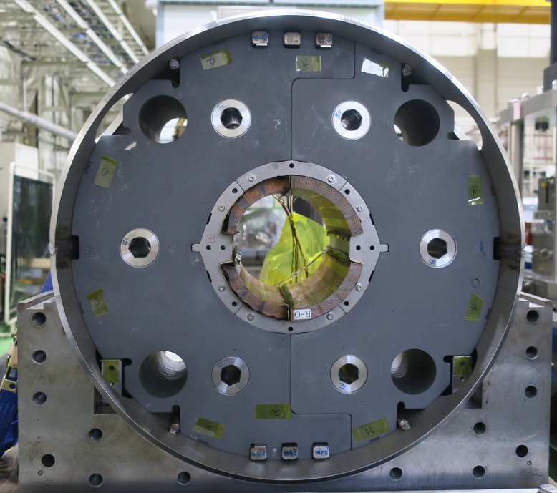
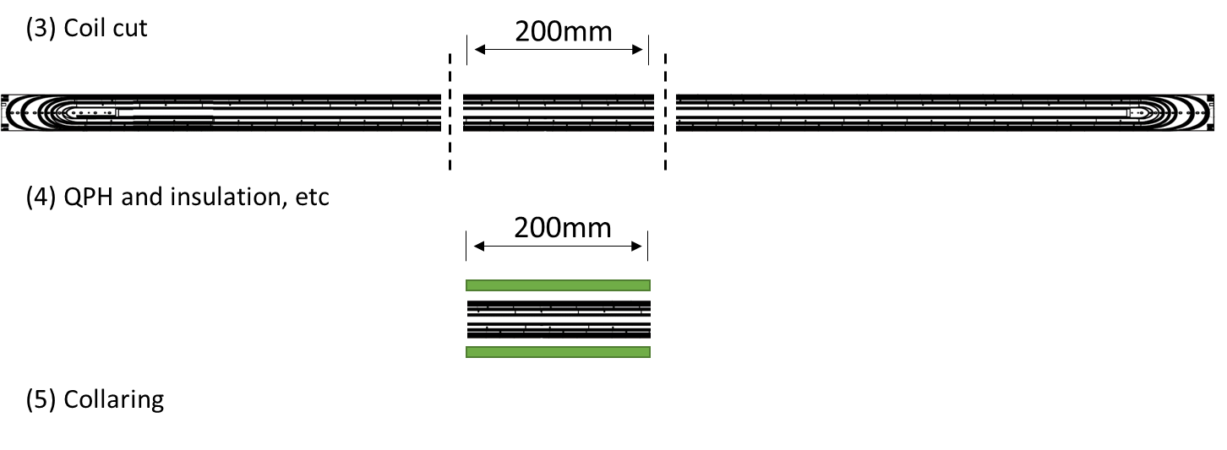
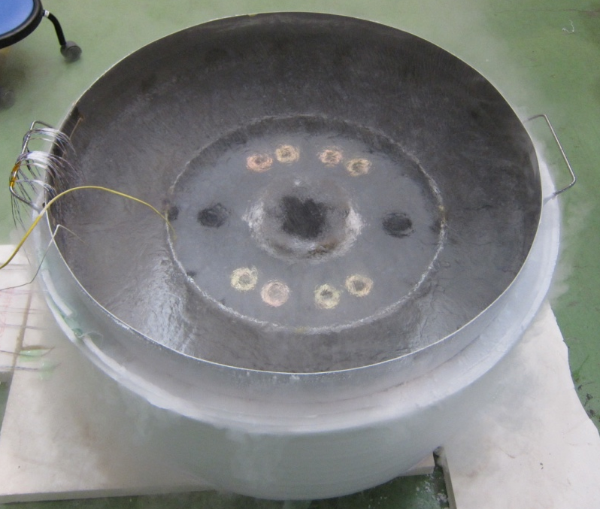
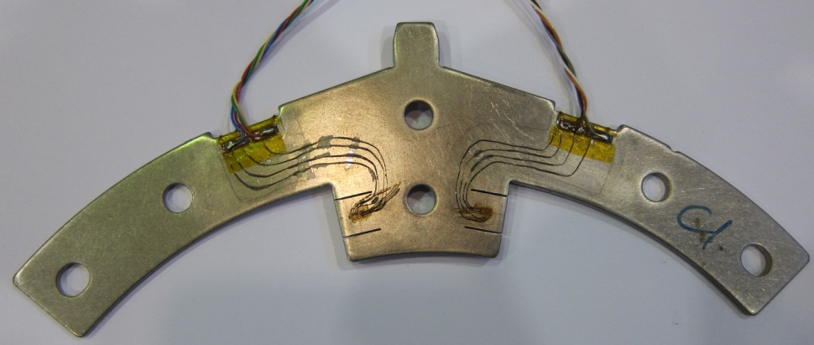
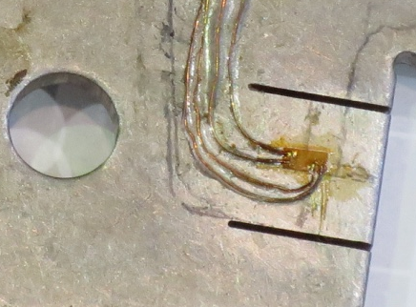
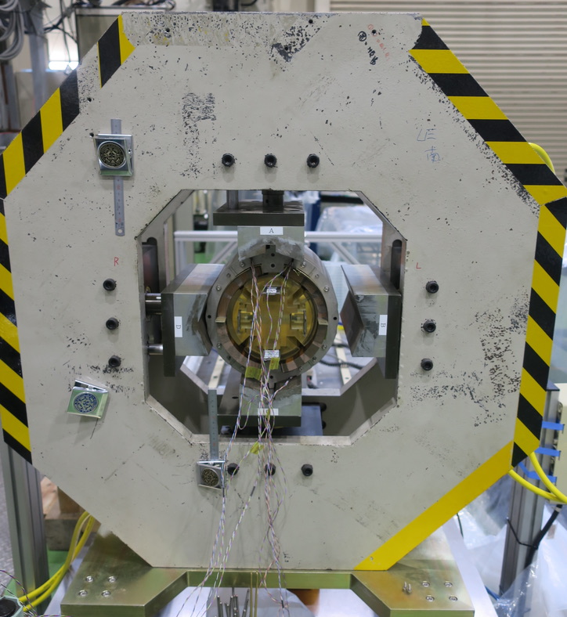
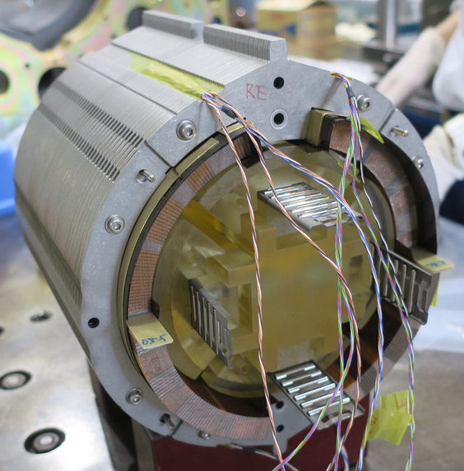
Mechanical short model assembly
7 m-long
test coil winding
Yoking
Curing
Shell welding
Coil cut
QPH, insulation
wrapping,
Brass shoe
assembly
Instrumented collar
Cooling-down
to 77 K
Collaring
Purposes:
Validation of wedge design to be applied to
a prototype by evaluating azimuthal coil
pre-stress
Technical transfer of magnet assembly

Slide 27
EIQA withstand voltage test

Slide 28
EDMS document for EIQA
ElQA test conditions are defined in EDMS2187266.
The test for the third model magnet (MBXFS3) already followed this criteria.

Slide 29
Maximum voltage condition for Hi-pot test
 | Coil | QPH | Inspector
Before QPH cutting | – | 4.6 kV | KEK
After yoking w/o collaring mandrel | 2.6 kV* | 4.6 kV | Hitachi
* Voltage is applied between one of the coils and the ground.
Another coil is grounded.
Maximum voltage condition of Hi-pot test up to yoked magnet in compliant with EDMS2187266.
Hi-pot test was performed at the same condition in MBXFS3.

Slide 30
Conclusion
7 m-long yoked magnet for a prototype of MBXF will be constructed in the processes similar to the model magnets.
Technical transfer from KEK to Hitachi is crucial in terms of quality and schedule.
Manufacturing procedures will be prepared by Hitachi based on those for model magnets and test coil fabrication.
EIQA test will be performed according to the conditions defined in EDMS document.

