Slide 1
LINAC3, LEIR: status of ISTs
C. Wetton, D. Nicosia, R. Scrivens, S. Jensen, R. Alemany, all equipment groups!

Slide 2
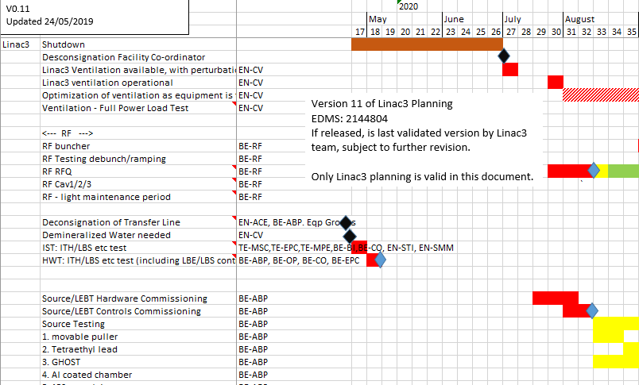
NOT VALIDATED - EXAMPLE
Source-Linac3 planning is kept for the moment in excel and as EDMS doc ➔ to be migrated to Microsoft Project by Richard

Slide 3
Title / description of the test | Servic es required | Access / safety impacts | Time need / anticipated readiness dates
Magnets + Converters ITH Line + LBS.BVT10 TE-EPC, TE-MSC, TE-MPE LBS.BVT10 – Full commissioning ITH.* light independent WIC test. | Electricity Controls | A 2 + 1 days access to switchyard for MPE + MSC (minimum) | 1 week IST 1 week HWT (2020-w17-18)
Linac3 Magnet Interlock test TE-MPE Validate WIC program, no current to magnets | Power 2 racks Controls for WIC | B Access to magnets needed (NO RFQ/IH powering) | 1 week IST 1 week HWT (2020-w17-18)
Proposed safety: Conditions are the Equipment Group Responsibility in the Shutdown
A: Ballisage and flashing around beam lines, and power converters
B: No equipment risk, sign on powered racks (low voltage systems + 220V)
C: Ballisage and flashing on moving equipment?, sign on powered racks (low voltage systems + 220V)
Not confirmed

Slide 4
Title / description of the test | Servic es required | Access / safety impacts | Time need / anticipated readiness dates
Beam Instruments in Switchyard (ITH and LBS SEMGrids, BCTs) BE-BI BCTs – Full commissioning, noise, calibration and timing commissioning. SEMGrids - IN/OUT movements. Injection of test signals from SEMGrid connector to front end** Final state – Ready for application tests. | Electricity Vacuum Compressed Air Controls | C 2 days access** | 1 week IST 1 week HWT (2020-w17-18)
LBS Slit EN-STI Validate movements, end stops and referencing. Final state – Operational | Electricity Controls | C Access requirements to be confirmed. | 1 week IST 1 week HWT (2020-w17-18)
** Test of SEMGrids requires 2 days tunnel access (ITH,LTB,LBS). As low voltage signals, could be advanced before access closed, if permitted and services ready.
Proposed safety: Conditions are the Equipment Group Responsibility in the Shutdown
A: Ballisage and flashing around beam lines, and power converters
B: No equipment risk, sign on powered racks (low voltage systems + 220V)
C: Ballisage and flashing on moving equipment?, sign on powered racks (low voltage systems + 220V)
Not confirmed

Slide 5
Title / description of the test | Services required | Access / safety impacts | Time need / anticipated readiness dates
Magnets + Converters Linac3 TE-EPC, TE-MSC, TE-MPE (MPE will have test the WIC earlier) All Converters and Magnets. Can include ITF.BHZ14 – condemned as “EIS” | Electricity Water Ventilation Controls | Operational conditions Need ITF.BHZ14 - condemned as “EIS” | 1 week IST 1 week HWT (2020-w27-28)

Slide 6
Title / description of the test | Services required | Access / safety impacts | Time need / anticipated readiness dates
Linac3 RF RFQ BE-RF Checks of sub-systems and in interlocking and ramp up to nominal amplitude. Verification of LLRF. Tube gain verification and replacement if necessary. Check of operation with different user cycles (number of pulses). Final state - ON at operational settings. | Vacuum Electricity Water Ventilation Controls | Operational conditions | 3 week IST (2020-w30-32)
Linac3 RF Cavity 1,2,3 BE-RF As above | Vacuum Electricity Water Ventilation Controls | Operational conditions | 4 week IST (2020-w38-41)
Linac3 RF bunchers, ramping, debuncher BE-RF Full commissioning, including interlocking (internal/external), powering, tuning, stability, timing, FESA class functionality (including different user cycles). At end of test, ready for LSA control test and beam commissioning. | Vacuum Electricity Water Ventilation Controls | Operational conditions | 8 week IST (2020-w36-43)

Slide 7
Title / description of the test | Services required | Access / safety impacts | Time need / anticipated readiness dates
Beam Instruments (Linac3 Faraday Cup SEMGrids, BCTs) BE-BI BCTs – Full commissioning, noise, calibration and timing commissioning. SEMGrids - IN/OUT movements. Injection of test signals from SEMGrid connector to front end Faraday Cups – IN/OUT movements. Suppression voltage. Signal noise test. Final state – Ready for application/OASIS tests. | Electricity Vacuum Compressed Air Controls | Operational conditions | 2 weeks IST (2020-w32+36)
Slits and Stripper and stopper mechanisms EN-STI, EN-SMM, BE-ABP Foils should be mounted before this test. | Electricity Vacuum Compressed Air Controls | Operational conditions | 1 weeks IST (2020-w32)

Slide 8
Title / description of the test | Services required | Access / safety impacts | Time need / anticipated readiness dates
Source BE-ABP, TE-EPC, TE-VSC, BE-RF Close source and pump down. Leak detection High voltage testing Solenoid power testing + heat run (with EPC) Sub-system tests Injection of microwaves (Note: Beam is produced already in the first week) | Electricity Vacuum Water Compressed Air Controls | Operational conditions | 4 weeks IST (2020-w29+32)

Slide 9
Linac3 responsible people to respond
Shutdown co-ordinator: C. Mastrostefano
Machine Operation Co-ordinator: E. Mahner
2020 Restart Planning (including ISTs): R. Scrivens
Magnets: D. Bodart (OK by Phone)
Power converters: S. Joffe (OK: 23/06)
Warm Interlock System: R. Mompo (OK: 24/05)
RF: G. Piccinnini, D. Valuch (OK: 04/06)
Source: D. Kuchler (OK: at 03/06 meeting)
Slits&Stopper: E. Grenier-Boley
Slits&Stopper Controls: C. Mitifiot
Beam instrumentation: F. Roncarolo (Info received – OK)
Controls: A. Dworak (Requested list of services – see next page)
CV: S. Deleval, R. Bozzi (Ventilation – note >1 month delay – Discussion this afternoon)
Vacuum: J. Ferreira Somoza (OK: 24/05 – Note about priorities if the proton chain needs more work)

Slide 10
Controls Requirements for Restart
Needed for W17 2020
  - CMW/ TIMING
  - LSA
  - Logging
  - LASER
  - OASIS
  - DIAMON
Needed from W32 2020
  - VISTAR/SIS
  - other specific – AutoPilot Services (Maciej Peryt)
Not needed
  - CESAR

Slide 11
Safety
Switch Yard
  Denis said the removal of the consignation for switchyard equipment has to be asked by EN-ACE. It can mean modification of the layout. I propose that we ask Fernando/Denis/Ana-Paula for a discussion.
  Access is requested in the switchyard for the ISTs.

Slide 12
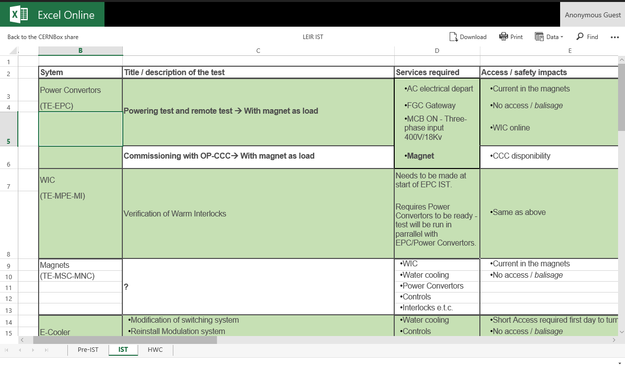
LEIR IST, pre-IST & HWC is for the moment being followed up with Excel Online
TO BE TRANSFER TO MICROSOFT PROJECT BY Chris & Dom

Slide 13
IST for LEIR/LN3 BCTDC
Title / description | Services required | Access / safety impacts | Time need / anticipated readiness dates | Shut-down | IST Period | HW comm.
Tests (S. Thoulet): HW testing done earlier Test system | Timing FEC White Rabbit Vistar | None | 0.5 days
To be filled by OP

Slide 14
IST for LEIR/LN3 BTVs
Title / description | Services required | Access / safety impacts | Time need / anticipated readiness dates | Shut-down | IST Period | HW comm.
Tests (S. Burger - ITE, ETL, EI, EE, ETP, PI) Connectivity tests Screens and Filters movements Check adjustable light intensity Check cameras Check FESA class (if timing available) Check calibration (if operational apps available) | Power 220V Compressed air Network (TN/WIFI) Controls (FESA3) Timing (GMT) | None | 0.5 days
To be filled by OP

Slide 15
IST for LEIR ionization profile monitor
Title / description | Services required | Access / safety impacts | Time need / anticipated readiness dates | Shut-down | IST Period | HW comm.
Tests (A. Frassier): Power on MCP Test acquisitions in FESA class (further tests require beam) | FEC on Timing | Yes, for visual inspection (1hour) | 1 day
To be filled by OP

Slide 16
IST for LEIR/LN3 SEMs
Title / description | Services required | Access / safety impacts | Time need / anticipated readiness dates | Shut-down | IST Period | HW comm.
Tests (F. Roncarolo): SEMGrids - IN/OUT movements. Injection of test signals from SEMGrid connector to front end | Electricity Vacuum Compressed Air Controls | Operational conditions | 1 day
To be filled by OP

Slide 17
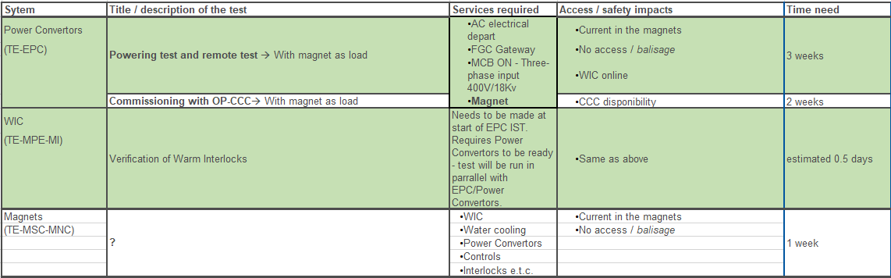
System | Title / description of the test | Services required | Access / safety impacts | Time need
Power Convertors | Switch On of electronics à check Ethernet, Interlocks and Measurements | AC electrical depart FGC Gateway | •No current on magnets, just access to the building | 1 week
(TE-EPC)
 | Test of electronics without pulses on Thyristors à The MCB is closed, but cables to thyristors are disconnected, check measurements and control loops | AC electrical depart FGC Gateway MCB ON - Three-phase input 400V/18Kv | No current on magnets MCB ON | 1 week
 | Test with dummy load à Small load used to simulate magnet |  |  | 1 week
Polarity tests and Audio-visual inspection

Slide 18
Title / description |  | Services required | Access / safety impacts | Time need / anticipated readiness dates
E-cooler (A. Frassier) | Startup with cold filament Heat filament Produce electrons | Vacuum Water cooling Power supplies unlocked Collector water-cooling Controls for power supplies | Access: Yes | 1 day
New
TFB (David Landre)
check interlocks and control PLC
2 days
B-Train electronics (calibration, WhiteRabbit transmission to TE-MSC-MM lab) in simulated mode
3 days
B-Train
(A. Beaumont)
No need of RF,BCT.

Slide 19
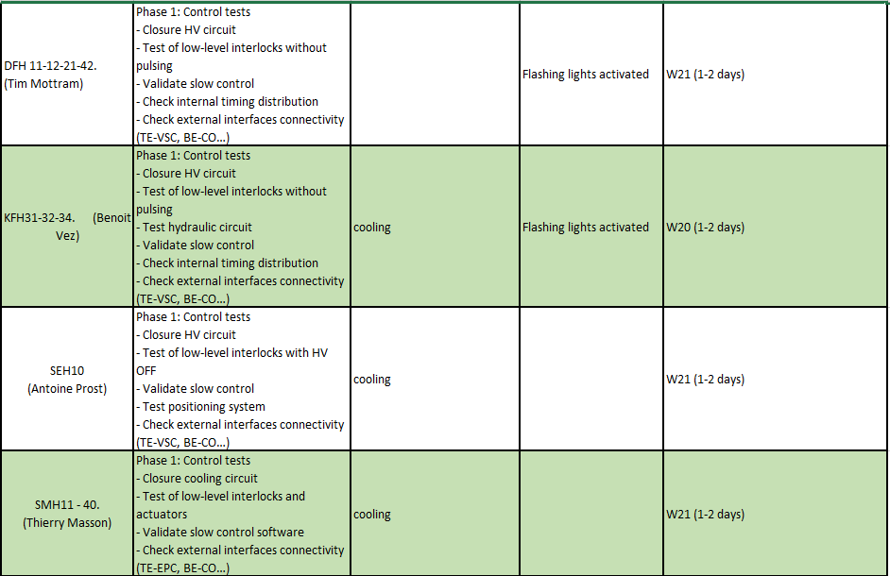
Phase 1

Slide 20
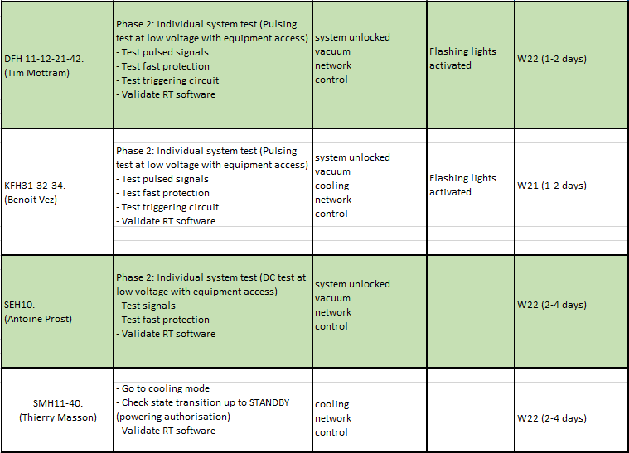
Phase 2

Slide 21
RF Power (BE-RF-IS) | Ring maintenance: |  |  | 2 weeks
 | •Cleaning Amplifier |  |  | To be scheduled last quarter 2019
 | •Replacing Ventilators
 | •Maintenance Grid circuit
 | •Replacing and renovate Screen Voltage circuit
 | •Verification Water circuit
 | •Some measurements with Networkanalyser
 | Platform maintenance: |  |  | 2 weeks
 | •Replacing Beam CTL Interface |  |  | To be scheduled last quarter 2019
 | •Replacing of PLC (Interlock)
LLRF (MEA) | 1. Tests of LLRF system as standalone (i.e. without HLRF and without WR Btrain) Functional system validation after the upgrade of MasterVME OS and FESA classes versions. a. Validation of function generators embedded in the LLRF. b. Validation of frequency program with a Btrain function generated internally by the LLRF via an embedded function generator. The correctness of the new charge-over-mass ration will also be checked. c. Validation of firm-timings operation (start various loops etc). d. Validation of the synoptics and their data exchange with the LLRF (controls and diagnostics). e. Validation of the Oasis signals. f. Validation of the alarms generation. | 1. Timings (with correct particle type in the telegram), full controls infrastructure 2. HLRF. 3. Btrain system |  | Total: 4 days 1. 2 days 2. 2 days 3. 1 day
 | 2. Tests with HLRF Functional system validation when interfacing with the HLRF. The Btrain will be generated internally by the LLRF via an embedded function generator a. Measurement of the LLRF-HLRF transfer function b. Re-commissioning and re-setup of the servoloops at harmonics 1,2,3,4, 6.
 | 3. Tests with WR Btrain system (no beam)
 | Functional system validation when interfacing with the new WR Btrain system. The aim if these tests are to validate the LLRF with respect to the WR Btrain system. They are not a replacement for the tests specified in the B-train commissioning proposal.
 | a. Validation of the optical fiber interfacing between LLRF and WR Btrain systems
 | b. Validation of the Btrain diagnostics
 | c. Validation of the frequency program when using the R Btrain as input.

Slide 22
Summary
Compilation of IST tests with time, services and safety requirements is very much completed
Still missing:
  BCTs
  BPMs
  Collimators
  TL beam stoppers
Richard Scrivens will migrate the Source and L3 IST planning to Microsoft Project
Chris Wetton and Dom Nicosia the LEIR IST planning to Microsoft Project
Next steps:
  Another meeting will be organized within the LIU-IONs hardware and beam commissioning working group to do the actual schedule
  Put all this in Project (template to be provided by Julies’ team)
  Handover the plan to Julie’s team for integration with other machines’ plans
  Start iteration to solve potential conflicts
We have already started to fill the HWC tests
We are reviewing the HWC and beam commissioning check lists

