Slide 1





Monte Carlo Model of High-Gradient Conditioning and Operation
Lee Millar^{1,2}
¹Lancaster University Engineering Department: Graeme Burt
²CERN, BE-RF Section: Walter Wuensch
RF Development Meeting
13/05/2020

Slide 2



Backstory
Notes:
Talks started a year ago.

Slide 3
Disclaimer: Types of Conditioning
Intrinsic (BDR Conditioning):
Modification of the cavity material properties through repeated exposure to high fields.
Breakdowns nucleated by mobile dislocations in metal, largely stochastic behaviour.
Results in a sustained increase in propensity for establishing high fields.
I’ll be referring to this one today.
Extrinsic (Vacuum Conditioning):
Limited by vacuum activity.
Related to the removal of contamination on the surface. Breakdown may also be nucleated by such residual particulates.
Prevalent at low power in the early stages of conditioning, “cleans” component.
Notes:
Tensile stress induces plastic behaviour, i.e. creates dislocations.
Dislocations move to surface to reduce energy.
Projection of dislocation on surface in nucleation point for continuation of breakdown process

Slide 4



Contents
Overview of High Gradient Conditioning.
Motivation for Modelling.
Simulation Setup.
Results of the Model.
Conclusion and Future Work.

Slide 5
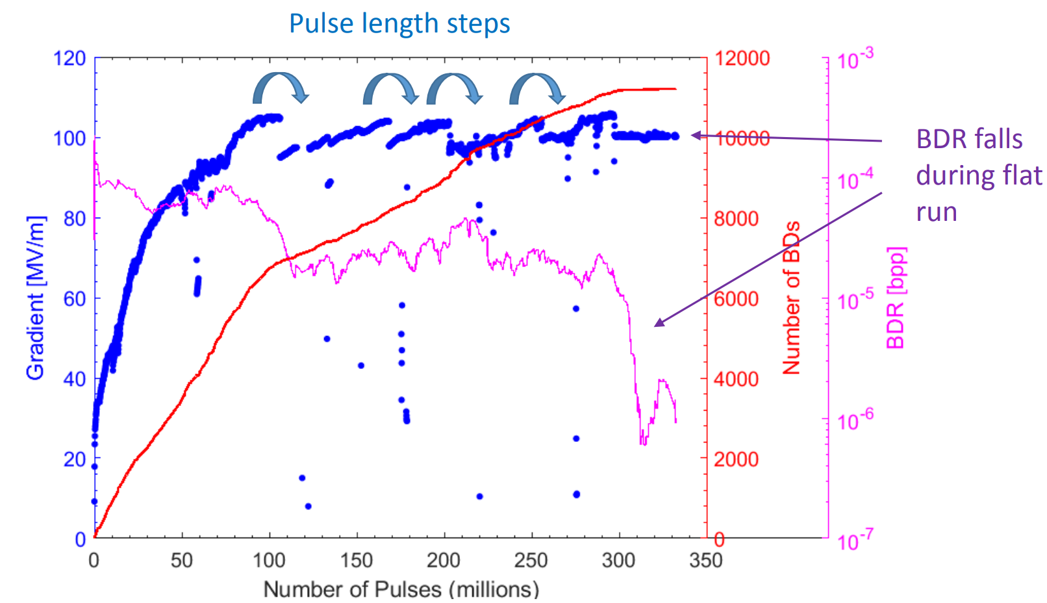
High Power Conditioning
To date the Xbox test stands have successfully conditioned many structures (and high power RF components).
Generally follows three phases:
Increasing gradient/power while keeping constant BDR.
Drop the power, increase the pulse length (50, 100, 150, 200ns) and ramp back up.
Finally, the BDR drops.
Work hardened copper
Figure: A typical conditioning curve.

Slide 6
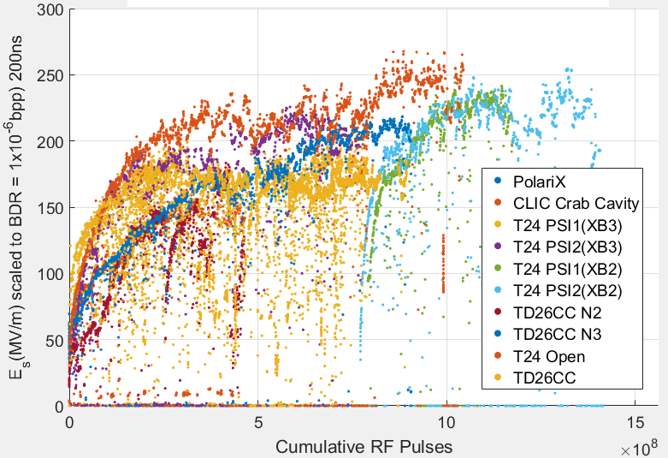
High Power Conditioning
Conditioning is now automated and accomplished algorithmically [1,2].
Occasionally we must deviate from the “ideal” case, but the behaviour is typically comparable.
A key point is that conditioning takes many (≈hundreds of millions) pulses and is reproducible, implying a well defined underlying physical mechanism.
Figure: Initial conditioning of many structures conditioned to date normalised to BDR and Pulse length. Note the asymptotic behaviour.

Slide 7
High Power Conditioning
Conditioning is now automated and accomplished algorithmically [1,2].
Occasionally we must deviate from the “ideal” case, but the behaviour is typically comparable.
A key point is that conditioning takes many (≈hundreds of millions) pulses and is reproducible, implying a well defined underlying physical mechanism.
Several other observations have emerged too…
“Typical” Behaviour
Work hardened copper
Figure: Typical behaviour overlaid on existing structure test data.
Notes:
Dynamic, changes with time I.e long time and history, and short timescale (plasmons, pulse shape), single pulse i.e. bd

Slide 8
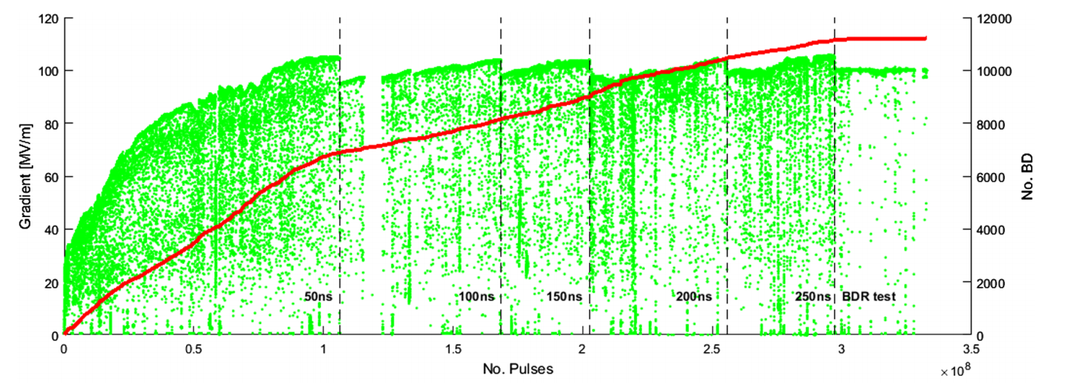
High Power Conditioning Limit
However we cannot condition indefinitely, there is an intrinsic limit which cannot be exceeded (the asymptotic behaviour shown below).
Quasi-limit
Figure: Full conditioning history of a TD26CC [3].
Notes:
220MV/m, beta of 30 or at least 10s range means we have GV fields which rip deformations/emission sites apart.

Slide 9
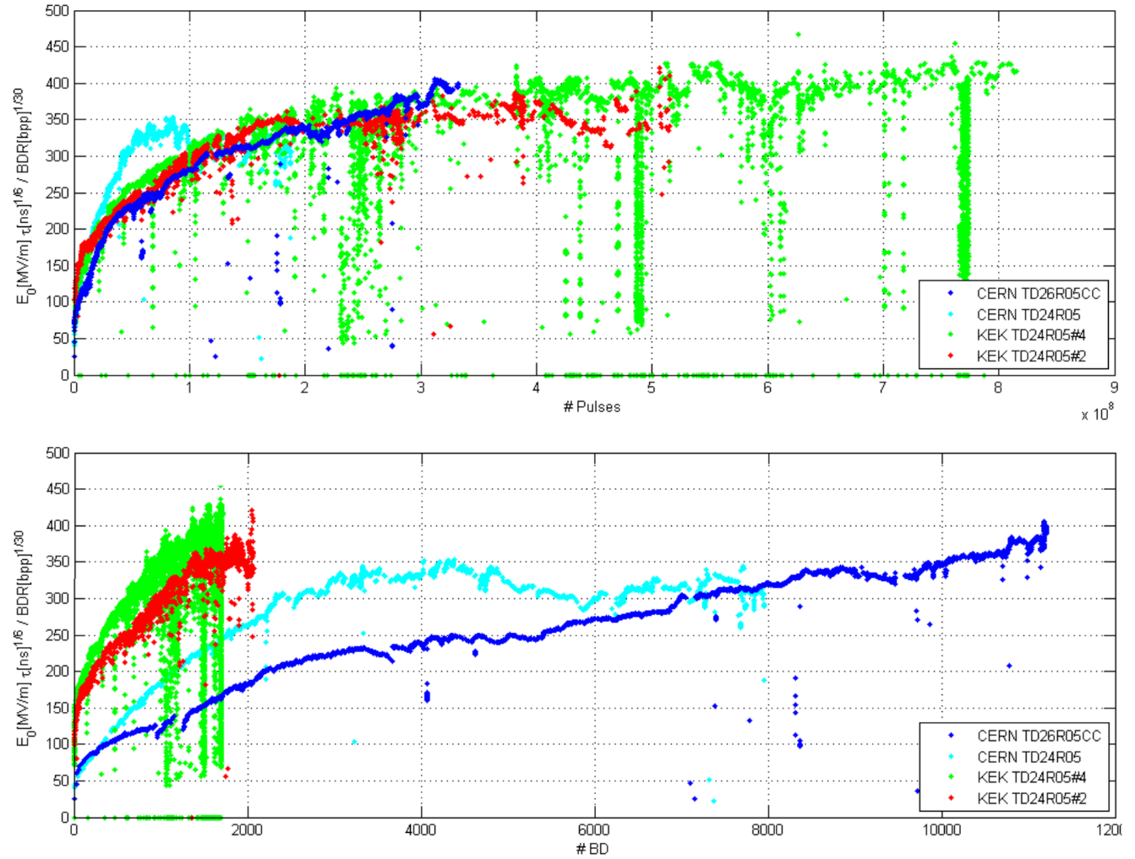
The Conditioning Process
Initially suspected that BDs were the quantity on which we condition.
Later proposed that structures condition on the number of pulses not the number of breakdowns [3].
Cleanliness of preparation was however shown to affect number of breakdowns during conditioning, not ultimate performance [4].
Figure: Scaled gradient vs. cumulative no. pulses (top) and scaled gradient vs. cumulative no. breakdowns (bottom) for four different structures[3].
Notes:
Mevex still condition on BDs.
In 2010 SLAC conditioned two identical structures, one of which was built processed and hermetically sealed at KEK then assembled at SLAC under the best available conditions similar to those of superconducting cavities while the other was subject to conventional methods (18). nt: ≤ 3x10⁻⁷ bpp/m.

Slide 10
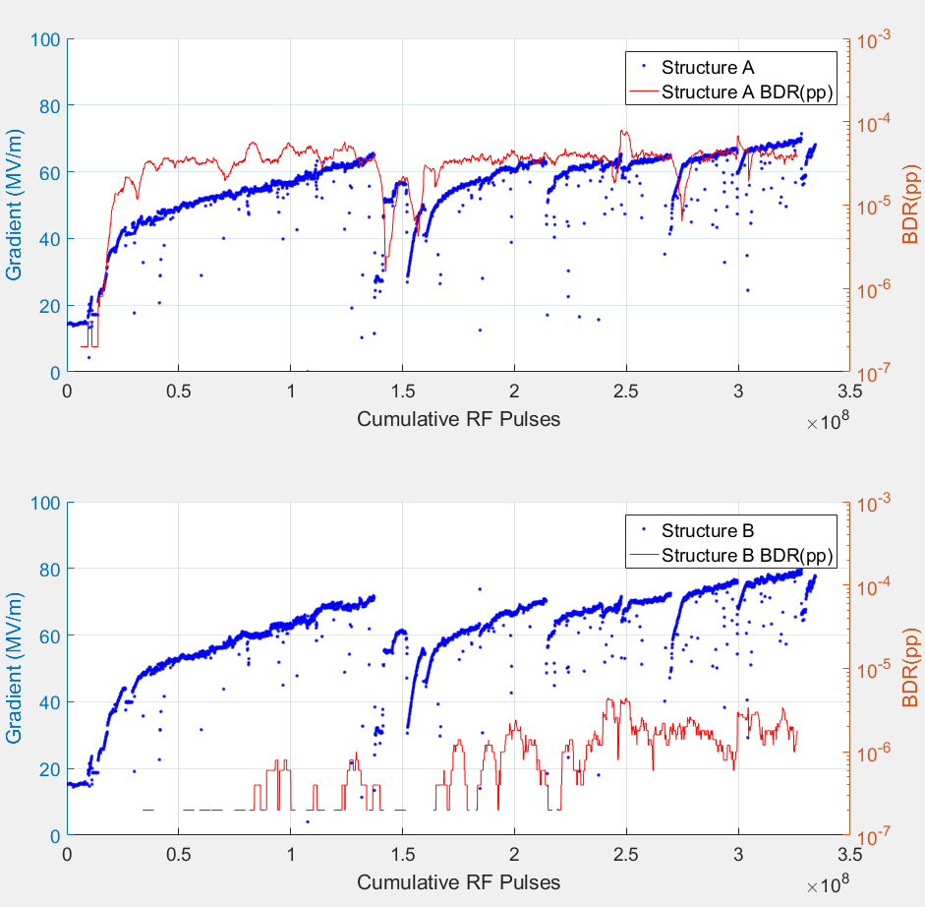
Recent Evidence for Conditioning on Pulses
The ongoing superstructure test shows one structure to have a BDR orders of magnitude lower than the other.
Structure A ≈ 11,000 BDs
Structure B ≈ 400 BDs (some of which were provoked)
Reasonable evidence for this hypothesis.
Figure: Superstructure test results showing structure A (top) and structure B (bottom).
Notes:
Provoked by reflected power in 2nd structure. Also we had software issues where it send a long flat pulse with same peak power, provoked BDs in both.

Slide 11
Interpretation of Conditioning
If held sufficiently close to inducing breakdown, the surface’s propensity to establish high field/endure power flow increases (what we call conditioning).
Unconditioned = high BD probability at low power/field.
Conditioned = low BD probability below the level to which it has been conditioned.
However we can’t condition indefinitely, each material has an intrinsic ultimate limit above which we cannot condition/operate.
Maximum Permissible BDR
Characteristic of a poorly conditioned structure
Breakdown Probability
Ultimate Field Limit
Conditioning shifts this line.
Characteristic of a well conditioned structure
Electrical Quantity e.g. Input Power

Slide 12
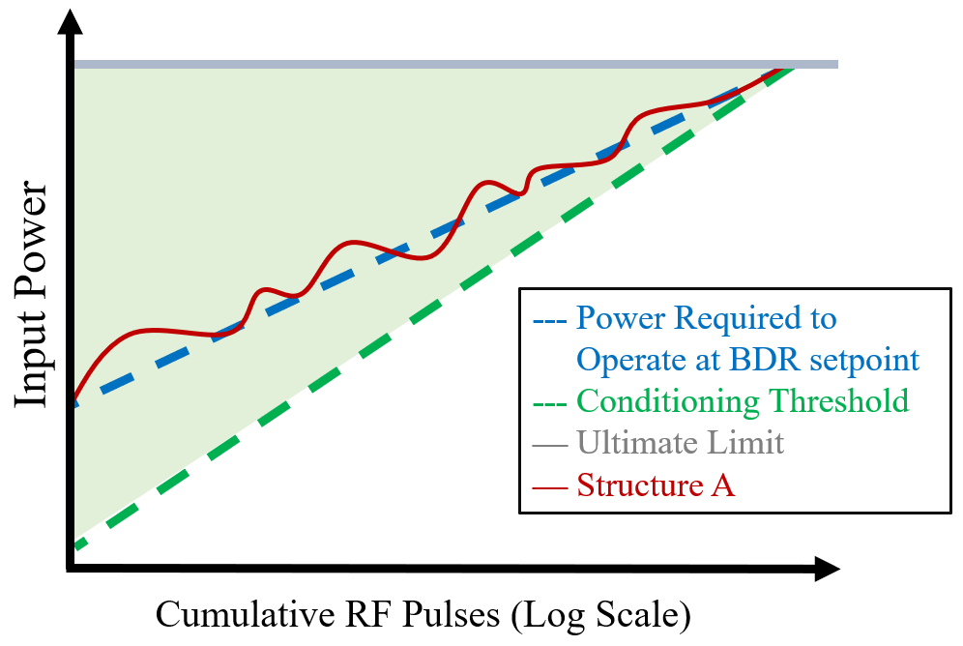
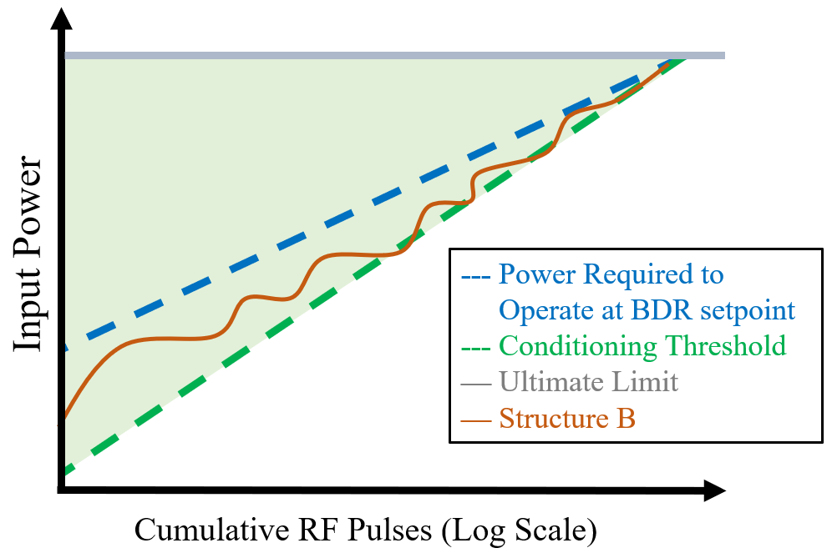
Interpretation of SuperStructure Results
Notes:
With the BDR as our process variable our conditioning algorithm then acts as a PID loop which tracks this BD threshold.
It appears that the second structure has consistently been held sufficiently close to breakdown to condition, but not to induce the breakdown itself.
If this interpretation is correct, it has some interesting implications

Slide 13
Low BDR Conditioning Regime
Suggests increasing the input power while remaining below the point of breakdown induction should allow conditioning to high power without inducing breakdown.
Currently impracticable, breakdowns are the mechanism on which we feed back (unless we use a sacrificial cavity).
But is it worthwhile to do so?
This is a talk for another occasion….
Input Power
-- Power required for __ __ __significant BD probability.
-- Conditioning Threshold
—Ultimate Limit
— Low BDR conditioning __Regime.
Cumulative RF Pulses (Log Scale)
Notes:
In other words the breakdowns may be mostly inessential.
We accumulate thousands of BDs and still operate at HG.

Slide 14
Contents
Overview of High Gradient Conditioning.
Motivation for Modelling.
Simulation Setup.
Preliminary Results of the Model.
Conclusion and Future Work.

Slide 15
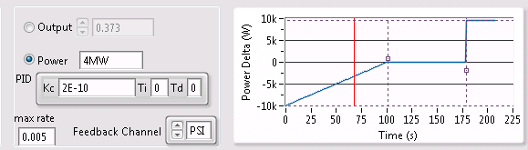
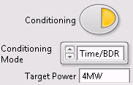
Automation of Conditioning
Several years ago a conditioning algorithm was developed on XB1 to automate conditioning using a two level hierarchy (respond to short and long term behavior).
Short-term behaviour (seconds to minutes):
Steps up in power regularly, BDs can cause a drop in power.
Long term behaviour:
BDR is measured in a user defined window.
If above the user defined threshold the power level can no longer be increased.
Subsequent breakdowns will still reduce the power as described previously.
A BD here would cause a drop in power by 2.5kW
Note: There are of course other interlocks which are not mentioned on this slide.

Slide 16
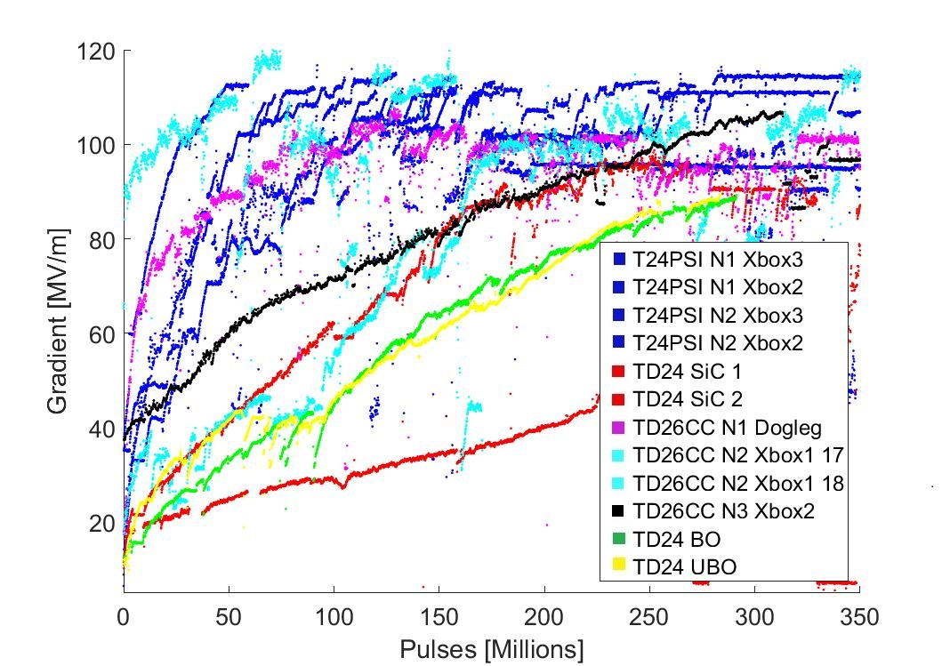
Automation of Conditioning
Was implemented pragmatically, similar empirically derived procedures also in place at KEK, Daresbury, SLAC.
Has since conditioned many structures however to my knowledge was never the subjected to thorough modelling and optimisation.
Any features added/tuned were done so as a consequence of operational observations i.e. responsive implementation.
Figure: Conditioning curves for various X-band structures.
Notes:
It worked and so parameters were carried forward, other facilities have their own algorithms in place

Slide 17
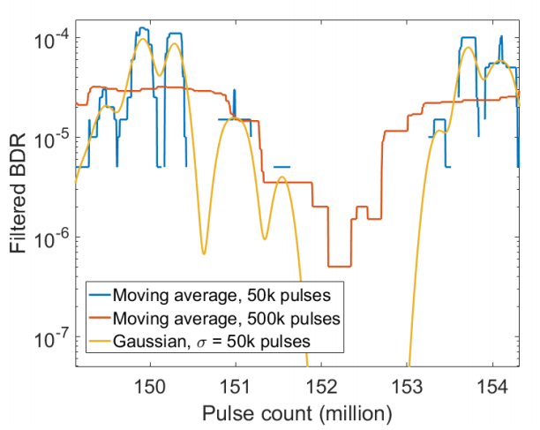
Why Model Conditioning?
In recent years several suggestions have emerged:
Cluster management (implemented).
Recovery mode following large power drops.
Gaussian BDR measurement window to improve dynamic behaviour.
Of course tests require a long timeframe and significant expense…
Would be nice to examine the macroscopic consequences of such features without the risk (and monetary/temporal expense) of sacrificing a structure.
Figure: Comparison of BDRs calculated with different windowing presented by Jan Paszkiewicz in 2018 [5].

Slide 18
Contents
Overview of High Gradient Conditioning.
Motivation for Modelling.
Simulation Setup.
Preliminary Results of the Model.
Conclusion and Future Work.

Slide 19
Another disclaimer…..
As Sergio kindly pointed out a very nice study on the LES was also previously carried out however with some different objectives.
Today I’ll be focusing on macroscopic consequences of algorithmic changes in our conditioning procedure in the test stands.

Slide 20
Conditioning Process
Evidence suggests we condition on pulses, the present model is then fundamentally built around the idea of progressive modification of the surface on a pulse to pulse basis.
Of course we’ll need some behavioural characteristics on which to base any assumptions we make.
Notes:
Does exclude some features, pulse length, time of bd in pulse etc.

Slide 21
Conditioning Simulation: Broad overview
Exit simulation and plot
Software PID Loop
(Determines characteristics of next pulse)
Pulse goal met
Calculate BDR
Pulse goal not met
Input Values
Run
Modify Surface
Pulse RF
Check for BD
Notes:
Looks at probabilistic behaviour of test stand as a whole.
The present model is built around an idea of progressive
surface modification

Slide 22
Conditioning Simulation: Broad overview
Exit simulation and plot
Software PID Loop
(Determines characteristics of next pulse)
Pulse goal met
All but two of these functions are already well defined.
Calculate BDR
Pulse goal not met
Input Values
Run
Modify Surface
Pulse RF
Check for BD
?
Notes:
Looks at probabilistic behaviour of test stand as a whole.
The present model is built around an idea of progressive
surface modification

Slide 23
Conditioning Simulator: BD Probability
We then need several functions which encapsulate our previously observed behaviour… let’s first define a few useful terms.
E_{Operate}= The accelerating gradient at which we operate.
E_{State} = Represents the conditioned state of the surface, modified on a pulse to pulse basis.
E_{Sat} = The maximum achievable gradient, i.e. saturation point (typically ≈ 110-120MV/m).
Notes:
OR BDR=10^-5(Eoperate/Estate)^(15x(1+Eoperate/Estate))

Slide 24
Conditioning Simulation: Surface Modification
Based on our previous interpretation let us assume the structure exists in a certain conditioning state, E_{state} and we pulse at a given field level E_{operate}.
We need a term to modify the surface every pulse i.e. describe conditioning.
It must increases with E_{operate} but approach zero in the later stages of conditioning as we reach the limit, E_{sat}.
E_{Sat}
E_{State}
E_{operate}
Gradient (MV/m)
Cumulative RF Pulses
Figure: Visualisation of proposed quantities during conditioning.
24

Slide 25
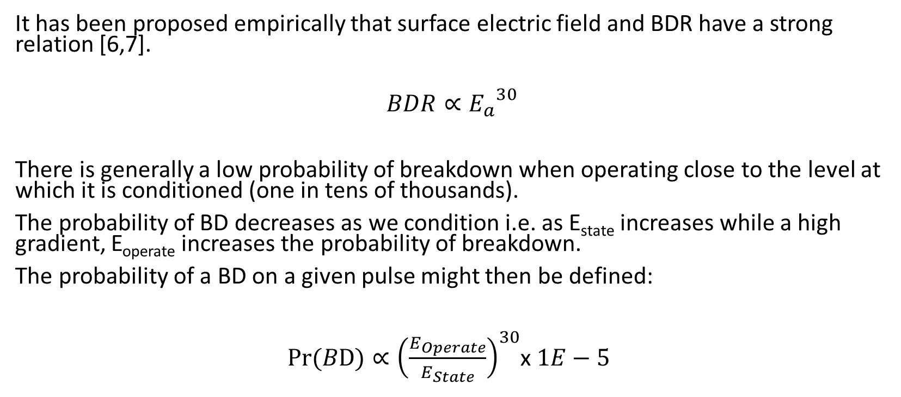
Conditioning Simulator: BD Probability
It has been proposed empirically that surface electric field and BDR have a strong relation [6,7].
$$BDR∝{E_{a}}^{30}$$
There is generally a low probability of breakdown when operating close to the level at which it is conditioned (one in tens of thousands).
The probability of BD decreases as we condition i.e. as E_{state} increases while a high gradient, E_{operate} increases the probability of breakdown.
The probability of a BD on a given pulse might then be defined:
$Pr⁡(BD)∝{\left(\frac{E_{Operate}}{E_{State}}\right)}^{30}$x $1E−5$

Slide 26
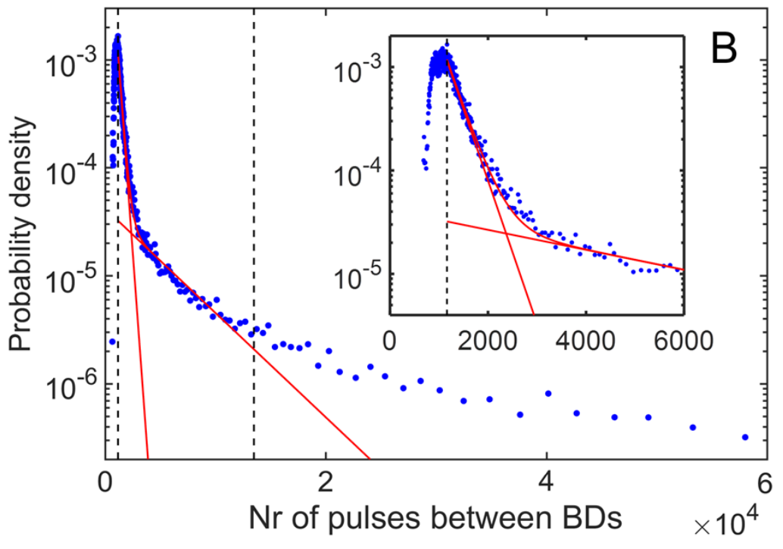
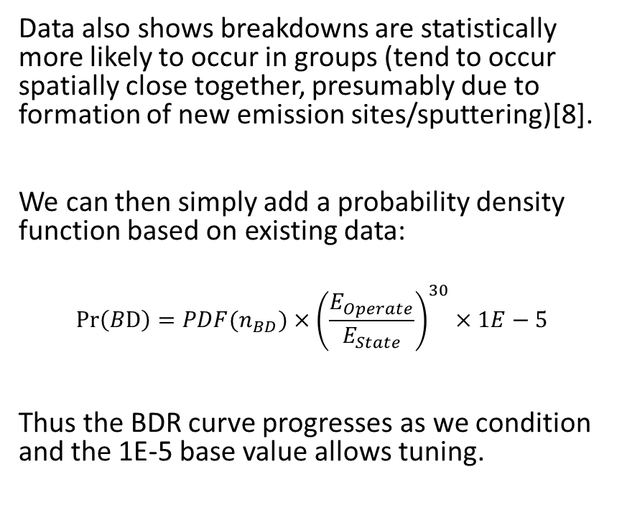
Conditioning Simulator: BD Probability
Data also shows breakdowns are statistically more likely to occur in groups (tend to occur spatially close together, presumably due to formation of new emission sites/sputtering)[8].
We can then simply add a probability density function based on existing data:
$$\operatorname{Pr}\left(BD\right)=PDF(n_{BD})×{\left(\frac{E_{Operate}}{E_{State}}\right)}^{30}×1E−5$$
Thus the BDR curve progresses as we condition and the 1E-5 base value allows tuning.
Figure: Probability distribution of test stand data[4].

Slide 27
Contents
Overview of High Gradient Conditioning.
Motivation for Modelling.
Simulation Setup.
Preliminary Results of the Model.
Conclusion and Future Work.

Slide 28
Conditioning Simulation: Benchmarking
The model will obviously require some iterative tuning and adjustment.
For this purpose it is useful to define some sort of typical behaviour.
We don’t yet have a pulse length dependence, so we are limited to the preliminary behaviour.

Slide 29
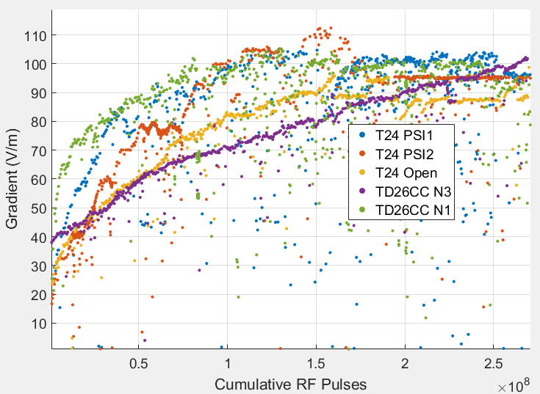
Typical Conditioning of Structures
“Typical” curve
(variance between structures, software settings, operational deviations etc.)
Figure: Proposed typical conditioning curve overlaid on test stand data.

Slide 30
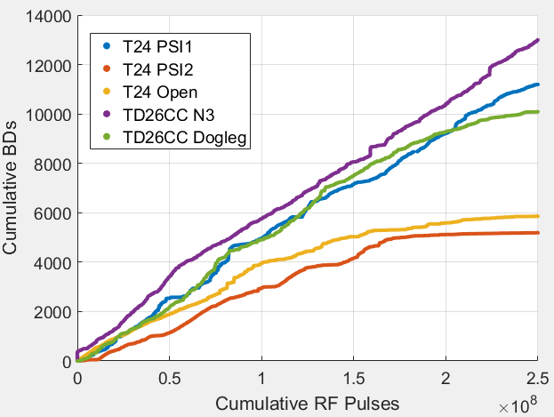
Typical Conditioning of Structures
“Typical” BD accumulation ends up in the thousands range.
Figure: Proposed typical BD accumulation overlaid on test stand data.

Slide 31

Typical Conditioning of Structures
Gives us some approximate goal for tuning our parameters.
Figure: Benchmark used for tuning model.

Slide 32
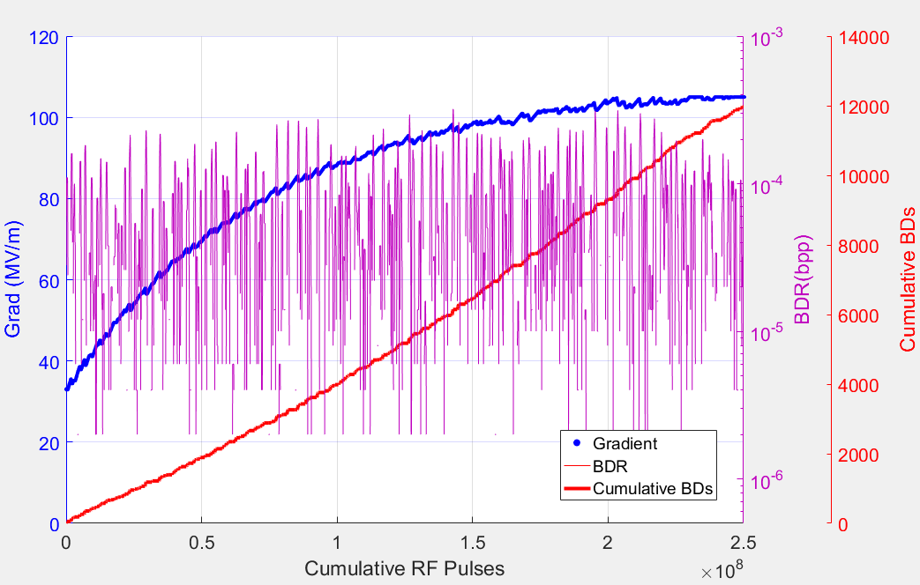
Preliminary Simulation Result
Figure: Results of preliminary simulation.

Slide 33
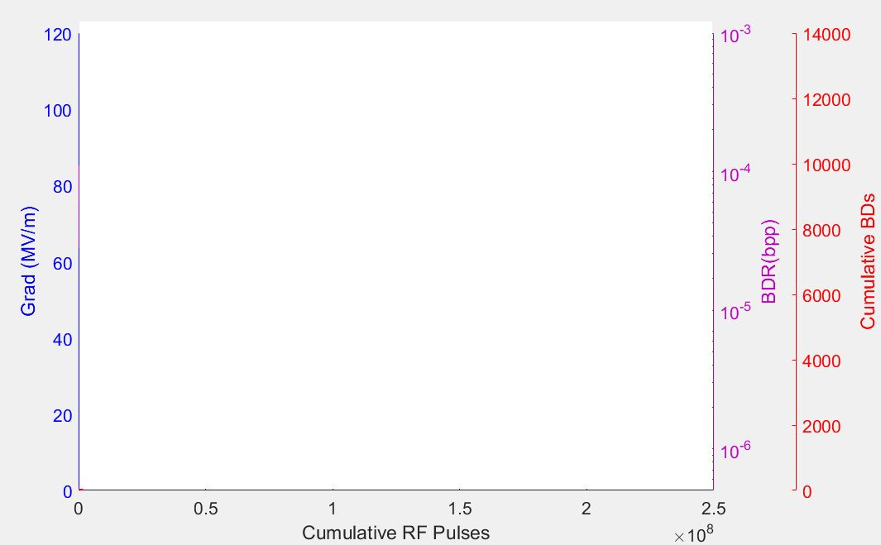
Preliminary Simulation Result
Asymptotic conditioning.
BDR setpoint tracked.
Reasonably
Linear BD accumulation, could be improved.

Slide 34
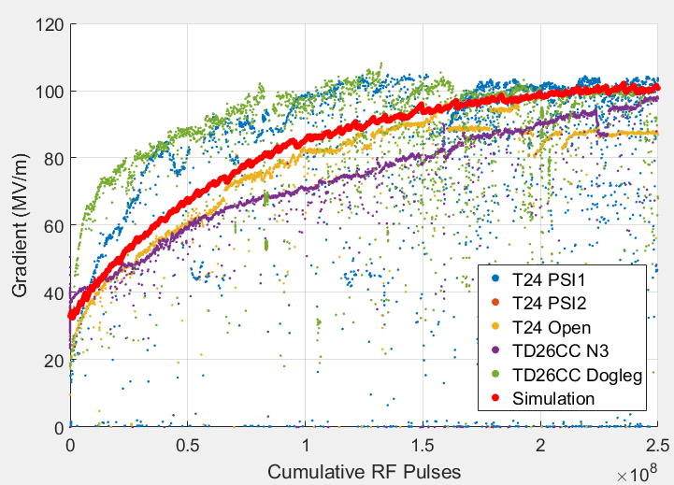
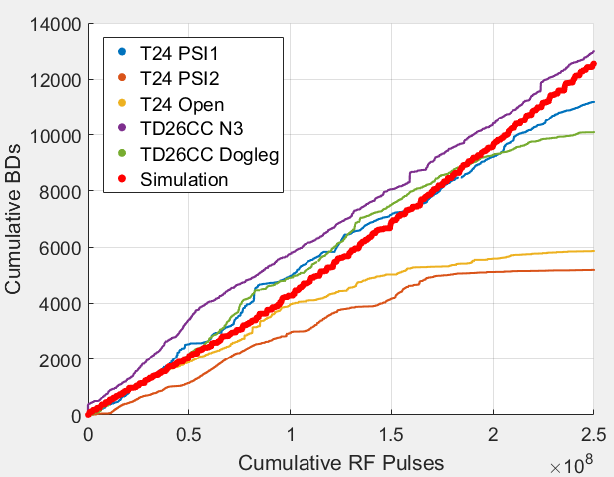
Result 1: Comparison with Real Data
Simulated conditioning in red

Slide 35
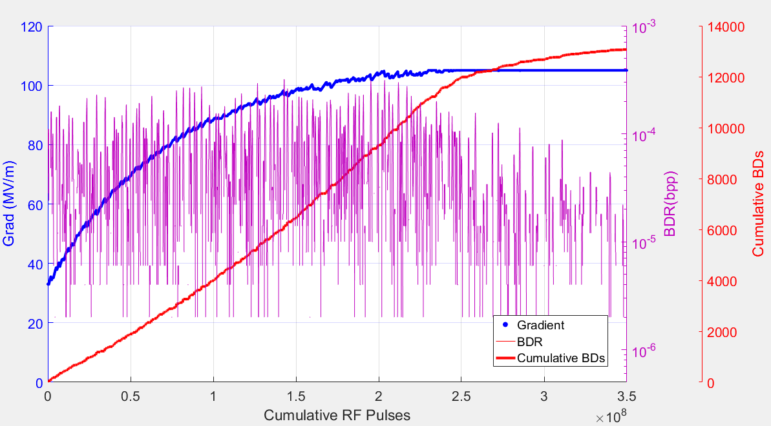
Result 2: Running Longer Term

Slide 36
Result 2: Running Longer Term
BDR begins to drop during flat run in at rate comparable to test stands.

Slide 37
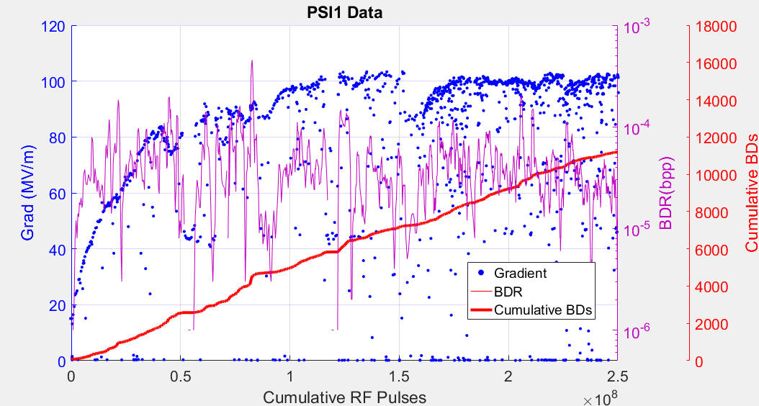
Result 3: Effect of Changing Setpoint.
Algorithm controls power to track the BDR Setpoint shown here.
Historically we have used 5E-5 (one breakdown in 20k pulses) but what happens when varied?

Slide 38
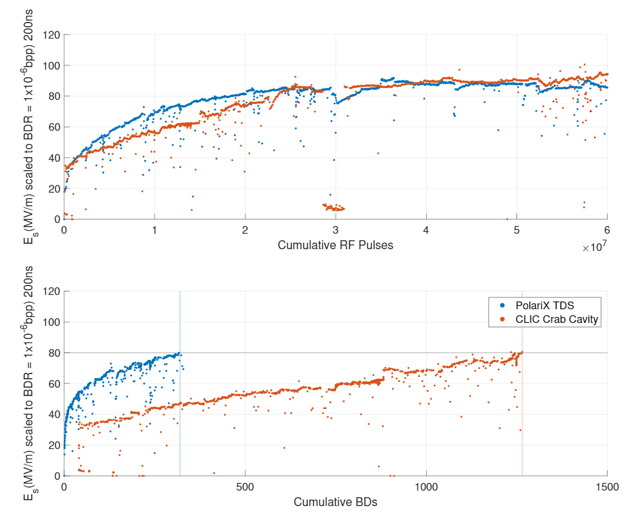
Result 3: Effect of Setpoint on Conditioning.
Some experimental data:
PolariX Setpoint: 3E-5
Crab Setpoint: 5E-5
Result:
PolariX accumulated fewer BDs.

Slide 39
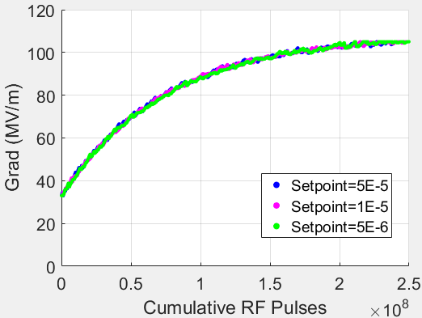
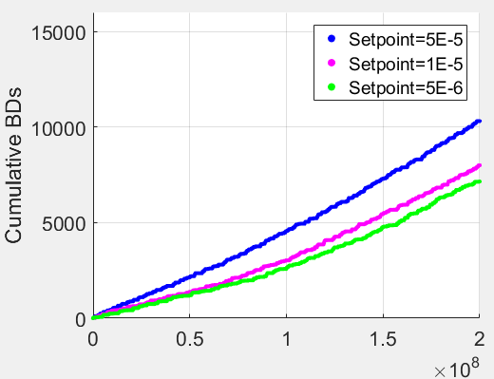
Result 3: Effect of Changing BDR Setpoint.
Simulation run three times with a different BDR setpoint each time.
Still requires checking and more investigation but seems to indicate a similar result.

Slide 40
Result 4: Dual Structure Simulation.
What about the case of two structures?
We set one to have a slightly higher limit, E_{sat} or an initially higher E_{state}.
Does the idea of progressive modification or surface while being held at low BD probability agree?
In this example, the limit for the second structure was increased by 5MV/m.

Slide 41
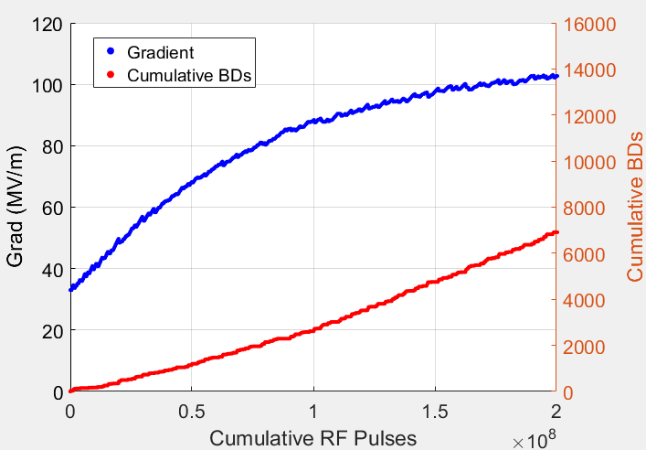
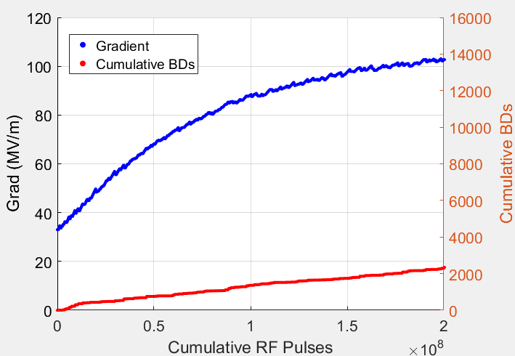
Result 4: Dual Structure Simulation.
Structure A
Structure B
Notes:
Shows even a small difference in the limit (or the start point) yields the same conditioning curve but changes the number of accumulated BDs.

Slide 42
Contents
Overview of High Gradient Conditioning.
Motivation for Modelling.
Simulation Setup.
Preliminary Results of the Model.
Conclusion and Future Work.

Slide 43
Conditioning Simulator: Conclusion
Although in the early stages a very simple lumped model based on a pulse to pulse modification of the surface has been created and tuned to give reasonable agreement with test stand data.
Altering the PID loop settings yields results which align with those observed in the test stands.
May eventually be used to investigate the implications of algorithmic values/methods and provide a suggestion of “optimal” settings.

Slide 44
Conditioning Simulator: Future Work
Validate and Correct Model:
Additional tuning.
Review past data control settings and implement in code to check for agreement.
Comparison with DC Test data.
Investigations:
Explore alternative algorithmic features (gaussian BDR window, alternative ramping, varying setpoints etc.).
Addition of pulse length dependence.
Vacuum conditioning model.
Power/ E-field BDR dependencies.

Slide 45
Thank you. Questions/Discussion?

Slide 46
References
[1] –B. Woolley, “High Power X-band RF Test Stand Development and High Power Testing of the CLIC Crab Cavity,” Lancaster University, United Kingdom, 2015.
[2] – L.Millar, “Conditioning and Operational Algorithms”, Presentation, Available online: https://indico.cern.ch/event/719535/
[3] – J. Giner Navarro, Breakdown Studies for High Gradient Rf Warm Technology in: CLIC and Hadron Therapy Linacs, University of Valencia, 2016.
[4] – Study of Basic Breakdown Phenomena in. Dolgashev, V.A. Tsukuba, Japan : s.n., 2010. XXV International Linear Accelerator Conference (Presentation).
[5] – J.Paszkiewicz, “X-Band RF Test Stands at CERN” Presentation at SINAP, Shanghai, 4-8 June 2018, Available online: https://indico.cern.ch/event/675785/contributions/3022037/attachments/1661499/2662246/CERN_Xboxes_Jan_Paszkiewicz_HG18.pdf
[6] –New local field quantity describing the high gradient limit of accelerating structure. Wuensch, W. et al. 10, s.l. : American Physical Society, 2009, Phys. Rev. ST Accel. Beams, Vol. 12.
[7] - https://indico.cern.ch/event/449801/contributions/1945266/attachments/1212465/1770218/korsback_clicworkshop16_v3.pdf
[8] – Statistics of vacuum breakdown in the high-gradient and low-rate regime. Wuensch, W. et al. 10, s.l. : American Physical Society, 2009, Phys. Rev. Accel. Beams 20, 011007 – Published 25 January 2017, Available online: https://journals.aps.org/prab/pdf/10.1103/PhysRevAccelBeams.20.011007
Notes:
[9] –Defect model for the dependence of breakdown rate on external electric fields, Nordlund and F. Djurabekova, Phys. Rev. ST Accel. Beams 15, 071002 (2012).
[10] - Stochastic Model of Breakdown Nucleation under Intense Electric Fields, Zvi Engelberg et al. (2018). Physical Review Letters. 120. 10.1103/PhysRevLett.120.124801
[11] -- J.Paszkiewicz, “Breakdown-Loaded Electric Fieldas a High Gradient Limit” Presentation at MeVArc 2019, Padovaat, Available online:https://indico.cern.ch/event/774138/contributions/3507942/attachments/1908081/3151939/Breakdown_Limit_MeVArc_2019_Jan_Paszkiewicz.pdf

Slide 47
Automation of the Conditioning Process
Several years ago a conditioning algorithm was developed on the XB1 software to automate this process using a two level hierarchy (respond to short and long term behavior).
Short-term behavior(seconds to minutes):
  A graphical representation pictured right. The vertical red bar scrolls to the right as time increases. If the red bar gets to the step-up in the blue curve, the power level is increased by the size of the step (in this case 10 kW). The timer is then reset and the red bar starts again from 0 seconds.
  If the structure is operating near its conditioned limit, the increase in power may trigger a breakdown shortly after. The slope in the blue line is designed to lower the power level if a breakdown occurs shortly after the previous “event”.
Long term behaviour:
  BDR is measured in a user defined window.
  If the measured BDR increases above a user defined threshold the power level can no longer be increased by the software.
  Subsequent breakdowns will however reduce the power as described previously.
A BD here would cause a drop in power by 2.5kW
Note: There are of course other interlocks which are not mentioned on this slide.

Slide 48
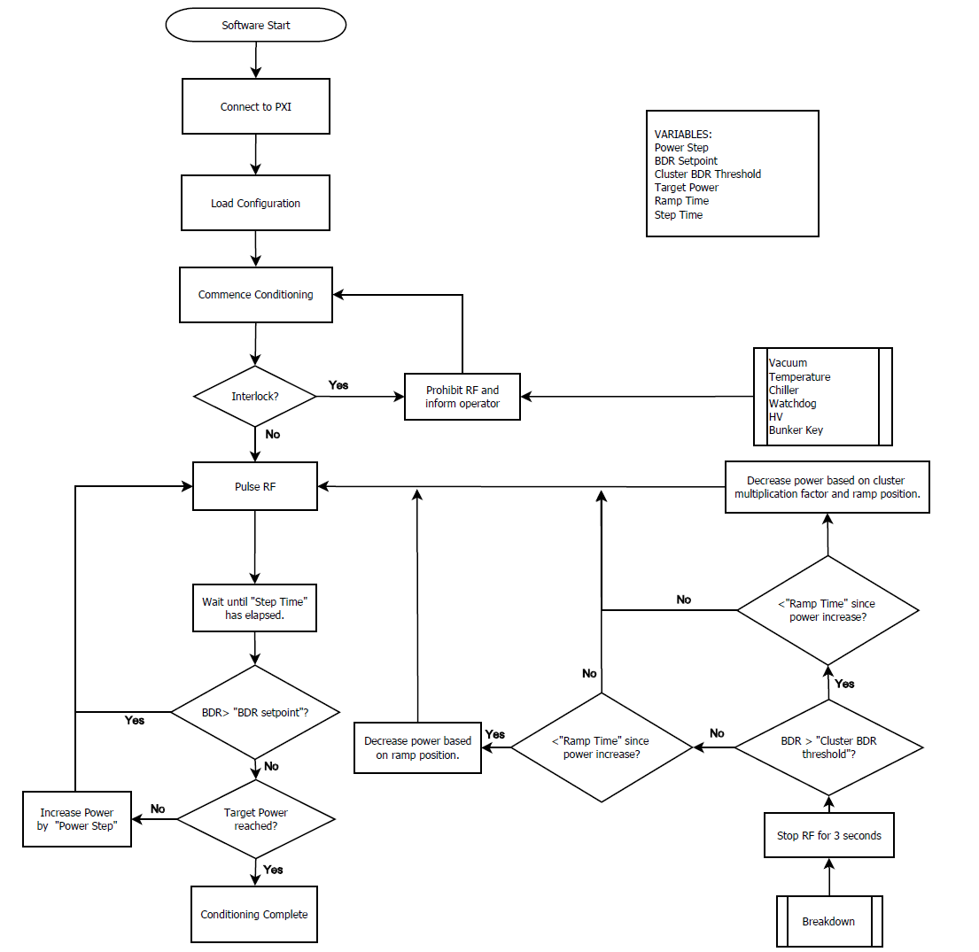
Current Algorithm
I have attempted to condense the existing algorithm into a (greatly simplified) block diagram. (Pictured right)
Does not show PID loop gains and several other fine details for the sake of simplicity.
Step Time
Power Step
Ramp Time

Slide 49
Ramp Settings in the Test Stands

Slide 50
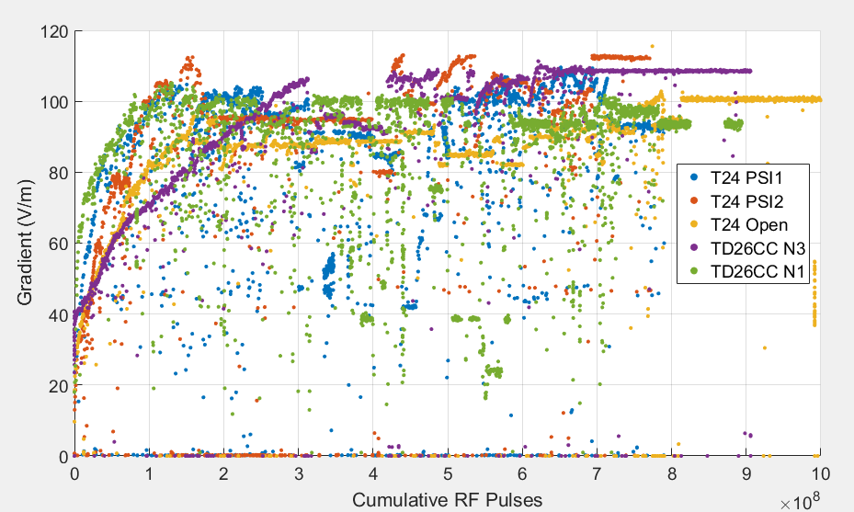
Initial Conditioning of Structures
Initial conditioning at 50ns Pulse length

Slide 51
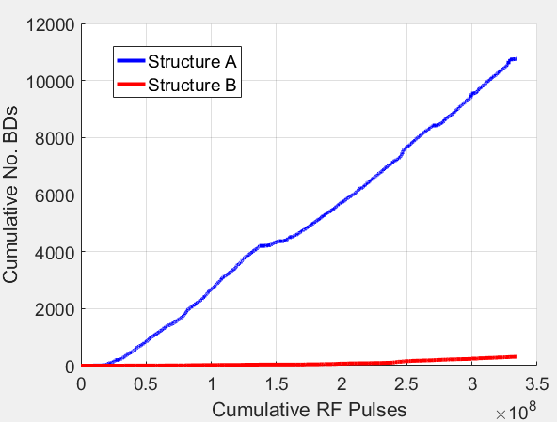
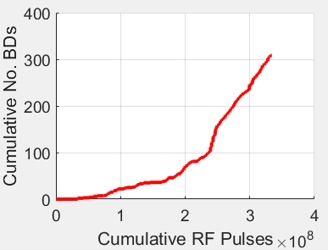

Superstructure BDR Distinction
The structures show an large discrepancy in the accumulated breakdowns to date.
Structure A: ≈ 12000
Structure B: ≈ 300
However they have been subjected to the same ramp in input power. Lets examine the conditioning in terms of their cumulative BDs instead…
Figure: Cumulative breakdowns vs pulse number for the CLIC superstructure constituents.

Slide 52
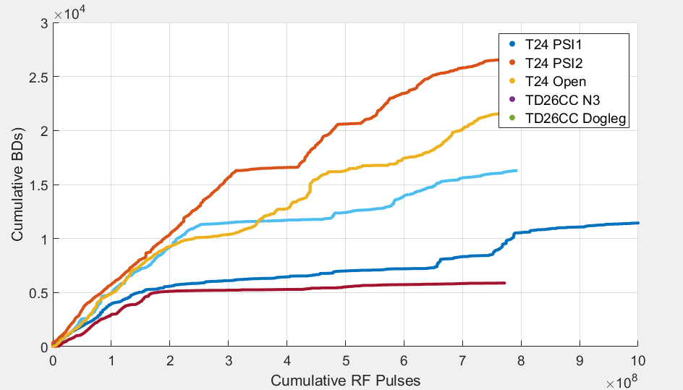
Initial Conditioning of Structures
Initial conditioning at 50ns Pulse length

