Slide 1


Development of the ALICE MFT Detector
Jack Smedley
Final Presentation
Thursday, August 15, 2019
Supervised by Dr. Stefano Panebianco

Slide 2
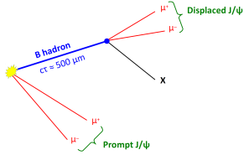
Quarkonia Melting in ALICE
Quarkonia serve as probe for QGP
  J/Ψ, or charm-anticharm meson
  ϒ, or bottom-antibottom meson
Difficulty distinguishing prompt and displaced J/Ψ in Muon Spectrometer

Slide 3
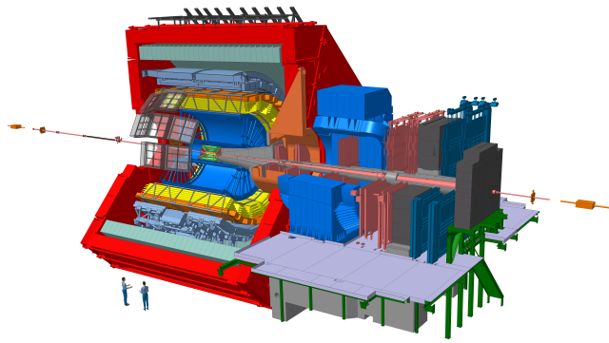

Slide 4
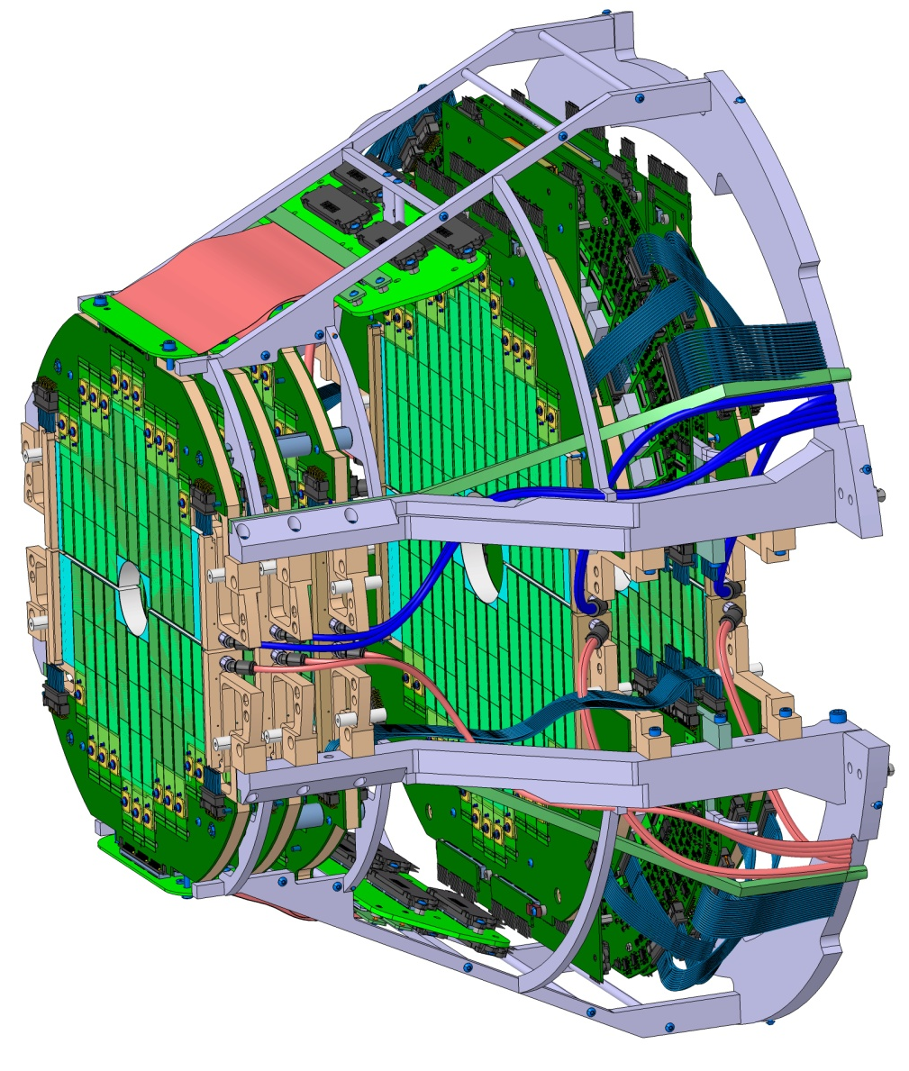
Muon Forward Tracker
Silicon tracking detector
Pixel sensors designed for ITS upgrade
Situated between ITS and absorber cone to detect forward-moving muons

Slide 5
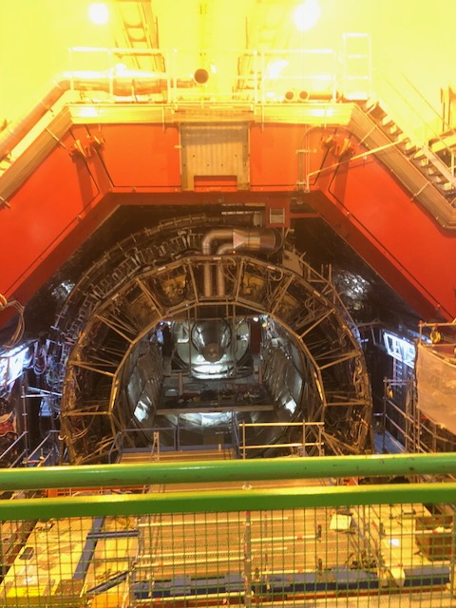
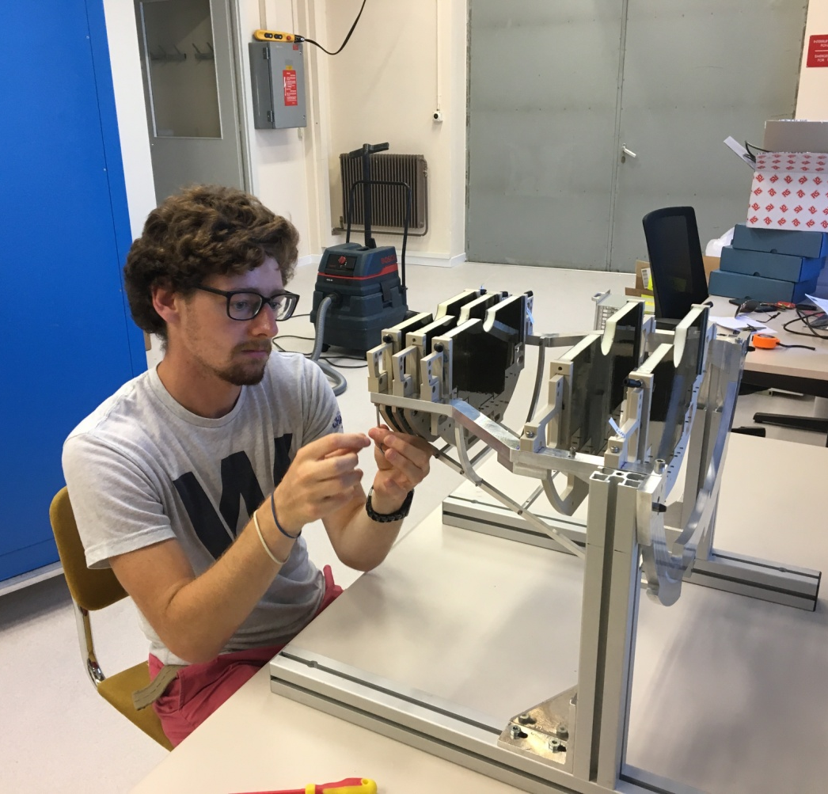

Slide 6
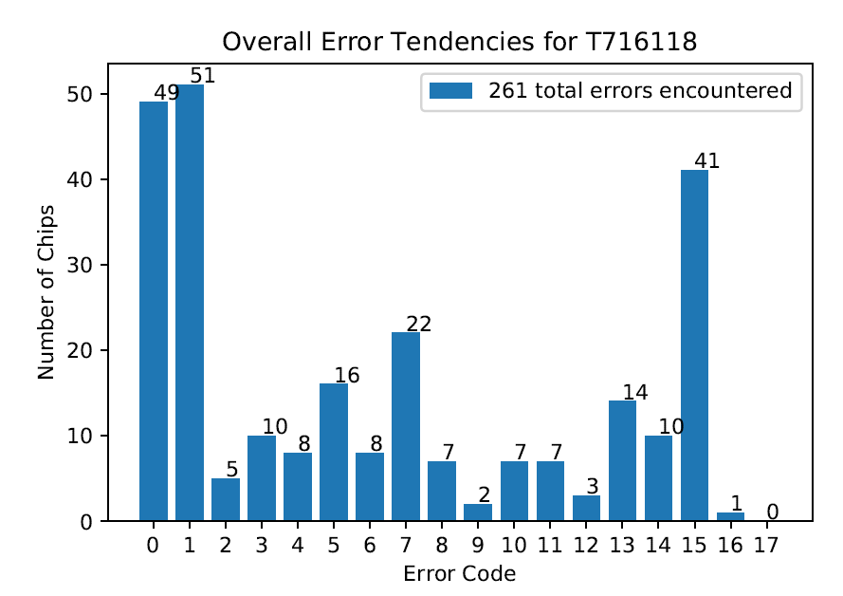
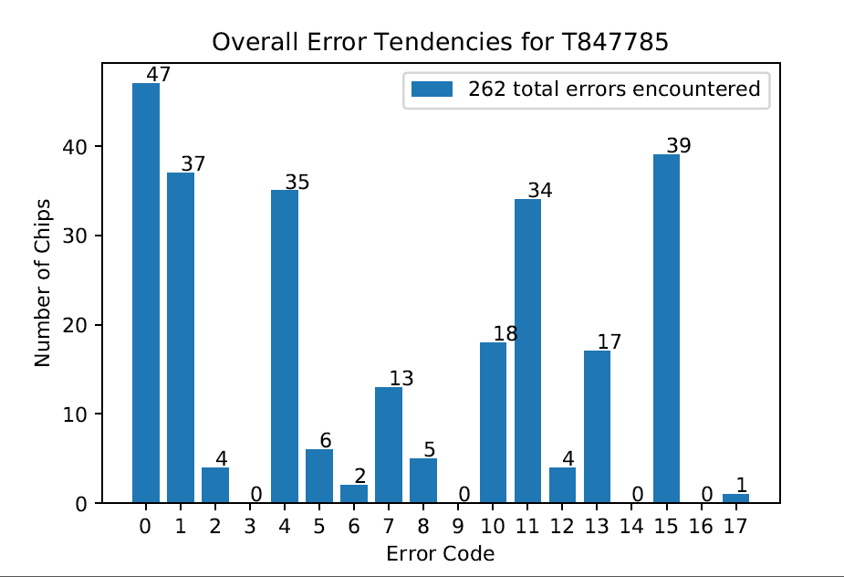
ALPIDE Chip Testing
30mm by 15mm by 50μm monolithic silicon pixel sensors designed for ALICE ITS upgrade
Tested and classified by performance before use
Code written to further analyze test results

Slide 7
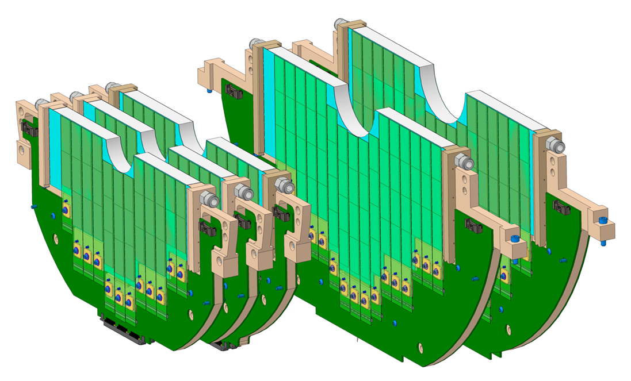
Ladder Assembly
Two to five chips are glued and bonded to a flexible printed circuit board
Extremely sensitive to dust and contamination, performed in clean room
Two per day, over 500 needed

Slide 8
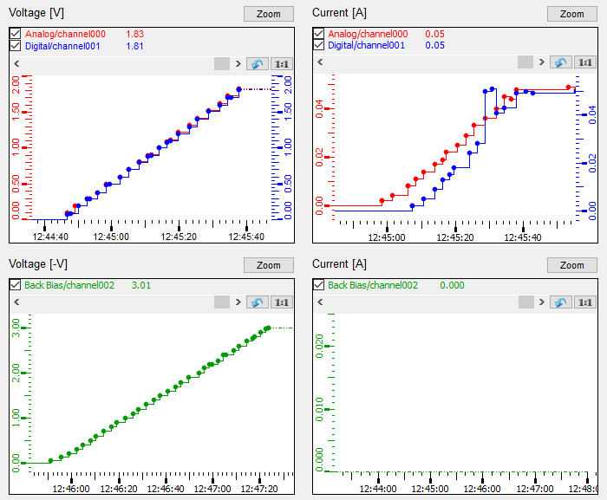
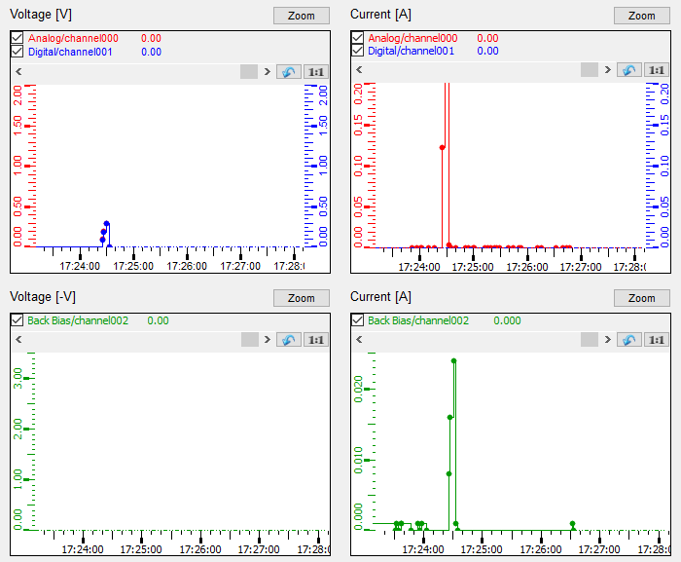
Ladder Qualification
Smoke Test to check that there are no shorts
Functional test to check noise levels, dead pixels, and the chips’ readout capabilities
  Performed with and without a back-bias voltage

Slide 9


Slide 10


Slide 11
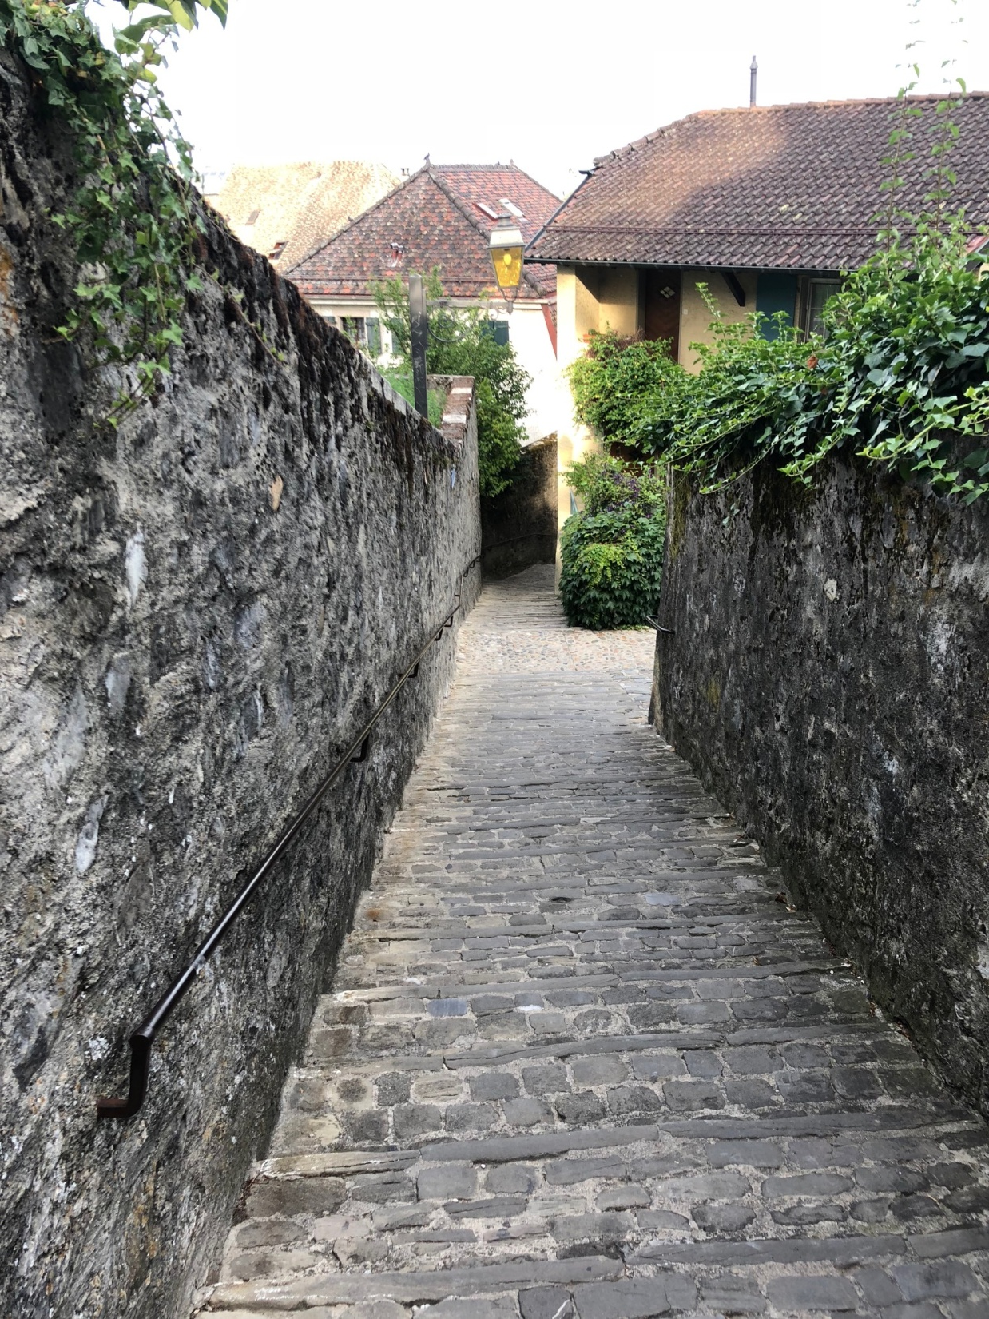

Slide 12
Questions?

Slide 13
Thank you to all the University of Michigan staff and the National Science Foundation for making this all possible!

