Slide 1
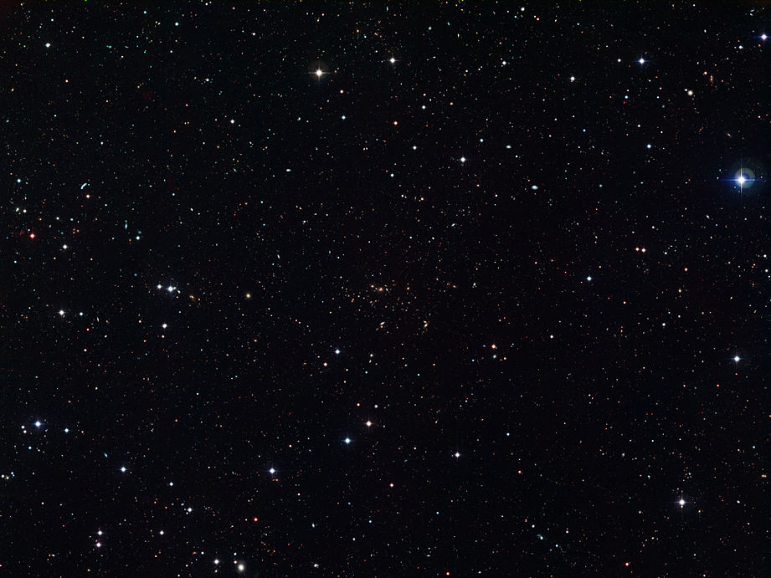

Global crustal structure from geostatistical analysis
Wolfgang Szwillus
Geoneutrino science meeting, Prague
22. October 2019
Notes:
Welcome to the defense of my PhD thesis. You can see my title up there, but this presentation will focus on satellite gravity data alone.

Slide 2
O, what a tangled web we weave,…
38 TW
Al₂O₃ = 7.9%
Upper Mantle is 300 K hotter*
Viscosity is lower
*back of the envelope!

Slide 3
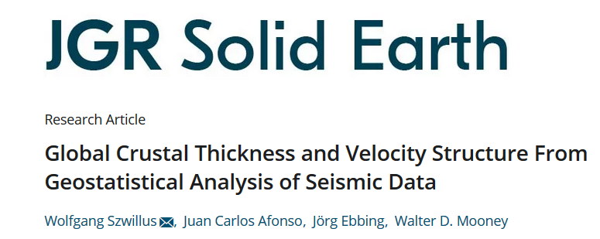
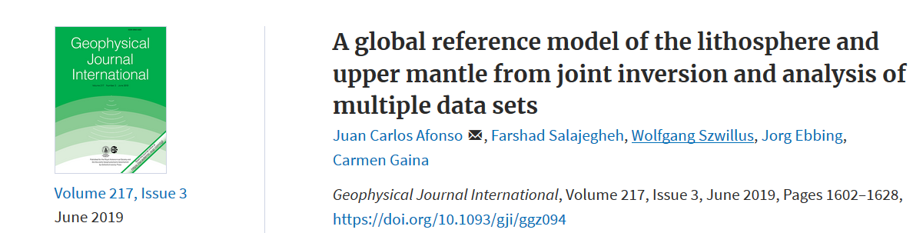
Part I
How accurate are global crustal models?
Combined inversion of gravity field and topography (Lithoref18)
Part II

Slide 4
What is the Crust and how do we know?
Crustal rocks are formed by melt extraction from mantle rocks
  Melt extraction leads to enrichment in certain elements (important here: Uranium, Thorium)
Crustal rocks are lighter and seismically slower than mantle rocks
Sources of information:
  Topography
  Gravity field
  Active source seismology
  Passive seismology

Slide 5
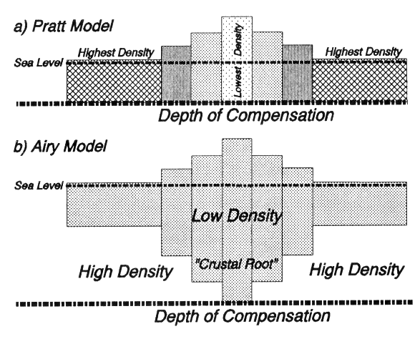
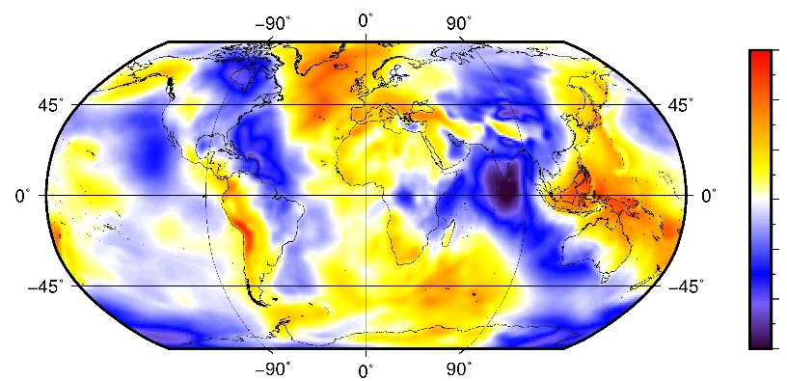
How do we know the crust?
Answer 1: Crust is lighter
Iceberg principle (a.k.a. isostasy):
High topography -> thick crust
  It‘s not quite as simple …
Gravity field
Weak gravity field -> thick crust
  It‘s not quite as simple …
+60 mGal = 60 * 10⁻⁵ m s⁻²
Free air anomaly
(225 km height)
-60 mGal

Slide 6
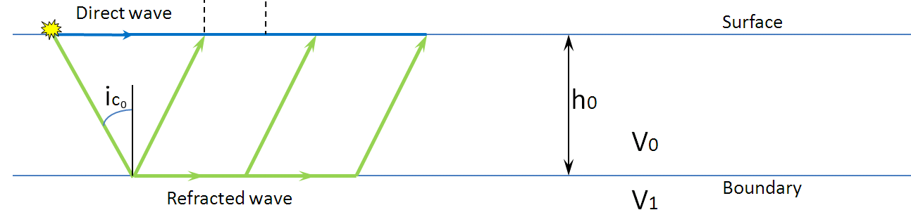
How do we know the crust?
Answer 2: Crust is seismically slower
Crustal structure can be studied effectively using active source seismology (e.g. refraction and reflection)
Reflected wave
V₀<V₁
Image source: Wikipedia: Seismic refraction

Slide 7
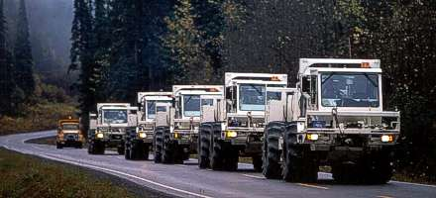
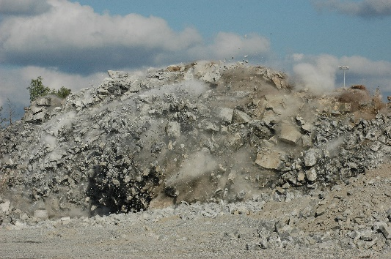
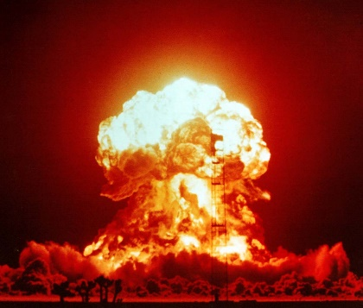
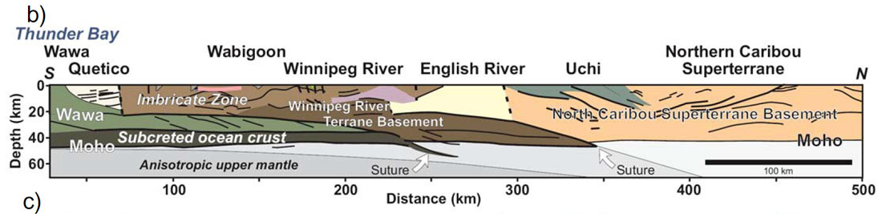
Active source seismology (continental scale)
Rowes 2009
Hydraulic
vibrations
Chemical
Explosives [1]
Peaceful nuclear
Explosions [2]
Rowes 2009
Continental scale
Refraction and reflection profiles
Global crustal models are based on compilations of
published interpretations!

Slide 8
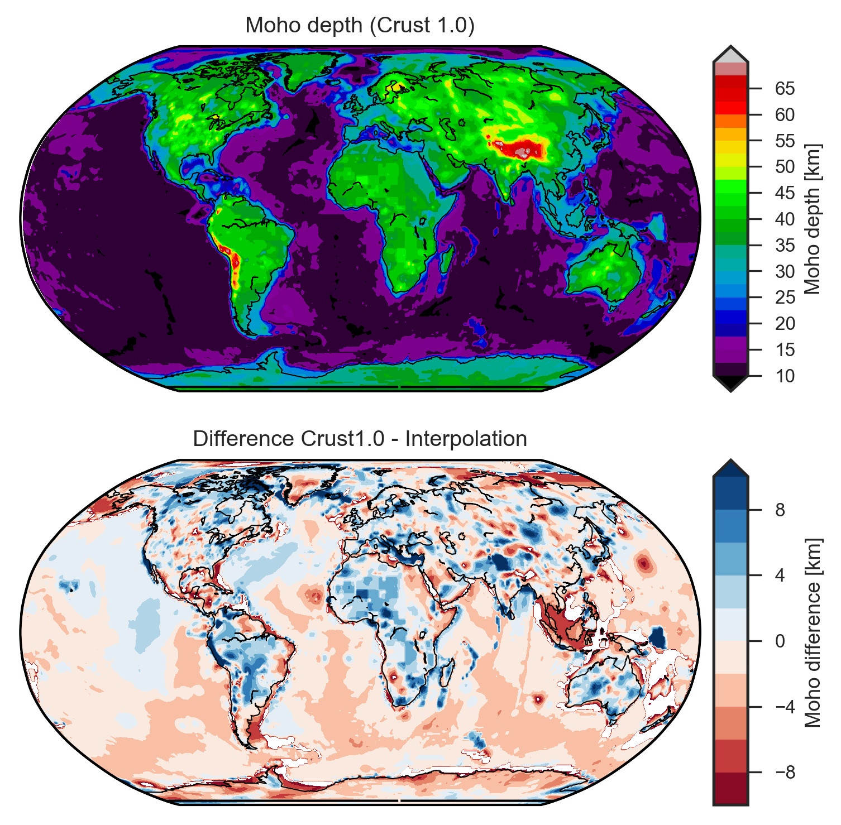
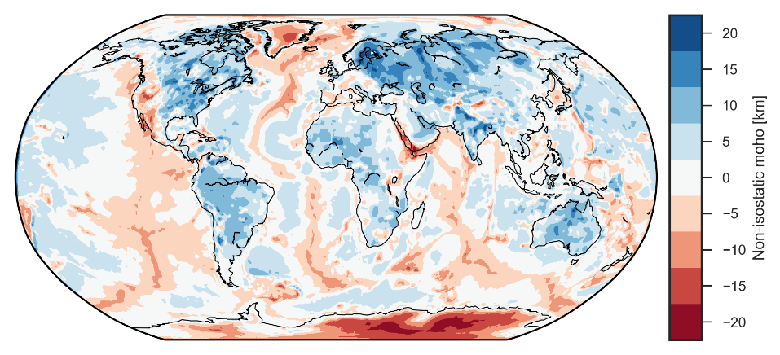
Global crustal model Crust1.0
Is the crust really in isostatic balance?
Moho depth from Crust1.0
(Laske et al. 2013)
Difference between isostatic Moho (Szwillus et al. 2016) and Crust1.0
De-facto standard for global crustal models
Gives crustal layers and seismic velocities
Based on results from active seismics combined using expert knowledge
Uses predefined geological domains
Causes for no isostatic balance in Crust1.0
Errors of crustal model
Isostatic contribution from mantle lithosphere
Dynamic contribution from convecting mantle

Slide 9
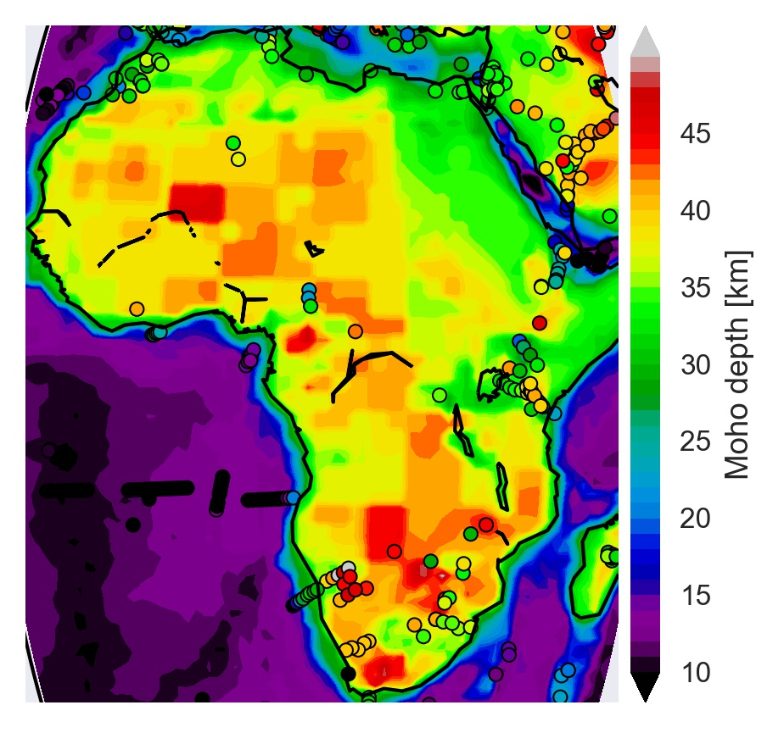
How well do we actually know the crust?
Moho depth from Crust1.0 (Laske et al. 2013)

Slide 10
Global crustal model
Part I

Slide 11
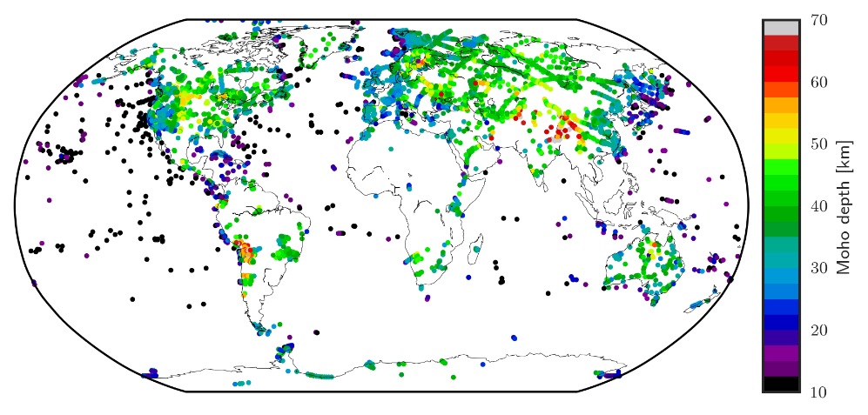
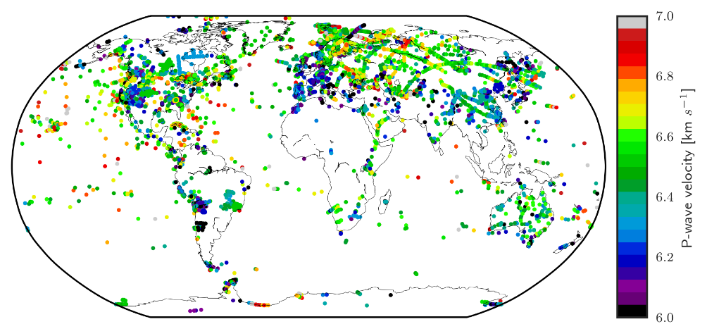
USGS Gamma Seismic Catalagoue
Moho depths points
Information extracted at each point:
Crustal thickness
Average P-wave velocity of crystalline crust
P-wave velocity points
Use data-driven interpolation to estimate global model!
Interpolation method: Kriging

Slide 12
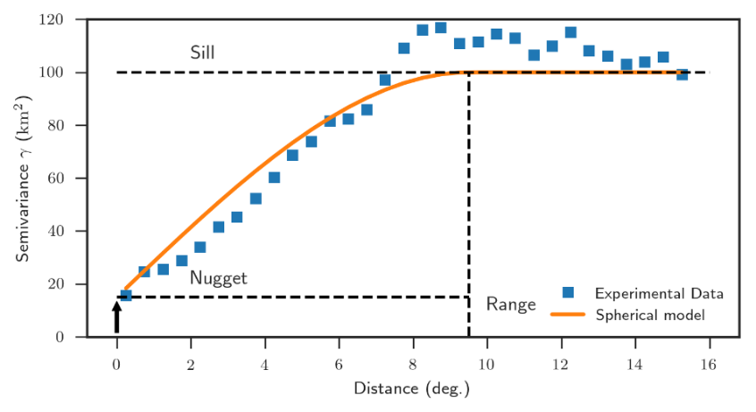
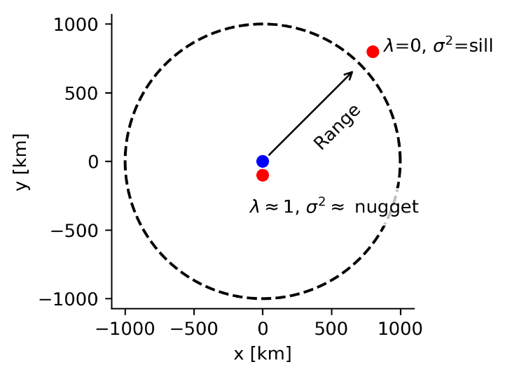
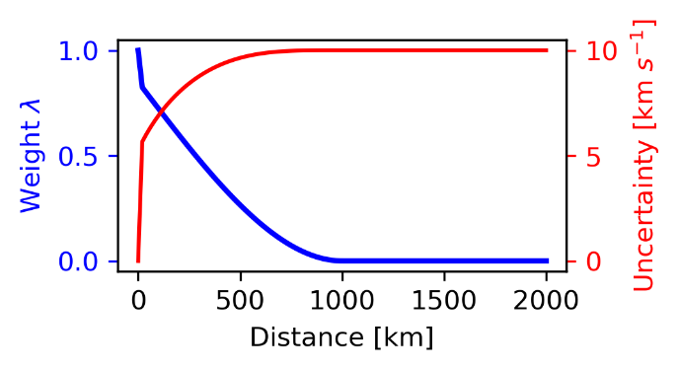
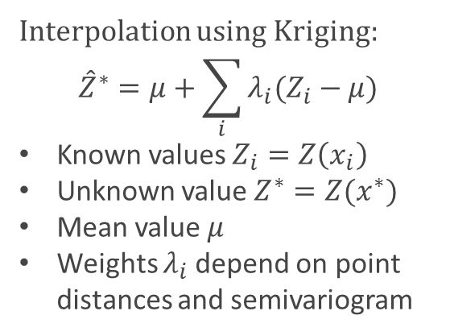
Kriging interpolation
Semivariance:
Mean squared difference as a function of separation
Interpolation using Kriging:
$${\hat{Z}}^{∗}=μ+\sum_{i}{λ_{i}(Z_{i}−μ)}$$
Known values $Z_{i}=Z\left(x_{i}\right)$
Unknown value $Z^{∗}=Z(x^{∗})$
Mean value $μ$
Weights $λ_{i}$depend on point distances and semivariogram
Example: One known point
Range: 9.5° (approx. 1000 km)
Nugget: 15 km²
Sill: 100 km²
Meaning of parameters
Nugget: Small-scale + measurement errors
Range: Correlation distance
Sill: Scale of variability

Slide 13
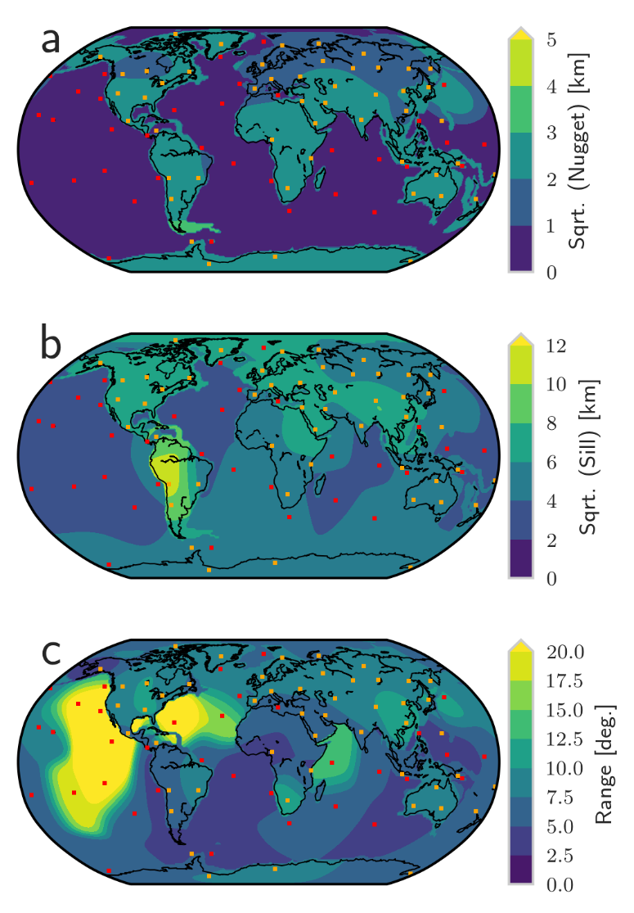
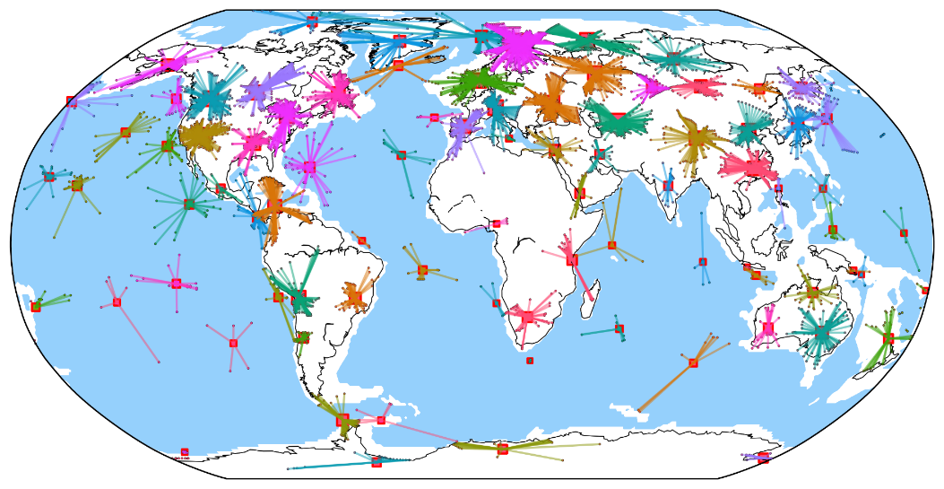
Global scale kriging – technical challenges
One semivariogram for entire Earth insufficient!
Separate oceanic and continental domains
Determine semivariograms for point clusters
Nugget
Sill
Range
Result of Agglomerative Clustering

Slide 14
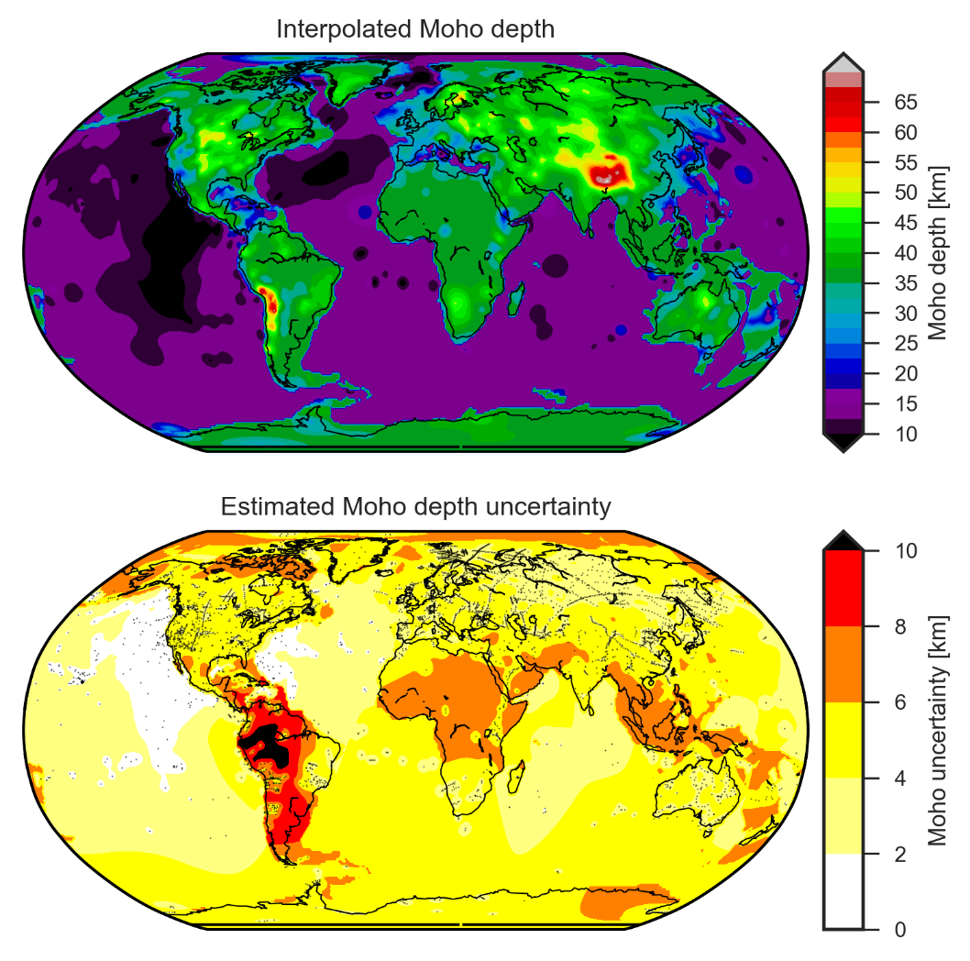
Interpolation results (Moho depth)

Slide 15
Global scale kriging - uncertainty
Polar regions
Indonesia
> 8 km
(South America)
> 12 km
Southern Oceans
c. 4 km
Africa
> 8 km
Median relative accuracy +/- 20 %

Slide 16
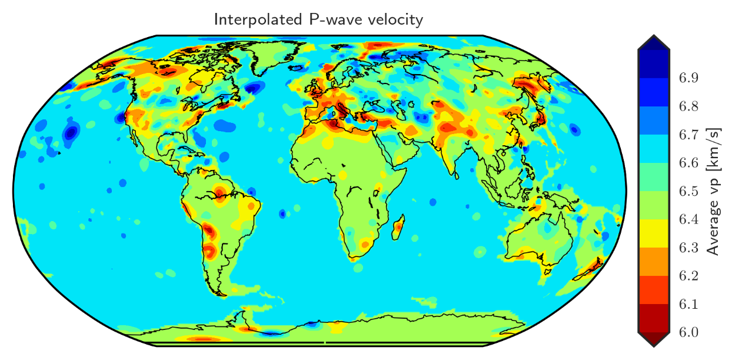
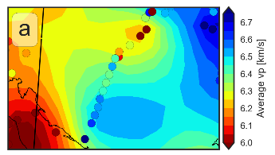
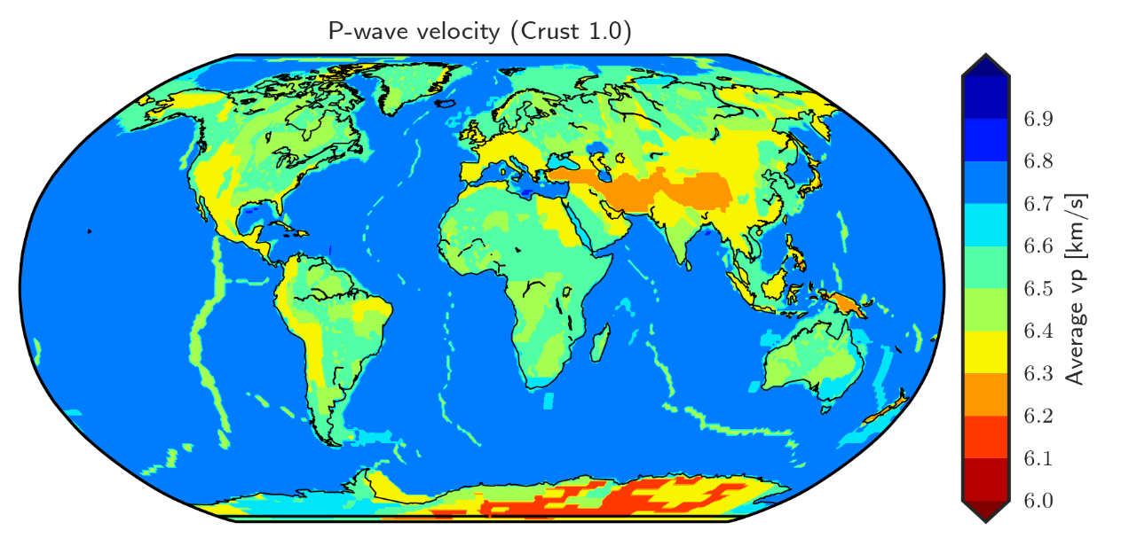
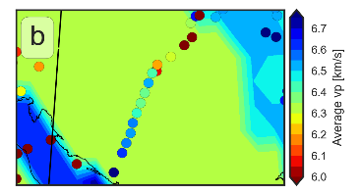
Average P-wave velocity
The two models are extremely different
Crust1.0 uses geological domains to define P-wave velocity

Slide 17

Global scale kriging - uncertainty
Median relative accuracy +/- 3 %

Slide 18
Commercial break
New crustal model based on active source seimology compilation available
Contains Moho depth and average P-wave velocity
Contains uncertainty information
Code freely available
(if you want to make your own model)
https://agupubs.onlinelibrary.wiley.com/doi/abs/10.1029/2018JB016593

Slide 19
Joint inversion of topography, geoid, gravity and gravity gradients
Part II

Slide 20
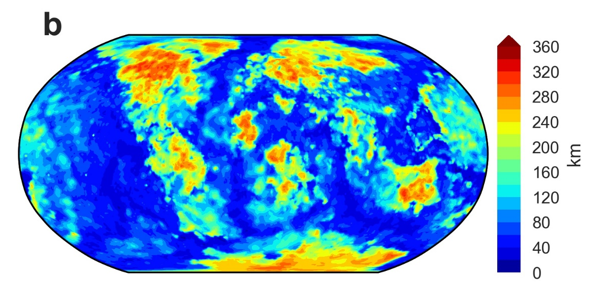
Lithoref18 - Why and how?
Litho1.0 (Pasyanos et al. 2014) is an update of Crust1.0 that adds information about lithospheric thickness
Lithoref18: Update Litho1.0 to be more in isostatic balance and fit the gravity field (+geoid and gradients)
Purpose: Far-field calculations
Try to change Litho1.0 as little as possible, because otherwise surface waves are no longer explained

Slide 21
Litho1.0 Topography and gravity
Measured gravity
Calculated gravity
Measured Elevation

Slide 22
Lithoref18 Parametrization
Horizontal resolution 2 degrees
At each location 4 unknowns:
  Moho depth
  LAB depth
  Crustal density
  Asthenospheric density
Lithospheric density is defined by LAB
Initially, all values are set to Litho1.0

Slide 23
+10 km
-10 km
+30 km
-30 km
+100 kg/m³
-100 kg/m³
+60 kg/m³
-60 kg/m³

Slide 24
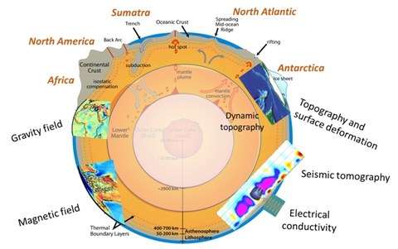
Take Home
New crustal model based on active source seimology compilation available
Update of Litho1.0 based on topography and gravity available
Future directions
ESA‘s 3D-Earth Project
(->Javier‘s talk)
Uncertainty matters
(kicking in open doors?)

Slide 25
Thank you for your attention!

Slide 26
Image sources
[0] https://commons.wikimedia.org/wiki/File:The_Earth_seen_from_Apollo_17.jpg#/media/File:The_Earth_seen_from_Apollo_17.jpg
[1] https://commons.wikimedia.org/wiki/File:Blasting_honkanummi_4-6.jpg#/media/File:Blasting_honkanummi_4-6.jpg
[2] https://commons.wikimedia.org/wiki/File:Operation_Upshot-Knothole_-_Badger_001.jpg#/media/File:Operation_Upshot-Knothole_-_Badger_001.jpg
[3] https://www.esa.int/Our_Activities/Observing_the_Earth/GOCE/Satellite
[4] https://commons.wikimedia.org/wiki/File:Unveiling_distant_stars_and_galaxies.jpg#/media/File:Unveiling_distant_stars_and_galaxies.jpg

