Slide 1
Atlas Computing Model for HL-LHC
G. Usai (UTA)

Slide 2
Scope clarification
This talk is mean to describe concepts in the modeling (a/o implementation) of the ATLAS computing resource and not actual estimates.

Slide 3
Computing Resources for Run-3 and HL-LHC
Resources required for ATLAS computing in a given year:
  CPU @ Tier-0, Tier-1, Tier-2
  Disk @ Tier-0, Tier-1, Tier-2
    Tape @ Tier-0, Tier-1
  are estimated using a bottom-up approach considering all the computing task:
    Data: Reconstruction and (re)processing, Derivation/ analysis, Storage
    MC: event generation, Detector Simulation (Full and Fast), Digitization, Reconstruction, Derivation/analysis, storage
  accumulating were necessary current year data/MC and all the previous year for storage, reprocessing campaigns, etc.

Slide 4
Modeling using effective parameters
Overall some ~76 parameters are used to model the resources required for all the computing tasks
  time dependent (with a year granularity) are stored in an excel workbook.
Readout and all modeling/computation are performed in python using DATA Frame:
  CPU/Disk/Tape models are implemented in a handful of Libraries
  Different/alternative models use different parameters/sheets in the workbook.
  Steering scripts are used to control the read-out and produce resources tabs and plots
Easy to compare/study the effect of performance improvement or evolution of technologies

Slide 5
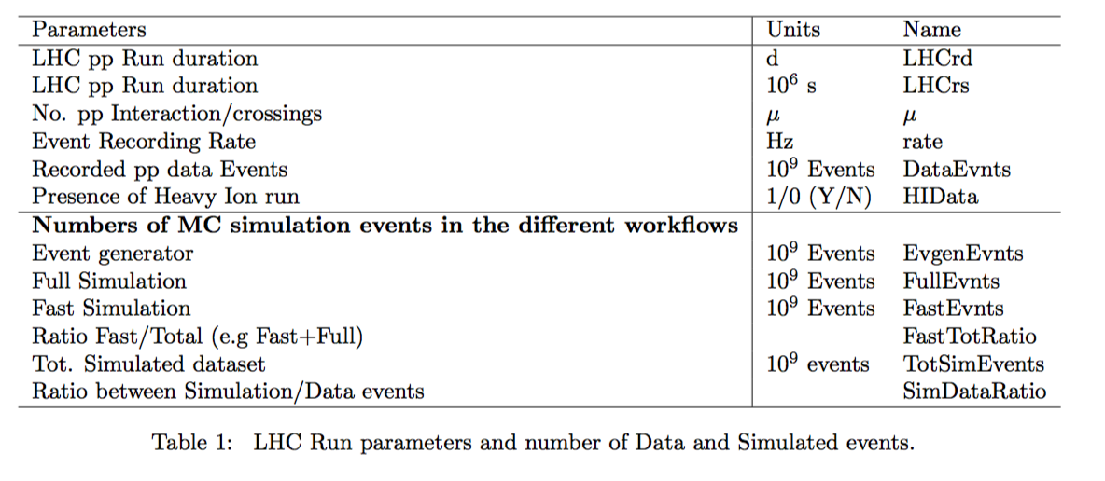
Input Parameters (1)
N event Data:
  Machine plans & performances, DAQ Rate
Nevents MC:
  Requirements from the physics program. Event Generation, FULL/FAST simulation, ratios MC/data, past experience help extrapolating for future.

Slide 6
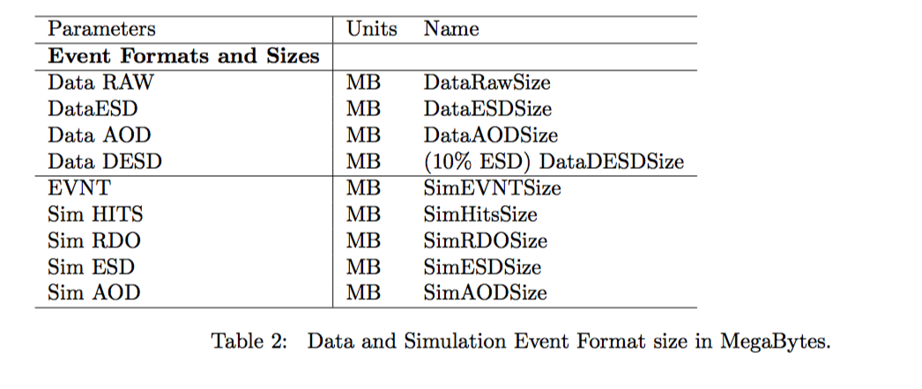
Input Parameters (2)
Event Formats and Size/events
  defined in average considering the pileup and a representative set of data and physics process (MC)

Slide 7
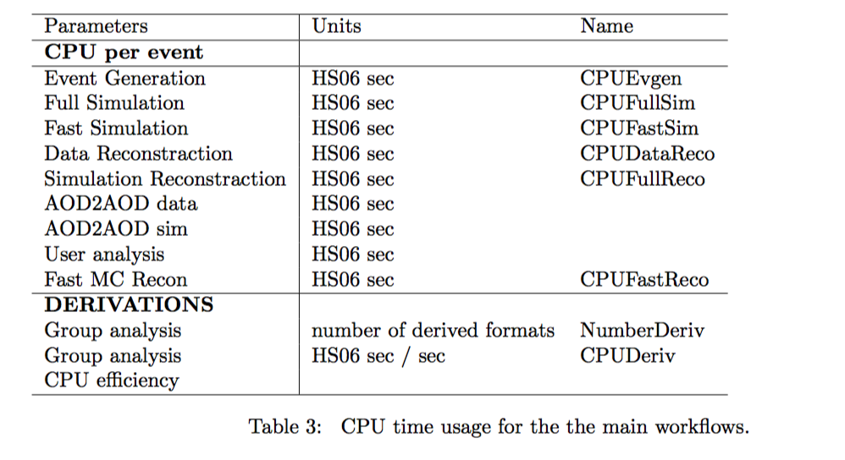
Input Parameters(3)
CPU time for all applications
  pileup/ year dependence
  defined/measured on benchmarks machines on representative sets of data/MC physics processes

Slide 8
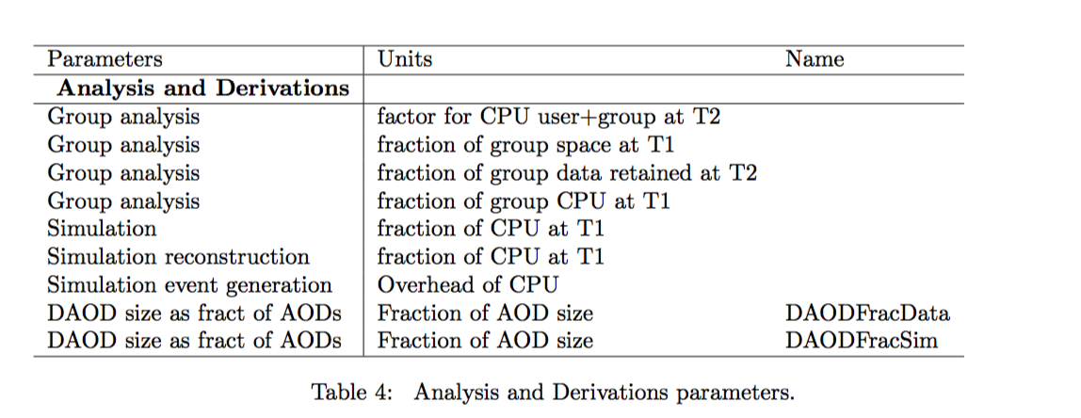
Input parameters (4)
Analysis model, currently being improved

Slide 9
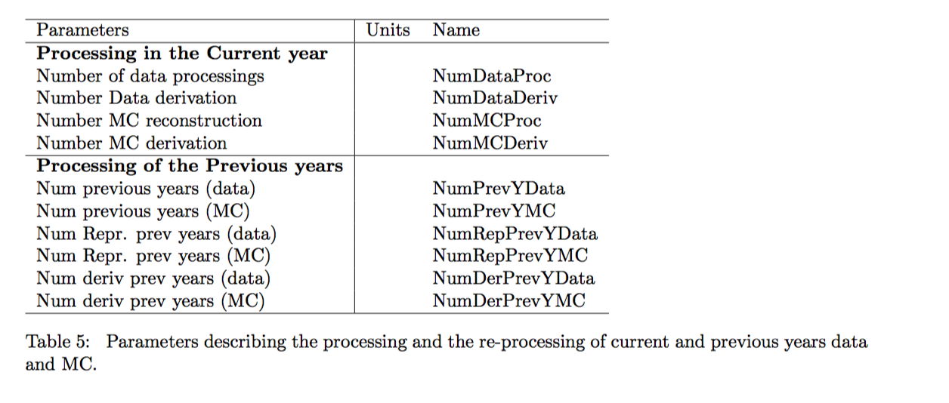
Input Parameters (5)
Processing/reprocessing campaigns in current and previous years
number of derivation Copies

Slide 10
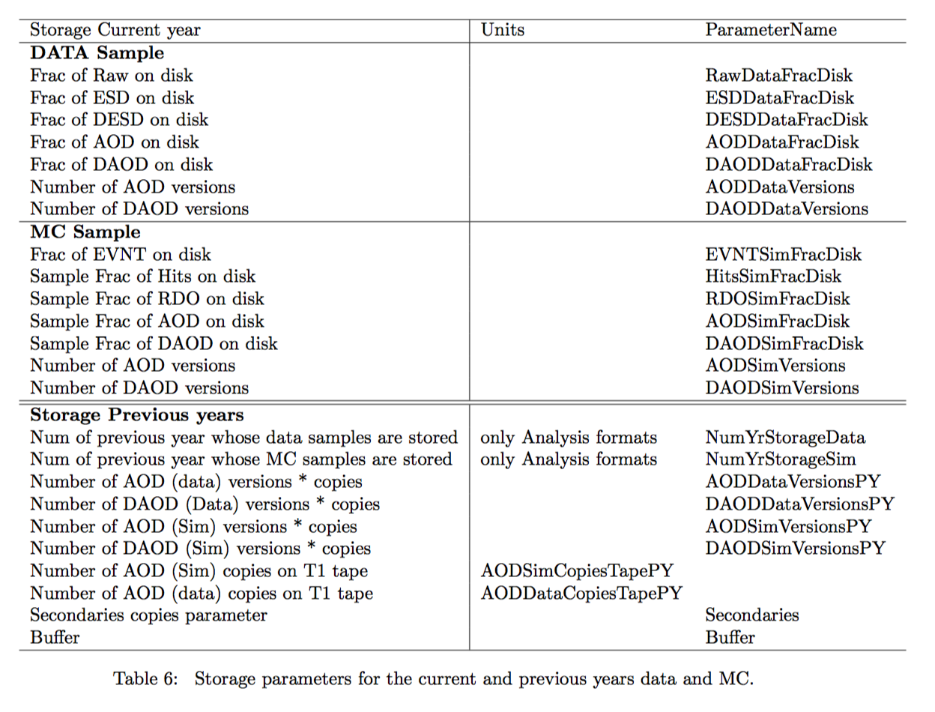
Input Parameters (6)
Storage policy
Number of distributed copies
Number of version,
Copies on tapes
Buffer

Slide 11
Example: CPU
For each workflow: w_{i} ={EVGEN,FullSim,FastSim,FullReco,FastReco, DataReco,DataDerivation,MCDerivation}
CPUNeedOneRound[y,w_{i}]=EVENTS[y,w_{i}] *CPU[y,w_{i}]*CPUeff[w_{i}]*N[y,w_{i}]
  N[y,w] can be 1 or >1 e.g. Number of derivations used for analysis
Then the number of (re)processing for data/MC/Derivation for the current year and for previous years is accounted. (alignement/calibration)

Slide 12
Example: Storage Volume
For each main Format: F_{i} ={ Data:RAW,ESD,DESD,AOD; MC:HITS,RDO,ESD}
  One round Volume[y,F_{i}] =Size[y,F_{i}] * EVENTS[y,F_{i} (w_{i})]
Analysis derived Format Volume: D_{i} ={Data:DAOD(i), MC:DAOD(i)} are considered as a fraction (average over the different derivation) of the AOD Volume.
Disk/tape use at Tiers-X is evaluated considering the distribution model
  Number of copies on disk/tape available at Tiers, number of different Derivation, buffer copies, etc.

Slide 13
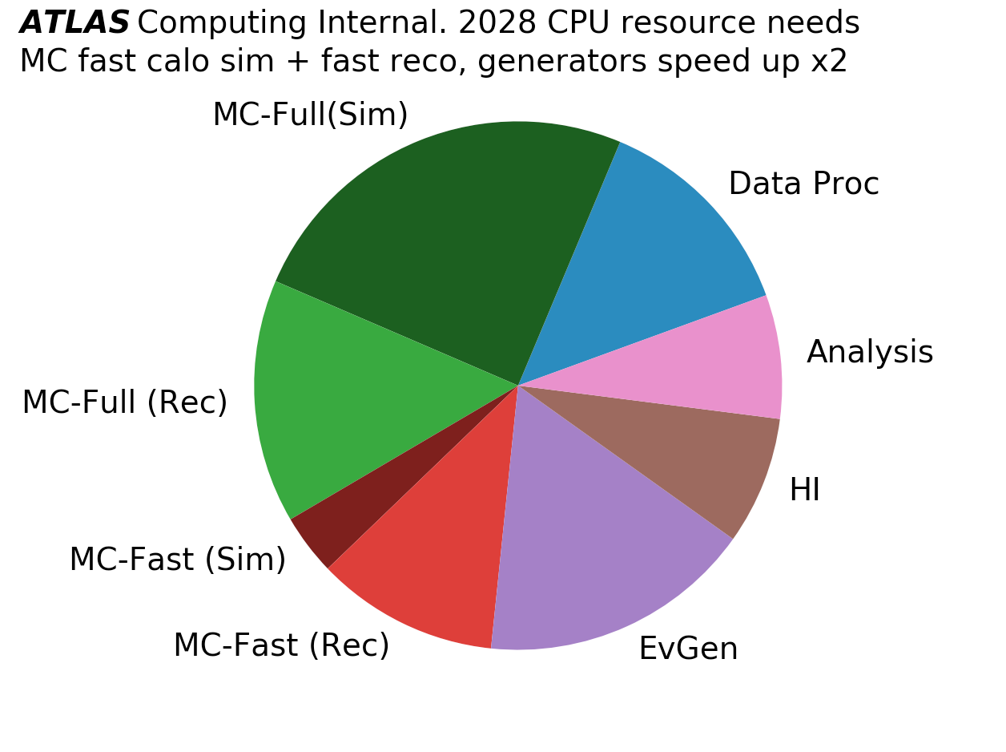
Plots examples (do not consider the data)

Slide 14
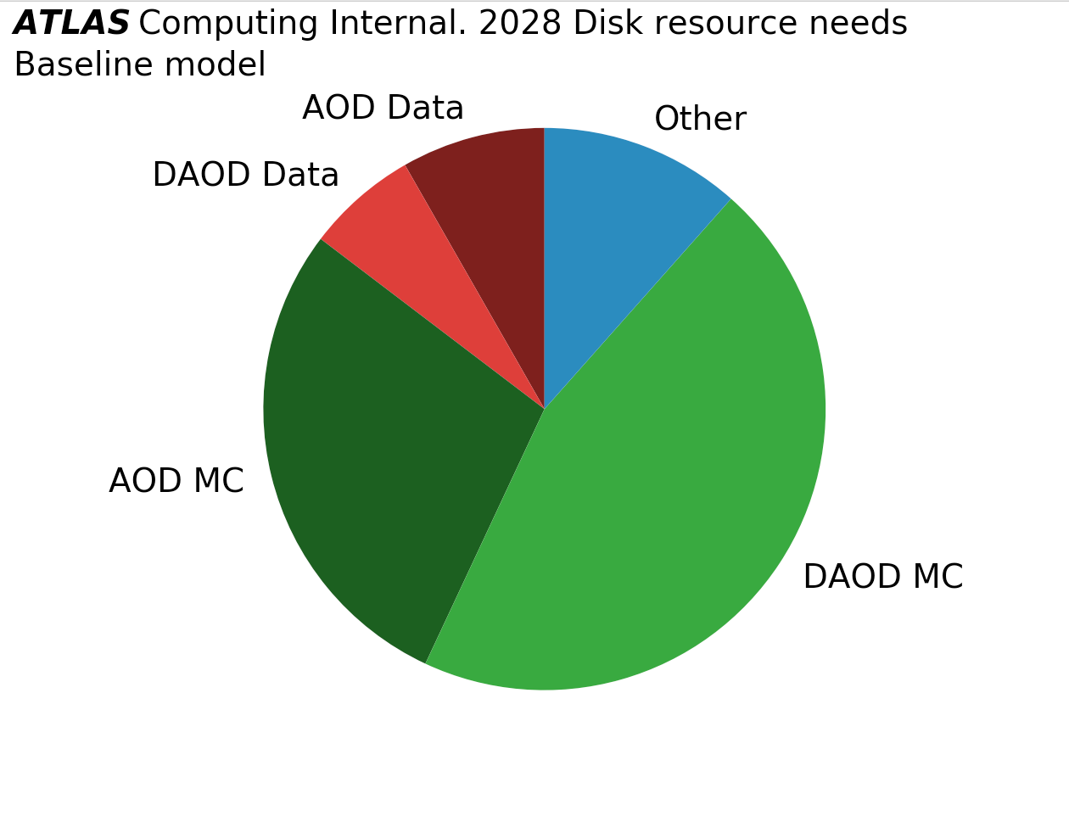
Plot examples (do not consider the data)

Slide 15
summary
The ATLAS computing model previously based on excel was recently implemented using python and DataFrame.
All parameters are keep on on workbook sheets, all computation are defined in few libraries.
The model is simple and flexible enough to evaluate easily possible evolutions of technologies.
Some effort was put to validate this implementation against the previous estimates in order to became the official source.
Then used for the 2021 estimates.
Improvements in the analysis modeling and other areas are being considered
More effort will go into documentation/definition of parameters and benchmarking.

