Slide 1


Energy deposition for HL-LHC v1.5:
TAXN aperture study
Marta Sabaté-Gilarte, Francesco Cerutti
WP10
Energy deposition & R2E
151st WP2 Meeting CERN Jun 18th, 2019

Slide 2
CONTEXT
Point 1 for HL-LHC machine
Horizontal crossing of 250 μrad
HL-LHC optics version 1.5 (end of May 2019)
Region of interest from Q1 to Q4
Mention to version 1.3 only for comparison reasons

Slide 3
OUTLINE
Updates in the layout since v1.3
Impact in the triplet+D1 region, and in the TAXN-Q4 region
TAXN aperture considerations (85 vs 80 mm) for HL-LHC optics v1.5
Problem of the Dose to the Q4 MCBY correctors

Slide 4
Updates in the layout since v1.3

Slide 5
Updates in the layout since v1.3 for HL-LHC
Focus on Horizontal Crossing: IP1 for v1.5.
Revision of the vacuum layout from TAXS to Q7:
  Additional modifications are expected at the end of D2 and from Q5 to Q7.
Update on the triplet-D1 IC model.
Inclusion of end covers of the thermal shield in the triplet+D1 and D2 cryostats.
Update of the CP magnetic and mechanical lengths.
D1 beam screen:
  Prolongation of the beam screen: modification of the inermet shielding and the horizontal aperture.
Inclusion in the geometry of the Cold Diode at the end of D1.
Increase TAXN beam separation from 148mm-158mm to 151mm-161mm.
Implementation of the full model of the Crab Cavities Cryomodule.
TCLM-masks on Beam2 before Q4 tentatively removed.

Slide 6
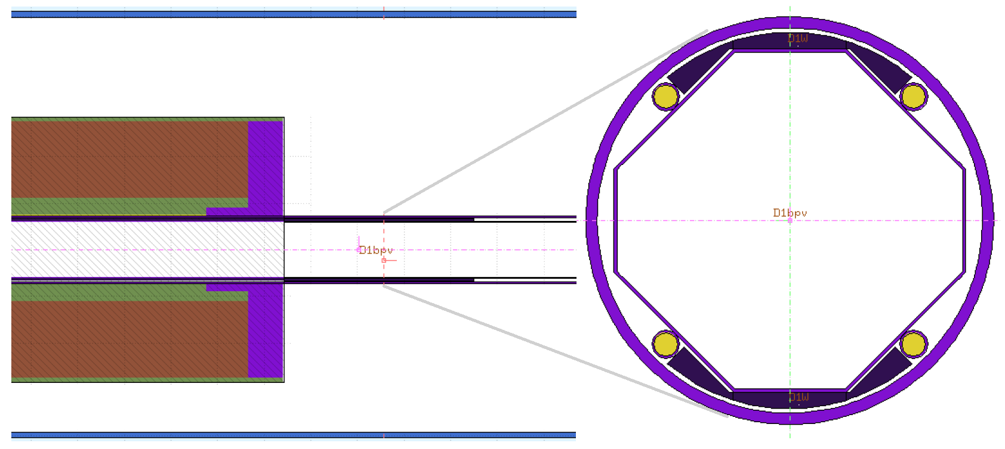
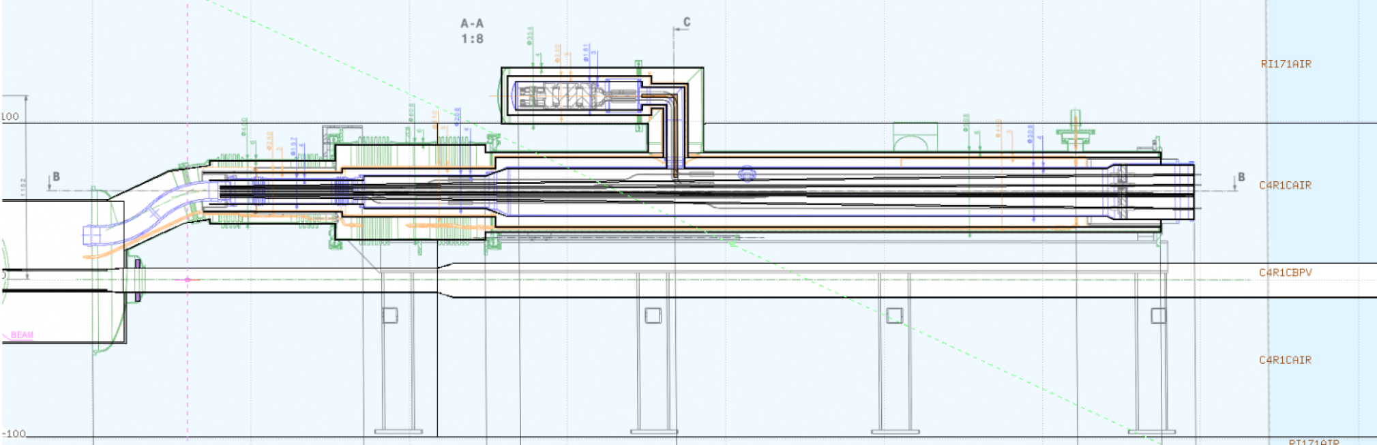
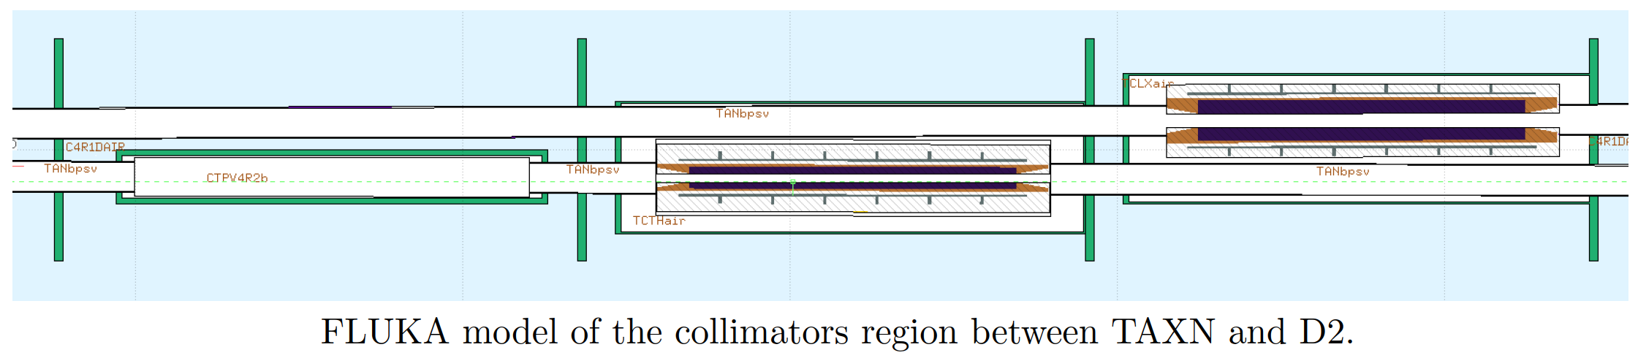
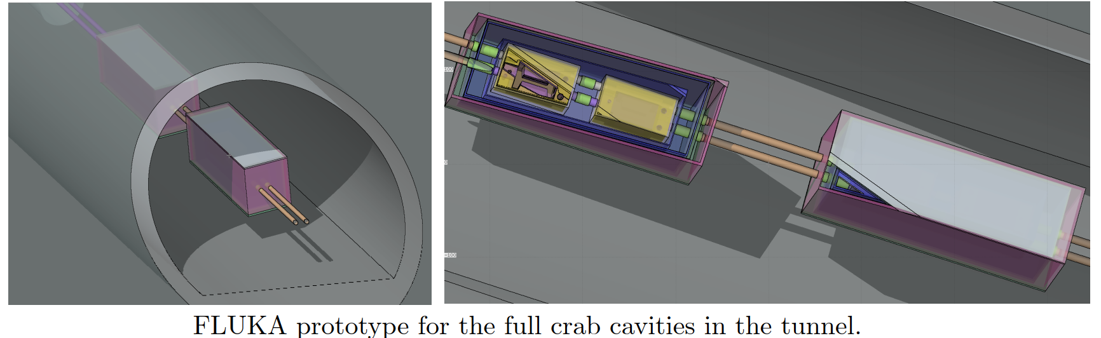
D1 beam screen extension and cold diode
Tanks added

Slide 7
Impact in the triplet+D1 region

Slide 8
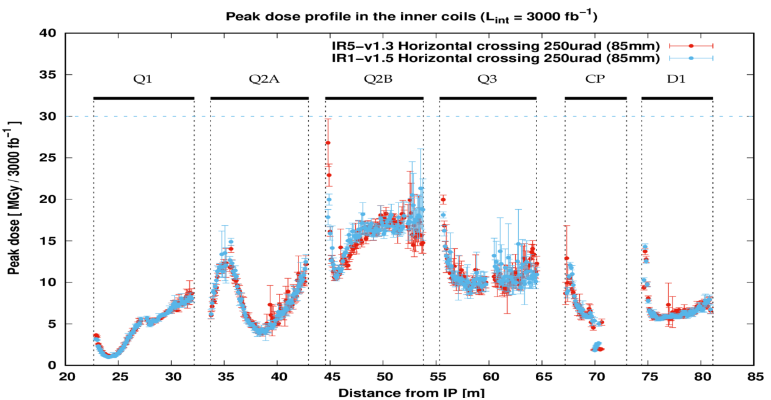
Impact in the triplet+D1 region
v1.3 Horizontal crossing in IP5
v1.5 Horizontal crossing in IP1

Slide 9
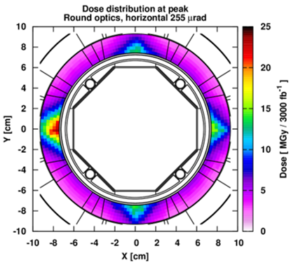
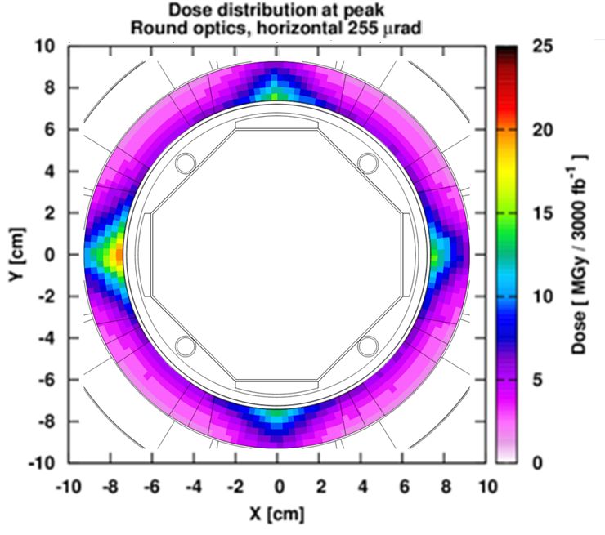
Impact in the triplet+D1 region
v1.3
v1.5

Slide 10
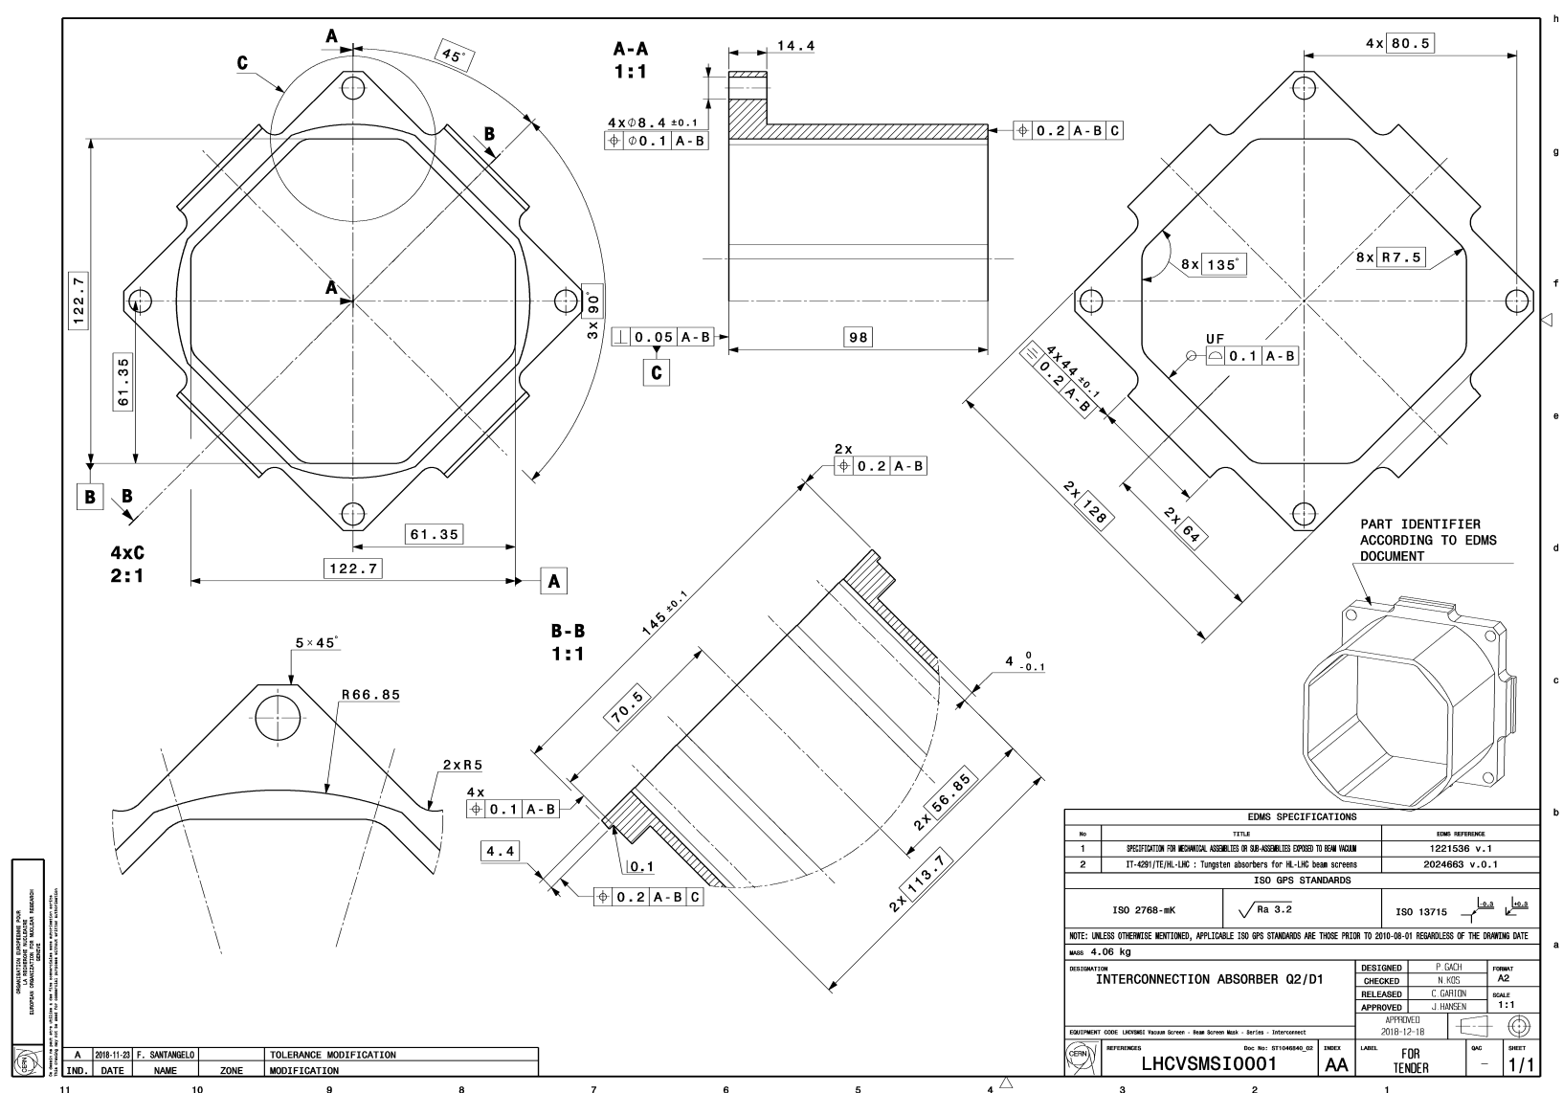
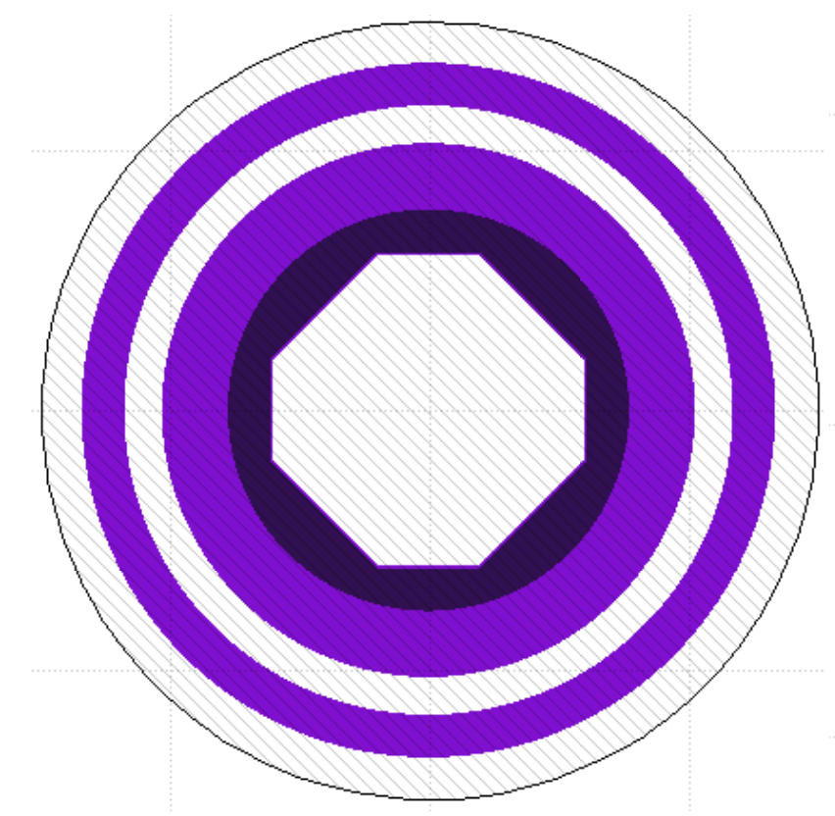

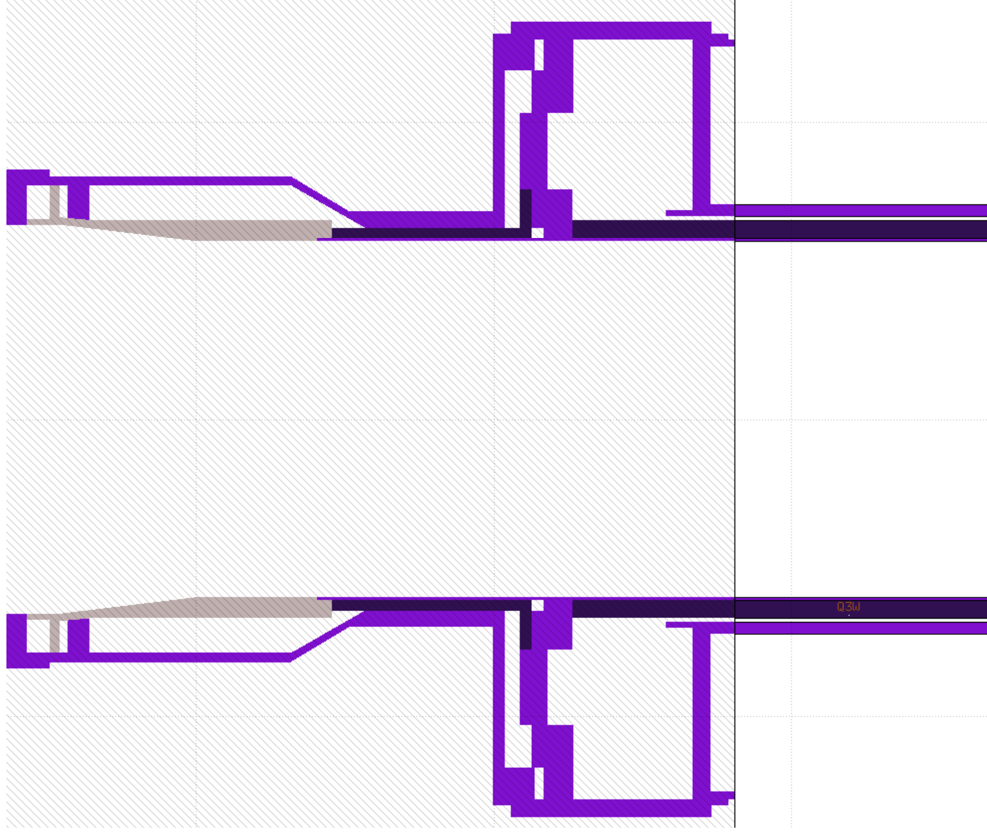
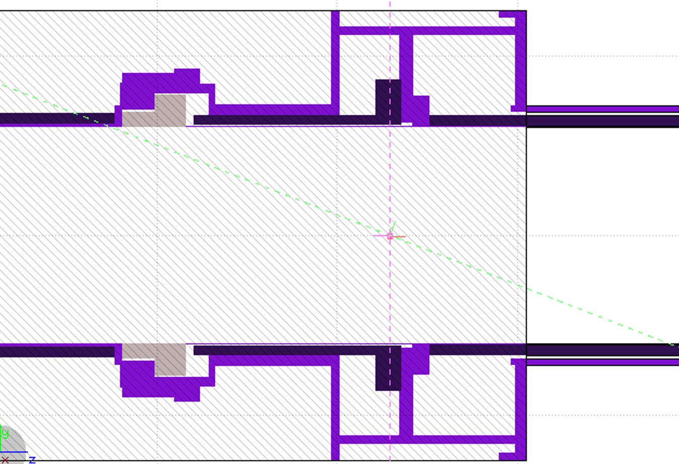
The reason behind
The 11.5cm inermet block on the non-IP side of the IC
is as follow:
v1.3
v1.5

Slide 11
Impact in the TAXN-Q4 region

Slide 12
v1.3 vs. v1.5: Total Power from TAXN to the Q4
 | v1.3 | v1.5
TAXN | 819 | 929
D2 | 30.9 | 22.5
D2 H corr. | 1.32 | 1.08
D2 V corr. | 0.95 | 0.98
Q4 corr. | 5.06 | 4.04
Q4 | 3.1 | 3.4
TCLX4-int | 155.6 | 151.0
TCLX4-ext | 88.5 | 104.9
Beam separation:
148mm-158mm (v1.3) 151mm-161mm (v1.5)
Power in W L_{int}=5·10³⁴ (cm⁻² s⁻¹) and σ(p-p collision) = 85 (mb)
Notes:
Already the differences between the versions regarding the vacuum layout, the TAXN position and other modifications, imply a reduction in the total power. The main contribution to the reduction comes from the increase in the beam separation in the Y-chamber.

Slide 13
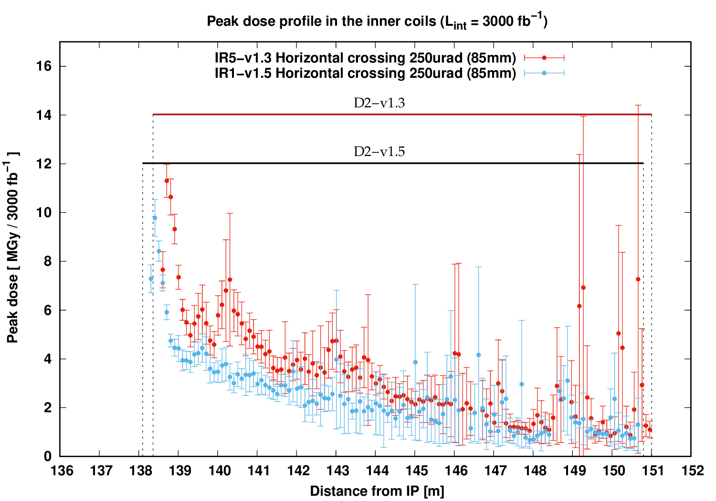
v1.3 vs. v1.5: Impact in D2
15% reduction (from 11.5 to 10 MGy)

Slide 14
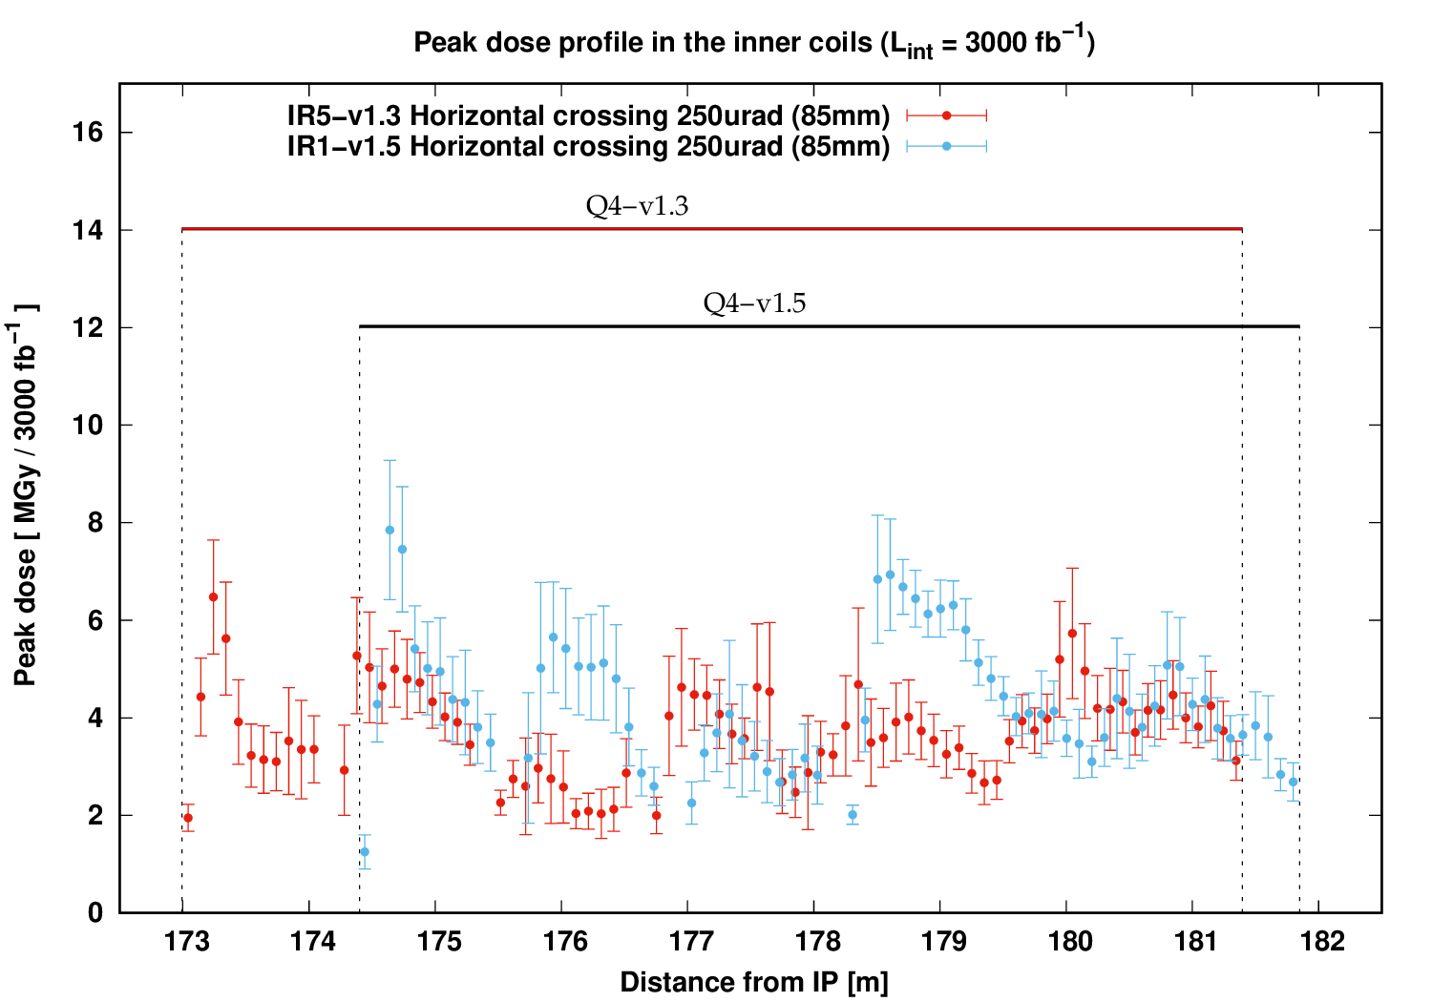
v1.3 vs. v1.5: Effect on Q4
Note:
4-corr. in v1.3
vs.
3-corr. in v1.5
from 7 to 8 MGy

Slide 15
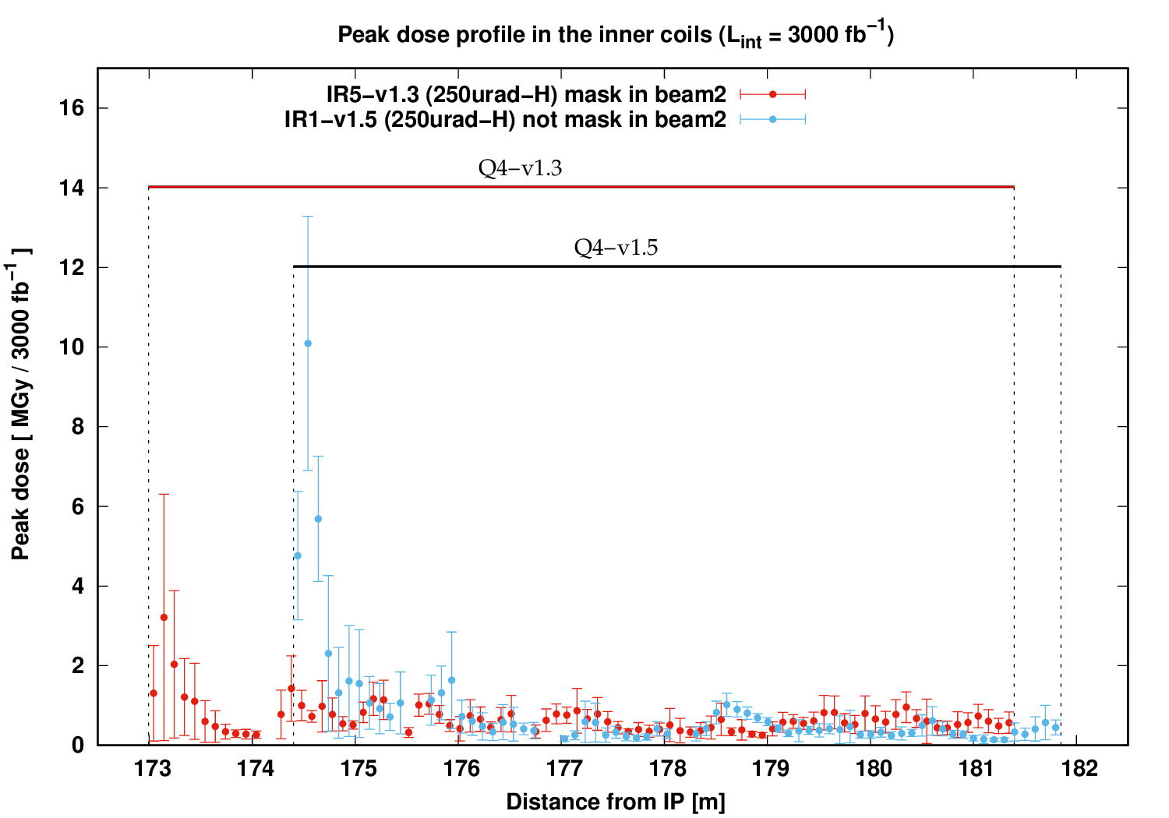
Importance of the TCLM4-masks on B2
Indication of an important increment in the IP-side of the first MCBY
With mask in beam 2
No mask in beam 2

Slide 16
TAXN aperture considerations (85 vs 80 mm) for HL-LHC optics v1.5

Slide 17
TAXN aperture considerations for HL-LHCv1.5
Twin apertures of the Y-chamber of the TAXN: 85mm as reference.
Study the impact on the D2 and Q4 when reducing the TAXN aperture down to 80mm.
The vacuum layout between TAXN and D2 depends on the TAXN twin aperture: ID=90mm in case of 85mm or ID=80mm in case of 80mm. Except in the collimators and the sector valve.
Any benefit?

Slide 18
TAXN aperture considerations for HL-LHCv1.5
Total power
 | 85mm v1.5 | 80mm v1.5
TAXN | 929 | 997
D2 | 22.5 | 20.5
D2 H corr. | 1.1 | 0.7
D2 V corr. | 1.0 | 0.7
Q4 corr. | 4.0 | 4.2
Q4 | 3.4 | 3.7
TCLX4-int | 151.0 | 97.2
TCLX4-ext | 104.9 | 89.2
Aperture reduction (v1.5):
ID=90mm for 85mm ID=80mm for 80mm
Power in W L_{int}=5·10³⁴ (cm⁻² s⁻¹) and σ(p-p collision) = 85 (mb)
Notes:
The difference between the two configurations is les notable.
The increment in the total power in the TAXN helps to reduce it in the TCLX and a minor grade in the D2.
While for Q4, the results are comparable within uncertainties.
Therefore, the reduction of the beam aperture at the exit of the y-chamber does not play a role in the exposure of the MCBYs.

Slide 19
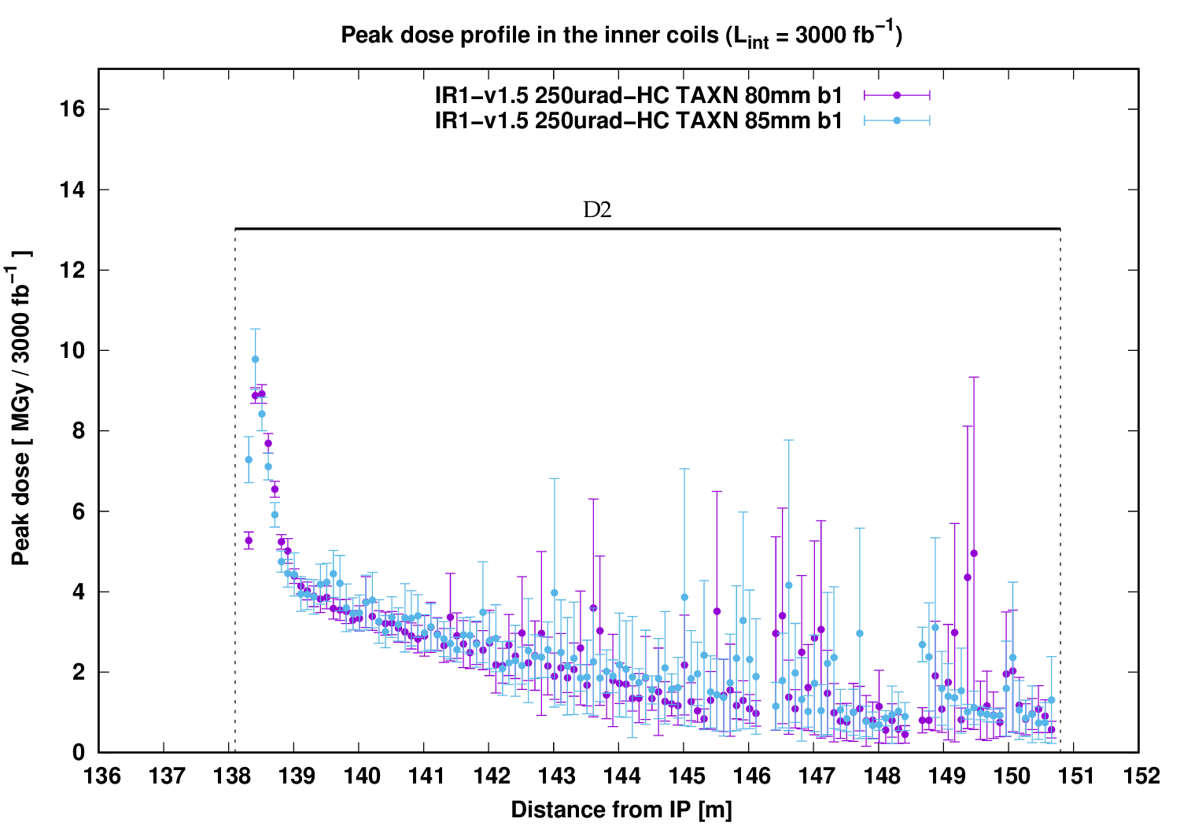
TAXN aperture considerations for HL-LHCv1.5
Dose to the D2
Reduction in the first 20cm
from 10 to 9 MGy
Notes:
Reduction of the dose only at the front face of the D2

Slide 20
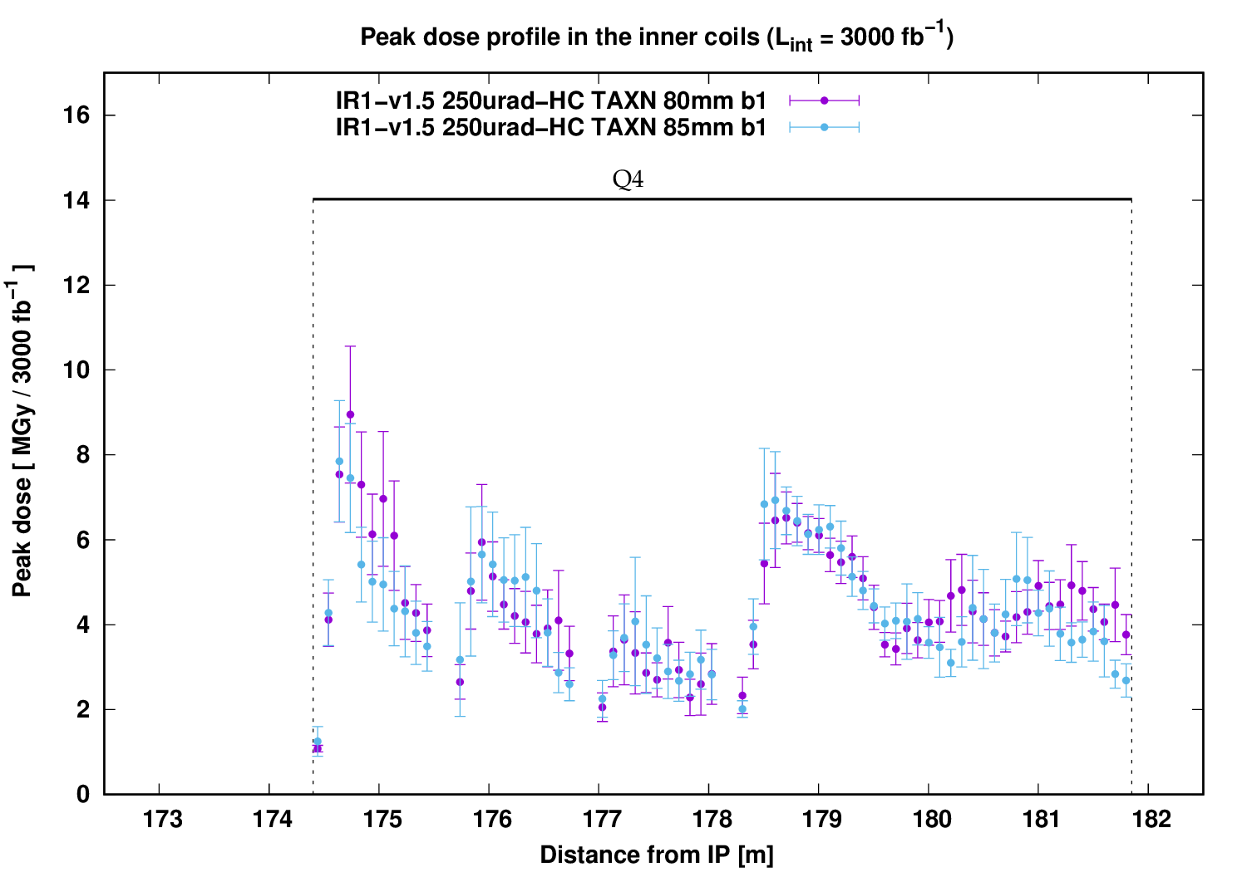
TAXN aperture considerations for HL-LHCv1.5
Dose to the Q4 assembly
No effect
Notes:
O difference within the uncertainties.

Slide 21
Problem of the Dose to the Q4-correctors

Slide 22
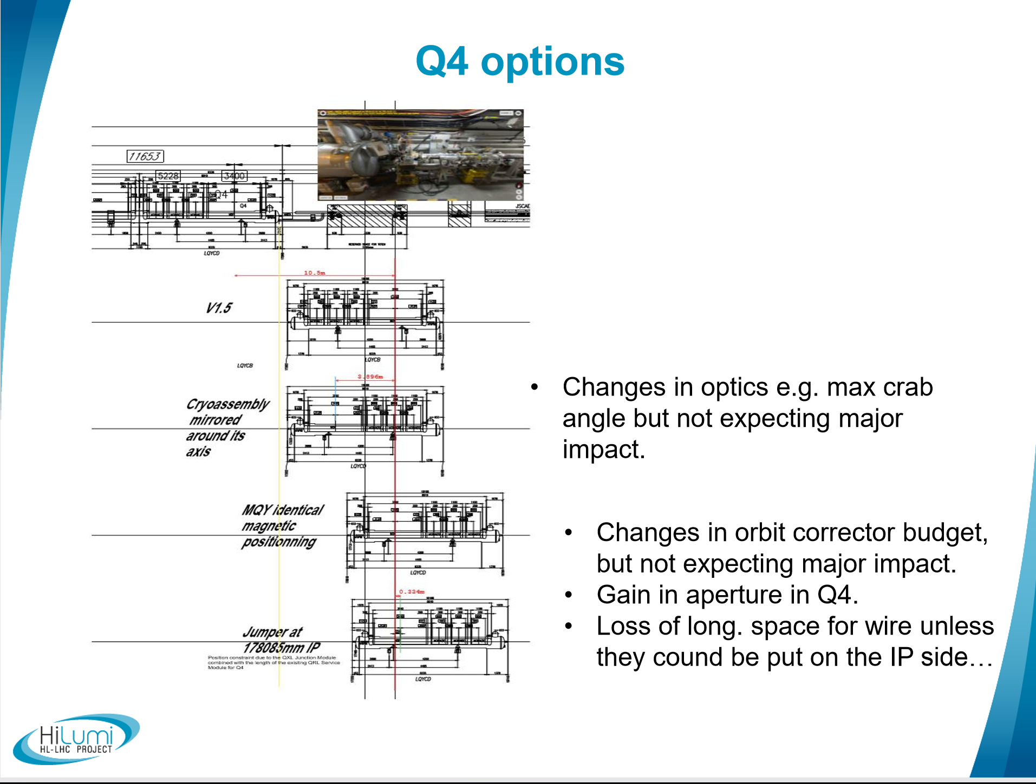

Problem of the Dose to the Q4-correctors
The proposed rotation of the Q4 cryostat could help to protect the MCBYs in a limited way:
  Q4 (MQY) identical magnetic position BUT the drift before the cryostat will increase its length → the expected dose at the from face of Q4 may be higher than 8 MGy.
  The Q4-corr. (MCBYs) will be
  more protected BUT the dose
  could not go below 2 MGy.

Slide 23
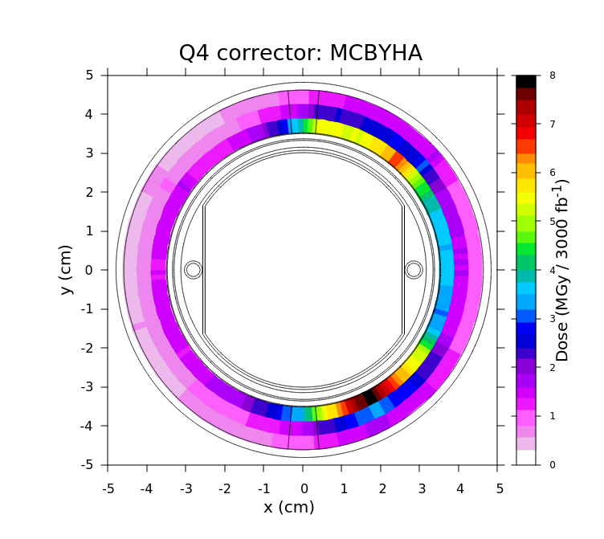
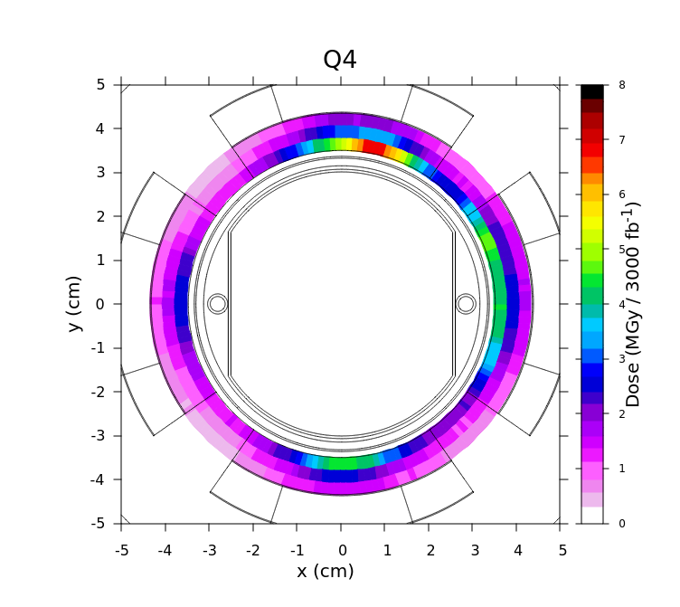
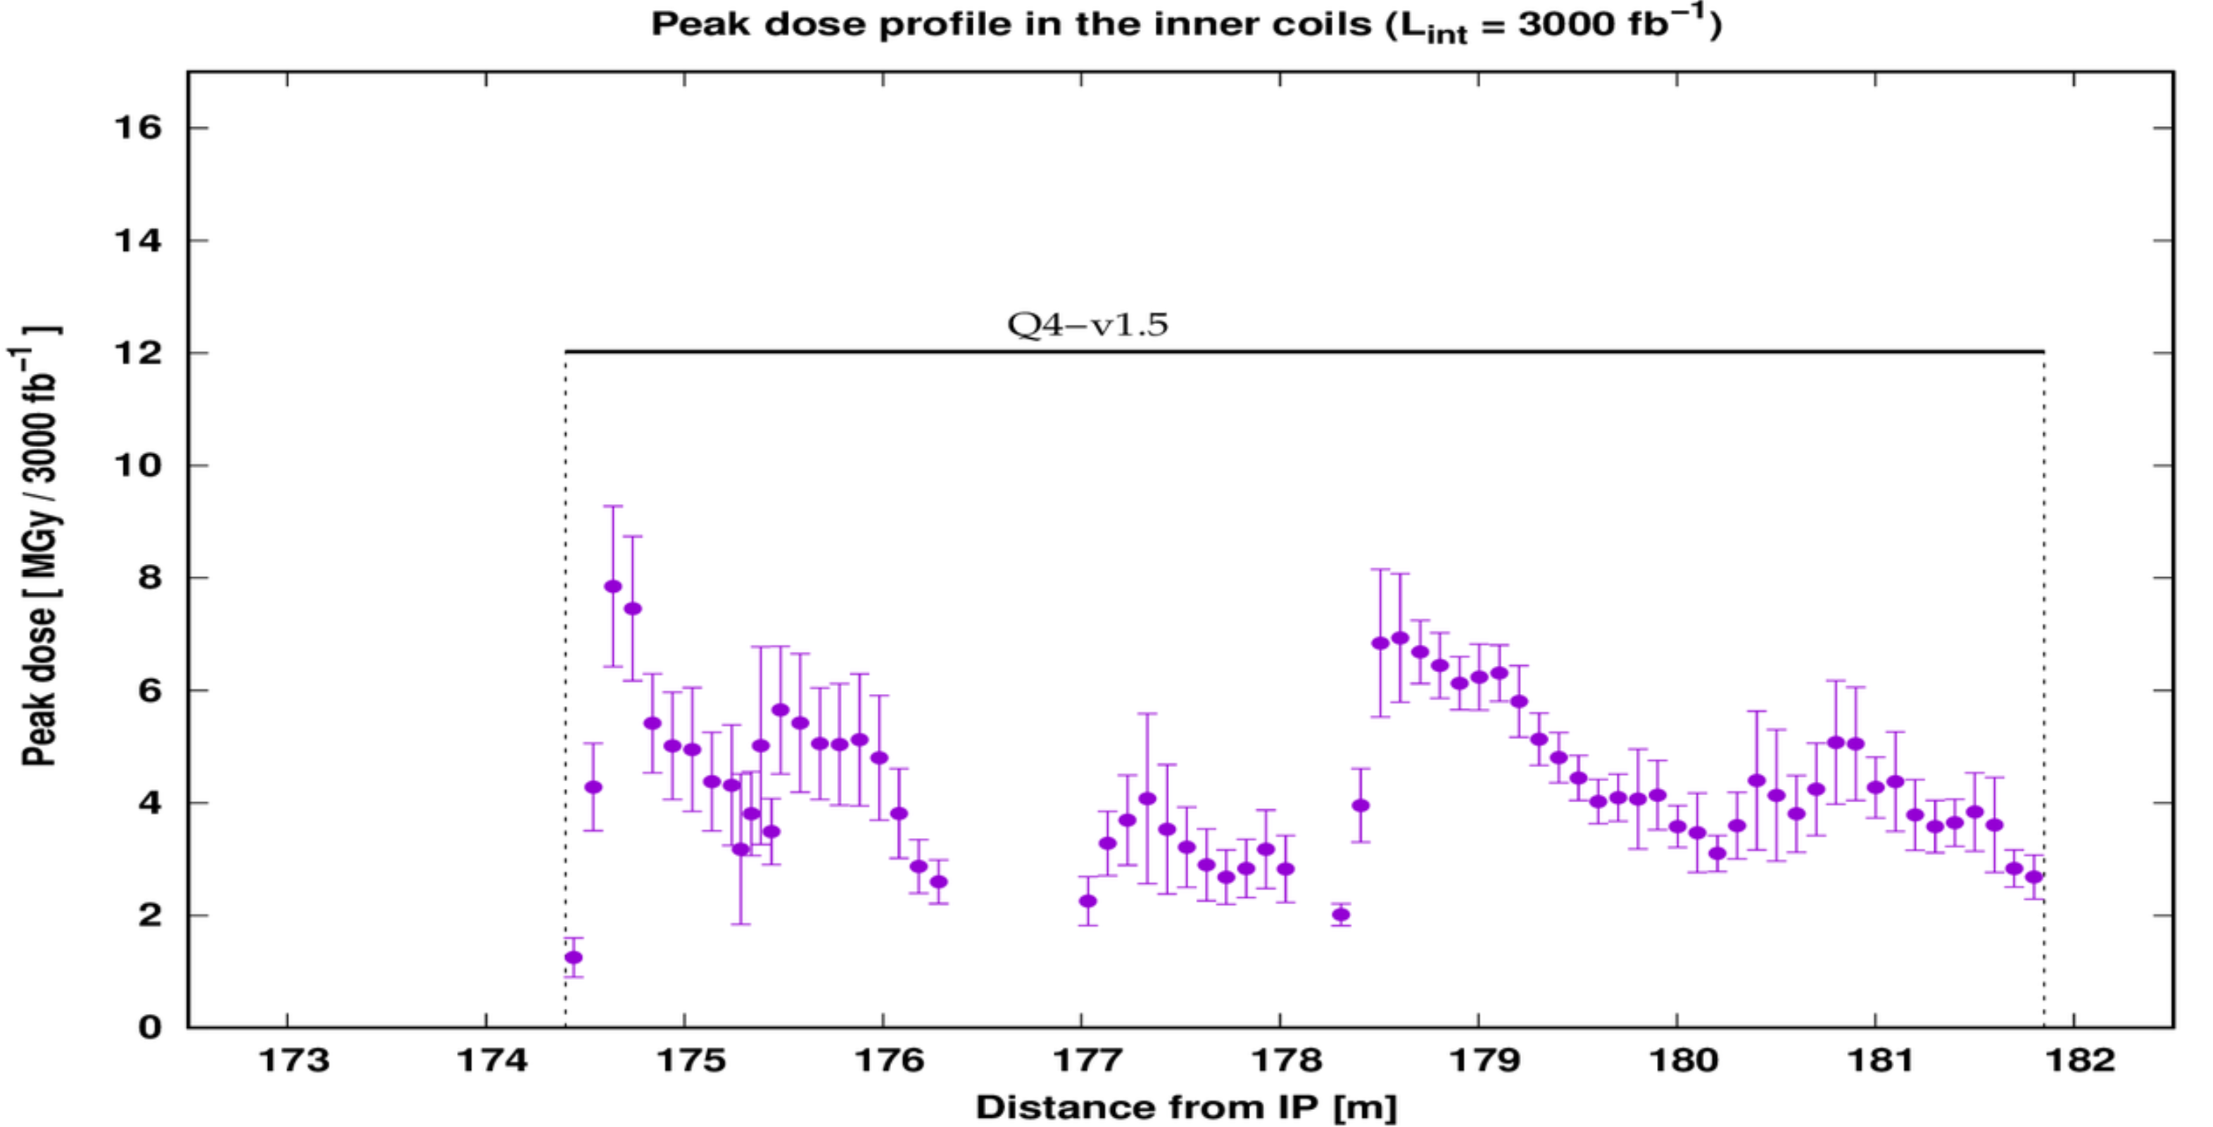
Problem of the Dose to the Q4-correctors
85mm
Comparable within uncertainties
85mm
In order to grant a major reduction of the MCBY corrector dose, an internal shielding should be considered, although sacrificing a fraction of the 70 mm coil aperture.
85mm
Notes:
O difference within the uncertainties.

Slide 24
Summary and Conclusions

Slide 25
Summary and Conclusions (I)
v1.5 impact in the triplet+D1 region and in the TAXN-Q4 region
The inclusion of the most updated model of the interconnect in the triplet+D1 region shows an improvement in the dose, especially at the entrance of Q2B, where a reduction of the maximum value from 26 to 20 MGy was obtained.
(With the total power in the cold mass and beam screen remaining unchanged).
The increase of the beam separation in the TAXN for v1.5 with respect to v1.3 entails a rise in the total power taken by the TAXN (110 W more) together with a reduction of the D2 load (max dose down to 10 MGy and 25% less power).
Indication for the need of the TCLM4-mask on beam 2, to limit the respective dose on the front face of the first MCBY.

Slide 26
Summary and Conclusions (II)
TAXN aperture reduction study for HL-LHCv1.5 from 85mm to 80mm:
  With a 80 mm twin aperture, the total power in the TAXN increases by ~70 W, which are removed from the TCLX4 jaws.
  Minor beneficial effect on D2: the max dose at the IP-side is reduced by 10% and the total power (~20 W at nominal HL lumi) decreases by 10%.
  No effect on Q4 and its MCBYs.
Problem of the Dose to the Q4-correctors
  Evidence of the fact that all along the Q4 assembly the peak dose in the coils remains above 2 MGy. Therefore, the rotation of the Q4-cryostat could help only to a rather limited extent.
  To significantly change the picture, one needs internal shielding.

